Slide 1
Integrating Active Networking and Commercial-Grade Routing Platforms
Rob Jaeger
Tal Lavian, Rob Duncan, Franco Travostino,
J.K. Hollingsworth, Bobby Bhattacharjee
Networks 2000
September 13, 2000

Slide 2
The Network Paradigm Spectrum
Traditional Networks
End-to-end connectivity
Well defined protocols
Increasingly perform forwarding in hardware
?
Active Networks
On-the-fly service introduction
Per-flow granularity possible
Inject software in data path

Slide 3
Outline
Research Objectives
Accomplishments
System Concepts/Components
Open Device Architecture
Dynamic Classification Experiment
Status & Future
Summary
Notes:
To introduce the new Open Networking Architecture that is based on Java-enabled Network Devices
To enable easy 3rd party integration and leverage Nortel Networks’ competitive advantage

Slide 4
Research Objectives
Create OPEN platform for introduction of new services
  Specify OPEN interfaces for Java applications to control a generic, platform-neutral forwarding plane
  Enable downloading of services to network node
  Allow object sharing and inter-service communication
Implement flow performance enhancement mechanisms without introducing software into data forwarding path
  Service defined packet processing in a silicon-based forwarding engine
  Policy-based Dynamic packet classifier
Notes:
To introduce the new Open Networking Architecture that is based on Java-enabled Network Devices
To enable easy 3rd party integration and leverage Nortel Networks’ competitive advantage

Slide 5
Accomplishments
JVM on a Silicon-based Routing Switch
ORE - Oplet Run-time Environment
  Java-enabled platform for secure downloading and safe execution
  of services
  Ensures required services are installed for a downloaded Oplet
Java SNMP API (proxy mode for non Java devices)
Implementation of Network Forwarding API (JFWD)
RESULT: Dynamic Classification in Silicon-based forwarding engine on a Gigabit Routing Switch

Slide 6
System Concepts/Components
Oplet Runtime Environment (ORE)
  A kernel that manages the life cycle of oplets and services
  Provides a registry of services
Services
  The value being added. Minimal constraints
  Represented as a Java interface
Oplets
  The unit of deployment: a JAR file
  Contains meta-data (eg signatures, dependency declarations)
  Contains services and other resources (data files, images,
  properties, JAR files)

Slide 7
Oplet Runtime Environment Overview
A platform to dynamically deploy services
on network elements
Desirable properties
  Portable to many different devices
  Secure, reliable
  Low impact on device performance
  Open
  Provide a framework to structure code
    Reusable, maintainable, robust
Implemented in Java

Slide 8
Oplet Lifecycle
Install
  Loaded from URL
Start
  Services that are depended on must already be started
Stop
  Any oplets that depend on this oplet’s services will be stopped
  Code and data can be unloaded from ORE
Uninstall

Slide 9
Dependencies
A service S can use facilities provided by
another service T
This means that the oplet containing S has a dependency on service T
Before an oplet can be started, all of its dependent services must have be started
ORE manages dependencies and lifecycle of oplets
and services

Slide 10
Some Services
Bootstrap (ORE start time) - basic configuration
Log - Centralized logging for oplets
HTTP server
  Simple servlet support
Command line shell
  Service depends on shell to register commands
Administration commands
  Manage oplets and services
Access to router resource including hardware instrumentation via JMIB

Slide 11
Security Issues
Sandbox
  Each oplet provides a Java name space and applet-like sandbox
Signed oplets
  Oplets can be signed for assigning trust
Denial of service
  Vulnerable to DoS (memory, cycle, bandwidth, persistent storage, monitors) like all Java applications
  Resource management is a problem

Slide 12
Java Forwarding API
Five-Tuple Filters
  src/dest IP
  src/dst port numbers
  protocol (TCP or UDP)
Actions
  copy the packet to the control plane
  drop packet
  set TOS field or set VLAN priority field
  adjust priority queue
Notes:
To introduce the new Open Networking Architecture that is based on Java-enabled Network Devices
To enable easy 3rd party integration and leverage Nortel Networks’ competitive advantage

Slide 13
Outline
Research Objectives
Accomplishments
System Concepts/Components
Open Device Architecture
Dynamic Classification Experiment
Status & Future
Summary
Notes:
To introduce the new Open Networking Architecture that is based on Java-enabled Network Devices
To enable easy 3rd party integration and leverage Nortel Networks’ competitive advantage

Slide 14
Open Device Architecture
C/C++
API
Java
API
ORE
Service
Device
Code
JNI
Download Oplet
ORE
Device
Drivers
JVM
JFWD API
Operating System
Device HW

Slide 15
Silicon-based Forwarding Engines
Network Services
Control Plane
ORE
JFWD
CPU/Operating System
Filtered packets
New rules
Switching Fabric
Wire Speed
Forwarding
Forwarding
Rules
Forwarding
Rules
Forwarding
Rules
Forwarding
Processor
Forwarding
Processor
. . .
Forwarding
Processor
Statistics
& Monitors
Statistics
& Monitors
Statistics
& Monitors
Traffic Packets

Slide 16
Dynamic Configuration of Forwarding Rules
Dynamic
Policy
CPU
Forwarding
Rules
Forwarding
Processor
Forwarding
Processor
Forwarding
Processor
Forwarding
Processor
SW
HW

Slide 17
CarbonCopy Capability
CPU
Forwarding
Processor
Forwarding
Processor
Forwarding
Processor
Forwarding
Processor

Slide 18
Outline
Research Objectives
Accomplishments
System Concepts/Components
Open Device Architecture
Dynamic Classification Experiment
Status & Future
Summary
Notes:
To introduce the new Open Networking Architecture that is based on Java-enabled Network Devices
To enable easy 3rd party integration and leverage Nortel Networks’ competitive advantage

Slide 19
Dynamic Classification
Identify real-time flows (e.g. packet signature/flowId)
  1. Use CarbonCopy filters to deliver multimedia control protocols
  to control plane
    e.g. SIP, H.323. RTSP
    Determine dynamically assigned ports from control msgs
  2. Use CarbonCopy filters to sample a number of packets from
  the physical port and identify RTP packets/signature
Set a packet processing filter for packet signature to:
  adjust DS-byte OR
  adjust priority queue
Notes:
To introduce the new Open Networking Architecture that is based on Java-enabled Network Devices
To enable easy 3rd party integration and leverage Nortel Networks’ competitive advantage

Slide 20
Dynamic Packet Configuration
Policy
DSC
Service
Filters
Packet
Filter
Packet
Forwarding
Processor
Forwarding
Processor
Packet

Slide 21
Experimental Setup
Source 1
tcp_send()
Acclear
1100B
Routing
Switch
100 Mbps
Destination
1. tcp_recv()
2. tcp_recv()
100 Mbps
Source 2
tcp_send()
100 Mbps

Slide 22
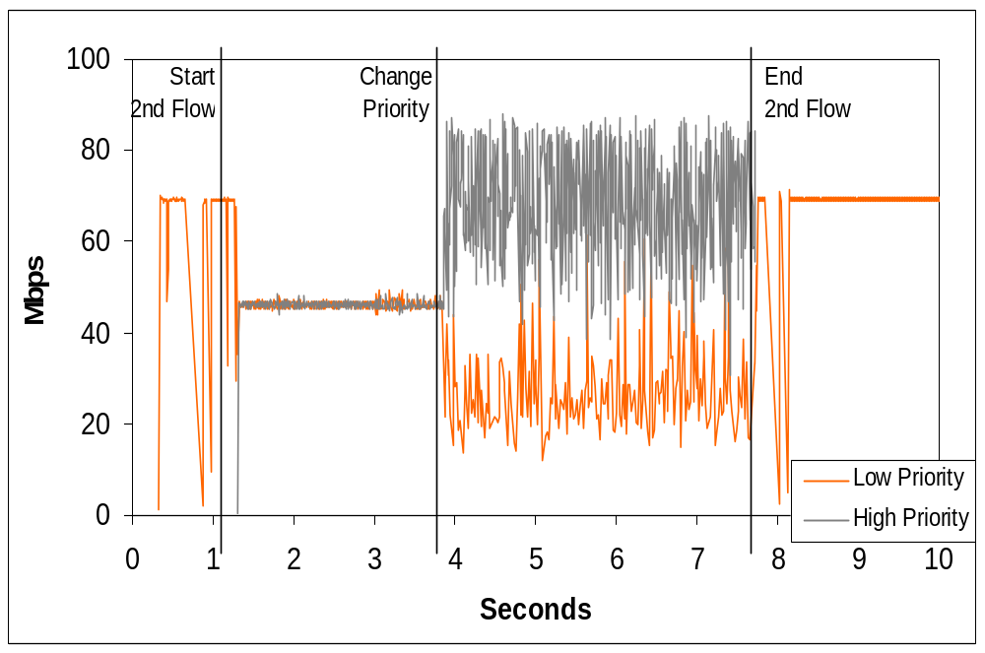
TCP Behavior with Dynamic Priority Filters

Slide 23
Outline
Research Objectives
Accomplishments
System Concepts/Components
Open Device Architecture
Dynamic Classification Experiment
Status & Future
Summary
Notes:
To introduce the new Open Networking Architecture that is based on Java-enabled Network Devices
To enable easy 3rd party integration and leverage Nortel Networks’ competitive advantage

Slide 24
Status
Runs on several Nortel routing products
Run on workstations
First release of ORE SDK complete
JMIB monitor/control system through MIBs
JFWD
Ported ANTS Execution Environment as ORE service

Slide 25
Future ORE work
Capabilities
  Revocable services
Security
  Java 2 style permissions to perform operations
Resource limits, DoS protection
  Probably requires support from JVM
Jini, Oplet Directory - locate and load services
Agents/Services
Open source

Slide 26
Summary
Developed the ORE for downloading and safely running services onto network devices
Without introducing software into data path we performed Dynamic Classification of flows in a
Silicon-based Gigabit Routing Switch
  Introduced a new service to a Gigabit Routing Switch
  Identified real-time flows
  Performed policy-based flow behavior classification
  Adjusted DS-byte value
  Showed that flow performance can be improved
For more info email: rfj@cs.umd.edu
Notes:
To introduce the new Open Networking Architecture that is based on Java-enabled Network Devices
To enable easy 3rd party integration and leverage Nortel Networks’ competitive advantage

Slide 27
Integrating Active Networking and Commercial-Grade Routing Platforms
Rob Jaeger
Tal Lavian, Rob Duncan, Franco Travostino,
J.K. Hollingsworth, Bobby Bhattacharjee
Networks 2000
September 13, 2000

Slide 28
Architecture
Oplet
Service
Oplet
Oplet
Service
Service
Oplet
Service
Service
Oplet Runtime Environment
Java Virtual Machine
API Extensions

Slide 29
Silicon-based Forwarding Engines
Control
Plane
CPU
Switching Fabric
Wire Speed
Forwarding
Forwarding
Rules
Forwarding
Rules
Forwarding
Rules
Forwarding
Processor
Forwarding
Processor
. . .
Forwarding
Processor
Statistics
& Monitors
Statistics
& Monitors
Statistics
& Monitors

Slide 30
JFWD 5-tuple Filtering
Copy the packet to the control plane
Don't forward the packet
Set TOS field
Set VLAN priority
Adjust priority queue
Notes:
To introduce the new Open Networking Architecture that is based on Java-enabled Network Devices
To enable easy 3rd party integration and leverage Nortel Networks’ competitive advantage

