Slide 1
HMMs and SVMs for Secondary Structure Prediction

Slide 2
HMMs and Transmembrane Proteins (again)

Slide 3
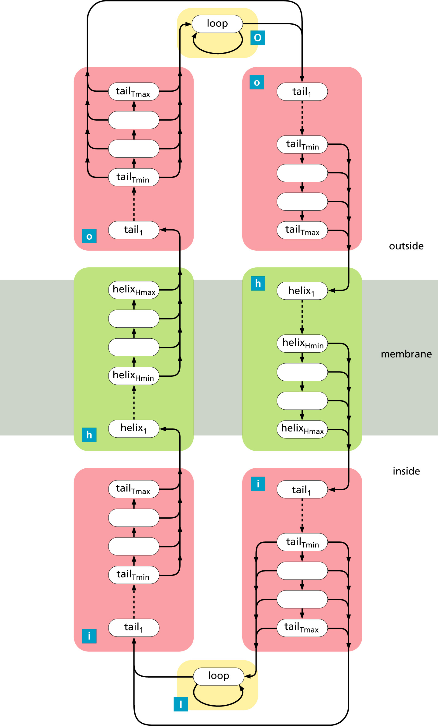
HMMTOP Architecture
TMHs 17-25 residues
Tails 1-15 residues
Blue letters show structural state labels

Slide 4
TMHMM Architecture
Helices are 5-25 residues
Caps follow helices
Cytoplasmic:
  Loop: 0-20 residues
  Globular: 1 state
Extra-cellular:
  Long loop: 0-100 residues
  Globular: 3 states

Slide 5
NN + HMM Hybrid for General Secondary Structure

Slide 6
Predicting Globular Proteins with “Hidden Neural Networks”
YASPIN
  Neural net predicts seven classes (He,H, Hb,C,Ee,E,Eb) using 15-residue window of PSSM input
  HMM “filters” this output
  Can you imagine how this is done?

Slide 7
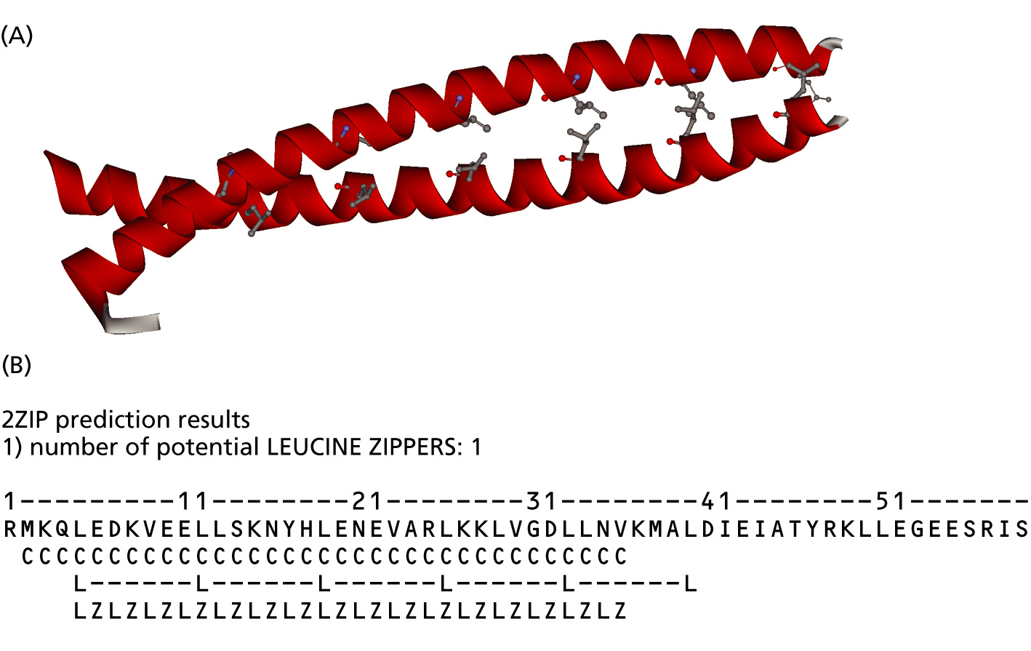
Coiled-coil HMM
MARCOIL
Design lets you start and end in any
phase of the heptad repeat

Slide 8
Support Vector Machines (SVMs)

Slide 9
SVM Basics
Classifiers
  Basic “machine” is a 2-class classifier
  Training Data
    set of labeled vectors
    {<x₁, x₂, …,x_{n}, C>},
    Class: C=1 or C=-1
  Supervised learning (like neural nets)
    Learn from positive and negative examples
  Output
    Function predicting class of unlabeled vectors

Slide 10
SVM Example
Alpha helix predictor
  15 residue window
  21 numbers per residue
    Psi-BLAST PSSM: 20 numbers
    “spacer” flag indicating “off end” of protein
  315 numbers total per window
  Training samples
    Non-helix samples: {<x₁, x₂, …, x₃₁₅, -1>}
    Helix samples: {<x₁, x₂, …, x₃₁₅, +1>}
  Training finds function of X that best separates the non-helix from the helix samples

Slide 11
SVM vs NN as Classifiers
Similarities
  Compute a function on their inputs
  Trained to minimize error
Differences
  NNs find any hyperplane that separates the two clases
  SVMs find the maximum-margin hyperplane
  NNs can be engineered by designing their topology
  SVMs can be tailored by designing the kernel function

Slide 12
SVM Details
Separating Hyperplanes:
Choose w, b to minimize ||w||
subject to:
Dual form (support vectors):
Kernel trick:
replace dot products
by a non-linear kernel
function.
s.t.
where

Slide 13
Dubious Statement
“In marked contrast to NN, SVMs have few explicit parameters to fit…”
  The vector of weights, w, is as long as the number of training samples
  But the minimum-margin hyperplane will have most of the weights equal to zero; only the “support vectors” will have non-zero weights.

