Slide 1
Proteome and Gene Expression Analysis
Chapter 15 & 16

Slide 2
The Goals
Functional Genomics:
  To know when, where and how much genes are expressed.
  To know when, where, what kind and how much of each protein is present.
Systems Biology:
  To understand the transcriptional and translational regulation of RNA and proteins in the cell.

Slide 3
Genes and Proteins
First, we’ll talk about how to find out what genes are being transcribed in the cell.
  This is often referred (somewhat misleadingly) to gene “expression”.
Second, we’ll look at measuring the levels of proteins in the cell.
  The real “expression” of protein coding genes…
Third, we’ll talk about how we process and analyze the raw data using bioinformatics.

Slide 4
Getting the Data

Slide 5
Getting Gene Expression Data
To be able to understand gene and protein expression, we need to measure the concentrations of the different RNA and protein molecules in the cell.
High-throughput technologies exist to do this, but suffer from low-repeatability and noise.
Low-throughput technologies for gene expression provide corroboration.

Slide 6
Measuring Gene Expression
What we want to do is measure the number of copies of each RNA transcript in a cell at a given point in time.
  Extract the RNA from the cell.
  Measure each type of transcript quantitatively.
How do you measure it?
  Sequence it in a quantitative way
  But sequencing is (used to be) very expensive
So, use technology and tricks…

Slide 7
The Technologies:
Gene Expression
Low-throughput
  qPCR
Expression microarrays
  Affymetrix
  Oligo arrays
  Illumina (beads)
High-throughput sequencing
  Tricks: SAGE, SuperSAGE, PET
  The real deal: 454 sequencing

Slide 8
Low-throughput Sequencing
qPCR (also called rtPCR) allows you to accurately measure a given transcript.
  But you have to decide which transcript you want to measure and make primers for it.
  So it is very expensive and low-throughput.
So the “array technologies” were born…

Slide 9
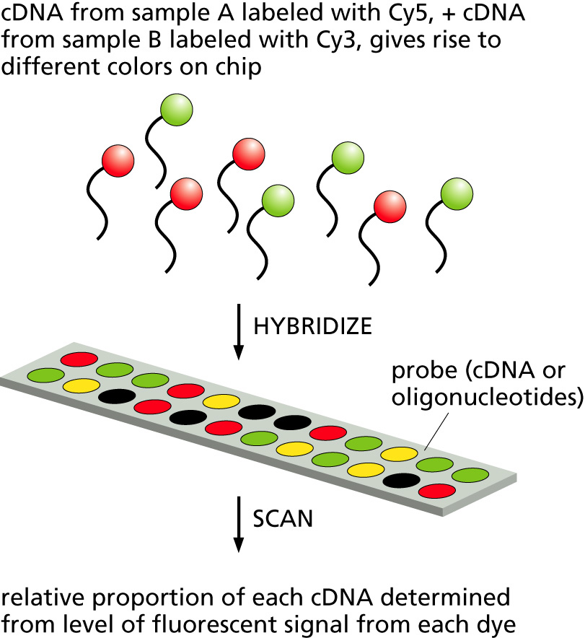
Gene Arrays
Put a bunch of different, short single-stranded DNA sequences at predefined positions on a substrate.
Let the unknown mixture of tagged DNA or RNA molecules hybridize to the DNAs.
Measure the amount of hybridized material.

Slide 10
Affy Gene Chips
The first gene chips were made by Affymetrix.
The technology “grew” very short (25-mer) DNAs on a silicon wafer using the same technology (photolithography) as for micro-electronics.
Each “spot” on the chip had a unique DNA sequence on it (there were also duplicates and off-by-one check spots.)

Slide 11
Oligo Gene Chips
Later, printing (e.g, ink jet) was used to to create chips.
Each spot is “printed” with a single, much longer oligonucleotide.

Slide 12
Illumina BeadArray Gene Chips
Oligonucleotides are bonded to 3micron beads which then self-assemble on a silica or fiber-optic substrate

Slide 13
Using Expression Microarrays
To reduce noise and variability, two-channel (two-color) experiments are often done.
This allows measurements of RNA under two conditions to be compared via the “fluorescence ratio”.
Single-channel data would be more useful, since it allows many conditions to be compared (e.g., time courses…), but noise and variability are a problem.

Slide 14
Expression Analysis Using
Sequencing
Ideally, we would just quantitatively sequence all the RNA in the sample.
qPCR can do this but its really expensive.
Genome sequencing technologies are getting cheaper.
But tricks to reduce the amount of sequencing required are still popular.

Slide 15
SAGE
A sequencing reduction trick
Serial Analysis of Gene Expression
Identify unique tags associated with different possible transcripts.
Isolate just those tags from the RNA.
Sequence the concatenated tags.
Search genome database to identify which RNAs the tags belonged to.

Slide 16
More Tricks:
SuperSAGE and PET
Advanced form of SAGE
  Uses longer tags cut from cDNAs: 26 bp instead of 20 bp
  Less ambiguous location on genome
PET: Paired-End Tag
  5’ and 3’ signatures from full-length cDNAs
  Concatenated together for sequencing

Slide 17
No more tricks!
Just sequence all the transcripts!
454 Sequencing (Life Sciences, Inc.)
  100 megabases per hour!
  DNA fragments captured by beads and amplified by PCR.
  Nucleotides (ACGT) are flowed over the substrate and added to the template strand.
  After each flow, the added nucleotide is detected using flourescence.

Slide 18
The Technologies:
Protein Levels
Protein Expression
  Gels
  Liquid Chromatography + Mass Spectrometry

