Slide 1
Phylogeny
Ch. 7 & 8

Slide 2
Overview
Evolution and sequence variation
Phylogenetic trees
  The meaning of distance
  Evolutionary sequence models
Constructing trees
  Sequence alignment

Slide 3
Evolution and Sequence Variation

Slide 4
Sequence similarity may imply common descent
Similarity of genomic and protein sequence is one way to try and infer the relationships among organisms.
  If two sequences are homologs, they are descended from a most recent common ancestor sequence.
  This may imply that the ancestral sequence was in the ancestral organism, but horizontal transfer can occur.

Slide 5
Phylogenetic Trees

Slide 6
Trees are a convenient way to summarize the relationships among a set of (orthologous) sequences or a set of species.

Slide 7
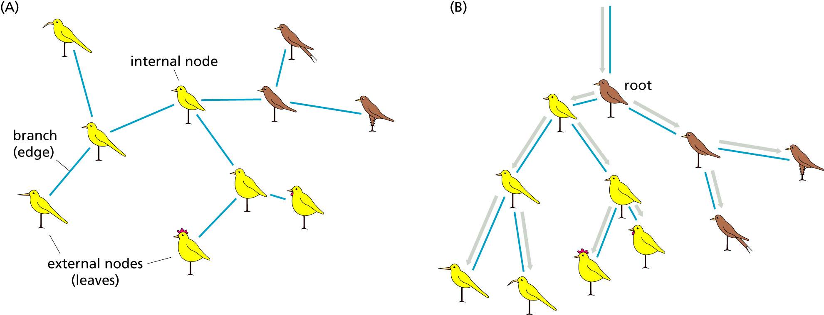
Rooted and Unrooted Trees
“Leaves” are extant species
Internal nodes are ancestral species
Adding a root gives time a direction
It is very difficult to accurately determine where the root should go, so it is best to avoid placing it…

Slide 8
The Data
Phylogenetic trees predate genomic sequence data.
Traditional taxonomy used physical characteristics.
  Qualitative: eg, fur-bearing
  Quantitative: number of petals
Sequence data is quantitative and plentiful.

Slide 9
What’s in a tree?
Cladograms
Additive trees
Ultrametric trees

Slide 10
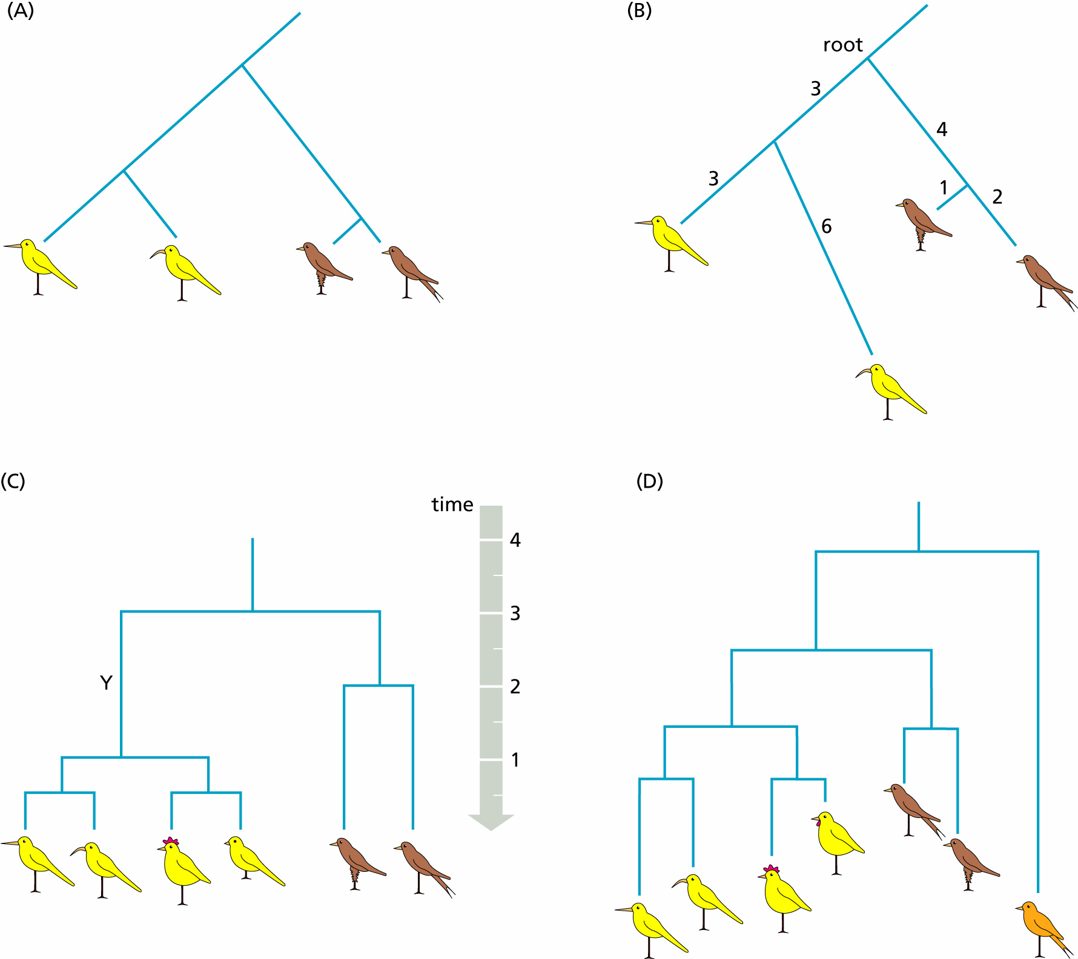
Cladograms
Branch lengths are meaningless.
Shows evolutionary relationships of “taxa” only.

Slide 11
Additive Trees
Branch lengths measure “evolutionary distance”.
Total distance between two taxa is the sum of the branch lengths separating them.
Don’t have to be rooted.

Slide 12
But how can two species be at different “evolutionary distances” from their ancestor?
?

Slide 13
Distance ≠ Time
The rate of evolution, r, can vary over time.
The distance is equal to the rate times the time:
  d=rt

Slide 14
Ultrametric Trees
Simplest type of rooted, additive tree.
Assumes that the rate of evolution is constant over time.
  With sequences, called the “molecular clock”.
  Horizontal lines have no meaning.

Slide 15
Evolutionary Sequence Models

Slide 16
We want to build phylogenetic trees from orthologous genes or proteins.
Evolutionary sequence models give us a way to model how one ancestral sequence evolves (independently) into two daughter sequences.

Slide 17
What is the evolutionary distance between two DNA sequences?
Align the two DNA sequences.
Count the number of places where they differ (ignoring gaps)
p = D/L
  D is the number of differences and
  L is the total number of aligned positions

Slide 18
Is p the evolutionary distance?
NO!
p is just the observed number of differences.
  What is value will p tend towards as evolutionary distance increases???

Slide 19
All things being equal…
If all mutations (from one nucleic acid to another) are equally likely,
  p → 3/4
Do you see why?

Slide 20
So what is going on here, really?
A position can mutate to any of the 3 other nucleic acids.
If the ancestral sequence is distant, this can happen multiple times.
  But all we get to see is the final result!
  So a position with a different nucleic acid may be the result of one or more mutation events.
  And positions with the same nucleic acid can also have had an even number of mutations.
Seq 1: A ->T
Seq 2: A -> T

Slide 21
If we model mutations as a Poisson process
Probability of no mutation in time t is
  exp(-rt)
Both sequences evolving so
exp(-2rt)
Let d=2rt
Then 1-p = exp(-d)
So d = -ln(1-p)

Slide 22
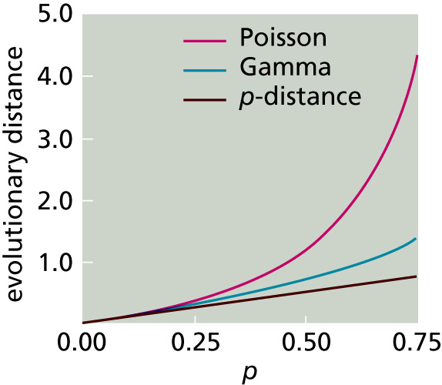
Relationship between p-distance and evolutionary distance

Slide 23
Summary
So the branch lengths of the tree are “d=rt”.
We must propose an evolutionary model to compute “d” from the observed p-distance.
The Poisson model is too simple.
It doesn’t capture real evolution.

Slide 24
Other Evolutionary Models
Jukes-Cantor
  Assumes all base frequencies are ¼
  Has one parameter, α, the substitution rate (per unit time).
  Distance formula: d = ¾ ln(1- ⁴⁄3 p)

Slide 25
Kimura Two-Parameter Model
Models transversions and transitions separately because the former are very uncommon in reality.
  Transitions: A<->G, C<->T
  Two parameters: transition rate α, transversion rate β.
Distance formula:
d = ½ ln(1-2P-Q) - ¼ ln(1-2Q)
  where P and Q are fraction of transitions and transversions, respectively.

Slide 26
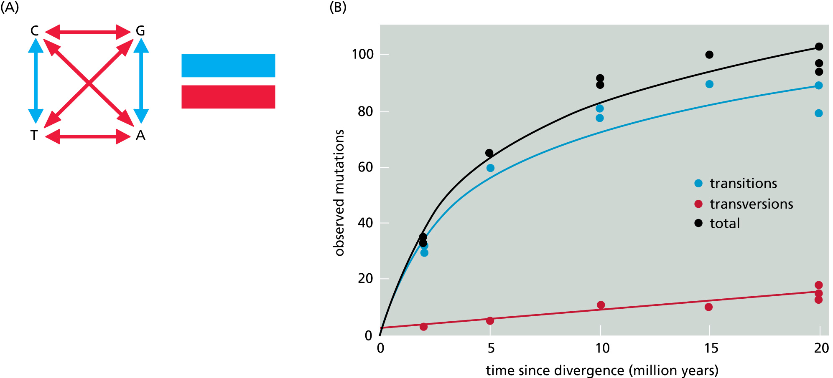
Transitions and Transversions

Slide 27
More General Models
More general models take into account other realities like:
  Non-uniform base frequencies
  Non-uniform mutation rates (Gamma correction)

Slide 28
Constructing Phylogenetic Trees

Slide 29
First, construct a multiple alignment
A good multiple alignment is key.
The p-distances between pairs of sequences can then be computed.
This allows the d-distances between pairs of sequences to be computed.
Some tree-building methods use the multiple alignment directly
  Parsimony Methods

Slide 30
Next, choose a tree-building method
UPGMA (1958)
  Builds rooted, ultrametric trees
  Assumes constant rate of evolution in all branches
Neighbor-joining (1987)
  Builds unrooted, additive trees
  Assumes the best tree has the shortest total branch length.
  Principal of minimum evolution, as with maximum parsimony trees.

Slide 31
Neighbor-Joining
Similar to maximum parsimony, but works with large datasets.
Maximum parsimony methods consider many more tree topologies, so they don’t scale to large numbers of species.

Slide 32
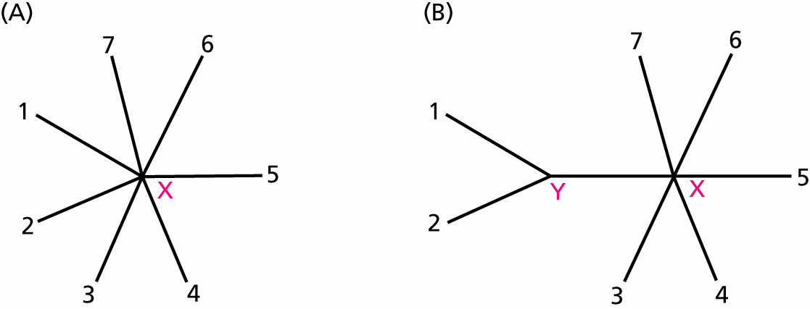
Neighbors are separated by one node.
Start with a star topology.
Everybody’s a neighbor!

Slide 33
Neighbors are separated by one node.
Assume Sequences 1 and 2 were nearest neighbors.
So they are joined with new node Y.
The method computes the new branch lengths.

Slide 34
Find pair of neighbors that reduces total branch length most
N sequences
d_{ij} = distance between sequences i and j
U_{i} = sum of distances from sequence i to all other sequences
δ_{ij} = d_{ij} - (U_{i} + U_{j})/(N-2)
Find pair of sequences with minimum δ_{ij}.

Slide 35
Initial tree: 5 sequences
A
B
C
E
D

Slide 36
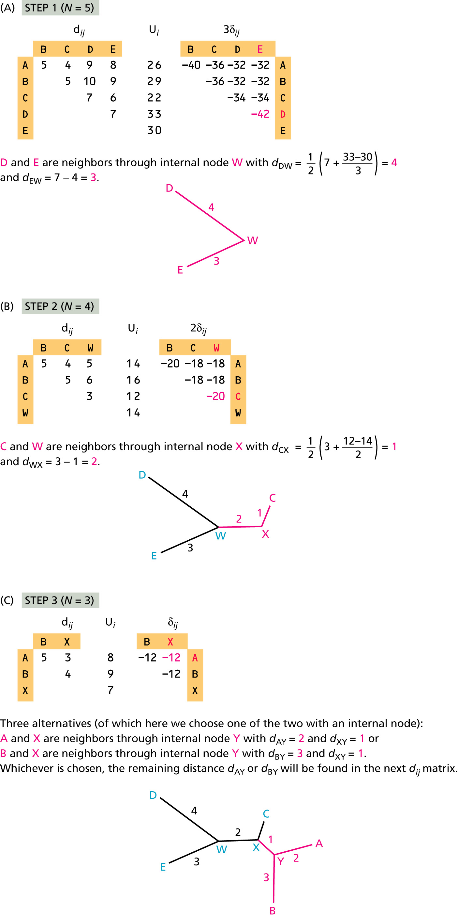
Step 1.
Join nearest neighbors.

Slide 37
How the new branch lengths are computed
The new branch lengths from the joined neighbors to the new node W are
b_{iW} = ½(d_{ij} + (U_{i} – U_{j})/(N-2))
and
b_{jW} = d_{ij} – b_{iW}
where i = E and j = D in the example.

Slide 38
Replace joined neighbors with new node W.
A
B
A
B
C
C
E
W
D

Slide 39
Compute distances from new node W to each remaining sequence
The new distances (to each remaining sequence k)
d_{Wk} = ½(d_{ik} + d_{jk} – d_{ij})
where i and j are the nearest neighbors (D and E in this example).

Slide 40
Step 2: Repeat with the new star tree

Slide 41
Replace neighbors with new node X.
A
B
A
B
C
X
W

Slide 42
Step 3: Repeat again

Slide 43
All done.
The tree is now a binary tree so the procedure is complete.

