Slide 1
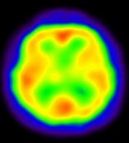
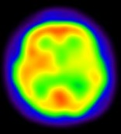
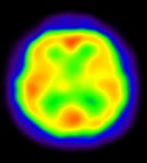
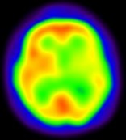
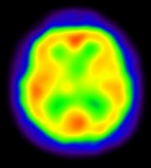
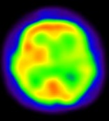

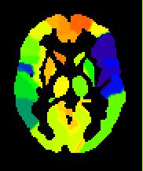
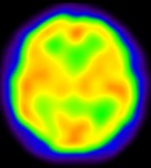
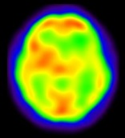
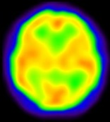
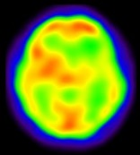
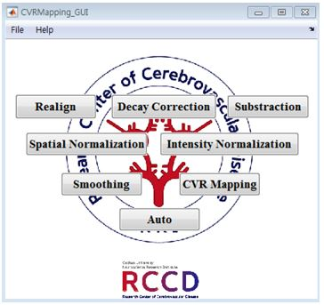
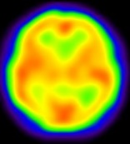
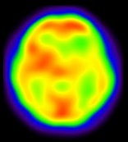
Base
Diamox
1. Realign
7. CVR Method
ROI-based Method
2. Decay Correction
3. Subtraction
8. CVR Mapping
4. Spatial Normalization
Template: SPECT.nii
CVR Map
5. Intensity Normalization
Mask: Lt./Rt. Cerebellum
6. Smoothing
CVR Mapping GUI
Notes:
Fig. 1. Diagram for SPECT CVR calculation

Slide 2
Base
Diamox
1. Realign
7. CVR Method
ROI-based Method
2. Decay Correction
3. Subtraction
8. CVR Mapping
4. Spatial Normalization
Template: SPECT.nii
CVR Map
5. Intensity Normalization
Mask: Lt./Rt. Cerebellum
6. Smoothing
CVR Mapping GUI
Notes:
Fig. 1. Diagram for SPECT CVR calculation

Slide 3
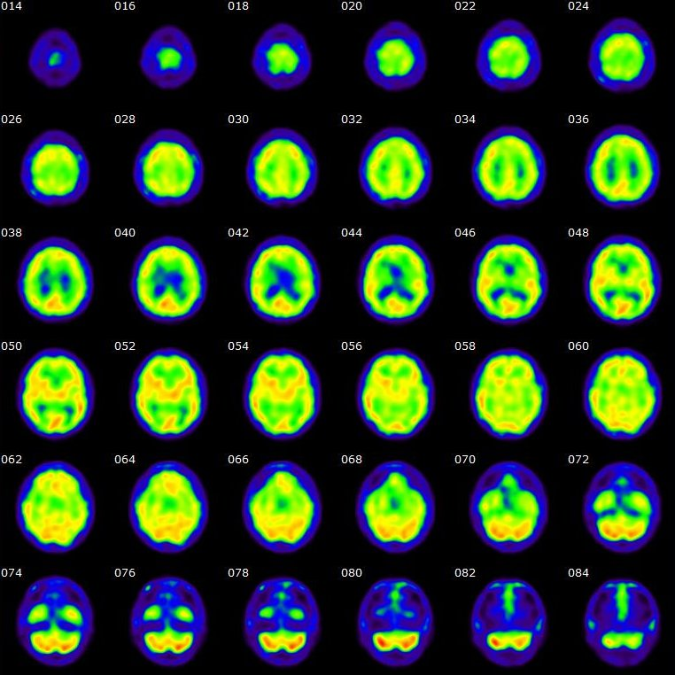
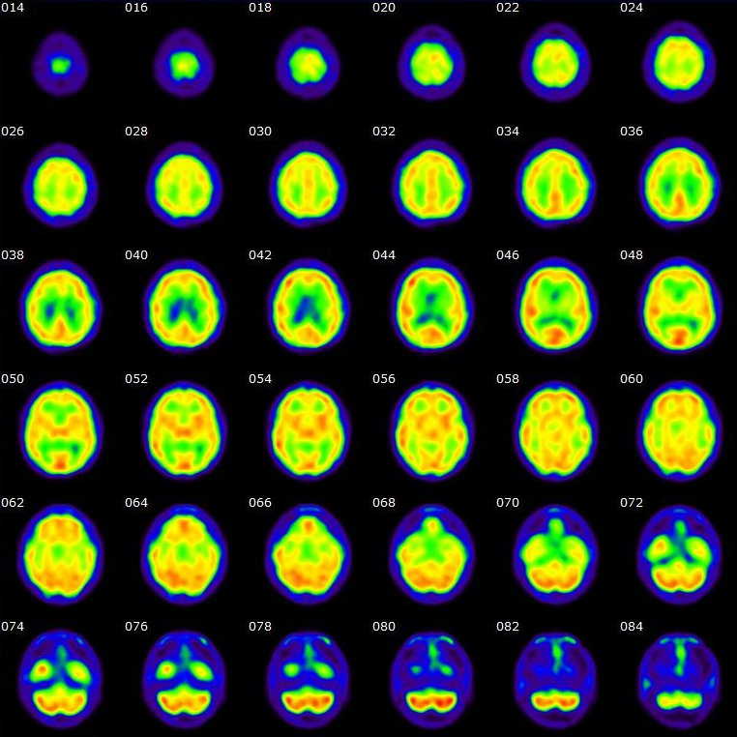


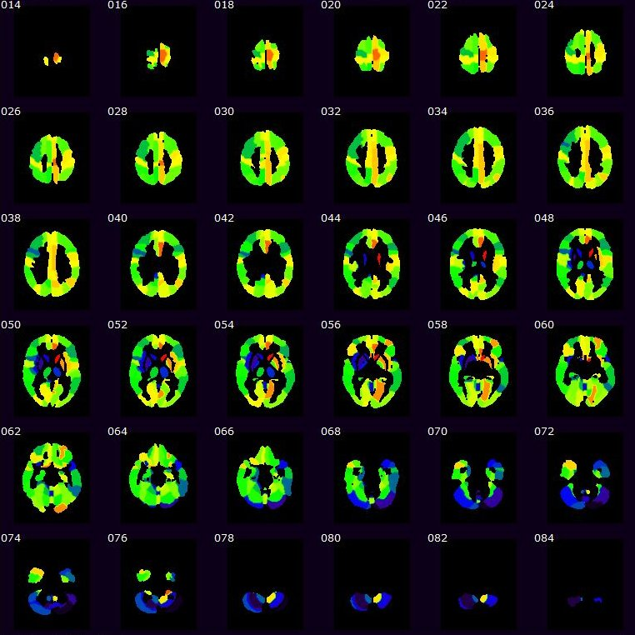
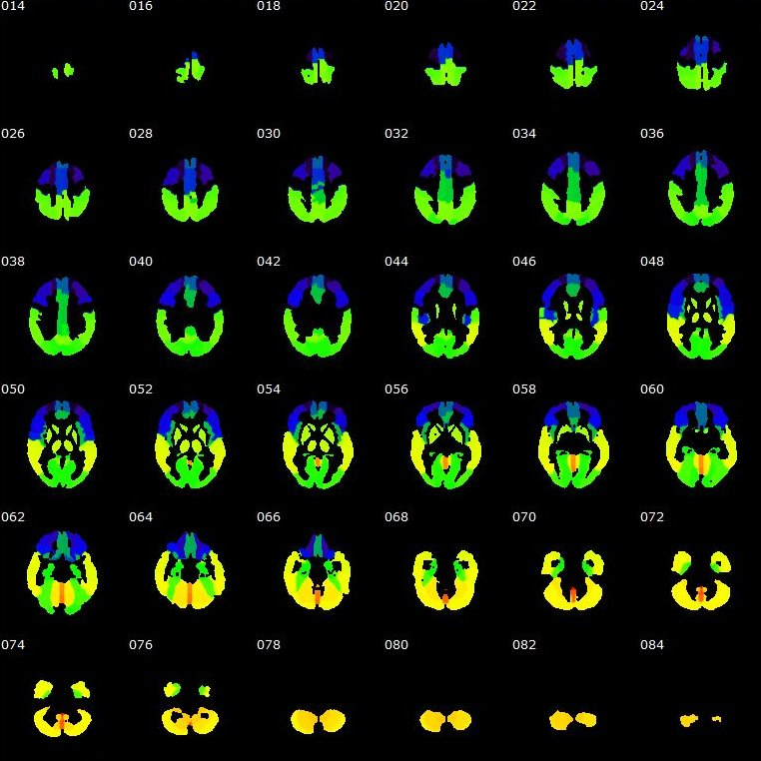


patient No.14
(a)Rest
(b)Acetazolamide
0
20
40
60
80
100
120
140
160
0
50
100
150
200
250
300
350
(c)CVR Map
(d)featured CVR Map
0
2
4
6
8
10
12
14
16
0.0
0.1
0.2
0.3
0.4
0.5
0.6
0.7
0.8
0.9
1.0

Slide 4
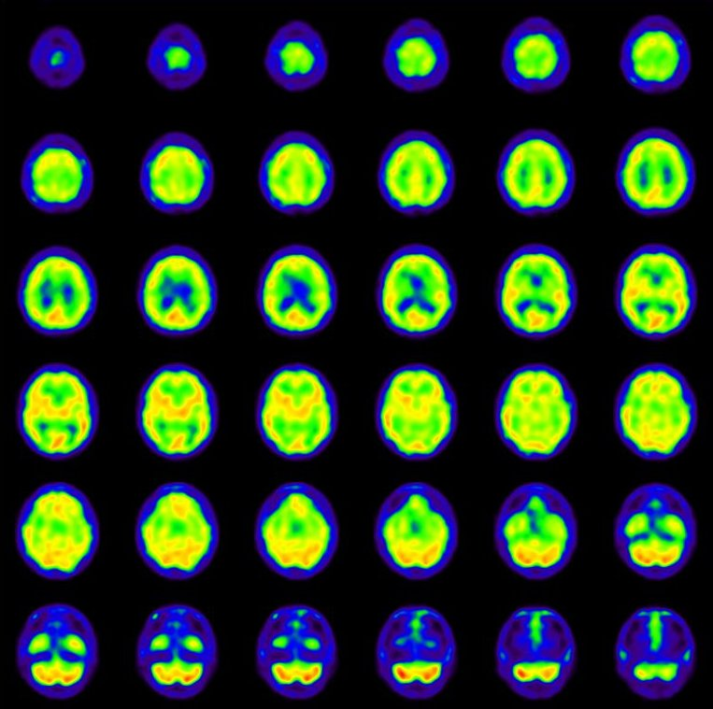
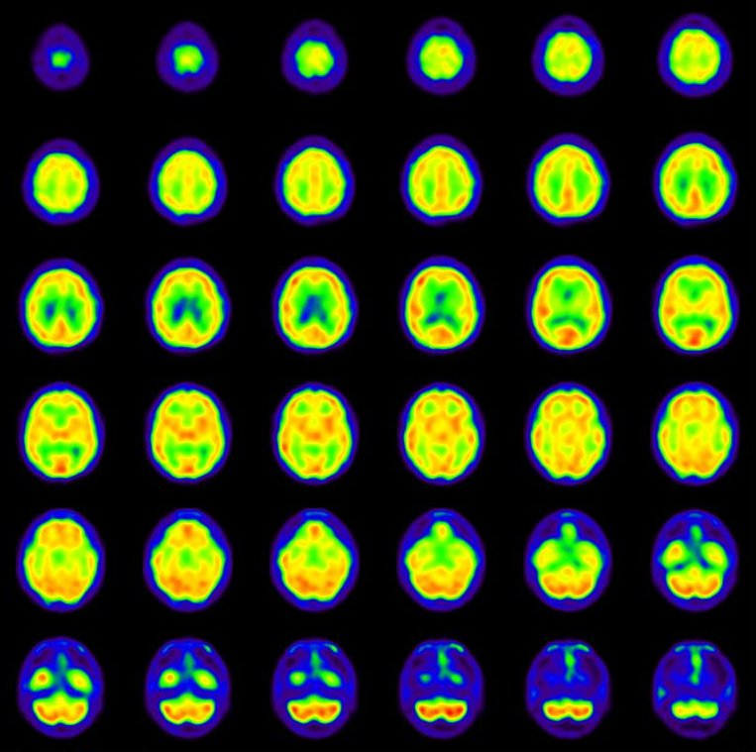
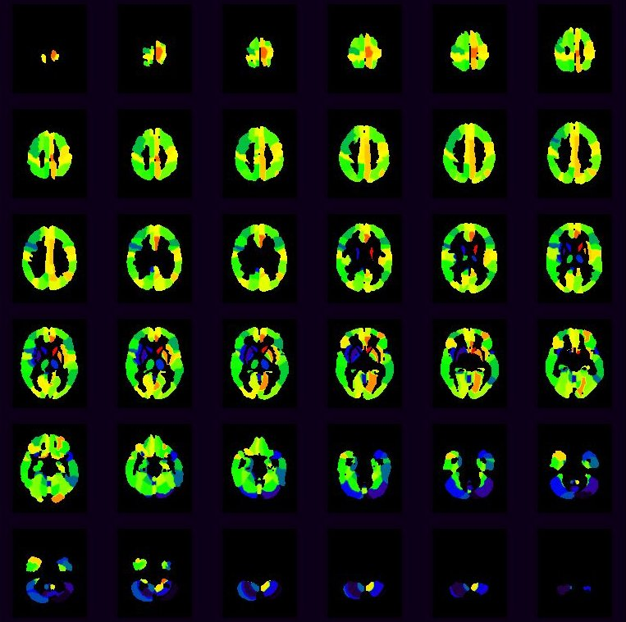
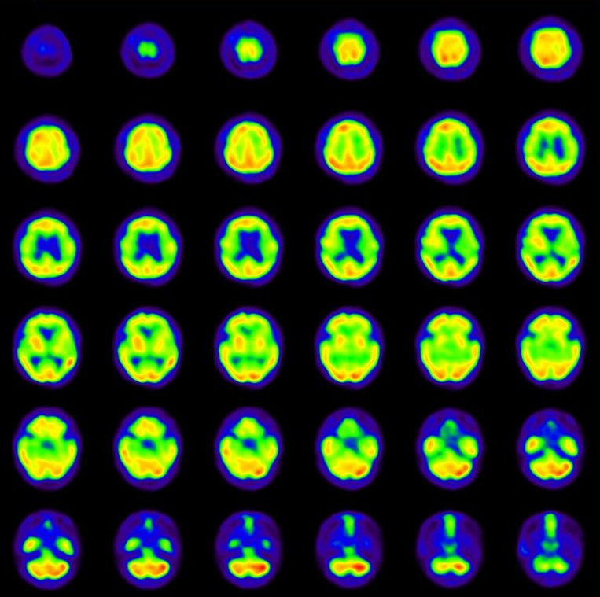
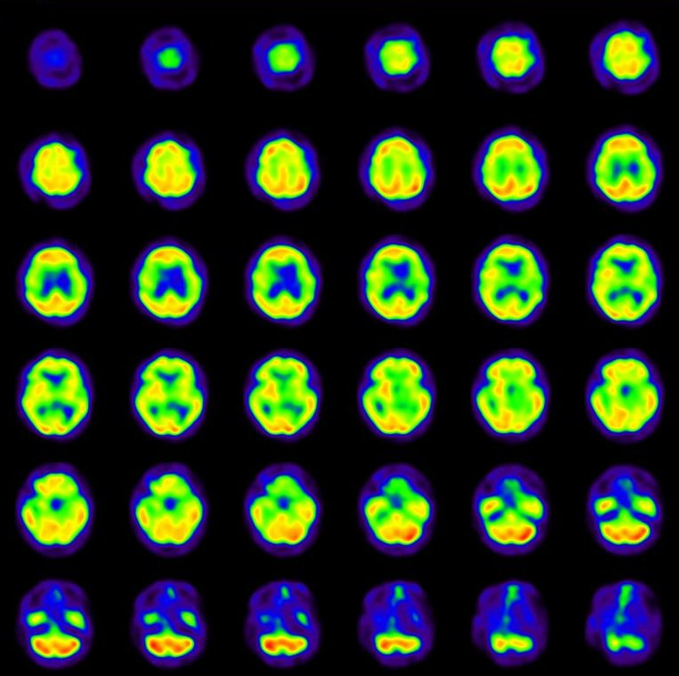
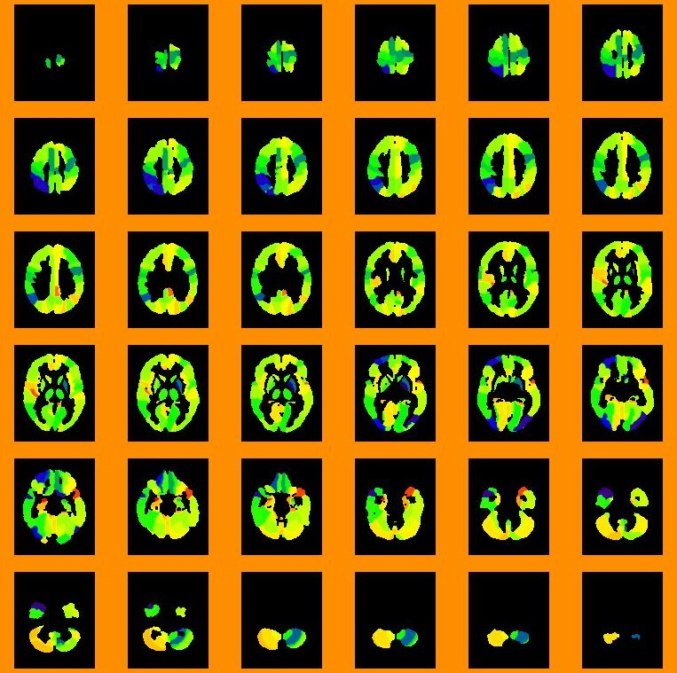



patient No.14
(a)Rest
(b)Acetazolamide
(c)CVR Map
0
20
40
60
80
100
120
140
160
0
50
100
150
200
250
300
350
0
2
4
6
8
10
12
14
16
patient No.54
(d)Rest
(e)Acetazolamide
(f)CVR Map
0
50
100
150
200
250
0
100
200
300
400
500
600
-30
-25
-20
-15
-10
-5
0
5

