Slide 1
Scratch Code Camp
Articulate Rise Project

Slide 2
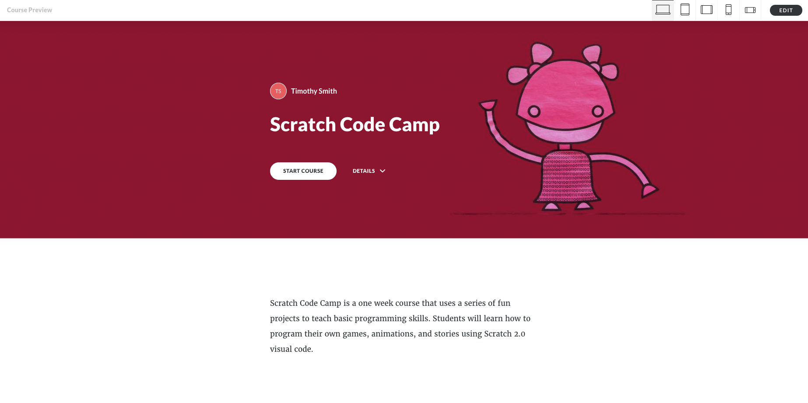

Slide 3
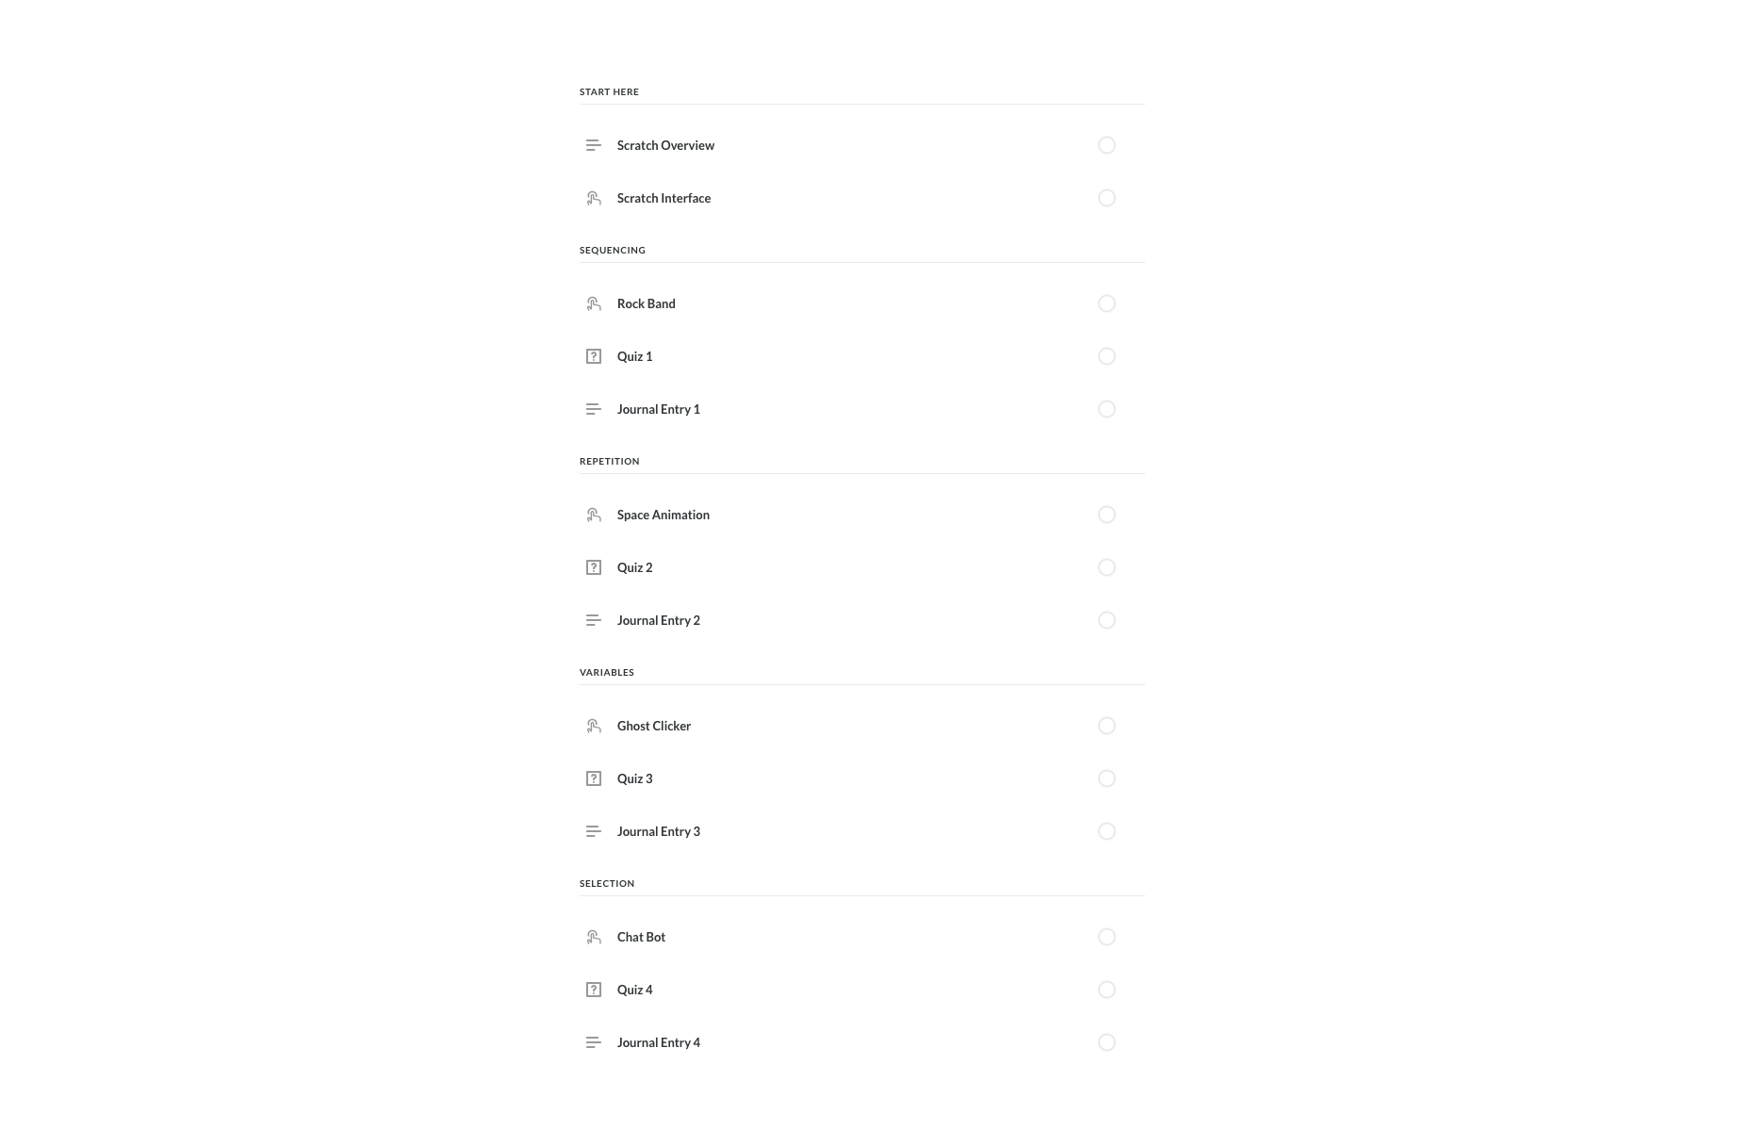

Slide 4
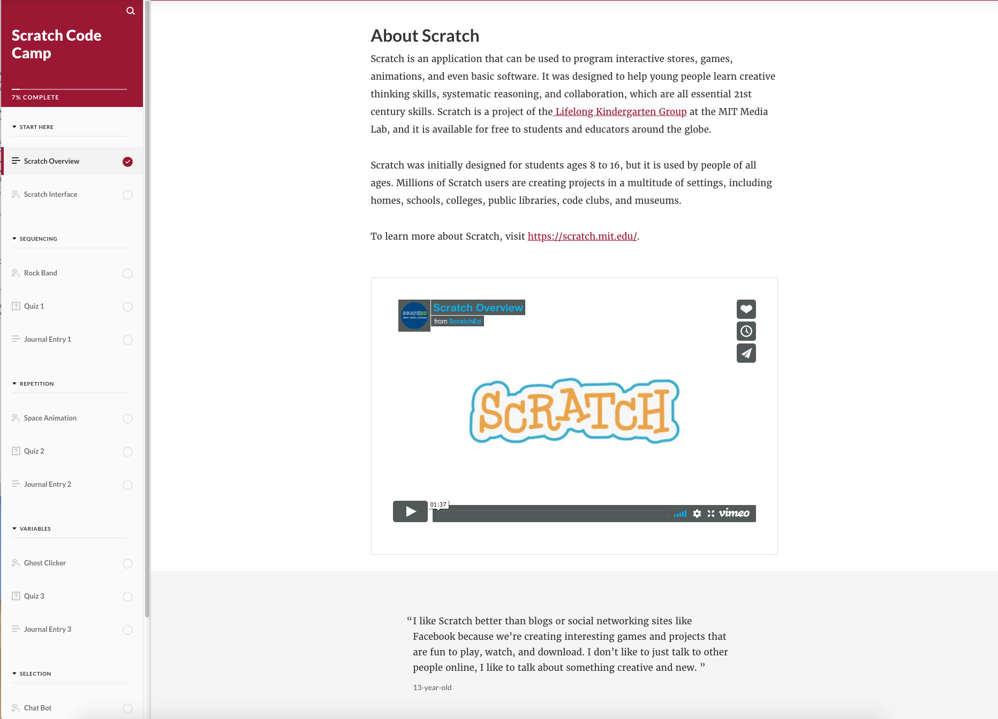

Slide 5
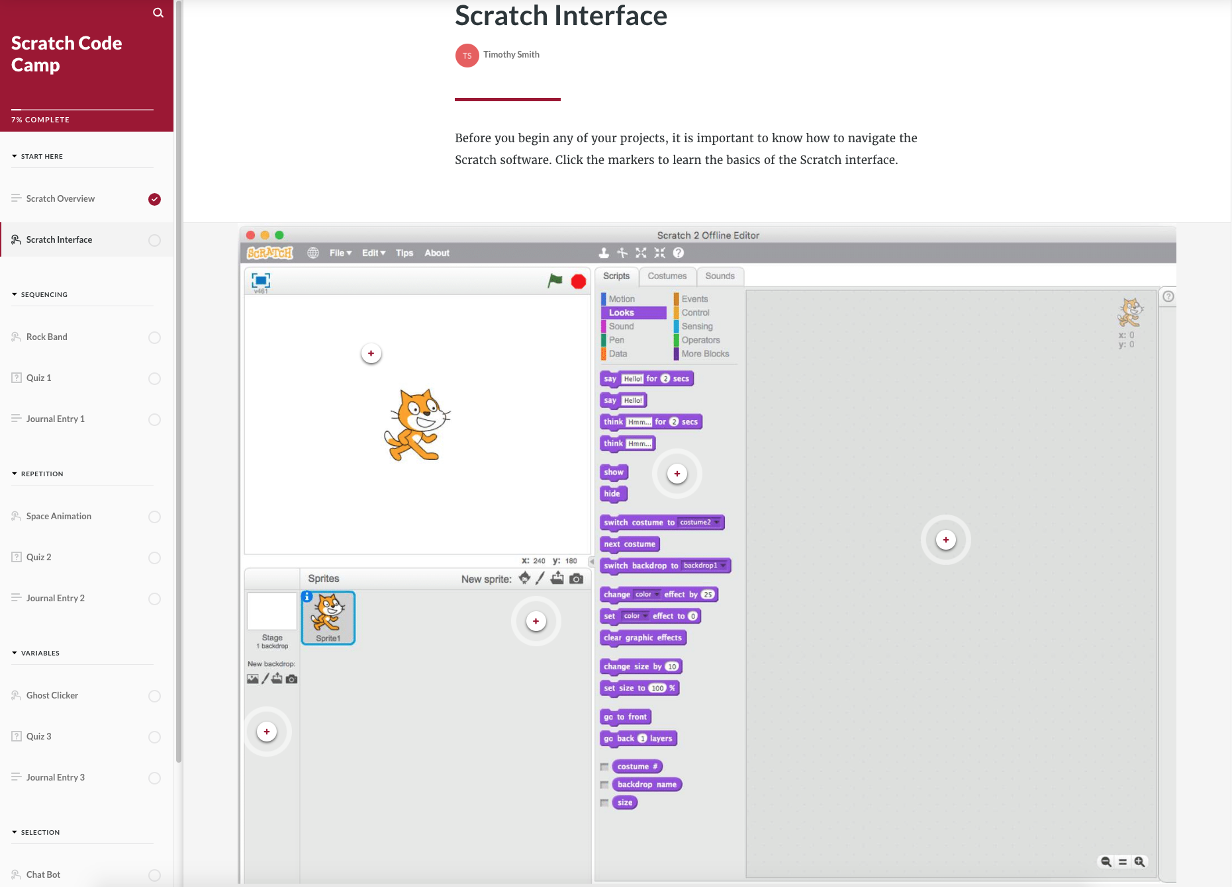

Slide 6
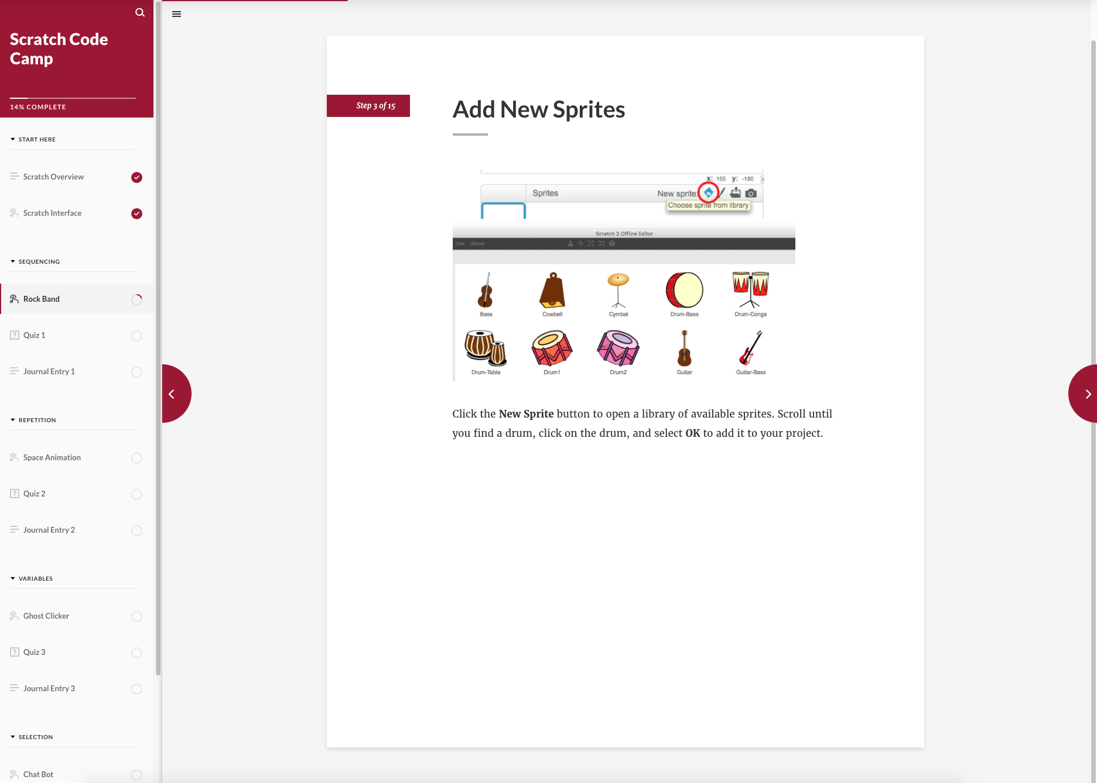

Slide 7
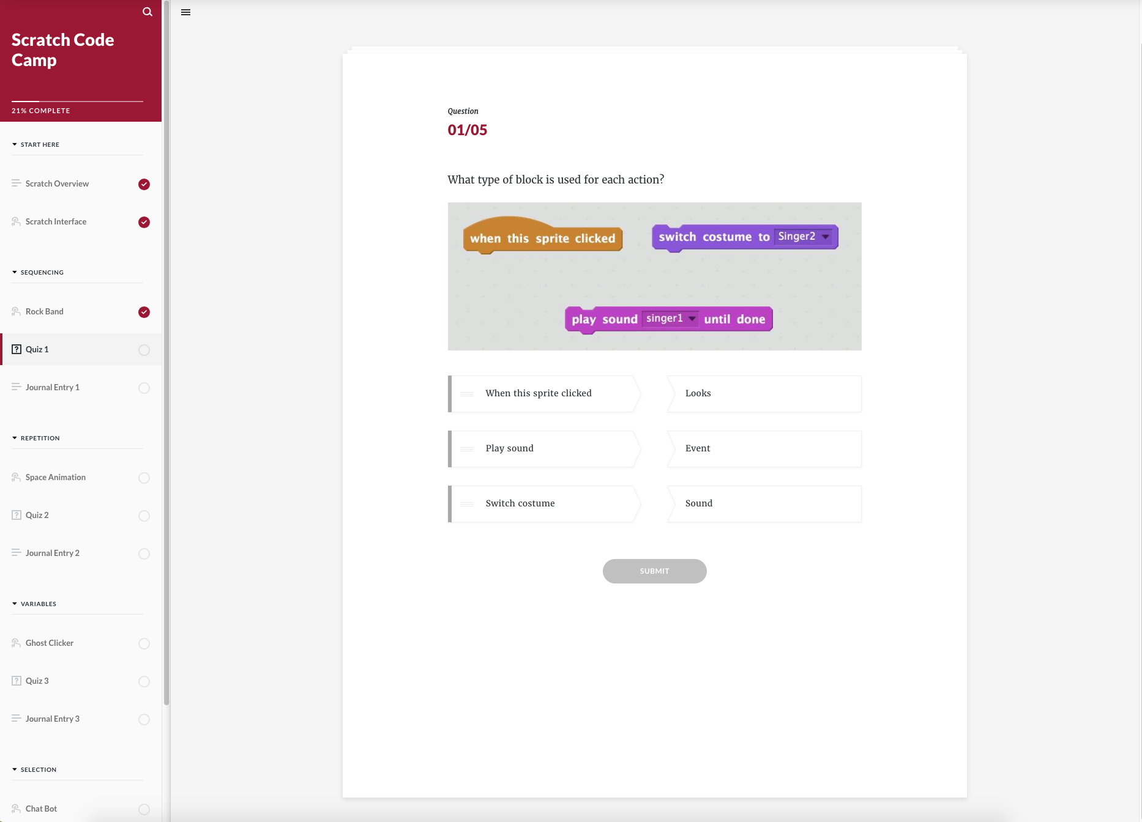

Slide 8
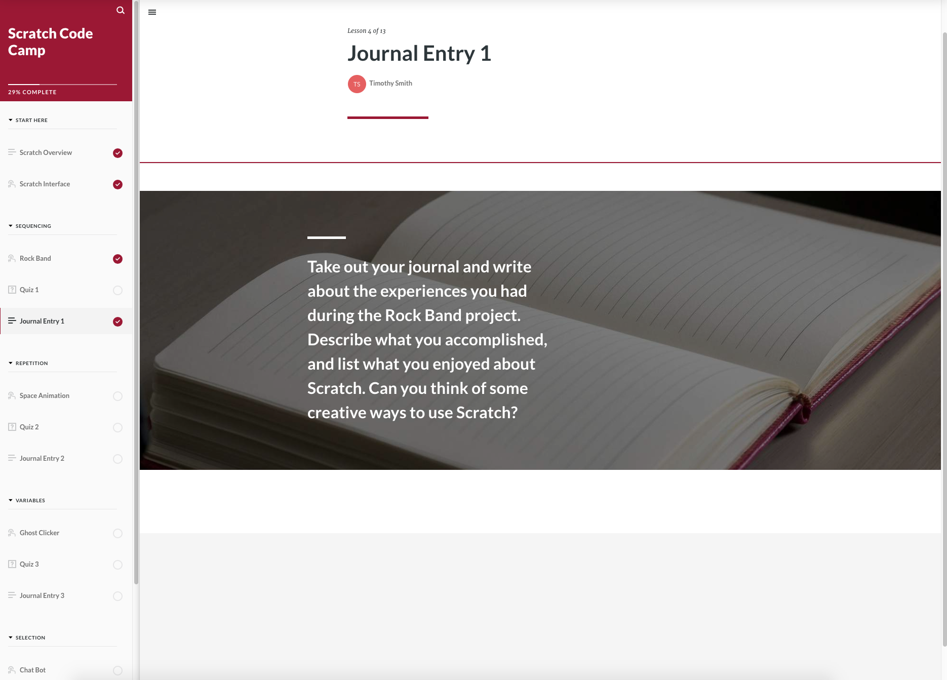

Slide 9
Resources & References
Some instructional materials provided by Raspberry Pi Foundation under a Creative Commons license. View project & license on GitHub
Adapted from the Code Club Scratch Module 1 Curriculum
https://projects.raspberrypi.org/en/codeclub/scratch-module-1

