Slide 1
Influenza Spread Over UCSB College of Engineering
Tiawna Cayton, Axel Haaker, Ayme Tomson

Slide 2
Motivation
In 1918-1919 there were between 20 and 40 million deaths due to an influenza pandemic.
In the 1990’s there were an average of 36,000 deaths and 200,000 hospitalizations annually in the US
This is an annual cost of $87 billion
Influenza is largely preventable through a simple vaccine, though most forego it

Slide 3
Scope
A model leveraging network properties of an organization such as a school or office building could be used to identify individuals that when infected could spread the infection most effectively
Policy makers could then implement efficient infection-prevention campaigns targeting these ‘super spreaders’ to save money and lives across the organization
This model could be used to predict the spread of other infectious diseases as well
The purpose of this project was to create such a model that illustrates the diffusion of an infection through a familiar network (the UCSB College of Engineering freshman class) to develop a sense of how attending class when sick affects the network as a whole

Slide 4
Scope (Outline)
Develop Dataset
Network Creation
Epidemic Model
Interface

Slide 5
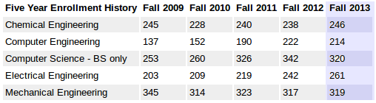
Data Development

Slide 6
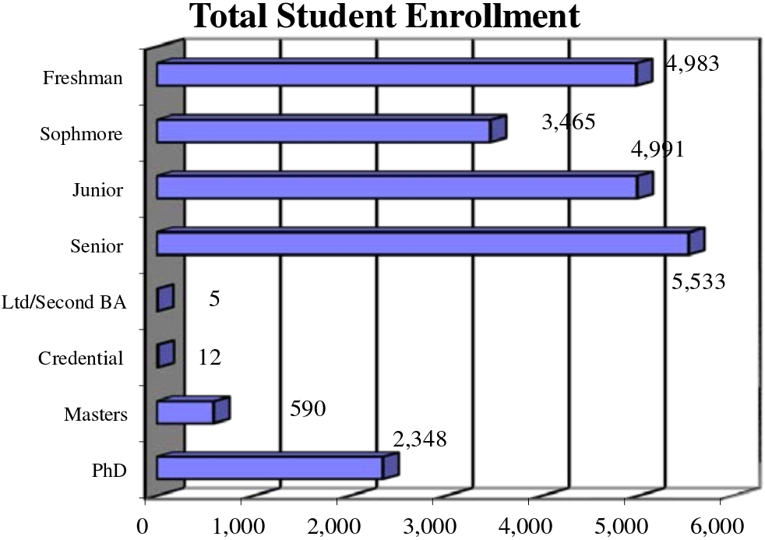
Data Development
Freshmen make up approx. 26% of the population at UCSB

Slide 7
Network Creation
Adjacency matrix describing which students were in the same course section at each given time slot
An entire network graph was created showing how students across the college of engineering were linked based on class schedule

Slide 8
Infection Model
ODE model was not used
Stochastic model implemented instead due to:
Small sample size of dataset
Individual interactions cannot be seen with ODE model
Define contact sample as a random sample of percentage of people in course that have contact with infected individual
Beta (%) of contacted individuals are infected (also a random sample)
This continues at each timeslot as infected individuals attend classes

Slide 9
GUI
Used tkinter for visualizations
Difficult to implement dynamic graphs, slider has not yet been implemented
Three modes implemented:
Single (s)
Batch (b)
Presentation (p)

Slide 10
GUI
Single:
Uses GUI to allow single student to view how many people would be infected if they attend class while sick
Batch:
Runs a specified number of simulations infecting each student and finding an average number of people infected by each individual
We ran a batch with 1000 simulations for our data
Presentation:
Shows each time slot in succession when the “Next” button is clicked

Slide 11
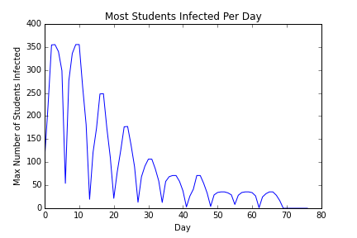
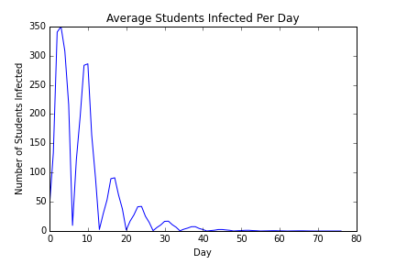
Batch Analysis Data

Slide 12
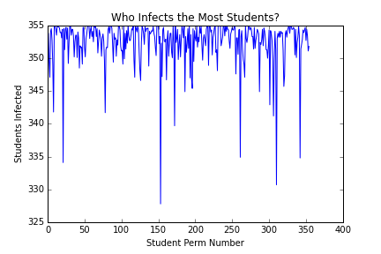
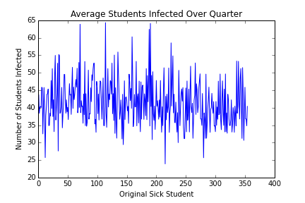
Notes:
Most of the lower points on the max infected are computer engineering students

Slide 13
Demonstration

Slide 14
Future Work
Represent time with a slider
Improve graph visualization
Expand population to all UCSB students
Vary beta – different strains have different infection rates

Slide 15
References
References available in final deliverable

