Slide 1

MyWealthPath
Your Tailored Investment Advisor

Slide 2

Project Outline
Project 1
Portfolio Back-testing and Benchmarking
(Visual Dashboard)
Monte Carlo Simulation (Future expected Performance)
Client Questionnaire & Risk Tolerance Assessment (UI)
Project 2
Portfolio Matching with Client Risk Tolerance
Trading Strategies
(Signal Performance)
Machine Learning Models Predictions
Portfolio Design
Conservative
Balanced
Growth
Aggressive
Alternative
Project 3
Client Onboarding (Interface and Sign-in form)
Transactions Interface (Smart Contract - deposit/withdrawal)
Notes:
For project 2 we chose to build off of project one, which positioned us as an online investment service.
After determining a user’s risk tolerance level they were assigned to one of 5 pre-defined portfolios.

Slide 3
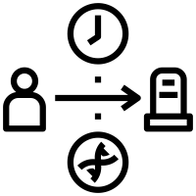
Overall Investment Strategy
Risk Assessment
Portfolio Matching
Project 1
Project 2
Project 3
Initial Investment
Client Onboarding Form
(landing page)
Buy & Hold
'Client Data'
Buy/Sell based on Signals
Transaction Interface (Smart Contract)
'Portfolio Holdings'
'Entry/Exit Position'
'Portfolio Holdings'
'Portfolio Cash'
Benchmark vs Market
Montecarlo Simulations
Client Portal
Admin Portal
Benchmark vs Market and vs ‘Buy & Hold’
Monte Carlo Simulations
'Deposit'
'Withdrawal'
'Balance Check'
'Sending'
'Withdrawing'
'Display Client Data'
Notes:
The strategy was a simple buy-and-hold strategy.
Project 2 added in an active investment strategy using simple market indicators or machine learning predictions
The model is based on a user investing a set amount of money (100,000)
roughly half of that is used for an initial investment of X shares. this base investment does not change
rest is cash reserves
we watch for buy/sell signals
if buy comes in the cash reserves are used to buy X shares as long as the last signal was a sell
if a sell comes X share are sold with proceeds going to cash reserves (only if last signal was a buy)

Slide 4


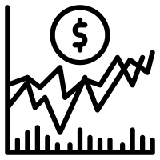
Landing Page - React Website
Client welcome, onboarding and data collection
Client Welcoming
Redirecting to online App Portal
Data filling form
Interface with brief intro and interactive buttons
Button redirecting user to the main MyWealthPath interface
Client Data Collection sent to Smart Contract
Notes:
after creating the buy/sell signals performance data was created for each portfolio/investment strategy combination
investment strategy performance was calculated for display by using backtesting using historical data for the time period of the ml test data forward,
determine if buy/sell is taking place
recalculate holdings and cash reserves
calculate daily returns and cumulative returns
also calculate same data for S&P 500 and portfolio without investment strategy

Slide 5
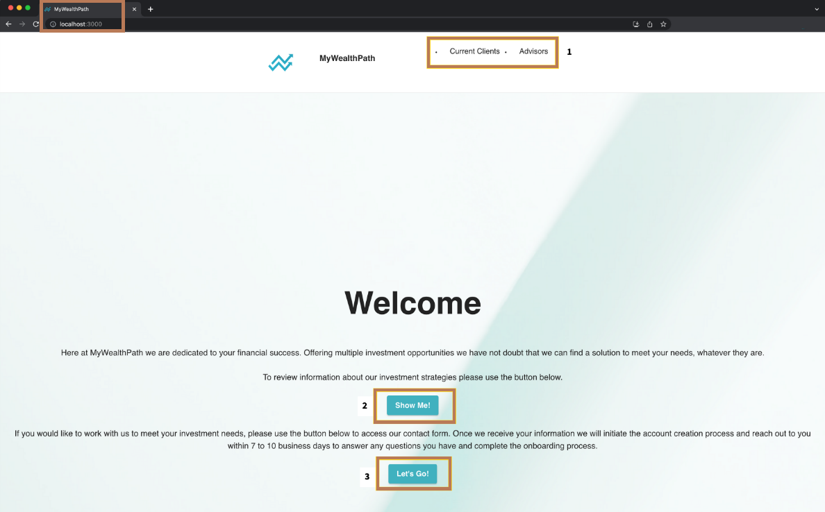
Landing Page - React Website
Links for clients or company employees to their respective dashboards for account activities (ie. deposit/withdrawal of funds)
Panel Dashboard app
Client Engagement Form
Notes:
after creating the buy/sell signals performance data was created for each portfolio/investment strategy combination
investment strategy performance was calculated for display by using backtesting using historical data for the time period of the ml test data forward,
determine if buy/sell is taking place
recalculate holdings and cash reserves
calculate daily returns and cumulative returns
also calculate same data for S&P 500 and portfolio without investment strategy

Slide 6
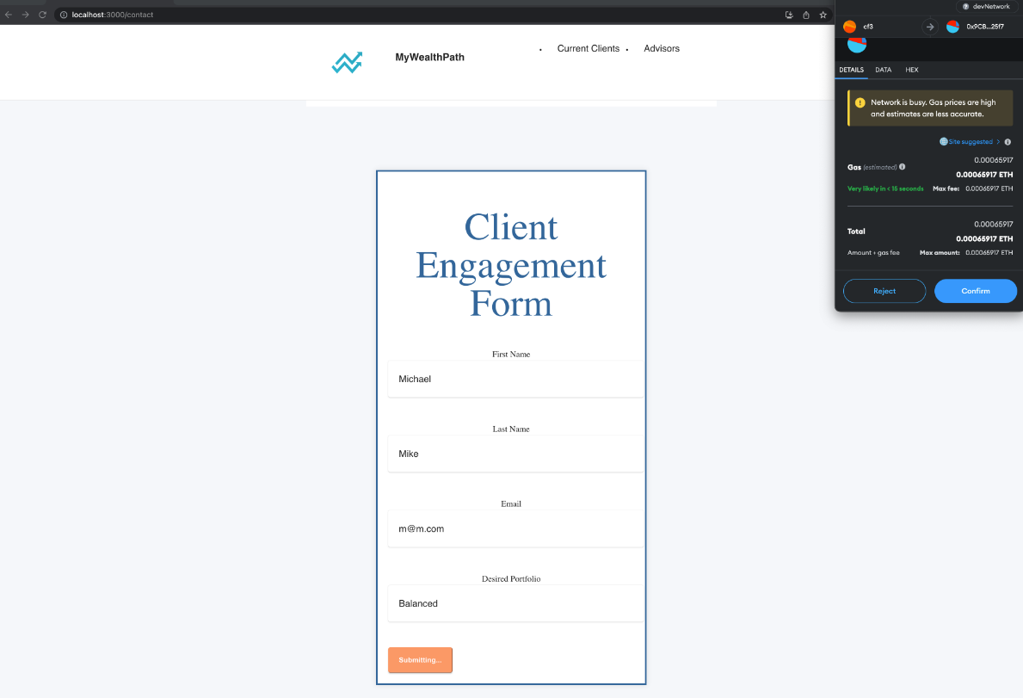
Data Collection Form
Client Engagement Form
Connection with Smart Contract
Variables saved in the contract for future transactions
Local host
Connection to the Solidity contract via Metamask and Ganache
Data Collection (name, email, desired Portfolio, etc.)
Notes:
we started with creating a series of indicator based buy/sell signals to be used for separate investment strategies
portfolio data is pulled using a yahoo finance api
combine separate stocks into one set of data based on weights
performance indicator = buy/sell based on pct_change
using python-ta library add performance indicators
sma ( 30, 100, 200)
macd (12/26/9 )
BBands
RSI (14) - Relative Strength Indicator (average ups divided by average downs over 14 days) 0 to 100
STOCH (14/3/3) Stochiastic Oscillator (relation to highest and lowest points over time period)
HLC3
OHLC4
Following were used to generate buy/sell signals based upon indicator values or relationships to create a set of investment strategies
SMA
MACD
BBANDS
RSI
STOCH

Slide 7

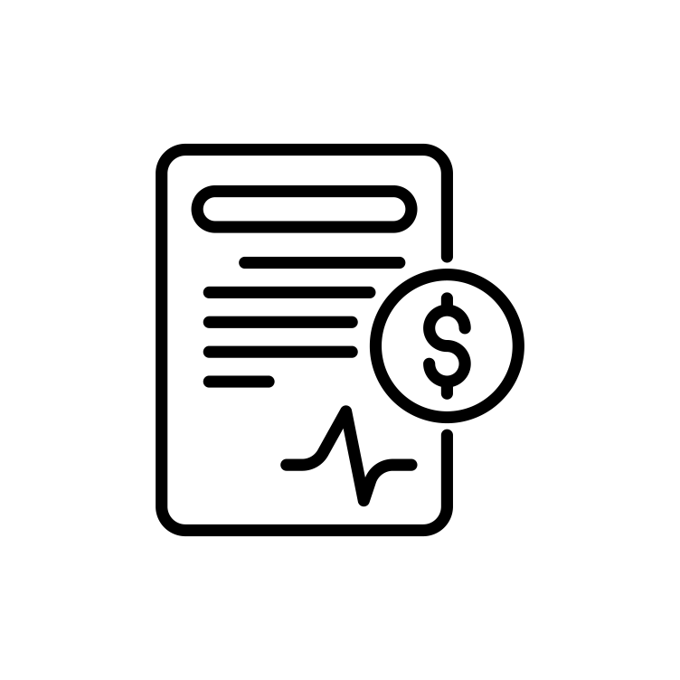

Transactions Flow - Solidity Contract
Client Deposit Function
Client deposits from their wallet into their reserve account
Company Withdraw Function
Company withdraws from client's reserve account to use for purchase of portfolio assets
CLIENT
Wallet
CONTRACT Wallet
COMPANY
Wallet
Client Withdraw Function
Client withdraws funds from their reserve account for use outside the investment platform
Company Deposit Function
Company deposits funds into a client's reserve account, such as after selling portfolio assets
Notes:
we started with creating a series of indicator based buy/sell signals to be used for separate investment strategies
portfolio data is pulled using a yahoo finance api
combine separate stocks into one set of data based on weights
performance indicator = buy/sell based on pct_change
using python-ta library add performance indicators
sma ( 30, 100, 200)
macd (12/26/9 )
BBands
RSI (14) - Relative Strength Indicator (average ups divided by average downs over 14 days) 0 to 100
STOCH (14/3/3) Stochiastic Oscillator (relation to highest and lowest points over time period)
HLC3
OHLC4
Following were used to generate buy/sell signals based upon indicator values or relationships to create a set of investment strategies
SMA
MACD
BBANDS
RSI
STOCH

Slide 8


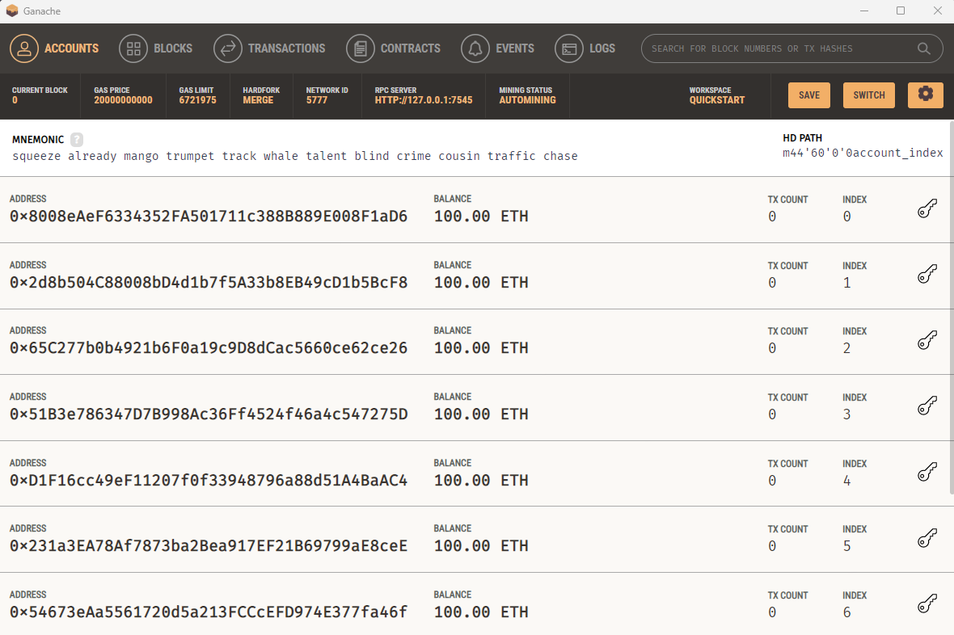


Transactions Flow - Local Blockchain
Potential Company and Clients Accounts
Notes:
we started with creating a series of indicator based buy/sell signals to be used for separate investment strategies
portfolio data is pulled using a yahoo finance api
combine separate stocks into one set of data based on weights
performance indicator = buy/sell based on pct_change
using python-ta library add performance indicators
sma ( 30, 100, 200)
macd (12/26/9 )
BBands
RSI (14) - Relative Strength Indicator (average ups divided by average downs over 14 days) 0 to 100
STOCH (14/3/3) Stochiastic Oscillator (relation to highest and lowest points over time period)
HLC3
OHLC4
Following were used to generate buy/sell signals based upon indicator values or relationships to create a set of investment strategies
SMA
MACD
BBANDS
RSI
STOCH

Slide 9
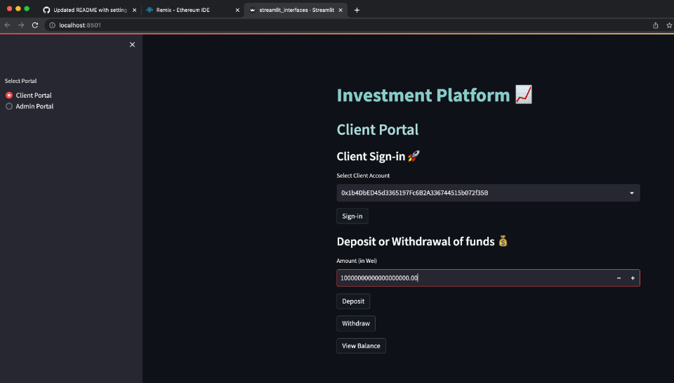
Transaction Interface - Streamlit
Client Portal
Notes:
we started with creating a series of indicator based buy/sell signals to be used for separate investment strategies
portfolio data is pulled using a yahoo finance api
combine separate stocks into one set of data based on weights
performance indicator = buy/sell based on pct_change
using python-ta library add performance indicators
sma ( 30, 100, 200)
macd (12/26/9 )
BBands
RSI (14) - Relative Strength Indicator (average ups divided by average downs over 14 days) 0 to 100
STOCH (14/3/3) Stochiastic Oscillator (relation to highest and lowest points over time period)
HLC3
OHLC4
Following were used to generate buy/sell signals based upon indicator values or relationships to create a set of investment strategies
SMA
MACD
BBANDS
RSI
STOCH

Slide 10
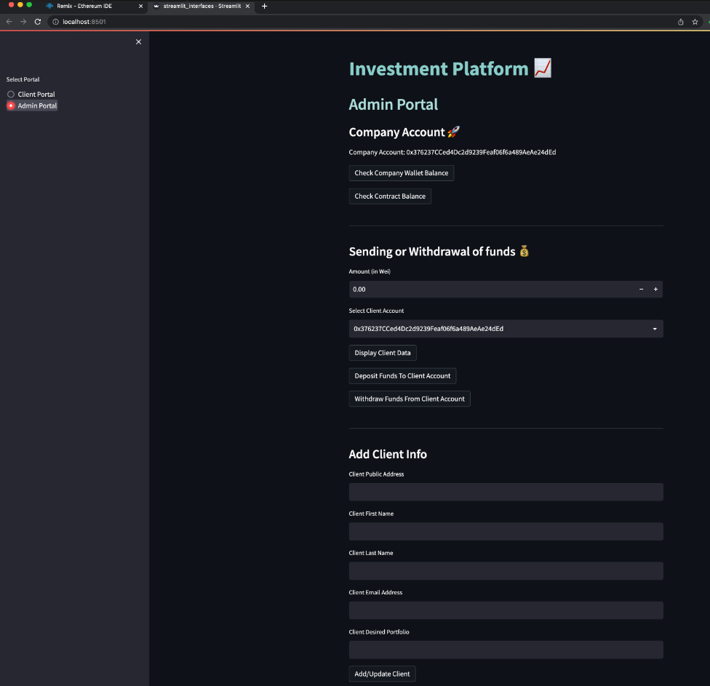
Transaction Interface - Streamlit
Admin Portal
Notes:
we started with creating a series of indicator based buy/sell signals to be used for separate investment strategies
portfolio data is pulled using a yahoo finance api
combine separate stocks into one set of data based on weights
performance indicator = buy/sell based on pct_change
using python-ta library add performance indicators
sma ( 30, 100, 200)
macd (12/26/9 )
BBands
RSI (14) - Relative Strength Indicator (average ups divided by average downs over 14 days) 0 to 100
STOCH (14/3/3) Stochiastic Oscillator (relation to highest and lowest points over time period)
HLC3
OHLC4
Following were used to generate buy/sell signals based upon indicator values or relationships to create a set of investment strategies
SMA
MACD
BBANDS
RSI
STOCH

Slide 11
Impact for Finance and Next Steps
IMPACT
NEXT STEPS
The finance industry has seen a growing demand for automated personal wealth advisors, as they offer several key benefits, including:
Accessibility: Accessible to a wider range of individuals, from anywhere and at any time.
Cost-effectiveness: Less expensive than traditional financial advisors.
Customization: Tailored to the specific needs and goals of individual clients.
Consistency: Consistent and objective investment advice, without being influenced by emotions or personal biases.
Speed and efficiency: They can process vast amounts of financial data and provide investment recommendations quickly, especially useful in fast-paced and rapidly changing markets.
By offering these benefits, automated personal wealth advisors can help the finance industry to better serve the needs of individual investors, particularly those who are looking for accessible, affordable, and customized investment advice.
Integrating the Streamlit interface into the React Website
Further tuning of the ML models
Customization Bar: So that he Client can play around with some factors to check other possible portfolios.
Portfolio Optimization Tool: Finding Optimal and more customized Portfolios instead of choosing from 5 predetermined ones.
Improve visualization and UX.
Fees and Monetization System: Include commissions and fees in the performance analysis for transparency with the client..
Add Market Information: Retrieved from APIs to offer further info to the client.
Notes:
Impacts are the same…
Accessible to wider audience
reduced costs to user
remove ‘human factor’
emotions, biases, etc
response time
future:
account creation
contracting
fine tune ML models
allow user to select base investment level, amount of additional shares
more targeted portfolios
improved UI/UX
add in fee impact

Slide 12

Live Demo

Slide 13
MyWealthPath
Your Tailored Investment Advisor

