Slide 1

MyWealthPath
Your Tailored Investment Advisor

Slide 2

Project Outline
Project 1
Portfolio Backtesting and Benchmarking
(Visual Dashboard)
Monte Carlo Simulation (Future expected Performance)
Client Questionnaire & Risk Tolerance Assessment (UI)
Portfolio Matching with Client Risk Tolerance
Portfolio Design
Conservative
Balanced
Growth
Aggressive
Alternative
Project 2
Trading Strategies
(Signal Performance)
Machine Learning Models Predictions
Notes:
For project 2 we chose to build off of project one, which positioned us as an online investment service.
After determining a user’s risk tolerance level they were assigned to one of 5 pre-defined portfolios.

Slide 3
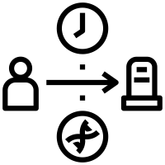
Overall Investment Strategy
Risk Assessment
Portfolio Matching
Project 1
Project 2
Buy & Hold
Initial Investment
'Portfolio Holdings'
Buy/Sell based on Signals
Benchmark vs Market
Montecarlo Simulations
'Entry/Exit Position'
'Portfolio Holdings'
'Portfolio Cash'
Benchmark vs Market and vs ‘Buy & Hold’
Monte Carlo Simulations
Notes:
The strategy was a simple buy-and-hold strategy.
Project 2 added in an active investment strategy using simple market indicators or machine learning predictions
The model is based on a user investing a set amount of money (100,000)
roughly half of that is used for an initial investment of X shares. this base investment does not change
rest is cash reserves
we watch for buy/sell signals
if buy comes in the cash reserves are used to buy X shares as long as the last signal was a sell
if a sell comes X share are sold with proceeds going to cash reserves (only if last signal was a buy)

Slide 4


Data Collection and Signals Creation
Data Sources
Combine OCHLV Data
Add Performance Signal Column
5 year historical data from finance API
Open/Close/High/Low/Volume data for individual stocks into one OCHLV dataset, scaling each stock's contribution based on its weight in the portfolio
Indicating buy or sell condition for each day based on closing price
Convert Indicators into Buy/Sell Signals
Add Indicators
Indicator | Buy | Sell
SMA | SMA30 >= SMA100 | SMA30 < SMA100
MACD | MACD >= MACDs | MACD < MACDs
BBANDS | close <= BBL | close > BBU
RSI | RSI <= 30 | RIS >= 70
STOCH | STOCHk < 20 | STOCHk > 80
SMA (30, 100, 200), EMA (50), MACD (12/26/9), BBANDS (20/2.0), RSI (14), HLC3, OHLC4, LINREG (14), and STOCH (14/3/3)
Notes:
we started with creating a series of indicator based buy/sell signals to be used for separate investment strategies
portfolio data is pulled using a yahoo finance api
combine separate stocks into one set of data based on weights
performance indicator = buy/sell based on pct_change
using python-ta library add performance indicators
sma ( 30, 100, 200)
macd (12/26/9 )
BBands
RSI (14) - Relative Strength Indicator (average ups divided by average downs over 14 days) 0 to 100
STOCH (14/3/3) Stochiastic Oscillator (relation to highest and lowest points over time period)
HLC3
OHLC4
Following were used to generate buy/sell signals based upon indicator values or relationships to create a set of investment strategies
SMA
MACD
BBANDS
RSI
STOCH

Slide 5

Machine Learning Pathway
Matching each Portfolio with the most optimal ML Model out of >70 variations trained and tested
Make Predictions
Predictions become buy/sell signals for machine learning strategy
Clean and Shift Data
Retaining performance signal and indicator, and shifting dataset by one time period so that today's performance is used to determine tomorrow's buy/sell action.
06
05
01
Models Testing
Test >70 variations of 7 Model types to find the optimal for each Portfolio.
Create target dataset
Using the buy/sell performance indicator.
04
02
Saved train/test datasets
For use in modeling process.
03
Train/test datasets
Splitting data based on a 24-month window for train and 12 month for test.
Notes:
We then moved onto a Machine Learning Pathway for crating an investing strategy
For ML models only performance indicator itself and indicator values were kept
features = indicators (sma, macd, bollinger bands, stoch, rsi, etc)
target = performance indicator (base on daily closing price)
train/test split: train had 24 months. test had 12 months, remainder for predictions
models:
Adaboost
BaggingClassifier
GaussianNB
Logistic Regression
Random Forest
Support Vector Machine
Neural Network (2 hidden layers)
predictions from ML model become buy/sell signals

Slide 6
Machine Learning Model Performance
Models were evaluated primarily on F1 Score, with AUC-ROC score as a secondary measure if needed
The selected ‘best models’ were:
Portfolio | Selected Model | F1 Score | AUC-ROC
Conservative | Neural Network | 0.668464 | 0.499312
Balanced | Random Forest | 0699229 | 0.451357
Growth | Random Forest | 0.699482 | 0.579342
Aggressive | Random Forest | 0696104 | 0.580878
Alternative | Random Forest | 0.696104 | 0.547933
Notes:
AUC-ROC curve plots TPR vs FPR. Overall it tells how well the model does in distinguishing between classes. A higher score is desired
TPR = TP/(TP + FN) out of all true positives how many were correctly classified?
FPR = FP/(TN + FP) out of all true negatives how many were incorrectly classified as true?

Slide 7
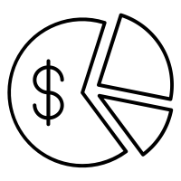

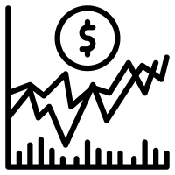
Signal Performance Pathway
Backtesting and display of the trading ‘enhanced’ Portfolio
Portfolio position evaluation
Trading Strategy performance analysis
Performance Benchmarking
'Entry/Exit Position'
'Portfolio Holdings'
'Portfolio Cash'
'Portfolio Daily Returns'
'Portfolio Cumulative Returns'
vs Base ‘buy & hold’ strategy and vs Market reference (S&P500)
Notes:
after creating the buy/sell signals performance data was created for each portfolio/investment strategy combination
investment strategy performance was calculated for display by using backtesting using historical data for the time period of the ml test data forward,
determine if buy/sell is taking place
recalculate holdings and cash reserves
calculate daily returns and cumulative returns
also calculate same data for S&P 500 and portfolio without investment strategy

Slide 8
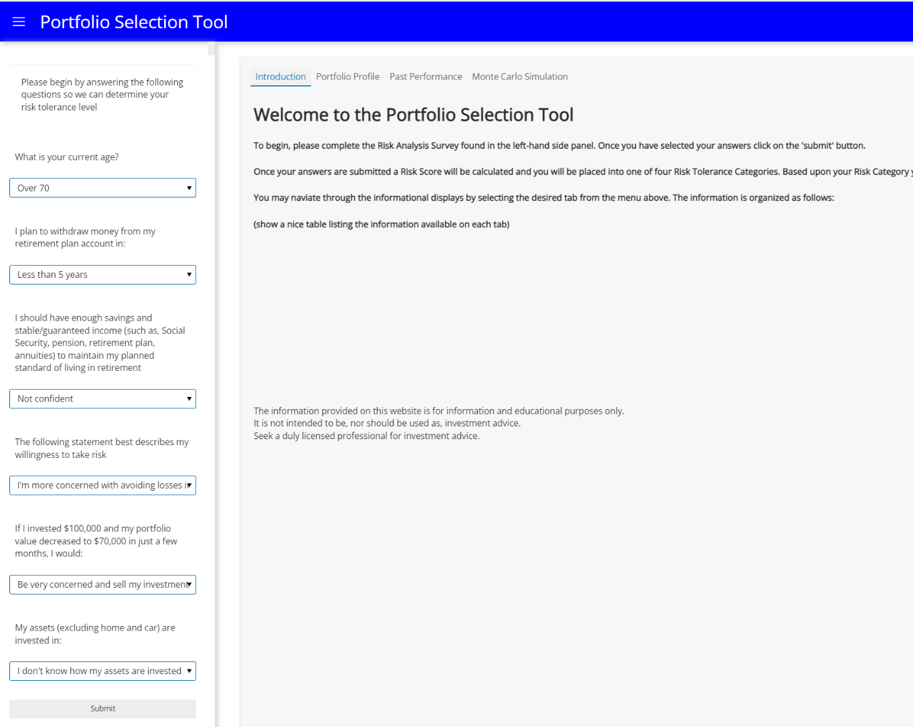
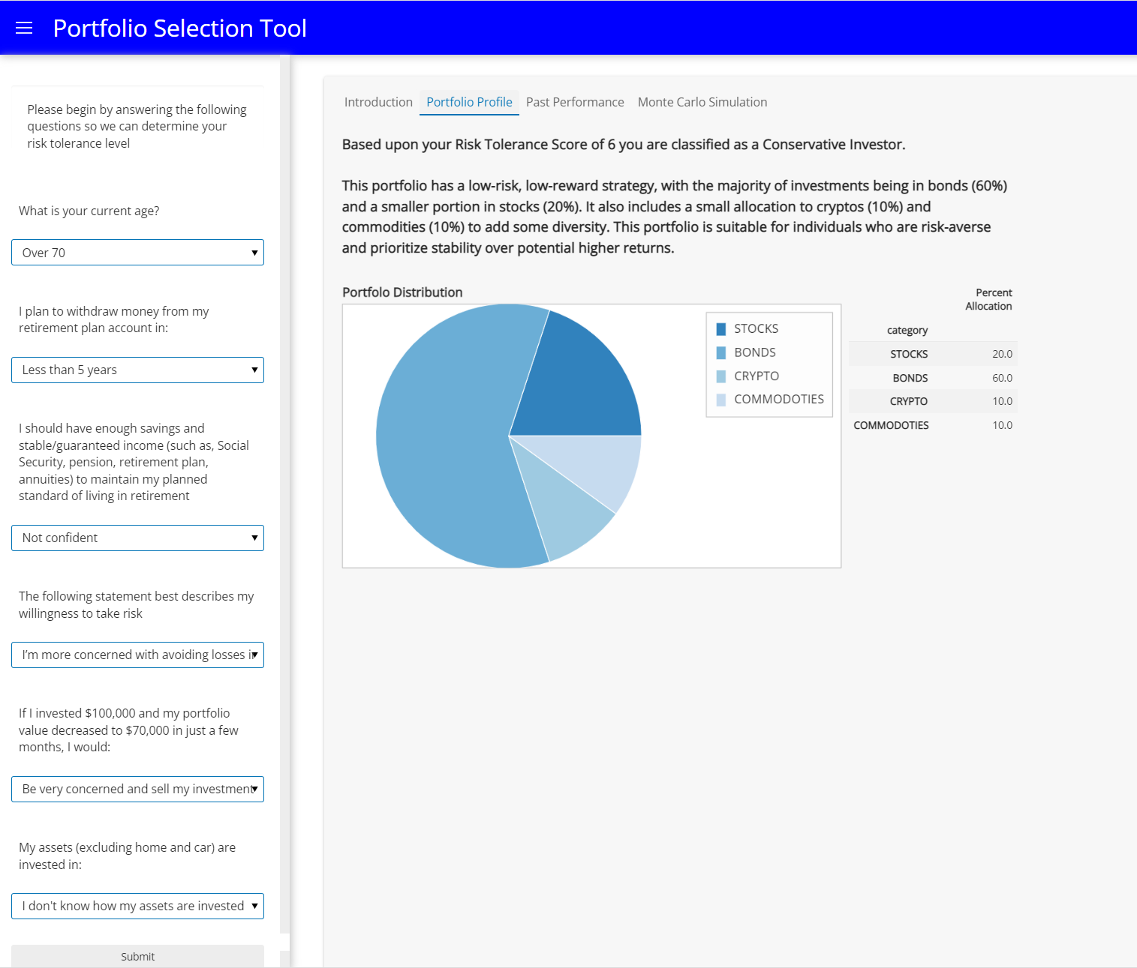
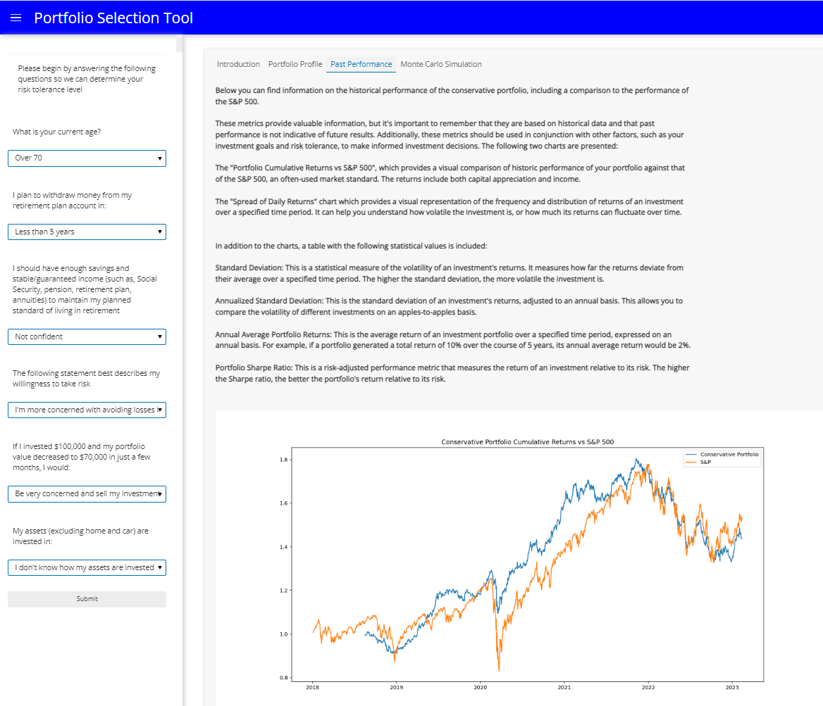
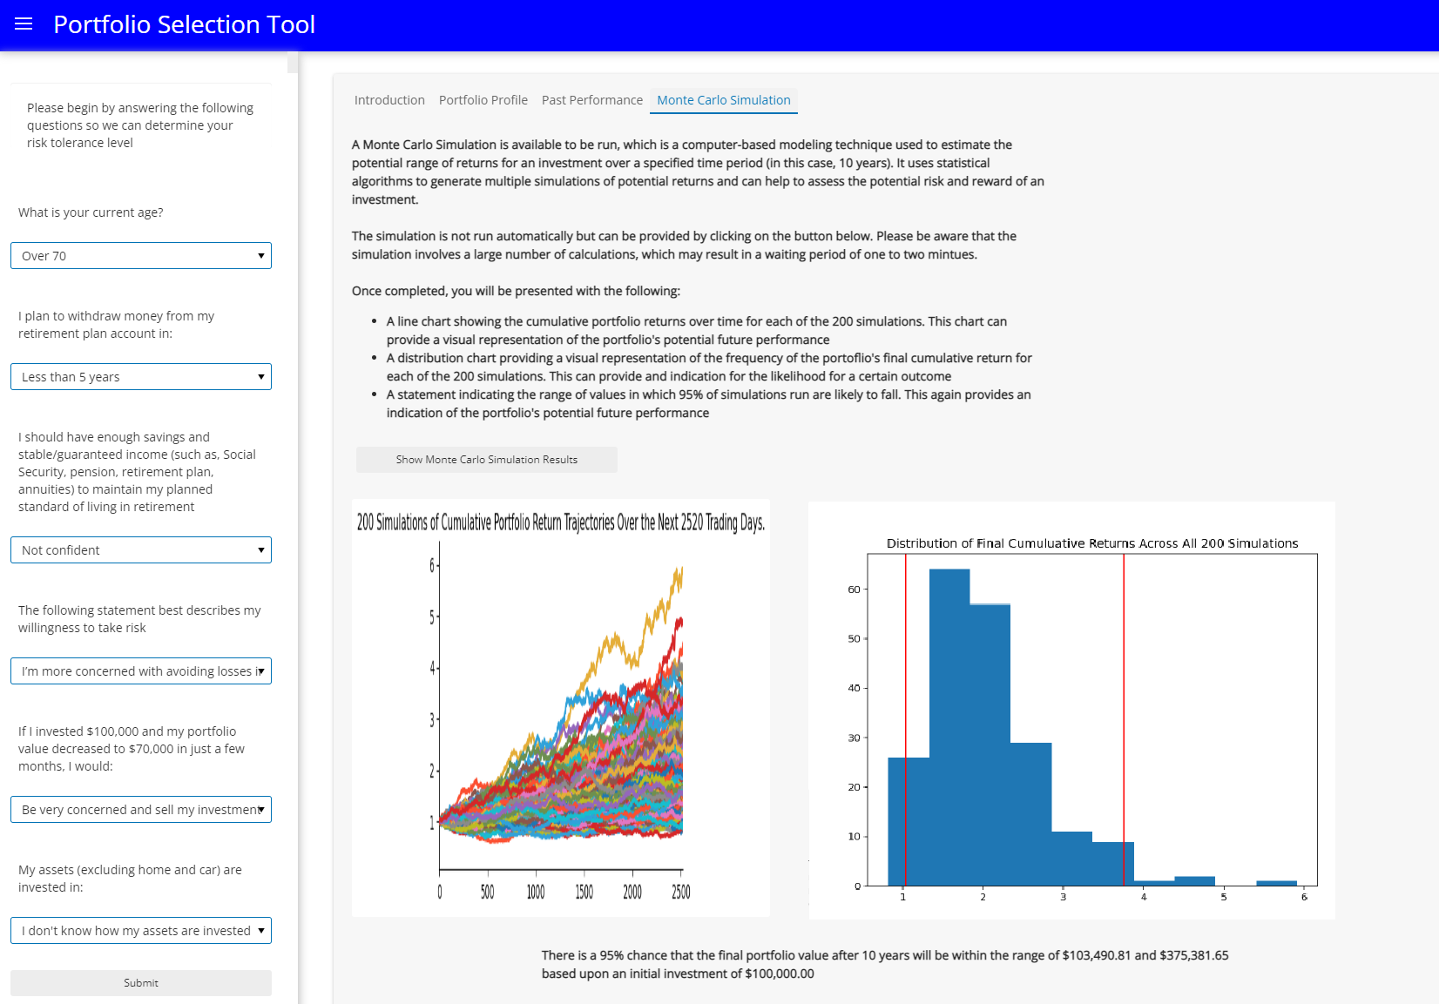
Output Visualization
Features deployed in Project 1…
Client Questionnaire & Risk Tolerance Assessment (UI)
Portfolio Profile Details and Description
Past Performance and Benchmarking
Monte Carlo Simulations and Future Expected Performance

Slide 9
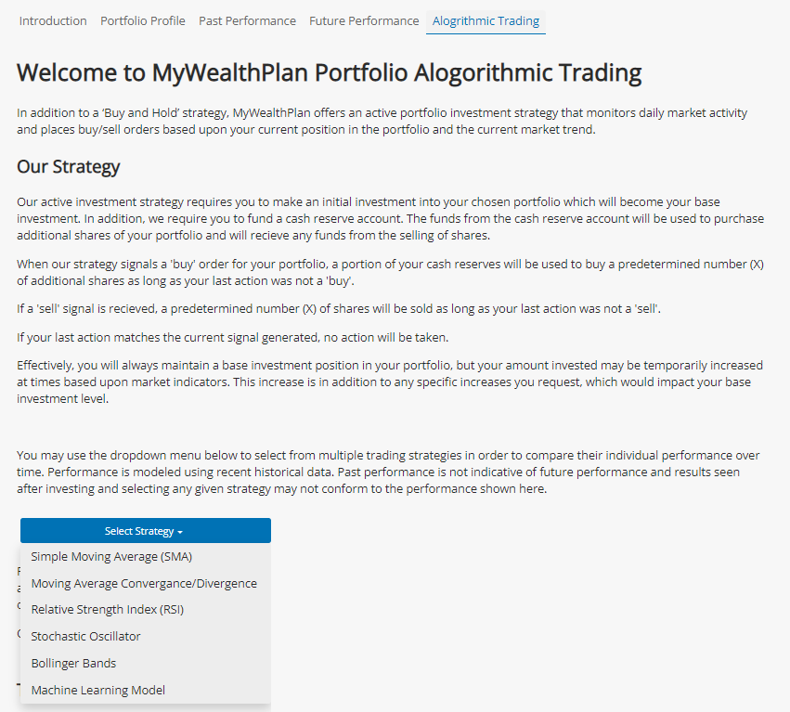
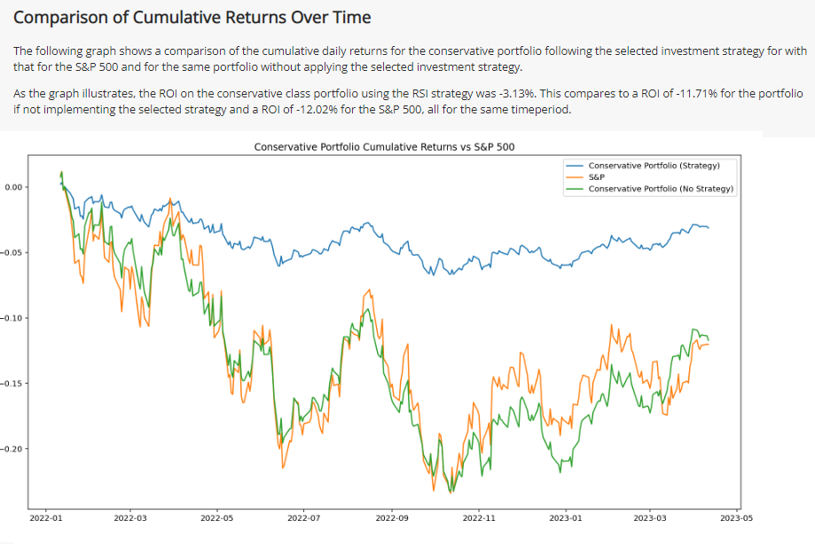
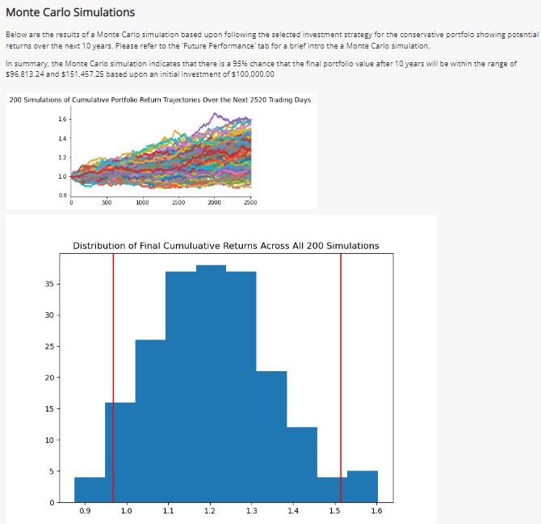
Output Visualization
And new features from Project 2
Trading Strategy Selection by the User
Past performance benchmarking vs base strategy and Market reference
Future Expected Performance with Montecarlo

Slide 10
Impact for Finance and Next Steps
IMPACT
NEXT STEPS
The finance industry has seen a growing demand for automated personal wealth advisors, as they offer several key benefits, including:
Accessibility: Accessible to a wider range of individuals, from anywhere and at any time.
Cost-effectiveness: Less expensive than traditional financial advisors.
Customization: Tailored to the specific needs and goals of individual clients.
Consistency: Consistent and objective investment advice, without being influenced by emotions or personal biases.
Speed and efficiency: They can process vast amounts of financial data and provide investment recommendations quickly, especially useful in fast-paced and rapidly changing markets.
By offering these benefits, automated personal wealth advisors can help the finance industry to better serve the needs of individual investors, particularly those who are looking for accessible, affordable, and customized investment advice.
Blockchain contracts for onboarding and signing-up the client, and for registering portfolio transactions,
Further tuning of the ML models
Customization Bar: So that he Client can play around with some factors to check other possible portfolios.
Portfolio Optimization Tool: Finding Optimal and more customized Portfolios instead of choosing from 5 predetermined ones.
Improve visualization and UX.
Fees and Monetization System: Include commissions and fees in the performance analysis for transparency with the client..
Add Market Information: Retrieved from APIs to offer further info to the client.
Notes:
Impacts are the same…
Accessible to wider audience
reduced costs to user
remove ‘human factor’
emotions, biases, etc
response time
future:
account creation
contracting
fine tune ML models
allow user to select base investment level, amount of additional shares
more targeted portfolios
improved UI/UX
add in fee impact

Slide 11

Live Demo

Slide 12
MyWealthPath
Your Tailored Investment Advisor

