Slide 1
Installation

Slide 2
1. Download
Google Play Store
https://play.google.com/store/apps/details?id=host.exp.exponent&hl=en_SG
Apple Store
https://apps.apple.com/us/app/expo-client/id982107779

Slide 3
2. Download
GitHub (Source Code)
https://github.com/tlcheow/10KAY-PassiveAssistanceTrigger_SCDFXIBM
Download Visual Studio Code
https://code.visualstudio.com/download

Slide 4
2. Install Relevant Packages
Open the project folder from the Downloaded Source code
Open Terminal in Visual Studio Code
run: “npm install -g expo-cli”
After installing Expo
run: “expo start”

Slide 5
Step by Step

Slide 6
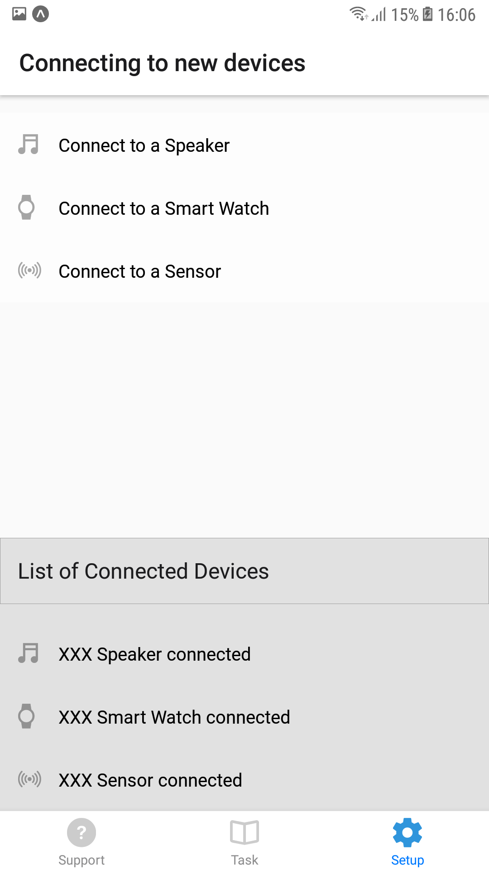
1. Setup
Assume all devices has been purchase.
Download the app and link up with our services.
Go to the “Setup” tab to connect all devices with our system.
And everything will be running in background

Slide 7
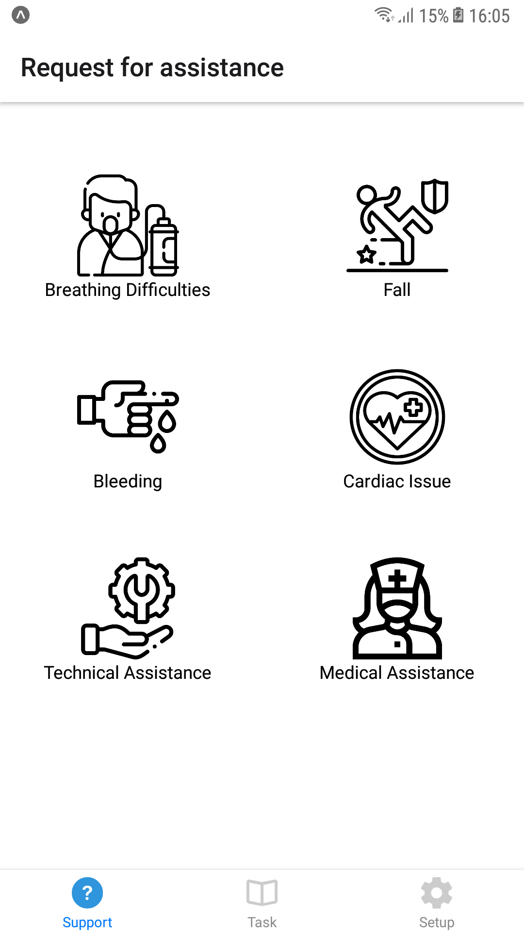
Active Triggers
Users can manually request for assistant
Click on the services they need.
And the request will be broadcast to nearby responders

Slide 8
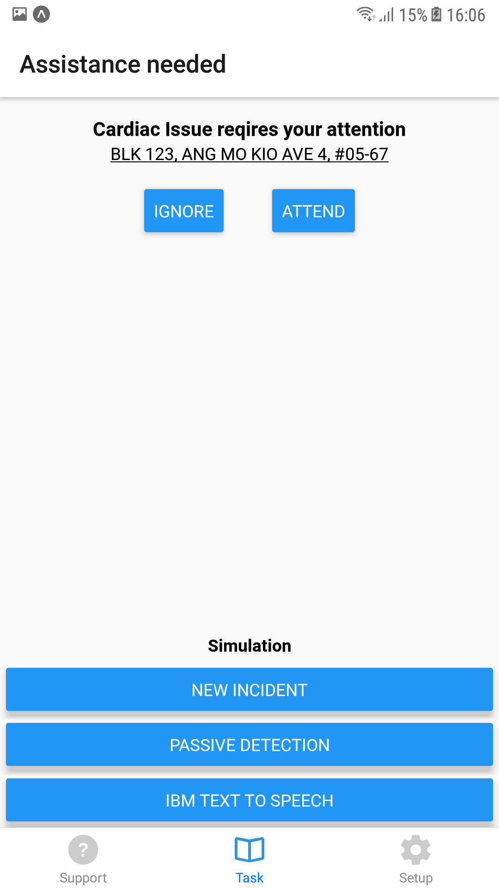
Based on the services they select, the responders will be able to see the request.
They can choose to attend or ignore the case.
Click on the address and it will bring you to Maps

Slide 9
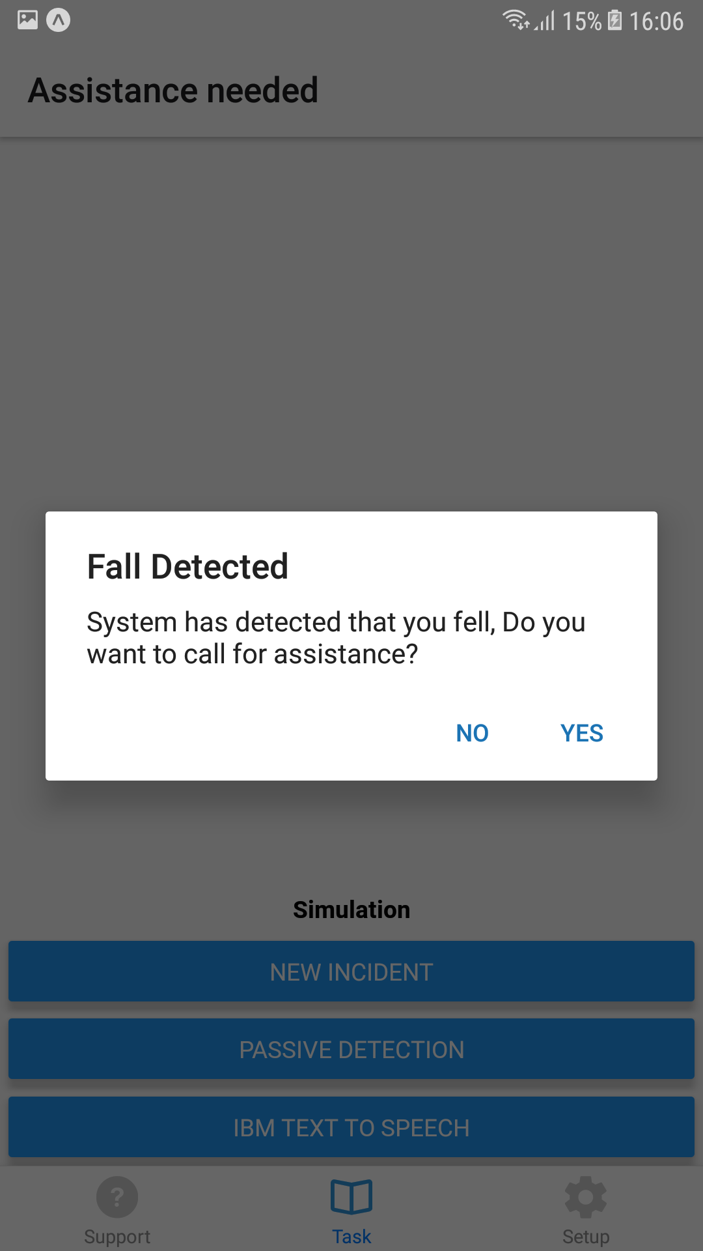

Passive Trigger
The system will detect the user’s motion and check if the user will need any assistance.
This notification will also be send out to the Speaker, Smart Watch and the Application.
If the user did not respond to the verification, a request for assistance will be send out automatically

Slide 10
Tools Used

Slide 11
Tools Used
React Native (Expo)
Flaticon.com
Visual Studio Code
IBM Cloud Services

