Slide 1
Chapter 9 Inheritance

Slide 2
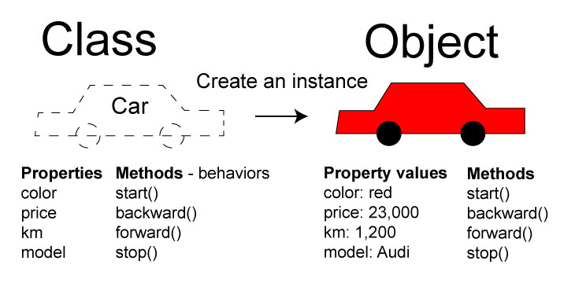
Review
What is a class, and an object ?
Notes:
Figure credits: https://codersite.dev/understanding-oop-concepts/ (accessed on 9/8/2025)

Slide 3

Design a product of various subscriptions (e.g. Dropbox)

Slide 4
Suppose you are designing the system using JAVA classes
Class DropboxPlus
Class DropboxStandard
Class DropboxAdvenced

Slide 5
When you need to update some functions.
Say, update a method in 2FA.
Update several files.

Slide 6
A better way?
One change can be made to all associated methods.
Linking all related classes and sharing code among them.
The solution is inheritance.

Slide 7
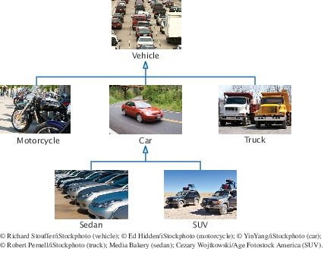
Concept
Inheritance: the relationship between a more general class (superclass) and a more specialized class (subclass).
The subclass inherits data and behavior from the superclass. Cars share the common traits of all vehicles
Example: the ability to transport people from one place to another

Slide 8
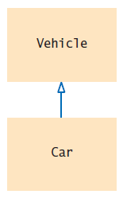
Inheritance Hierarchies
The class Car inherits from the class Vehicle
The Vehicle class is the superclass The Car class is the subclass
Figure 2 Inheritance Diagram

Slide 9
Task 1
In the Dropbox subscription case, decide if the listed class is a super class, special class, or Both.
Class DropboxPlus
Class DropboxStandard
Class DropboxAdvenced

Slide 10
Task 2
Consider classes Manager and Employee. Which should be the superclass and which should be the subclass?

Slide 11
Task 3
What are the inheritance relationships between classes BankAccount, CheckingAccount, and
SavingsAccount?

Slide 12
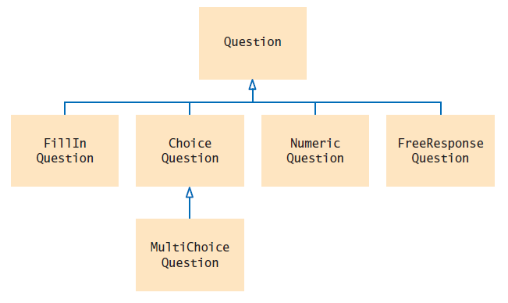
Inheritance Hierarchies
Figure 3 Inheritance Hierarchy of Question Types
Example: Computer-graded quiz
There are different kinds of questions
A question can display its text, and it can check whether a given response is a correct answer.
You can form subclasses of the Question class.

Slide 13
section_1/Question.java
1 /**
2 A question with a text and an answer.
3 */
4 public class Question
5 {
private String text;
private String answer;
8
9
10
11
12
13
14
15
16
17
18
19
20
21
22
23
24
25
26
27
28
29
30
31
32
/**
Constructs a question with empty question and answer.
*/
public Question()
{
text = ""; answer = "";
}
/**
Sets the question text.
@param questionText the text of this question
*/
public void setText(String questionText)
{
text = questionText;
}
/**
Sets the answer for this question.
@param correctResponse the answer
*/
public void setAnswer(String correctResponse)
{

Slide 14
section_1/QuestionDemo1.java
1 import java.util.Scanner;
2
3 /**
4 This program shows a simple quiz with one question.
5 */
6 public class QuestionDemo1
7 {
8 public static void main(String[] args)
9 {
10 Scanner in = new Scanner(System.in);
11
12
13
14
15
16
17
18
19
20
21 }
22
Question q = new Question();
q.setText("Who was the inventor of Java?"); q.setAnswer("James Gosling");
q.display(); System.out.print("Your answer: "); String response = in.nextLine();
System.out.println(q.checkAnswer(response));
}
Program Run:
Who was the inventor of Java? Your answer: James Gosling true

Slide 15
Inheritance Hierarchies
Inheritance lets you can reuse code instead of duplicating it. Two types of reuse
A subclass inherits the methods of the superclass
Because a car is a special kind of vehicle, we can use a Car object in algorithms that manipulate
Vehicle objects
The substitution principle:
You can always use a subclass object when a superclass object is expected.
A method that processes Vehicle objects can handle any kind of vehicle

Slide 16
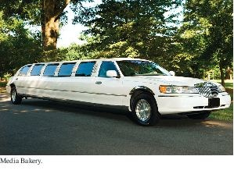
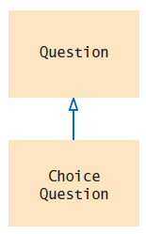
Implementing Subclasses
Like the manufacturer of a stretch limo, who starts with a regular car and modifies it, a programmer makes a subclass by modifying another class.
To get a ChoiceQuestion class, implement it as a subclass of Question
Specify what makes the subclass different from its superclass.
Subclass objects automatically have the instance variables that are declared in the superclass. Only declare instance variables that are not part of the superclass objects.
A subclass inherits all methods that it does not override.
Figure 4 The ChoiceQuestion Class is a Subclass of the Question
Class.

Slide 17
Implementing Subclasses
A ChoiceQuestion object differs from a Question object in three ways:
Its objects store the various choices for the answer. There is a method for adding answer choices.
The display method of the ChoiceQuestion class shows these choices so that the respondent can choose one of them.

Slide 18
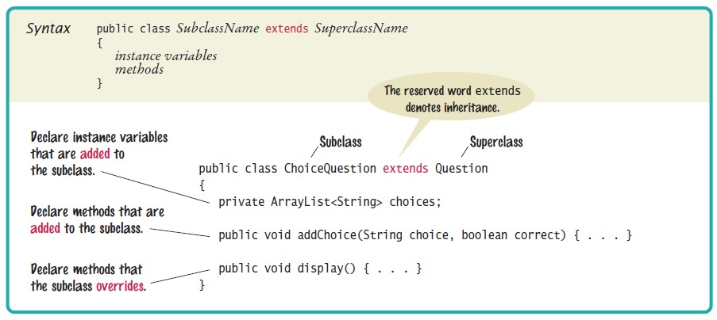
Syntax 9.1 Subclass Declaration

Slide 19
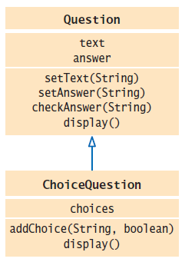
Implementing Subclasses
UML of ChoiceQuestion and Question
Figure 5 The ChoiceQuestion Class Adds an Instance Variable and a Method, and Overrides a Method

Slide 20
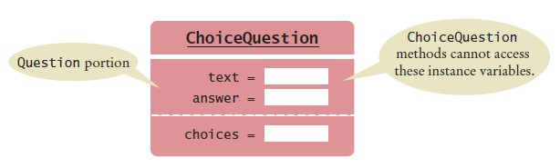
Implementing Subclasses
A ChoiceQuestion object
You can call the inherited methods on a subclass object:
choiceQuestion.setAnswer("2");
The private instance variables of the superclass are inaccessible.
The ChoiceQuestion methods cannot directly access the instance variable
answer.
ChoiceQuestion methods must use the public interface of the Question
class to access its private data.

Slide 21
Implementing Subclasses
The subclass inherits all public methods from the superclass. You declare any methods that are new to the subclass.
You change the implementation of inherited methods if the inherited behavior is not appropriate.
Override a method: supply a new implementation for an inherited method

Slide 22
Implementing Subclasses
Adding a new method: addChoice
public void addChoice(String choice, boolean correct)
{
choices.add(choice);
if (correct)
{
// Convert choices.size() to string
String choiceString = "" + choices.size();
setAnswer(choiceString);
}
}
addChoice method can not just access the answer variable in the superclass: It must use the setAnswer method
Invoke setAnswer on the implicit parameter:
setAnswer(choiceString);
OR
this.setAnswer(choiceString);

Slide 23
Overriding Methods
Problem: ChoiceQuestion's display method can’t access the text variable of the superclass directly because it is private.
Solution: It can call the display method of the superclass, by using the reserved word super
public void display()
{
// Display the question text super.display(); // OK
// Display the answer choices
. . .
}
super is a reserved word that forces execution of the superclass method.

Slide 24
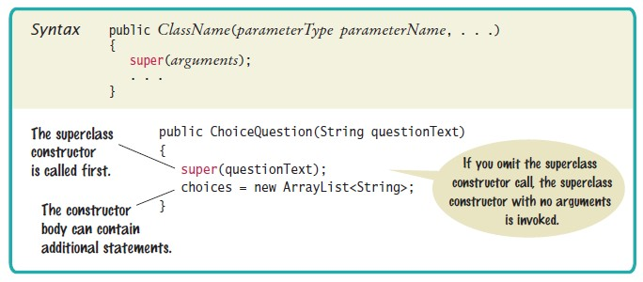
Syntax 9.3 Constructor with Superclass Initializer

Slide 25
Task 4
Suppose q is an object of the class Question and cq an object of the class ChoiceQuestion. Which of the following calls are legal?
q.setAnswer(response)
cq.setAnswer(response)
q.addChoice(choice, true)
cq.addChoice(choice, true)

Slide 26
Task 5
Suppose the class Employee is declared as follows:
public class Employee
{
private String name;
private double baseSalary;
public void setName(String newName) { . . . }
public void setBaseSalary(double newSalary) { . . . }
public String getName() { . . . }
public double getSalary() { . . . }
}
Declare a class Manager that inherits from the class Employee and adds an instance variable bonus for storing a salary bonus. Omit constructors and methods.

Slide 27
Task 6
In the Manager class, provide the method header (but not the implementation) for a method that overrides the getSalary method from the class Employee.

Slide 28
section_3/ChoiceQuestion.java
1 import java.util.ArrayList;
2
3 /**
4 A question with multiple choices.
5 */
6 public class ChoiceQuestion extends Question
7 {
8 private ArrayList<String> choices;
9
10
11
12
13
14
15
16
17
18
19
20
21
22
23
24
25
26
27
28
/**
Constructs a choice question with no choices.
*/
public ChoiceQuestion()
{
choices = new ArrayList<String>();
}
/**
Adds an answer choice to this question.
@param choice the choice to add
@param correct true if this is the correct choice, false otherwise
*/
public void addChoice(String choice, boolean correct)
{
choices.add(choice); if (correct)
{
// Convert choices.size() to string

Slide 29
section_3/QuestionDemo2.java
1 import java.util.Scanner;
2
3 /**
4 This program shows a simple quiz with two choice questions.
5 */
6 public class QuestionDemo2
7 {
8 public static void main(String[] args)
9 {
ChoiceQuestion first = new ChoiceQuestion();
first.setText("What was the original name of the Java language?");
first.addChoice("*7", false);
first.addChoice("Duke", false);
first.addChoice("Oak", true);
first.addChoice("Gosling", false);
16
17
18
19
20
21
22
23
24
25
26
27
28
29
30
31
32
33
34
35
ChoiceQuestion second = new ChoiceQuestion();
second.setText("In which country was the inventor of Java born?"); second.addChoice("Australia", false);
second.addChoice("Canada", true); second.addChoice("Denmark", false); second.addChoice("United States", false);
presentQuestion(first); presentQuestion(second);
}
/**
Presents a question to the user and checks the response.
@param q the question
*/
public static void presentQuestion(ChoiceQuestion q)
{
q.display(); System.out.print("Your answer: ");

Slide 30
Program Run:
What was the original name of the Java language? 1: *7
2: Duke
3: Oak
4: Gosling
Your answer: *7 false
In which country was the inventor of Java born?
1: Australia
2: Canada
3: Denmark
4: United States
Your answer: 2 true

Slide 31
Program Run:
What was the original name of the Java language? 1: *7
2: Duke
3: Oak
4: Gosling
Your answer: *7 false
In which country was the inventor of Java born?
1: Australia
2: Canada
3: Denmark
4: United States
Your answer: 2 true

Slide 32
Polymorphism
Problem: to present both Question and ChoiceQuestion with the same program.
We do not need to know the exact type of the question
We need to display the question
We need to check whether the user supplied the correct answer
The Question superclass has methods for displaying and checking.
We can simply declare the parameter variable of the presentQuestion
method to have the type Question:
public static void presentQuestion(Question q)
{
q.display();
System.out.print("Your answer: ");
Scanner in = new Scanner(System.in);
String response = in.nextLine(); System.out.println(q.checkAnswer(response));
}

Slide 33
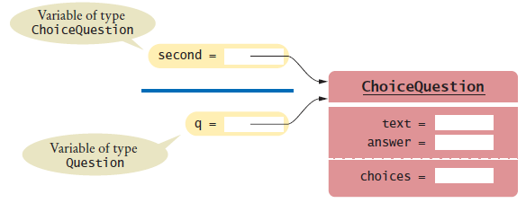
Polymorphism - continued
We can substitute a subclass object whenever a superclass object is expected:
ChoiceQuestion second = new ChoiceQuestion();
. . .
presentQuestion(second); // OK to pass a ChoiceQuestion
When the presentQuestion method executes -
The object references stored in second and q refer to the same object The object is of type ChoiceQuestion
Figure 7 Variables of Different Types Referring to the Same Object

Slide 34
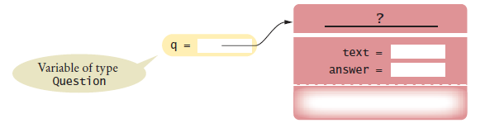

Polymorphism - continued
The variable q knows less than the full story about the object to which it refers
Figure 8 A Question Reference Can Refer to an Object of Any Subclass of Question
In the same way that vehicles can differ in their method of locomotion, polymorphic objects carry out tasks in different ways.

Slide 35
Polymorphism - continued
When the virtual machine calls an instance method -
It locates the method of the implicit parameter’s class. This is called dynamic method lookup
Dynamic method lookup allows us to treat objects of different classes in a uniform way.
This feature is called polymorphism.
We ask multiple objects to carry out a task, and each object does so in its own way.
Polymorphism means “having multiple forms”
It allows us to manipulate objects that share a set of tasks, even though the tasks are executed in different ways.

Slide 36
section_4/QuestionDemo3.java
1 import java.util.Scanner;
2
3 /**
4 This program shows a simple quiz with two question types.
5 */
6 public class QuestionDemo3
7 {
8 public static void main(String[] args)
9 {
Question first = new Question();
first.setText("Who was the inventor of Java?");
first.setAnswer("James Gosling");
13
14
15
16
17
18
19
20
21
22
23
24
25
26
27
28
29
30
31
32
33
34
35
ChoiceQuestion second = new ChoiceQuestion();
second.setText("In which country was the inventor of Java born?"); second.addChoice("Australia", false);
second.addChoice("Canada", true); second.addChoice("Denmark", false); second.addChoice("United States", false);
presentQuestion(first); presentQuestion(second);
}
/**
Presents a question to the user and checks the response.
@param q the question
*/
public static void presentQuestion(Question q)
{
q.display(); System.out.print("Your answer: ");
Scanner in = new Scanner(System.in); String response = in.nextLine();
System.out.println(q.checkAnswer(response));

Slide 37
Program Run:
Who was the inventor of Java? Your answer: Bjarne Stroustrup false
In which country was the inventor of Java born? 1: Australia
2: Canada
3: Denmark
4: United States
Your answer: 2 true

Slide 38
Task 7
Assuming SavingsAccount is a subclass of BankAccount, which of the following code fragments are valid in Java?
BankAccount account = new SavingsAccount();
SavingsAccount account2 = new BankAccount();
BankAccount account = null;
SavingsAccount account2 = account;

Slide 39
Object: The Cosmic Superclass
Every class defined without an explicit extends clause automatically extend Object:
The class Object is the direct or indirect superclass of every class in Java. Some methods defined in Object:
toString - which yields a string describing the object
equals - which compares objects with each other
hashCode - which yields a numerical code for storing the object in a set

Slide 40
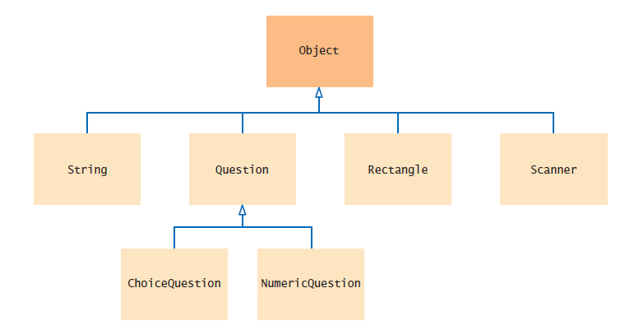
Object: The Cosmic Superclass
Figure 9 The Object Class Is the Superclass of Every Java Class

Slide 41
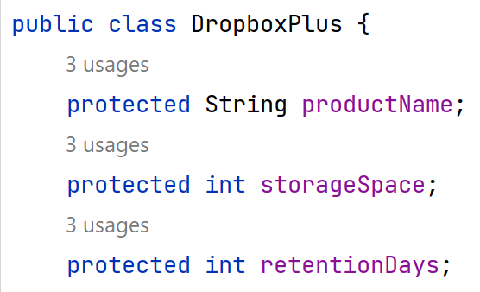
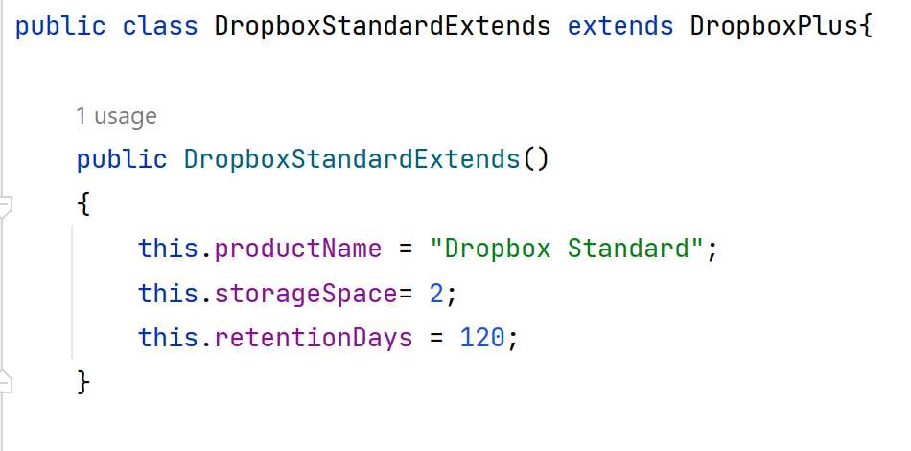
The Protected Keyword
The protected access modifier allows the class members to be accessed within their own package (like default access) and also by subclasses of their class in other packages.

