Slide 1
Geostatistics
Second session

Slide 2
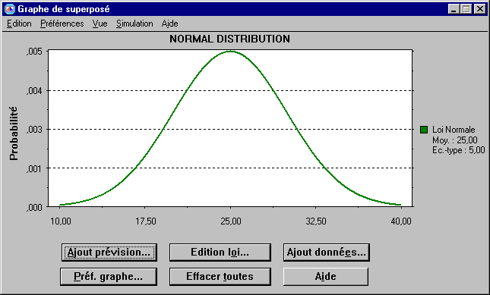
The Normal/Gaussian distribution
Frequency/Probability
= 1
P90: 90% probability of simulating higher
P50: 50% probability of simulating higher
P10: 10% probability of simulating higher
σ
Porosity
p90
p10
m = 25
p50

Slide 3
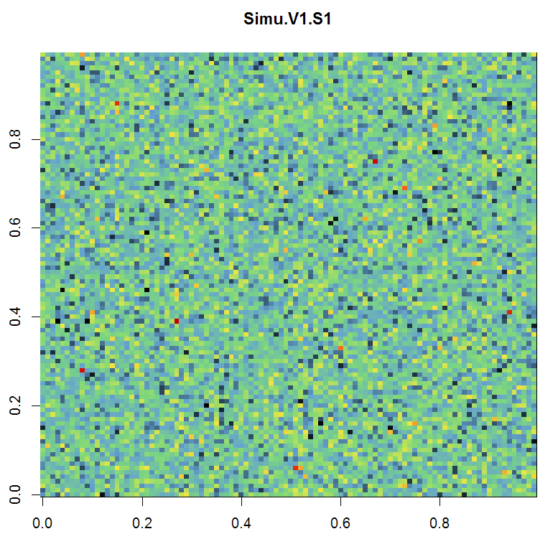
How it would look like without geostats:
No correlation between points
Variogram = variance
-> pure nugget effect

Slide 4
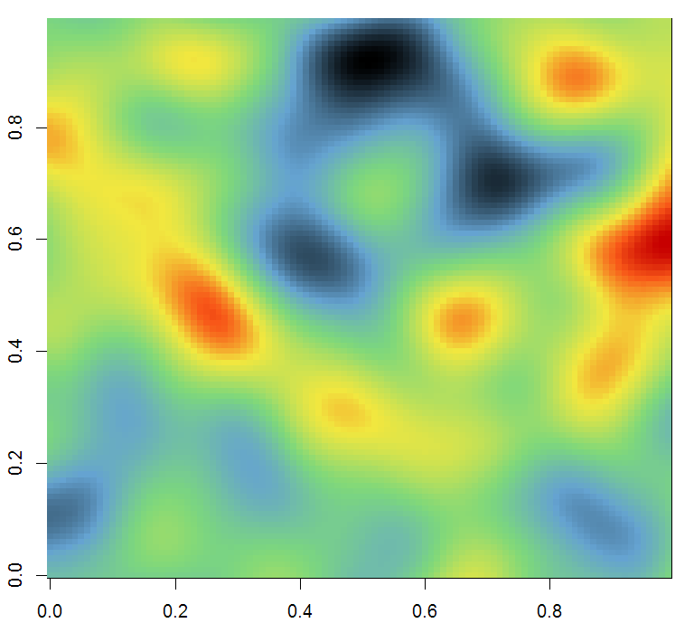
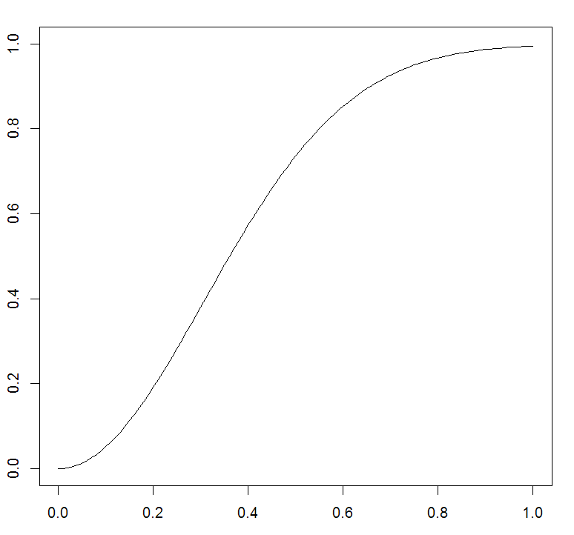
The variogram: introducing correlation
Main assumption: the similarity between points only depends on their spatial relation
Variogram: how non similar are two points depending on the
distance separating them
Vario
Two points correlated
Equals to the variance -> uncorrelated
Correlation decreases
With distance
Two points non correlated
Close to 0 -> very similar
Distance between the two points

Slide 5





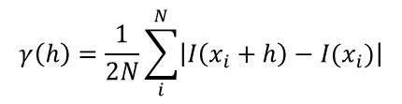



The indicator variogram
Variogram of the indicator variable I:
Mean of orange facies ?
0
1
$$m= \frac{9}{17}≈0.53$$
1
$$γ\left(h\right)=\frac{1}{2}Var\left[I\left(x+h\right)−I(x)\right]$$
0
Variance of orange facies ?
Variance definition
= 0 (Stationary)
1
0
$$γ\left(h\right)=\frac{1}{2}E\left[{\left(I\left(x+h\right)−I(x)\right)}^{2}\right]−\frac{1}{2}{E\left[\left(I\left(x+h\right)−I(x)\right)\right]}^{2}$$
1
$$v=0.53∗(1−0.53)≈0.25$$
1
Development of the expected value
1
Variogram of orange facies ?
$$γ\left(h\right)=\frac{1}{2N}\sum_{i}^{N}{{\left(I\left(x_{i}+h\right)−I(x_{i})\right)}^{2}}$$
0
0
1
$$γ\left(1\right)=\frac{10}{2∗16}≈0.31$$
N: number of pairs
I is an indicator
$$γ\left(h\right)=\frac{1}{2N}\sum_{i}^{N}{\left|I\left(x_{i}+h\right)−I(x_{i})\right|}$$
0
0
$$γ\left(2\right)=\frac{10}{2∗15}≈0.33$$
1
1
$$γ\left(3\right)=\frac{6}{2∗14}≈0.21$$
0
Variogram= ½ probability of having two different facies at distance h

