Slide 1




Network admin
Monitors the legitimacy of the client
Listens + collects in-air frames
Collects CSI
Example Authentication Setup
WAP
For wireless communication on network
Client:
Generates traffic (surfs web)
Internet
Visited streaming servers are YouTube, Netflix, Stan, etc.
Also plan to visit websites
Network admin wants to determine whether the client is legitimate and working legitimately

Slide 2

Example Authentication Setup
Network admin
Capture traffic
Collect CSI
Processing
Analyse wlan and csi packets
Classify client legitimacy
Client
Generate traffic
WAP
Are they a legitimate user?
Wireless 2.4GHz RF
WPA2 encrypted (ssid:pwd known)
Internet

Slide 3




Network Admin
Example Experiment Setup
(OVERALL)
Use RFMON
Capture traffic
Collect CSI
Monitor
Monitor
Client A
Client B
WAP
Communicate
Communicate
NOT Legitimate
Legitimate
Three independent variables:
Different traffic (detect anted activity)
Different devices (detect masquerading)
Different device locations (detect intrusion or unauthorised location)

Slide 4
Example Experiment Setup
(INDEPENDENT VARS)
Independent Variable | Values
Traffic | 3 different YouTube videos
Device | Custom built PC, Rpi-4
Location (distance) | 0.5m, 2m, 5m
Location (is through wall) | Yes, No
Currently taking 100 captures for each independent variable combination.
RED denotes captures for this have not been finished yet.

Slide 5



Synchronisation
Python socket programming – client sends traffic generating info and network admin receives messages to start/store/record captures accordingly.
Example Experiment Setup
(SINGLE CLIENT CAPTURE)
Network Admin
Capture data storage
Store in 64GB SD cards on Pi’s. Periodically transfer data to a larger HDD/server.
Use RFMON
Capture traffic
Collect CSI
Client
or
WAP
Generate traffic
Channel 11, bandwidth 20MHz
Transmit power is “auto”
WPA2 encrypted (ssid:pwd known)
Internet
Generate traffic & synchronise captures

Slide 6


socket sync
Example Experiment Setup
(SINGLE CLIENT CAPTURE)
Interfaces
CAT6 – auto MDI-X
Network Admin
Synchronisation
collect CSI
collect WLAN
bcm43455c0
RTL8812BU
socket sync
CAT6 – auto MDI-X
Client
WAP
gen traffic
Channel 11, bandwidth 20MHz
Transmit power is “auto”
WPA2 encrypted (ssid:pwd known)
Internet
RTL8812AU or
bcm43455c0

Slide 7
Client Items
Experiment Items Explanation
Item
Usage
Reason
Hardware
Client A: 2-core CPU custom built PC. It is using a Linux OS
Client B: RPi4
or
OS
Client A: Ubuntu
Client B: Raspberry Pi OS
NOTE: Both use 64bit versions
or
Generate traffic
Browsing automation framework on Python (and others). Works with Chrome, FireFox, etc. drivers.
Can stream videos.
nmcli is the NetworkManager client. It allows a user to connect, disconnect, reconnect, and manage network settings (e.g. default channel, gateway).
Use nmcli

Slide 8

Network Admin Items
Experiment Items Explanation
Item
Usage
Reason
Hardware
Lightweight and versatile. Pi 4 is preinstalled with WiFi chip supported by Nexmon CSI and we use a USB RTL8812bu WNIC.
32bit ARM version works with Nexmon CSI *AND* RTL8812bu WNIC WiFi adapter. I’ve written install instructions in 0_setup – this is the only setup I have gotten working with Nexmon and another RFMON WiFi adaptor.
OS
Capture in-air packets
Listening and capturing all WiFi frames in air with TCPdump.
Collect CSI
To collect the CSI of the client’s in-air packets

Slide 9
Synchronisation
Python socket programming – client sends traffic generating info and network admin receives messages to start/store/record captures accordingly.
Experiment Development
Network Admin
Capture data storage
Store in 64GB SD cards on Pi’s. Periodically transfer data to a larger HDD/server.
Use RFMON
Capture traffic
Collect CSI
Client
or
WAP
Need to prevent ads on YouTube. Experimenting with using adblocker ext.
Generate traffic
Channel 11, bandwidth 20MHz
Transmit power is “auto”
WPA2 encrypted (ssid:pwd known)
Internet
Generate traffic & synchronise captures

Slide 10
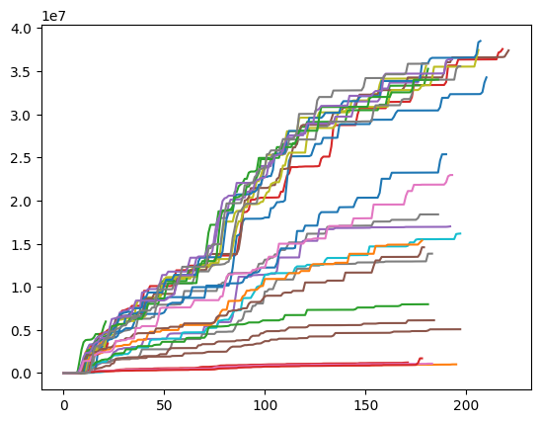
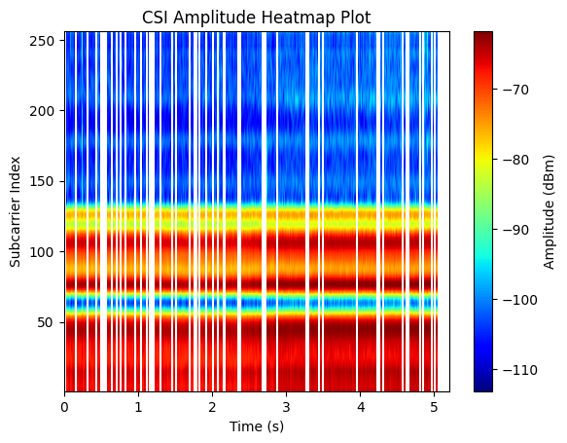
Proposed Data Analysis
Type | Feature | Filter
WLAN | Number of packets Number of bytes NOTE: these metrics are consistently the best for traffic classification but we can try others Min packet size Max packet size Ave packet size Var packet size Group by packet number (groups of p packets) Group by timestamp (in time bins of size t) | Incoming MAC addr is client Outgoing MAC addr is client Both All streams included Top n streams included Streams with total transferred bytes above k
CSI | Each subcarrier’s amplitude Each subcarrier’s phase NOTE: there are bandwidth * 3.2 subcarriers | Incoming MAC addr is client Outgoing MAC addr is client Both
Example WLAN capture.
Shows cumulative packet sizes across time (seconds) for 35 captures of the same YT video
Example CSI from GitHub.
Shows amplitude of all subcarriers (256 for a 80MHz bandwidth) across time for a single capture

