Slide 1
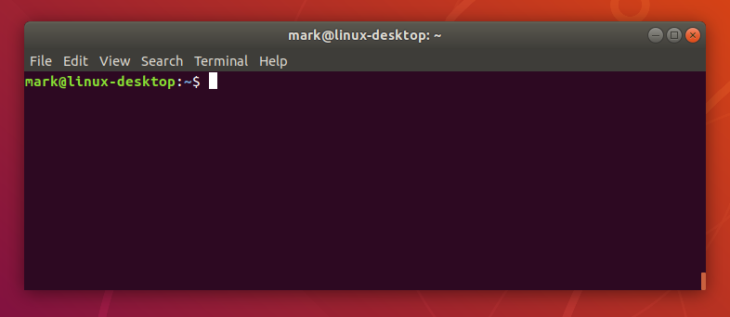
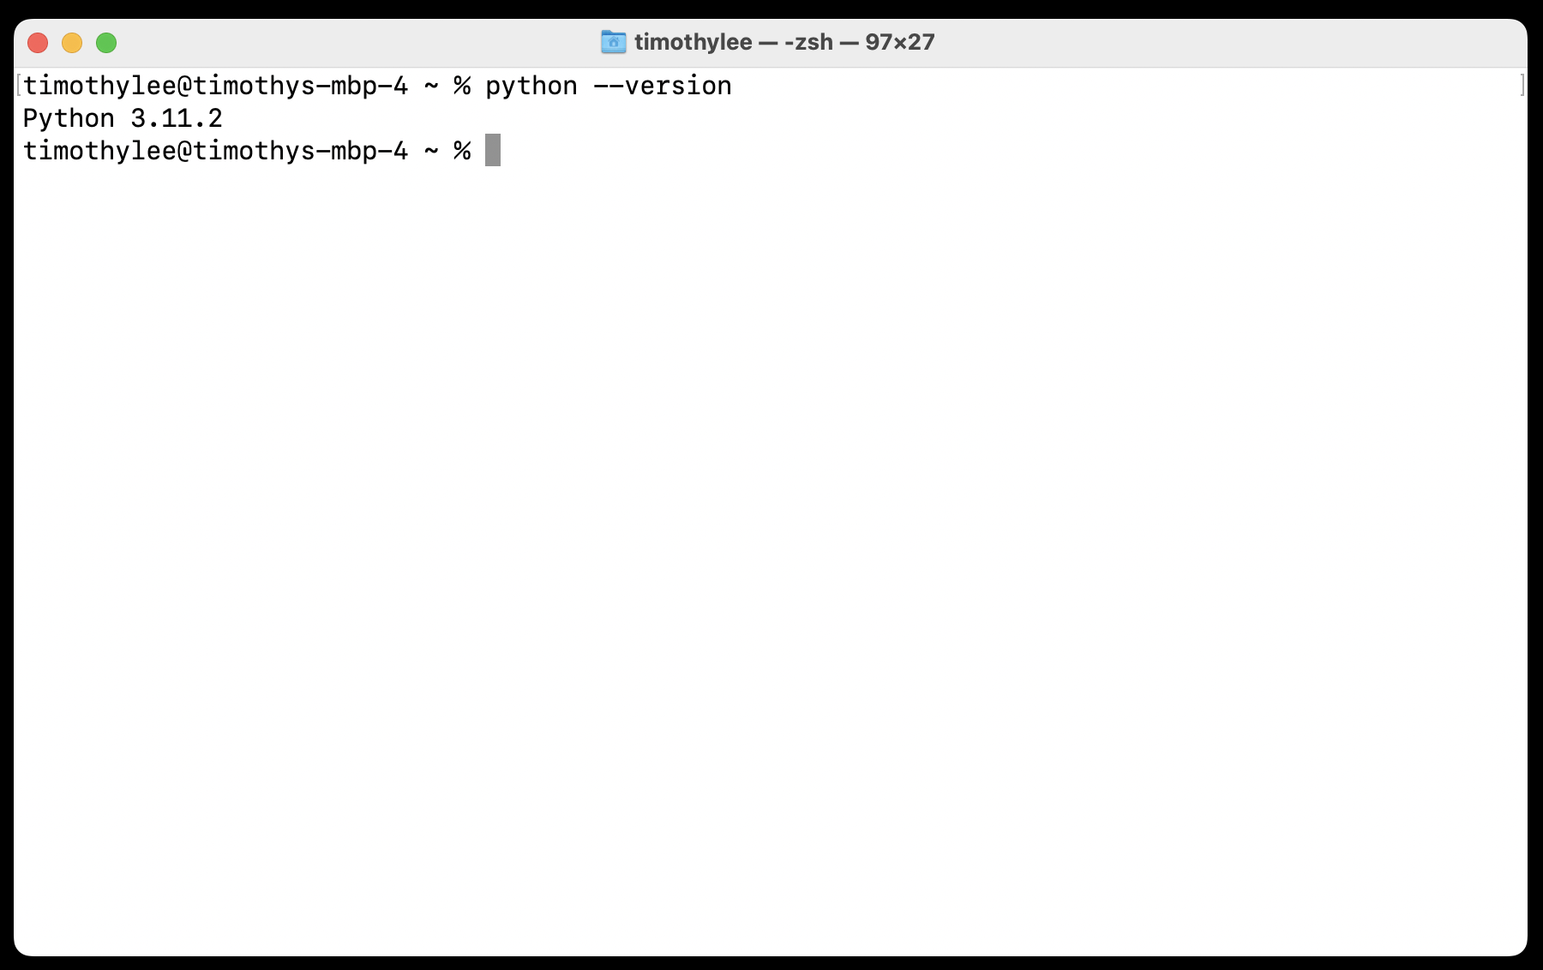
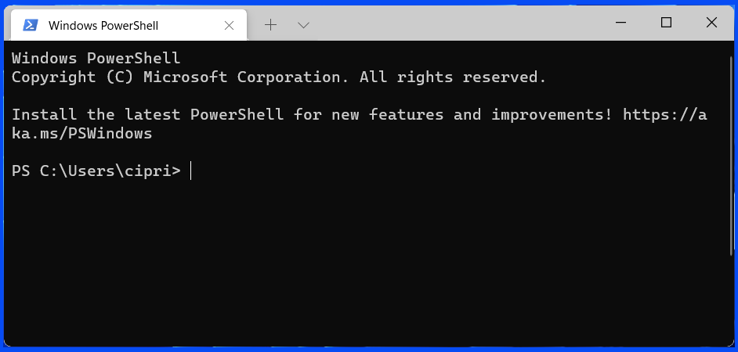
Linux
MacOS
Windows

Slide 2
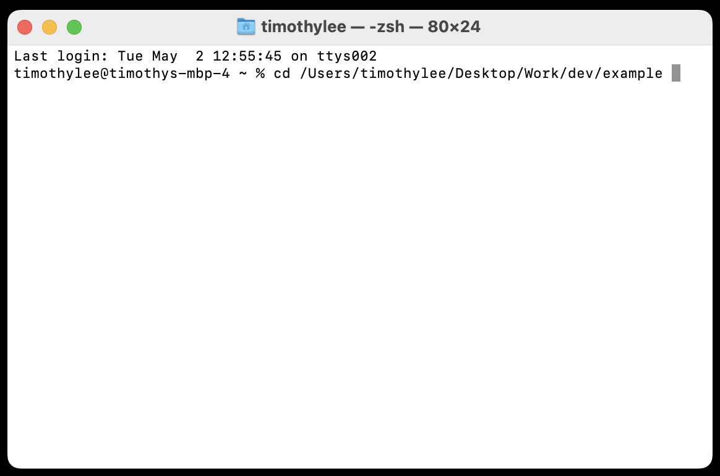
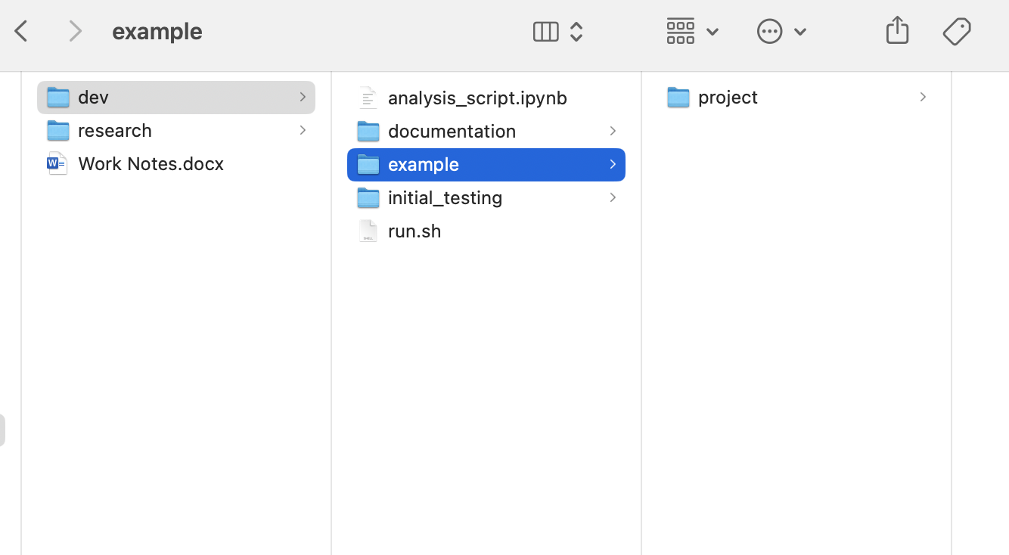
Navigate to this example folder
The example folder contains the project we want to analyse

Slide 3
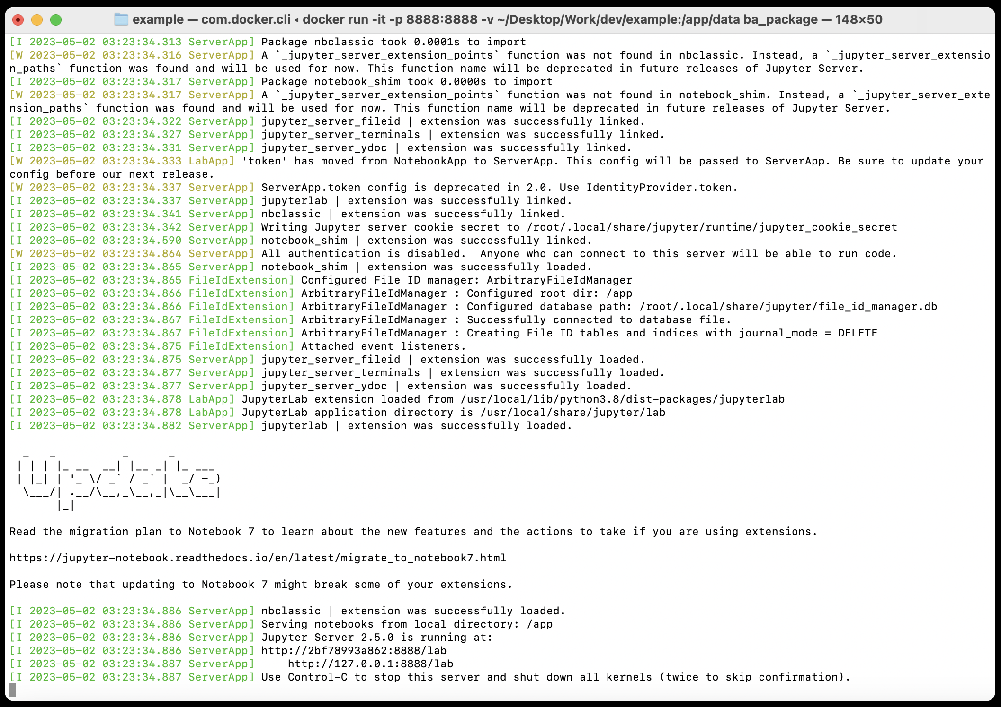
Output from the docker run command

Slide 4
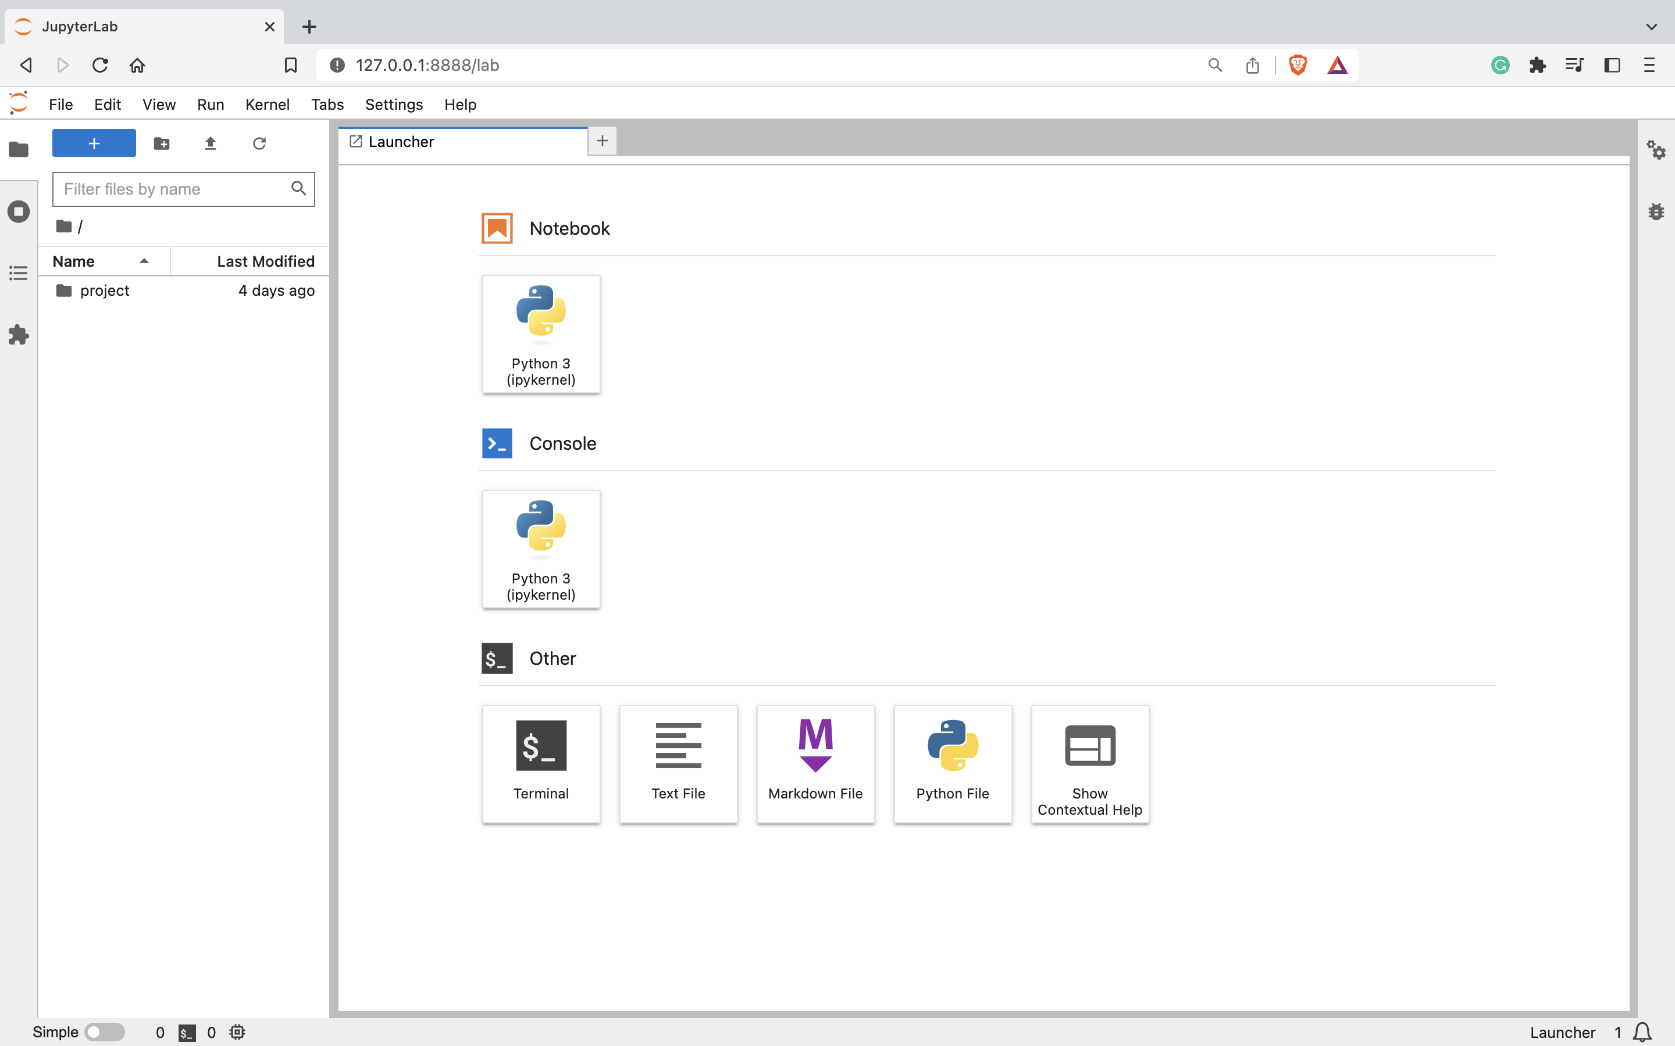
Jupyter notebook window

Slide 5









<project folder name>
raw_mp4
dlc_mp4
preprocessed_csv
configs
formatted_mp4
dlc_csv
analysis

Slide 6

…
…
1
1
1
1
1
…
2
2
2
2
2
…
3
3
3
3
3
…
…
…
…
…

Slide 8
Stores the parameters for how to process the experiment at each stage
configs
down-sample
run pose estimation
raw_mp4
formatted_mp4
dlc_mp4
generates csv key-points
calculate parameters &
preprocess data
generate analysis
analysis
dlc_csv
preprocessed_csv

Slide 9

https://ffmpeg.org/
https://deeplabcut.github.io/DeepLabCut/

