Slide 1
Color Analysis
Framework and Plugins
ikang, takhol, pkaufhol

Slide 2
Domain
01
Notes:
The idea is to perform color analysis on different images. The framework analyzes given images from different sources, provided by data plugins, and shows results in different ways, using visualization plugins. The framework is constructed to provide benefits for reuse. Users can provide a new data plugin or visualization plugin to fully reuse the framework.

Slide 3
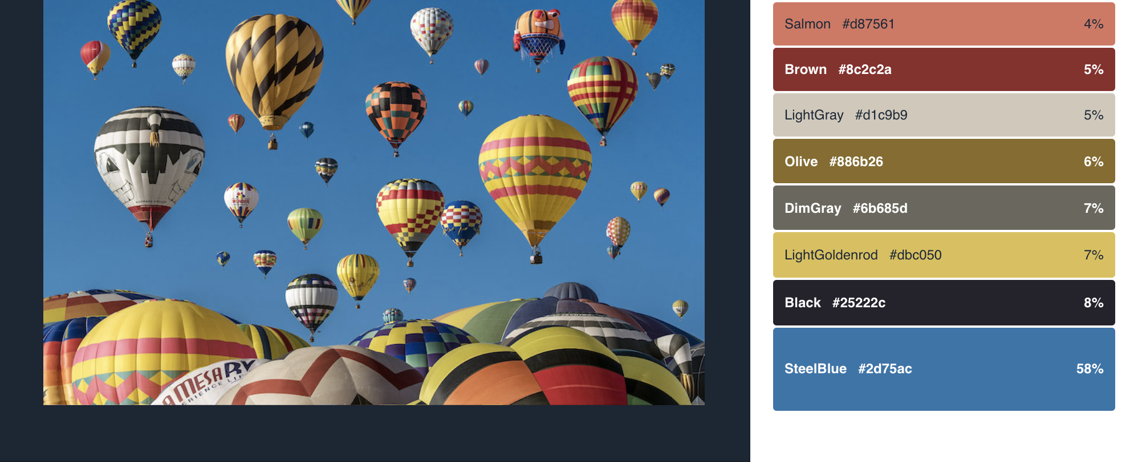

Notes:
We chose the color detector model tool from clarifai as our main ML model to detect colors in images. The tool returns dominant colors in hex format and their density values within an image. Since the returned values are in hex format, we can represent colors in a more specific way as we visualize the outputs. We can call the Predict API with the 'Color' model. Simply pass in an image input with a publicly accessible URL or by directly sending image bytes.

Slide 4
Plugins
02

Slide 5



Data plugins
Serp API
Pexels API
Unsplash API
Notes:
All data plugins take queries and provide corresponding images in JSON format. Data plugins include: Serp API, Pexels API, and Unsplash API. Serp API searches photos from Google Image. On the other hand, Pexels and Unsplash search images from their own databases. They all have different JSON formatting as responding given queries; however, since the general formatting is similar, we can preprocess JSON data in framework to output cleaner data to display plugins.

Slide 6
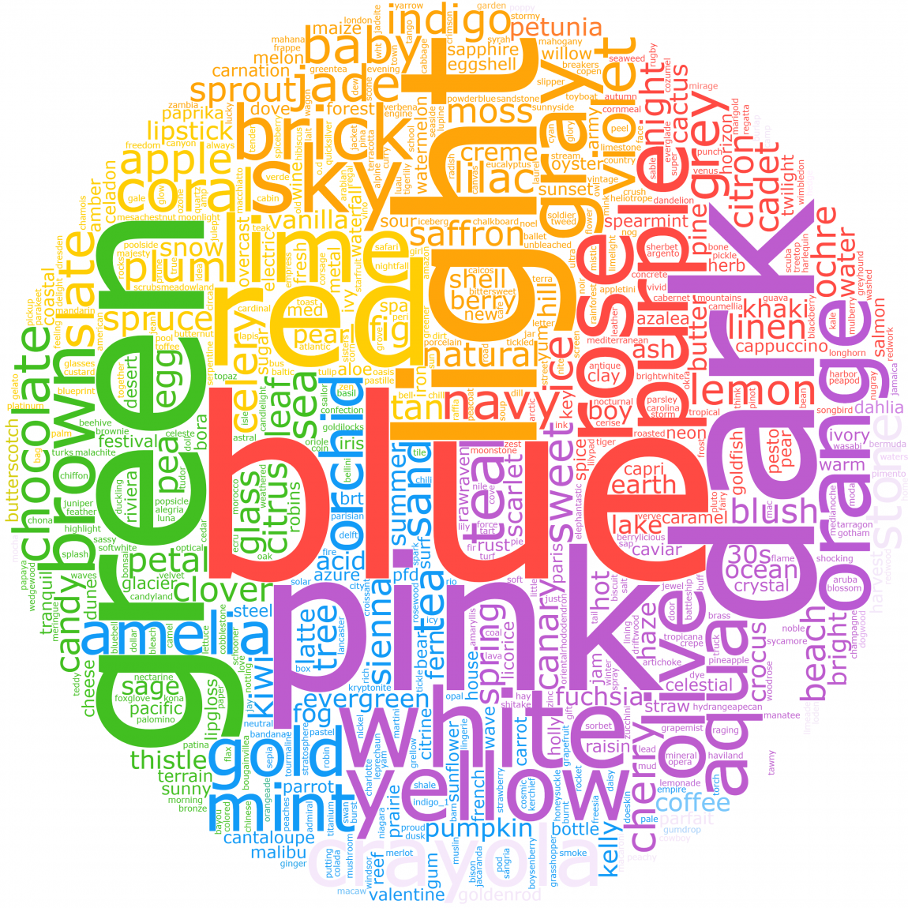
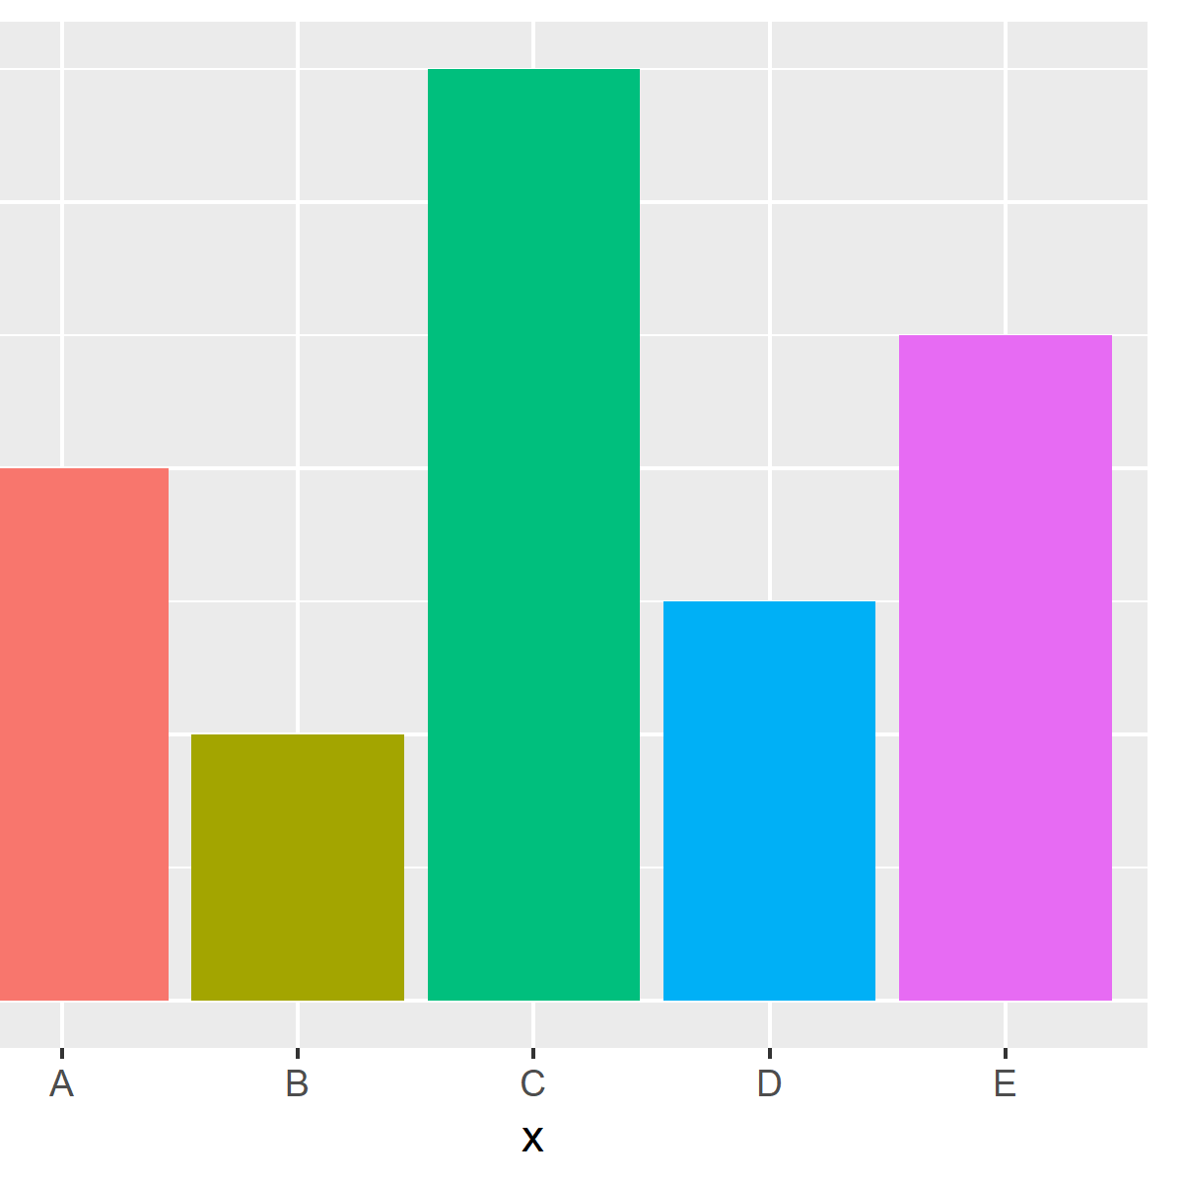
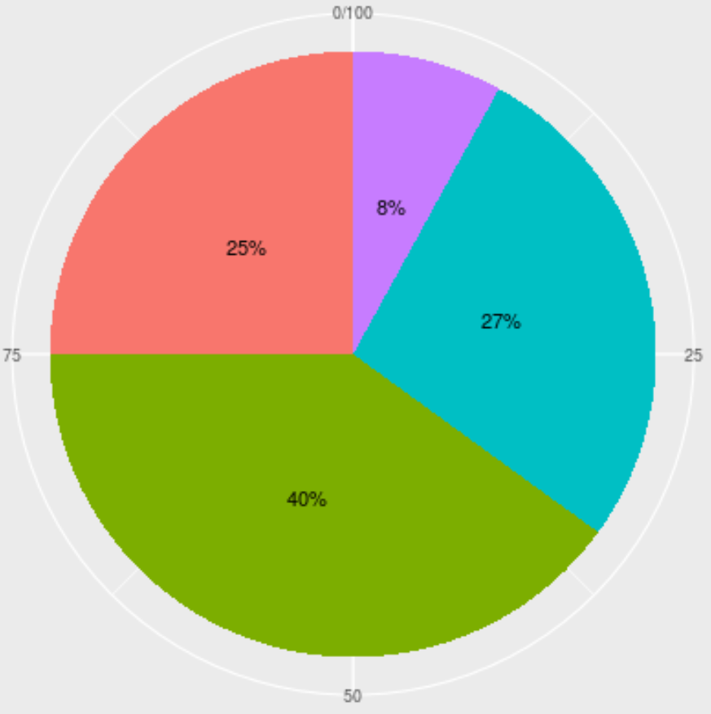
Display plugins
Word cloud
Histogram
Pie chart
Notes:
The framework can provide a list of colors in images to visualization plugins.
Word cloud: provides the top 10 dominant colors in images queried by the user (a.k.a. "color contents") as words, proportional to its density in the image.
Histogram visualizes the color contents in a histogram form.
Pie Chart visualizes the color contents in a pie chart form.

Slide 7
Reusability
03

Slide 8
Generality vs
Specificity
This is where you section ends. Duplicate this set of slides as many times you need to go over all your sections.
Notes:
We have designed a framework that is reusable and specific in scope, while allowing for many different plugins. Firstly, we made the decision to focus only on the Color Detection Model accessible with the Clarifai API. We could have increased our functionality to include more models, like the Food model and the General model, but we thought that analyzing the colors in an image/a group of images and providing a GUI to display visualizations was useful enough to focus more heavily on. This allows us to provide reuse in a more specific space, instead of having to make decisions about many different models that all have different inputs and outputs.

Slide 9
Plugin
Reusability
This is where you section ends. Duplicate this set of slides as many times you need to go over all your sections.
Notes:
For data plugins, we are going to require the plugin developer to provide a function that outputs a standardized JSON file that will be read by the framework. The JSON will include the image source URL, dimensions, and file type, and will have some required specifications. Basically, it is up to the developer to use an API or other method to grab images from a source and create the JSONs that the framework can use. The plugin will also have to take user input from the GUI/framework, in the form of a search keyword and # of images. The reuse available is the fact that every developer will provide the same information to the framework in the same structure, and there will be a standard interface to take in information from the GUI.
Additionally, the plugin loader will take in information about the data plugins, mainly the name that the plugin developer wants to have in the GUI. The GUI will allow a user to pick between any of the data plugins loaded, and no matter which plugin is chosen the user will input a search keyword and # of images. This keeps the user experience cohesive and allows reuse.

Slide 10
GUI
Reusability
This is where you section ends. Duplicate this set of slides as many times you need to go over all your sections.
Notes:
The framework provides the GUI where display plugins will be able to show whatever visualizations the plugin developers want. Firstly, the user will interact with a slideshow display of the images that the data plugin loaded in. Once an image and a visualization is selected, the plugin will have to provide an HTML file of the visualization that fits the specifications the framework provides, which will then be displayed by the GUI. This provides a lot of reuse and functionality as the visualization will display correctly as long as the HTML file provided by the plugin fits the specifications given (based on implementation of the GUI).

