Slide 1


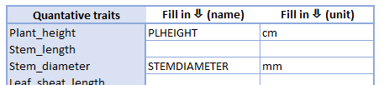
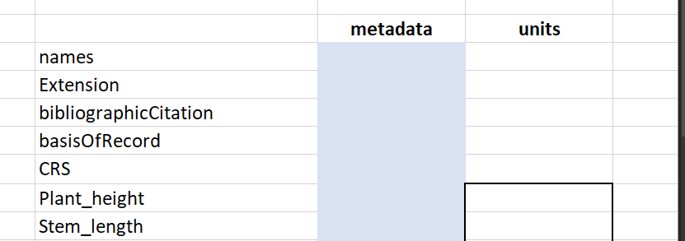
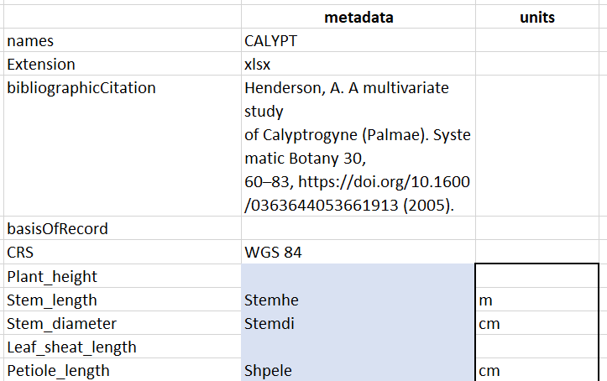
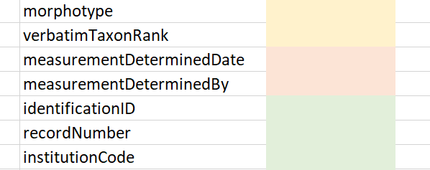
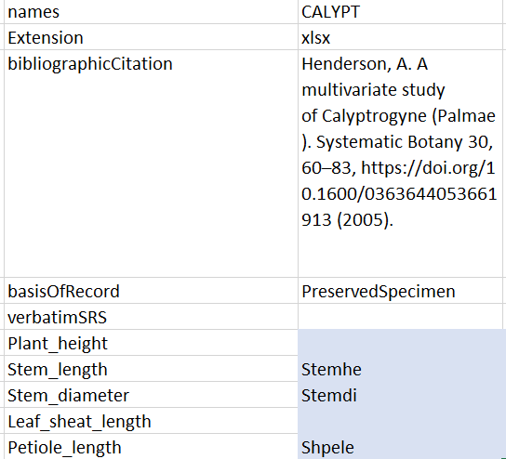
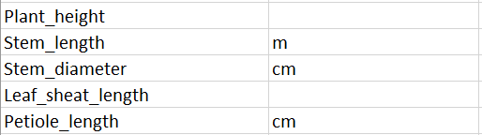
Newly added
Metadata form
...
...
Metadata thesaurus
Units thesaurus

Slide 2
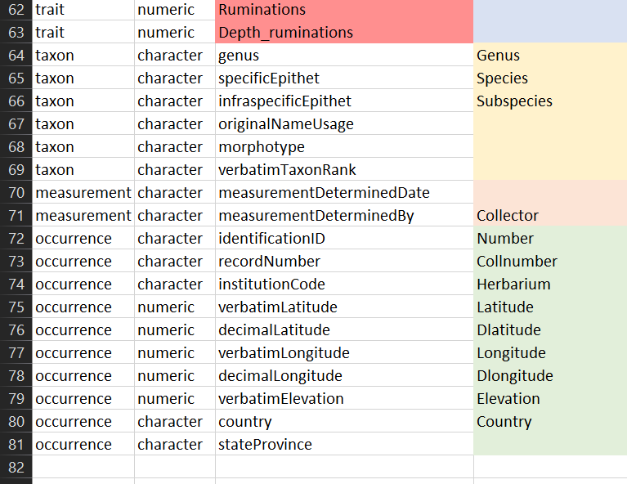


Insert new row for...
a.
Traits
Taxon
Measurement or Fact
Occurrence
...
b.
trait, taxon, measurement, occurrence
character, numeric
Standardized term
URI from ontology

