Slide 1
Python Integration with C and C++
Calling C and C++ code from Python
using
Cython, SWIG, and CFFI
Example Code on GitHub at:
https://github.com/tleonhardt/Python_Interface_Cpp
Todd Leonhardt

Slide 2
Motivation
Leverage the strengths of C/C++ to alleviate the weaknesses of Python (and vice versa)
Python
  Strengths
    Let’s you write code quickly
    Good at integrating systems and testing
  Weaknesses
    Pure Python can run much slower than C/C++
C/C++
  Strengths
    Very fast execution speed
  Weaknesses
    Slower development speed due to manual memory management, static types, worse library, etc.
    Slow compile time
Typical use cases calling C/C++ from Python
  Optimize pre-existing Python to make critical parts run faster (after profiling, of course)
  Leverage existing C/C++ in Python
    For Python’s rapid development
    For Python’s ease of creating a UI
    For Python’s testing capabilities

Slide 3
What will be covered
Wrapping an existing C/C++ shared library and making calls into it from Python code
  Cython
  SWIG
  CFFI
Optimize existing Python code by converting a small amount of critical code to C/C++
  Cython

Slide 4
What won’t be covered
Numerous ways of interfacing Python with C/C++
  In particular ways which don’t involve wrapping or creating a shared library
Using Python subprocess to call C/C++ executable
  And communicate via stdin/stdout
Using an InterProcess Communication (IPC) mechanism to communicate
  Such as sockets or 0MQ
Embedding a Python interpreter within a C/C++ executable
Using weak asynchronous file-based data exchange
  e.g. serialize data from Python to JSON and then use that file in C/C++
Also the basic Python C-API won’t be covered
  And how to create extension modules from scratch (powerful, but lots of work)

Slide 5
CFFI - C Foreign Function Interface for Python
What is CFFI?
  Offers options very similar to built-in ctypes, but it’s a bit more direct
  Lets you interact with almost any C code from Python
    Based on C-like declarations that you can often copy-paste from header files or documentation
What is it good for?
  It makes it very easy to interface with C code from Python
    Either from a shared library or C code written “inline” in Python
What else can it do?
  Embedded Python code in a C shared library
    Which is then callable from other C code
  Fully compatible with PyPy JIT
Limitations
  No C++ support
  Performance noticeably worse than either SWIG or Cython
Advantages
  Self-contained. All code is inline within Python. No need to create any external files
    Assuming you already have a dynamic C library you want to call code from
  Quickest way to write Python code that calls functions in an existing C shared library

Slide 6
What does CFFI do?
Quickest way to wrap an existing external C shared library
Call C libs from Python directly
No interface code
  Specify function prototypes inline in your Python code
How?
  Python is implemented in C
    Make calls directly into C libraries at the binary level using the C ABI
4 step process:
  Instantiate the main top-level CFFI class: ffi = cffi.FFI()
  Declare function prototype: ffi.cdef(‘int compute_fibonacci(int n);’)
  Load the dynamic library: libfib = ffi.dlopen(‘./libfibonacci.so’)
  Call a function in the lib: fib_20 = libfib.compute_fibonacci(20)

Slide 7
SWIG - Simplified Wrapper and Interface Generator
What is SWIG?
  Tool that auto-generates wrapper code for C/C++ code/libraries
    Can target about 20 different programing languages
      Python, Java, C#, PHP, Javascript, Perl, Ruby, Go, R, D, Lua, etc.
    Not fully automatic - you need to create the *.i interface files to tell it what to do
      But it is relatively easy. You only need to wrap the things you need.
What is it good for?
  Wrapping existing C/C++ libraries/code
    So they can be used from a higher-level language
      Why? User interfaces, testing, optimization, etc.
What else can it do?
  Wrapping, that’s it. But it can do it for 20+ target languages and it’s relatively simple to use.
Limitations
  Getting template-heavy C++ code properly wrapped can be hard work
  Performance not as good as Cython (but better than CFFI)
  It’s “magic”- in the rare cases when it doesn’t work, debugging magic can be quite challenging
Advantages
  Easy and quick to use if you already have existing C/C++ code
  Targets numerous different languages
  Good C++ support

Slide 8
What does SWIG do?
Partially automates the process of wrapping existing C/C++ code
Easier to use to wrap code than Cython, but better performance
But a higher performance way to wrap than using CFFI
shared library
libabc.so
header file
abc.h
SWIG interface
abc.i
object file
abc_wrap.o
linker
shared library
_abc.so
You
compiler
swig
swig C code
abc_wrap.c
python
swig py wrapper
abc.py
python
in python:
“import abc”

Slide 9
Cython C-Extensions for Python
What is Cython?
  Cython is an optimising static compiler
    For both Python and the extended Cython languages
  Also a creole programming language which extends the Python language with optional static type declarations
What is it good for?
  It makes writing C extensions for Python easy
  Quickly port the performance-critical part of your code to C
What else can it do?
  Wrap existing C/C++ libraries
    In a very high-performance manner
  Embed Python interpreter in C/C++ code and have C/C++ call into Python
Limitations
  Large learning curve
  Laborious for wrapping large libraries (not as automated as SWIG)
Advantages
  Easy and quick way to optimize existing Python code if you don’t already have C/C++ code
  Performance is by far the best of the tools covered here
    Cython code often runs faster than hand-written C
  Good C++ support
  Good debugging support
  Allows you to rapidly build a prototype in Python and optimize it as needed
    Can get performance close to a pure C implementation but in a fraction of the time spent in terms of developer hours

Slide 10
What does Cython do?
Makes it much easier to create a C Extension Module for Python
Allows you to write code which looks very similar to Python
  With optional static type declarations added
  But which can be automatically compiled to a native binary library
How?
python code
mylib.py
object file
mylib.o
linker
shared library
mylib.so
You
compiler
python
cython code
mylib.pyx
cython
C code
mylib.c
in python:
“import mylib”

Slide 11
How to use Cython to optimize existing Python code
Conversion process
  Python code- start with a Python module you would like to speed up (mylib.py)
  Cython code- rename this file to have a *.pyx file extension (mylib.pyx)
  Edit – edit one or more lines to take advantage of what Cython has to offer
  cython – invoke cython to create a C language file (mylib.c)
  gcc – C file is compiled into an object file (mylib.o)
  linker – object file is linked into a shared library (mylib.so or mylib.pyd)
  Python – at this point the shared library can be imported from a Python script (“import mylib”)
Common ways of compiling Cython code?
  Easiest: Jupyter Notebook
    Interactive browser-based interface which allows you to evaluate cells of source code
    Makes it very easy to rapidly test ideas and measure performance
  Easy: “cythonize” command line script
    Provided as part of Cython
    Wrapper around all of the compilation steps shown in the conversion process above (steps 4, 5, and 6)
    cythonize -b mylib.pyx
      Generates mylib.c and then compiles that to mylib.so, which is directly importable in Python
    cythonize -b -a mylib.pyx
      The -a flag generates an HTML annotation file which indicates which lines are pure native code (fast) and which interact with the Python interpreter (slower)
  Medium: setup.py
    Use the Python packaging tools themselves to incorporate Cython compilation into your setup.py file
    Can call setup.py with extra arguments to compile your Cython files
    Makes it easy to combine packaging with compilation and is best if you distribute your code to others

Slide 12
Wrap existing library with Cython
A bit more complicated than using Cython to optimize Python
Also a bit more complicated than using SWIG to wrap
But a higher performance way to wrap than using SWIG
shared library
libabc.so
cdef
extern
header file
abc.h
cython interface
abc.pxd
object file
cyabc.o
linker
shared library
cyabc.so
You
You
cimport
python
compiler
cython wrapper
cyabc.pyx
cython
C code
cyabc.c
in python:
“import cyabc”

Slide 13
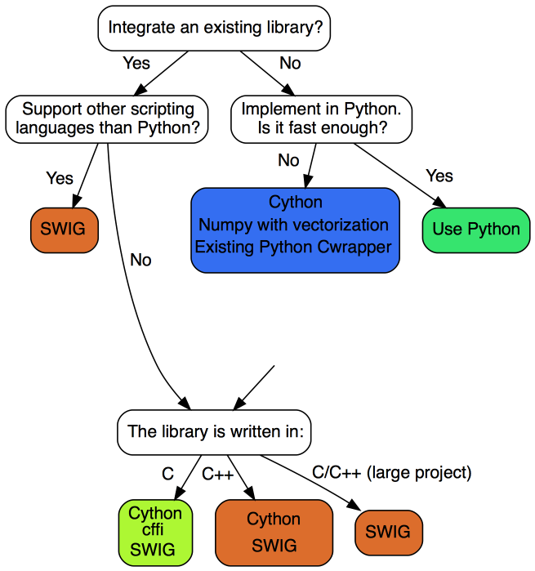
Which tool should I use?
It Depends

Slide 14
Where to Learn More
Cython
  Main Site: http://cython.org
  Documentation: http://docs.cython.org
  4 hour training video from SciPy 2015: https://www.youtube.com/watch?v=gMvkiQ-gOW8
    Code for this video on GitHub at: https://github.com/kwmsmith/scipy-2015-cython-tutorial
SWIG
  Main Site: http://www.swig.org
  Documentation: http://www.swig.org/Doc3.0
  40 minute training video from Univ. Oslo: https://www.youtube.com/watch?v=J-iVTLp6M9I
    Code for this video on GitHub at: https://github.com/UiO-INF3331/code-snippets-16/tree/master/mixed/swig
CFFI
  Main Site: http://cffi.readthedocs.io
  Mailing List: https://groups.google.com/forum/#!forum/python-cffi
  1 hour training video from PyCon: https://www.youtube.com/watch?v=ThDFmuXH15k

