Slide 1
Deep Dive Into Dependency Injection and Writing Decoupled Quality and Testable Code
Miguel A. Castro | @miguelcastro67

Slide 3
Agenda
Classes, Dependencies, and Coupling
Testing
DI Explained & Demoed
DI Containers
DI Container Usage: simple & advance
Real-world Usage Scenarios
WPF / Silverlight / WinRT
ASP.NET MVC
ASP.NET WebForms
WCF

Slide 4
Breaking a life-long habit

Slide 5
Class coupling (why it’s bad)
One class depending on another
Cannot exist (compile) without other class
Limits functionality to single implementation
If classes perform DB work, difficult to test without hitting DB

Slide 6
Embrace abstractions
The secret to writing testable software:
Stop “newing-up” objects in a class!
Define dependencies as interfaces
Listed as constructor args (or properties)
Calling class can sends in instances
Later done by a DI container automatically
Unit tests can send in Mocks
Or test versions

Slide 7
Demo
Esentials (coupled, abstracted, and testing)

Slide 8
DI: Concepts & Products

Slide 9
What is Dependency Injection
An architectural pattern designed to easily satisfy a class’ dependencies
Allows us to write decoupled code
Facilitate testability
Ease deployment of components
Typically implemented with the aid of an object container

Slide 10
The DI Container
A repository for definitions typically relating an abstraction to a concrete class
Core functionality
Provide facility for registering classes
Usually related to interfaces
Provide facility for resolving a request
Usually from a given interface (not always)

Slide 11
The DI Container
Type associations (registrations) achieved depending on container
Procedural (fluent interface)
Unity, NInject, Castle Windsor, StructureMap, Autofac
Configuration
Spring.NET, Autofac, etc.
Declarative (attributes)
Managed Extensibility Framework (MEF)

Slide 12
The DI Container
Recursively resolves dependencies
Injected interface variables
Constructor (usual)
Property
Requesting one class (from container) starts chain reaction

Slide 13
Available Containers
Unity
Ninject
Castle Windsor
StructureMap
AutoFac *
MEF
Spring.NET

Slide 14
demo 1
Using the DI Container

Slide 15
Other DI Techniques

Slide 16
On-Demand Instances
Sometimes a class receives many injections
May need only a few (or one), depending on method called
Services or Business engines receiving Data Repositories
Can use locator to obtain instance from container
Service locator ensures testability (or abstract factory)

Slide 17
Service Locator
Can be specific [to a type]
Billing Processor Locator
Generic-based (to handle many classes)
Processor Locator
Marker interface can be added for generic-constraint (IProcessor)

Slide 18
demo 2 & 3
Using service locator

Slide 19
Instance Lifetime
Transient is typically default for most containers
Not MEF
Resolved instance kept until parent goes away
Singleton (shared) kept around until container goes away
Every resolve request results in same instance

Slide 20
Disposable Components
DI containers hold onto resolved instances
Don’t really know when you called Dispose on them
Released when container is disposed
Usually equates to application termination
Some contexts require more release control
Web context

Slide 21
Disposable Components
Some containers offer help
Autofac is great for this
ILifetimeScope creation fom container
InstancePerLifetimeScope / InstancePerRequest upon registration
Automatically happens in MVC Autofac dependency resolver
Others require a sub-container hack

Slide 22
demo 4
Singleton & Lifetime Scope control

Slide 23
Advanced Registration Feature
Vary from container to container
Most offer discovery registration
Assembly scanning
Some containers offer rich DSL
Other features include Configuration definition

Slide 24
demo 5 & 6
Assembly scanning & Module usage

Slide 25
One-to-Many Registrations
Sometimes need to register > 1 class to interface
Can label each registration
Resolve by name (kinda dirty usage)
Can inject list of interface-type
More common usage

Slide 26
demo 7
One-to-Many dependencies

Slide 27
Post-Construction Resolve
Allows you to skip registration
Kick off resolve process AFTER class instantiated
Useful when something else needs to create class
WCF (can be handled through Instance Provider)
MVC or API Controllers (can be handled through Dependency Resolver)
These two examples are no longer a good example of this
Will need to use Property Injection
Ties class to DI container
Can be creative with abstraction to solve coupling

Slide 28
demo 8
Post-Construction Resolve & Property Injection

Slide 29
Deterministic Constructor Injection
DI containers have different techniques for deciding which constructor to use
Autofac picks constructor with most [registered] arguments
May not always be feasible
A “Contructor Finder” lets you decide how to decide on a constructor
IConstructorFinder interface
FindConstructorWith extension-method

Slide 30
demo 9
Deterministic Constructor Injection

Slide 31
DI Usage Scenarios

Slide 32
DI in WPF / Silverlight / WinRT
Used to resolve ViewModel classes
Used to resolve dependencies injected into ViewModels
Used to resolve nested ViewModels
ViewModels can be tested and test dependency implementations used
Advanced scenario: abstract ViewModel contents out

Slide 33
DI in ASP.NET MVC & Web API
Used to resolve controller classes
Used to resolve injected dependencies into controllers
Can use a custom controller factory or dependency resolver (recommended)
Dependency resolver gets hit post-constructor-selector
Controllers can be tested and test dependency implementations used
Most DI containers have NuGet integration package

Slide 34
DI in ASP.NET WebForms
Used to resolve injected dependencies into requested web forms
Uses a custom page handler factory
Need to run in a “classic .net” app-pool
Testing code-behind classes still troublesome

Slide 35
DI in WCF
Need to set up Instance Provider
Service Behavior installs it
Services can use constructor injection
Most DI containers have NuGet integration package

Slide 36
demo
Usage Scenarios

Slide 37
Conclusion
The core principle of testable code is usage of interfaces to build decoupled components
Eliminating newing-up inside classes
Inject into class or use service locator (on-demand)
DI Containers assist in managing components to be used
In most cases, more than “assist” – absolutely essential

Slide 38
Conclusion
Containers offer different features
For most part, all accomplish the same thing
Choose the one that you like
Autofac IMO is the more capable and modern one out there
A DI container does NOT facilitate testing
The DI concepts do

Slide 39
References
Dependency Injection in .NET
Mark Seemann – Manning
Martin Fowler’s DI/IoC article
http://martinfowler.com/articles/injection.html
Tons of info on the web

Slide 40

Resources
Learning
Sessions on Demand
Microsoft Certification & Training Resources
http://channel9.msdn.com/Events/TechEd
www.microsoft.com/learning
TechNet
msdn
Resources for IT Professionals
Resources for Developers
http://microsoft.com/technet
http://microsoft.com/msdn

Slide 41





@miguelcastro67
dotnetdude.com
miguelcastro67@gmail.com
Miguel A. Castro
© 2014 Microsoft Corporation. All rights reserved. Microsoft, Windows, and other product names are or may be registered trademarks and/or trademarks in the U.S. and/or other countries.
The information herein is for informational purposes only and represents the current view of Microsoft Corporation as of the date of this presentation. Because Microsoft must respond to changing market conditions, it should not be interpreted to be a commitment on the part of Microsoft, and Microsoft cannot guarantee the accuracy of any information provided after the date of this presentation. MICROSOFT MAKES NO WARRANTIES, EXPRESS, IMPLIED OR STATUTORY, AS TO THE INFORMATION IN THIS PRESENTATION.

Slide 42
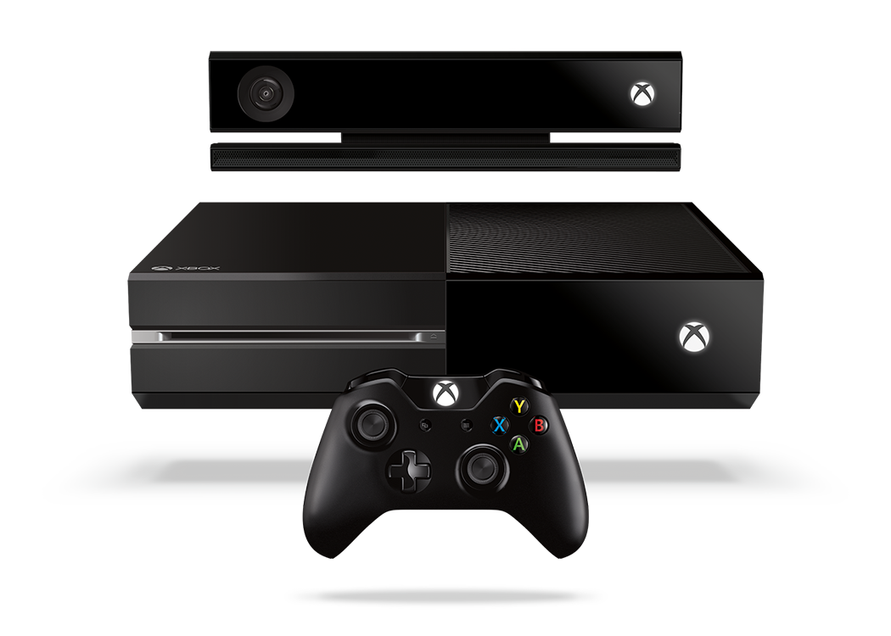


Complete an evaluation and enter to win!

Slide 43

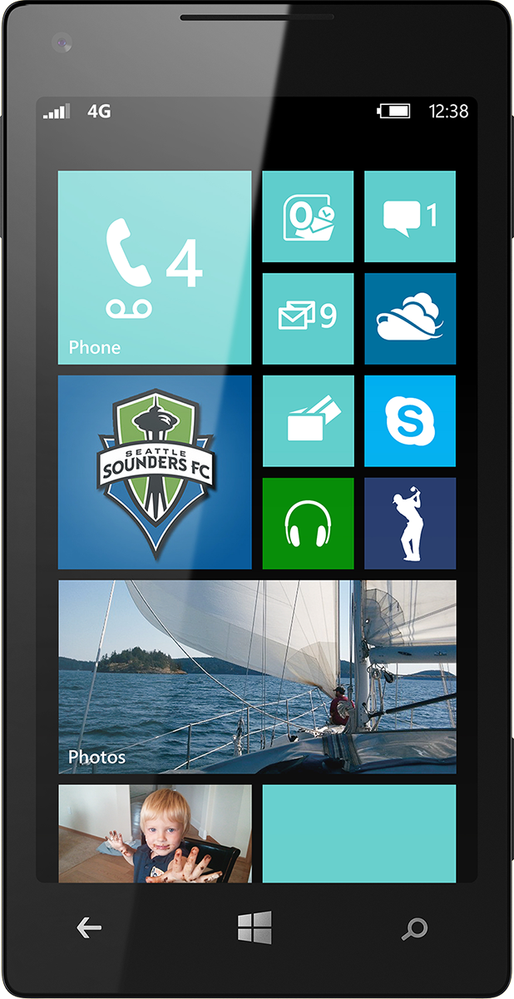
Evaluate this session
Scan this QR code to evaluate this session.

