Slide 1


Project Red Unicorn September 2022
Credit

Slide 2

Company Overview
Red Unicorn Company Snapshot:
KAH Hospice by the Numbers
Largest hospice platform in the US as measured by patients on census and one of the largest providers of home-based community and personal care services:
Headquarters: Atlanta, GA
Employees: ~29k
369
hospice locations across 35 states
~24K
hospice patients on daily census
8k
hospice caregivers
Nationwide scale and local market density:
Organic growth through capturing increasing referral volumes in existing markets and by expanding footprint though attractive ROIC de novos
Track record of M&A; completed 18
99.1%
HIS score*
80.7%
CAHPS score**
~17k
personal care clients
Key Financials
Best-in-class patient experience and clinical quality through interdisciplinary teams:
Highly trained teams include a medical director, hospice nurse, hospice aide, social worker, chaplain, bereavement coordinator, and volunteers
$1.5bn
31-Mar-22 LTM Pro Forma Adjusted Revenue
$320mm
31-Mar-22 LTM Pro Forma Adjusted EBITDA
*The HIS Comprehensive Assessment at Admission (NQF #3235) captures, in a single measure, the proportion of patients for whom the hospice performed all seven care processes, as applicable, threshold of 90%
**Measures and assess the experiences of patients who died while receiving hospice care, as well as the experiences of their informal primary caregivers, essentially a satisfaction poll
2

Slide 3
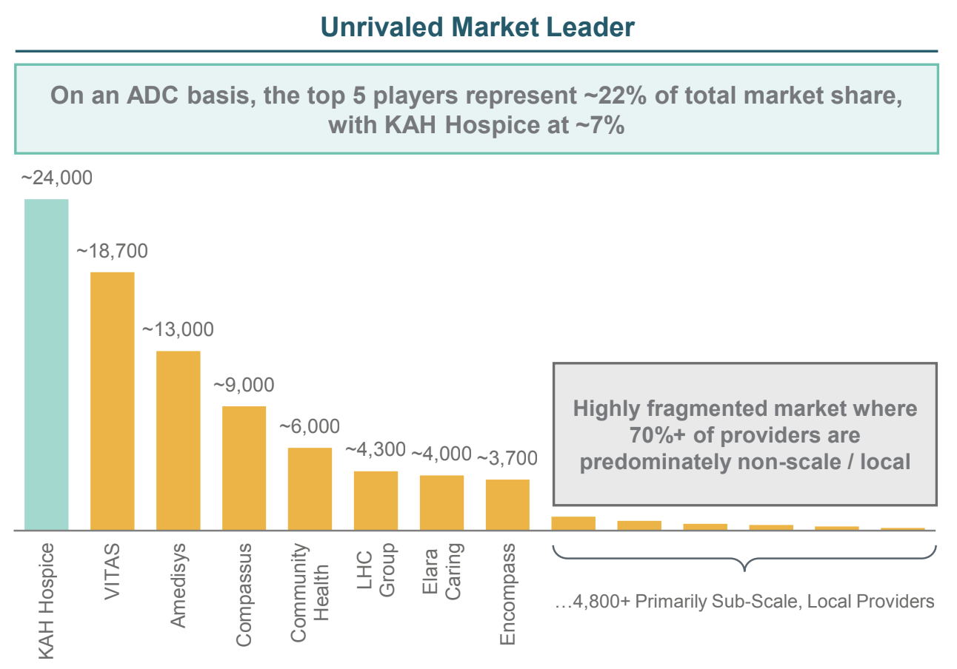
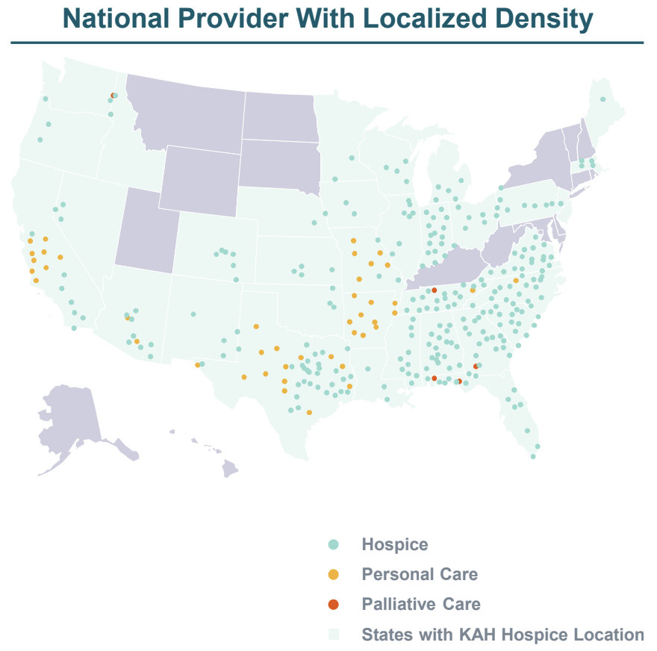
Financials and Comps
LTM | KAH Hospice Company, Inc. | Amedisys, Inc. | Addus Home Care | LHC Group
Revenue | 1,495.91 | 2,215.95 | 904.88 | 2,296.57
EBITDA | 320 | 232.70 | 97.06 | 210.63
Total Debt/EBITDA | 6.7x | 2.41x | 2.53x | 4.14x
EBIT/Int. Expense | 1.64x | 11.87x | 11.58x | 10.17x
CFR | B/B3 | - | - | -
3

Slide 4
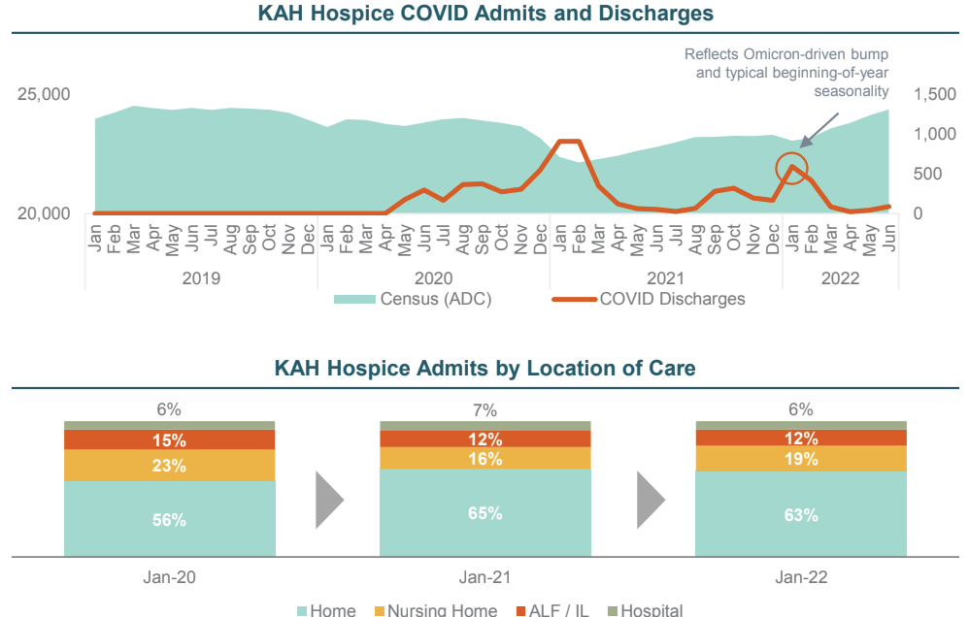
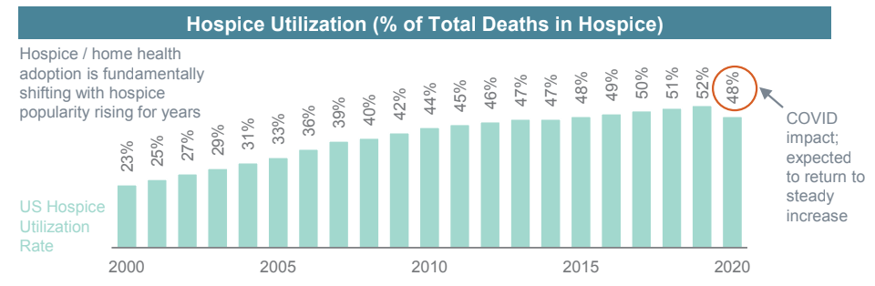
Transaction Overview
Borrowers: Charlotte Buyer, Inc. (Parent Borrower) and Curo Health Services, LLC (Subsidiary Borrower)
____________________________________________________________
Use of Proceeds: Financing CDR purchase
____________________________________________________________
Facilities: TLB ($1,600mm) and Second Lien TL (450mm)
____________________________________________________________
Index Floor: 0.50% (both)
____________________________________________________________
Negative Covenants: TLB (Usual), Second Lien (Dollar baskets 25% above the first lien term loan baskets)
____________________________________________________________
Maturity: TLB (5.5 years), Second Lien (6 years)
____________________________________________________________
Mandatory Amortization: TLB (1.00% per annum)
____________________________________________________________
Financial Covenants: None
____________________________________________________________
Mandatory Prepayments: 100% of asset sale proceeds, stepping down with changing lien leverage coverage
____________________________________________________________
Call Protection: TLB (101 6 month soft), Second Lien (102/101/Par, no carve-outs)
____________________________________________________________
Overview:
On April 21, 2022, Clayton, Dubilier & Rice (“CD&R” or the “Sponsor”) entered into a definitive agreement to acquire a majority interest in Red Unicorn at Home’s Hospice and Personal Care Divisions from Humana, Inc. (“Humana”), valuing the Company at $3.4 billion, or ~11x LTM 31-Mar-22 Pro Forma Adjusted EBITDA of $320 million
Growth-oriented partnership between Humana and CD&R where both Humana and CD&R will share 50 / 50 in upside once CD&R has received a 3x return on its invested capital
4

Slide 5
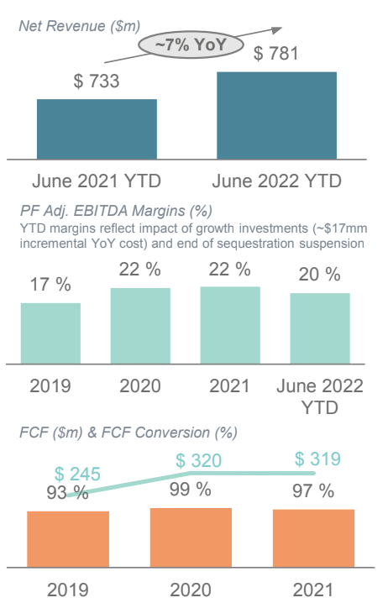
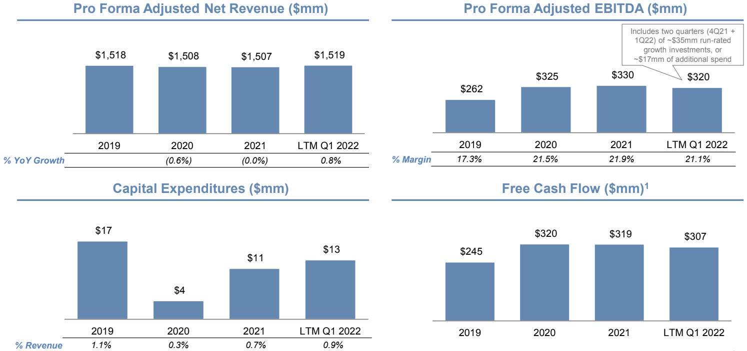
Current Credit Information
Red Unicorn TLV
Amount:
$1,600mm
__________________________
Current Price:
93.3750
__________________________
Issue Price:
93.00
__________________________
Index + Margin:
S + 525 bps
__________________________
Index Floor:
0.50%
__________________________
Yield:
9.09%
__________________________
Maturity Date:
02/12/2028
__________________________
Rating:
B/B2
__________________________
Total Debt Outstanding:
$2,153mm
__________________________
Net Leverage:
Total: 6.7x
5

Slide 6
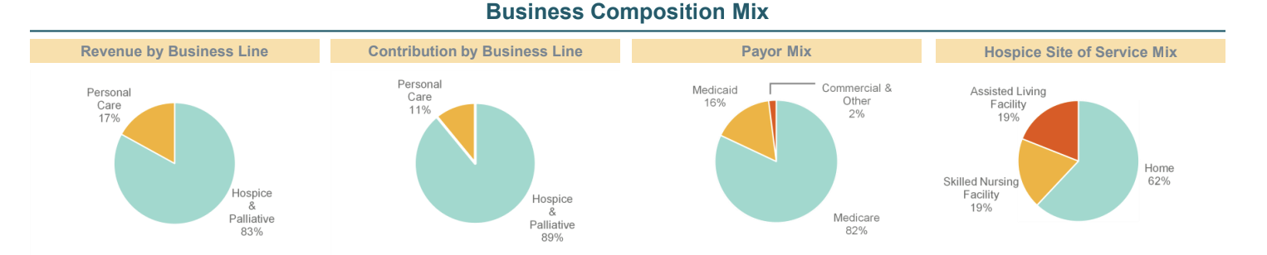
Credit Risks
Credit Risks | Description of Risk | Mitigants
High revenue concentration from Medicare, accounting for over 80% of total revenue | There will be a continued focus by the government on implementing measures to contain increasing health care costs, which may unfavorably impact future reimbursement rates | KAH Hospice's market position as one of the leading hospice providers in the US
High initial Moody's adjusted debt-to-EBITDA | Total Debt/EBITDA: 6.7x EBIT/Int. Expense: 1.64 | Key strengths include KAH's decent scale, relatively strong margins, good liquidity, positive FCF generation, good geographic diversity, and a cost structure with limited fixed costs
Presence of considerable competition in a highly fragmented industry, narrow focus on hospice services | Annual turnover of about 25%-30%, many different hospice companies | The hospice industry should benefit from favorable long-term growth prospects that are driven by aging demographics and a growing awareness of the benefits of hospice service for patients experience
Macro risks | Inflation, supply chain distributions, rising interest rates, recession risks | The company is well-diversified geographically with over 350 locations in 35 states, supported by government

