Slide 1
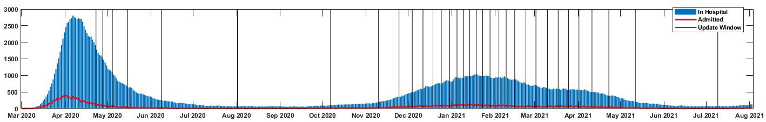
March 2, 2020
April 23, 2020
August 4, 2021
Development/Training
11 Northwell Health hospitals
7353 included patients
6479 survived past 7 days, 5684 survived past 28 days
Retrospective Validation
1 Northwell Health hospital
1891 included patients
1716 survived past 7 days, 1479 survived past 28 days
Prospective Monitoring / Updating
12 Northwell Health hospitals
16307 included patients
15656 survived past 7 days, 14529 survived past 28 days
Notes:
Figure 1: Study design and predictive performance of the NOCOS Calculator. The data sets include training, retrospective validation, prospective monitoring / updating comprising 25551 patients. The dashed red lines indicate the edge of the 50 patient sliding window.
NOCOS = Northwell COVID-19 Survival.
To reproduce use C:\Users\CBEM_NDDA_L1\Documents\covid-19\second wave\determine_cutoff_from_cum_hist.m
admitBefore = true, revised original Dev

