Slide 1
Hello, Docker Containers
South Mississippi Linux Users Group
October 20, 2018

Slide 2
About This Presentation
The source code for this presentation can be downloaded from Github
https://github.com/tlewis11/Docker-Presentation-SMLUG
Assumptions
Docker is installed on your Linux machine
  https://get.docker.com/
  Instructions for Ubuntu
    https://docs.docker.com/install/linux/docker-ce/ubuntu/
You have a working internet connection

Slide 3
Goals of this Talk
Compare containers vs virtual machines
Understand the benefits of using Docker
Run pre-built containers
Create custom Docker containers

Slide 4
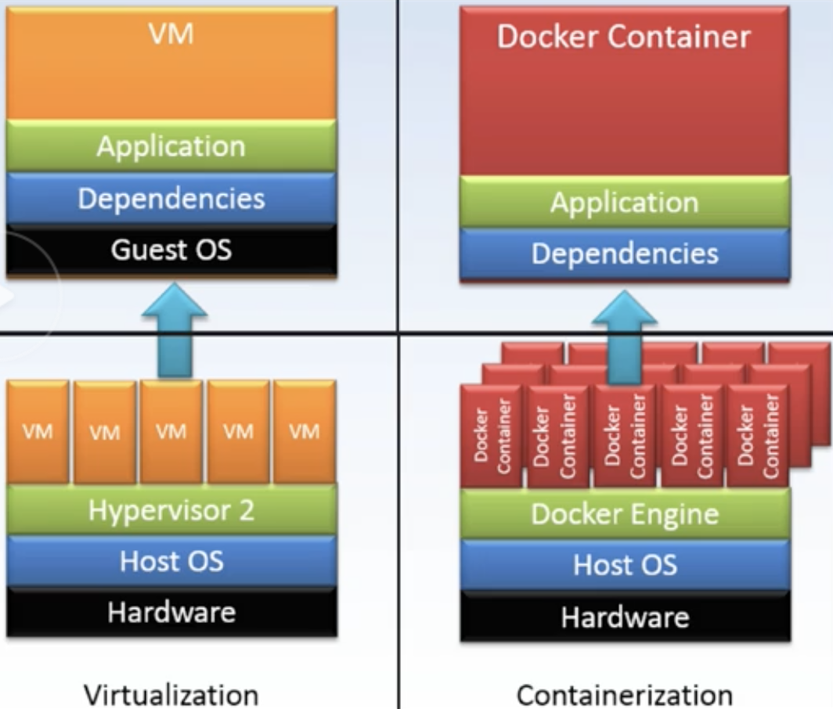
Virtualisation vs Containerisation

Slide 5
Benefits of Containers
Isolation of environments on the same host
Extreme code portability
Escape from “dependency hell”
Removes the “works on my machine” problem of development
Consistent environments from local development to Test, QA, and Production

Slide 6
What is Docker
Engine for building and running containers.
Applications are packaged into “containers”
Containers are portable among any system running the Linux operating system.
Containers are run inside Cgroups

Slide 7
Docker Components
Docker Image - basis of Docker containers (think .ISO)
Docker Container - contains everything that is needed for the application to run
Docker Volumes - provide storage for containers
Containers are running instances of Docker images
Notes:
Docker image is the basis of a Docker Container. Docker images are similar to ISO images.

Slide 8
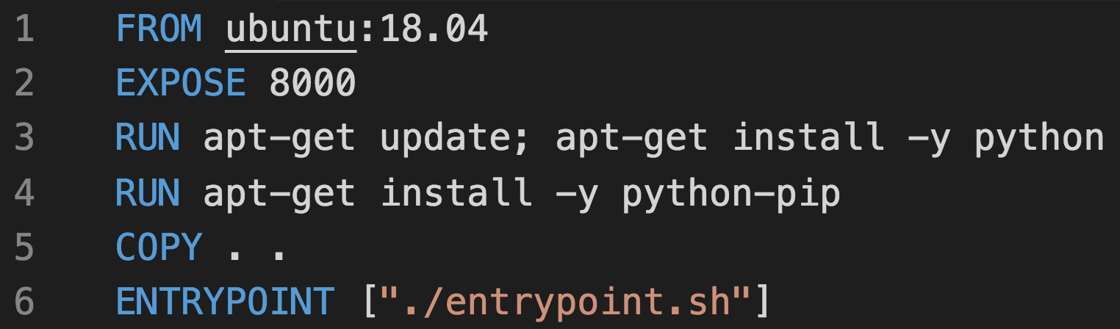
Examining the Dockerfile

Slide 9
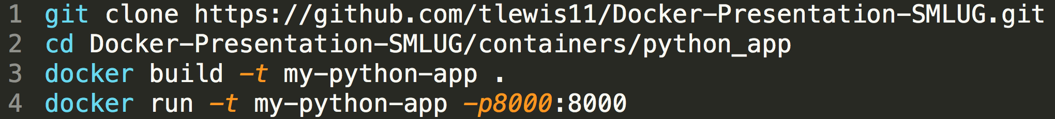
Running The Example Container

Slide 10
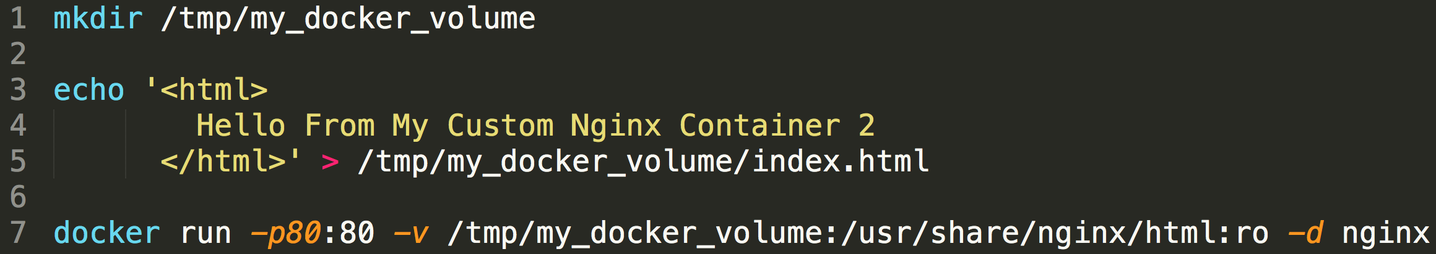
Running 3rd party Docker Containers
Run an Nginx container
Serve a custom HTML page with Nginx

Slide 11
Resources
Install Docker
https://get.docker.com/
Ubuntu: https://docs.docker.com/install/linux/docker-ce/ubuntu/
Using Docker by Adrian Mouat
Published by O'Reilly Media, Inc., 2015
https://www.amazon.com/Using-Docker-Developing-Deploying-Containers/dp/1491915765n

