Slide 1
What Affects Wine Quality
A Physicochemical Analysis
Teresa Ferrill
Bellevue University
DSC530

Slide 2
Agenda
Data Set
Hypothesis
Five Analysis Variables
Boxplots / Histograms
Descriptive Characteristics
PMF Fixed Acidity
CDF Fixed Acidity
Analytical Distribution
Scatter Plots
Hypothesis Testing
Regression Analysis
Conclusion
References

Slide 3
Data Set
University of California Irvine’s Machine Learning Repository (UCI, 2009)
Red wine: https://archive.ics.uci.edu/ml/machine-learning-databases/wine-quality/winequality-red.csv
Dataset based on wines produced at Vinho Verde, a region in the north of Portugal

Slide 4
Data Set
Dataset contains 11 variables plus a quality score
Fixed Acidity
Volatile Acidity
Citric Acid
Residual Sugar
Chlorides
Free Sulfur Dioxide
Total Sulfur Dioxide
Density
pH
Sulphates
Alcohol
Quality

Slide 5
Hypothesis
The null hypothesis (H₀) is that none of the variance in the quality ranking is explained by the input variables.
The alternate hypothesis (H₁) is that the input variables contribution to the variance in the quality ranking is significantly different from 0.

Slide 6
Five Analysis Variables
Determining the variables for analysis
Ran correlation and additional information on the red wine dataset
Ran boxplot plots to check for outliers with the target variable of quality and view that variable’s relationship to quality
Ran describe to gain better understanding

Slide 7
Five Analysis Variables
Determined use of these input variables
Fixed acidity – not much variance, many outliers
Volatile acidity – not much variance, many outliers
Citric acid – relatively uniform distribution
Residual sugar – with min 0.9 and max 15, too much difference, explains multiple outliers
Chlorides - with min 0.012 and max 0.611, big difference which explain multiple outliers
Free sulfur dioxide – multiple outliers across dataset
Ran histograms on these variables

Slide 8
Five Analysis Variables
Meaning of variables (Admin, 2013):
Fixed Acidity: measurement of the total concentration of titratable acids and free hydrogen ions present in wine
Volatile Acidity: measurement of wine’s volatile (or gaseous) acids; associated with smell and taste of vinegar
Citric Acid: specifically makes a wine taste fresh, balances a malic dominant fruit base
Residual Sugar: fermentable and unfermentable sugar left in wine after fermentation
Chlorides: salt in wine, influenced by type of grape
Free Sulfur Dioxide: used as a preservative; influences what the wine will taste like

Slide 9
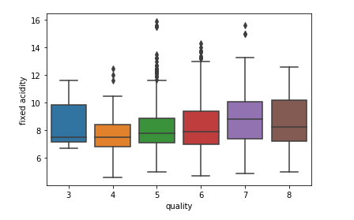
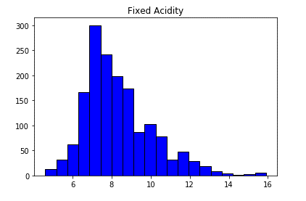
Boxplot / Histogram: Fixed Acidity
Fixed Acidity - 25% - 7.1 and 50% - 7.9; not much of a variance which could explain the huge number of outliers

Slide 10
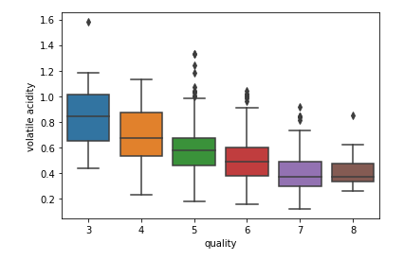
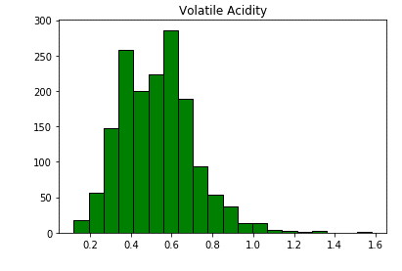
Boxplot / Histogram: Volatile Acidity
Volatile Acidity - not much variance between min and max which could explain the outliers

Slide 11
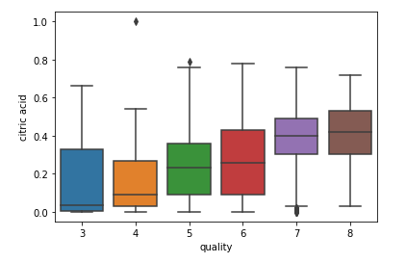
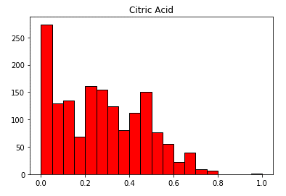
Boxplot / Histogram: Citric Acidity
Citric Acid - seems to be somewhat uniformly distributed with few outliers

Slide 12
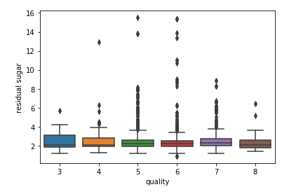
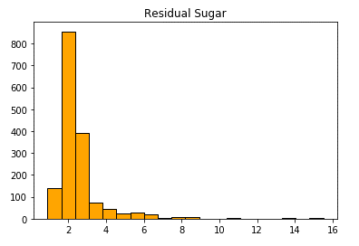
Boxplot / Histogram: Residual Sugar
Residual Sugar - with min 0.9 and max - 15, too much difference which explains multiple outliers

Slide 13
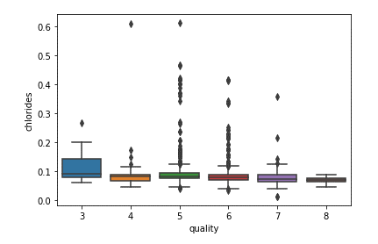
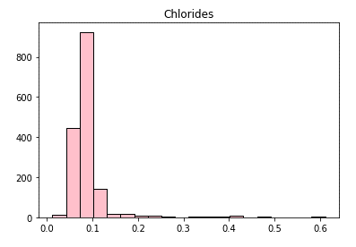
Boxplot / Histogram: Chlorides
Chlorides - with min 0.012 and max 0.611, big difference which explain multiple outliers

Slide 14
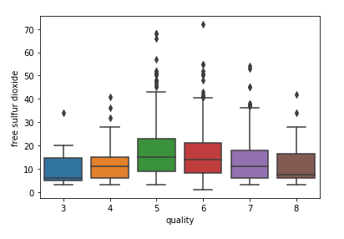
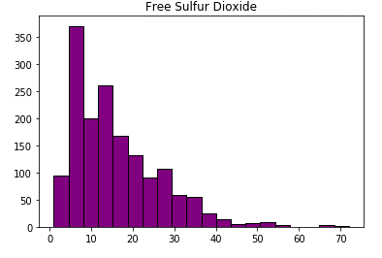
Boxplot / Histogram: Free Sulfur Dioxide
Free sulfur dioxide - min is 1 and max is 72, too much difference which explains multiple outliers across dataset

Slide 15
Descriptive Characteristics
Fixed Acidity Mean: 8.319637 Mode: 7.2 Variance: 3.031416 Tails: min: 4.6 max: 15.9 Spread: 11.3
Citric Acid Mean: 0.270976 Mode: 0.0 Variance: 0.037947 Tails: min: 0.0 max: 1.0 Spread: 1.0
Chlorides Mean: 0.087467 Mode: 0.08 Variance: 0.002215 Tails: min: 0.012 max: 0.611 Spread: 0.599
Volatile Acidity Mean: 0.527821 Mode: 0.6 Variance: 0.032062 Tails: min: 0.12 max: 1.58 Spread: 1.46
Residual Sugar Mean: 2.538806 Mode: 2.0 Variance: 1.987897 Tails: min: 0.9 max: 15.5 Spread: 14.6
Free Sulfur Dioxide Mean: 15.874922 Mode: 6.0 Variance: 109.414884 Tails: min: 1.0 max: 72.0 Spread: 71.0

Slide 16
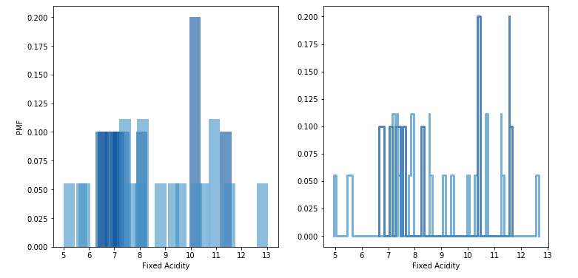
PMF: Fixed Acidity
Grouped dataset by quality –
Quality 1, 2, 3 = ‘Bad’
Quality 4, 5, 6, 7 = ‘Average’
Quality 8, 9, 10 = ‘Excellent’
Added review column, updated with grouped value for quality
Compared PMF for Fixed Acidity from ‘Bad’ and Excellent’ groups

Slide 17
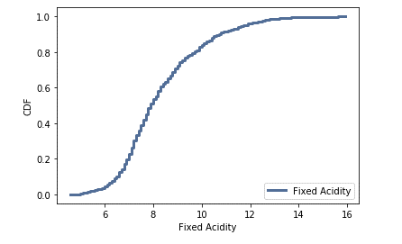
CDF: Fixed Acidity
CDF for Fixed Acidity plots as a typical distribution which indicates the fixed acidity across the dataset is evenly distributed. This supports the null hypothesis which means the fixed acidity does not necessarily contribute to wine quality.

Slide 18
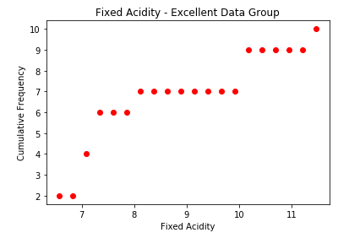
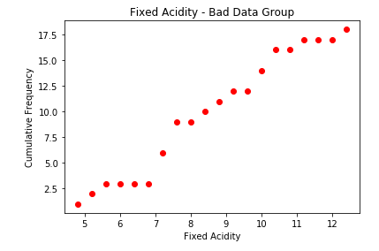
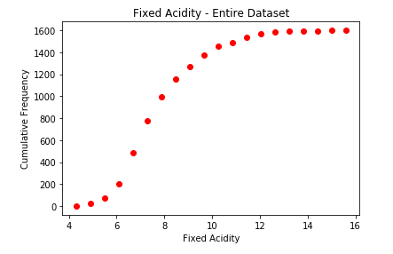
Analytical Distribution
Reviewing the Normal analytical distribution using Fixed Acidity from the 'excellent' and 'bad' grouped dataset against the whole dataset reflects that the fixed acidity across the dataset is evenly distributed.
This supports the null hypothesis which means the fixed acidity does not necessarily contribute to wine quality.

Slide 19
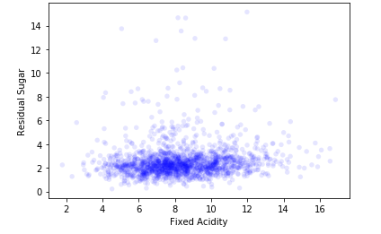
Scatter Plot - Fixed Acidity / Residual Sugar
Covariance is positive which means the variables are positively related.
Pearson's Correlation is positive and close to zero. This indicates the correlation is positive - when one variable is high, the other tends to be high also. The small value indicates there is little correlation between the variables.
With numerous outliers within the dataset, Spearman's Correlation was run also. This number is more than Pearson's Correlation but only by a small amount. These values are close which suggests that skewness in the distribution of residual sugar would explain most of the difference between the two correlations.
The plotted percentiles indicates that the relationship between fixed acidity and residual sugar is non-linear.

Slide 20
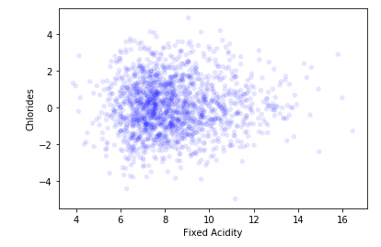
Scatter Plot - Fixed Acidity / Chlorides
Covariance is positive which means the variables are positively related.
Pearson's Correlation is positive and close to zero. This indicates the correlation is positive - when one variable is high, the other tends to be high also. The small value indicates there is little correlation between the variables.
With numerous outliers within the dataset, Spearman's Correlation was run also. This number is less than Pearson's Correlation but only by a small amount. These values are close which suggests that skewness in the distribution of chlorides would explain most of the difference between the two correlations.
The plotted percentiles indicates that the relationship between fixed acidity and chlorides is non-linear.

Slide 21
Hypothesis Testing
Tested the observed differences in fixed acidity for those identified as ‘excellent’ and ‘bad’ quality
P Value computed as about 80%, which indicates the sample results are consistent with a null hypothesis that is true

Slide 22
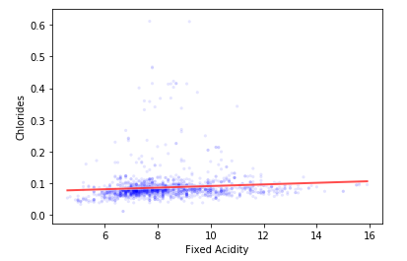
Regression Analysis
Least Squares Analysis
Fit to Fixed Acidity as a Function of Chlorides
Intercept: 0.066
Slope: .002
The slope is almost zero – as fixed acidity changes, there is no change to chlorides
These results support the null hypothesis

Slide 23
Conclusion
The results of this analysis supports the null hypothesis
The assumption is that, while there are differences in the chemical makeup of the various wine quality groups, the actual quality of wine is more subjective than objective

Slide 24
References
Admin. (2013, September 19). Understanding Wine Acidity. Retrieved from Winemaker’s Academy: http://winemakersacademy.com/understanding-wine-acidity/
UCI. (2009, October 7). Wine Quality Data Set. Retrieved from UCI Machine Learning Repository: https://archive.ics.uci.edu/ml/datasets/wine+quality

