Slide 1
R₁
x, y
R₂
y, z
R₃
z, w
z, u
R₄

Slide 2
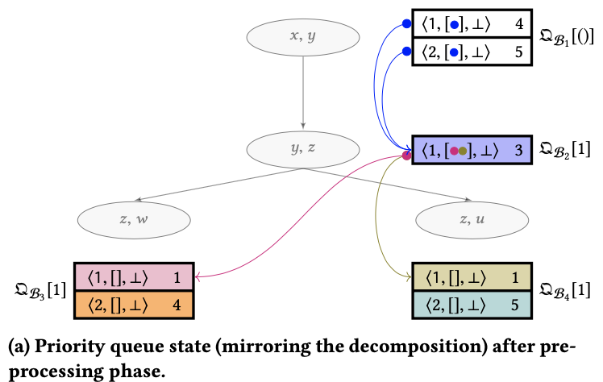
x, y
<1, [1], null> weight = 4
Q[B₁][()]
<2, [1], null> weight = 5
y, z
<1, [1,1], null> weight = 3
Q[B₂][y=1]
z, w
z, u
<1, [], null> weight = 1
<1, [], null> weight = 1
Q[B₃][z=1]
Q[B₄][z=1]
<2, [], null> weight = 4
<2, [], null> weight = 5

Slide 3
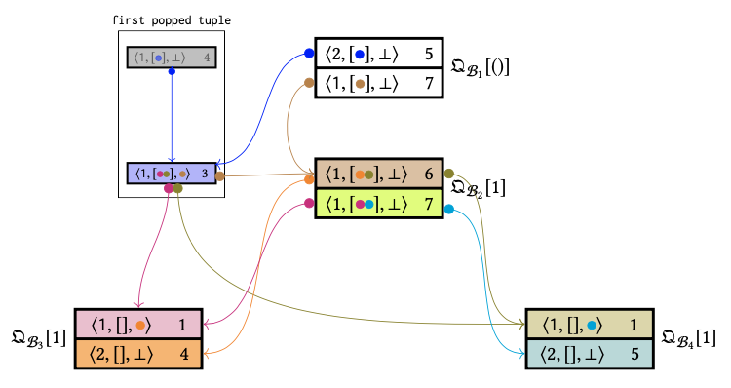
<1, [1], null> weight = 4
pop
<2, [1], null> weight = 5
Q[B₁][()]
<1, [1], null> weight = 7
pop
<1, [1,1], 1> weight = 3
<1, [2,1], null> weight = 6
Q[B₂][y=1]
<1, [1,2], null> weight = 7
pop
pop
<1, [], 2> weight = 1
<1, [], 2> weight = 1
Q[B₃][z=1]
<2, [], null> weight = 4
<2, [], null> weight = 5
Q[B₄][z=1]

