Slide 1
Mythic Quest Capstone Project
By: Team One
Notes:
Jenni

Slide 2
Agenda
01
02
03
04
Meet the team
About our project
Our challenges
Our learning
Notes:
Jenni

Slide 3

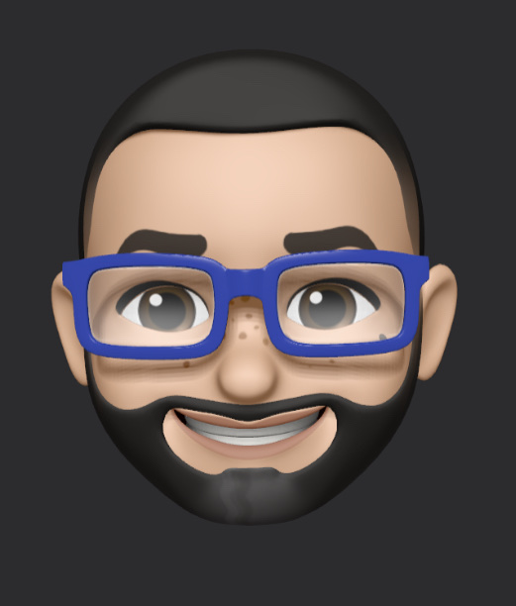
Meet the team
Ibrahim Mohamed
Dorian Majano
Notes:
Dorian, Ib

Slide 4
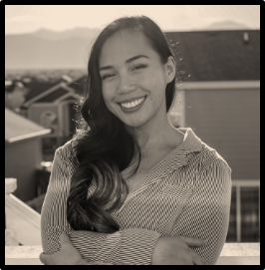
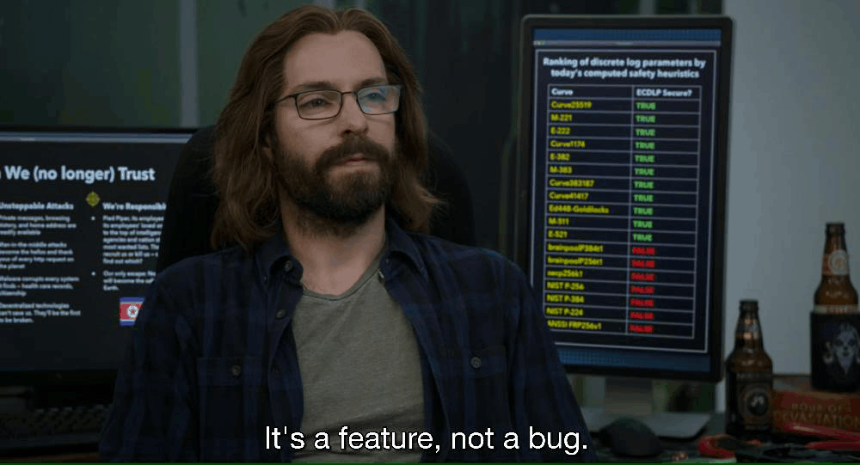
Meet the team
Mark Stokes
Jennilee Toctocan
“There are two ways to write error-free programs; only the third works.”
Meet
Meet
Notes:
Jenni, Mark

Slide 5
About our project
Mythic Quest is a fantasy game about the player's journey to defeat the enemies of humanity. The goal is to reach the ultimate boss, and rid the land of the deadly plague.
Notes:
Jenni

Slide 6
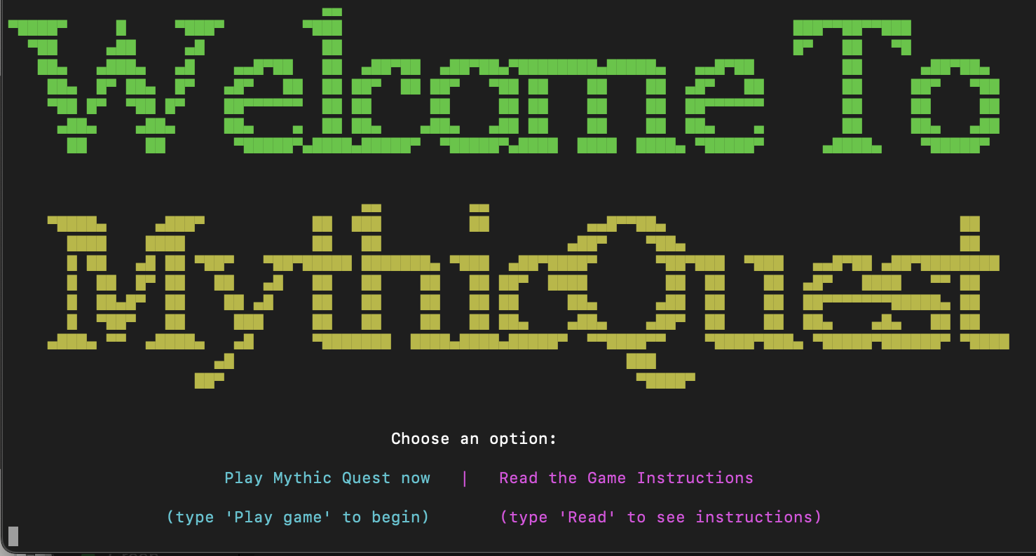
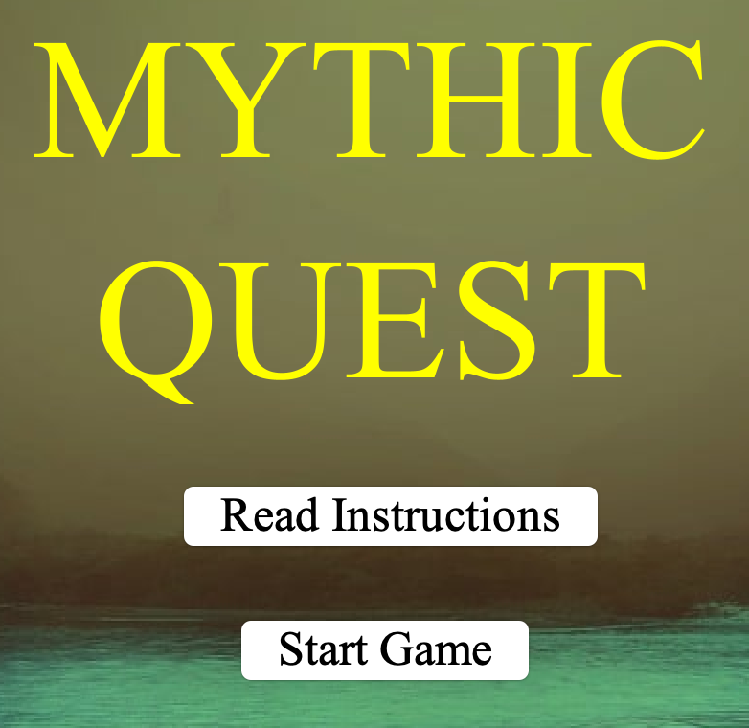
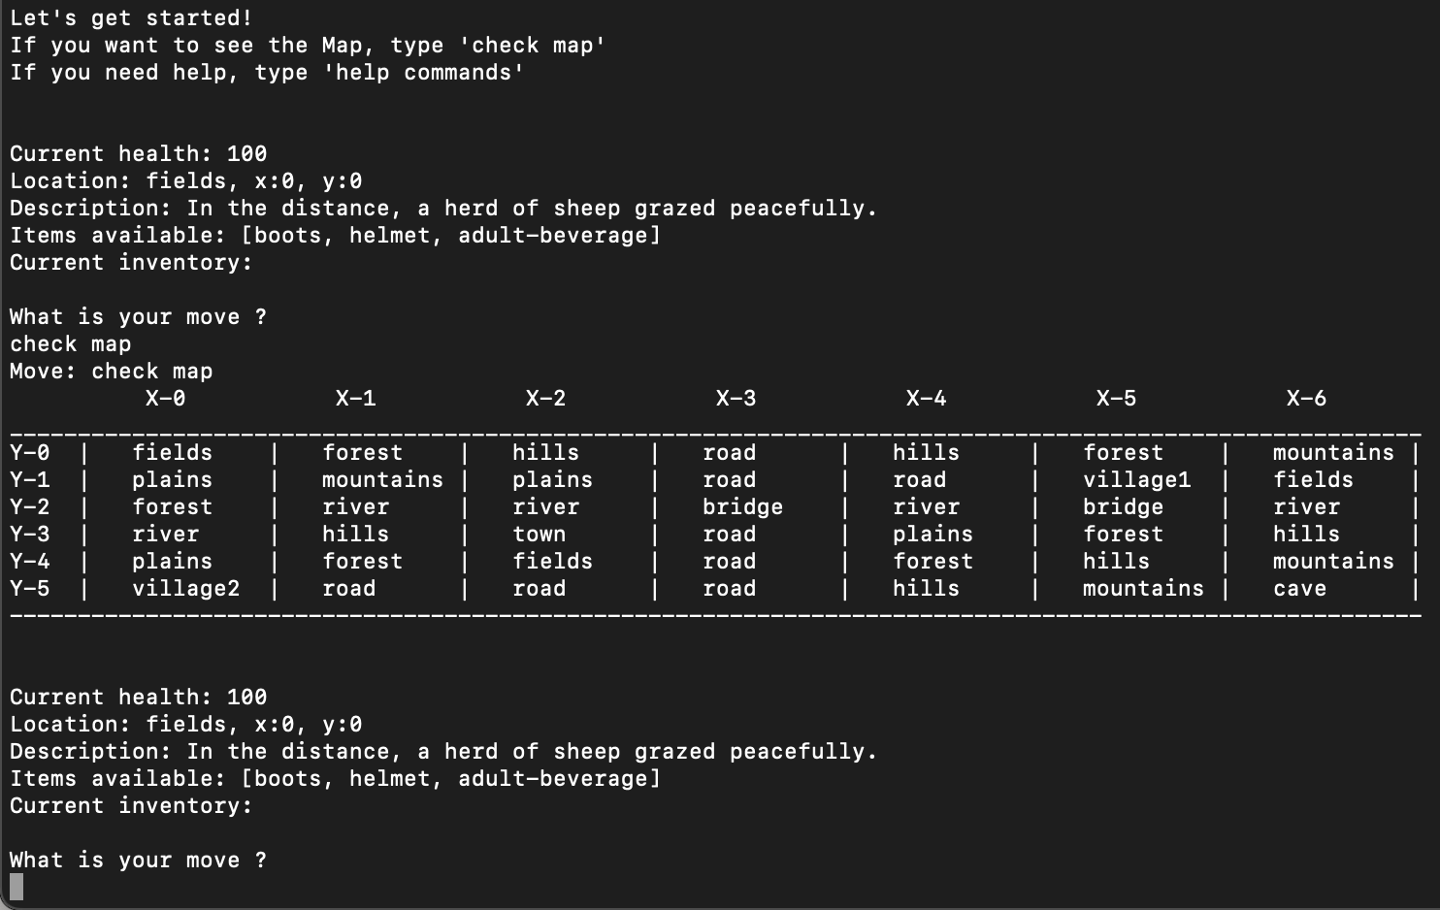
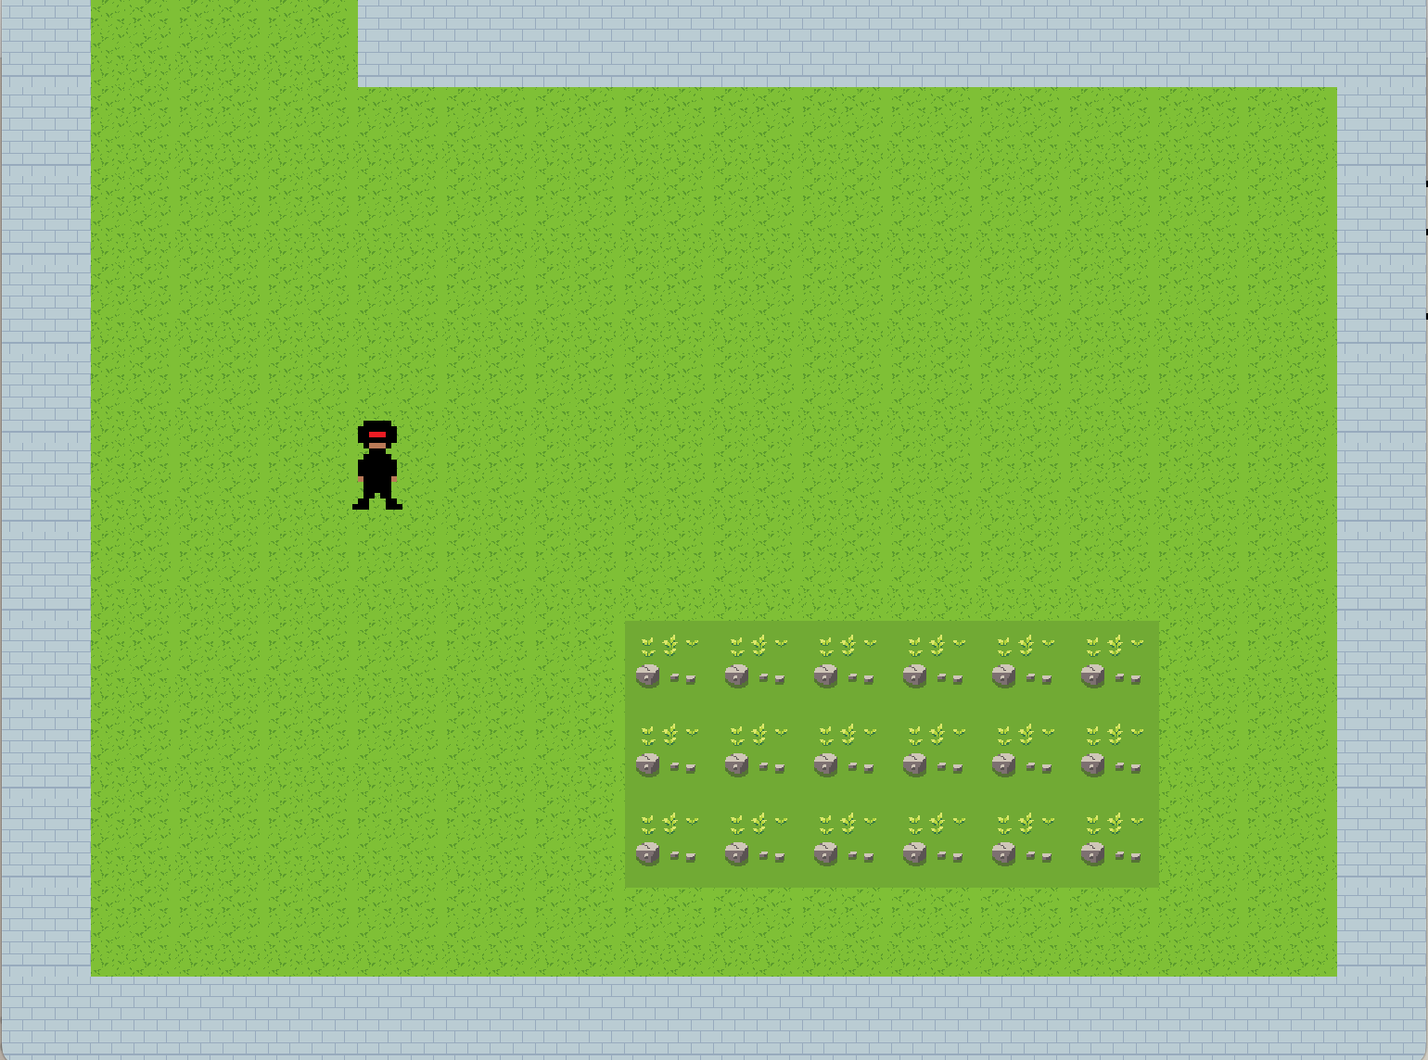
Game Evolution
Notes:
Dorian

Slide 7
Demo

Slide 8
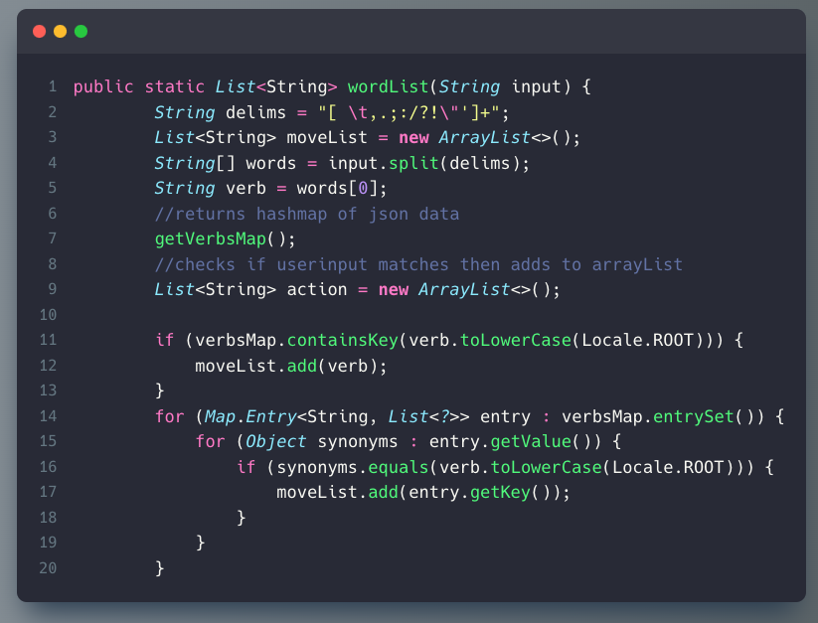
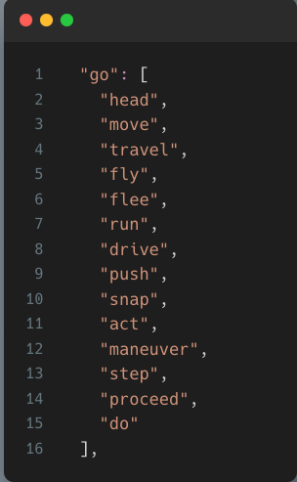
Ib
TextParser
Notes:
Ib

Slide 9
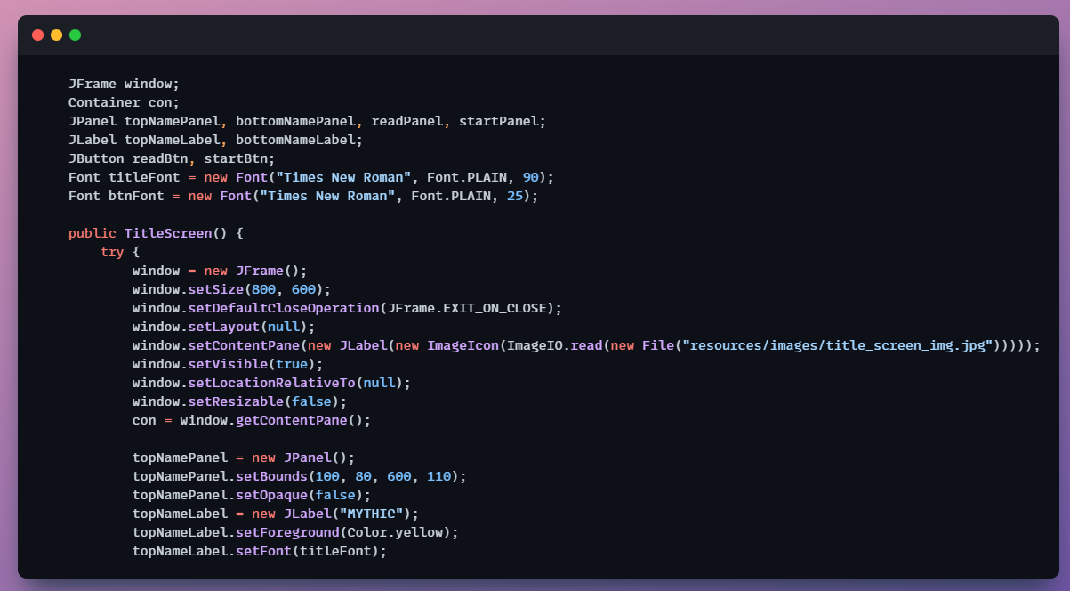
Jennilee
Notes:
Jenni

Slide 10
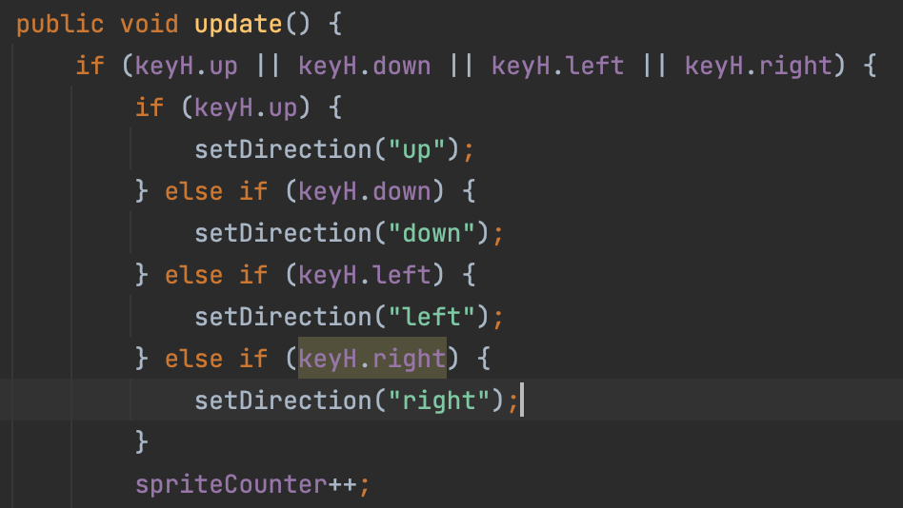
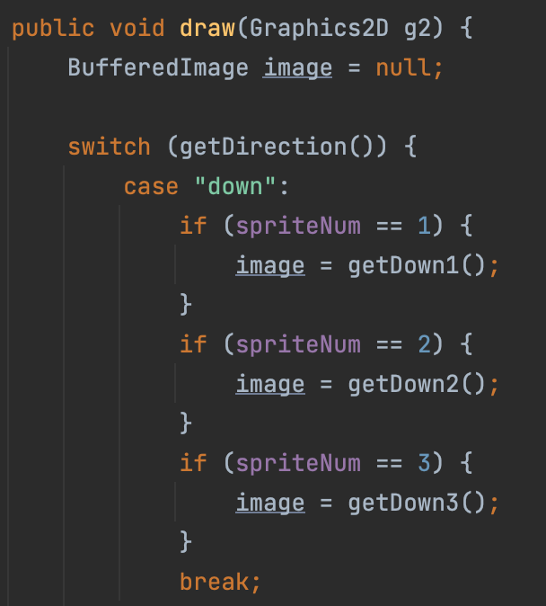



Dorian
Notes:
Dorian

Slide 11
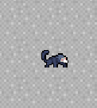
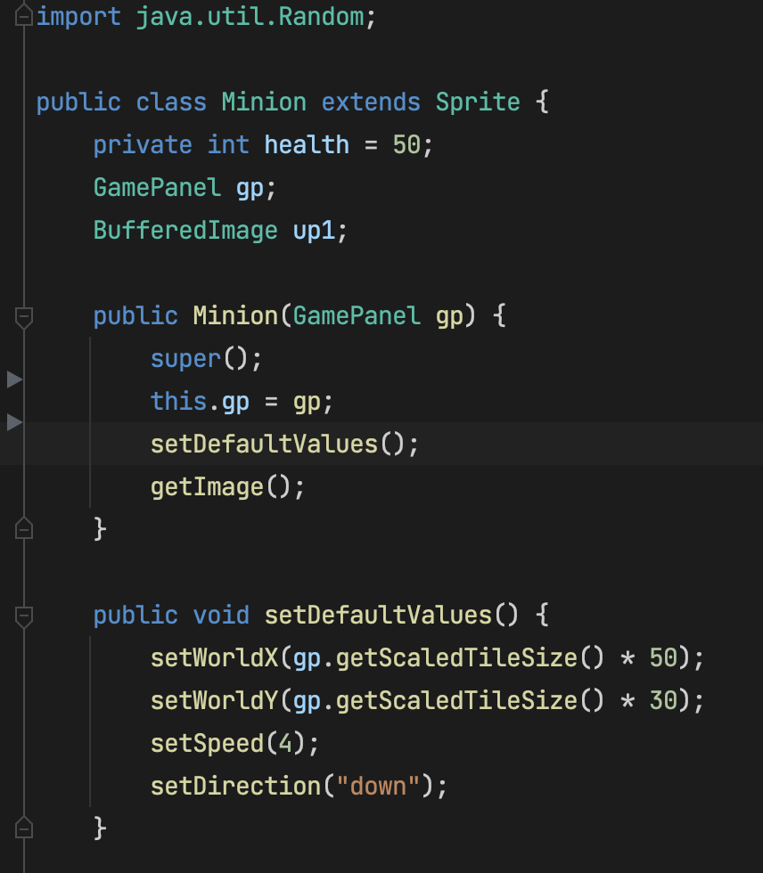
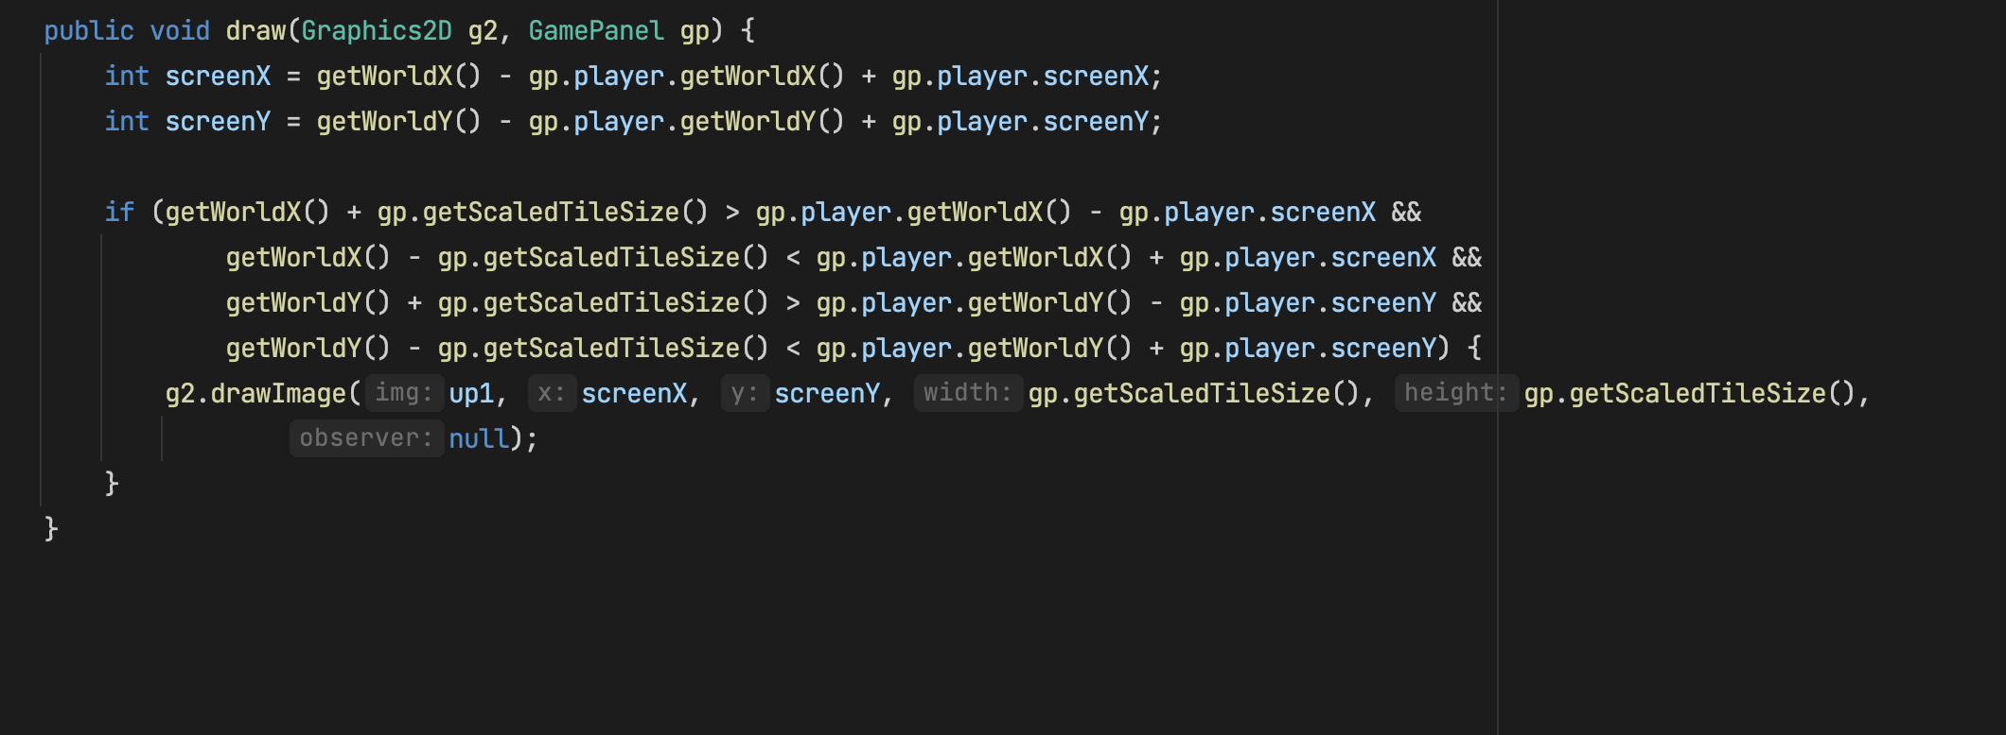
Mark
Notes:
Mark

Slide 12
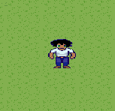
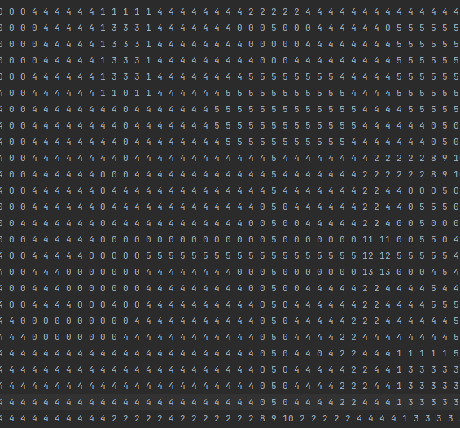
Highlights
Character
Map
Enemy
Notes:
Ib

Slide 13
Our Challenges
Dorian
Ibrahim
GSON
Git/Github
Integrating new code with old code
Planning
Communicating
Java Swing
Jennilee
Mark
Converting to GUI
Troubleshooting
Merge conflicts
Java Swing
2. Debugging
3. Overthinking
Notes:
All

Slide 14
Our Learning
Dorian
Ibrahim
Managing a backlog
SOLID design principles
Agile principles
Pixel Art
Letting go
Agile - #6
Git
Java Swing
Jennilee
Mark
Associating commits to tickets
Java Swing
The art of simplicity
Limiting Scope Creep
2. Recognize Patterns
3. Java Swing
Notes:
All

Slide 15
What we would do next
Sound effects
Music
Punching
Kicking
Bosses
NPC
Everything else...
Notes:
Mark

Slide 16
Thanks!
Notes:
Jenni

