Slide 1
MUHAFIZ.SOL
A machine-learning guardian for Ethereum smart contracts
AI2002 Artificial Intelligence - Semester Project, Fall 2026 - Path A (software)
Group 39: Sohaib (24I-3108) - Shaiman (24I-3074) - Talha Sami (24I-3118)
Notes:
Muhafiz means guardian in Urdu; .sol is the Solidity file extension.

Slide 2
Money lives in code that cannot be patched
!
The shopkeeper's mistake
US$3.4 bn
1. Check the ledger: customer is owed 100 rupees.
2. Hand over the 100 rupees.
3. Only then write 'owed: 0'.
A clever customer asks again between steps 2 and 3 - and is paid again and again. In a smart contract this is reentrancy, the pattern behind famous thefts.
stolen in crypto, Jan - early Dec 2025 (Chainalysis)
~12 %
of stolen value from contract-code exploits (TRM Labs via secondary source)
Audits are slow and costly; students and small teams often deploy unreviewed.
Muhafiz.sol - AI2002 Group 39
2

Slide 3
Why now, and why here
1
Pakistan 2026
2
Local demand
3
Honest positioning
Virtual Assets Act passed 6 March 2026; PVARA licenses the sector. Pakistan ranked 3rd in Chainalysis's 2025 adoption index.
New, small Web3 teams need cheap first-pass screening before paying for a full audit.
A student triage aid. Not a certification, not a compliance product, not affiliated with PVARA.
Muhafiz.sol - AI2002 Group 39
3

Slide 4
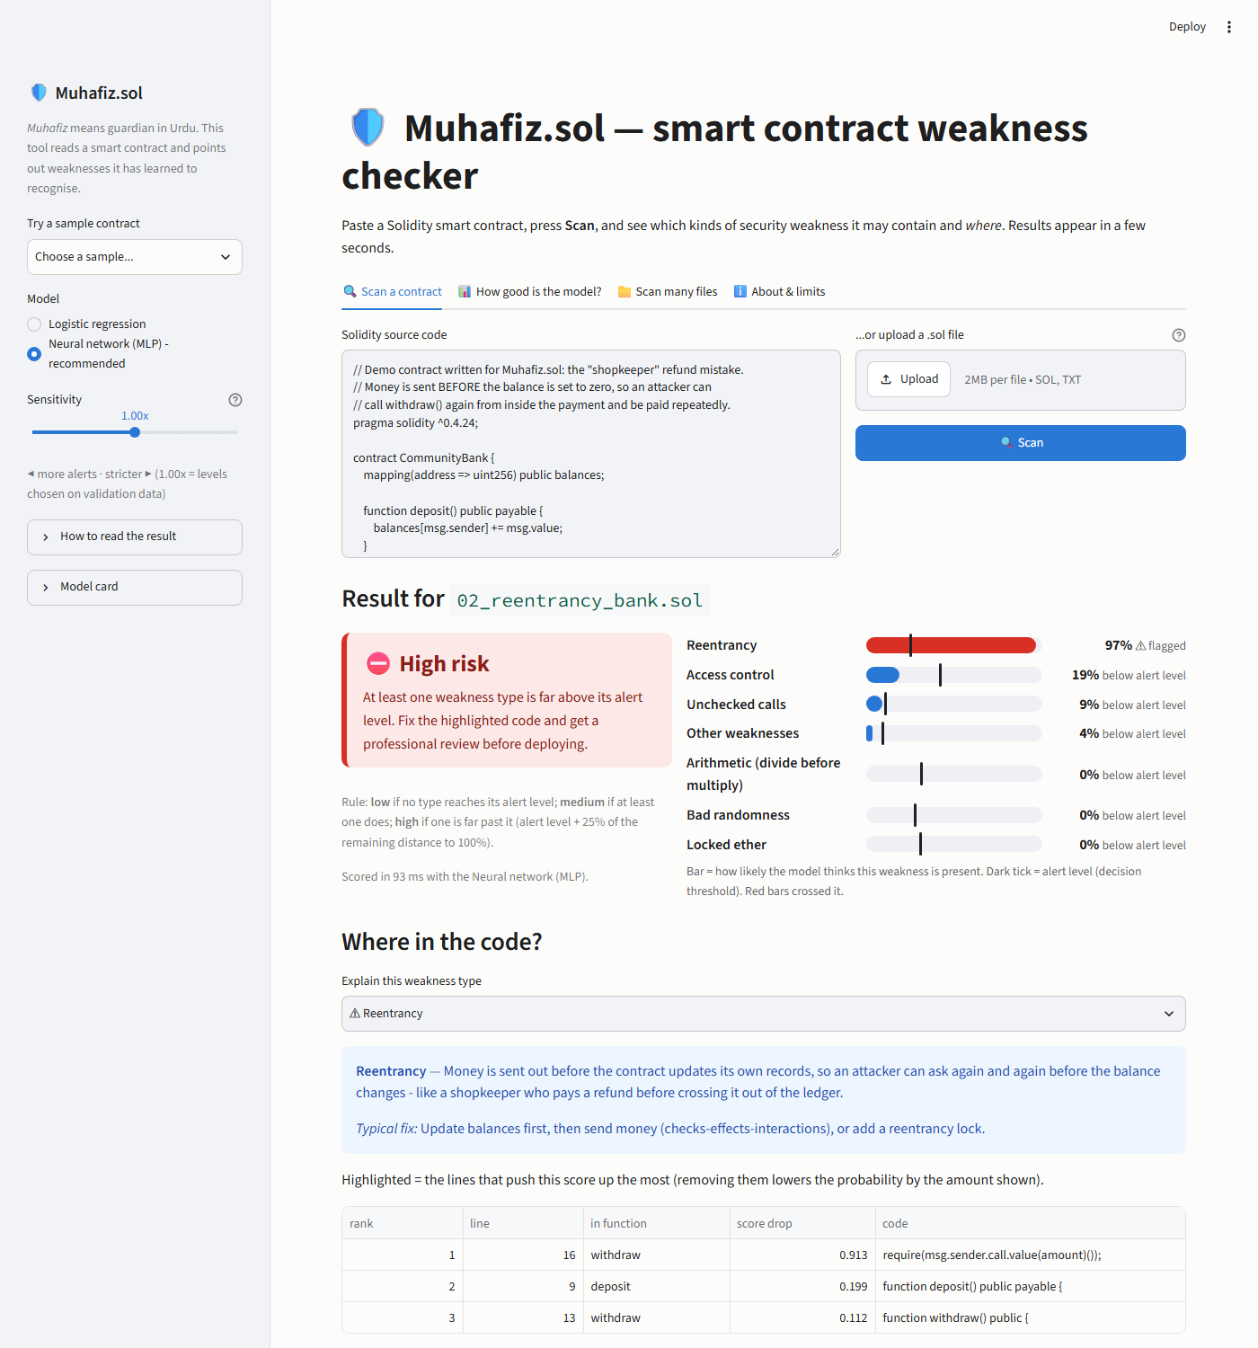
Paste a contract, get an explained risk report in seconds
▸ Probabilities for 7 weakness types
▸ Risk level low / medium / high with its rule
▸ Highlighted lines that drive the score
▸ Similar contracts from 45K real deployments
▸ Download a Markdown / JSON report
Muhafiz.sol - AI2002 Group 39
4

Slide 5
Two datasets: one to learn, one to check honestly
A
A - Slither Audited Contracts
B
B - SmartBugs Curated
120,608 verified Ethereum contracts labelled by the Slither analyser (38 detectors -> 7 families). Hugging Face, MIT licence. Used for training, validation and the in-distribution test.
143 vulnerable contracts annotated line by line by people (207 vulnerabilities). GitHub, Apache-2.0. Test only - never used for training or tuning; all annotation comments stripped first.
Muhafiz.sol - AI2002 Group 39
5

Slide 6
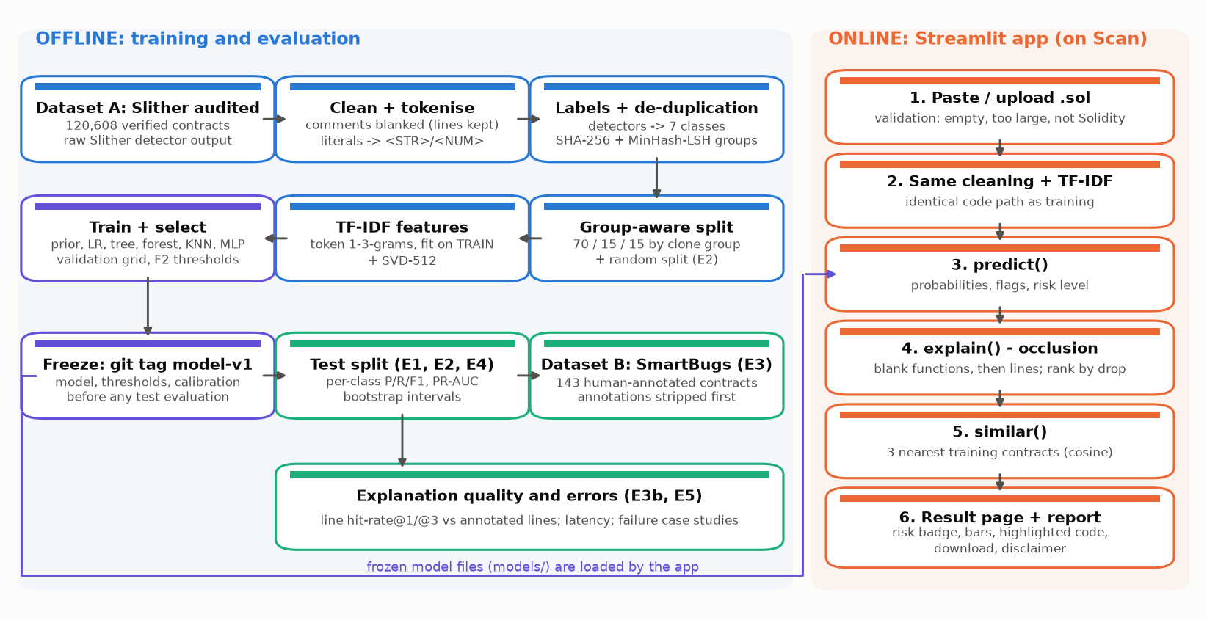
Pipeline: offline training, online scanning
Muhafiz.sol - AI2002 Group 39
6

Slide 7
Clean data first: duplicates would have faked our scores
46 %
59%
0 %
of contracts are exact or renamed copies (removed)
of validation and test contracts would have a clone in training under a random split
under our clone-group split
▸ Comments blanked, line numbers kept; literals -> <STR>/<NUM>
▸ MinHash + LSH on token 5-grams (Jaccard >= 0.8) -> clone groups; giant template families -> train
▸ Label 4 resolved: 'safe' in big/small, divide-before-multiply in 'all'; 0 failed Slither runs
▸ Split 45,540 / 9,759 / 9,759; TF-IDF fitted on train only
Muhafiz.sol - AI2002 Group 39
7

Slide 8
AI technique: multi-label classification on code tokens
?
Why machine learning
>
Input -> output
Works on raw source with no compiler, scores in under a second, handles code that does not compile, and ranks every weakness type by probability. Limit: it learns Slither's labels, so we test it on human annotations.
Contract -> tokens -> TF-IDF of 1-3-grams (20,000 features) -> one probability per class -> per-class threshold (F2 on validation) -> flags and risk level -> occlusion explanation.
Muhafiz.sol - AI2002 Group 39
8

Slide 9
Six model families, one fair comparison
model | val macro PR-AUC | val macro F2 | train time (min)
MLP neural network | 0.846 | 0.816 | 134.7
Logistic regression | 0.812 | 0.812 | 2.4
Random forest | 0.771 | 0.762 | 89.6
K-nearest neighbours | 0.615 | 0.651 | 0.0
Decision tree | 0.514 | 0.644 | 20.2
Majority / prior baseline | 0.207 | 0.503 | 0.0
Primary model: MLP neural network
Chosen by validation macro PR-AUC only - test and SmartBugs untouched until the git tag model-v1.
Train times are wall-clock on one laptop CPU, with several jobs sharing it.
Muhafiz.sol - AI2002 Group 39
9

Slide 10
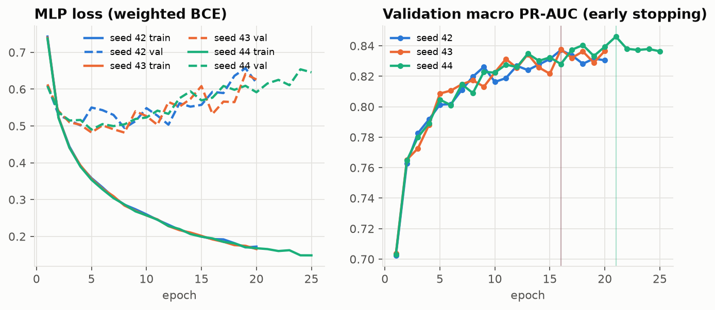
The neural network: how it learns
▸ 20,000 -> 512 -> 128 -> 7, ReLU, dropout 0.3
▸ Sigmoid per class (several weaknesses at once)
▸ Weighted binary cross-entropy for rare classes
▸ Backpropagation + Adam; early stopping on val PR-AUC
▸ 3 seeds: val PR-AUC 0.840 +/- 0.004
Muhafiz.sol - AI2002 Group 39
10

Slide 11
Thresholds favour recall; the risk rule is explicit
class | threshold | precision | recall
access-control | 0.419 | 0.599 | 0.772
arithmetic | 0.311 | 0.691 | 0.860
bad-randomness | 0.276 | 0.761 | 0.870
locked-ether | 0.306 | 0.511 | 0.779
other | 0.092 | 0.627 | 0.915
reentrancy | 0.248 | 0.653 | 0.936
unchecked-calls | 0.107 | 0.776 | 0.949
R
Risk level
LOW - no class reaches its threshold
MEDIUM - at least one does
HIGH - one reaches t + 0.25 x (1 - t)
Thresholds maximise F2 on validation (a miss costs more than a false alarm), with precision >= 0.2.
Muhafiz.sol - AI2002 Group 39
11

Slide 12
Results: model comparison on unseen contract families
0.862
macro PR-AUC of the MLP neural network [0.811, 0.889]
Never flagging anything would score 77% label accuracy and find nothing - why accuracy is not our metric. Intervals: clone-group bootstrap.
Muhafiz.sol - AI2002 Group 39
12

Slide 13
Clone leakage and the SmartBugs check
Independent number: 52.9% on the 51 contracts with no copy in training (62.6% on all 91). Intervals are wide: unchecked 35%-62%, reentrancy 74%-97%, bad 37%-88%.
Muhafiz.sol - AI2002 Group 39
13

Slide 14
Explanation: hide a line, watch the score drop
E
Two-stage occlusion
93%
1. Blank each function, measure the probability drop.
2. Inside the top functions, blank each line.
3. Highlight the lines with the biggest drops.
Exact fast trick: only n-grams touching the removed span change, so counts(full) - counts(L+S+R) + counts(L+R).
of 91 SmartBugs contracts in confirmed classes: annotated line in the top 3, 95 % CI [0.88, 0.98] (three random lines: 13%)
97%
top-3 line in the same function as the bug (random: 56%)
Muhafiz.sol - AI2002 Group 39
14

Slide 15
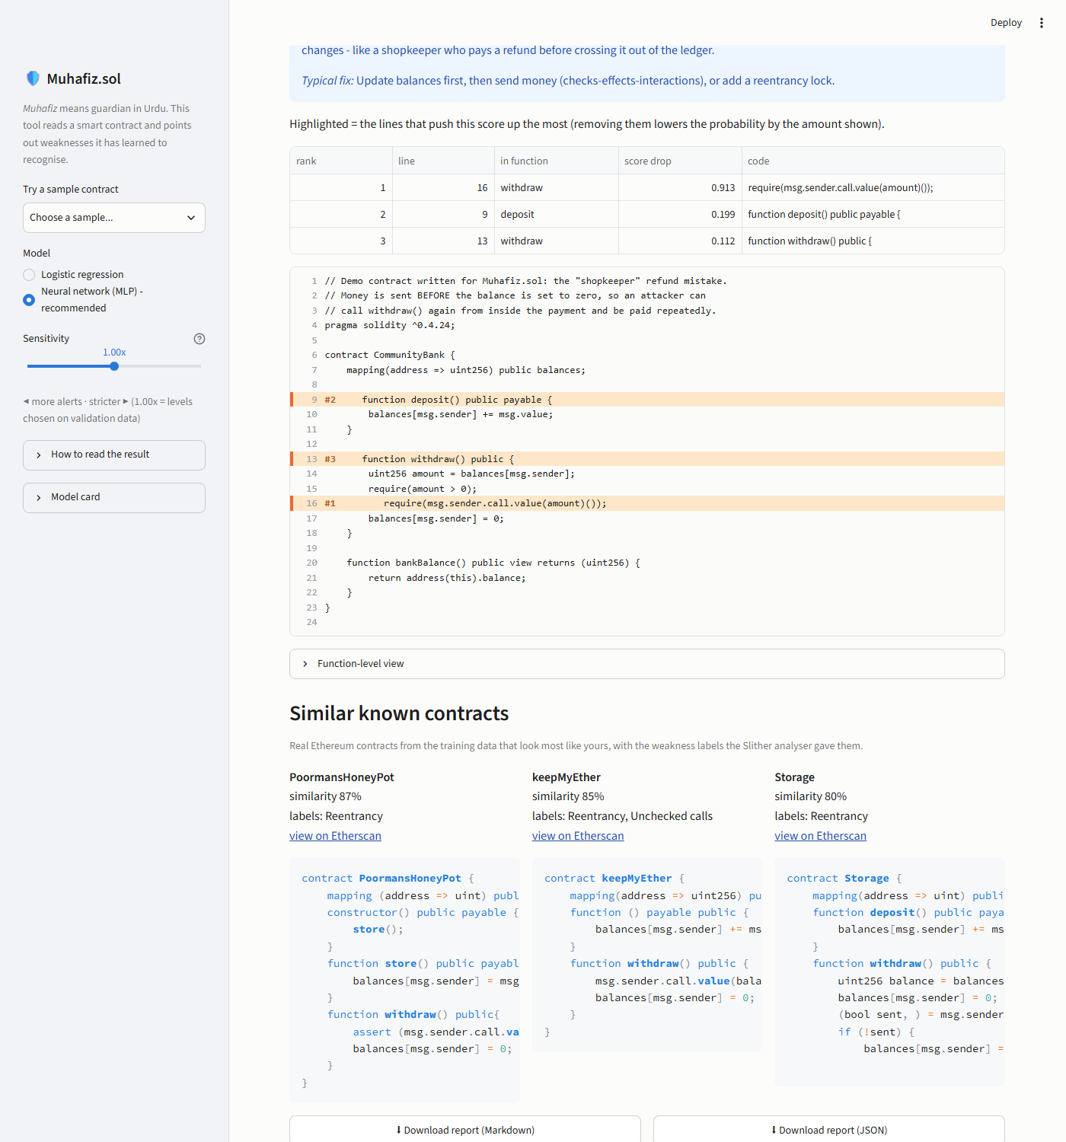
The Streamlit app
▸ One command: streamlit run app/app.py
▸ Paste, upload or pick one of 6 samples
▸ Plain-language explanation + typical fix
▸ Sensitivity slider, model toggle, batch scan
▸ Metrics tab reads the same tables as the report
▸ Disclaimer always visible
Muhafiz.sol - AI2002 Group 39
15

Slide 16
Testing: evidence, not claims
103/103
11 + 4 + 3
10 + fuzz
automated tests passing (with RUN_SLOW=1)
acceptance tests: 11 passed automatically, 4 shown by result tables, 3 need the team's laptops (A6, C1, C6)
fixed inputs and random inputs: no crash
▸ No annotation text and no clone group crosses splits (automatic tests)
▸ Model frozen before test evaluation - the evaluation script checks the git tag
▸ App output equals predict() exactly; sensitivity slider is monotone
▸ Fast occlusion equals full re-vectorisation (exactness test)
Muhafiz.sol - AI2002 Group 39
16

Slide 17
Qualitative results: where it works and where it fails
+
Hit - random_number_generator.sol
-
Miss - old_blockhash.sol
bad-randomness, p = 1.00. Top line: return uint256((h / x)) % max + 1;
bad-randomness, p = 0.00. Bug at: bytes32 answer = blockhash(guesses[msg.sender].block);
+
Hit - lotto.sol
-
Miss - 0x0cbe050f...acc9.sol
unchecked-calls, p = 1.00. Top line: winner.send(winAmount);
unchecked-calls, p = 0.00. Bug at: a.call();
Muhafiz.sol - AI2002 Group 39
17

Slide 18
Limitations and ethics
!
Limits
E
Ethics
Learns Slither's labels (and its mistakes). Cannot flag overflow, DoS, front running or timestamp bugs - no training label. Weaker on tiny Solidity 0.4 code. Token patterns, not program semantics. A low score can still hide a real bug.
Defensive only: detects and explains, never generates exploits. Never certifies safety; disclaimer in app, report and slides. Public contracts, no personal data, licences respected, datasets cited. No regulatory claims.
Muhafiz.sol - AI2002 Group 39
18

Slide 19
Conclusion
▸ Working ML triage tool: MLP neural network with 0.862 macro PR-AUC on unseen families
▸ Independent check: 52.9% recall on human-annotated SmartBugs contracts with no copy in training
▸ Honest evaluation: clone-aware split, frozen model, leakage measured
▸ Next: code-model embeddings, human labels for missing classes, cloud deployment

Slide 20
Team and questions
1
Talha Sami
2
Sohaib
3
Shaiman
Phase 1 - data, labels, de-duplication, splits, features
Phase 2 - models, MLP, thresholds, experiments E1-E4
Phase 3 - explanation, Streamlit app, testing, delivery
Questions?
Muhafiz.sol - AI2002 Group 39
20

