Slide 1
Jupyter Ascending: Security Use Cases using a Notebook Application

Slide 2
Take-aways
https://github.com/tlhendri/tptip_preso
Understand: Notebooks
Experience: See a couple examples
Integrate: Where it fits
Innovate: Getting started

Slide 3
Understand: Notebook Technologies
Development
Sharing - visualizations
Answers – enrichment, analysis
Presentations – reveal.js
Sites - Sphinx

Slide 4
Understand: Notebooks history
SAGE Notebook – 2005
Ipython – 2001 [2011]
Jupyter – 2014 Julia-Python-R
JupyterHub – 2015
JupyterLab – 2018
BeakerX – 2015
Zepplin – 2015
Cloud: AWS SageMaker/Azure Notebooks/Google Cloud Datalab/mybinder
Automation: airflow/papermill
Notes:
System for Algebra and Geometric Experimentation

Slide 5
Understand: Features
Dozens of kernels
Markdown and exports
Plug-ins
Collaboration
Hot keys and magic

Slide 6
Experience: Use Case Examples
Mapping Events
Predictive AV Analysis
API Lookups
Scenario: Management would like a geographical map showing the physical location of IDS activity.

Slide 7
Experience: Mapping Events
Use GeoLite2 library and database
Still use the IDS logs
Push long and lat into Pandas dataframe
Use Google Maps API widget to display pew-pew map

Slide 8
Experience: Use Case Examples
Mapping Events
Predictive AV Analysis
API Lookups
Scenario: AV detecting and removing bad = good, AV detecting lots of bad = something to investigate in a hurry.

Slide 9
Experience: AV Events
Detections = handled
What’s normal?
Time series
Number
Threshold estimation
Expands to other use cases

Slide 10
Experience: Use Case Examples
Mapping Events
Predictive AV Analysis
API Lookups
Scenario: Hunting for bad hashes.

Slide 11
Experience: Automation/Enrichment
Look up hashes
Compile reports for long time periods
Check against existing lists

Slide 12
Experience: Other resources
InfoSec Jupyterthon @jupyterthon + slack
Security oriented scripts in Python
Anaconda

Slide 13
Integrate: Where it fits
Operationize struggle bus
Ad-hoc jobs
Threat hunting
Analytical work-ups
SOC fatigue

Slide 14
Innovate: Getting started
Evaluate – environment, experience
Get some tech
Anaconda
Docker
Anaconda
Zeppelin
JupyterHub
Start notebooking – github, blogs

Slide 15
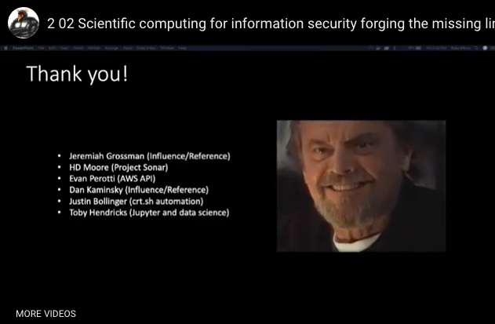
Tobias Hendricks
Eli Lilly – Security Analytics
@xcelr8, LinkedIn
Defense, Defense Contracting, Manufacturing, Energy, Insurance, Pharmaceutical
Data Science wannabe
http://www.irongeek.com/i.php?page=videos/derbycon9/2-02-scientific-computing-for-information-security-forging-the-missing-link-ryan-elkins

