Slide 1
The Data Incubator
Capstone Project: factors correlated with poverty rate in the US

Slide 2
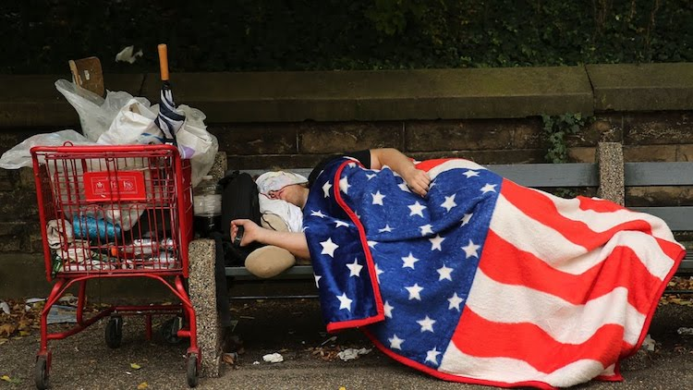
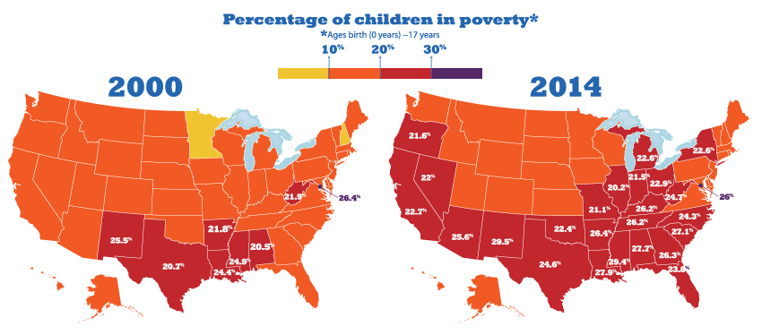

Motivation
Federal and State Policymakers
Community Stakeholders
Poverty Rate
(indicator)
Economic Conditions
&
Eligible families for government programs
Definition of ”poverty areas” in the U.S.: poverty rates >= 20%
Economic
challenges
Social
Source: 1.https://www.indepthnews.net/index.php/the-world/usa-and-canada/1566-un-expert-reveals-shocking-facts-about-poverty-in-the-u-s
2. https://www.aft.org/growth-child-poverty-mapped-county-50-states

Slide 3
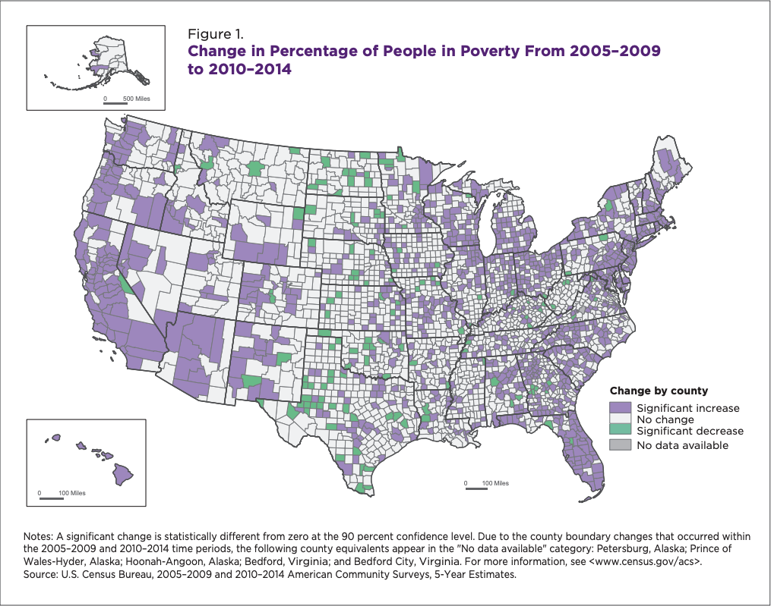
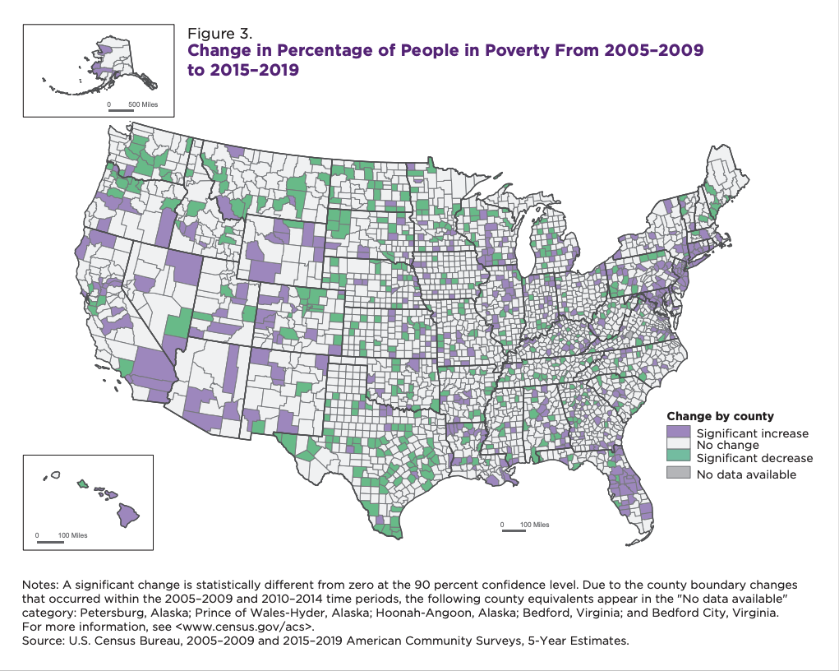
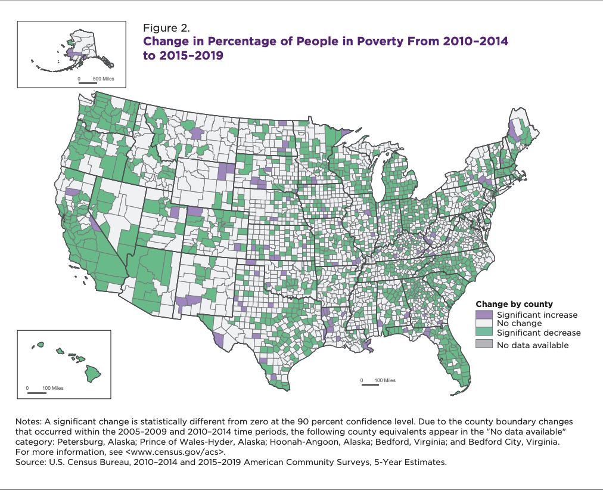
15.6%
2010-2014
Poverty Rate
2015-2019
13.4%
13.5%
13.5%
2005-2009
2005-2009
Poverty Rate
Poverty Rate
2010-2014
2015-2019
15.6%
13.4%
Source: https://www.census.gov/content/dam/Census/library/publications/2020/acs/acsbr20-008.pdf

Slide 4
What the census official report tells us:
From 2005–2009 to 2015–2019, a period that spanned both the Great Recession and the subsequent economic expansion, the poverty rate increased in 429 counties and decreased in 409 counties.
what I want to find out
what the government is interested in
&
From the data’s point of view:
What other factors besides the economic recession and expansion are causing the poverty rate changes?
What actions/programs the government can take to lower the poverty rate, e.g.
Adjusting state tax rate?
Making new laws?
Providing incentives for better education/training?

Slide 5
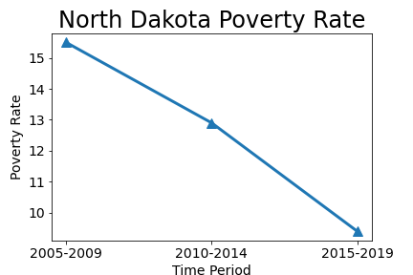
Plan
To look at the following aspects for each state during the three time period (2005-2009, 2010-2014, 2015-2019):
State tax rate changes
New state laws being passed
Education level changes
Geographical mobility of poverty population
Poverty Rate Dropped
One Interesting Data Point
What factors are affecting?
Can the experiences be borrowed by other states?
Tools: Python (pandas, numpy, scipy, matplotlib, scikit-learn)
Source: https://www.census.gov/content/dam/Census/library/publications/2020/acs/acsbr20-008.pdf

