Slide 1
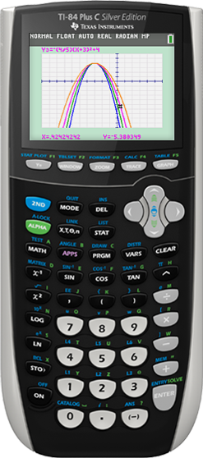
Z80 Calculator Operating Systems
TJ Liggett

Slide 2
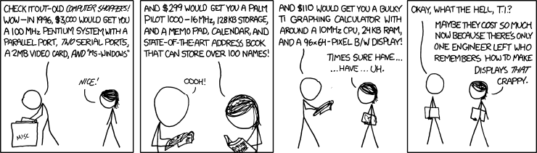

Slide 3
Texas Instruments Calculator Specifications
Zilog 80 Processor
Similar to the first microcomputer systems (1976)
4 AAA Batteries (Backup Lithium battery)

Slide 4
Texas Instruments Calculator Specifications
 | RAM | ROM
TI-83+ | 32 KB (24 KB*) | 512 KB (160 KB*)
TI-84+ | 48 KB (24 KB*) | 1 MB (480 KB*)
TI-84+ SE | 48 KB (24 KB*) | 2 MB (1.5 MB*)
*User Accessible

Slide 5
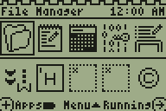
KnightOS
Open Source
Unix-esque
Limited Math operations

Slide 6
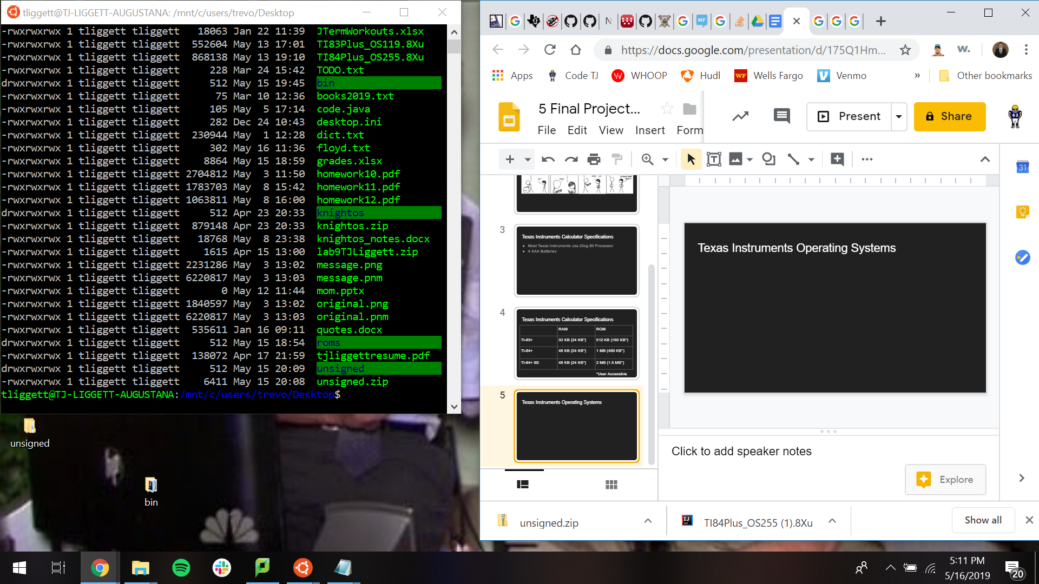
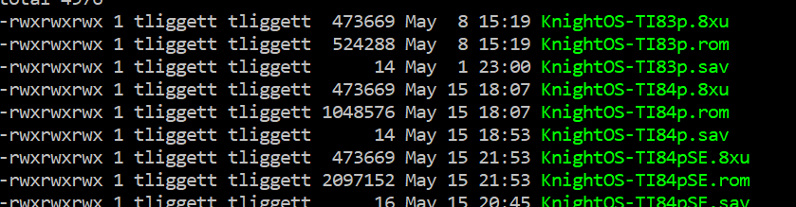
Why KnightOS?

Slide 7
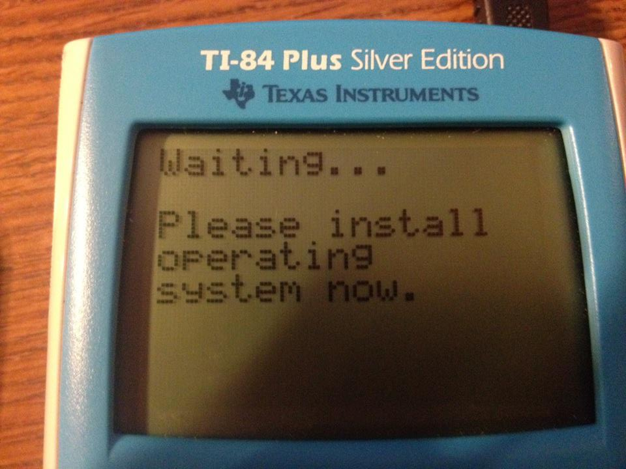
Replacing the OS on a TI-84+
Patch the Boot Code
Build KnightOS
TI-Connect
TI Graph Link Connectivity Kit
OS Independent ROM boot

Slide 8
Struggles
TI upgrade file for TI-83+ corrupted
Unsigned OS to TI-84+ with boot code of 1.03
Calculator app
Limited Support for project
Everything in Z80 assembly

Slide 9
REFERENCES
[1] “TI Products | Graphing Calculators | Scientific Calculators,” Texas Instruments. [Online]. Available: https://education.ti.com/en/products?category=graphing-calculators. [Accessed: 21-May-2019].
[2] J. Powers, “January 10, 1996: TI-83 Graphing Calculator,” Day in Tech History, 01-Jan-2019. [Online]. Available: https://dayintechhistory.com/dith/january-10-1996-ti-83-graphing-calculator-2/. [Accessed: 21-May-2019].
[3] R. O'Connell, “Why Are Graphing Calculators So Expensive?,” Mental Floss, 10-Mar-2016. [Online]. Available: http://mentalfloss.com/article/73831/why-are-graphing-calculators-so-expensive. [Accessed: 21-May-2019].
[4] J. C. Nash and C. Olsen, “The Texas Instruments TI-83 Graphing Calculator,” The American Statistician, vol. 52, no. 3, p. 285, Aug. 1998.
[5] R. Holland, “Chip Hall of Fame: Zilog Z80 Microprocessor,” IEEE Spectrum, pp. 29–40, Jun. 2017.
[6] D. DeVault,“KnightOS,” KnightOS. [Online]. Available: https://knightos.org/. [Accessed: 20-May-2019].
[7] Software, OS Updates and Apps. [Online]. Available: https://education.ti.com/en/software/search. [Accessed: 21-May-2019].
[8] D. DeVault, “KnightOS,” GitHub. [Online]. Available: https://github.com/KnightOS. [Accessed: 21-May-2019].
[9] “TI-83/84 Plus Operating Systems,” ticalc.org, 13-Apr-2015. [Online]. Available: https://www.ticalc.org/pub/83plus/os/. [Accessed: 21-May-2019].
[10] “BAOS Manual,” BZC. [Online]. Available: http://bzc.sourceforge.net/baos/Manual.pdf. [Accessed: 20-May-2019].
[11] B. Moody, T. Duponchelle, and L. Bruant, “TilEm: TI Linux Emulator,” Linux (TI) Programmer Group. [Online]. Available: http://lpg.ticalc.org/prj_tilem/. [Accessed: 21-May-2019].
[12] C. Hoffman, “How to Install and Use the Linux Bash Shell on Windows 10,” How-To Geek, 07-Mar-2018. [Online]. Available: https://www.howtogeek.com/249966/how-to-install-and-use-the-linux-bash-shell-on-windows-10/. [Accessed: 21-May-2019].
[13] “TI Connect™ Software,” Texas Instruments. [Online]. Available: https://education.ti.com/en/products/computer-software/ti-connect-sw. [Accessed: 21-May-2019].
[14] R. Liévin, “TiLP,” TiCalc.org. [Online]. Available: http://lpg.ticalc.org/prj_tilp/. [Accessed: 21-May-2019].
[15] B. Coventry, “Unsigned - Downgrade from OS 2.55,” ticalc.org. [Online]. Available: https://www.ticalc.org/archives/files/fileinfo/441/44190.html. [Accessed: 21-May-2019].

