Slide 1
ReAct Agent?
CSCI 495.32 – AI Agents
Lecture 6
Professor Tiziana Ligorio

Slide 2
Announcements

Slide 3
From fixed workflows to collaborating agents
Class | Core Idea
Pipeline / Chain (Deterministic AI Workflow) | A fixed sequence of LLM calls or transformations. No decision-making — data flows linearly.
ReAct (Reason + Act Loop) | The model alternates between reasoning (“Thought”) and action (“Tool Use”), then observes results before continuing.
Planner–Executor / Hierarchical Agents | One LLM acts as a planner (decomposes a goal), while others execute subtasks and report back.
Collaborative Systems | Multiple autonomous agents, each with its own role, memory, and tools, communicating or negotiating with each other.
Environment-Driven or Embodied Agents | Agents that act in a simulated or real environment, using sensors and continuous feedback.
Notes:
A quick taxonomy. A pipeline/chain is a deterministic workflow — a fixed sequence, no decisions. A ReAct agent alternates reasoning and action in a loop. Planner-executor / hierarchical agents split planning from execution. Collaborative systems are multiple autonomous agents with their own roles and memory — the multi-agent topic later in the course. Environment-driven / embodied agents act in a real or simulated world. Today we focus on the ReAct row.

Slide 4
4
How do we move towards the right end of the Agentic spectrum? What’s missing?
Ligorio - AI Agents

Slide 5
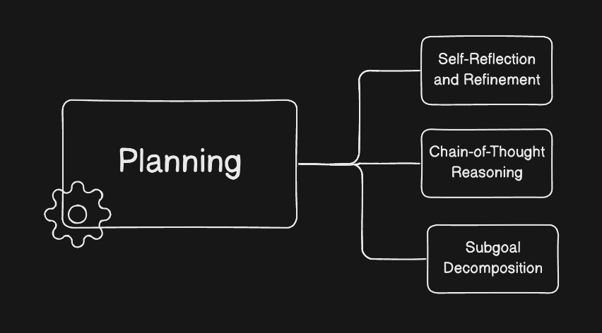
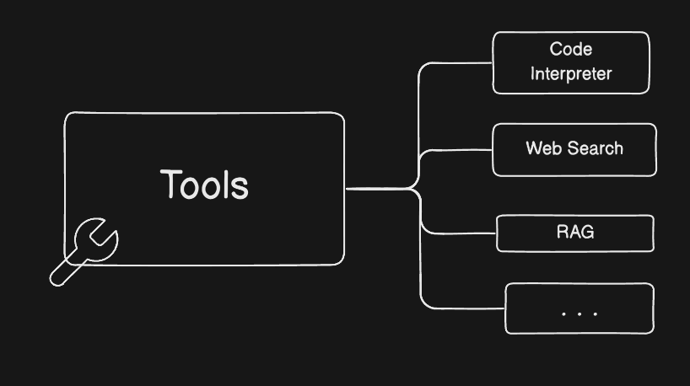
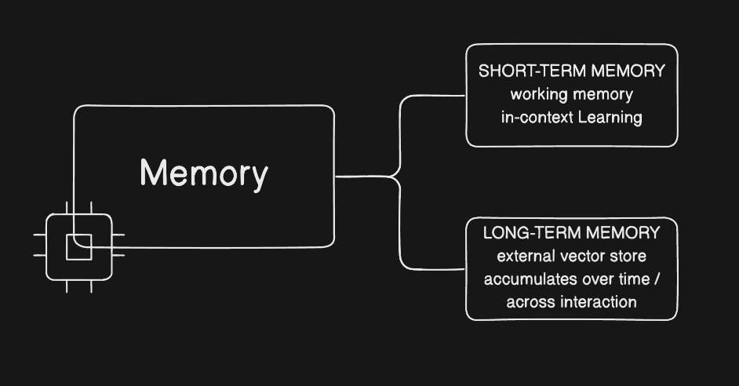
An agent adds reasoning, tools, and memory
Notes:
On its own an LLM only produces text. An agent wraps it with three capabilities: a reasoning system to plan and self-correct, tools to act on the world and read back results, and memory to carry information across steps. The next slides take each in turn.

Slide 6
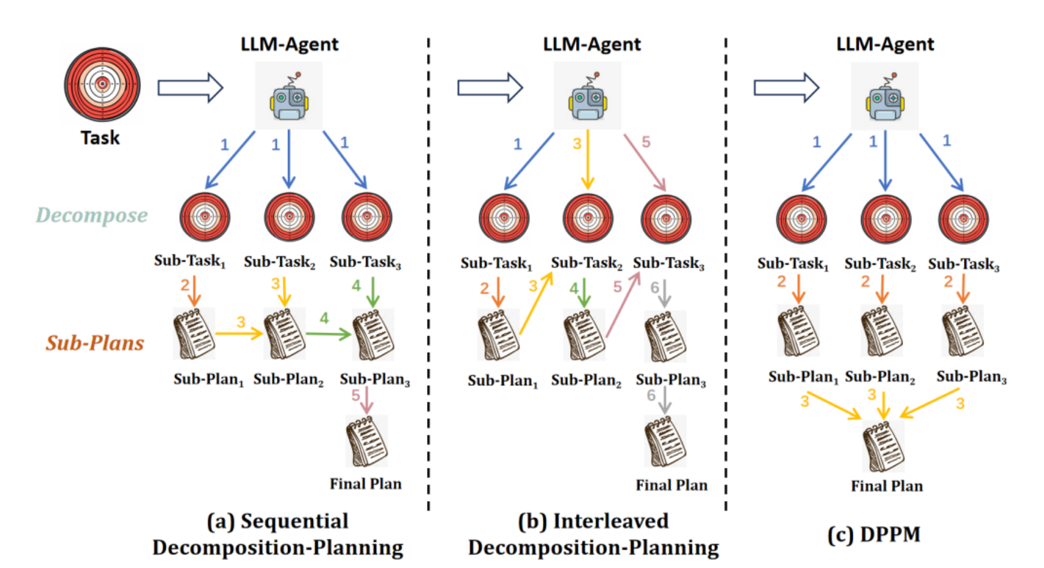
Reasoning: plan, reflect, and adjust
Image credits: de Lamo Castrillo et al., 2025"
Notes:
The reasoning system decomposes a task into subtasks, reflects on past actions, critically assesses progress, and adjusts the plan from feedback. Decomposition can happen up front, be interleaved with acting (CoT, ReAct), or be planned in parallel and merged (DPPM). Failure modes to watch: constraints across subtasks, errors carried forward, losing the main goal, weak cohesion. (Diagram: de Lamo Castrillo et al., 2025.)

Slide 7
Perception: act, then read the results
Notes:
The perception/action system is how the agent affects and senses the world: taking actions, deciding when and which tool to use, and folding tool results back into its context. It is the bridge between the model's reasoning and the tools we cover next.

Slide 8
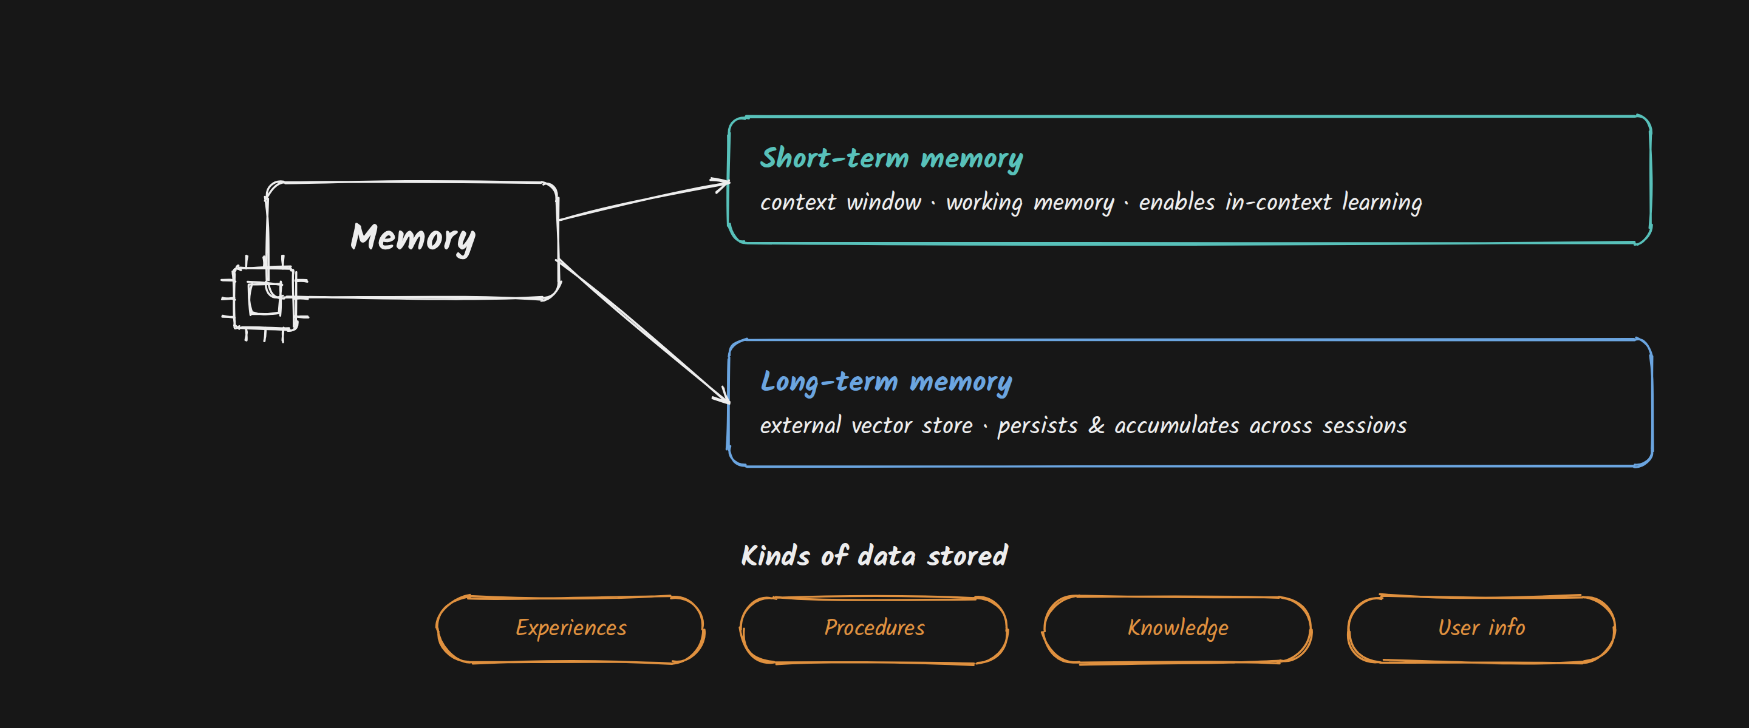
Two kinds of memory: short- and long-term
8
Ligorio - AI Agents
Notes:
Short-term memory is the context window — working memory that enables in-context learning within a session. Long-term memory lives in external stores such as a vector database that persist and accumulate across sessions. Agents store several kinds of data: experiences, reusable procedures, factual knowledge, and user information. We go deeper on managing context next lecture.

Slide 9
9
The ReAct Loop
Reasoning and acting, interleaved
Ligorio - AI Agents

Slide 10
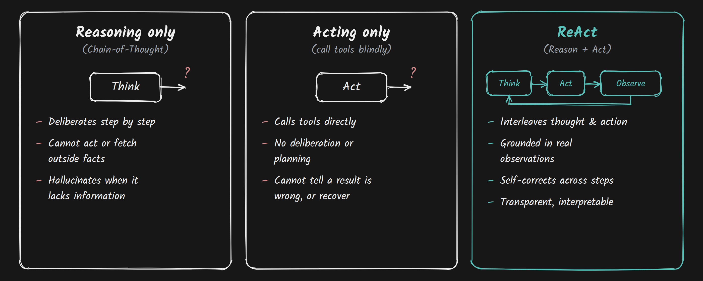
Reasoning and acting are stronger together
10
Ligorio - AI Agents
Notes:
Chain-of-thought reasons but can't act or fetch facts, so it hallucinates when it lacks information. Acting alone calls tools but can't deliberate or recover from a bad result. ReAct interleaves the two — think, act, observe, think again — which keeps the agent grounded in real observations, lets it self-correct, and makes its behavior interpretable.

Slide 11
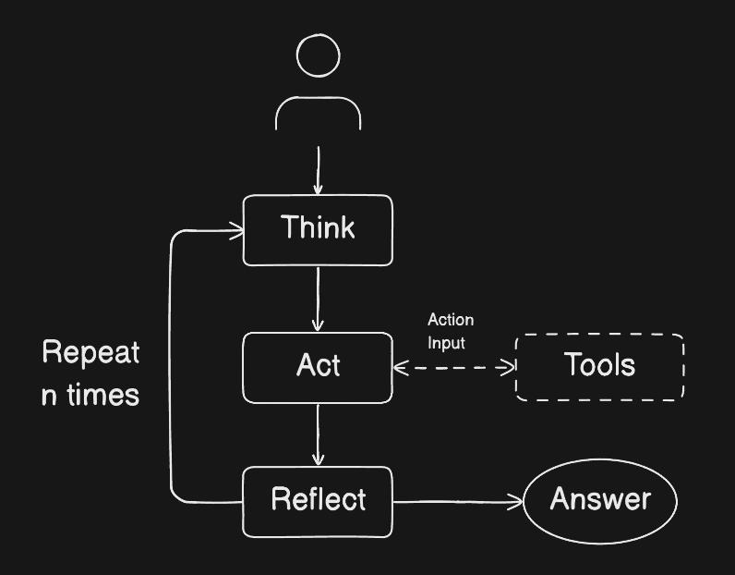
The loop: Think, Act, Observe, repeat
Notes:
ReAct (Yao et al., 2022) synergizes reasoning and acting. The agent loops: it thinks, optionally acts by calling a tool, observes the result, and reflects — repeating until it decides it has the answer. At each step the model decides whether and which tool to use. This loop is the core pattern the rest of the lecture builds on.

Slide 12
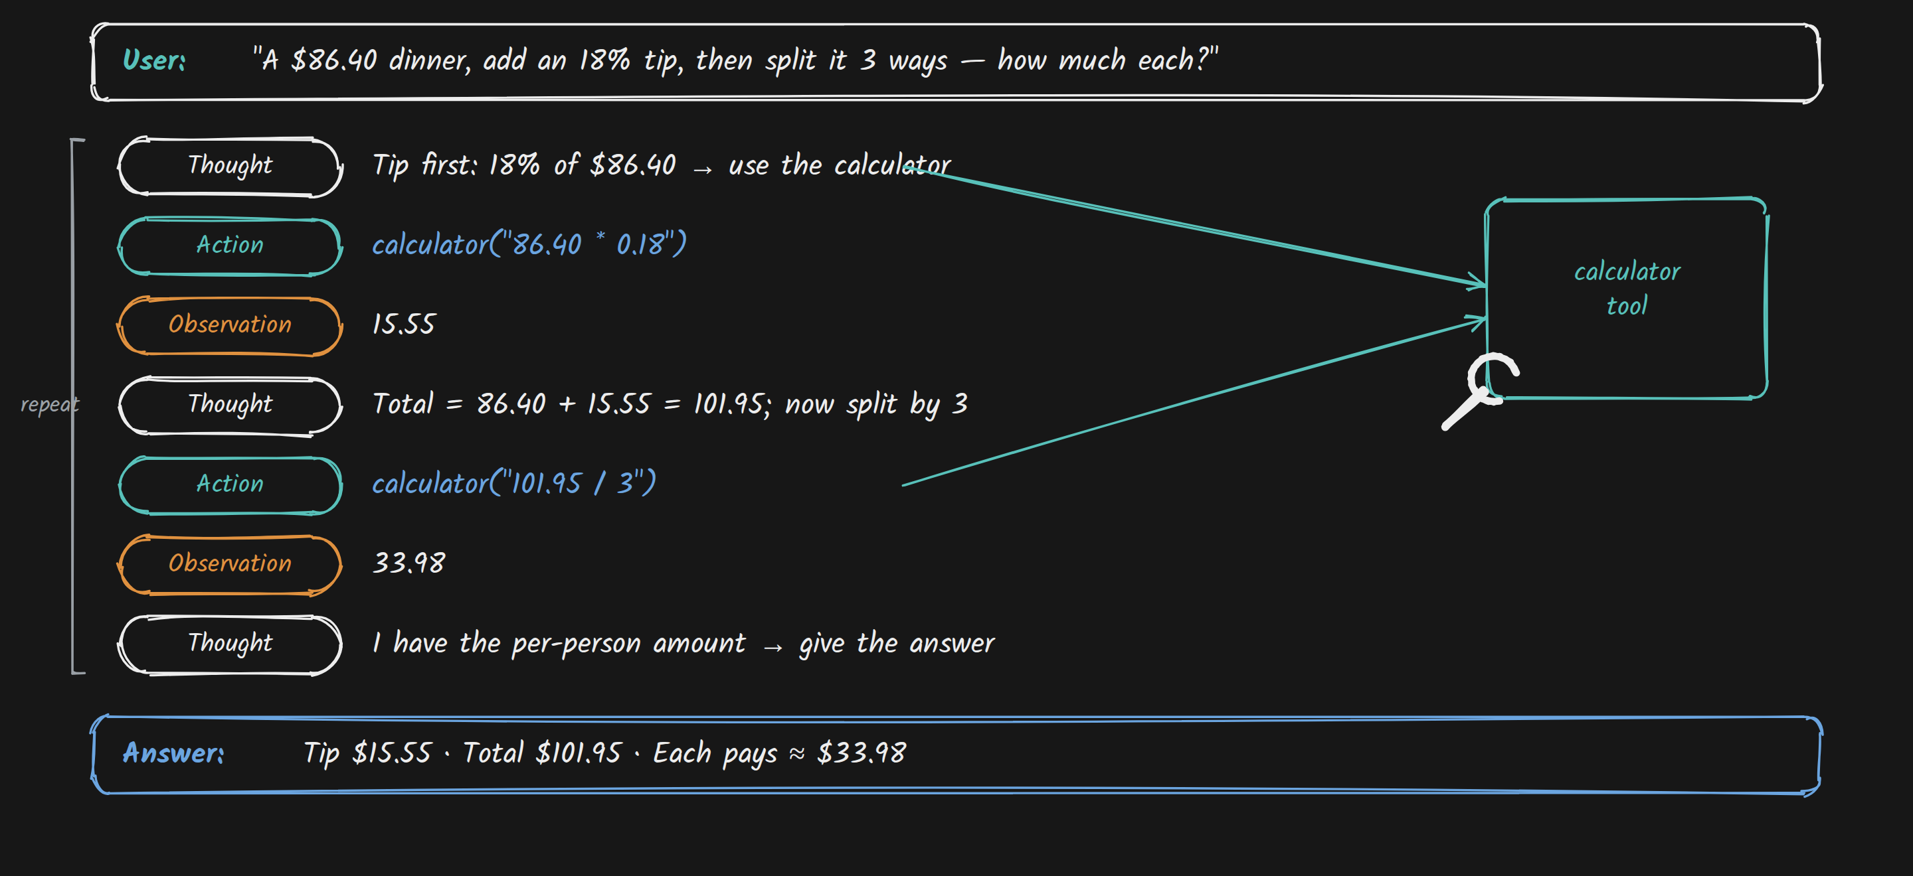
A ReAct run, one step at a time
12
Ligorio - AI Agents
Notes:
A concrete trace: the user asks for an 18% tip on $86.40 split three ways. The agent thinks (compute the tip), acts (calls the calculator), observes 15.55, thinks again (total, then divide), acts, observes 33.98, and answers. Each Action is a tool call; each Observation is the result fed back into the next Thought.

Slide 13
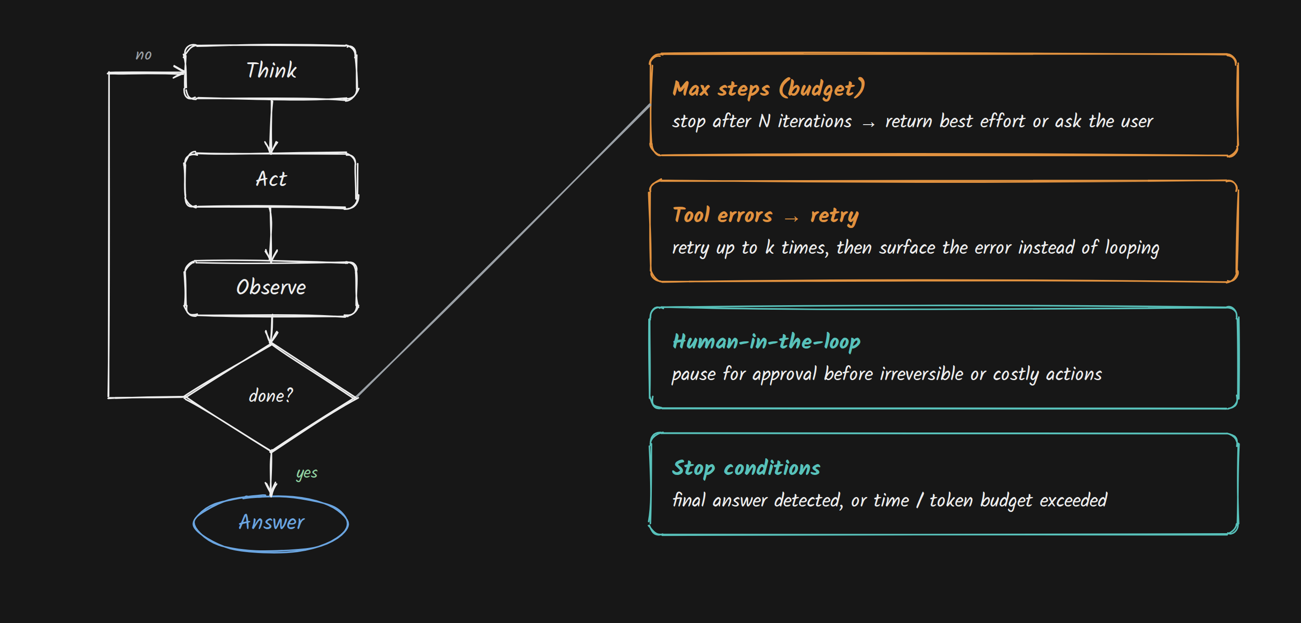
Guardrails keep the loop safe and bounded
13
Ligorio - AI Agents
Notes:
An open loop can run forever or take unsafe actions, so it needs explicit controls: a max-step or token budget so it stops and returns best effort or asks the user; retry-with-cap on tool errors instead of looping; human-in-the-loop approval before irreversible or costly actions; and clear stop conditions such as a detected final answer. This resolves the autonomy-vs-control tradeoff.

Slide 14
14
Tool Use
How an agent acts on the world
Ligorio - AI Agents

Slide 15
An agent acts by requesting a function call
Tool = function = action
different words for a capability the agent can invoke
The agent decides
if and when to call a tool, and requests the function call
Keep the set small
fewer, specialized tools -> more reliable selection
Tools are how the agent acts; the model chooses when to use them.
Notes:
Tools, functions, and actions are the same idea: capabilities the agent can invoke. Tool use is also called function calling. An agent may have several tools and decides, at each step, whether and which to call, emitting a function-call request. In practice keep each agent's tool set small and specialized — too many overlapping tools degrade selection.

Slide 16
The system message is the agent's policy
Tools & schemas
what the agent may call
When & how to call
rules, priority order, formatting (e.g. JSON-only)
Errors & stopping
retry rules and stop conditions
The system / developer message teaches the agent how to think and act.
Notes:
The system (or developer) message is the agent's policy — it teaches the model how to think and act. In practice it contains the tool list and schemas, rules and priority order for when and how to call tools, error-handling and retry rules, formatting constraints such as JSON-only, and stop conditions. Some setups split this across system vs developer messages, but the role is the same.

Slide 17
A tool is described as JSON
name
a stable identifier for the tool
description
what it does, and when to use it
parameters
a JSON schema for the arguments the model must build
The model reasons about the schema and constructs a valid call.
Notes:
Agent tools aren't invoked like ordinary Python functions — they're called via structured JSON the model must construct correctly. Each tool is described as a JSON object: a name, a short description of what it does and when to use it, and a parameters schema describing the exact shape of the argument object. The next slide shows the full anatomy of a call.

Slide 18
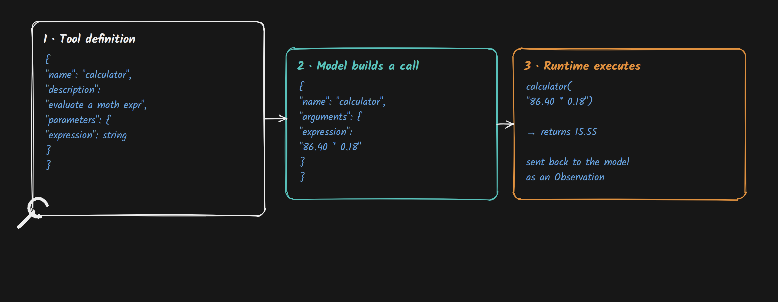
A tool call is JSON built from a schema
18
Ligorio - AI Agents
Notes:
Tools aren't called like Python functions — the model emits structured JSON. First the tool is defined by a schema (name, description, parameters). Then the model constructs a call matching that schema. Then the runtime executes the function and returns the result as an observation. The model's job is to produce valid JSON that matches the schema.

Slide 19
Example: a calculator tool, defined as JSON
TOOLS = {
"calculator": {
"description": "Evaluate a math expression "
"(basic arithmetic only).",
"function": calculator,
"parameters": {
"type": "object",
"properties": {
"expression": {"type": "string"}
},
"required": ["expression"],
},
},
}
Description + parameters are what the model reads to build the call.
Notes:
A concrete tool definition: a calculator whose description tells the model what it does and when to use it, a reference to the function that actually runs, and a parameters schema — an object with a required 'expression' string. This is the JSON structure from the previous slide, filled in.

Slide 20
Descriptions say when; parameters say how
Top-level object
what the tool is for, and when the model should use it
parameters
the exact argument object the model must construct
Write descriptions for the model to read — clarity drives correct tool use.
Notes:
The top-level tool object (its name and description) communicates what the tool is for and when it should be used — this is what steers the model's choice. The parameters field then defines the exact shape of the argument object the model must build: always an object, with typed properties and a required list. Good descriptions matter as much as the code behind the tool.

Slide 21
Code tutorial: building a ReAct agent
Live demo
Notes:
Live coding walkthrough: wiring the loop, defining the calculator tool, and watching the Think/Act/Observe steps run.

Slide 22
Three ways to give an agent tools
Custom tools
you write the functions; the agent calls them directly
Framework integrations
LangChain, LlamaIndex, ... ship ready-made wrappers
MCP
an open protocol so any client can use any server's tools
Same idea underneath: describe a tool, let the model decide when to call it.
Notes:
Three common ways to give an agent tools. Custom tools: you write your own functions and the agent calls them directly — most control, most maintenance. Framework integrations: LangChain, LlamaIndex and similar ship built-in wrappers you reuse. MCP (Model Context Protocol): an open standard that standardizes the connection so any MCP client can use any MCP server's tools. Underneath, all three are the same idea.

Slide 23
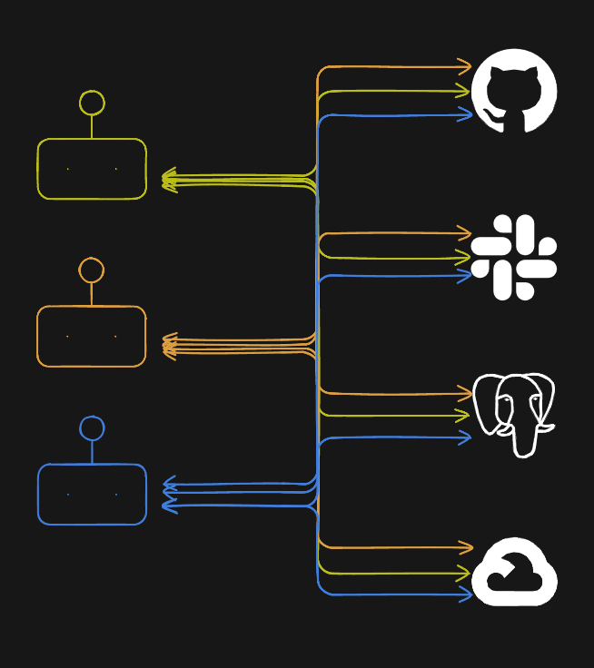
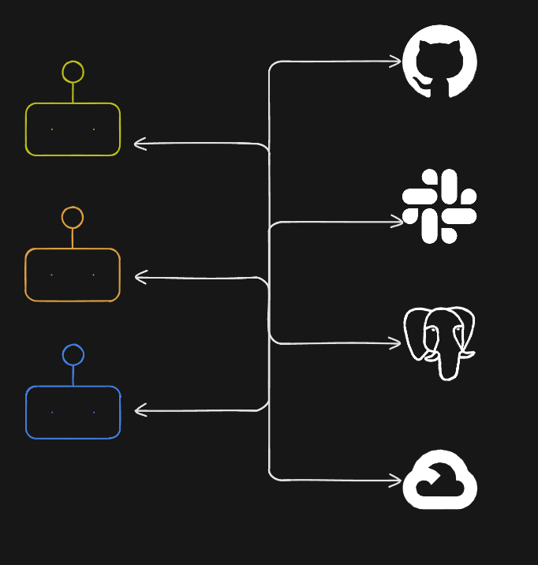
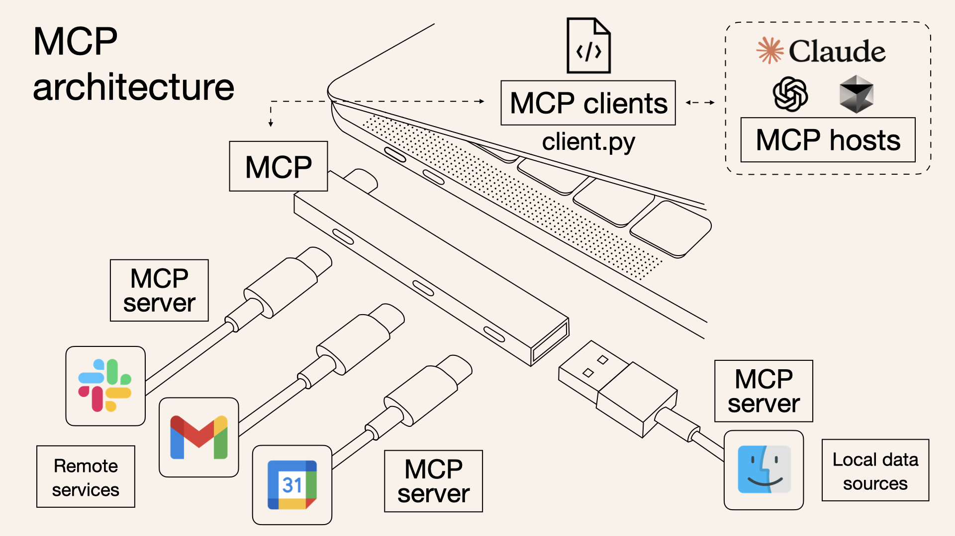
MCP is a shared standard for connecting tools
No standard
Clients
MCP servers
Source: Norah Sakal's Blog
Notes:
Before MCP, every agent needed custom wrappers to talk to each tool. MCP (Model Context Protocol, proposed by Anthropic in Nov 2024) is an open, widely adopted standard that standardizes that connection — like a USB port for tools: each tool exposes its capabilities the same way, so any client can use any server. (Diagram source: Norah Sakal's blog.)

Slide 24
MCP exposes tools, resources, and prompts
MCP client
the agent; one secure connection per server
MCP server
exposes a tool's capabilities through the protocol
A server can expose
tools (actions) · resources (data) · prompts (templates)
Where to find servers: official MCP registry · mcp.so · glama.ai/mcp · community servers
Notes:
MCP has two roles. The client is the agent, which opens a secure, one-to-one connection to each server. The server is a program that exposes a tool's capabilities through the standardized protocol. A server can expose three things: tools (actions the agent can perform), resources (files, documents, or query results it can load into context), and prompts (reusable templates). Servers are found via the official registry, directories like mcp.so and glama.ai, or the community.

Slide 25
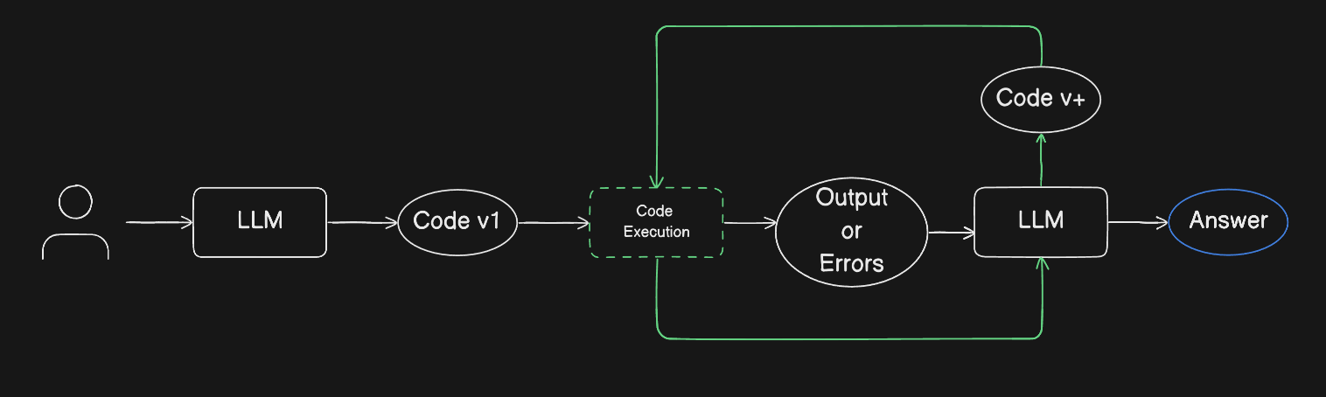
With code, an agent builds its own tools
Notes:
LLMs are increasingly strong at writing code, and code is a structured, well-defined action space that pre- and post-training heavily optimize. Giving an agent the ability to write and run code lets it extend itself, build its own tools, and run reflection loops — high autonomy and range, at the cost of control and predictability.

Slide 26
26
Planning
Deciding what to do, and in what order
Ligorio - AI Agents

Slide 27
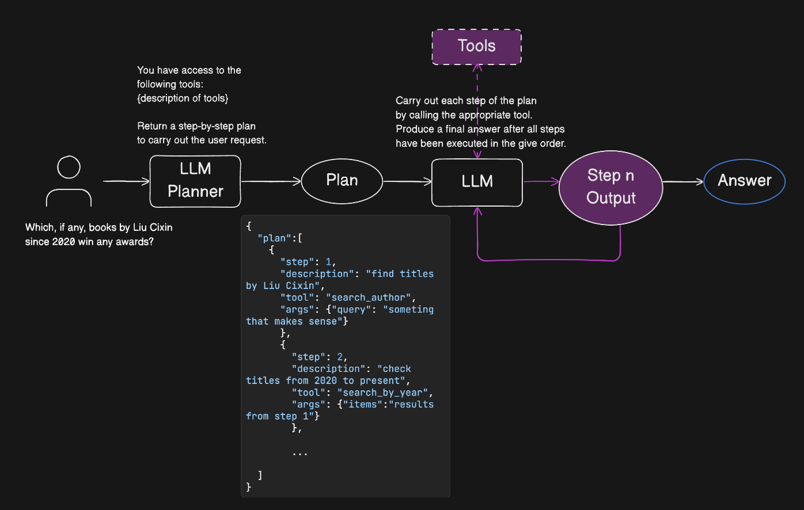
Plan first, then execute step by step
Notes:
One planning pattern: ask the LLM to break the problem into an ordered, actionable plan, then execute each step — often mapping each step to a tool call. The plan is produced up front; execution follows it.

Slide 28
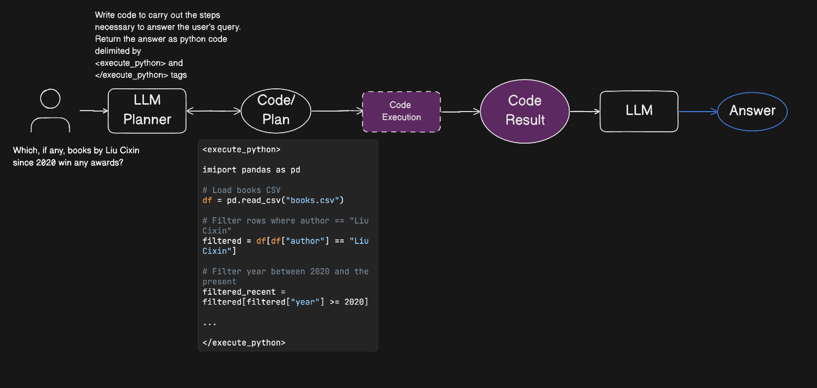
Code planning: more power, less control
Notes:
A variant: ask the LLM to write code that carries out the steps, then execute it. It works very well for coding agents but is less mature elsewhere. It gives high autonomy and expands what the agent can do, but lowers control — behavior is harder to predict and constrain.

Slide 29
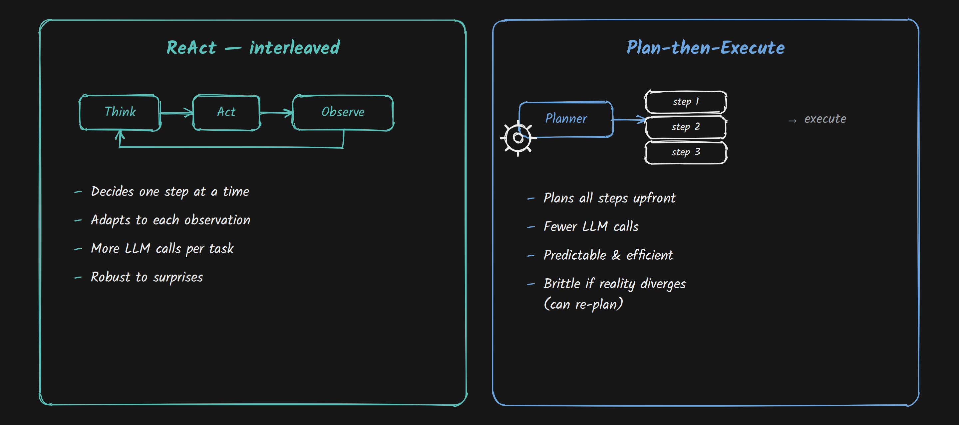
ReAct adapts; planning commits up front
29
Ligorio - AI Agents
Notes:
Two control patterns. ReAct interleaves: it decides one step at a time and adapts to each observation — robust to surprises, but more LLM calls. Plan-then-execute produces the whole plan first and runs it — fewer calls, more predictable and efficient, but brittle if reality diverges, though it can re-plan. Choose based on how uncertain the environment is.

Slide 30
30
Wrap-up & what's next
Where the agent loop leads
Ligorio - AI Agents

Slide 31
Wrap-up
31
The ReAct loop
Reason -> Act -> Observe, repeated until done
Tools
extend what an agent can do; defined & called as JSON (MCP standardizes it)
Planning
interleaved (ReAct) vs plan-then-execute
Guardrails
stopping conditions, retries, human-in-the-loop
Next
Context Engineering, then Multi-agent systems
Ligorio - AI Agents
Notes:
Recap of the agent loop and where it leads. The ReAct loop is Reason -> Act -> Observe until done. Tools extend the agent's reach and are defined and called as structured JSON, with MCP standardizing the connection. Planning ranges from interleaved (ReAct) to plan-then-execute. Guardrails keep the loop safe and bounded. Next we cover Context Engineering — managing what's in the context window — and then Multi-agent systems.

