Slide 1
CoinTrend AI
One Step Ahead Of The Market
AI-Powered Cryptocurrency Market
Analysis & Decision Support System
Maryem Tlili | Data Science & Machine Learning | 2026

Slide 2
What We Will Cover
01
02
03
04
Why CoinTrend ?
System Architecture
Data & EDA
ML Models
Which problem do we solve?
Big picture workflow
Sources, pipeline, insights
Experiments, models and evaluation
05
06
07
Performance Tracking system
RAG + Tavily + LLm + Chatbot
Live Demo
Monitoring, Drift detection and auto retraining
News retrieval and AI reasoning layer
Streamlit dashboard and chatbot walkthrough

Slide 3
Why Does the Crypto Market Need Intelligence?
O1
Cryptocurrencies are digital assets traded globally 24/7, with no central authority.
The crypto market exceeds 2 trillions in total value and attracts retail investors, institutions, and governments.
🌍 News and Macro Economy
😨 Market Sentiment
Interest rate cut ,inflation ,the strength of the US dollar , countries taxing strategies and wars
Fear driven selling or greed driven buying can amplify price swings.
📊 Technical Signals
Crypto moves in lo
⏰ Market Cycles
Price trends and momentum shifts that traders try to interpret.
Crypto moves in long bull and bear cycles. Strategies that work in one phase often fail in another.

Slide 4
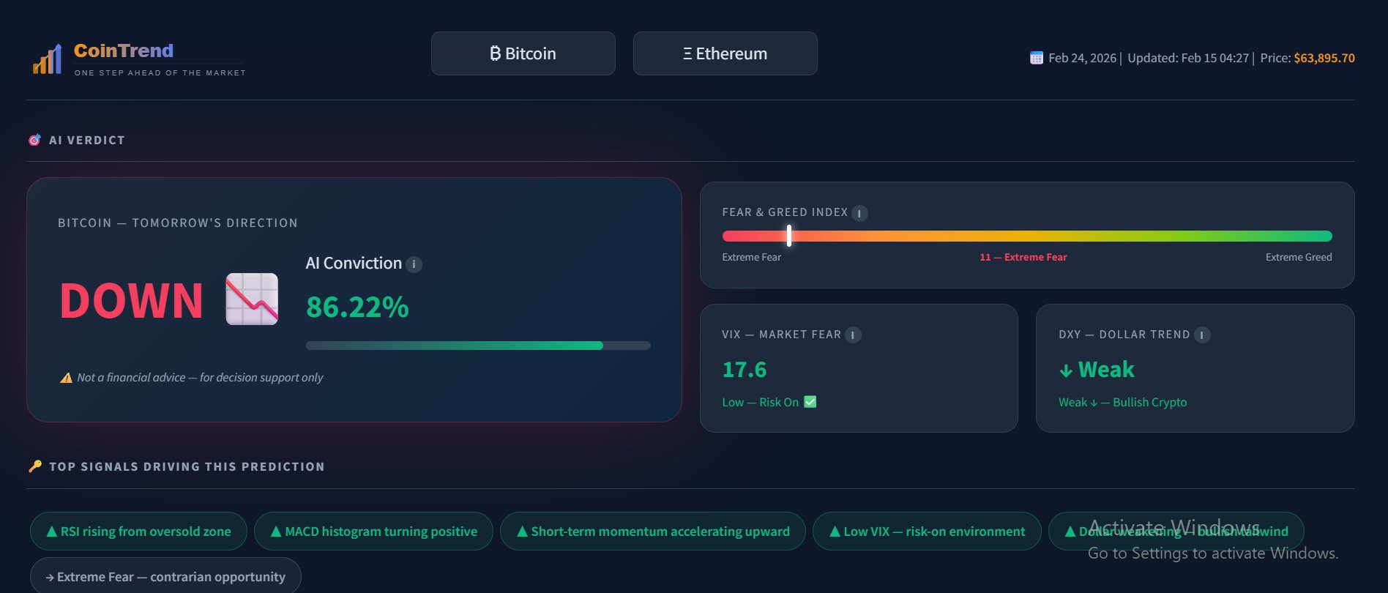
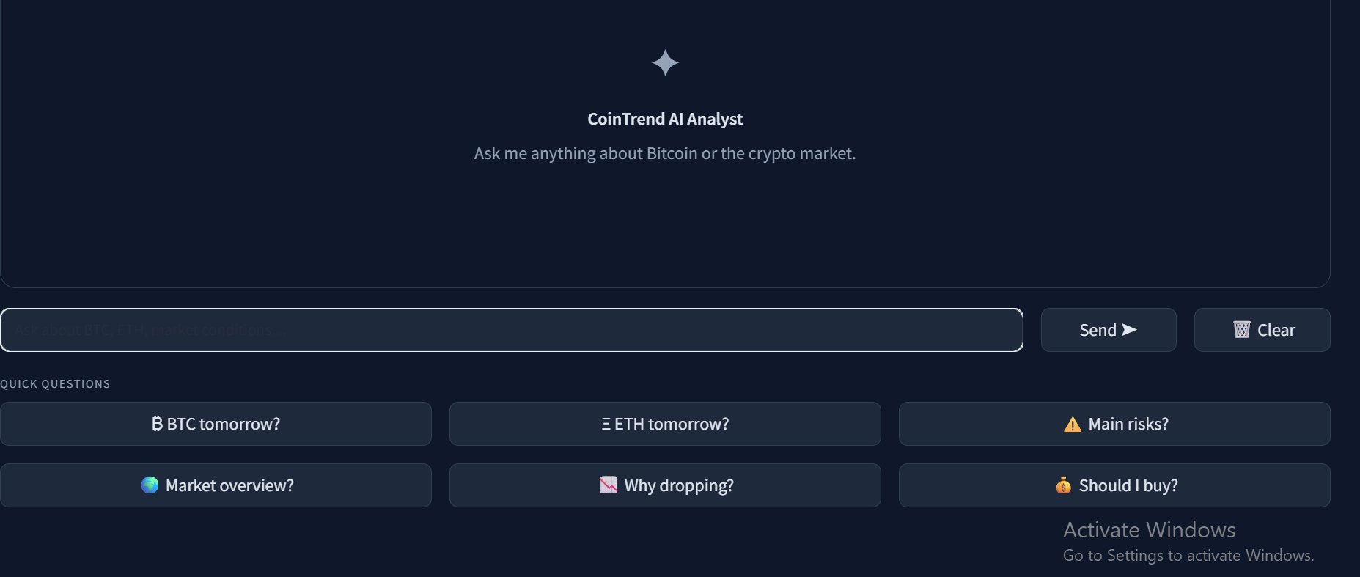
CoinTrend System Architecture
▶ ML PIPELINE
LIVE MARKET DATA
FEATURE ENGINEERING
ML MODELS
PREDICTION
DASHBOARD
STREAMLIT OUTPUT
📈 Crypto prices
😨 Fear & Greed
Global indicators
Source :yahoofinance / alt.me
Automated fetch daily at 00:30 AM
Structured signals Capturing trend, volatility & sentiment
Trained on 9 years historical regimes
Learning price direction patterns
Next day price direction: up/down
Live price prediction with Technical signals and charts
🌍
▶ RAG + LLM PIPELINE
📊 Dashboard — AI Verdict, Charts, Signals
TAVILY NEWS
RAG
LLM
AI CHATBOT
Answers any crypto question
Real-time crypto & macro headlines retrieval
Selecting the most impactful articles
ML + RAG
Analyses the full context and generates a structured, market report
🤖 AI Chatbot — Natural language market analysis

Slide 5
Raw Dataset
📦 DATASET AT A GLANCE
6,346
9
9 Years
2 Coins
Total rows
Raw columns
Date range
BTC + ETH
BTC + ETH combined
Price · Macro · Sentiment
Jan 2017 → Feb 2026
3,329 BTC · 3,017 ETH
🗂 RAW COLUMNS
📊 KEY STATISTICS
Column | What is it ?
timestamp | Date of observation
price | BTC or ETH closing price that day
volume | Total units traded that day
coin | BTC or ETH identifier
spy_return | US stock market daily return
dxy_return | US dollar daily return
vix / vix_change | Global fear level + daily change
fear_greed | Investor sentiment score (0 = panic · 100 = greed)
Price : highly skewed
$84 → $124,000 range · std of $28,604
VIX : fat tails
Mean 19 · peaked at 82 during COVID
Presence of outliers
Fear & Greed — healthy
Mean 47 · full range 5 → 95 used
Slightly fear-leaning on average
MISSING DATA
31%
SPY · DXY · VIX
7.7%
Fear & Greed
Why: No stock market data on weekends & holidays purely structural gap
Why: Index only starts in February 2018 nothing missing after that

Slide 6
Data Sources, Preprocessing and Feature Engineering
📦 DATA SOURCES
₿
yfinance — Prices
📈
yfinance — Macro
😨
alternative.me
📰
Tavily API
BTC & ETH daily OHLCV prices
Volume · History from 2017
Updated daily
SPY : US stock market
DXY : Dollar strength
VIX : Global fear index
Fear & Greed Index 0–100
0 = extreme panic
100 = extreme greed
Live crypto & macro news
Real-time retrieval
Used by chatbot pipeline
🔧 DATA PREPARATION
Normalize
Fill Missing Days
Compute Features
Transform to categorical
Cap outliers
Log transformation price and volume
Forward-fill gaps
21 signals
Fear and greed index
Vix extreme values capped to keep the model stable
📊 ENGINEERED FEATURES — 21 signals across 6 categories
Category | Features | What it tells the model ?
Trend | Price vs MA7 · MA30 · MA50 | Is price above or below its short, medium and long-term average?
Momentum | RSI 14 · MACD Histogram · Momentum Acceleration | Is the market overbought? Is buying pressure rising or fading?
Volatility | Volatility 7d · 21d · Bollinger Width · Bollinger %B | How wildly is the price moving, and where is it within its range?
Macro | SPY · DXY · VIX (returns, averages & regimes) | Is the global market rising, the dollar strengthening, fear spiking?
Sentiment | Fear & Greed · Lag1 · Lag7 | What is the investor mood today, yesterday and last week?
Regime | Bull/Bear Flag · Volatility Regime | Is the market in an uptrend/downtrend, and is volatility above or bellow normal?

Slide 7
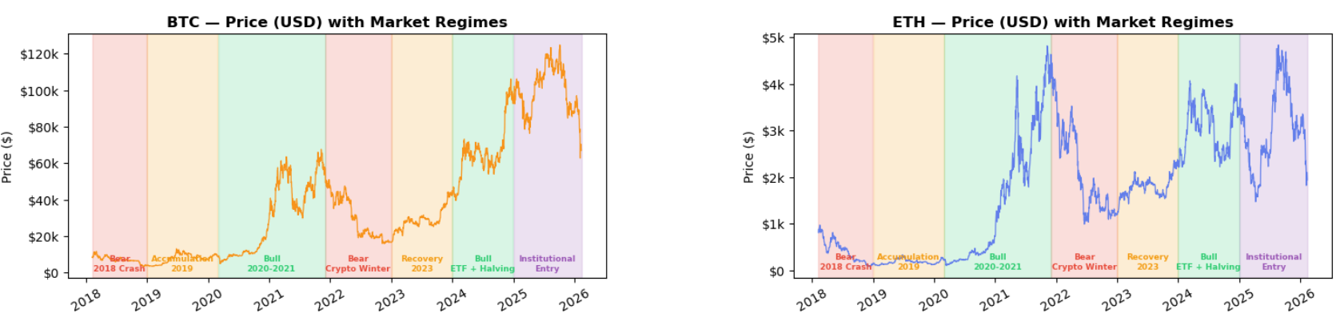
EDA : Why Markets Can't Be Modeled With a Simple Split ?
⚠️ Volatility is not uniform
🔁 Distinct market regimes
📈 Price is not stationary
Bear markets produce larger negative spikes.
Bull runs cluster upward moves.
The market structure shifts not just the price level.
Bear crashes, recovery periods, bull runs and institutional phases each behave differently.
A model trained on one regime is essentially blind to the next.
BTC moved from $3k to $124k across 8 years each regime has completely different price levels, trends and volatility.
💡 A random 80/20 split would mix these regimes leaking future information into training. We need a chronological split.
💡 Add regime flags features (bull/bear + volatility regime)
💡 Predict up and down tomorrow’s price trend rather than tomorrow’s exact price

Slide 8
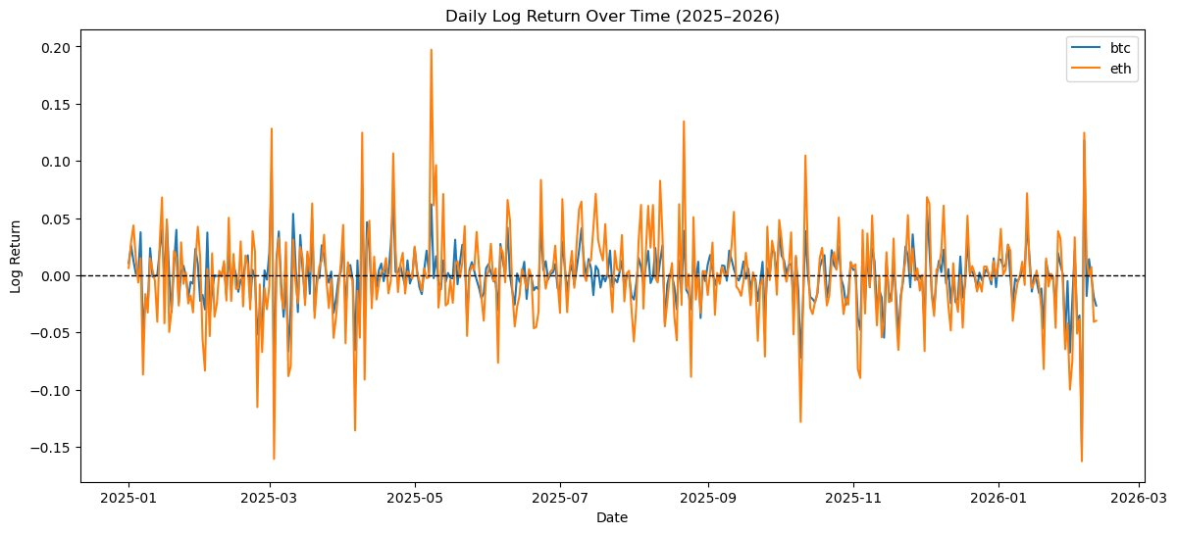
EDA :Daily Log Returns_ ETH vs BTC Volatility
Ξ ETH is more volatile than BTC
📊 Rolling volatility captures regime shifts
ETH daily swings regularly reach ±10–15% while BTC stays in a tighter range. They share the same trend direction but ETH amplifies every move.
Short windows (7d) catch sudden spikes. Longer windows (21d) smooth the noise and reveal the underlying risk trend. Both together give the model a richer picture.
💡 Separate models for BTC and ETH
💡 Include short/long-term volatility features

Slide 9
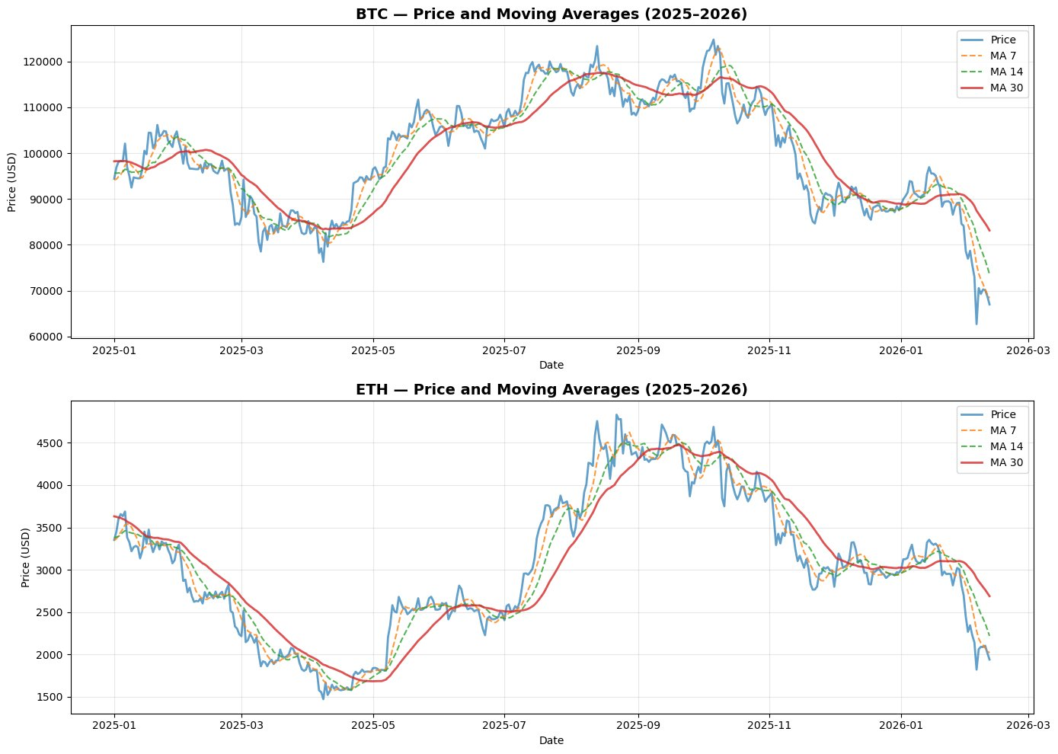
EDA: Price & Moving Averages
Trend direction
MA30 (long-term) → Smoothest, shows overall trend direction
MA14 (medium-term) → Less smooth, reacts faster to changes
MA7 (short-term) → Captures short-term volatility and price swings
Price Position Relative to MAs
Above all MAs → Strong uptrend, bullish momentum
Below all MAs → Strong downtrend, bearish momentum
Between MAs → Transition/consolidation phase, uncertainty
Crossovers
MA7 crosses above MA30 → Bullish signal (uptrend starting)
MA7 crosses below MA30 → Bearish signal (downtrend starting)
Support/Resistance Levels
Support during uptrends (price bounces off MA30)
Resistance during downtrends (price struggles to cross above MA30)
💡 Include moving average features

Slide 10
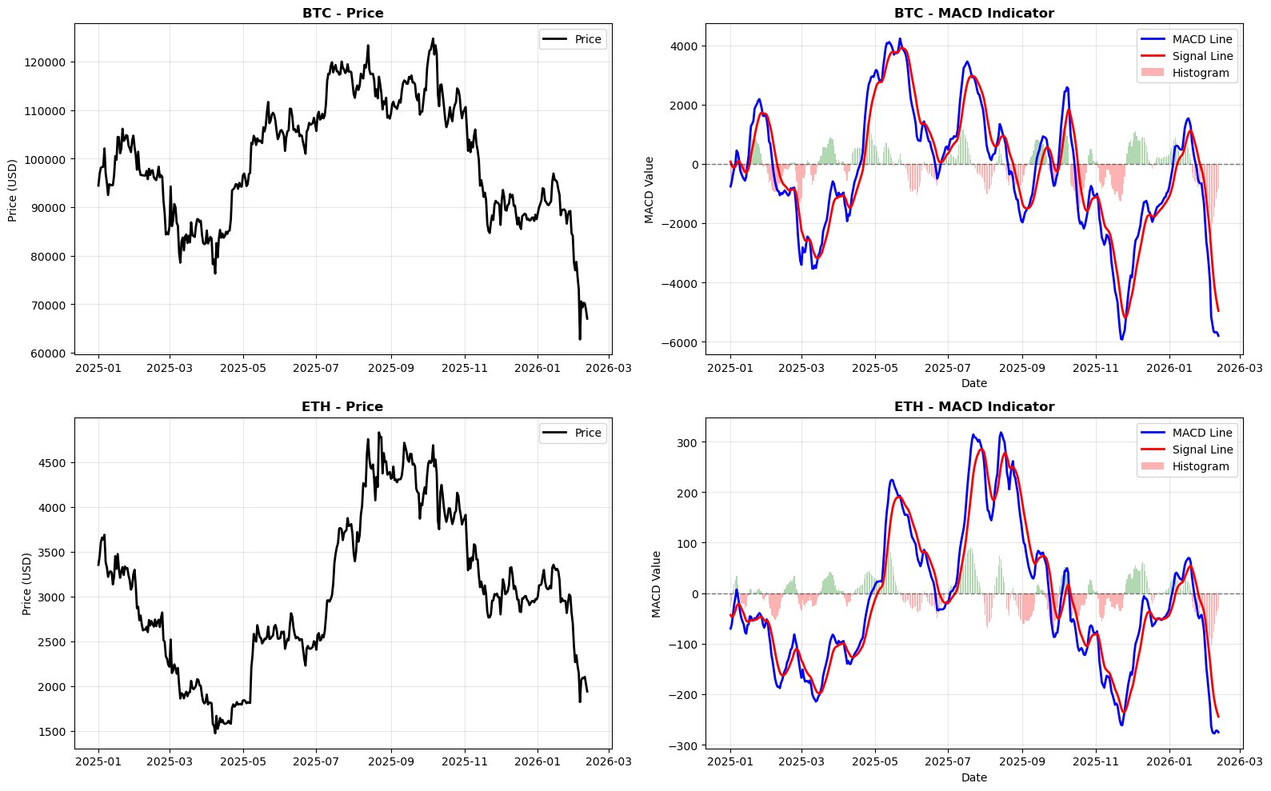
EDA :MACD A Leading Momentum Indicator
What is MACD and signal line?
MACD = measures whether the price movement is accelerating or decelerating
Signal line = smoothed average of the MACD over 9 days
Crossovers predict direction
Blue ( MACD) crosses above red (Signal Line) → Price tends to go up
Blue ( MACD) crosses below red (Signal Line) → Price tends to go down
Histogram = momentum strength
Green bars getting taller → buying pressure increasing
Peak green bar → Maximum bullish momentum → Reversal down coming soon.
Red bars getting taller→ selling pressure increasing
Peak red bar → Maximum bearish momentum → Reversal up coming soon.
Why it's a strong model feature
MACD histogram captures momentum shifts before they appear in price. It's a leading indicator exactly what a prediction model needs.
💡 Include MACD_histogram features

Slide 11
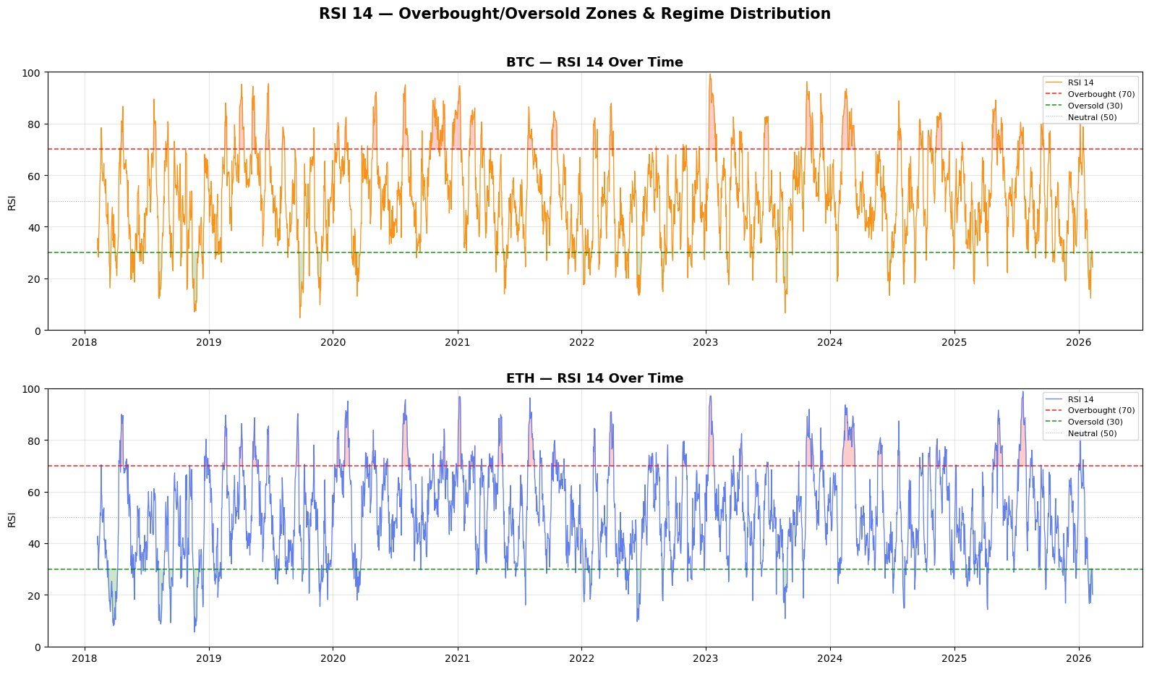
EDA: RSI 14, Is the Market Overbought or Oversold?
What is RSI?
RSI measures how fast and how much price has moved in recent days, on a scale of 0 to 100. It tells the model whether the market is exhausted from buying or selling.
Overbought & oversold zones
Above 70 → market is overbought, pullback likely.
Below 30 → market is oversold, bounce likely.
Around 50 → neutral.
RSI behavior differs by regime
Bull markets keep RSI above 50
Bear markets pin RSI below 50
RSI alone is not enough
An RSI of 60 means something very different in a bull market vs a bear market. The signal is regime-dependent which is exactly why bull_bear_flag and volatility_regime are critical context features for the model.
💡Include RSI features combined with bull_bear_flag & volatility_regime to give the model regime context

Slide 12
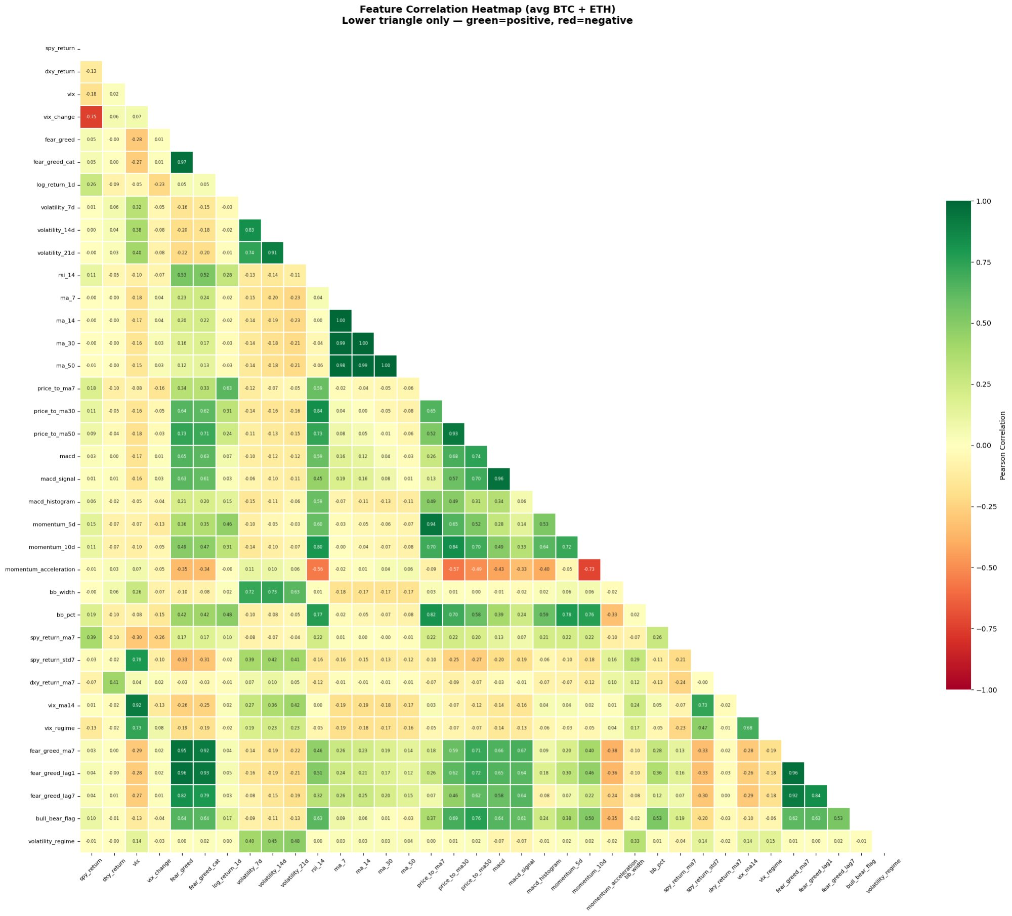
EDA: Feature Correlation & Selection
📋 FEATURE SELECTION DECISIONS
Group | ✅ Keep | ❌ Drop
Trend | price_to_ma7 · ma30 · ma50 | ma_7, ma_14, ma_30, ma_50
Momentum | rsi_14 · macd_histogram · momentum_acc | macd, macd_signal, momentum_5d/10d
Volatility | vol_7d · vol_21d · bb_width · bb_pct | volatility_14d
Macro | spy_ret · spy_ma7 · spy_std7 · dxy_ma7 · vix_ma14 · vix_regime | vix, vix_change, dxy_return
Sentiment | fg_ma7 · fg_lag1 · fg_lag7 | fear_greed, fear_greed_cat
Regime | bull_bear_flag · volatility_regime | —
💡 35 raw candidates → 21 final features , each capturing a distinct, non-redundant dimension of market behavior

Slide 13
Split Strategy : How We Divide Time?
EXP 1
Model: Random Forest (fixed)
Model | Val Acc | Val MCC | Test Acc | Test MCC | Test AUC | Gap | ✓
S2 Regime-Aware | 69% | 0.38 | 72% | 0.45 | 0.80 | 0.06 | ✅
S1 Fixed Chrono | 68% | 0.35 | 71.3% | 0.42 | 0.79 | 0.07 | ✅
S3 Walk-Forward | 69% | 0.36 | — | — | — | — | —
Features: 21 (fixed)
S1 — Fixed Chronological
Train 2018→2022
Val 2023
Test 2024→2026
Strict time order
↕ VARIABLE: Split type
S1 — Fixed Chronological
S3 — Rolling window
Rolling windows:
Train [2018→2021] → Val [2022]
Train [2018→2022] → Val [2023]
S2 — Regime-Aware ✓
S3 — Walk-Forward CV
S2 — Regime-Aware ✓ WINNER
Train → 2018 to 2022 (bear + accumulation + bull + crash)
Val → 2023 to 2024 (recovery + bull 2024)
Test → 2025 to 2026 (institutional , completely unseen regime)
- We already have flag regime features this helps the model know which regime it is
★ S2 Regime-Aware Split
Best Accuracy : 72%

Slide 14
Model Selection : Which Algorithm Wins?
EXP 2
Split: S2 Regime-Aware (fixed)
Model | Val Acc | Val MCC | Test Acc | Test MCC | Test AUC | Gap | ✓
Logistic Regression | 69% | 0.38 | 70% | 0.39 | 0.77 | 0.01 | ✅
Random Forest | 69% | 0.38 | 72% | 0.45 | 0.80 | 0.06 | ✅
Gradient Boosting | 69% | 0.38 | 71% | 0.43 | 0.79 | 0.24 | ⚠️
LightGBM | 67% | 0.36 | 70% | 0.42 | 0.77 | 0.25 | ⚠️
XGBoost | 70% | 0.40 | 71% | 0.43 | 0.80 | 0.12 | ⚠️
Features: 21 (fixed)
Random Forest ✓ WINNER
Depth=10, min_leaf=20, sqrt features, 200 estimators
RF dominates out of the box best test MCC, best AUC, clean gap.
GB/XGB/LightGBM overfit at default settings (gap > 0.10), this is a tuning problem, not an elimination reason.
Logistic Regression is a stable but limited baseline its low gap (0.02) signals underfitting, not good generalization.
Decision → test an ensemble
↕ VARIABLE: Algorithm
LightGBM
Gardien Boosting ✓
XGBoost
Logistic Regression
Random Forest
★ S2 Regime-Aware Split
★ Random Forest
Best Accuracy : 72%

Slide 15
Optuna Tuning : Fix the Overfitting
EXP 3
Split: S2 Regime-Aware (fixed)
Model | Val Acc | Val MCC | Test Acc | Test MCC | Test AUC | Gap | ✓
RF Tuned | 70% | 0.40 | 72.7% | 0.45 | 0.80 | 0.06 | ✅
GB Tuned | 71% | 0.43 | 73.7% | 0.47 | 0.81 | 0.06 | ✅
XGB Tuned | 71% | 0.43 | 72.7% | 0.45 | 0.81 | 0.05 | ✅
Models: RF + GB + XGB (fixed)
GB Best Params ✓ WINNER
'n_estimators': 155, 'max_depth': 9, 'min_samples_leaf': 16, 'max_features': 'sqrt‘
Tuning fixes overfitting in GB and XGB completely
all 3 models now land at gap ≈ 0.06.
GB overtakes RF after tuning (+0.030 MCC vs untuned).
All 3 converge very closely GB edges ahead on every metric.
Decision → GB selected as the base model so far
↕ VARIABLE: Hyperparameters
RF Tuned
GB Tuned ✓
XGB Tuned
★ S2 Regime-Aware Split
★ Gradient Boosting Tuned
Best Accuracy : 73.7%

Slide 16
LSTM : Does the DL beat the ML ?
EXP 4
Split: S2 Regime-Aware BTC + ETH (6,346 rows)
Model | Val Acc | Val MCC | Test Acc | Test MCC | Test AUC | Gap | ✓
LSTM | 51% | 0.45 | 51% | 0.03 | 0.52 | 0.01 | ✅
LSTM (Long short term memory ) eliminated due to insufficient data
Classical ML (GB) significantly outperforms LSTM
Deep learning requires more data than 6300 combined rows
Decisison → create lagged features for our simple Ml model to give it a memory capacity
↕ VARIABLE: LSTM
2 Stacked LSTM Layers (64/32)
Dropout (0.3) X2
Batch Normalization X2
Dense Layer (16 units, ReLU)
Output Layer / activation="sigmoid"
★ S2 Regime-Aware Split
★ Gradient Boosting Tuned
Best Accuracy : 73,7%

Slide 17
EXP 5
Lagged Features : Does History Predict Tomorrow?
Split: S2 Regime-Aware (fixed)
Model | Val Acc | Val MCC | Test Acc | Test MCC | Test AUC | Gap | ✓
GB Baseline 21 feat | 71.5% | 0.43 | 73.7% | 0.47 | 0.81 | 0.06 | ✅
GB + Lags 36 feat | 73.7% | 0.47 | 78.8% | 0.58 | 0.87 | 0.08 | ✅
Model: GB Optuna Tuned (fixed)
GB + Lags ✓ WINNER
LAGGED FEATURES = ["rsi_14", "macd", "volume", "volatility_21d", "price"]
LAG DAYS = [1, 2, 3]
TOTAL NEW FEATURES : 15
This is the single biggest performance jump of the entire project +5.2% accuracy and +0.104 MCC.
Adding yesterday's RSI, price, MACD and volume tells GB how the signal was moving, not just where it stands today.
Gap increases slightly (0.06 → 0.08) but stays well within the 0.10 threshold.
↕ VARIABLE: Feature set
Baseline: 21 features
Lagged: 36 features ✓
★ S2 Regime-Aware Split
★ Gradient Boosting Tuned
★ Lags (36 features)
Best Accuracy : 78.8%

Slide 18
SHAP Feature Selection : Less Is More
EXP 6
Split: S2 Regime-Aware (fixed)
Model | Val Acc | Val MCC | Test Acc | Test MCC | Test AUC | Gap | ✓
Top 10 SHAP | 74% | 0.48 | 78.8% | 0.58 | 0.87 | 0.06 | ✅
Top 15 SHAP | 74% | 0.48 | 78.6% | 0.58 | 0.87 | 0.08 | ✅
Top 20 SHAP | 73% | 0.46 | 80.1% | 0.60 | 0.87 | 0.08 | ✅
Top 25 SHAP | 73.1% | 0.46 | 79% | 0.58 | 0.87 | 0.08 | ✅
Top 30 SHAP | 73.7% | 0.47 | 78% | 0.58 | 0.87 | 0.08 | ✅
Top 20 SHAP ✓ WINNER
Model: GB Optuna Tuned (fixed)
Top 20 wins test MCC decisively (+0.024 over full 36) and crosses 80% accuracy for the first time.
Removing 16 noisy features gives GB a cleaner decision surface.
Note that val and test rankings are inverted (Top 10 wins val, Top 20 wins test)
Reminder : validation set ≠ test set in regime-shift scenarios.
RSI appears 4 times in the top 20 (rsi_14, lag1, lag2, lag3)
GB has learned that the 3-day RSI trajectory is the core predictive signal for BTC.
Decision → Top 20 SHAP features locked as FEATURES_FINAL.
↕ VARIABLE: Feature count (SHAP)
Top 10
Top 20 SHAP ✓
Top 15
Top 25
Top 30
★ S2 Regime-Aware Split
★ Gradient Boosting Tuned
★ Top 20 SHAP
Best Accuracy : 80,1%

Slide 19
Calibration Test : Are Probabilities Trustworthy?
EXP 7
Split: S2 Regime-Aware (fixed)
Model | Val Acc | Val MCC | Test Acc | Test MCC | Test AUC | Gap | ✓
GB Sigmoid | 73.2% | 0.45 | 78% | 0.58 | 0.87 | 0.09 | ✅
GB Isotonic | 73.8% | 0.46 | 78% | 0.57 | 0.86 | 0.09 | ✅
Calibration consistently hurts .
raw GB outperforms both methods on MCC and accuracy
Features: Top 20 SHAP (fixed)
Model: GB Optuna Tuned (fixed)
↕ VARIABLE: Calibration method
Sigmoid
Isotonic
★ S2 Regime-Aware Split
★ Gradient Boosting Tuned
★ Top 20 SHAP
Best Accuracy : 80,1%

Slide 20
Ensemble Test : Does Combining Beat the Best?
EXP 8
Split: S2 Regime-Aware (fixed)
Model | Val Acc | Val MCC | Test Acc | Test MCC | Test AUC | Gap | ✓
Soft Voting | 73% | 0.45 | 78% | 0.590 | 0.871 | 0.09 | ✅
Hard voting | 73% | 0.46 | 78% | 0.57 | _ | 0.09 | ✅
Stacking voting | 74% | 0.48 | 77% | 0.55 | 0.87 | 0.09 | ✅
Features: Top 20 SHAP (fixed)
Ensembles slightly underperform the
GB individual SHAP 20 model
Decision : we save the GB SHAP 20 as final BTC model
↕ VARIABLE: Ensemble method
RF+GB+XGB (Soft)
RF+GB+XGB (Hard)
RF+GB+XGB (Stacking)
★ S2 Regime-Aware Split
★ Gradient Boosting Tuned
★ Top 20 SHAP
Best Accuracy : 80,1%

Slide 21
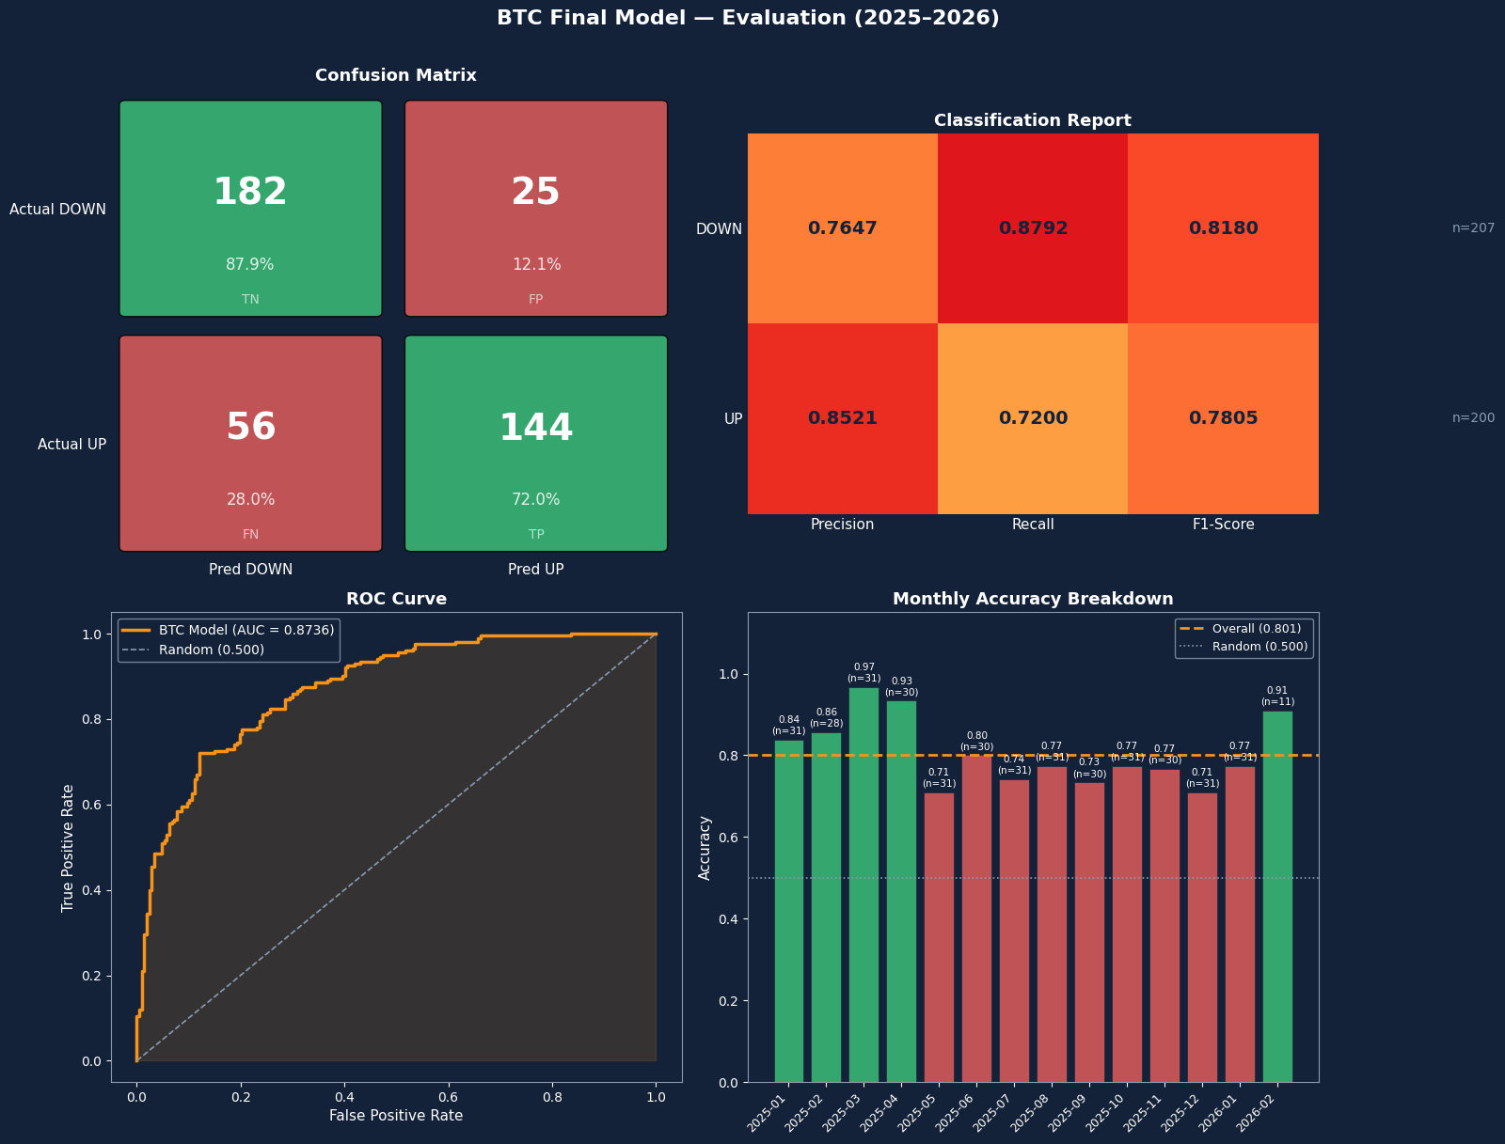
Evaluation
Detects DOWN days more reliably (87.9% recall)
More precise when calling UP (85.2% precision)
Only 5/14 months beat the average 80% , meaning performance is right-skewed a few very strong months pull the average up, while the majority cluster slightly below.
The 25.8pp spread between best and worst month is significant, This points to regime sensitivity:
The model performs differently depending on market conditions.
The 71% floor in May 2025 is still well above random, confirming robustness even in its worst period.

Slide 22
Benchmark Positioning : Where We Stand in Literature
Study | Authors | Year | Model | Horizon | Accuracy | # Feat. | Data Type | Source
Omole & Enke | A. Omole & D. Enke | 2024 | CNN-LSTM + Boruta | Daily | 82.44% | 87 | Blockchain + Price | Financial Innovation (Springer)
ScienceDirect Study | Elsevier Research Team | 2025 | SVM (best) | Daily | 83% | 225 | Blockchain + TA | Engineering App. AI (Elsevier)
Bianchi et al. | Bianchi et al. | 2022 | Random Forest | 5-day | 75–80% | 50 | Macro + Technical | J. Risk & Fin. Management
Jaquart et al. | Jaquart et al. | 2021 | GB / RNN | 1–60 min | 70% | 50 | TA + Chain + Sentiment | Electronic Markets
★ Our Model | Maryem.T | 2026 | GB + SHAP | Daily | 80.1% | 20 | TA + Macro + Sentiment
Our model is placed in the top tier of published daily BTC direction models.
Accuracy within 2–3% of the best deep learning models
Uses far fewer features (20 vs 87–225)
Do not rely on on-chain data

Slide 23
ETH testing journey
Exp | Experiment | Winner Configuration | Val Acc | Val MCC | Test Acc | Test MCC | AUC | Gap | Decision
1 | Split Strategy S1 / S2 / S3 — RF fixed | S2 Regime-Aware ✓ | 68.9% | 0.39 | 68.8% | 0.38 | 0.79 | 0.08 | S2 adopted → captures bull/bear regimes better
2 | Model Selection LR / RF / XGB / LGBM / GB | GB best untuned ✓ | 69% | 0.40 | 71% | 0.386 | 0.79 | 0.23 | GB overfits (gap 0.24) → sent to Optuna EXP 3
3 | Optuna Tuning 500 trials · gap penalty > 0.10 | GB Optuna Tuned ✓ | 71% | 0.45 | 70% | 0.410 | 0.79 | 0.05 | Gap fixed 0.24→0.06 · GB adopted
4 | Lagged Features 21 → 36 features · 3-day window | GB + Lags 36 feat ✓ | 75.2% | 0.50 | 73% | 0.47 | 0.8 | 0.07 | +0.068 MCC · best single gain
5 | SHAP Selection 36 feat → top N filter | Top 20 SHAP ✓ | 74.7% | 0.49 | 73.5% | 0.47 | 0.82 | 0.08 | Top 20 balances MCC + AUC + gap
★ | FINAL ETH MODEL GB + SHAP 20 feat · EXP3 params | GB + SHAP Top 20 ✓ | 74.7% | 0.497 | 73.5% | 0.47 | 0.82 | 0.08 | Saved
ETH is systematically harder to predict.
The performance gap is consistent across every experiment and every metric.
ETH's richer on-chain ecosystem (DeFi, gas, staking narratives) introduces noise that TA + macro + sentiment features don't fully capture.

Slide 24
Performance Tracking & ML Auto-Retrain
📡
🤖
📊
🔄
DAILY FETCH
PREDICT & STORE
EVALUATE ACCURACY
AUTO-RETRAIN
00:30 AM every day
ML model runs
vs yesterday's outcome
triggered if accuracy below 52%
BTC + ETH live prices
Generates price direction
Compute rolling accuracy: last 30 days
Downloads fresh market data
Macro signals + sentiment
Confidence and prediction stored
Alert if drops below 52%
Retrain the model
Compares new vs old model
Replaces the model only if the new model performs is better
💾 stored in : raw_prices
💾 stored in : predictions
💾 stored in : errors
💾 stored in : retraining_log
🔁 Daily Cycle — Pipeline runs automatically every day at 00:30 AM

Slide 25
RAG + LLM + Chatbot — Pipeline Overview
👤 UX VIEW — what the user experiences
🤖
👤
📊
USER
CHATBOT ORCHESTRATOR
ANALYSIS
natural language question
Detect • Route • Orchestrate • Maintain History
structured market analysis
——— internally triggers ———
⚙️ INTERNAL PIPELINE — what really happens behind the scenes
🔍
📰
🧩
🧠
Intent
Detection
Data
Layer
Context
Builder
LLM
Engine
LLM (LLaMA 3.3 70B)
REGEX
ML Models
Live Features
RAG/ News
History
Indicators
Intent specific prompt
LLM (LLaMA 3.3 70B)
Structured 280 words analyze

Slide 26
Intent Detection & Routing
💬
USER QUESTION
🤖 LLM CLASSIFIER / REGEX
LLaMA 3.3 70B • returns {intent, coin}
👋
Greeting
📈
Prediction
🔍
Explanation
🌍
Market
Overview
💰
Investment
Advice
📚
Factual
Crypto
🚫
Off-topic
🔁
Follow-up
⚡ Keyword routed
🤖 LLM routed
🤖 LLM routed
🤖 LLM routed
🤖 LLM routed
🤖 LLM routed
🤖 LLM routed
🔁 Regex routed
Chatbot rooting
Hardcoded list
before LLM call
ML model
+ News
ML + Live
features + News
News only
BTC + ETH
ML model
+ News
Pure LLM
no data
Friendly
redirect
fires after LLM returns off topic + history detected

Slide 27
RAG Pipeline — Selecting What Matters
📡
🚫
🧮
⚡
🕐
⭐
Tavily
Fetch
Crypto
Filter
TF-IDF
Scoring
Keyword
Boost
Recency
Score
Tavily
Score
6 parallel queries * 8 articles
3 coin-specific
3 macro queries
24-keyword blocklist
removes off-topic
cosine similarity
range [0 → 1]
coin + macro terms
normalized [0 → 1]
1.0 = today
0.1 = 30 days old
source quality
range [0 → 1]
x 0.50
+
x 0.20
+
x 0.20
+
x 0.10
🏆 = TOP 6 SELECTED
Min score: 0.20 • sorted by final score • top 6 from ~48 fetched articles

Slide 28
LLM & Response Generation
CONTEXT BUILDER
🧠
what goes into the prompt
💬
Conversation History
LLM
ENGINE
PREDICTION
EXPLANATION
MARKET
OVERVIEW
INVESTMENT
ADVICE
FACTUAL
CRYPTO
📊
ML Prediction
📊
ML Signal
🔍
What's Happening
🌍
Market Snapshot
📊
ML Signal
🧠
Pure LLM knowledge
📰
Top Stories
📊
📝
Max 200 words
LLaMA 3.3 70B
📰
Key News
📰
News Drivers
📰
Market Context
📈
Live Tech Indicators
📖
No fixed structure
via Groq API
✅
Bullish Signals
📊
Technical Picture
📊
Sentiment
✅
Arguments For
0.3
Temp
1024
Tokens
⚠
Risk Factors
🔗
Connections
🔮
Factors to Watch
⚠
Arguments Against
📰
TOP News Articles
🎯
Short-Term Outlook
💡
Summary
🎯
Neutral Assessment
Reasons over
full context
generates structured
response
📋
Intent specific Prompt

Slide 29
CoinTrend App
Live Demo

