Slide 1

Notes:
duration: 24 min SPEAKER NOTES — slide 1 (hook, 60 sec) - One line: "Today we turn a vague idea into a one-pass CLI." - Tease the demo: same task, vague prompt vs GCOE prompt, watch the lift.

Slide 2
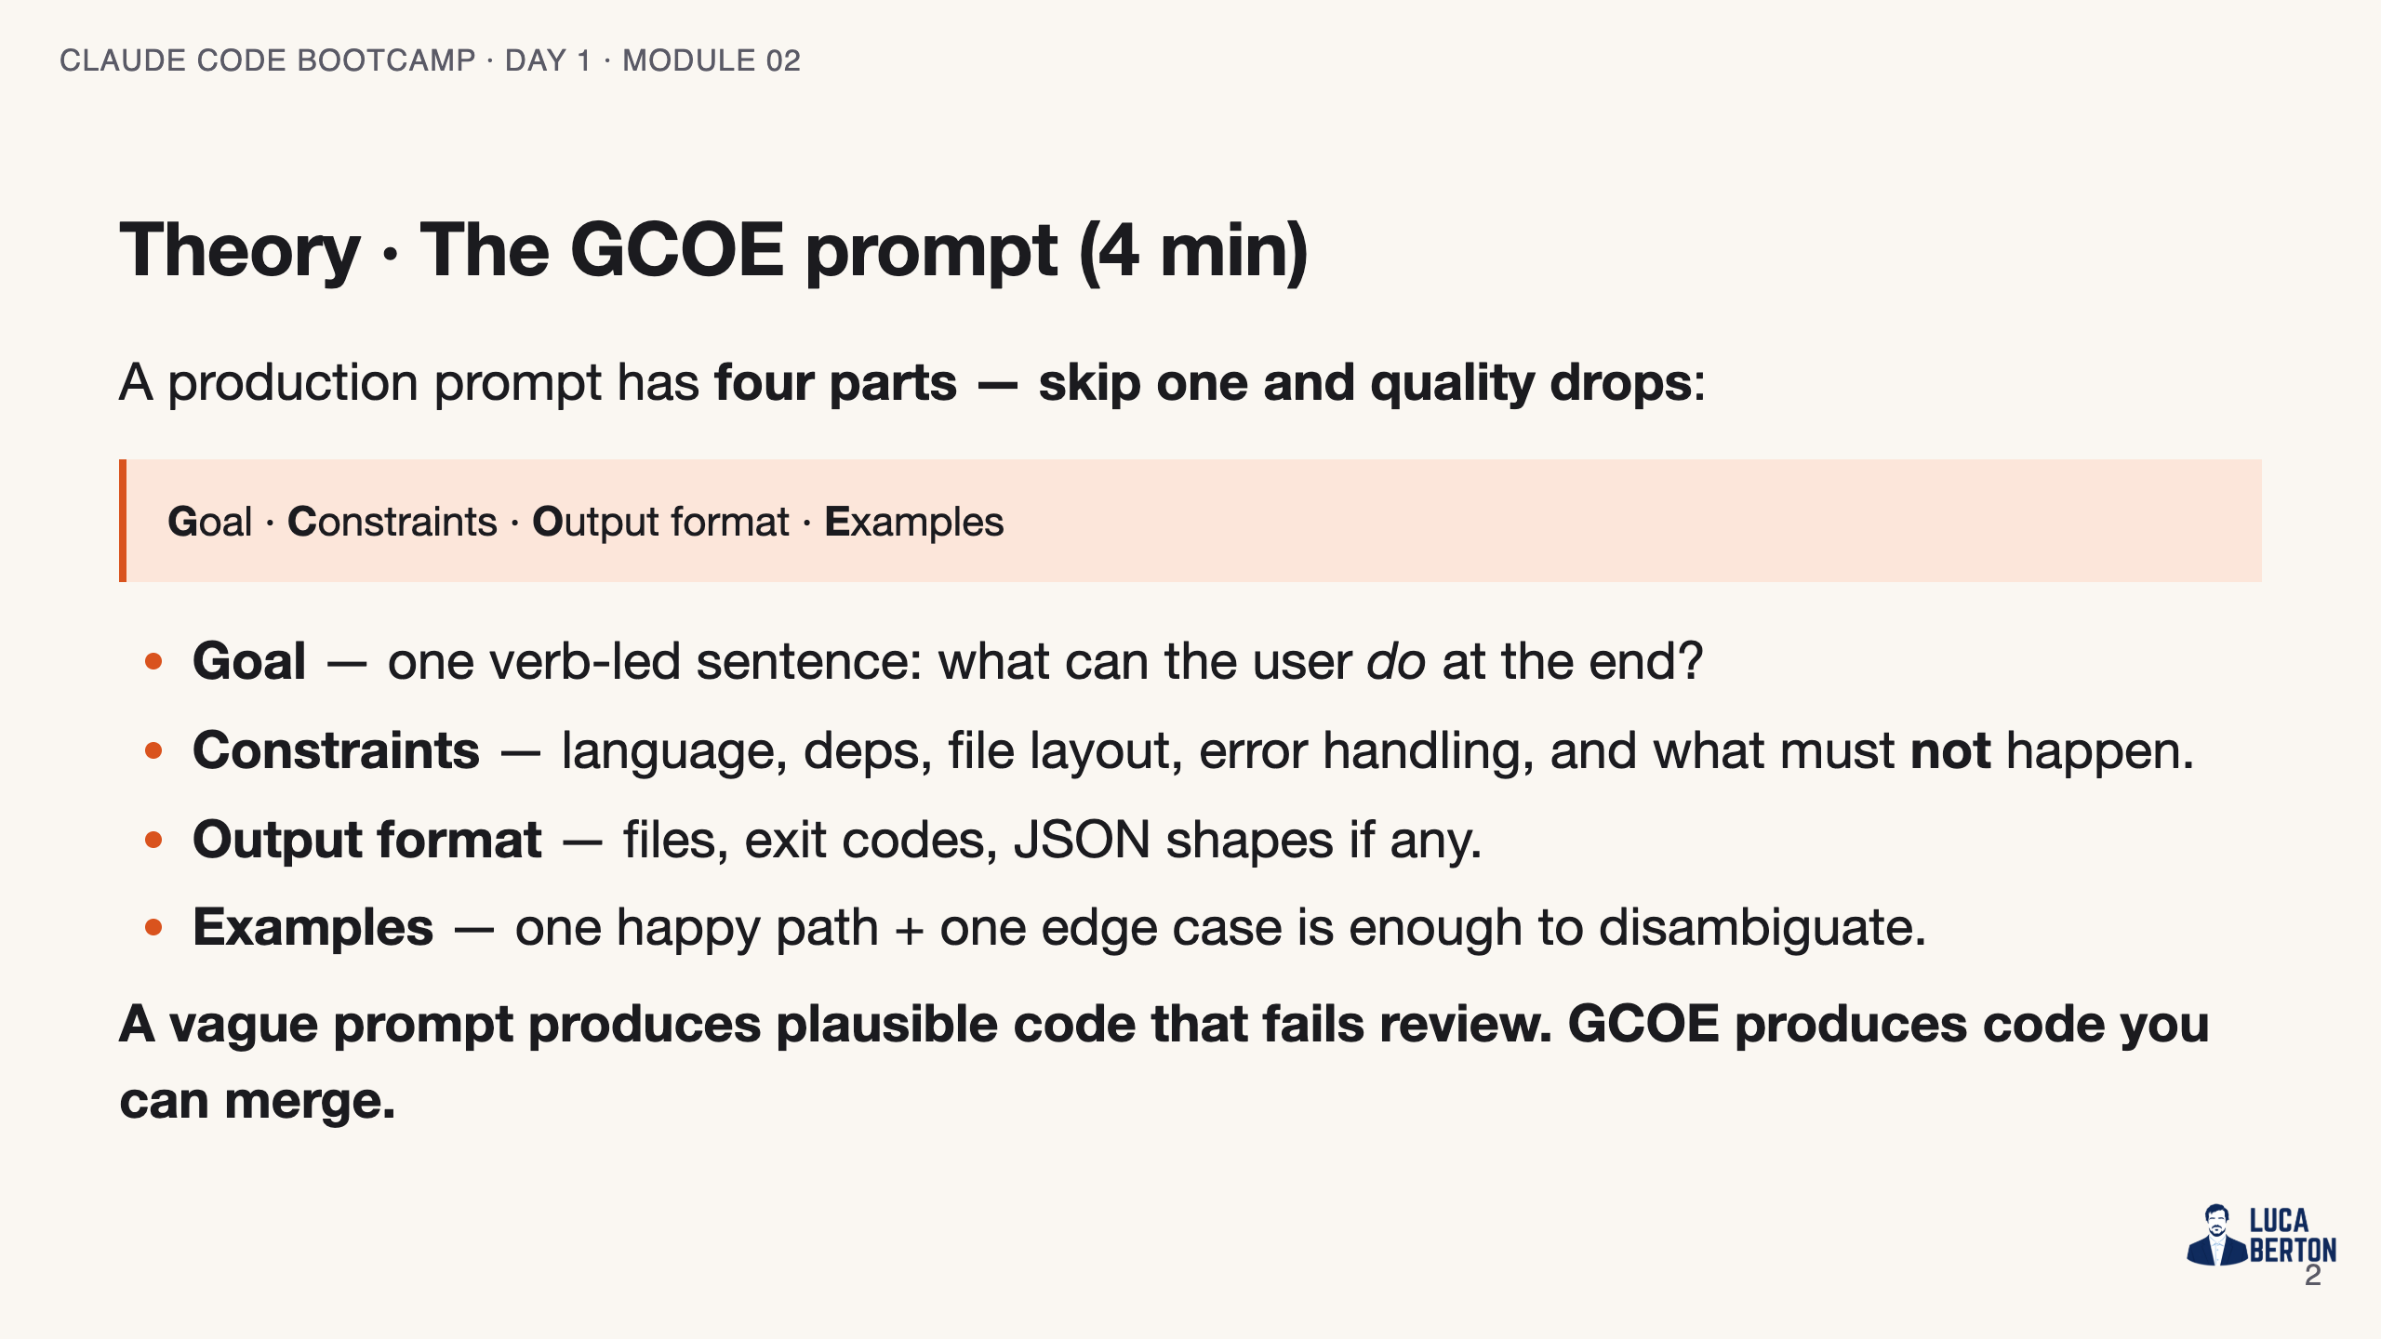
Notes:
SPEAKER NOTES — slide 2 (theory, 4 min) - Anchor: constraints are where the engineering lives. "No third-party deps" is a design decision. - Examples aren't optional — the model uses them to resolve ambiguity.

Slide 3
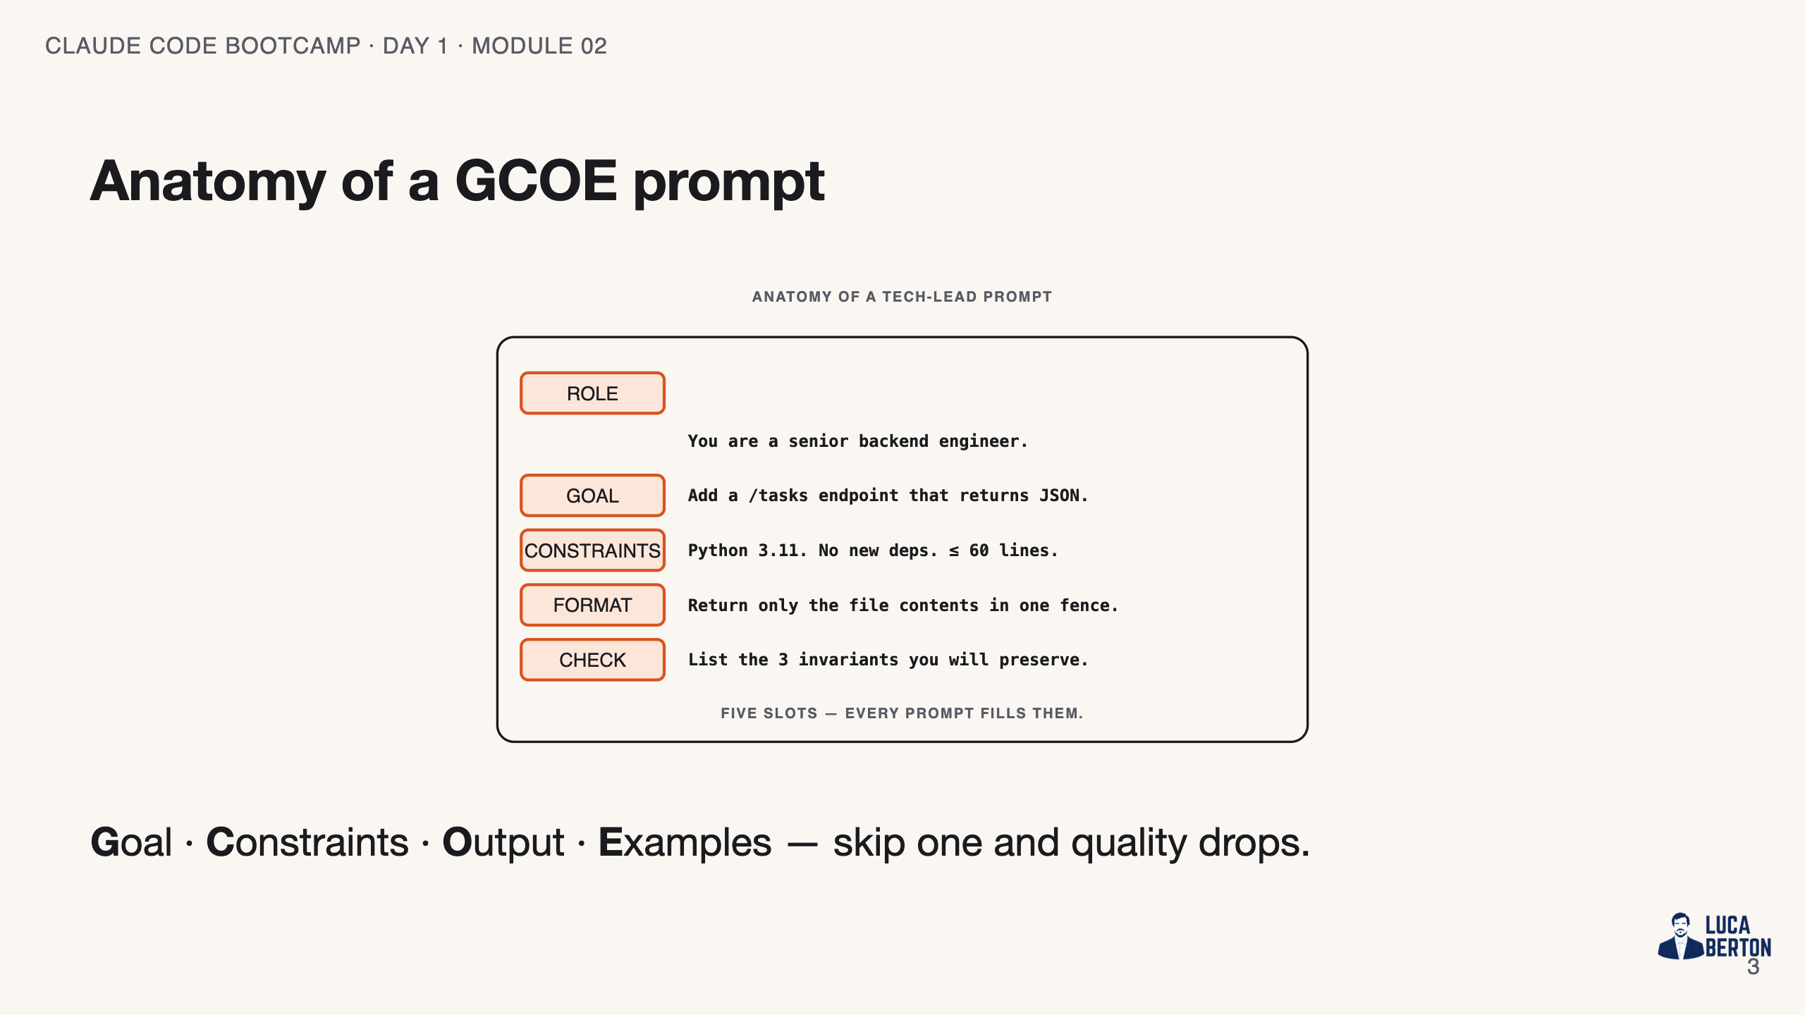
Notes:
SPEAKER NOTES — slide 3 (diagram, 1 min) - Point at each block; the skeleton on the next slide maps 1:1 to this picture.

Slide 4
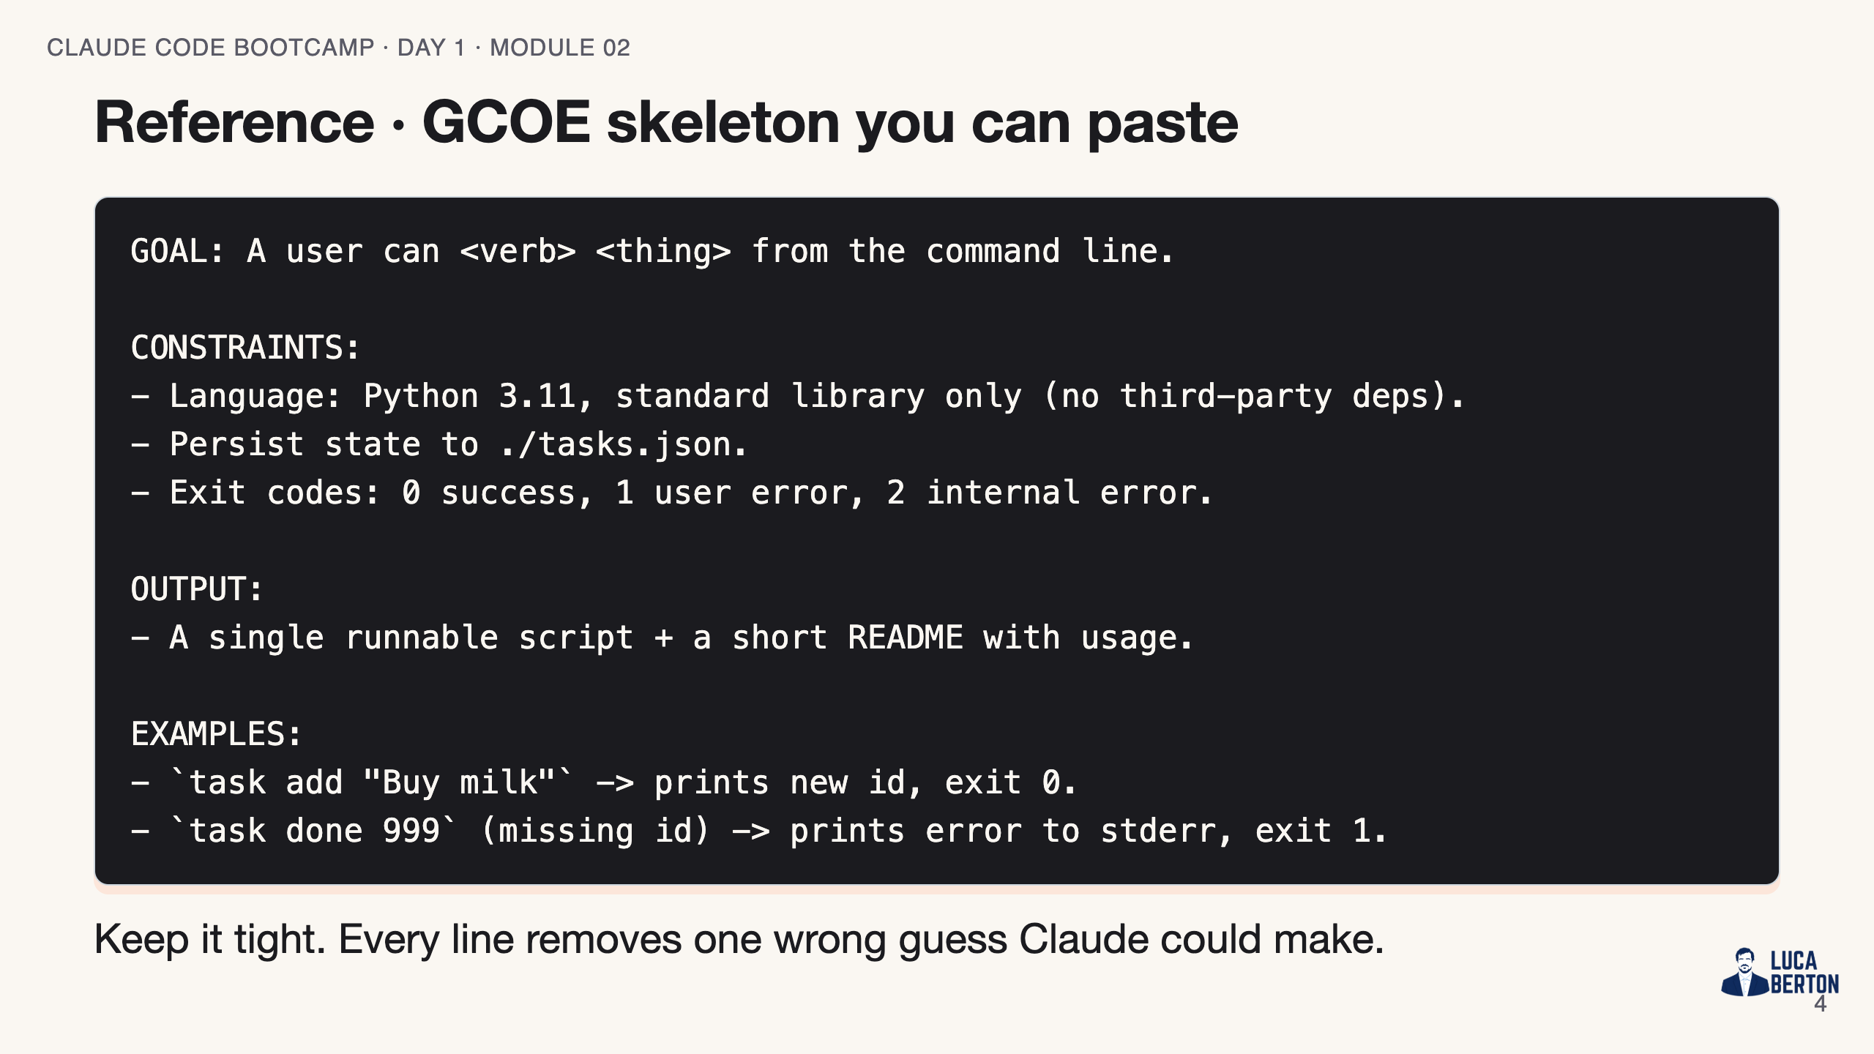
Notes:
SPEAKER NOTES — slide 3 (reference, 1 min) - This is the students' copy-paste starting point for the exercise.

Slide 5
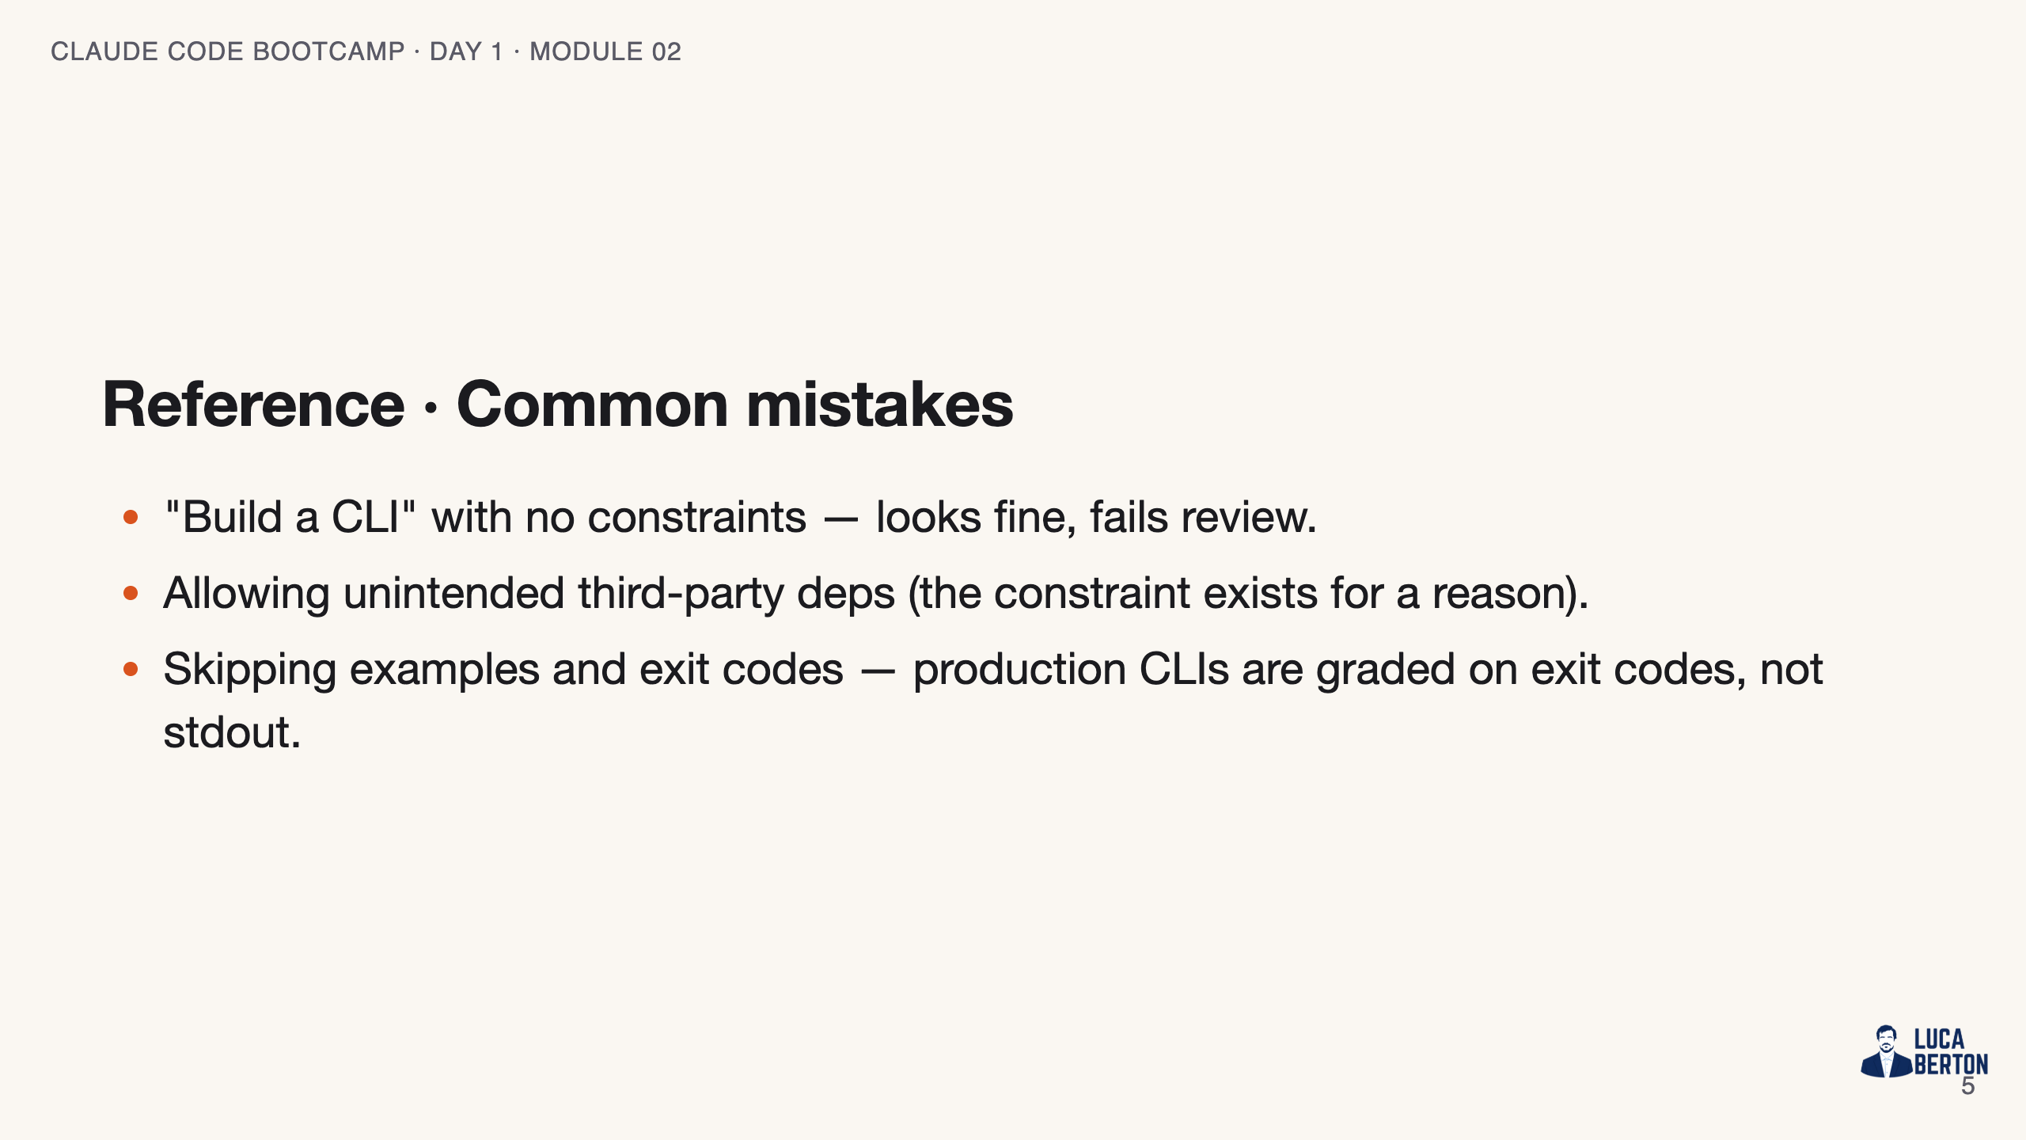
Notes:
SPEAKER NOTES — slide 4 (common mistakes, 30 sec) Instructor cues: - Show the vague-vs-GCOE diff live; let the lift sell itself. - Delete one constraint mid-demo to show the regression.

Slide 6
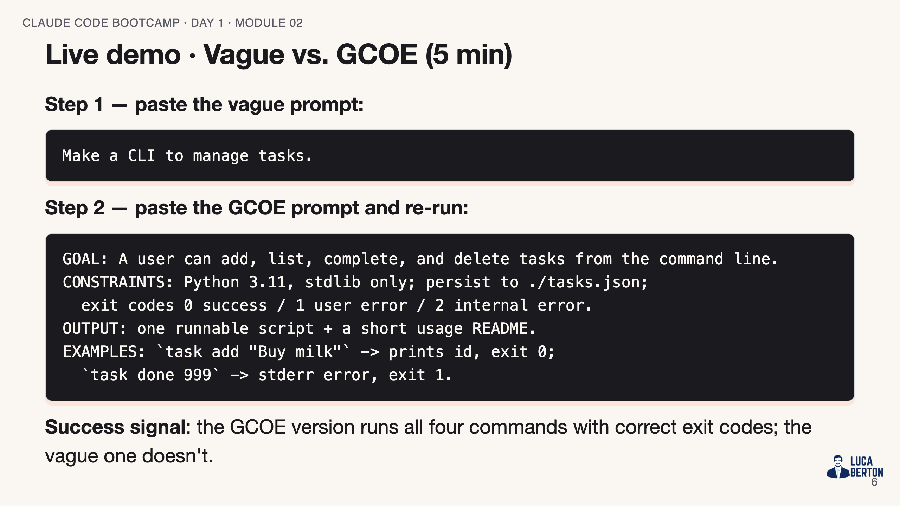
Notes:
SPEAKER NOTES — slide 5 (demo, 5 min) - Run vague first, show generic output (no persistence, no exit codes). - Run GCOE, show the lift: real CLI, tasks.json, tests scaffolded. - Then DELETE the "stdlib only" constraint and re-run -> show the regression. - Keep the two outputs side by side. The contrast is the lesson.

Slide 7
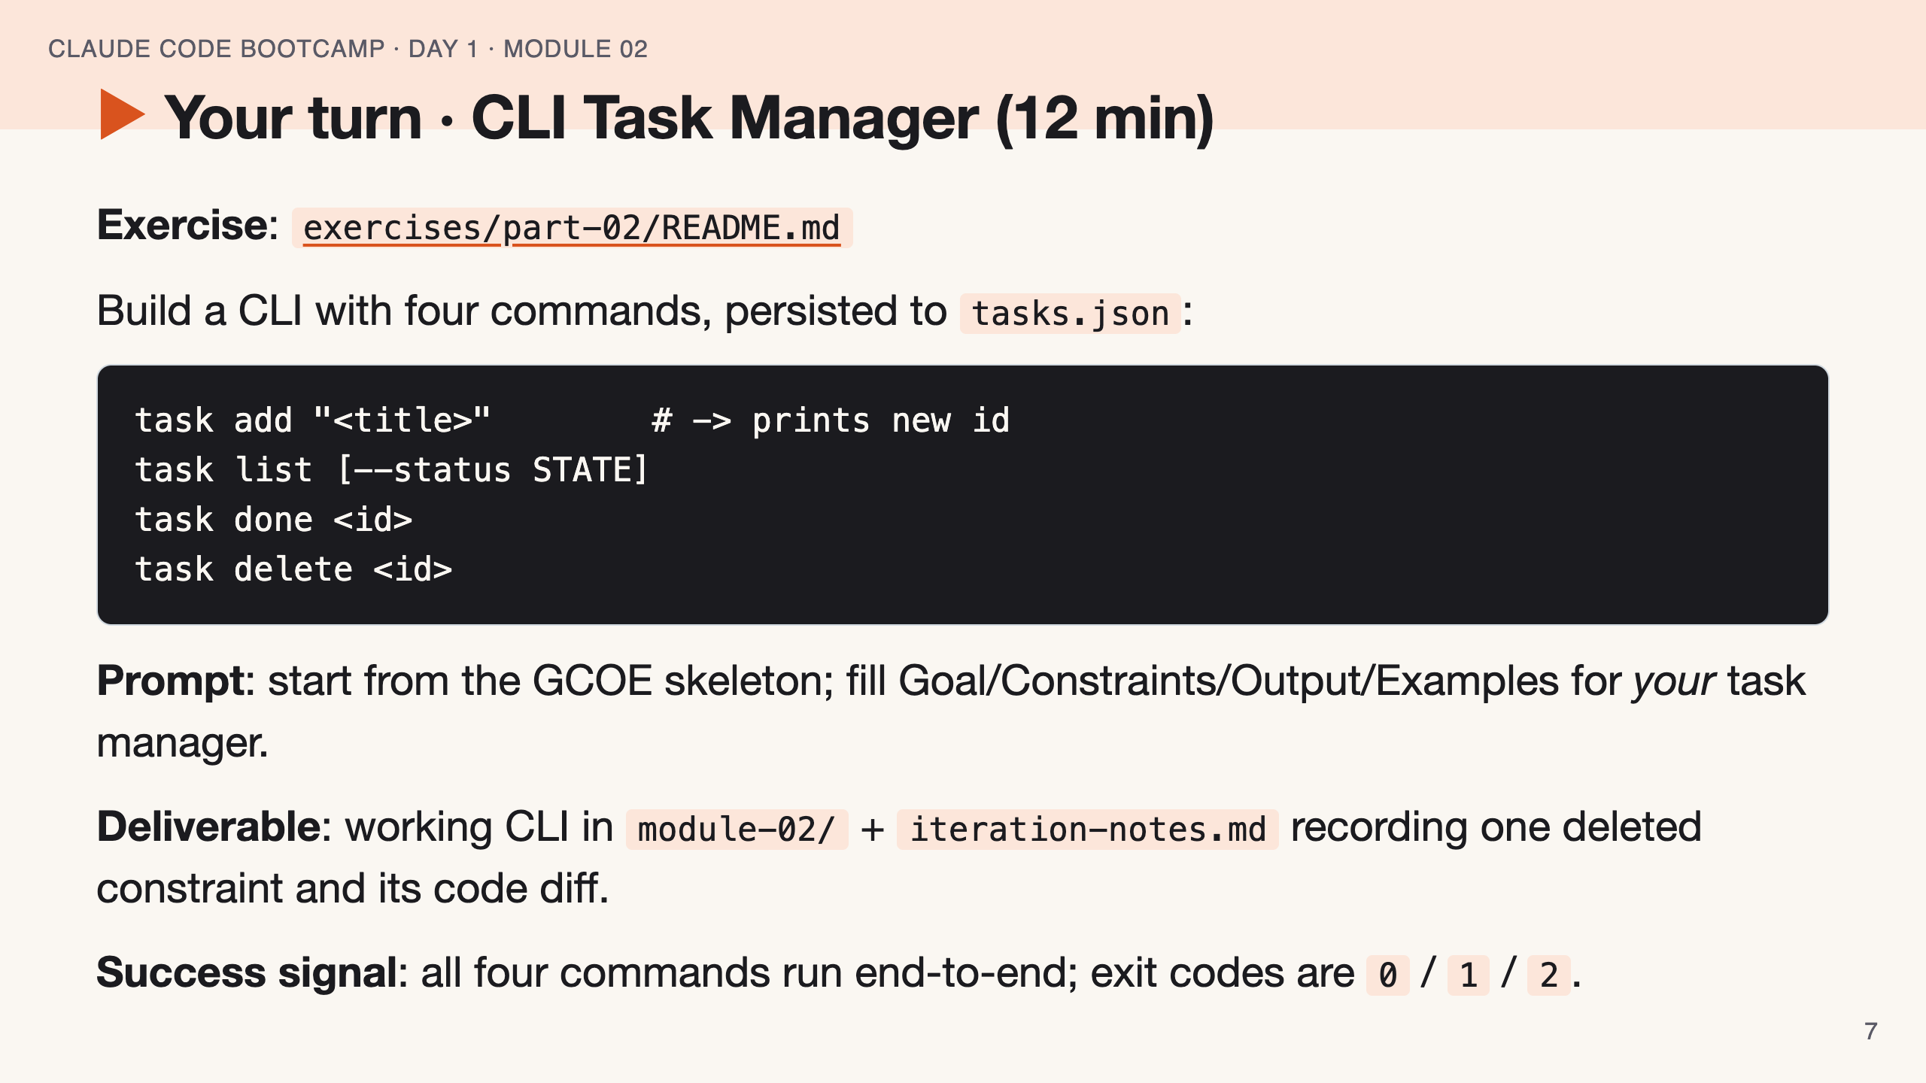
Notes:
SPEAKER NOTES — slide 6 (hands-on, 12 min) - Walk the room. Catch students who skipped Constraints — that's where they lose points. - 3-min warning. Anyone stuck: have them paste their prompt and grade it against GCOE out loud.

Slide 8
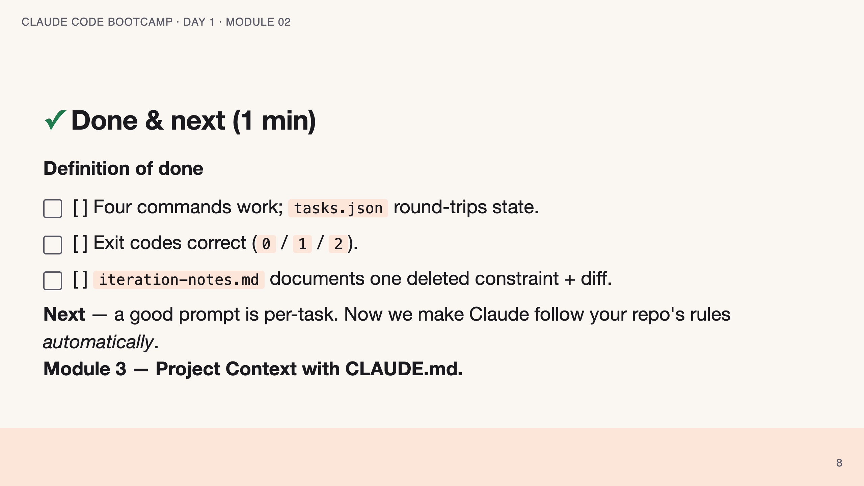
Notes:
SPEAKER NOTES — slide 7 (wrap, 1 min) - Bridge: "GCOE every time is tiring. Module 3 bakes the constraints into the repo." polish-log 2026-05-28 · lean instructor-pacing shape (matches Module 1 pilot). cover -> theory (GCOE) -> reference (skeleton · mistakes) -> live demo -> your turn -> done.

