Slide 1

Notes:
duration: 30 min SPEAKER NOTES — slide 1 (hook, 60 sec) - One line: "We exploit variance on purpose — three independent shots, one rubric, one winner."

Slide 2
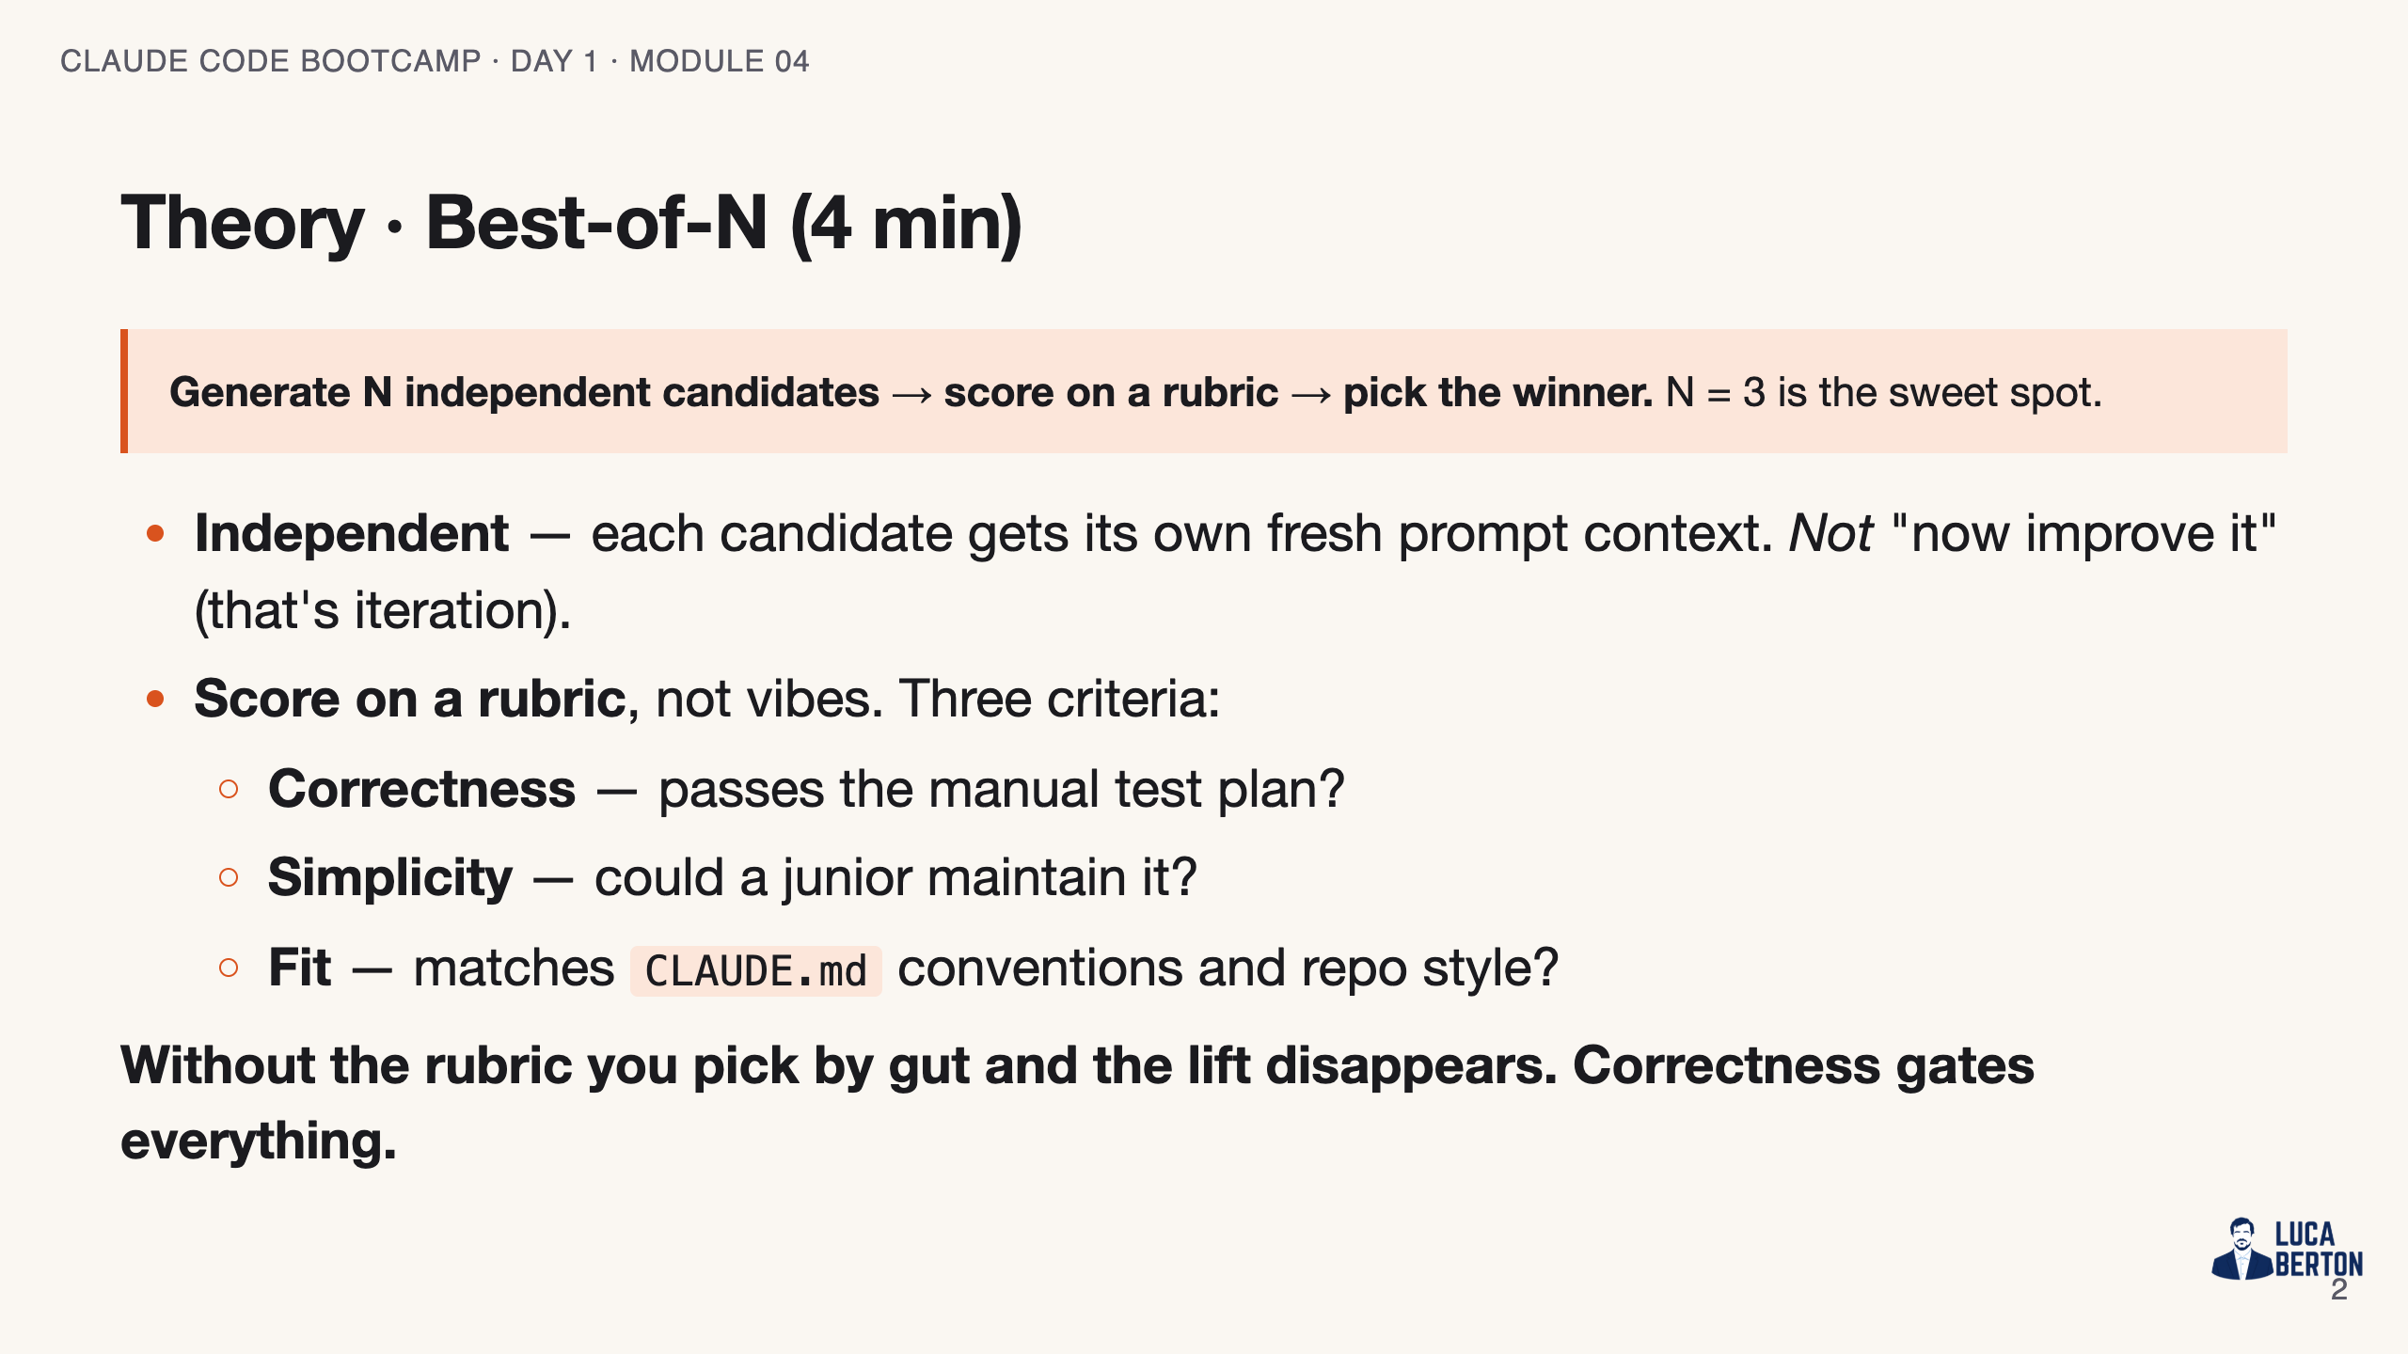
Notes:
SPEAKER NOTES — slide 2 (theory, 4 min) - Stress: BoN != iteration. Iteration converges on one lineage; BoN samples the space.

Slide 3
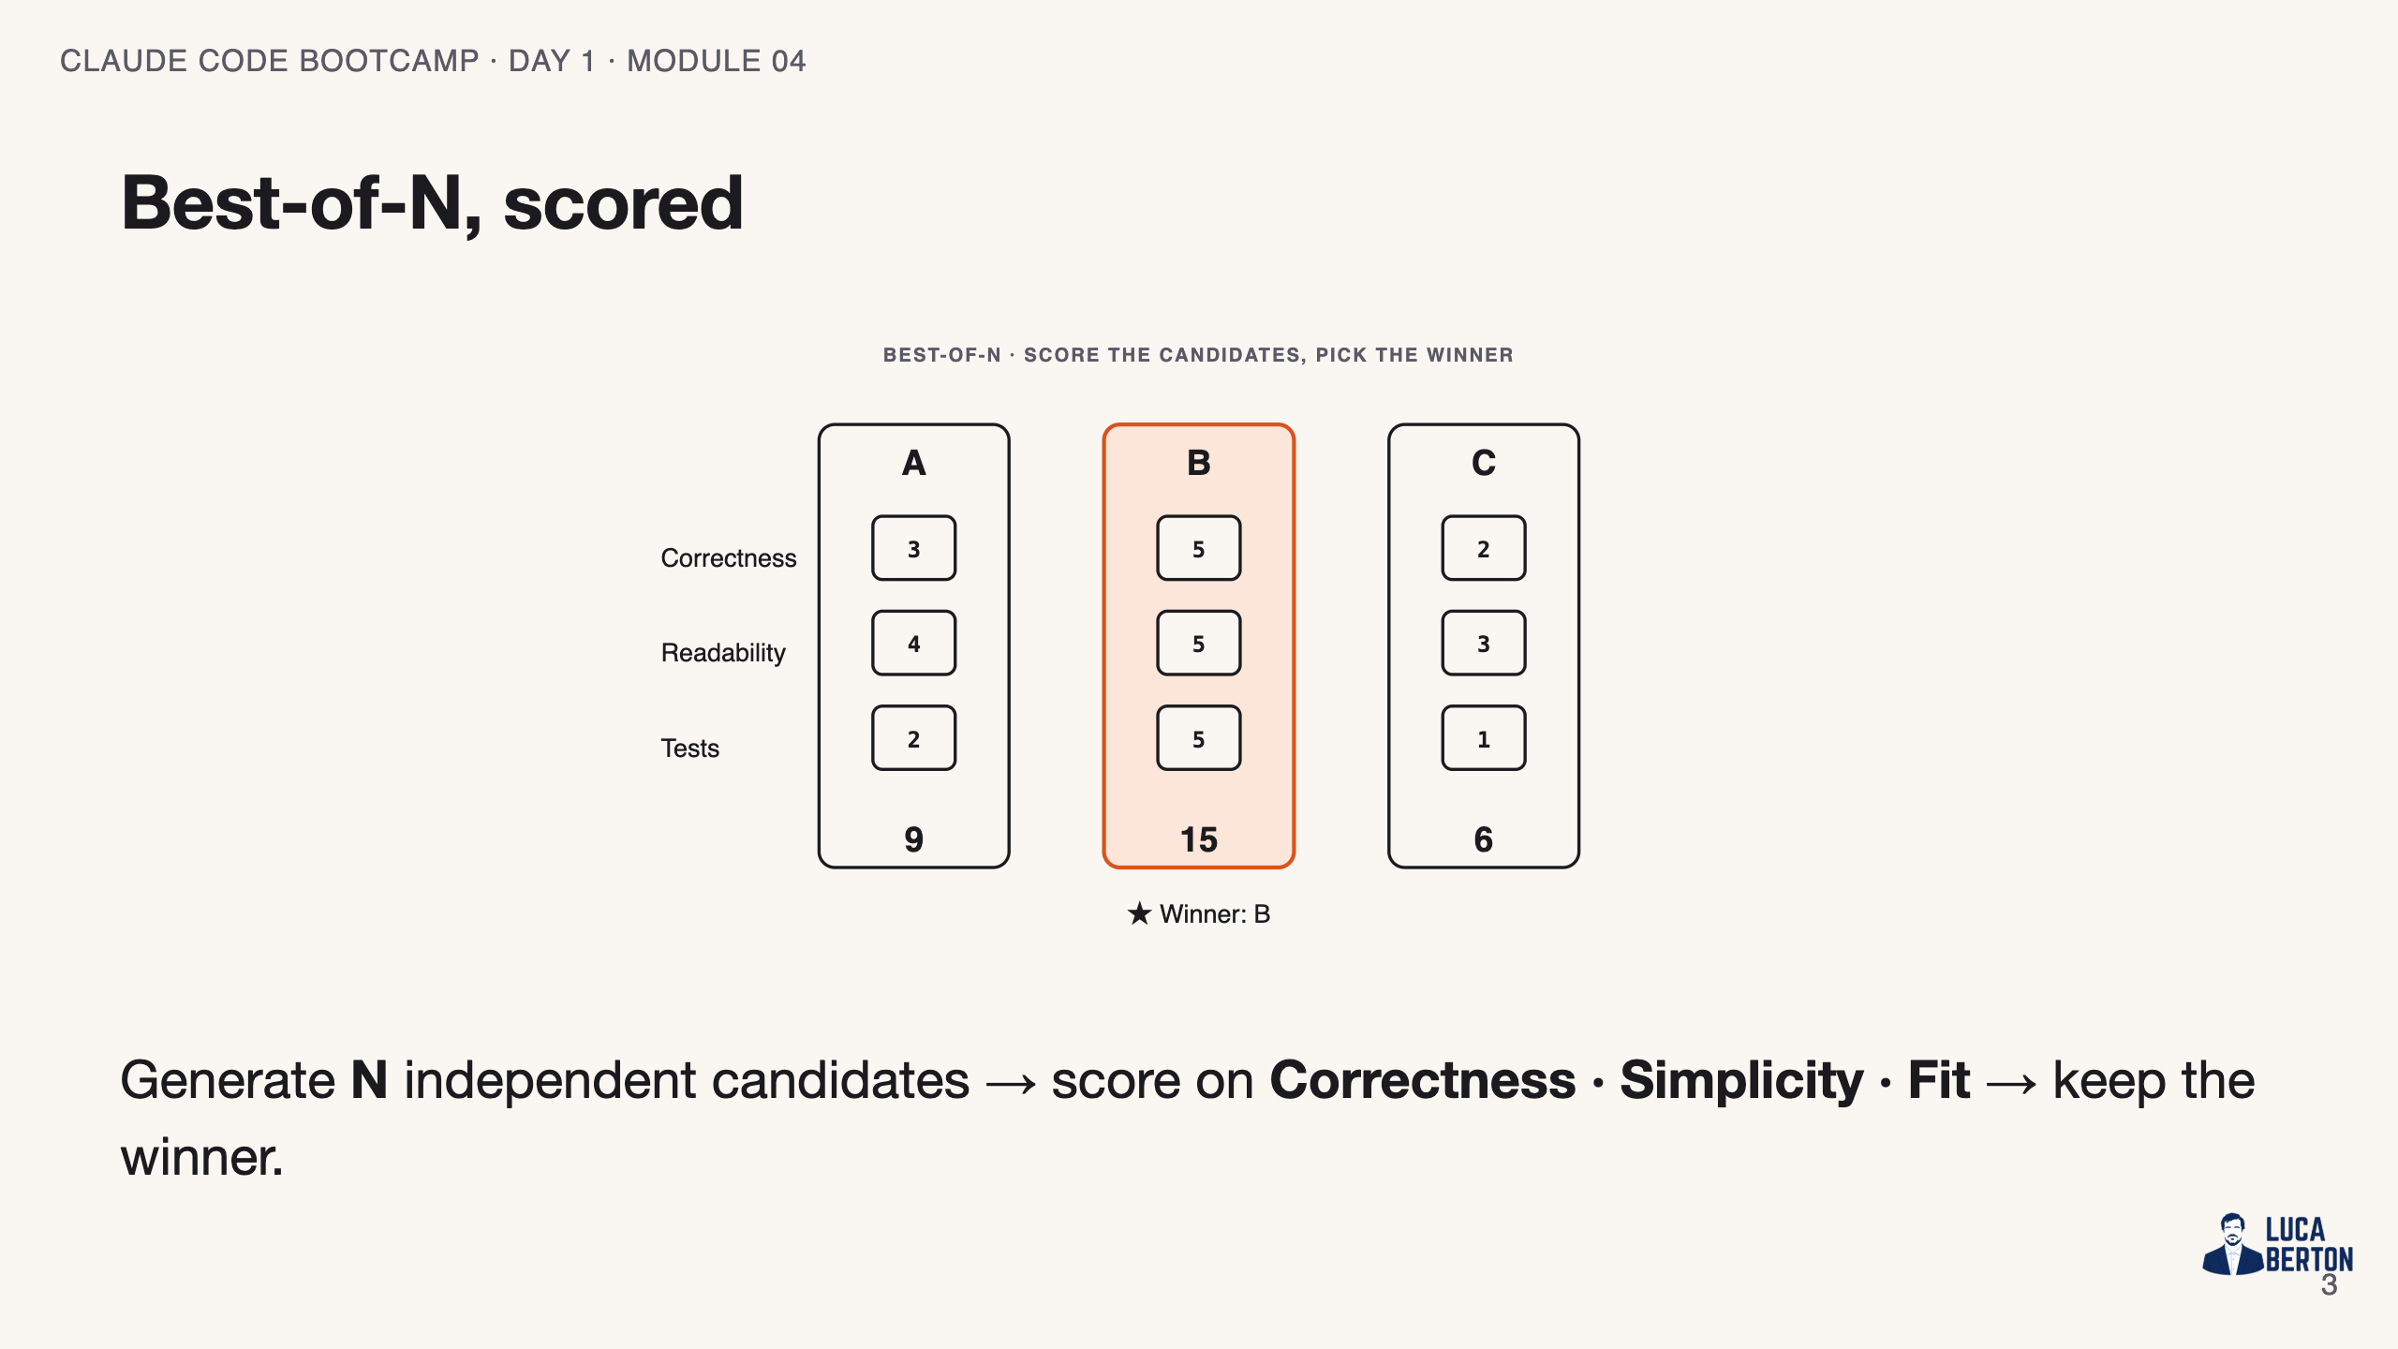
Notes:
SPEAKER NOTES — slide 3 (diagram, 1 min) - The scorecard on the next slide is the right-hand column of this picture.

Slide 4
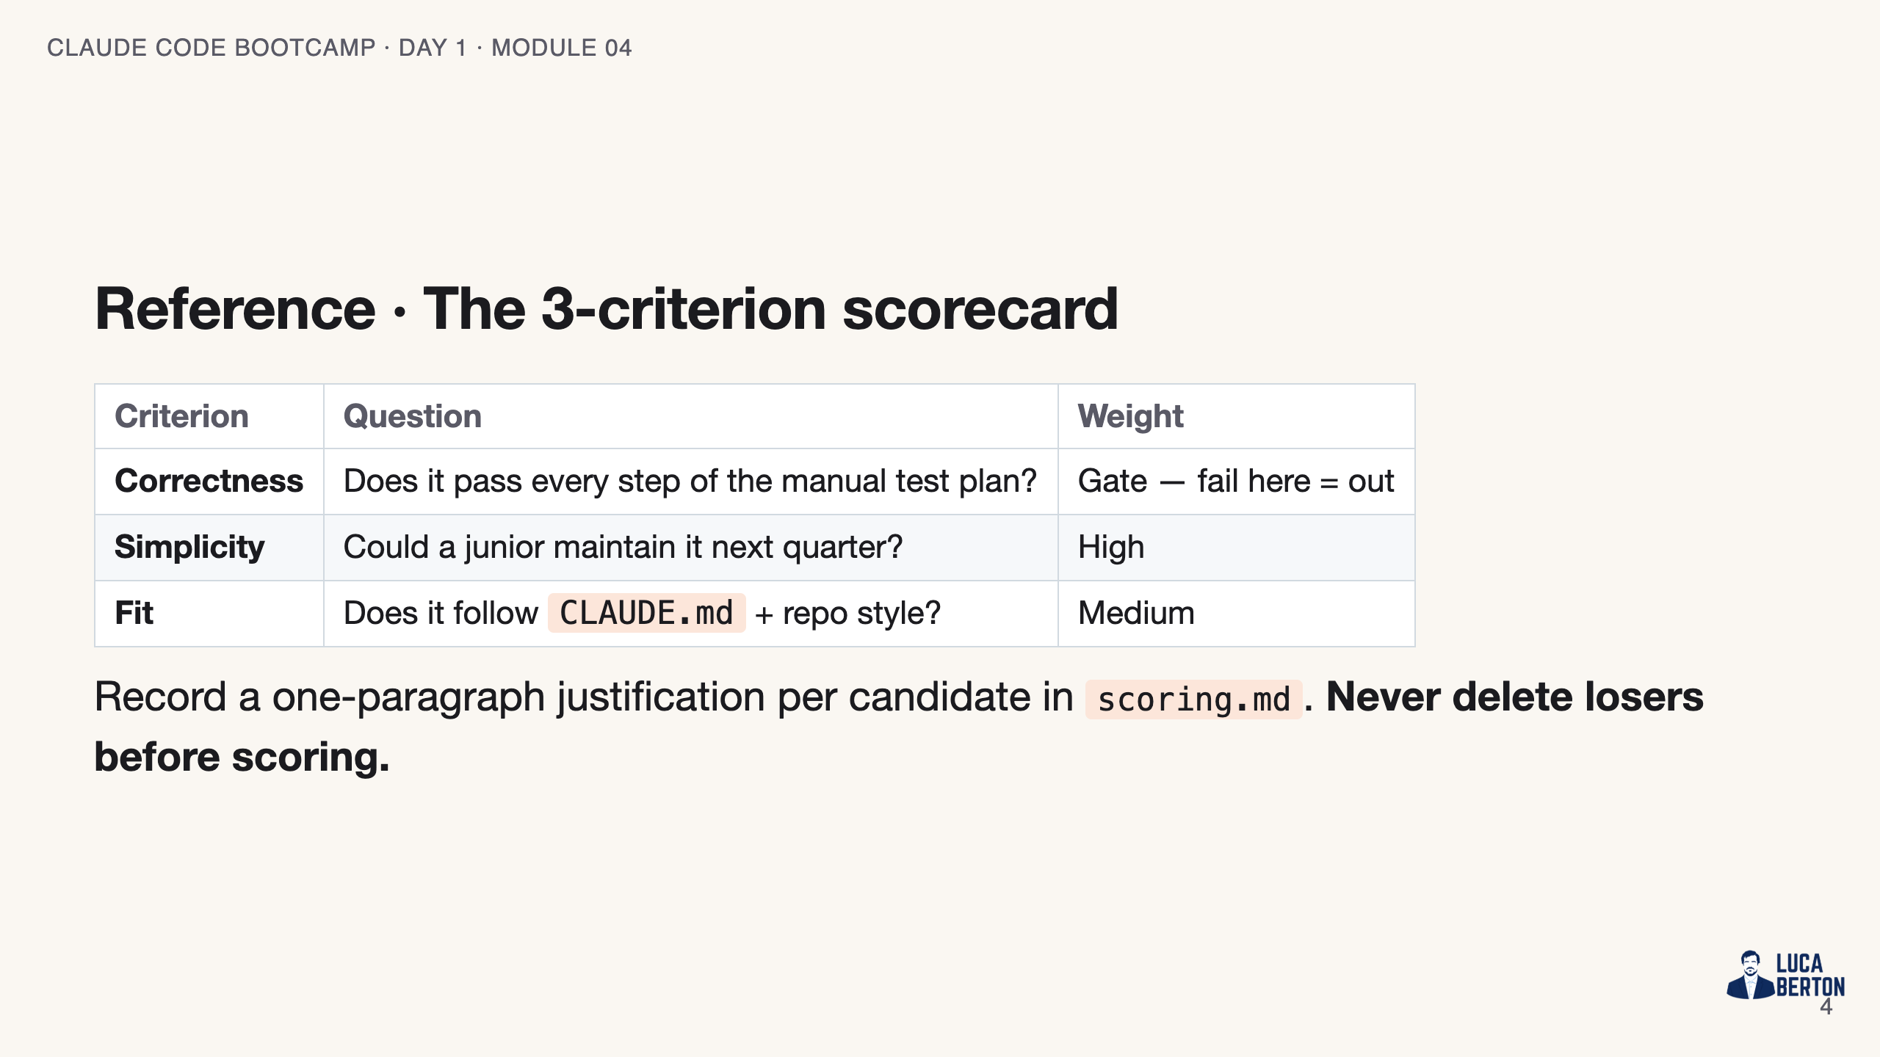
Notes:
SPEAKER NOTES — slide 3 (reference, 1 min)

Slide 5
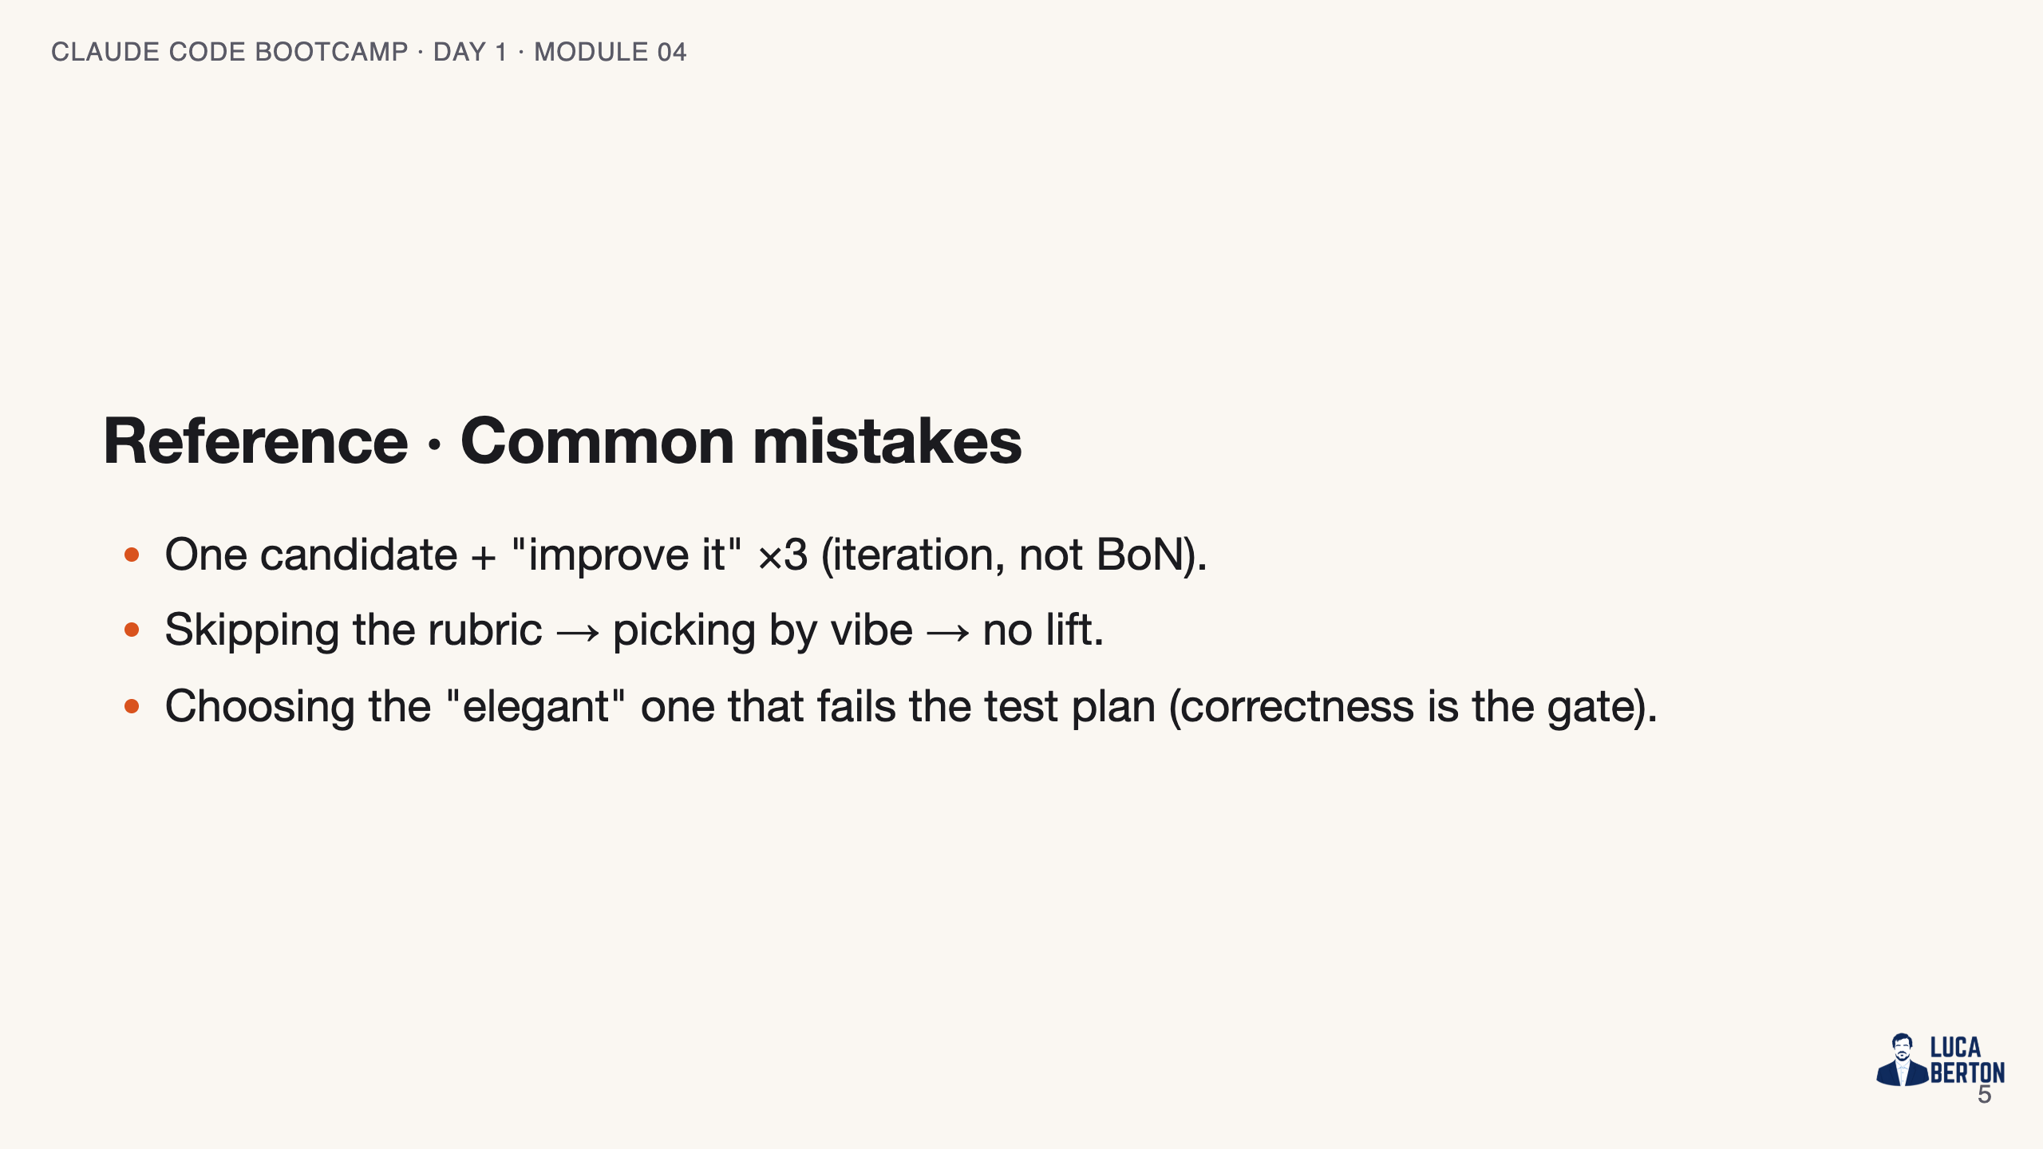
Notes:
SPEAKER NOTES — slide 4 (common mistakes, 30 sec) Instructor cues: - Score side-by-side; show the losers so the lift is visible.

Slide 6
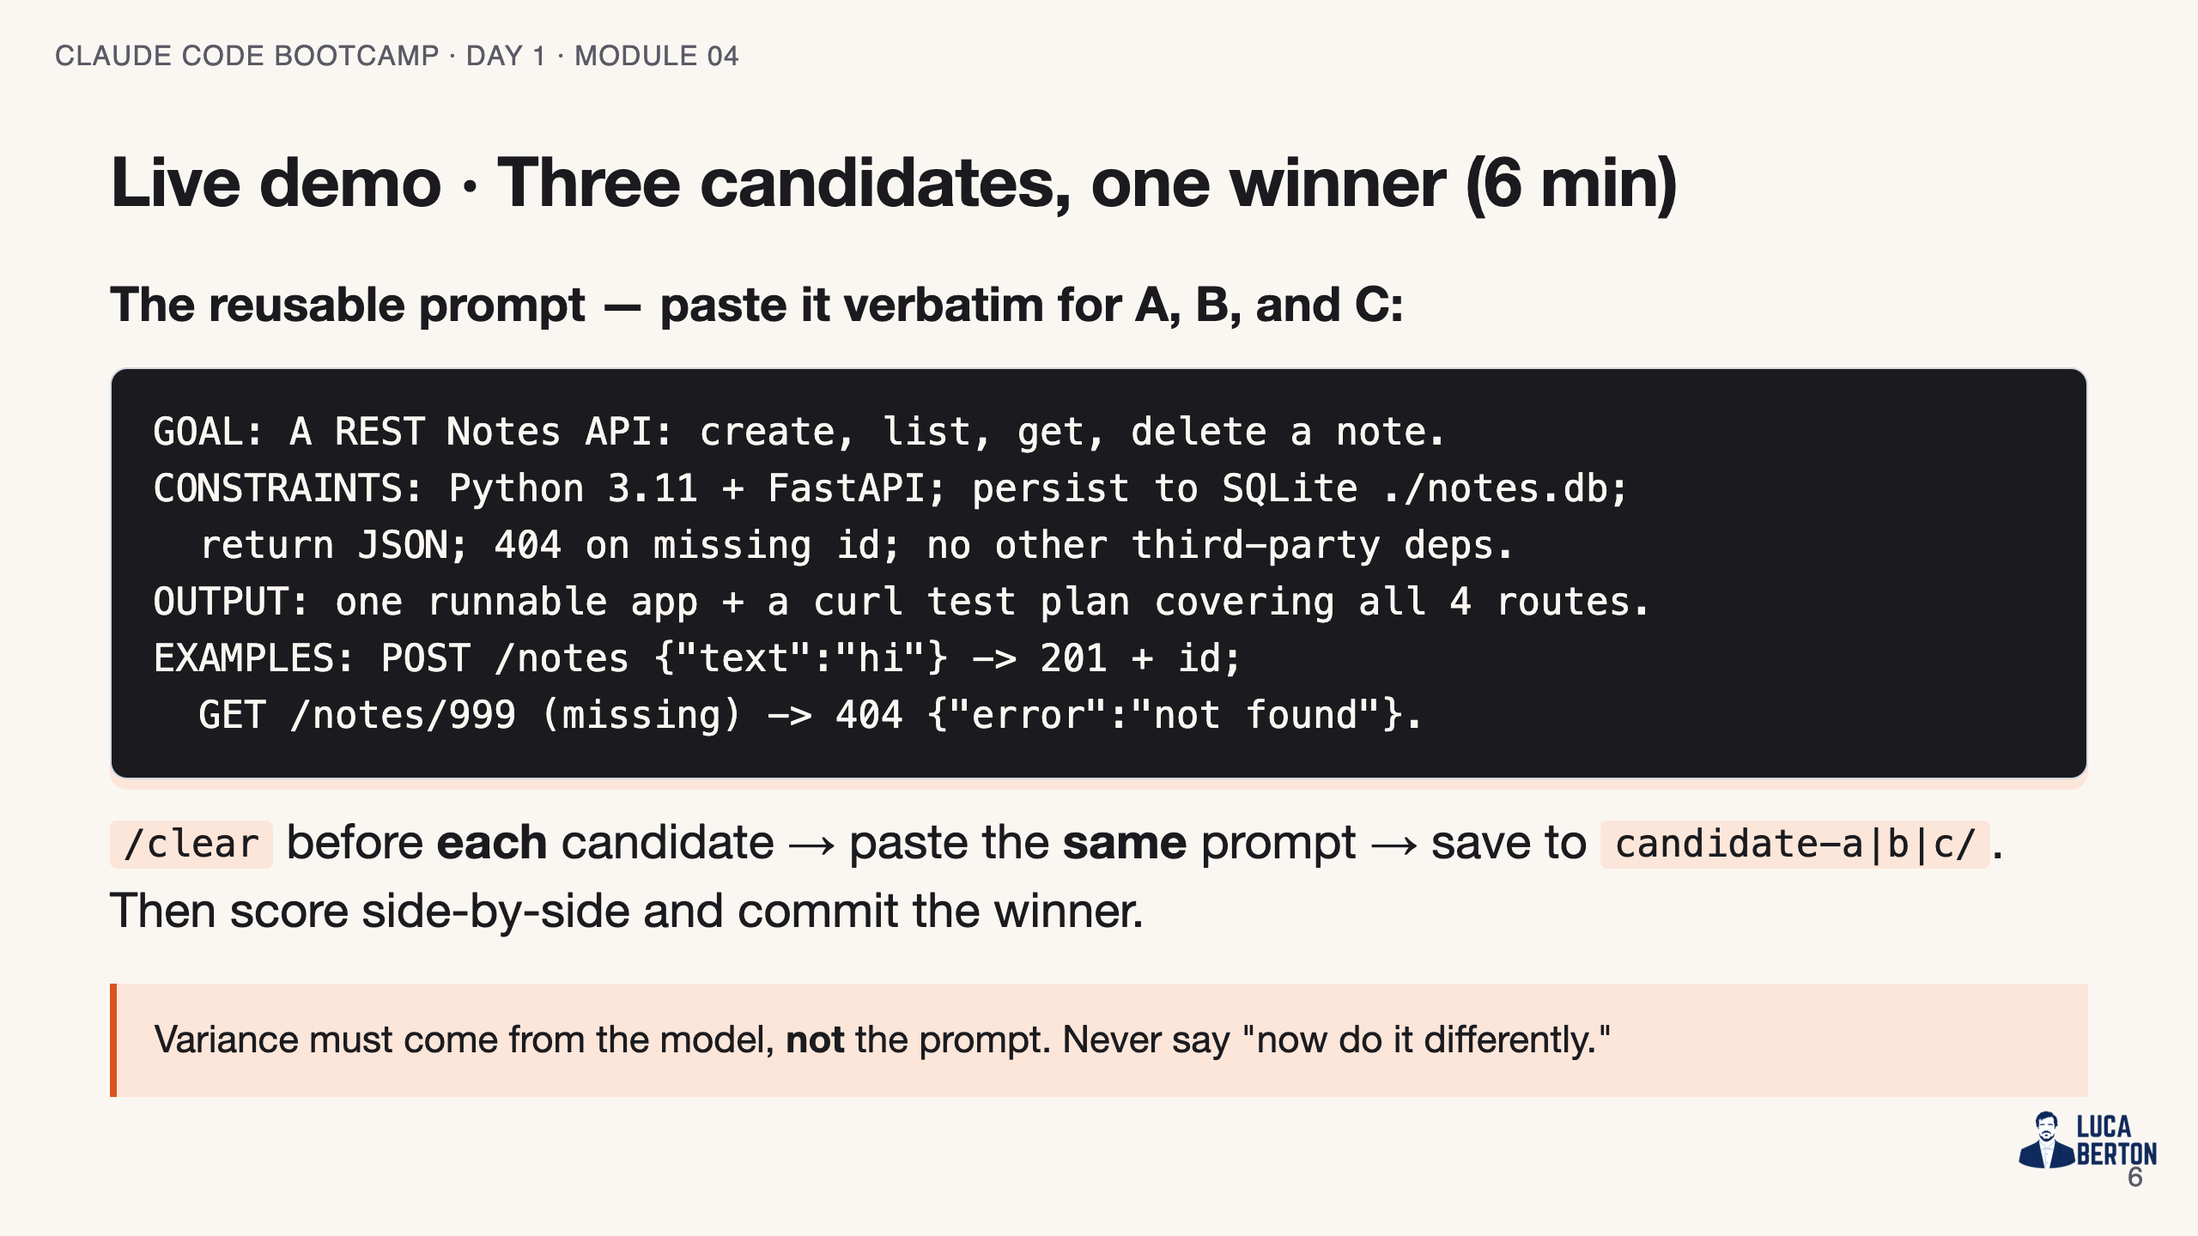
Notes:
SPEAKER NOTES — slide 5 (demo, 6 min) - The mechanism is independence: `/clear` between each candidate so no shared history leaks. - Paste the EXACT same prompt all three times — variance must come from the model, not the prompt. - A new terminal tab / new chat session works too; the point is zero carried-over context. - Tip: `claude -p "$(cat prompt.txt)"` three times is the scriptable version. - Success signal: the winner passes the curl test plan; at least one loser visibly doesn't.

Slide 7
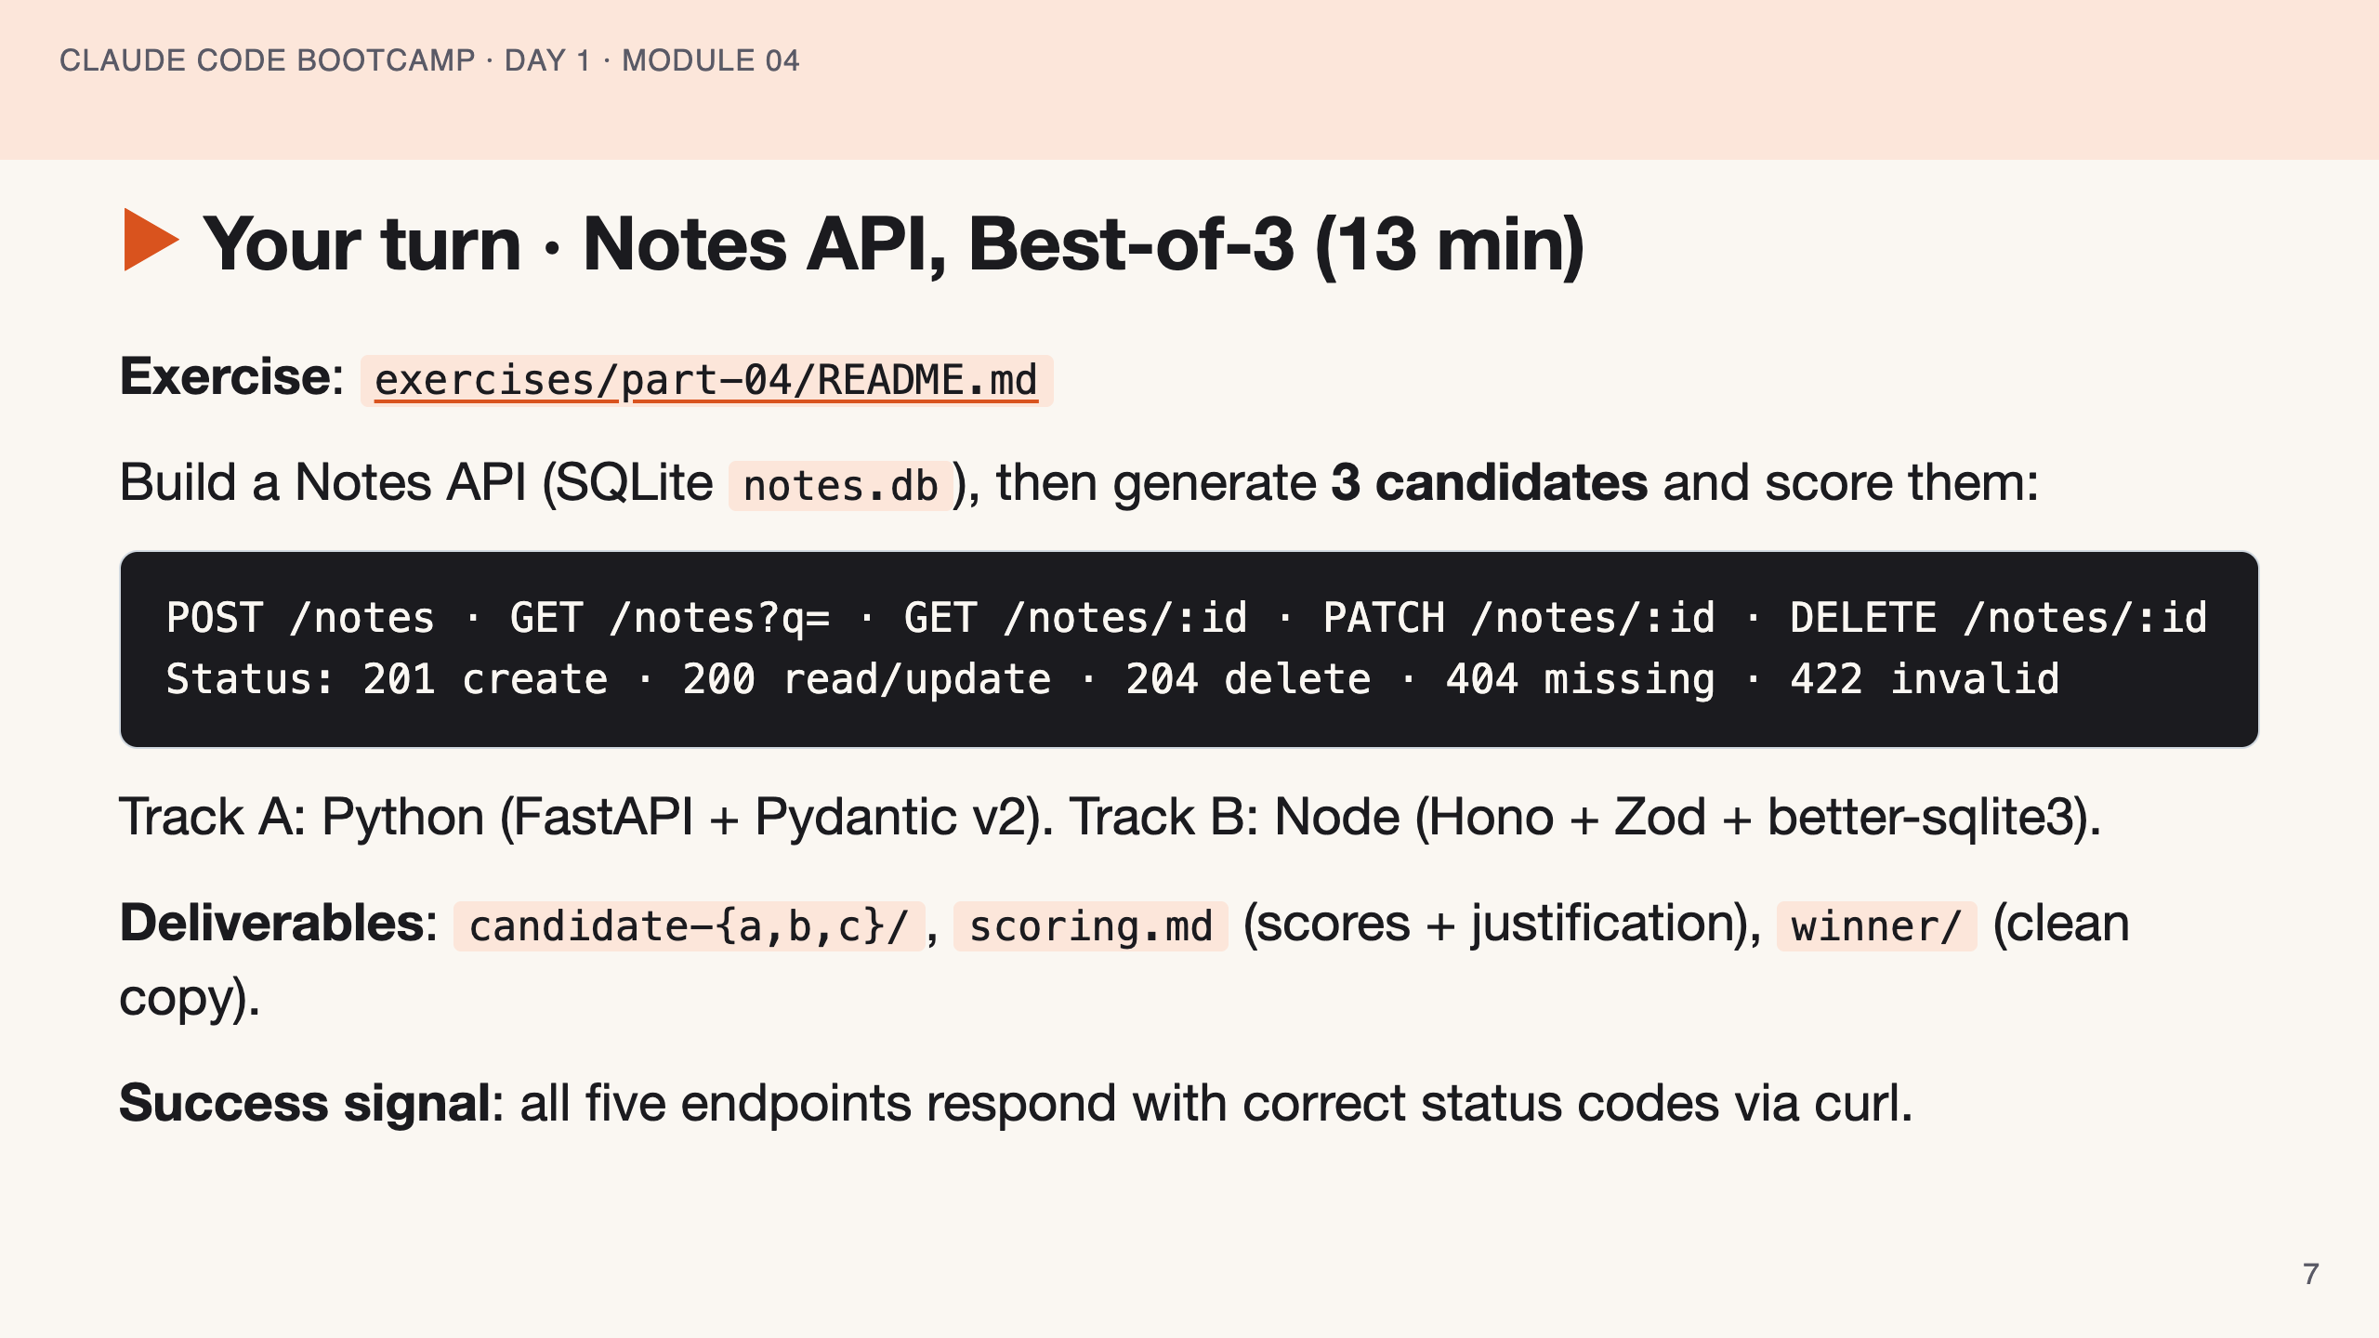
Notes:
SPEAKER NOTES — slide 6 (hands-on, 13 min) - Hold them to three independent prompts. Walk the room and check candidate folders exist. - 3-min warning. Stuck students: score what they have; partial BoN still teaches the loop.

Slide 8
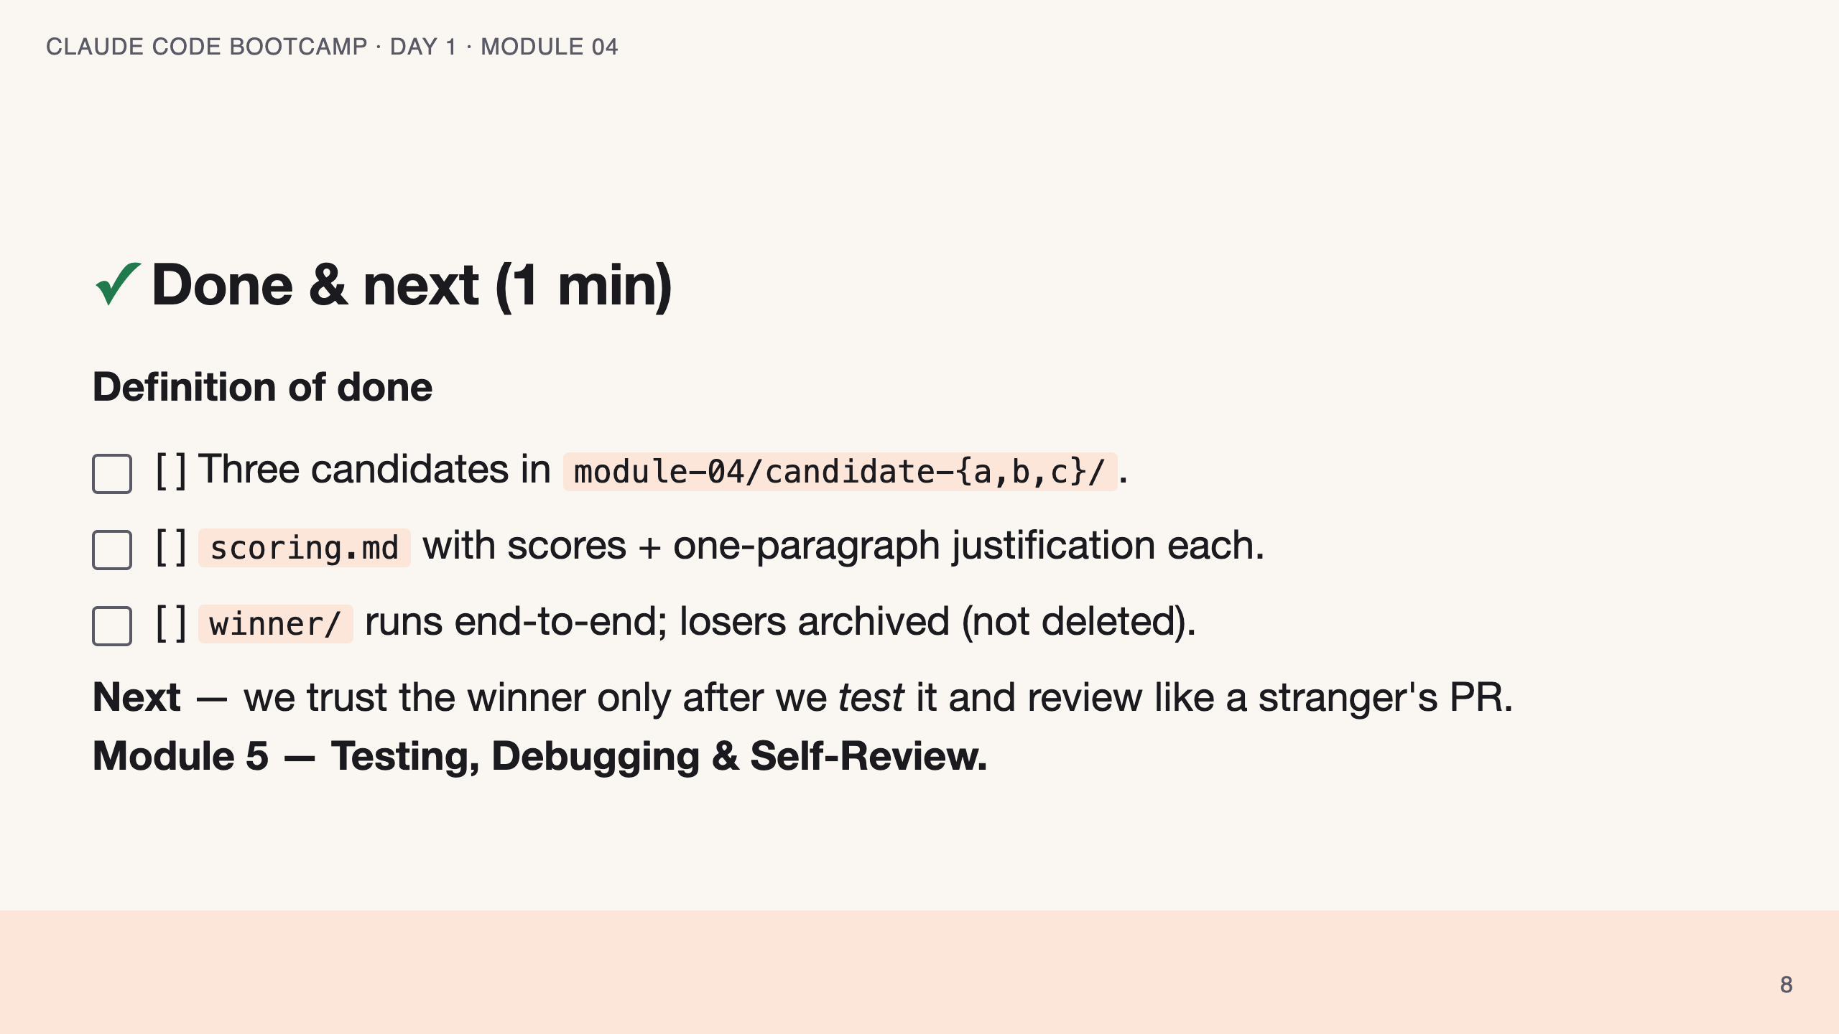
Notes:
SPEAKER NOTES — slide 7 (wrap, 1 min) polish-log 2026-05-28 · lean instructor-pacing shape (matches Module 1 pilot). cover -> theory (BoN) -> reference (scorecard · mistakes) -> live demo -> your turn -> done.

