Slide 1
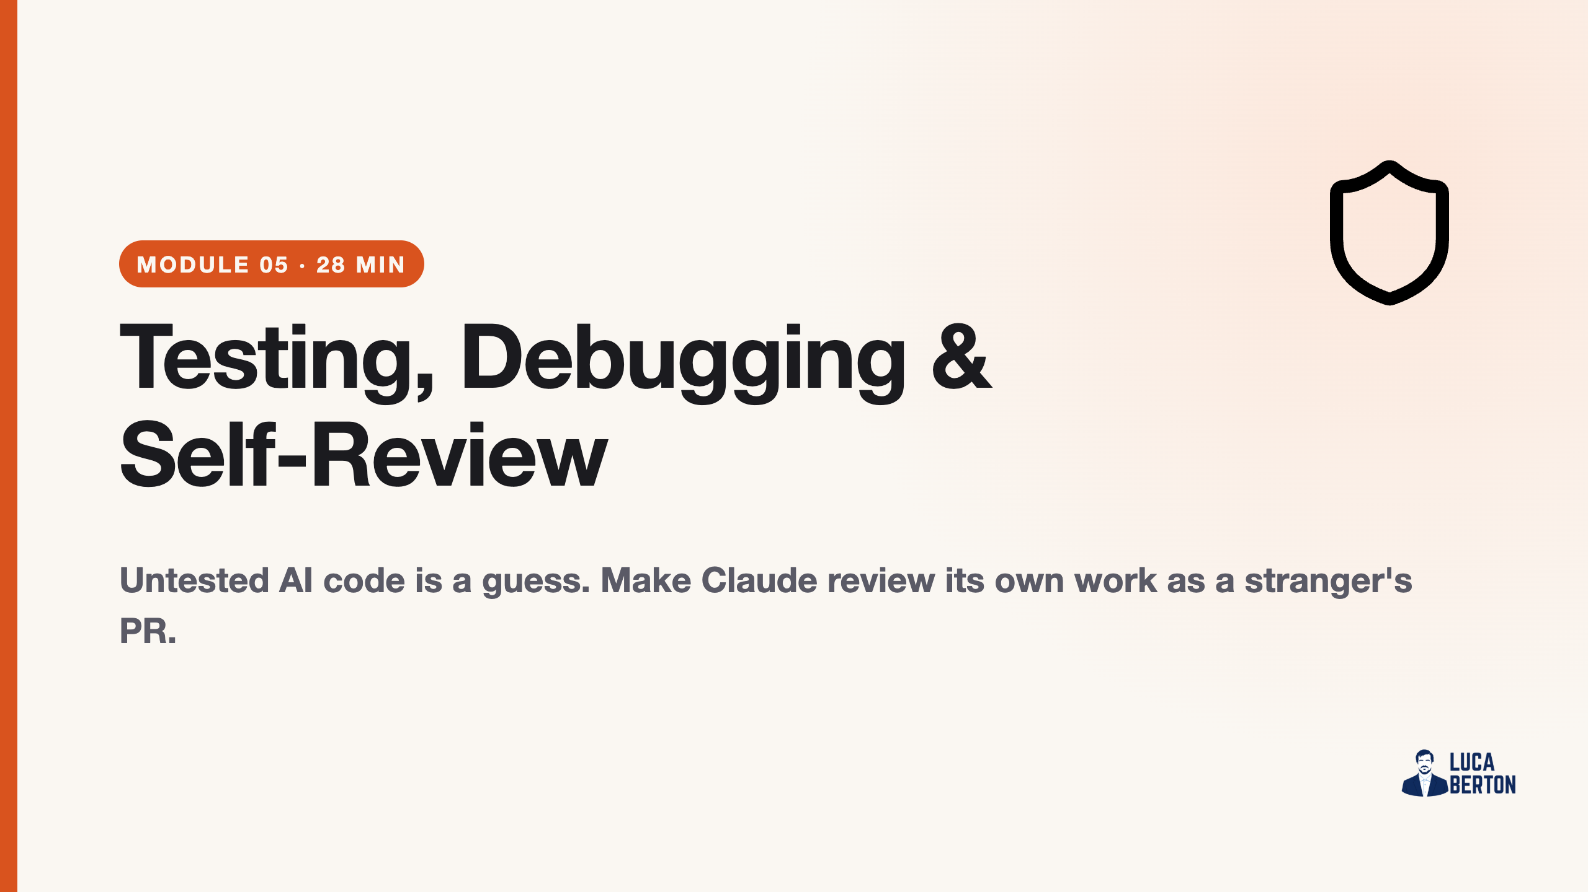
Notes:
duration: 28 min SPEAKER NOTES — slide 1 (hook, 60 sec) - One line: "We test the Module 4 winner, plant bugs, and let Claude catch them — with the right framing."

Slide 2
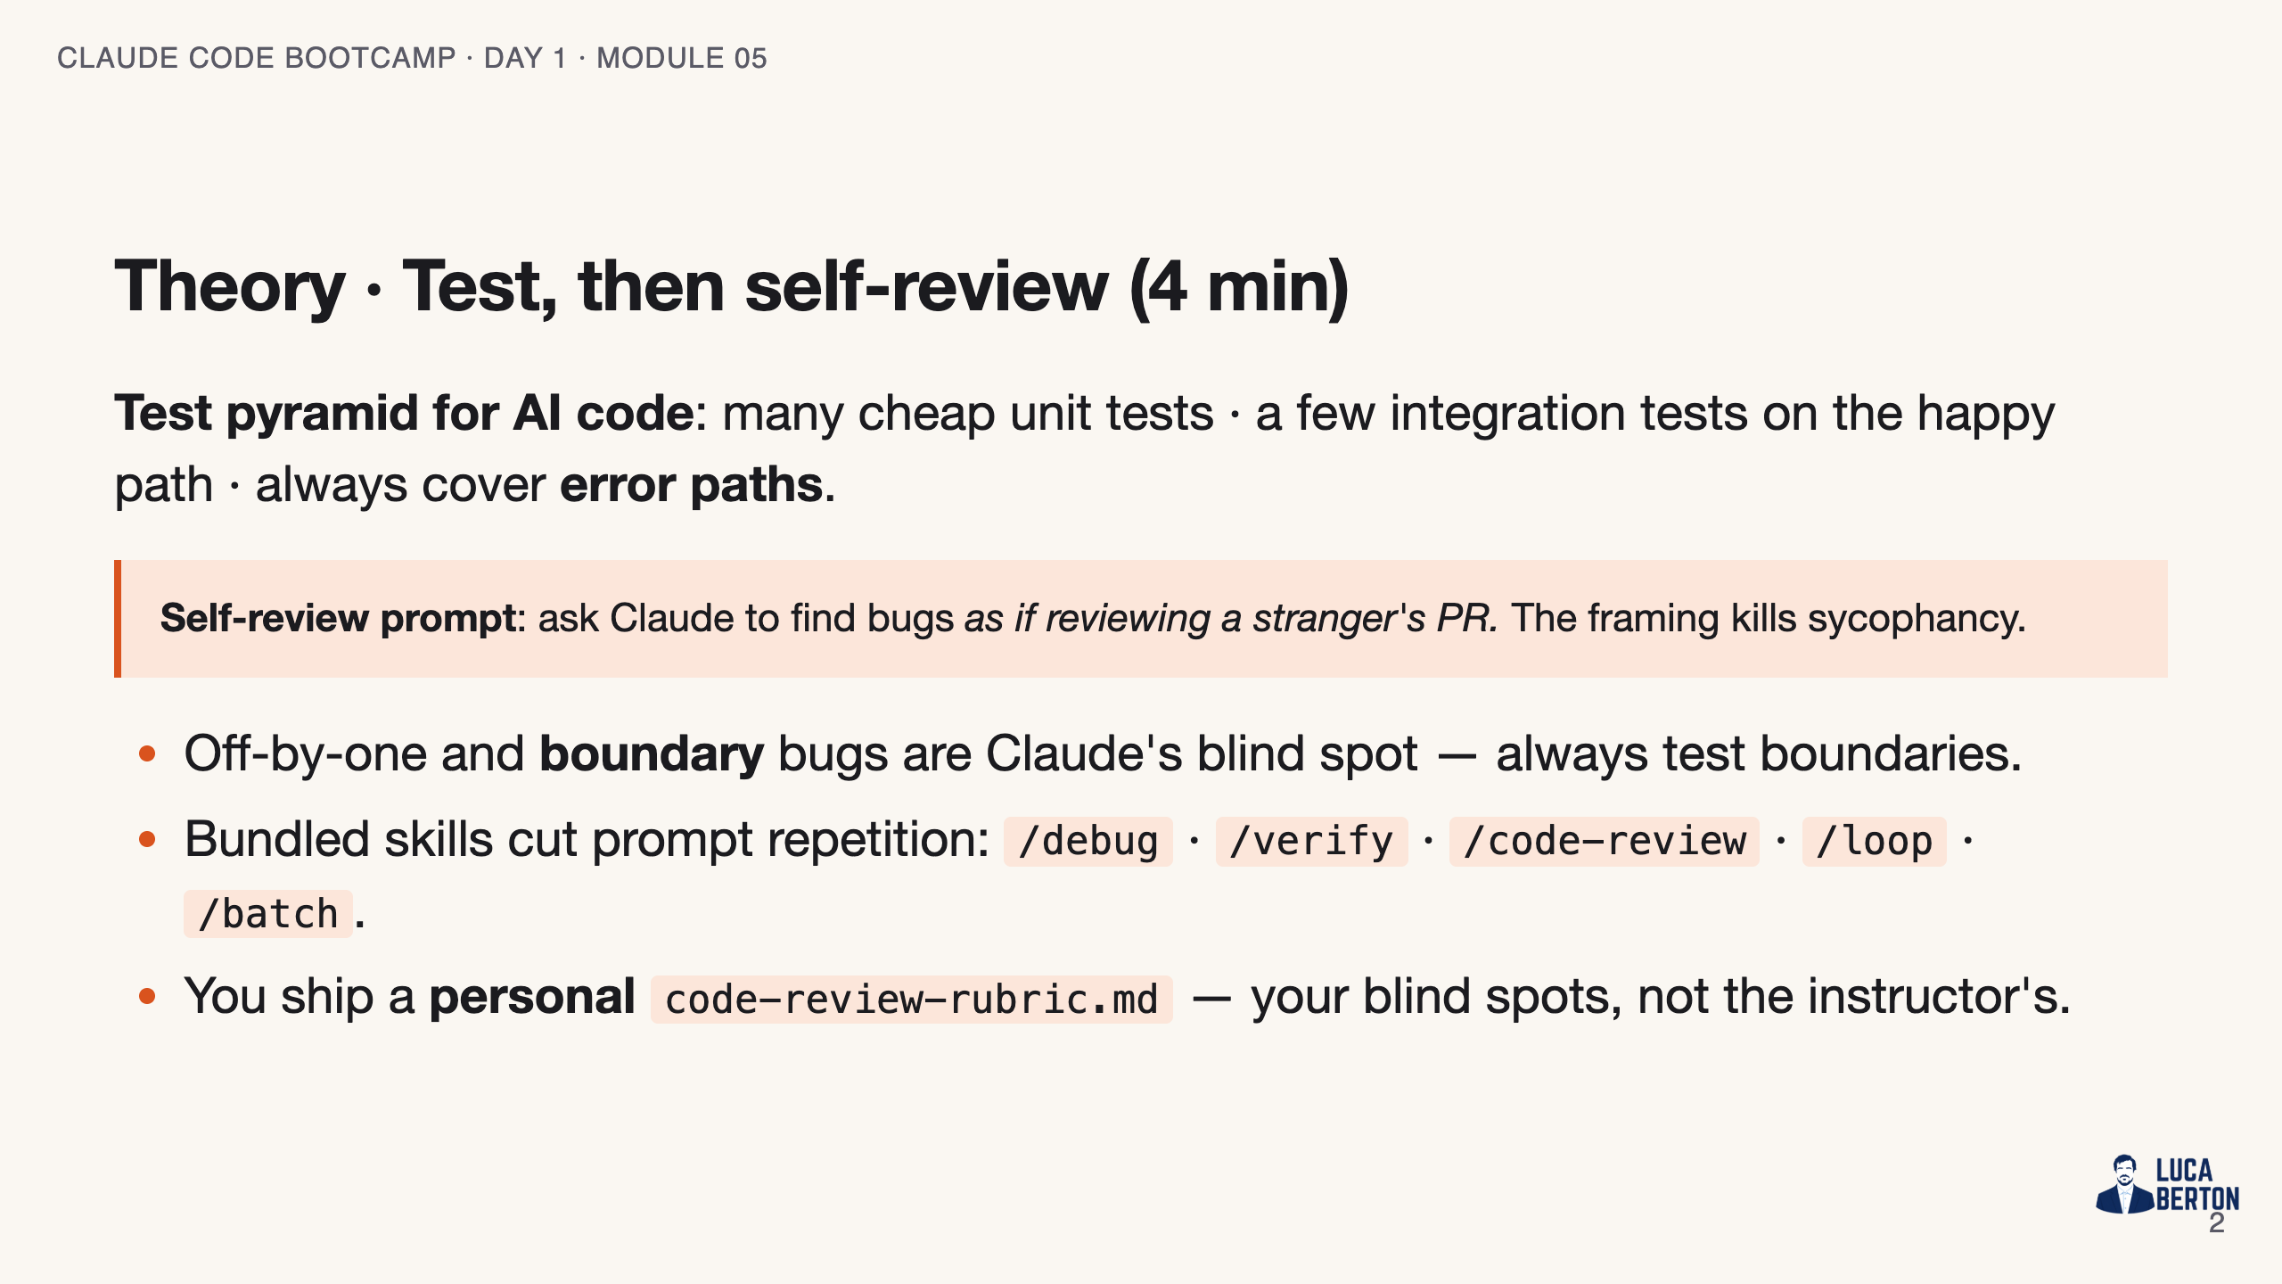
Notes:
SPEAKER NOTES — slide 2 (theory, 4 min) - The "stranger's PR" phrase is the whole trick — say it twice.

Slide 3
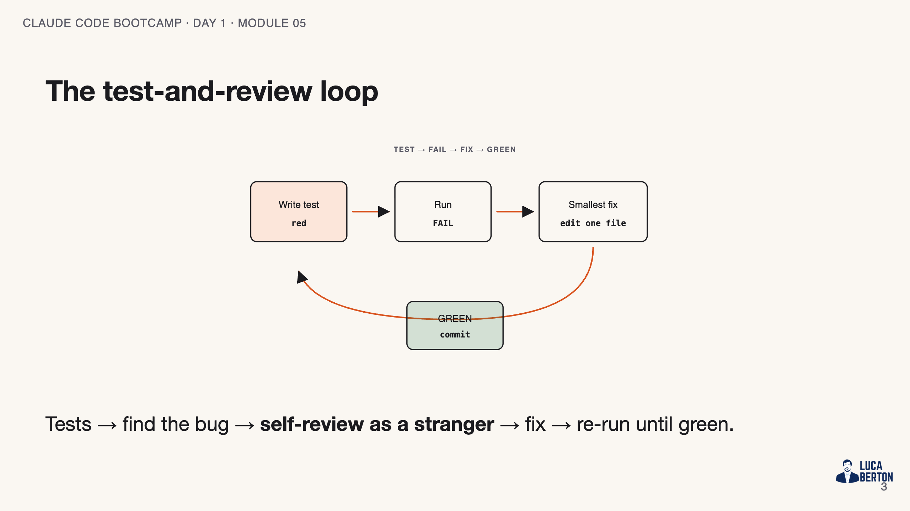
Notes:
SPEAKER NOTES — slide 3 (diagram, 1 min) - The self-review step is the one humans skip; that's where the rubric lives.

Slide 4
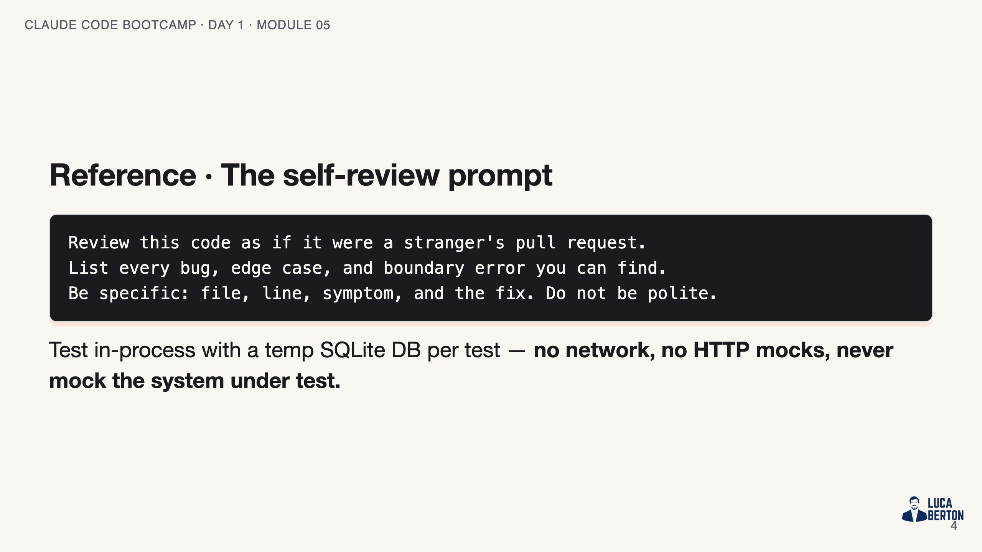
Notes:
SPEAKER NOTES — slide 3 (reference, 1 min)

Slide 5
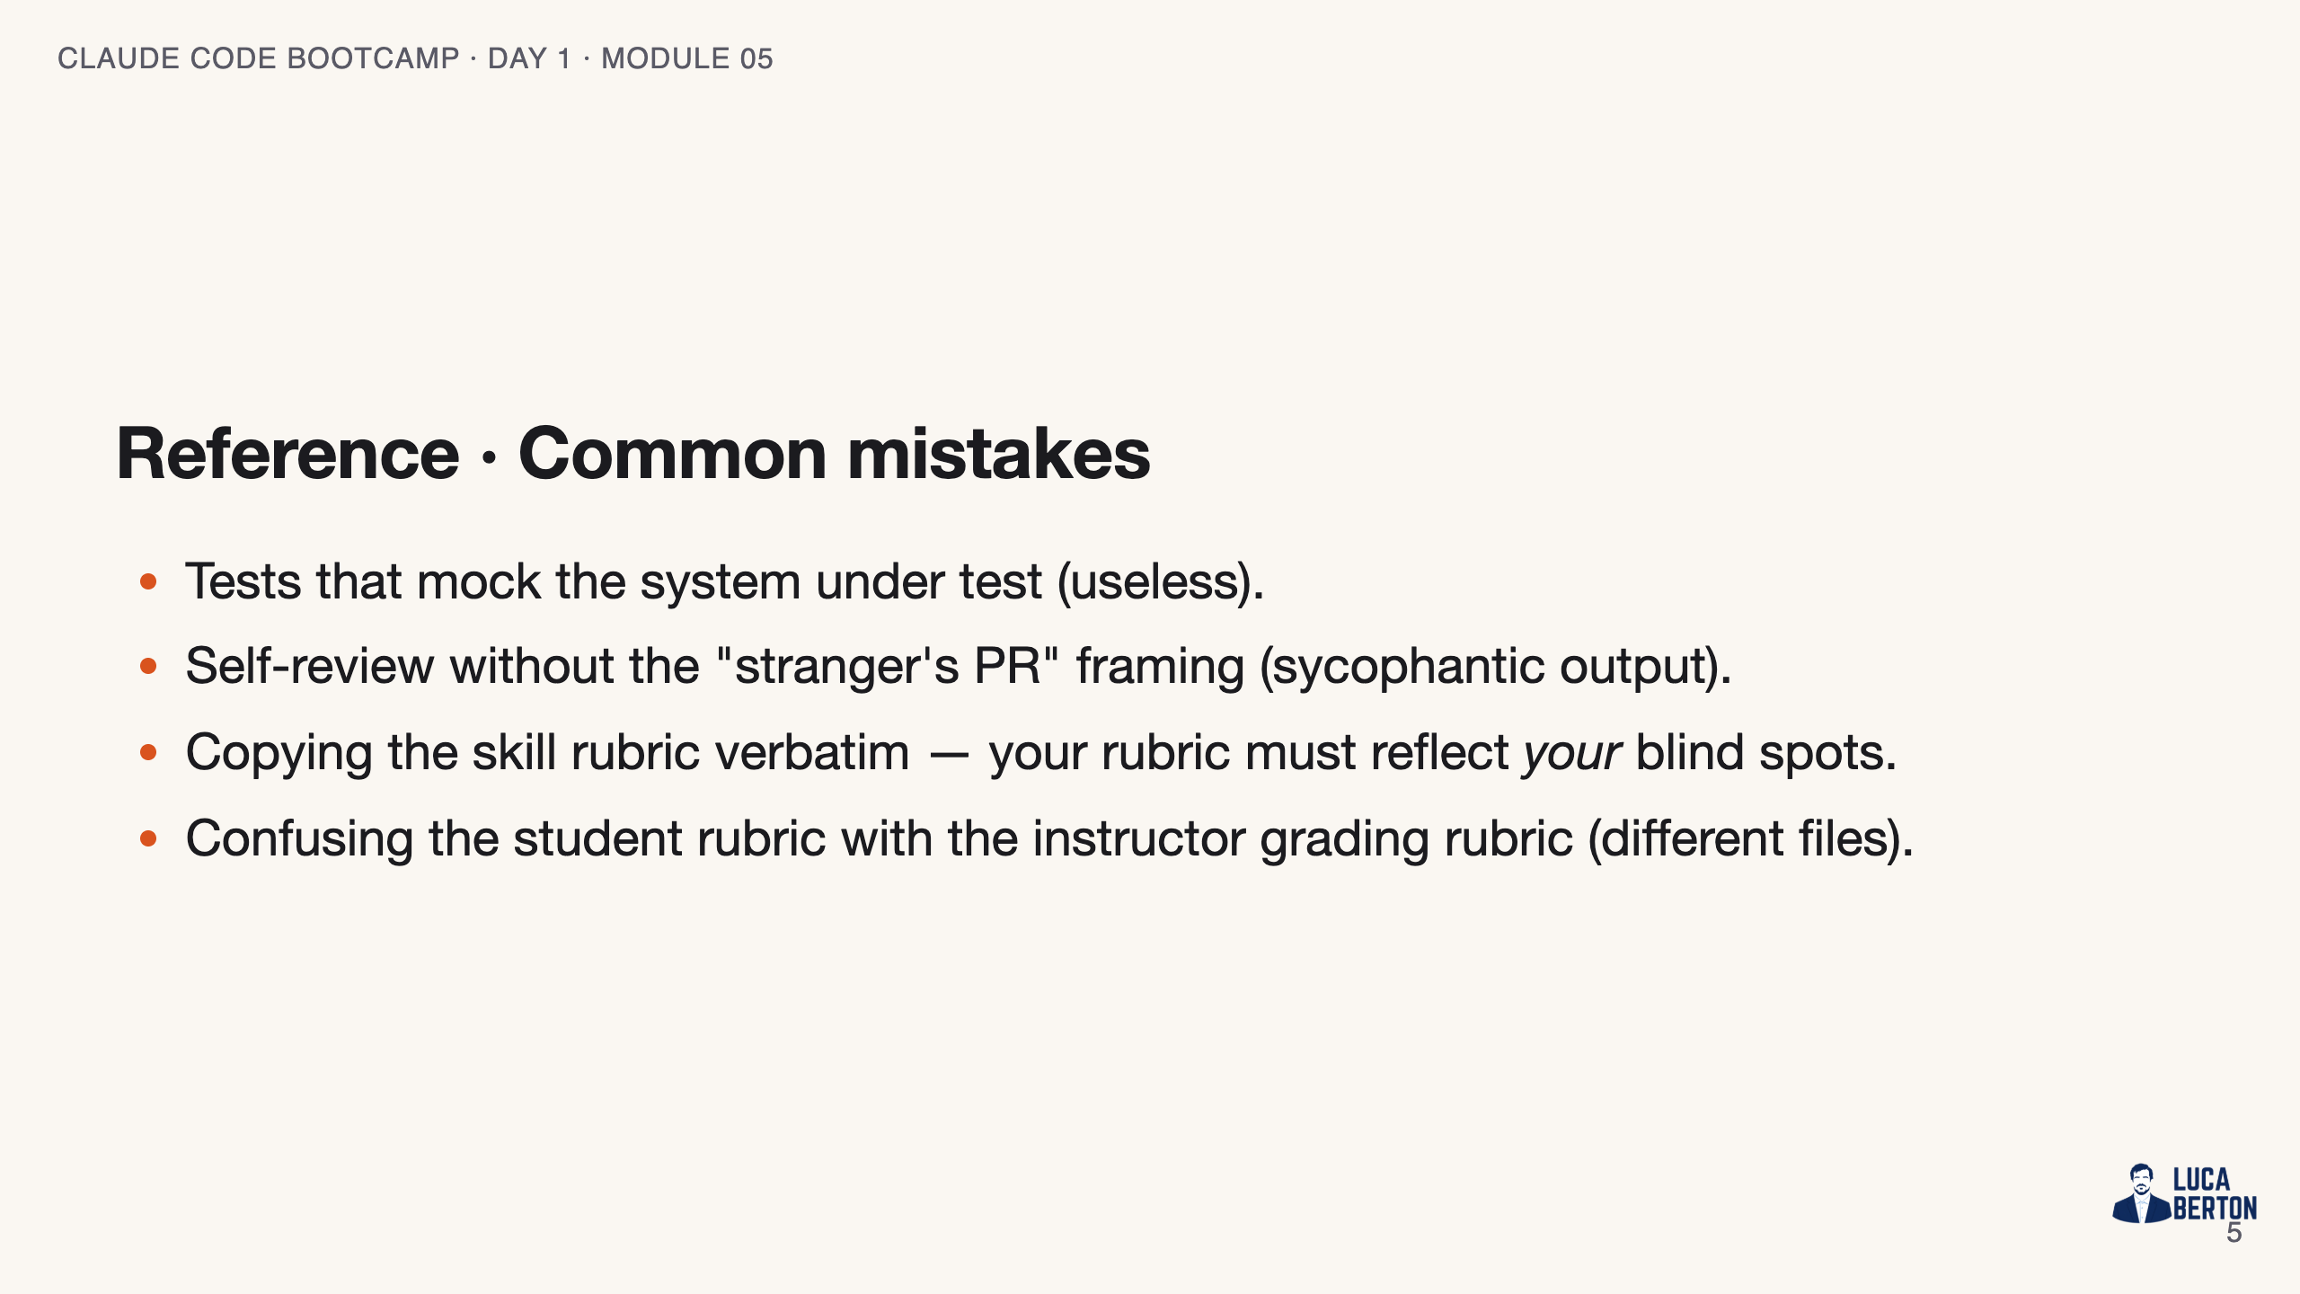
Notes:
SPEAKER NOTES — slide 4 (common mistakes, 30 sec) Instructor cues: - Plant the first bug live; let the class plant the second.

Slide 6
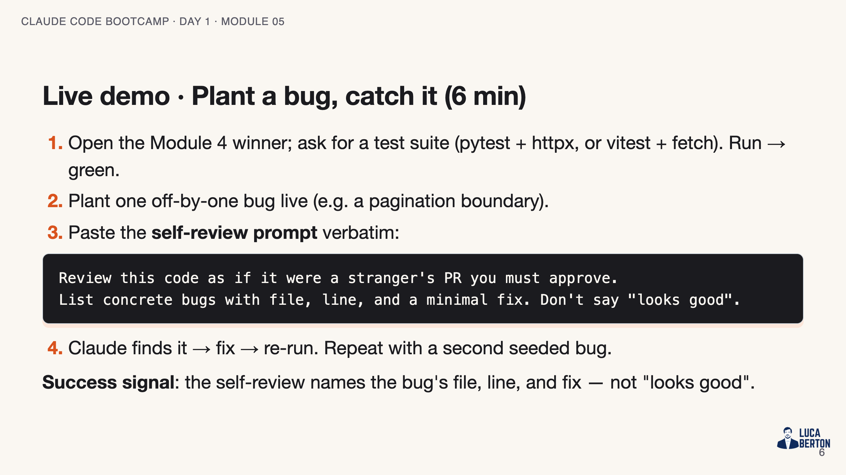
Notes:
SPEAKER NOTES — slide 5 (demo, 6 min) - If Claude misses the bug, that's a teachable moment: refine the framing, don't accept the miss.

Slide 7
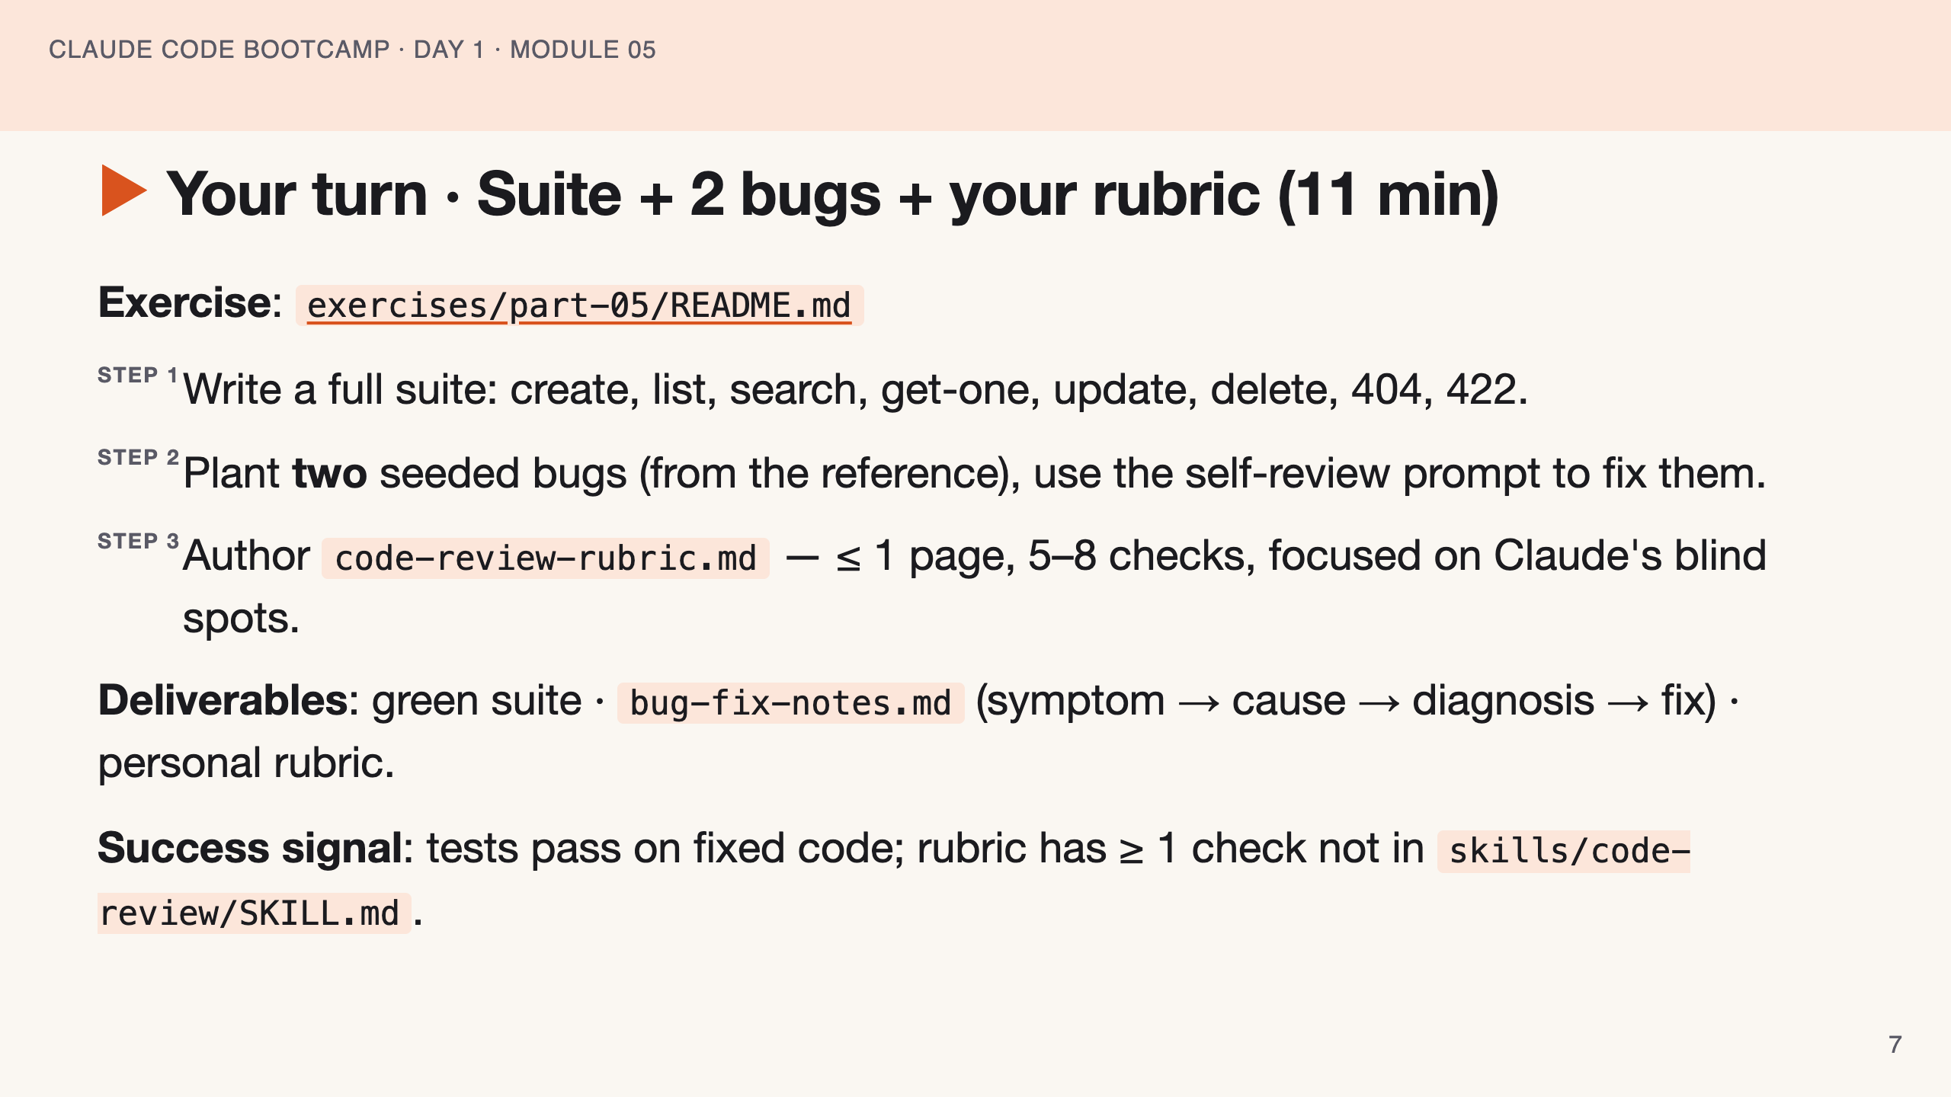
Notes:
SPEAKER NOTES — slide 6 (hands-on, 11 min) - Walk the room. Catch students mocking the app itself. 3-min warning before wrap.

Slide 8
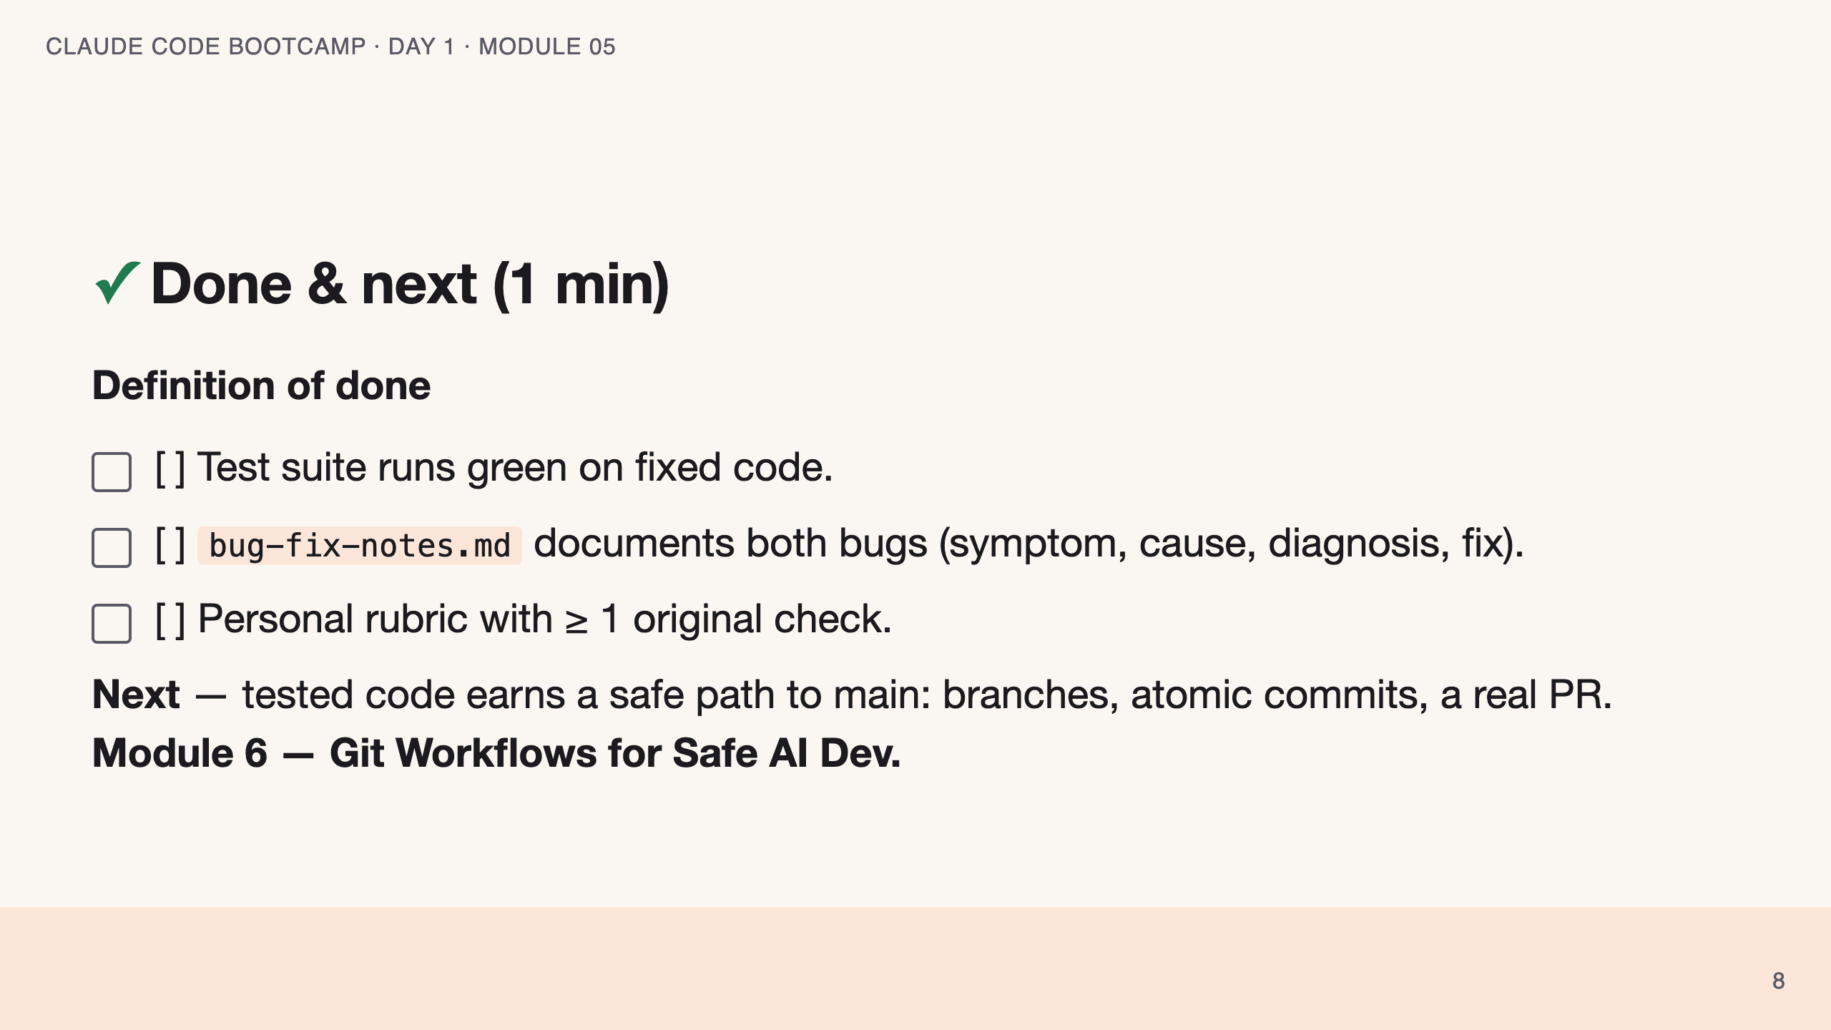
Notes:
SPEAKER NOTES — slide 7 (wrap, 1 min) polish-log 2026-05-28 · lean instructor-pacing shape (matches Module 1 pilot). cover -> theory (test + self-review) -> reference (prompt · mistakes) -> live demo -> your turn -> done.

