Slide 1

Notes:
duration: 22 min SPEAKER NOTES — slide 1 (hook, 60 sec) - One line: "Claude can write great commits and PRs — from the diff, not the prompt."

Slide 2
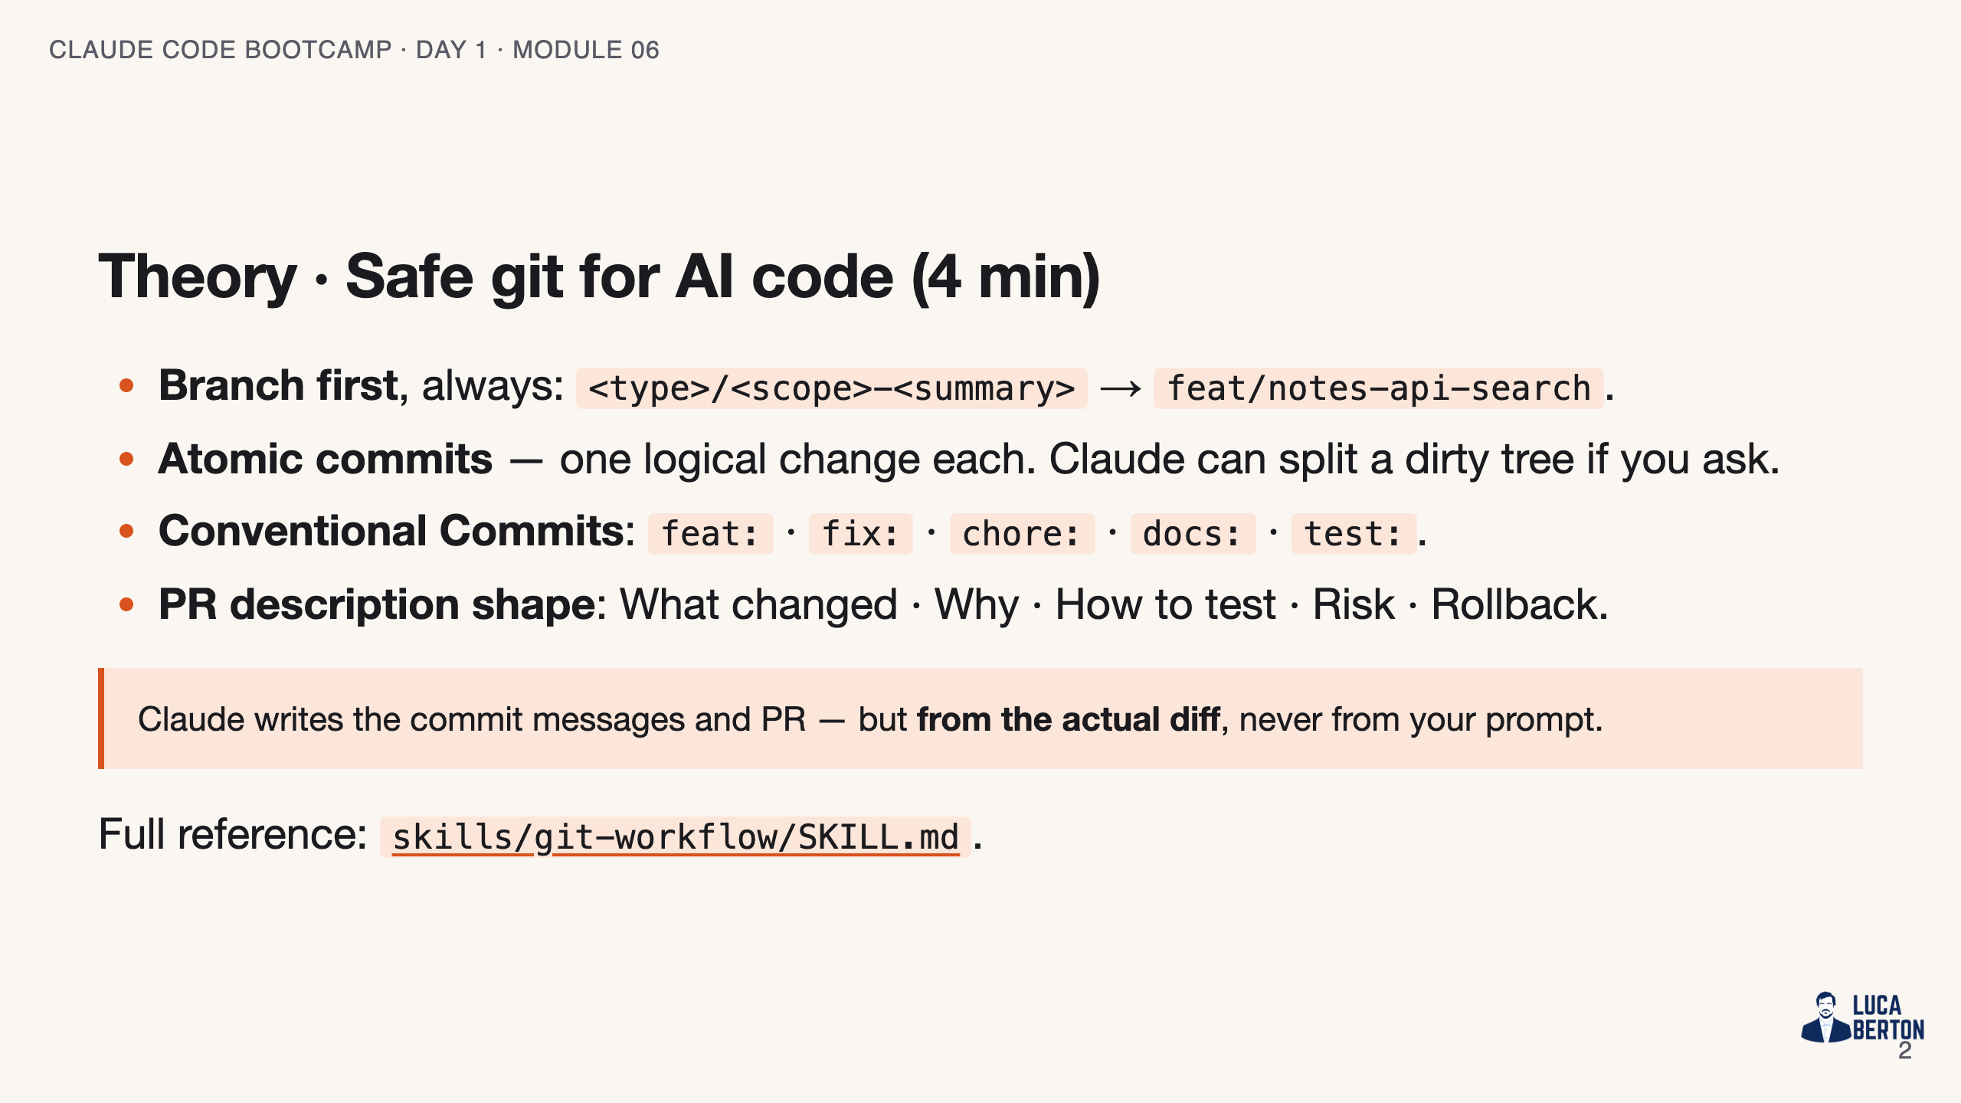
Notes:
SPEAKER NOTES — slide 2 (theory, 4 min) - "From the diff, not the prompt" — say it. PRs written from prompts lie about what shipped.

Slide 3
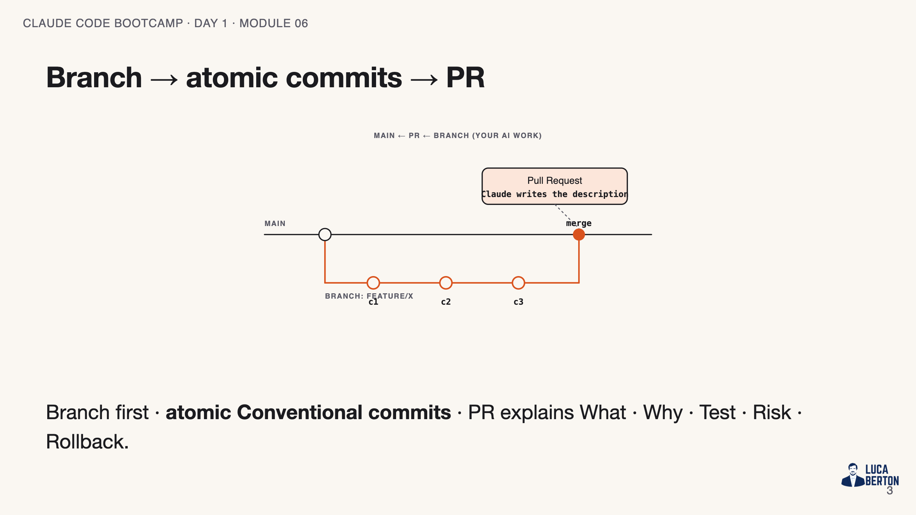
Notes:
SPEAKER NOTES — slide 3 (diagram, 1 min) - Trace left to right; every commit is one logical change.

Slide 4
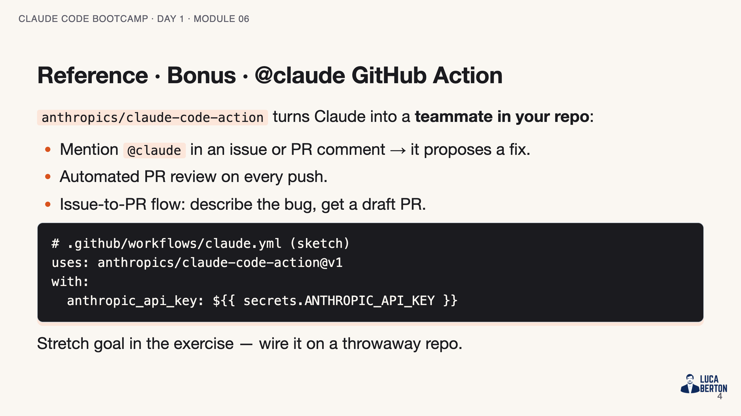
Notes:
SPEAKER NOTES — slide 3 (reference, 1 min) - Optional. Only the fast finishers wire the Action; everyone hears it exists.

Slide 5
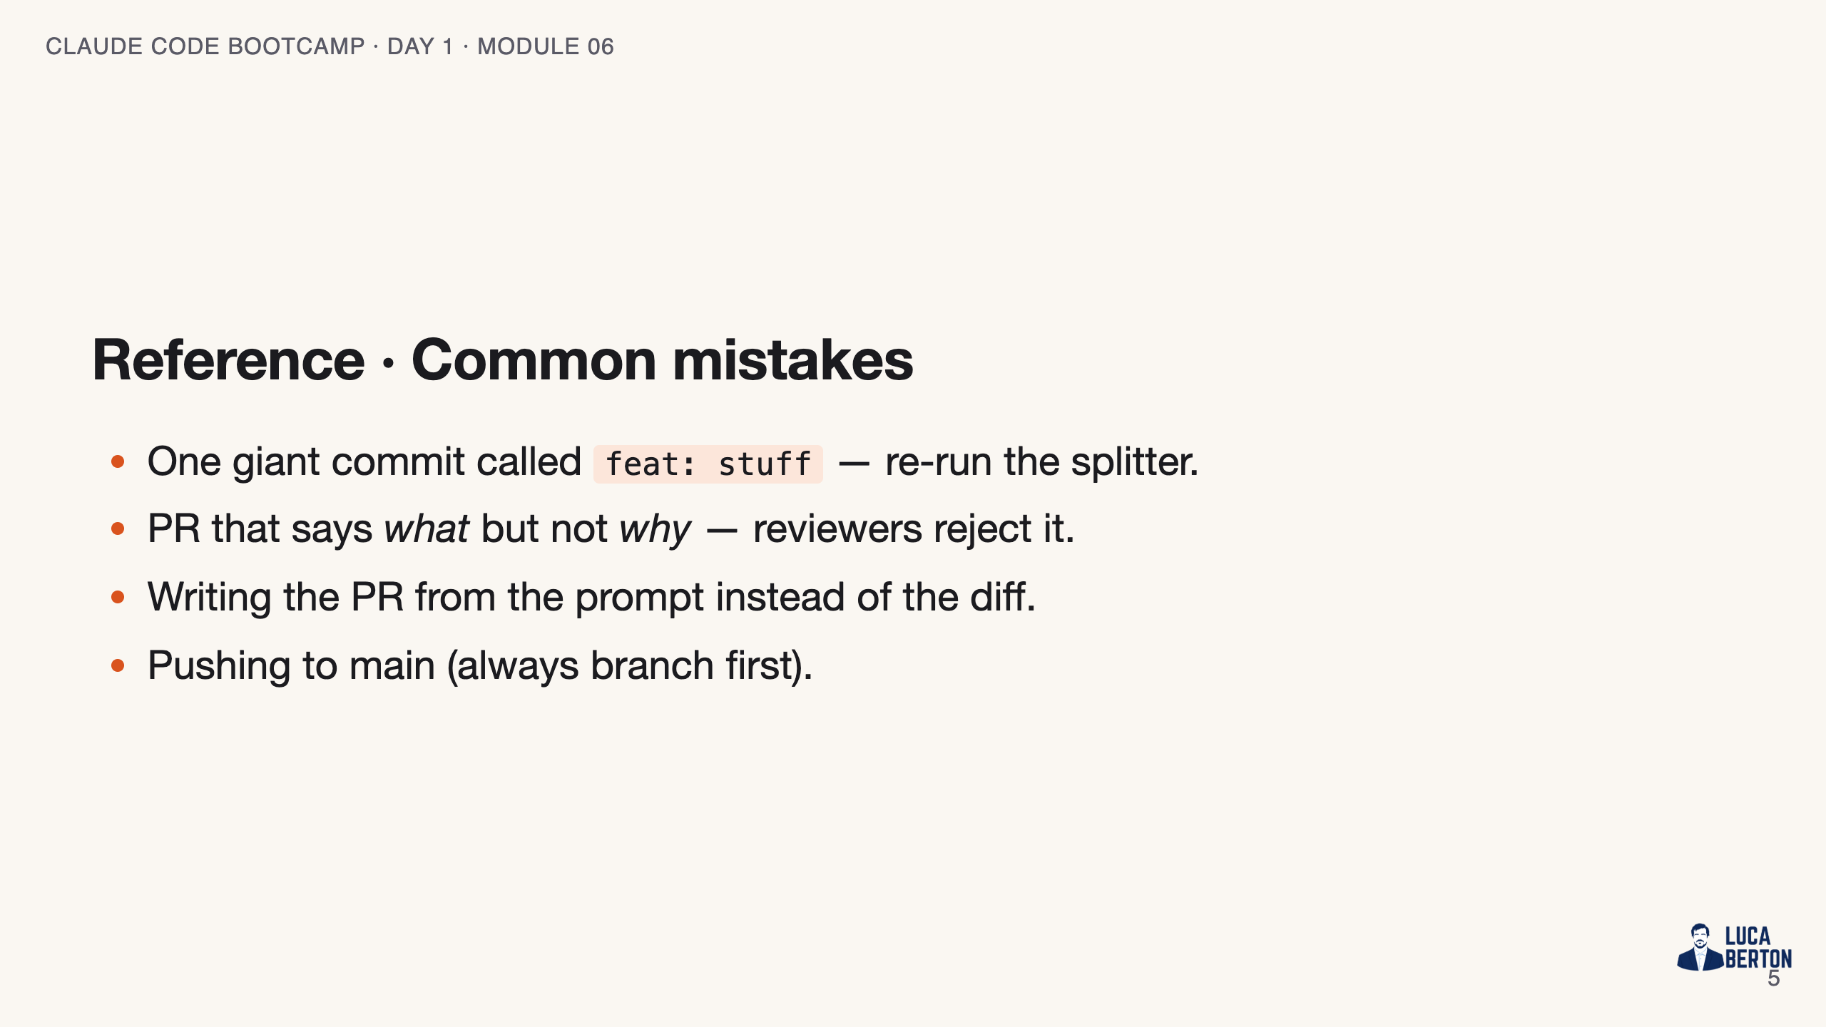
Notes:
SPEAKER NOTES — slide 4 (common mistakes, 30 sec) Instructor cues: - Demo on a dirty working tree so the commit-splitter has something to do.

Slide 6
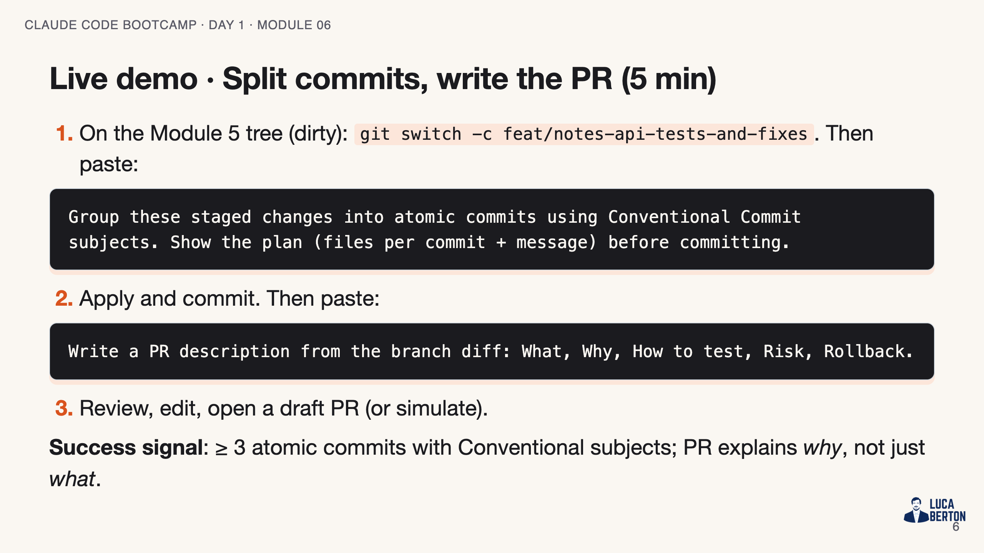
Notes:
SPEAKER NOTES — slide 5 (demo, 5 min)

Slide 7
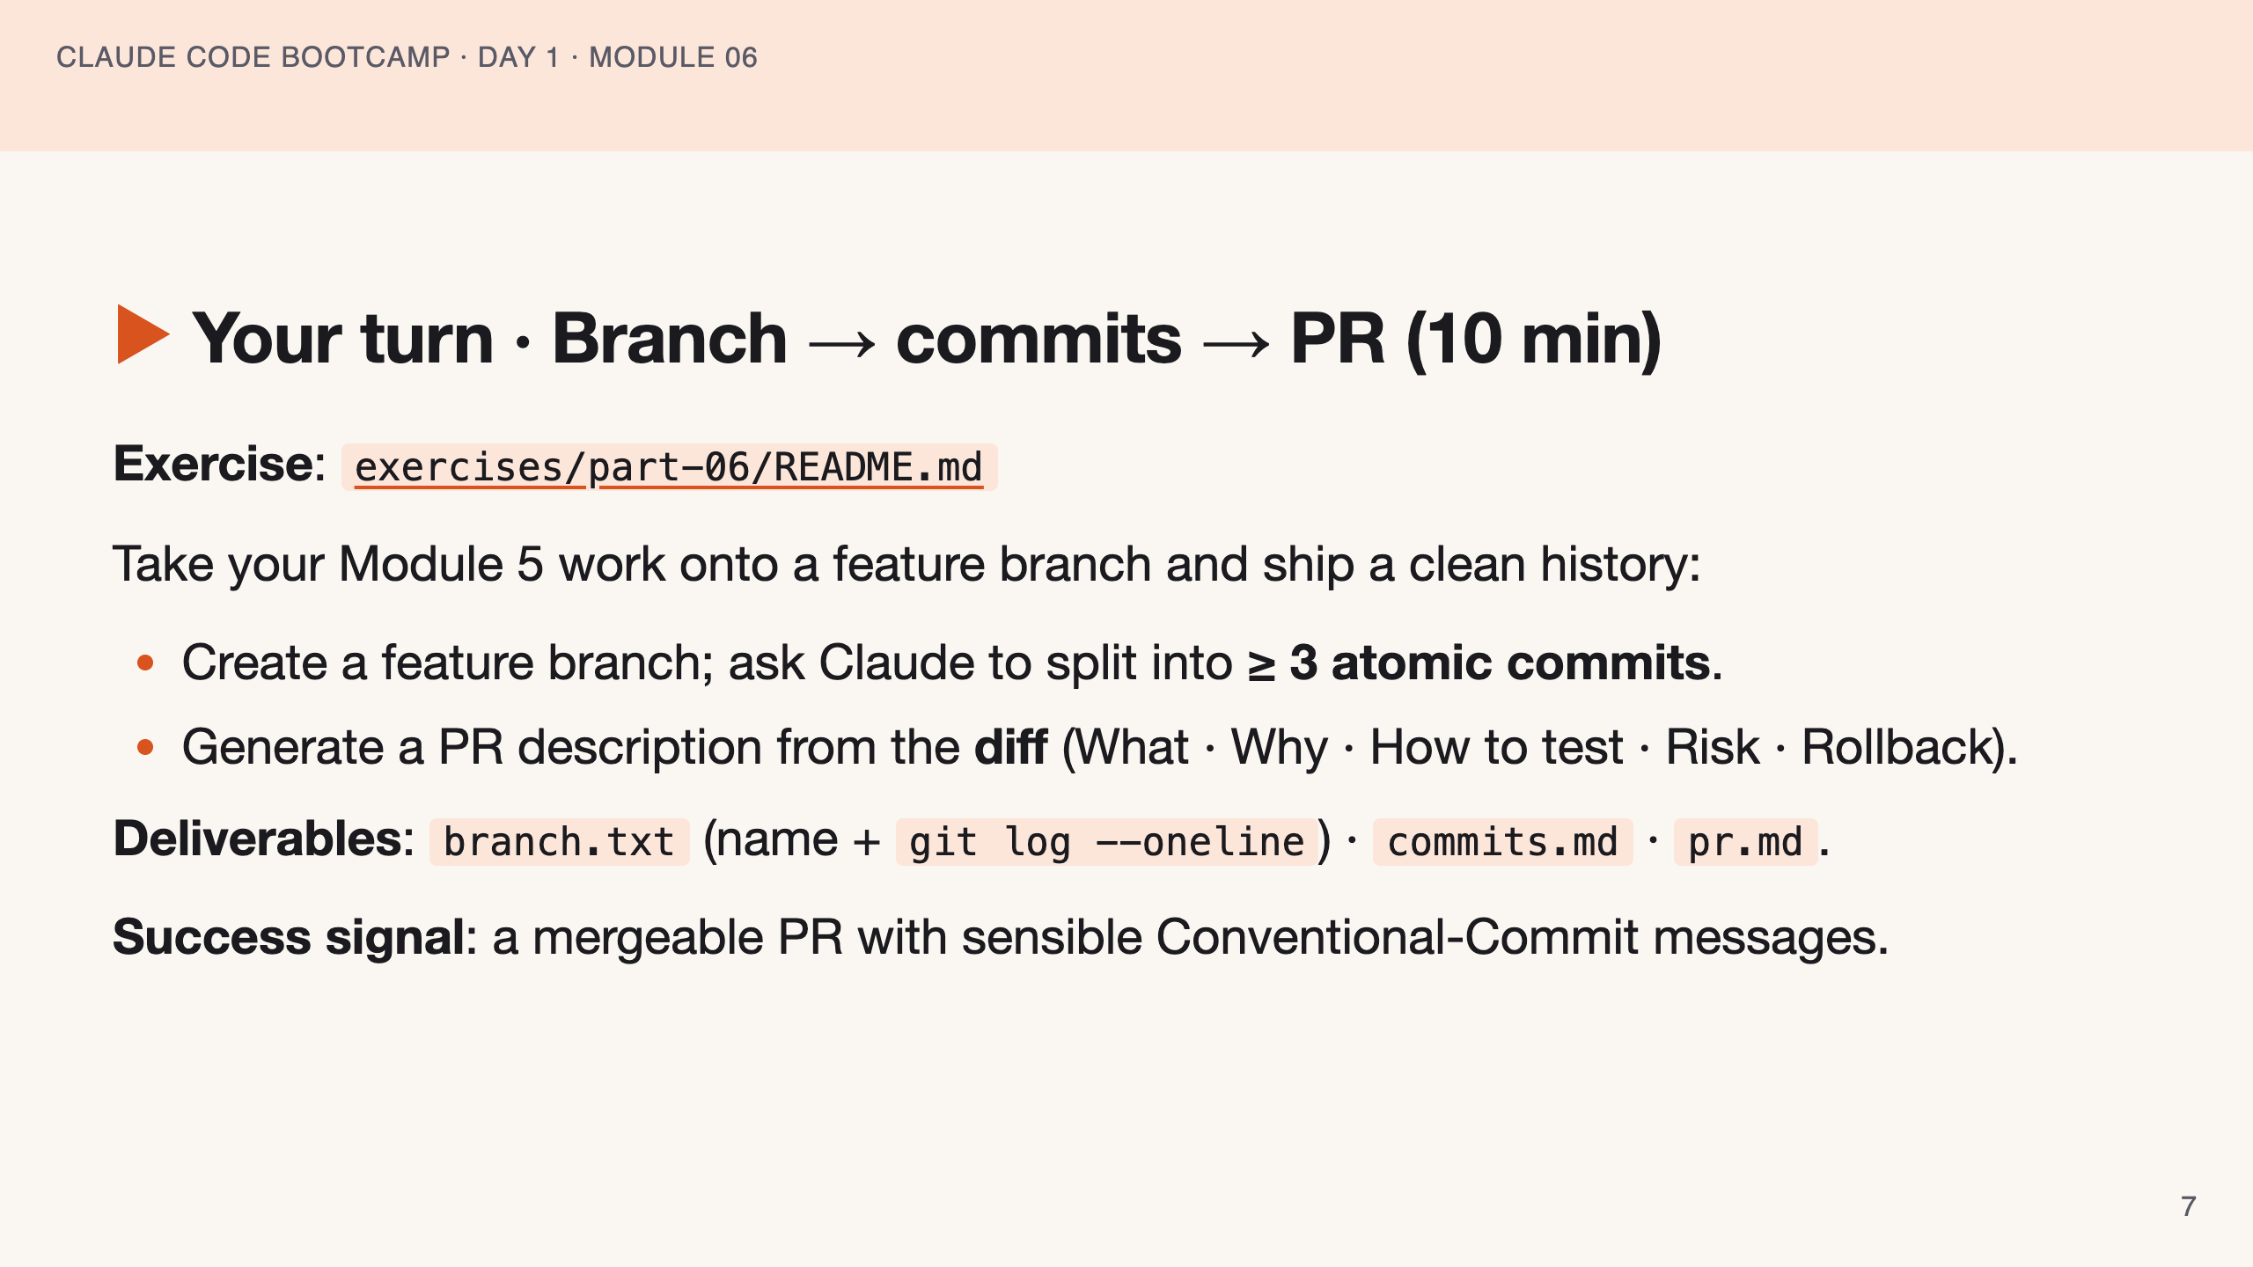
Notes:
SPEAKER NOTES — slide 6 (hands-on, 10 min) - Watch for one-commit submissions — send them back to the splitter. 3-min warning.

Slide 8
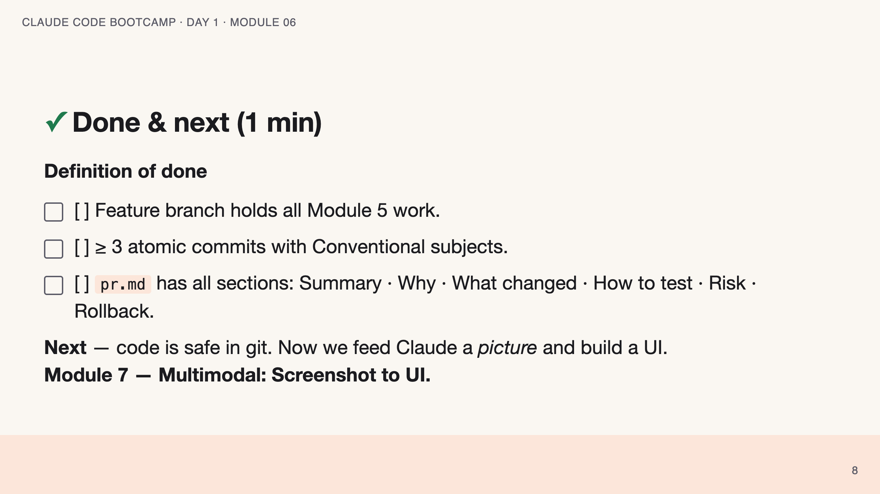
Notes:
SPEAKER NOTES — slide 7 (wrap, 1 min) polish-log 2026-05-28 · lean instructor-pacing shape (matches Module 1 pilot). cover -> theory (safe git) -> reference (@claude Action · mistakes) -> live demo -> your turn -> done.

