Slide 1

Notes:
duration: 30 min SPEAKER NOTES — slide 1 (hook, 60 sec) - One line: "Today the prompt includes an image. We turn a wireframe into a running dashboard."

Slide 2
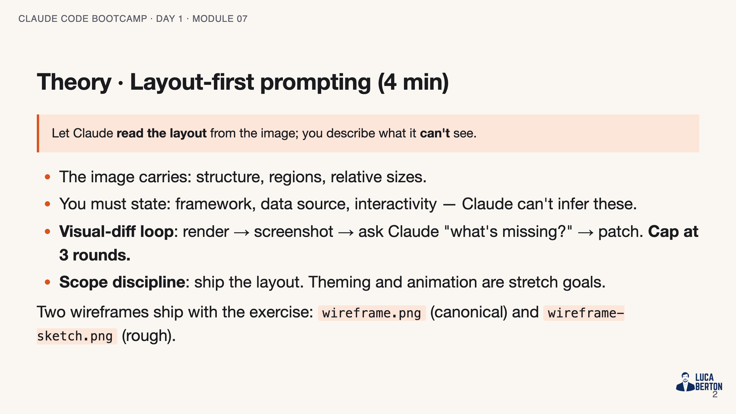
Notes:
SPEAKER NOTES — slide 2 (theory, 4 min) - Forgetting to attach the image is the #1 fail — Claude can't read what isn't attached.

Slide 3
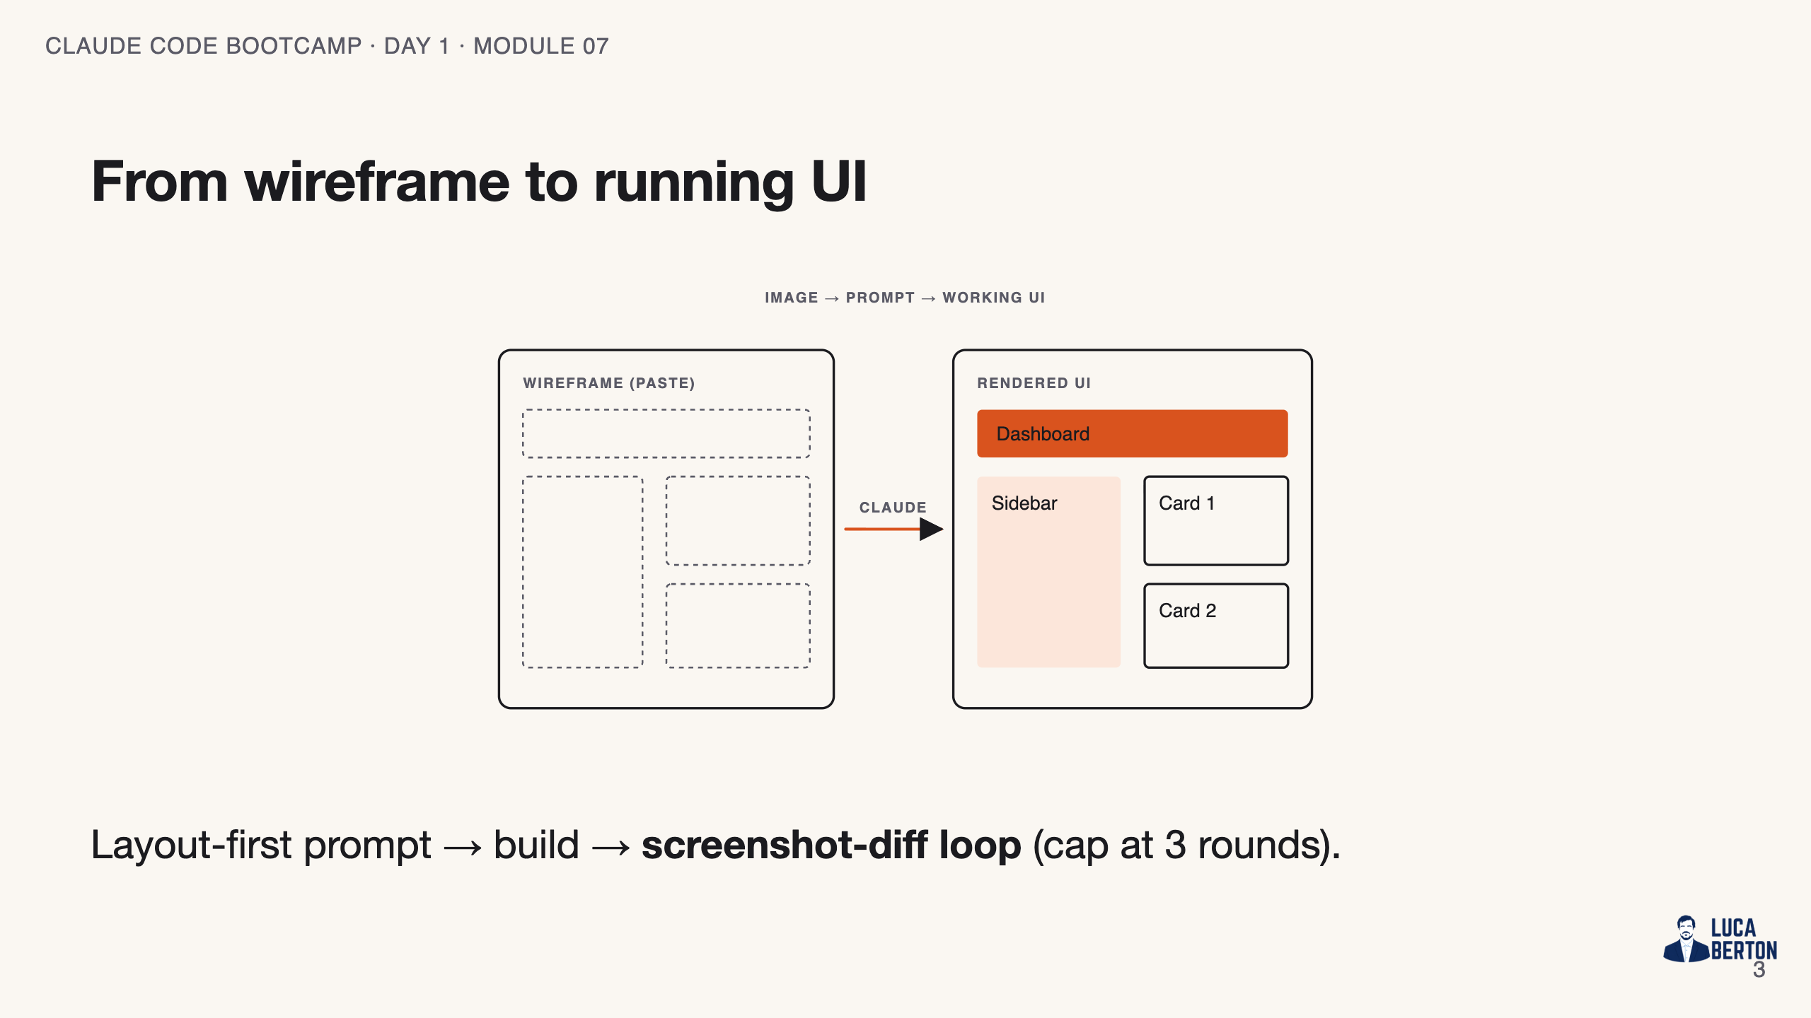
Notes:
SPEAKER NOTES — slide 3 (diagram, 1 min) - The diff loop is the engine; the cap stops infinite pixel-chasing.

Slide 4
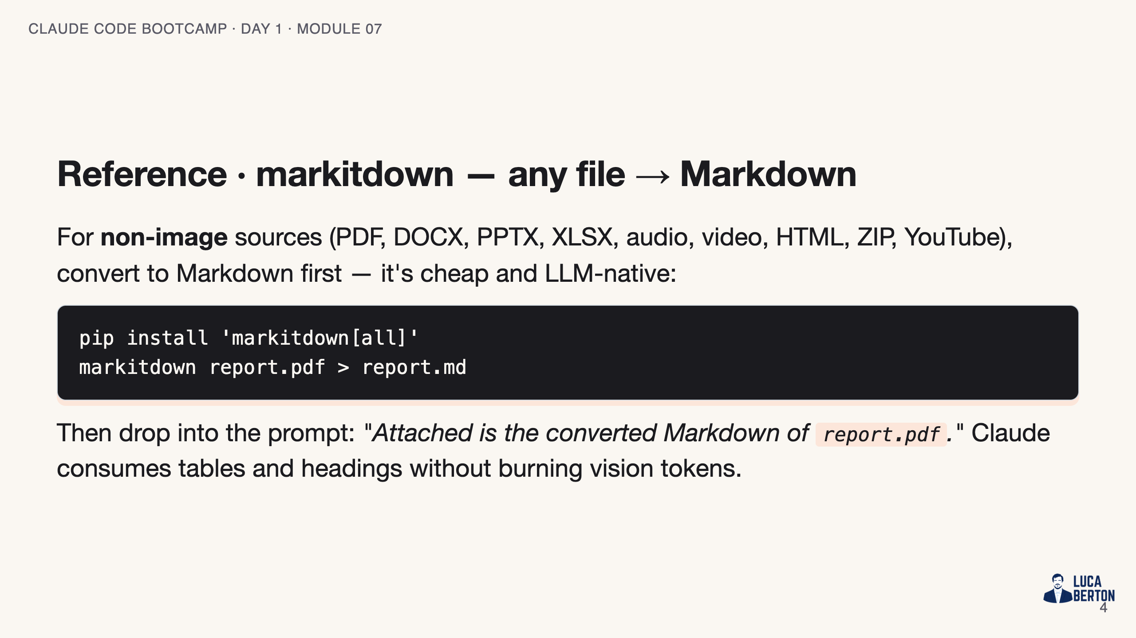
Notes:
SPEAKER NOTES — slide 3 (reference, 1 min) - markitdown is the bridge for documents; image attachment is the bridge for visuals.

Slide 5
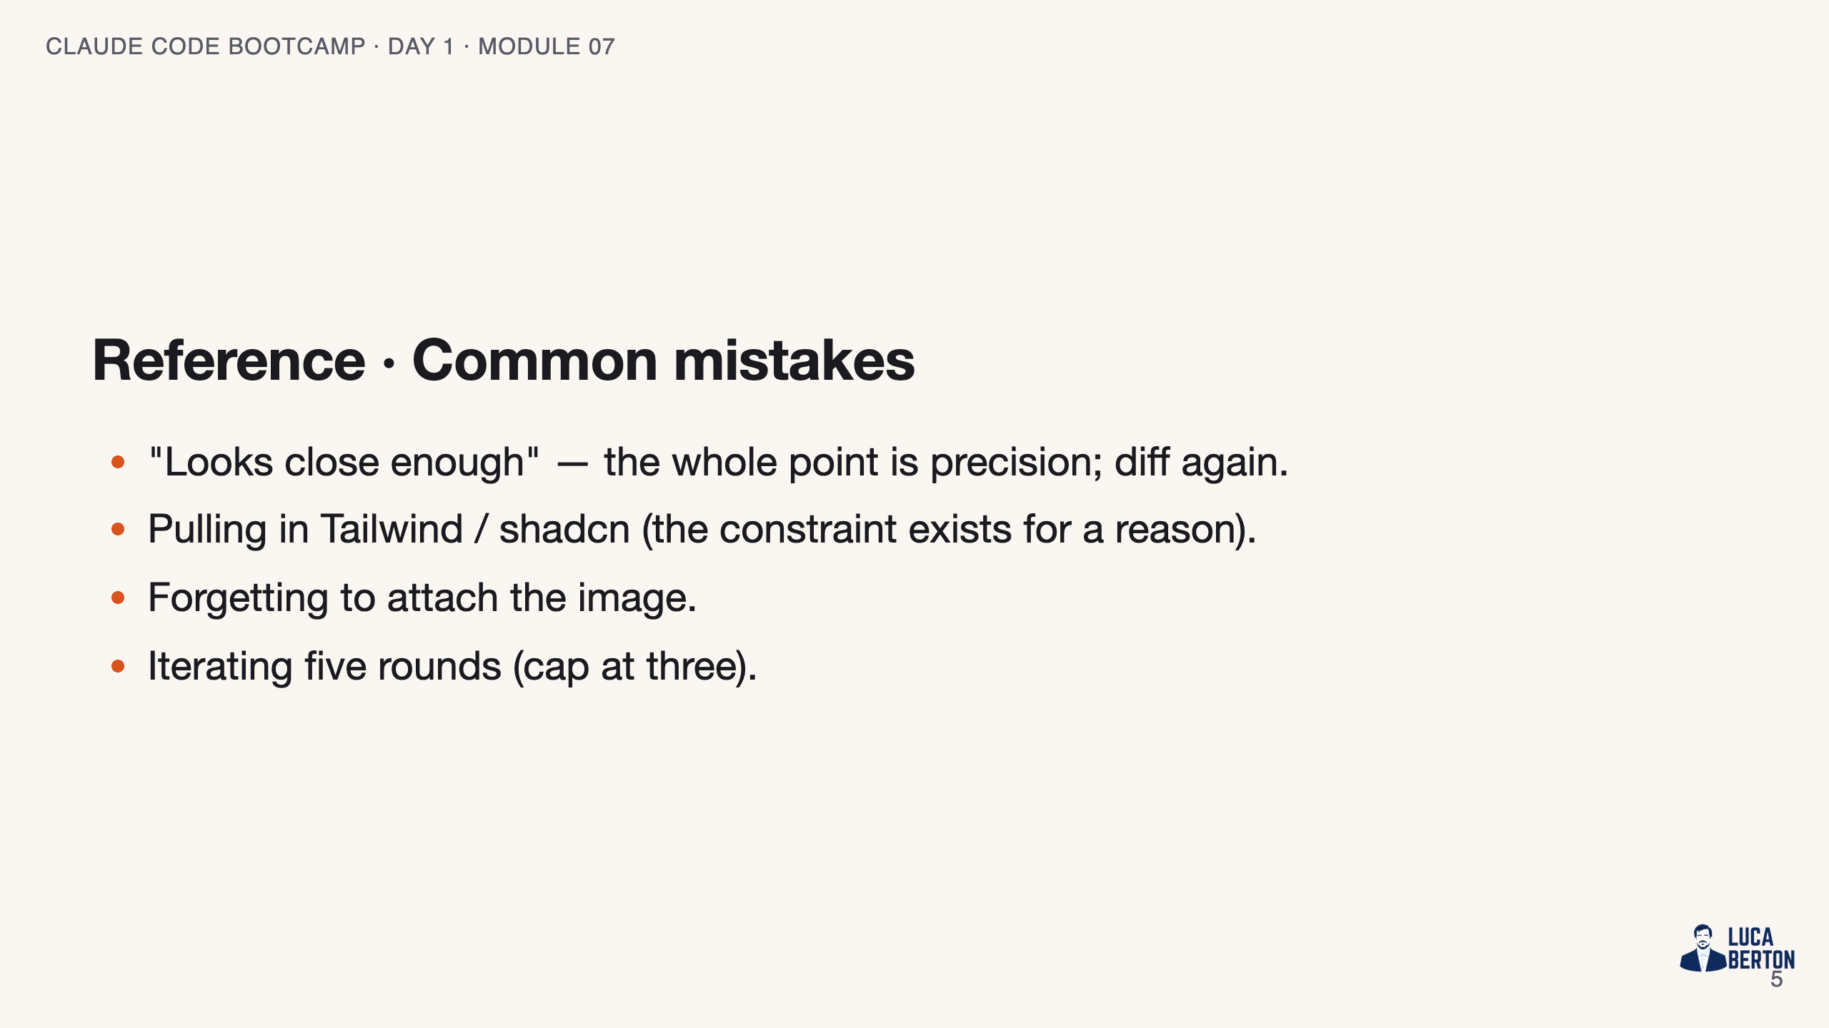
Notes:
SPEAKER NOTES — slide 4 (common mistakes, 30 sec) Instructor cues: - Project the wireframe and the render side-by-side throughout.

Slide 6
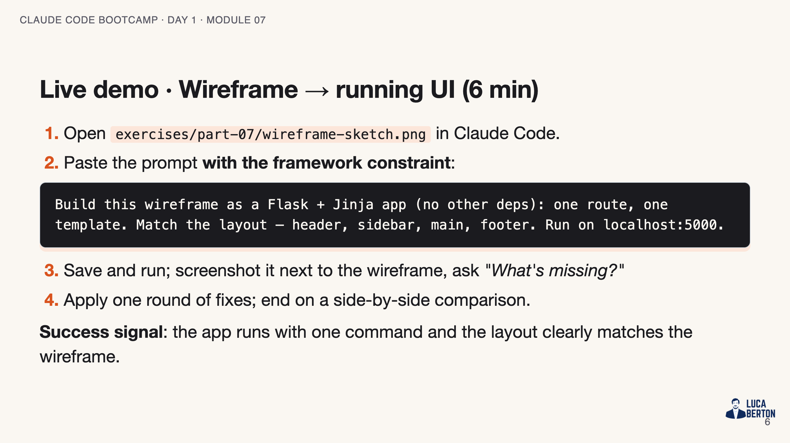
Notes:
SPEAKER NOTES — slide 5 (demo, 6 min)

Slide 7
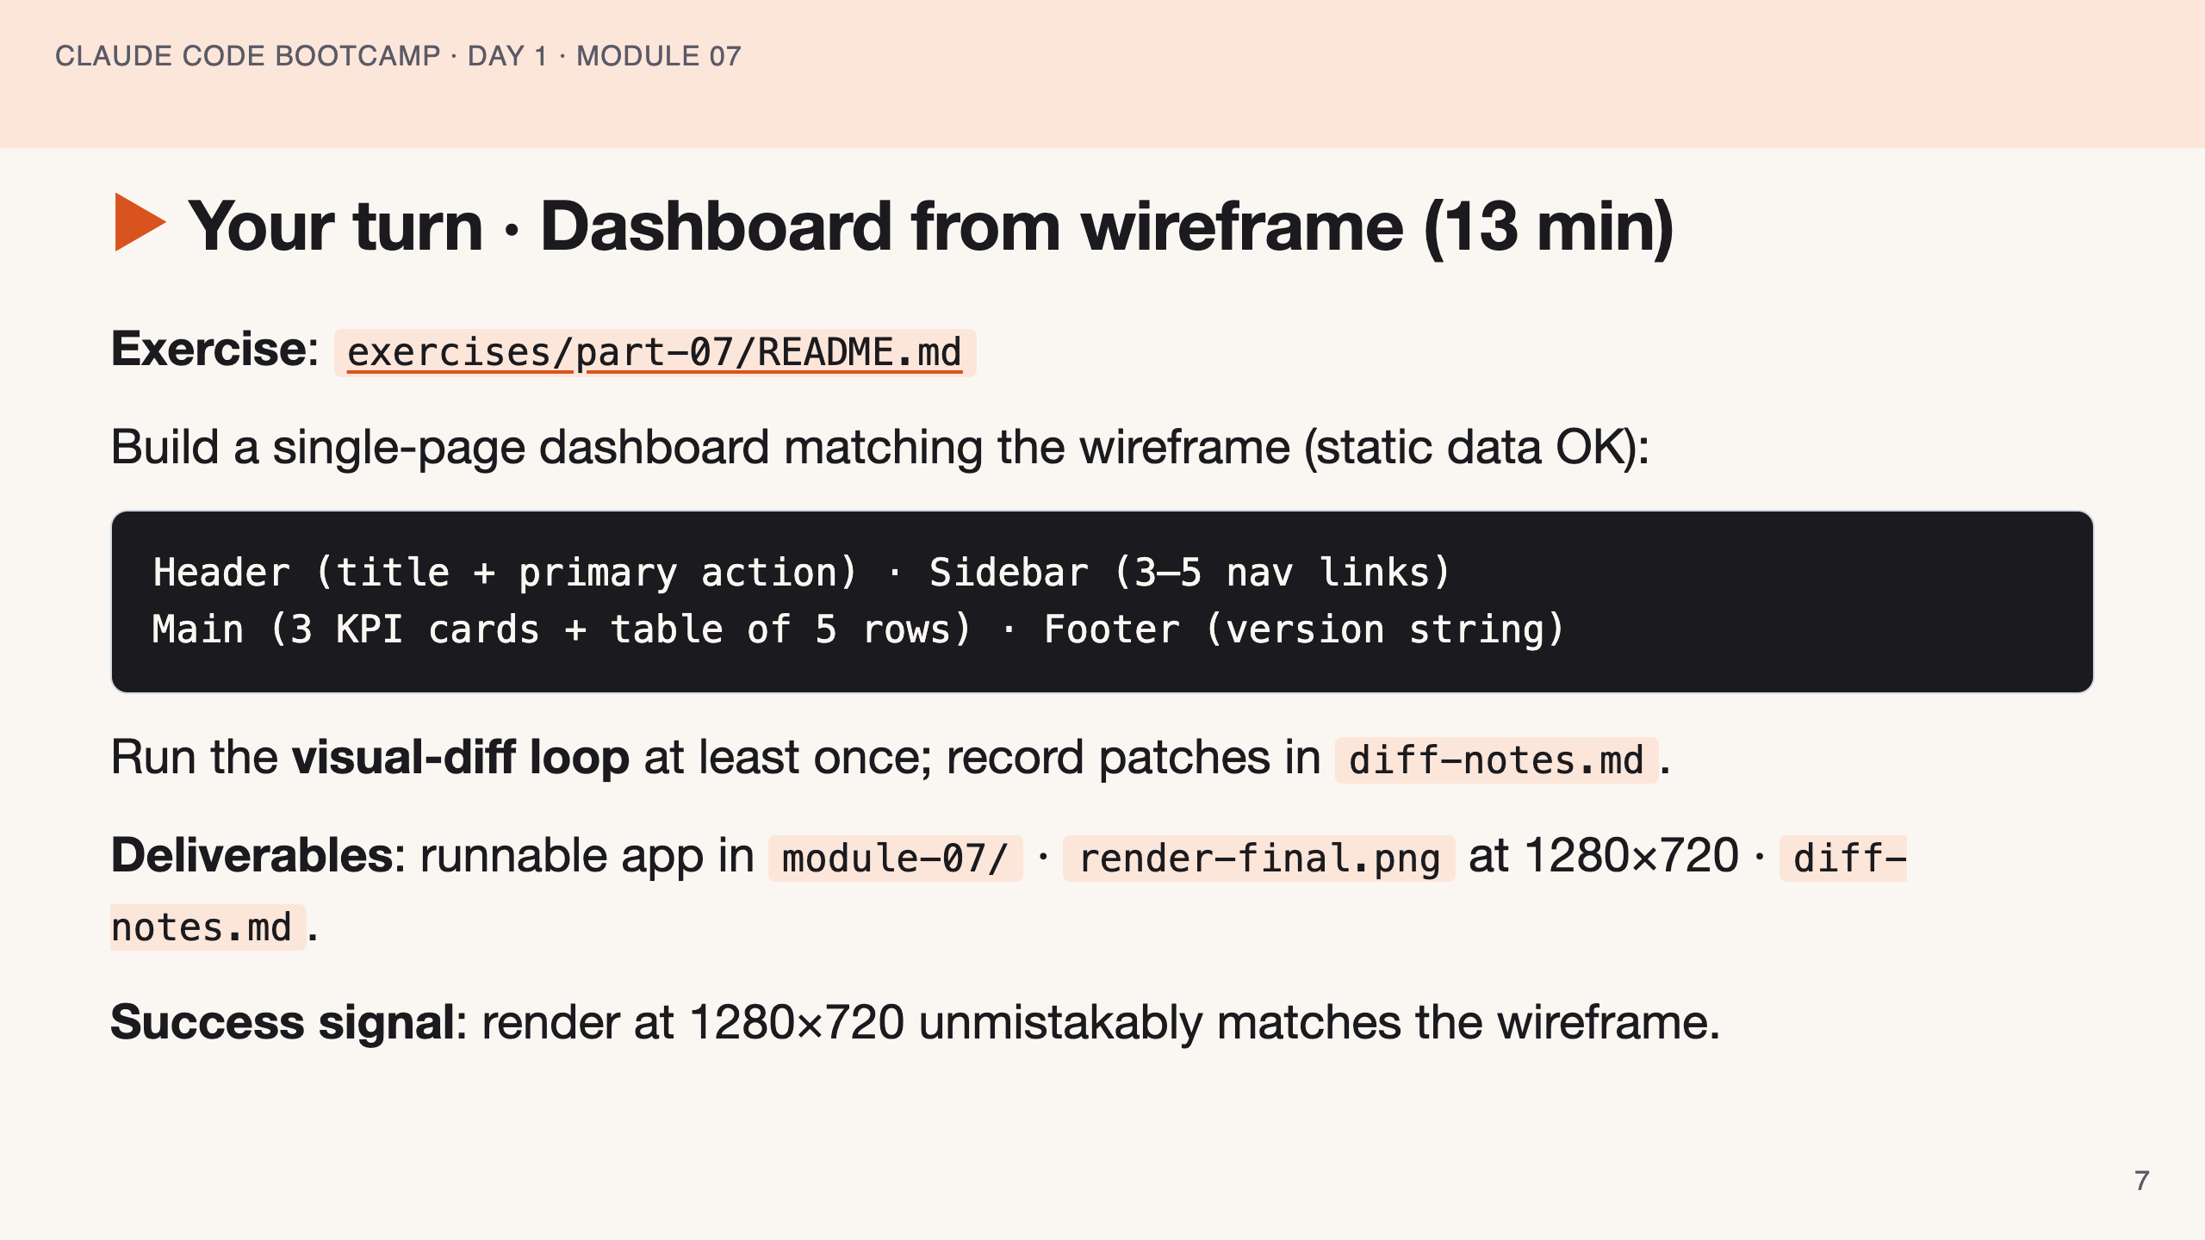
Notes:
SPEAKER NOTES — slide 6 (hands-on, 13 min) - Catch students who skip the diff loop. "Looks close" isn't done. 3-min warning.

Slide 8
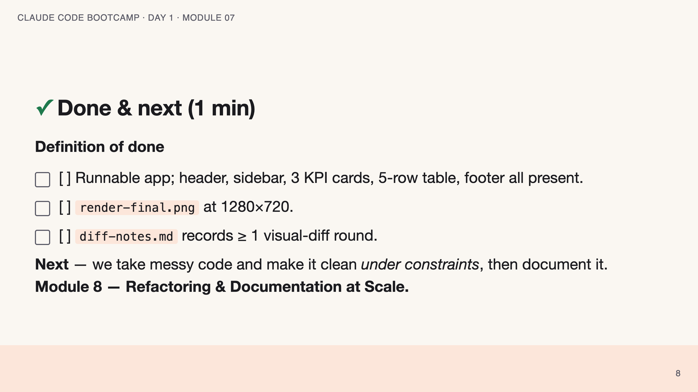
Notes:
SPEAKER NOTES — slide 7 (wrap, 1 min) polish-log 2026-05-28 · lean instructor-pacing shape (matches Module 1 pilot). cover -> theory (layout-first) -> reference (markitdown · mistakes) -> live demo -> your turn -> done.

