Slide 1
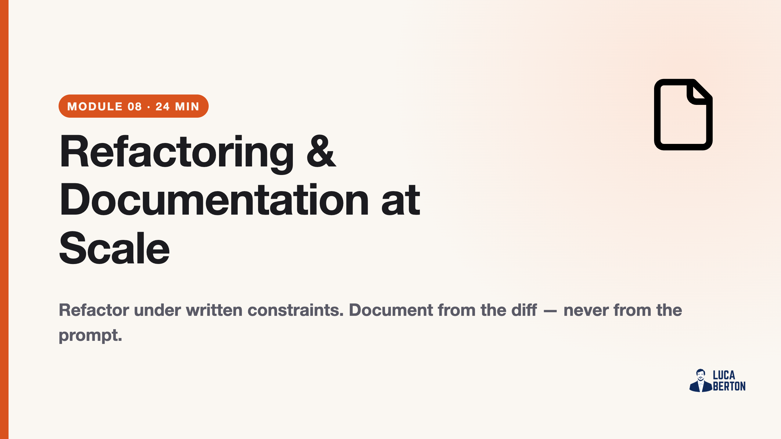
Notes:
duration: 24 min SPEAKER NOTES — slide 1 (hook, 60 sec) - One line: "Unconstrained, Claude rewrites everything. Constrained, it makes a surgical diff."

Slide 2
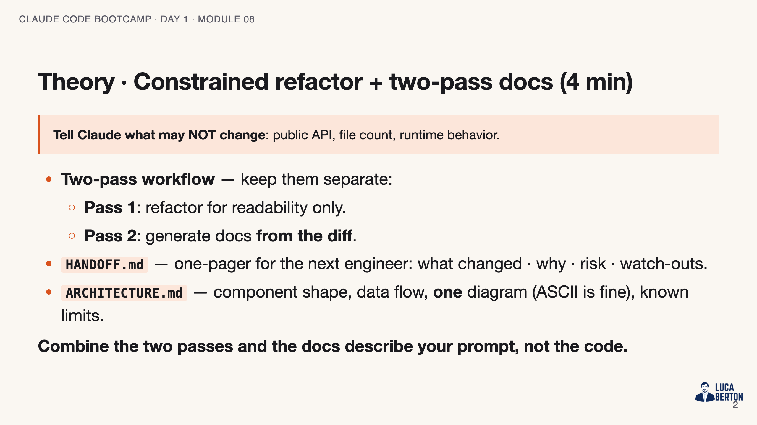
Notes:
SPEAKER NOTES — slide 2 (theory, 4 min) - constraints.md is the lab's load-bearing artefact. No constraints = no lab.

Slide 3
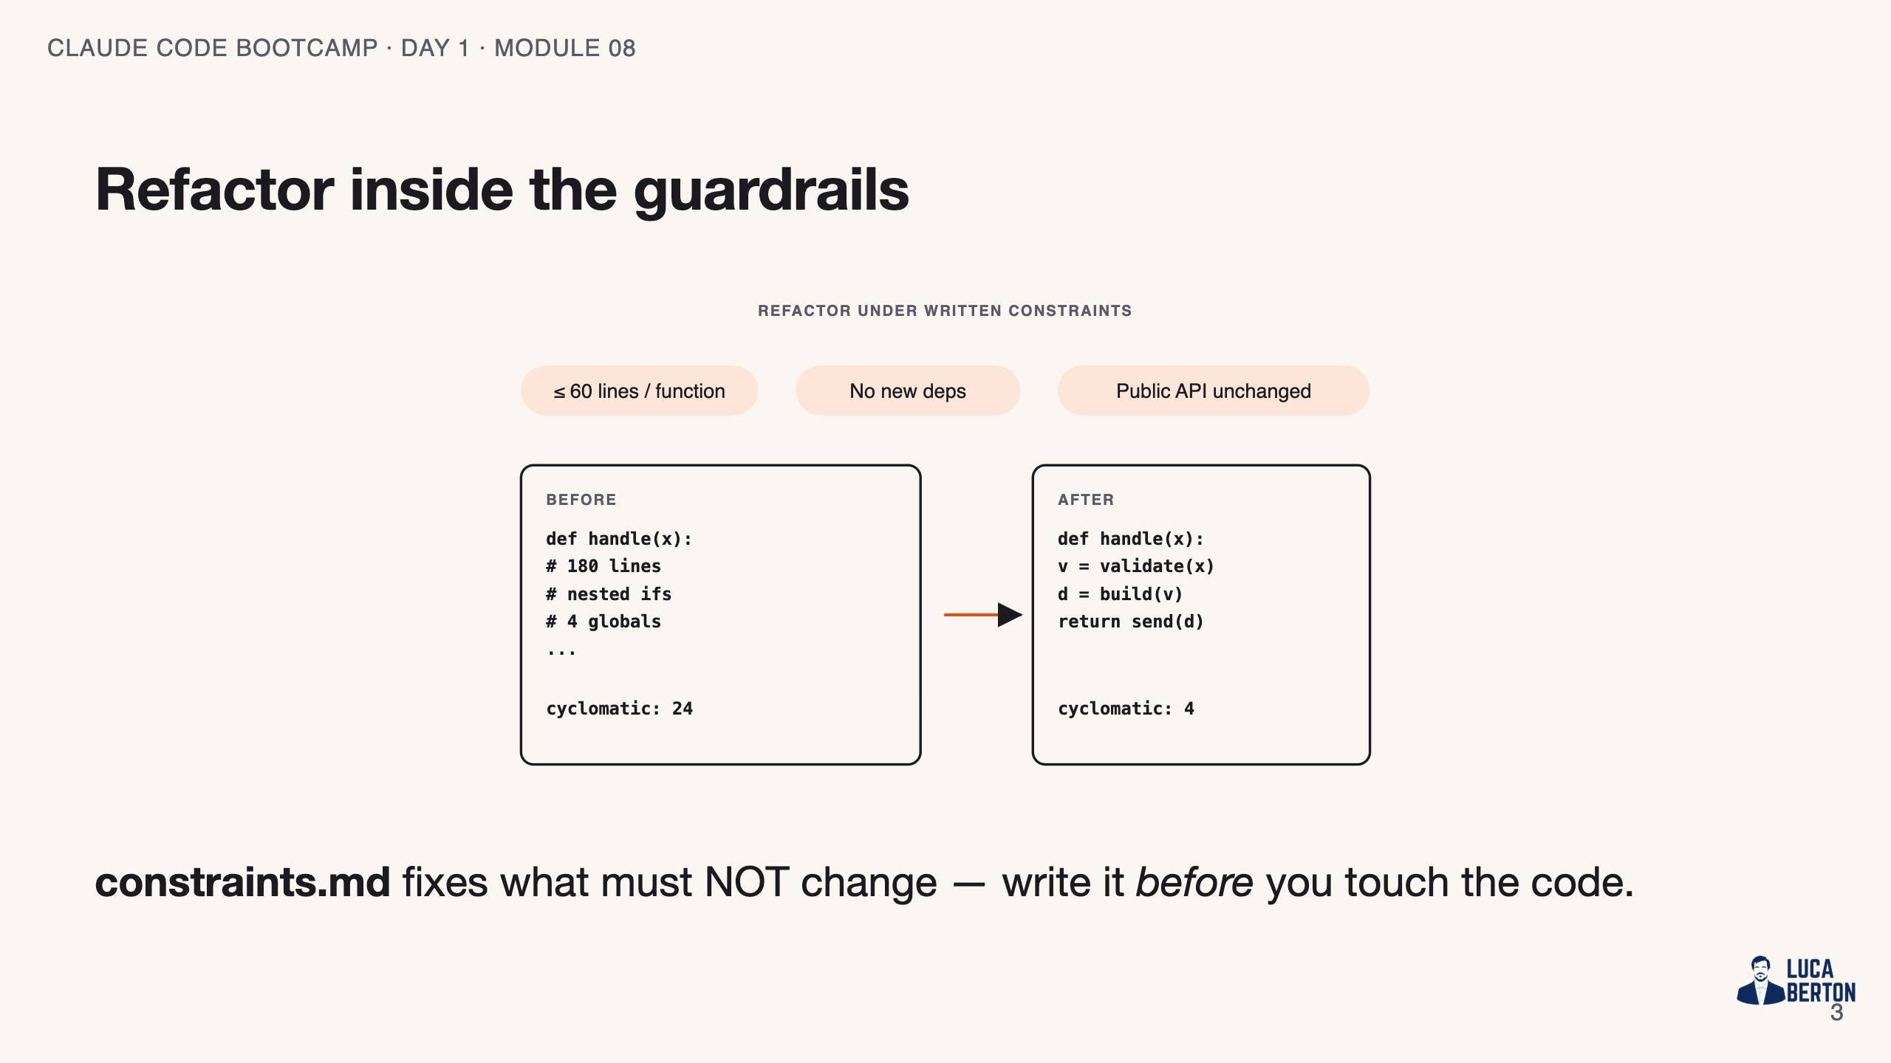
Notes:
SPEAKER NOTES — slide 3 (diagram, 1 min) - Left half = guardrails; right half = the two doc passes.

Slide 4
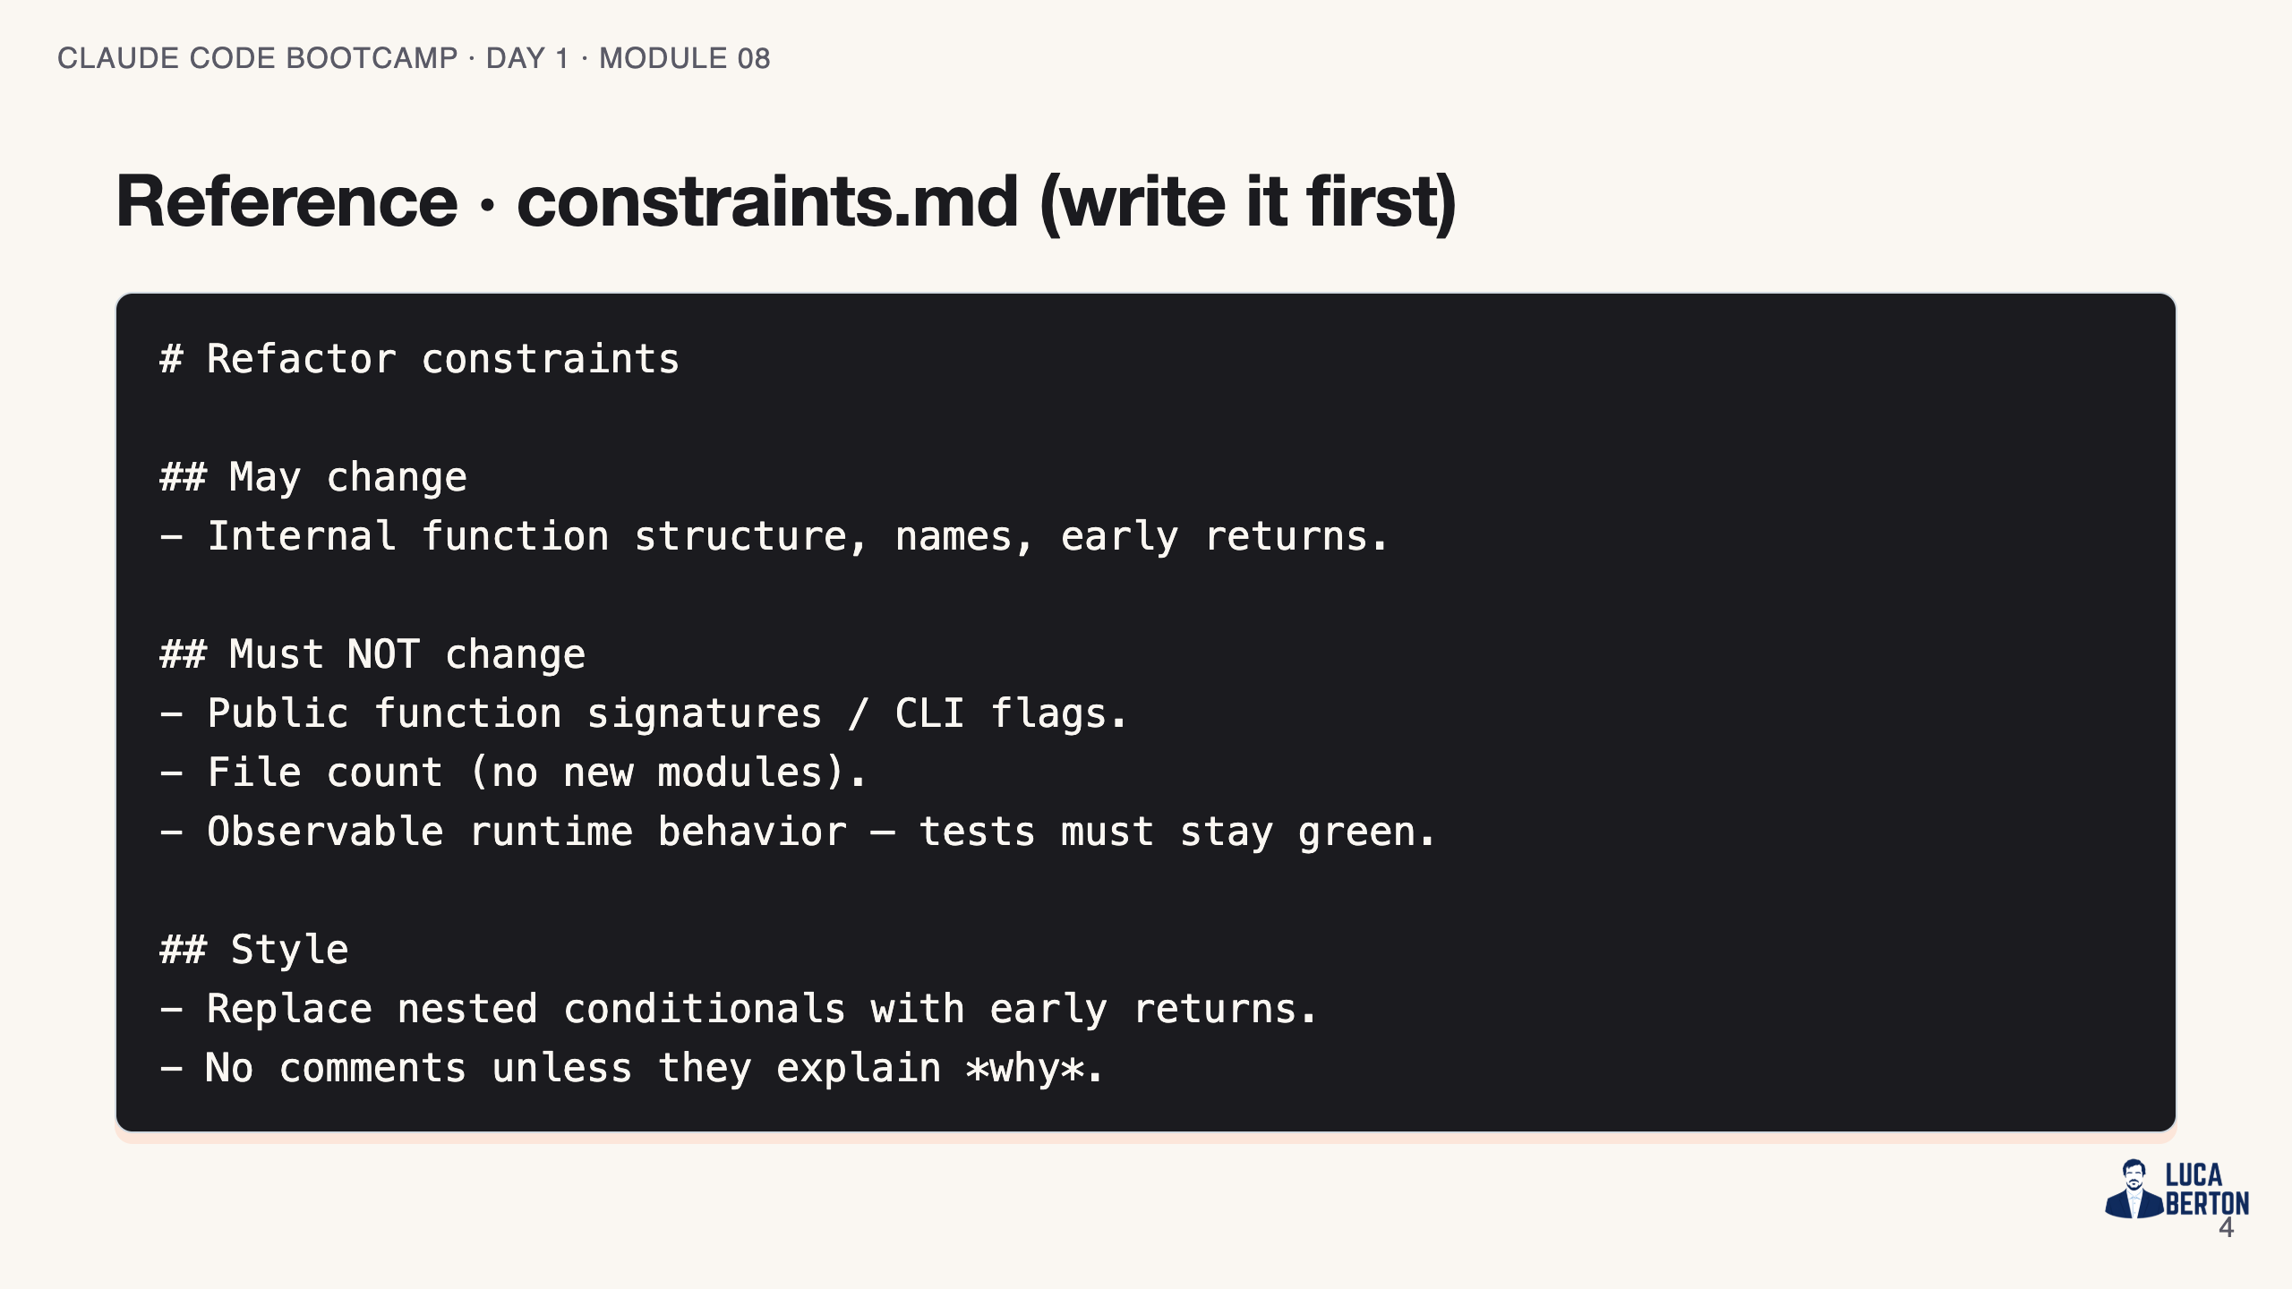
Notes:
SPEAKER NOTES — slide 3 (reference, 1 min)

Slide 5
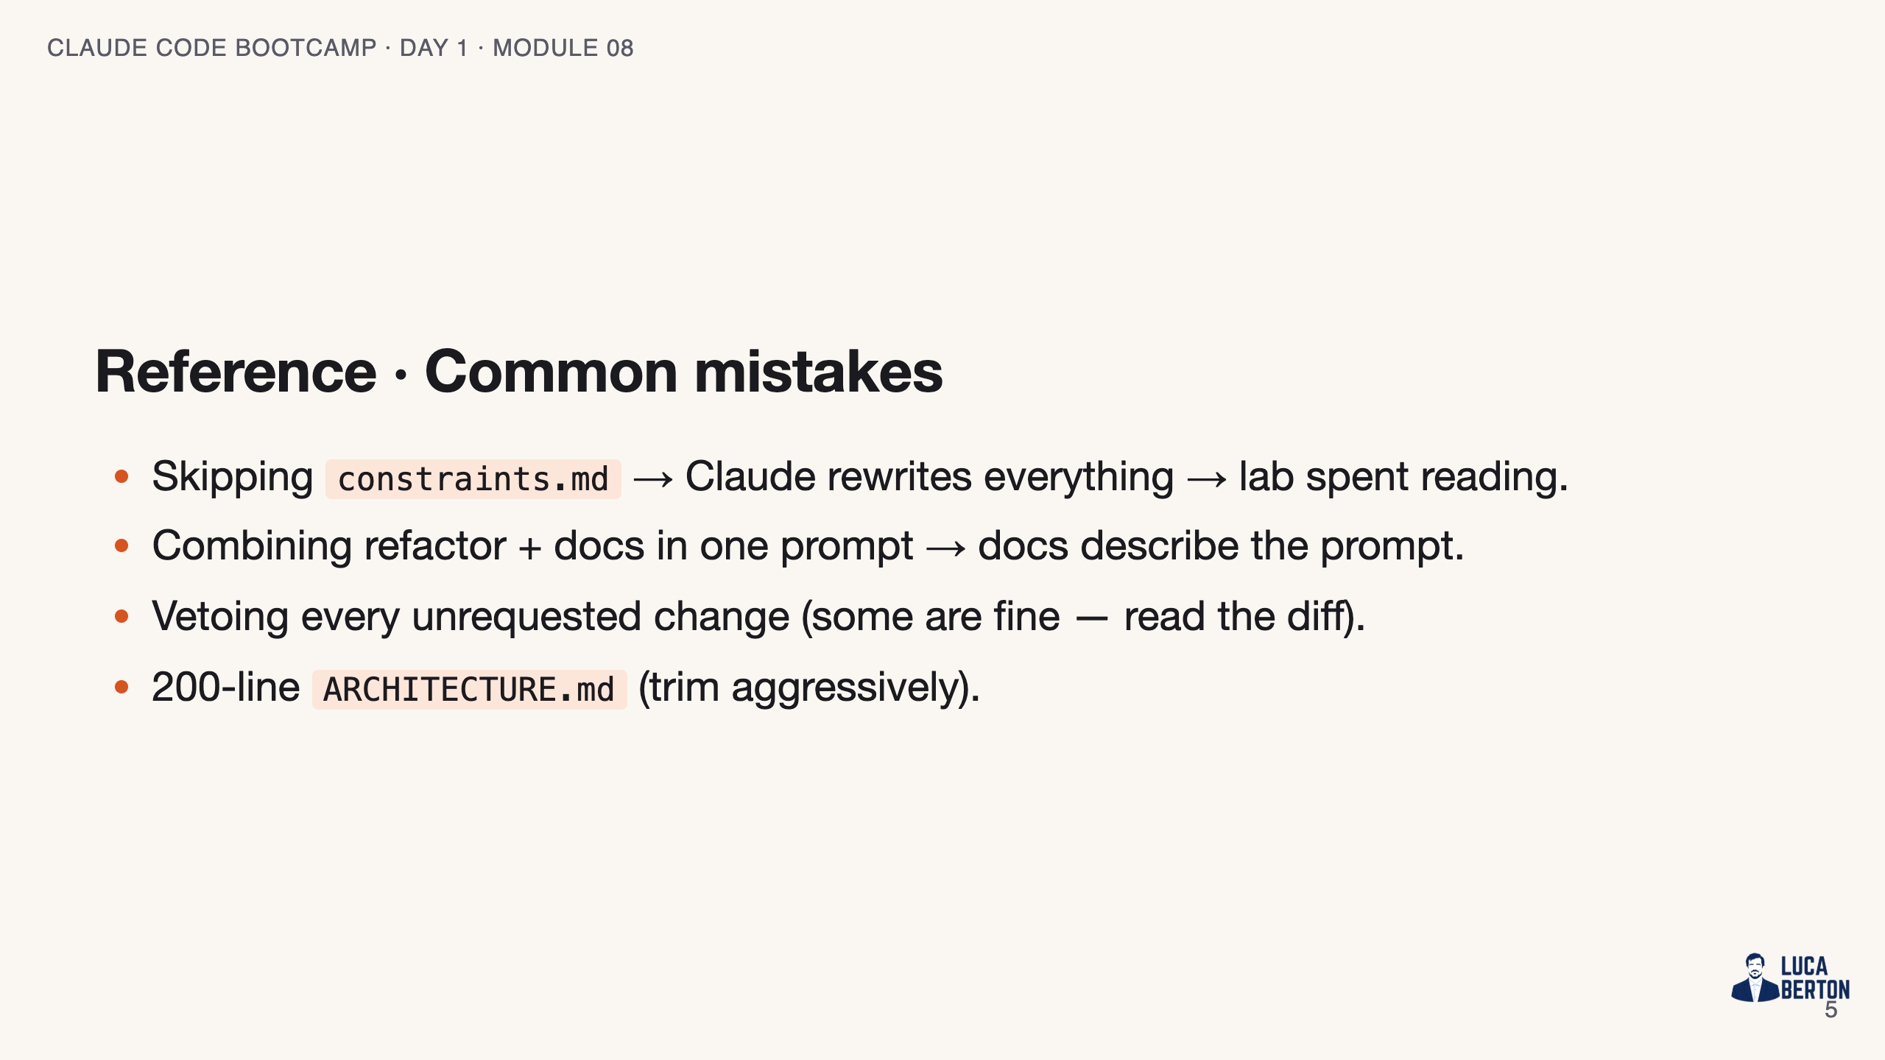
Notes:
SPEAKER NOTES — slide 4 (common mistakes, 30 sec) Instructor cues: - Show the bad (unconstrained) diff first, then the constrained one.

Slide 6
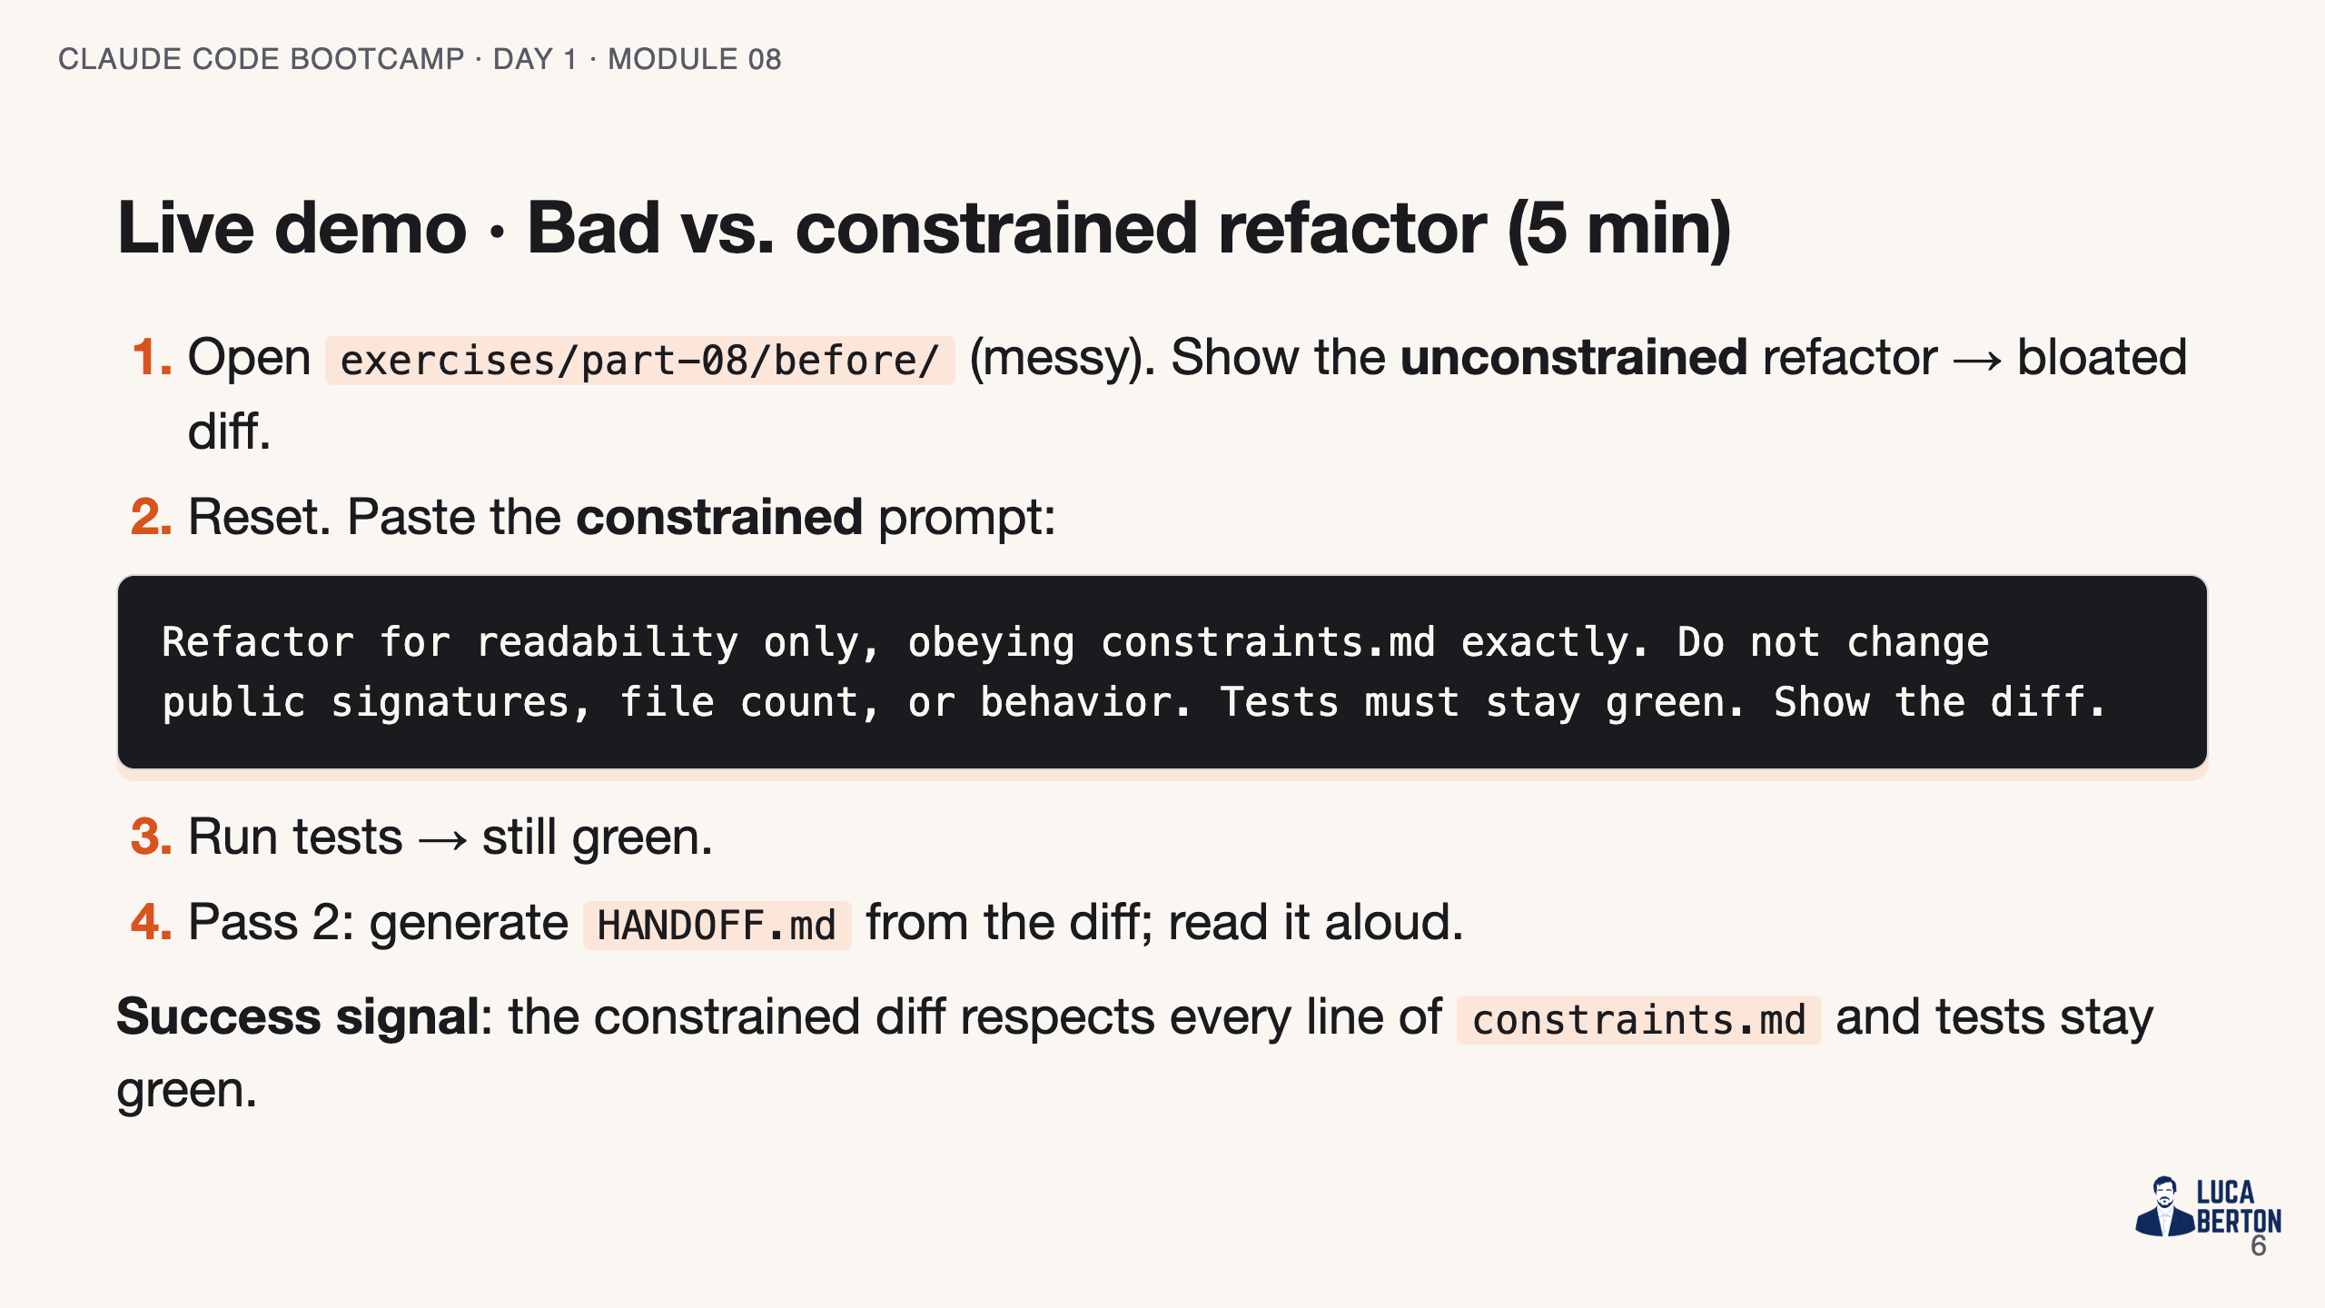
Notes:
SPEAKER NOTES — slide 5 (demo, 5 min)

Slide 7
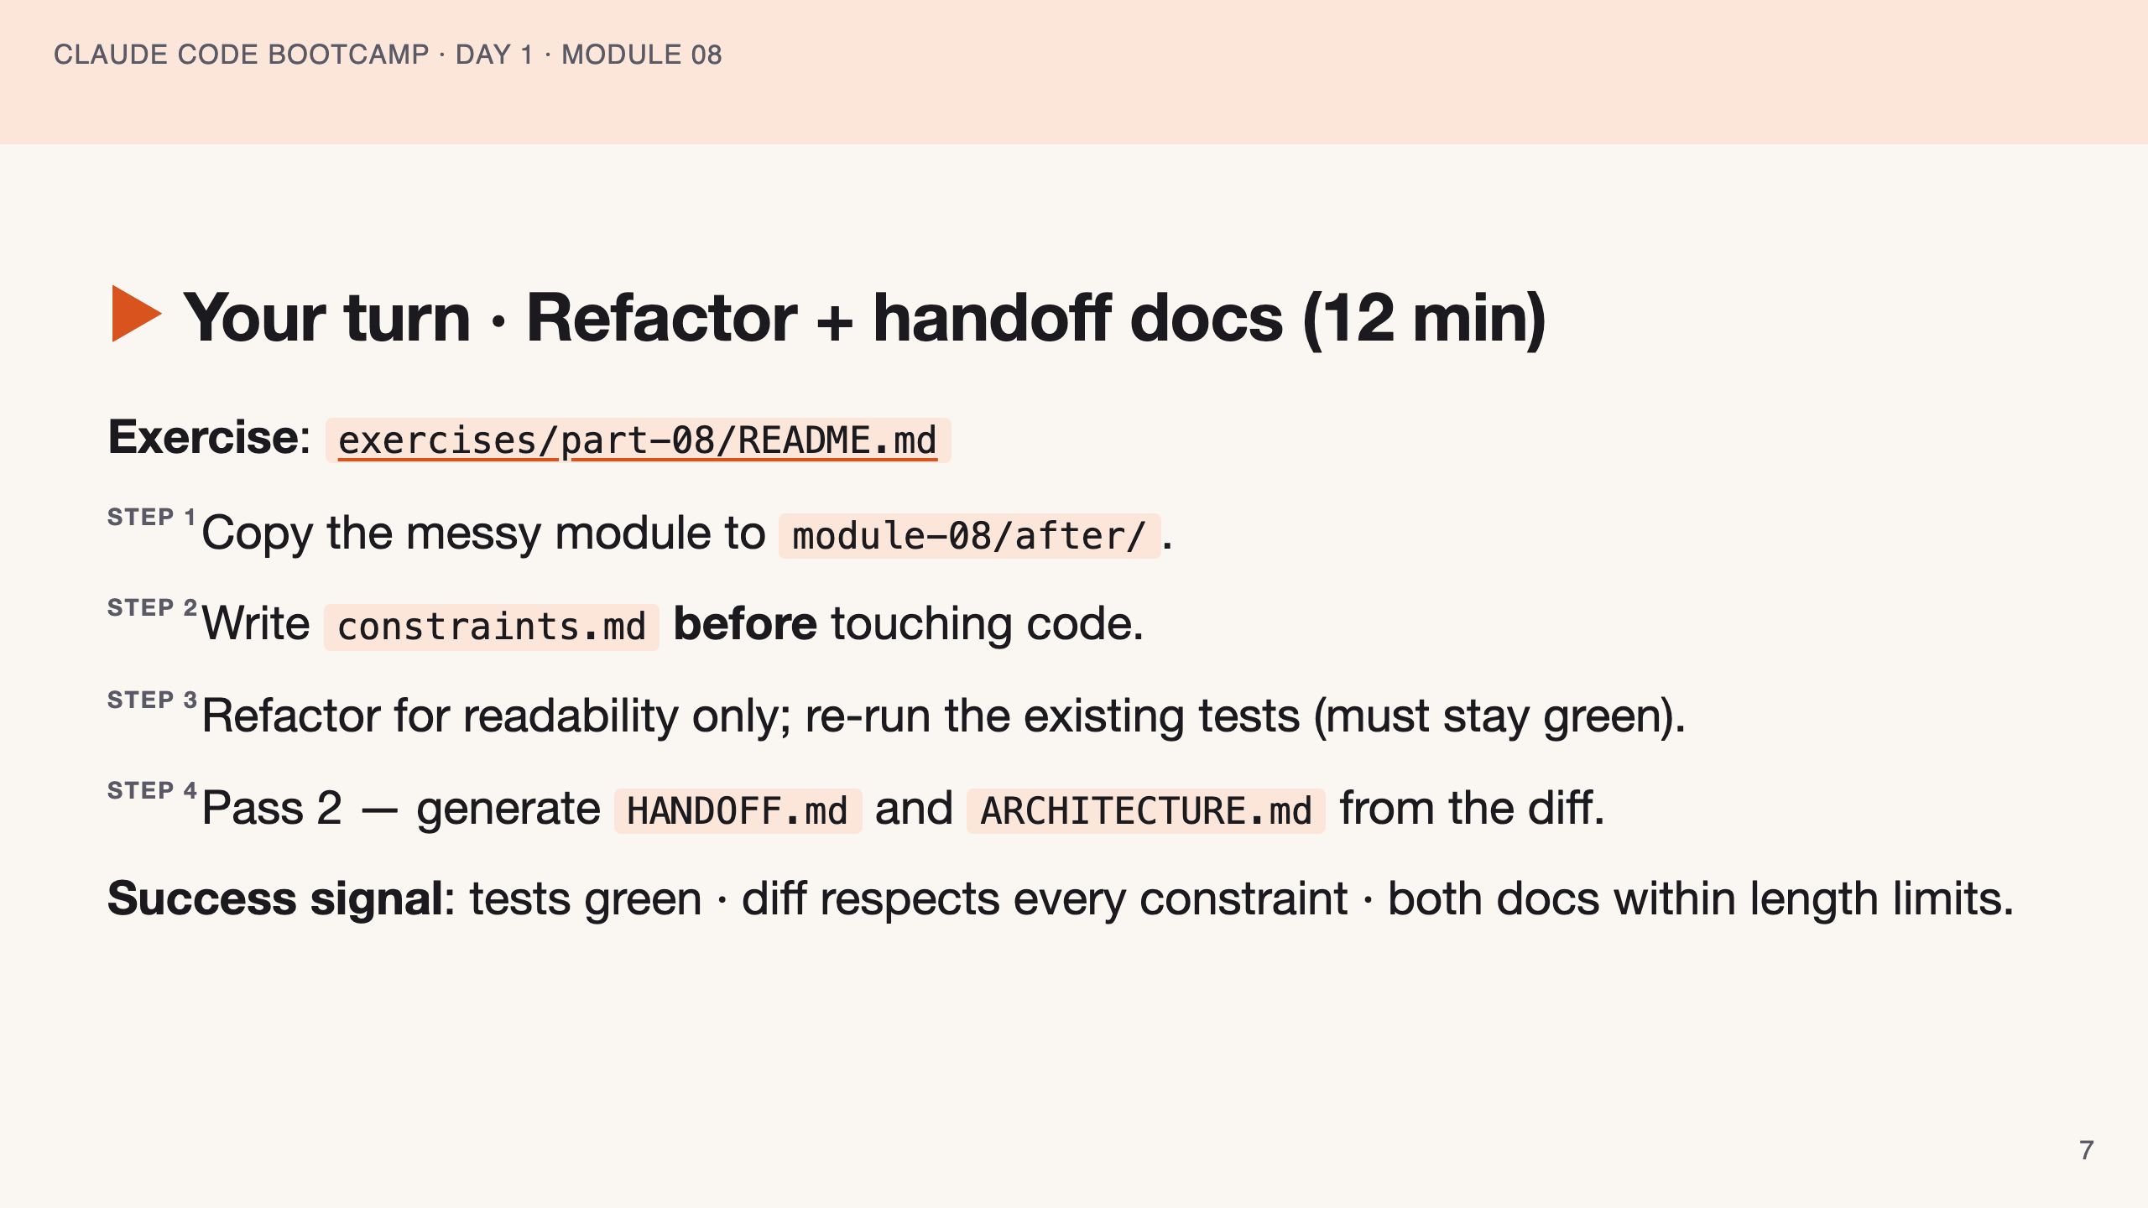
Notes:
SPEAKER NOTES — slide 6 (hands-on, 12 min) - Catch students who refactor before writing constraints.md. 3-min warning.

Slide 8
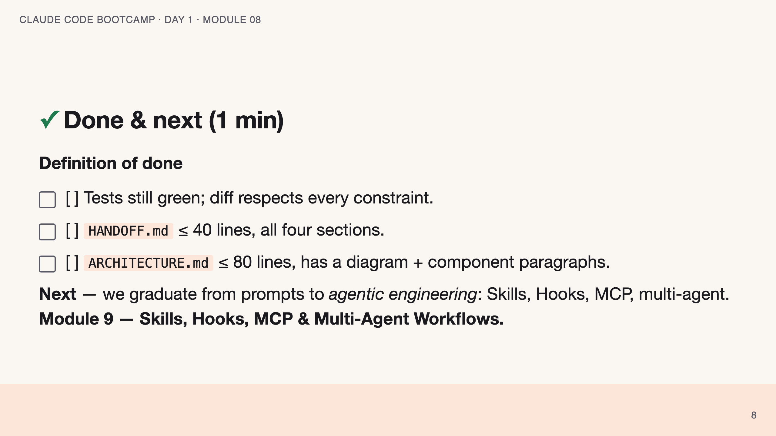
Notes:
SPEAKER NOTES — slide 7 (wrap, 1 min) polish-log 2026-05-28 · lean instructor-pacing shape (matches Module 1 pilot). cover -> theory (constrained refactor + 2-pass) -> reference (constraints.md · mistakes) -> live demo -> your turn -> done.

