Slide 1
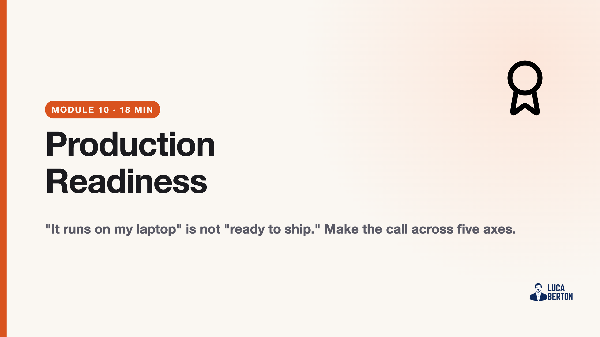
Notes:
duration: 18 min SPEAKER NOTES — slide 1 (hook, 60 sec) - One line: "We pick one project from today and decide, honestly, go or no-go."

Slide 2
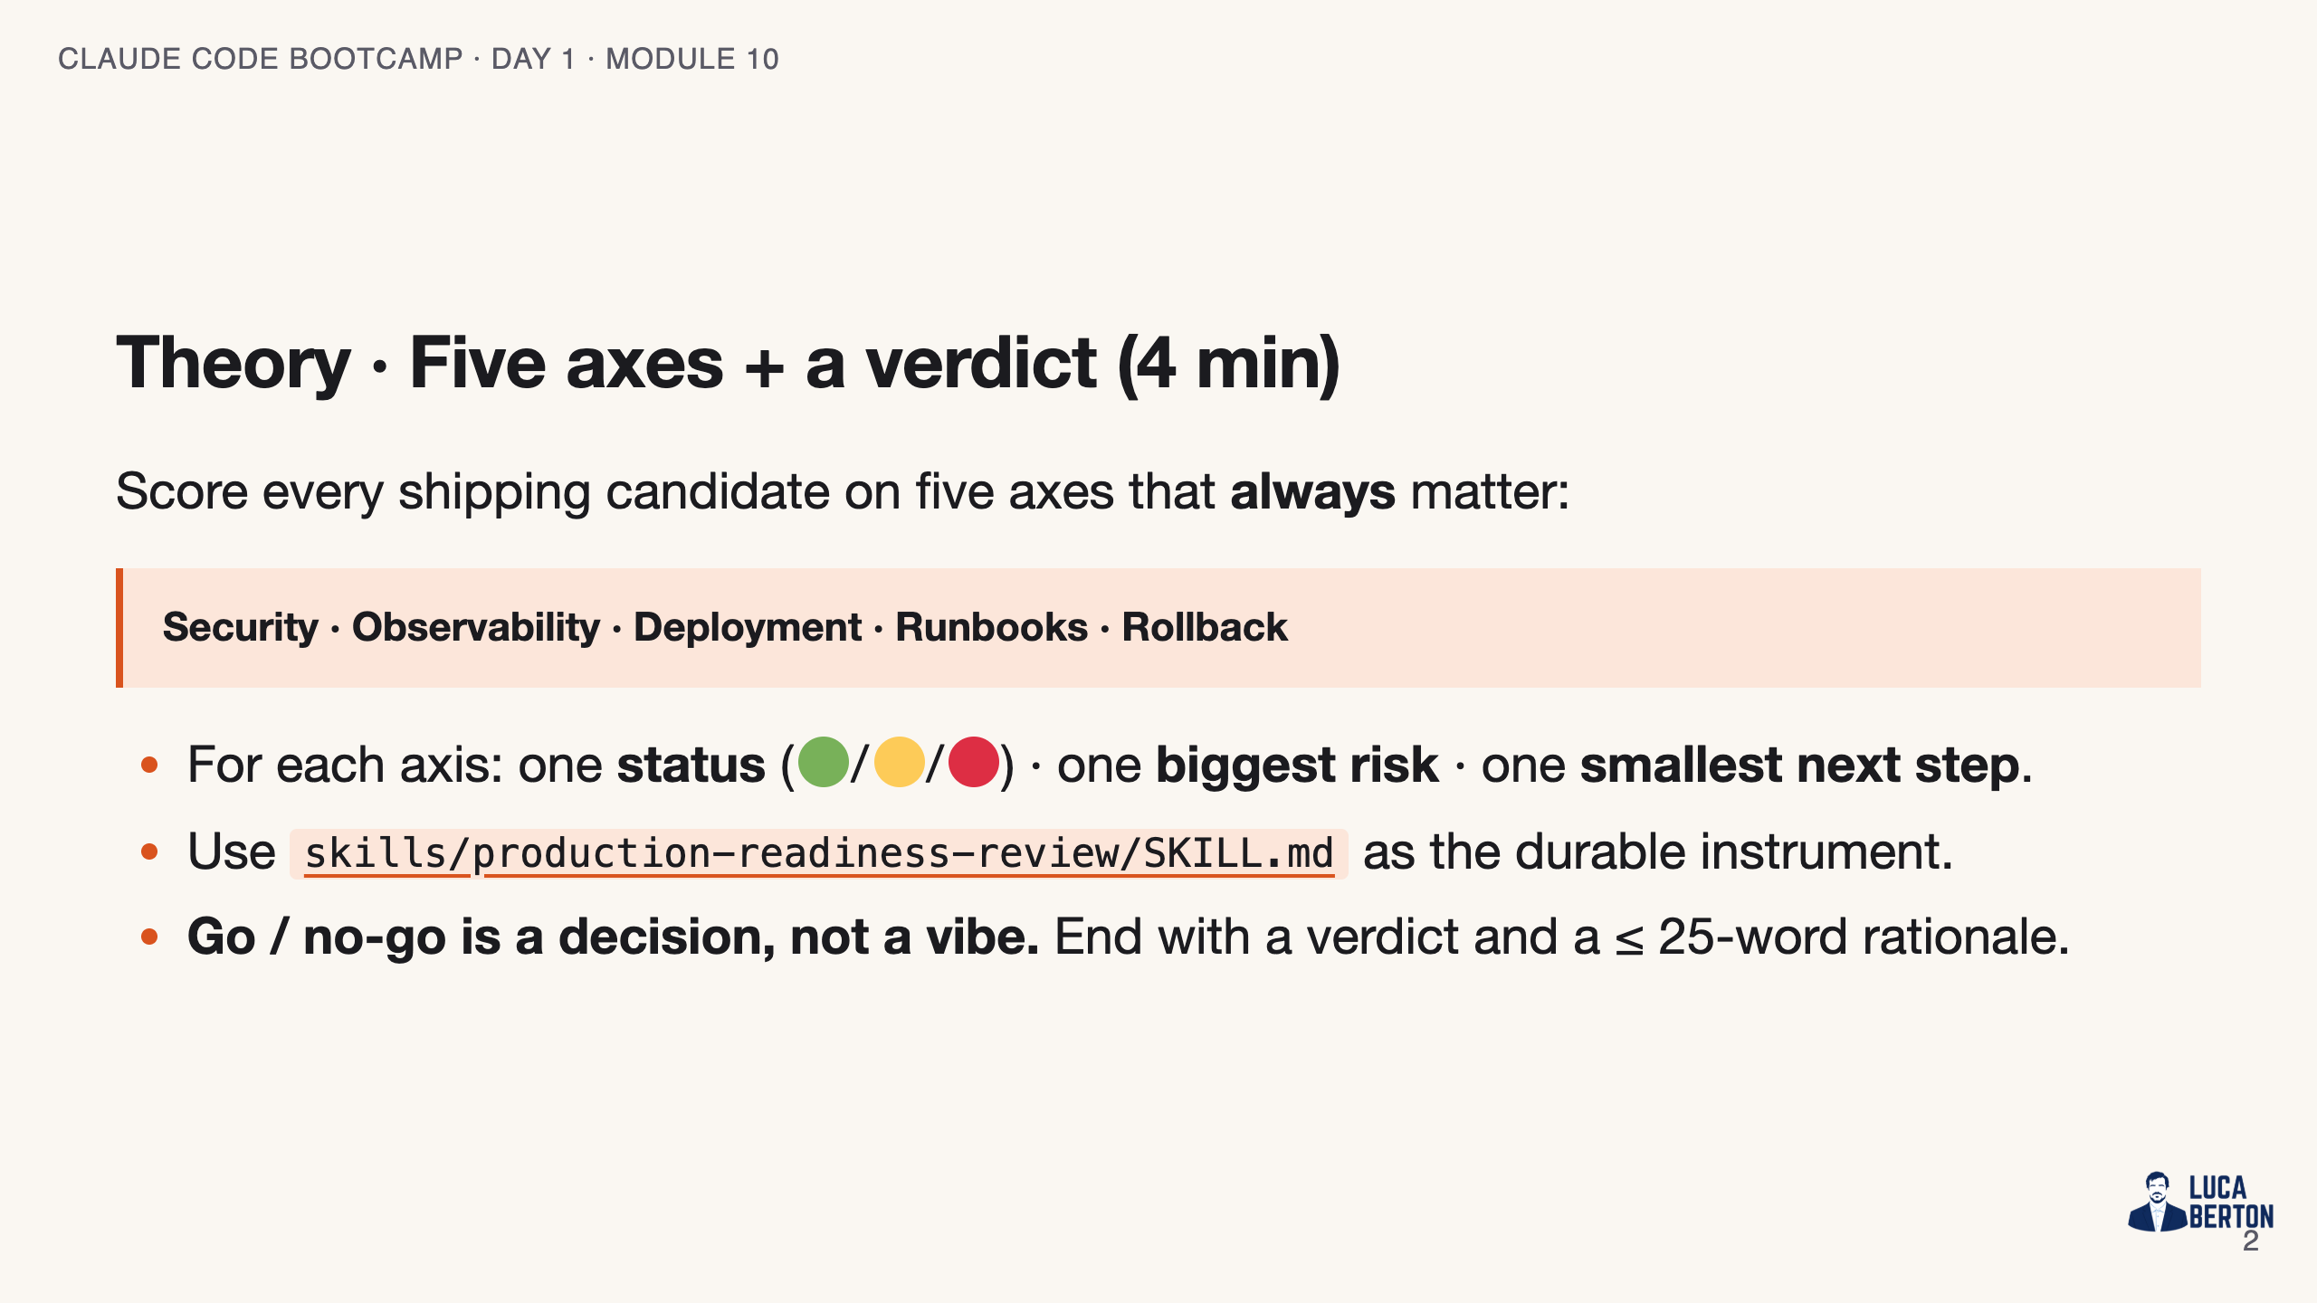
Notes:
SPEAKER NOTES — slide 2 (theory, 4 min) - Push honesty: after one workshop, "all green" is almost never true.

Slide 3
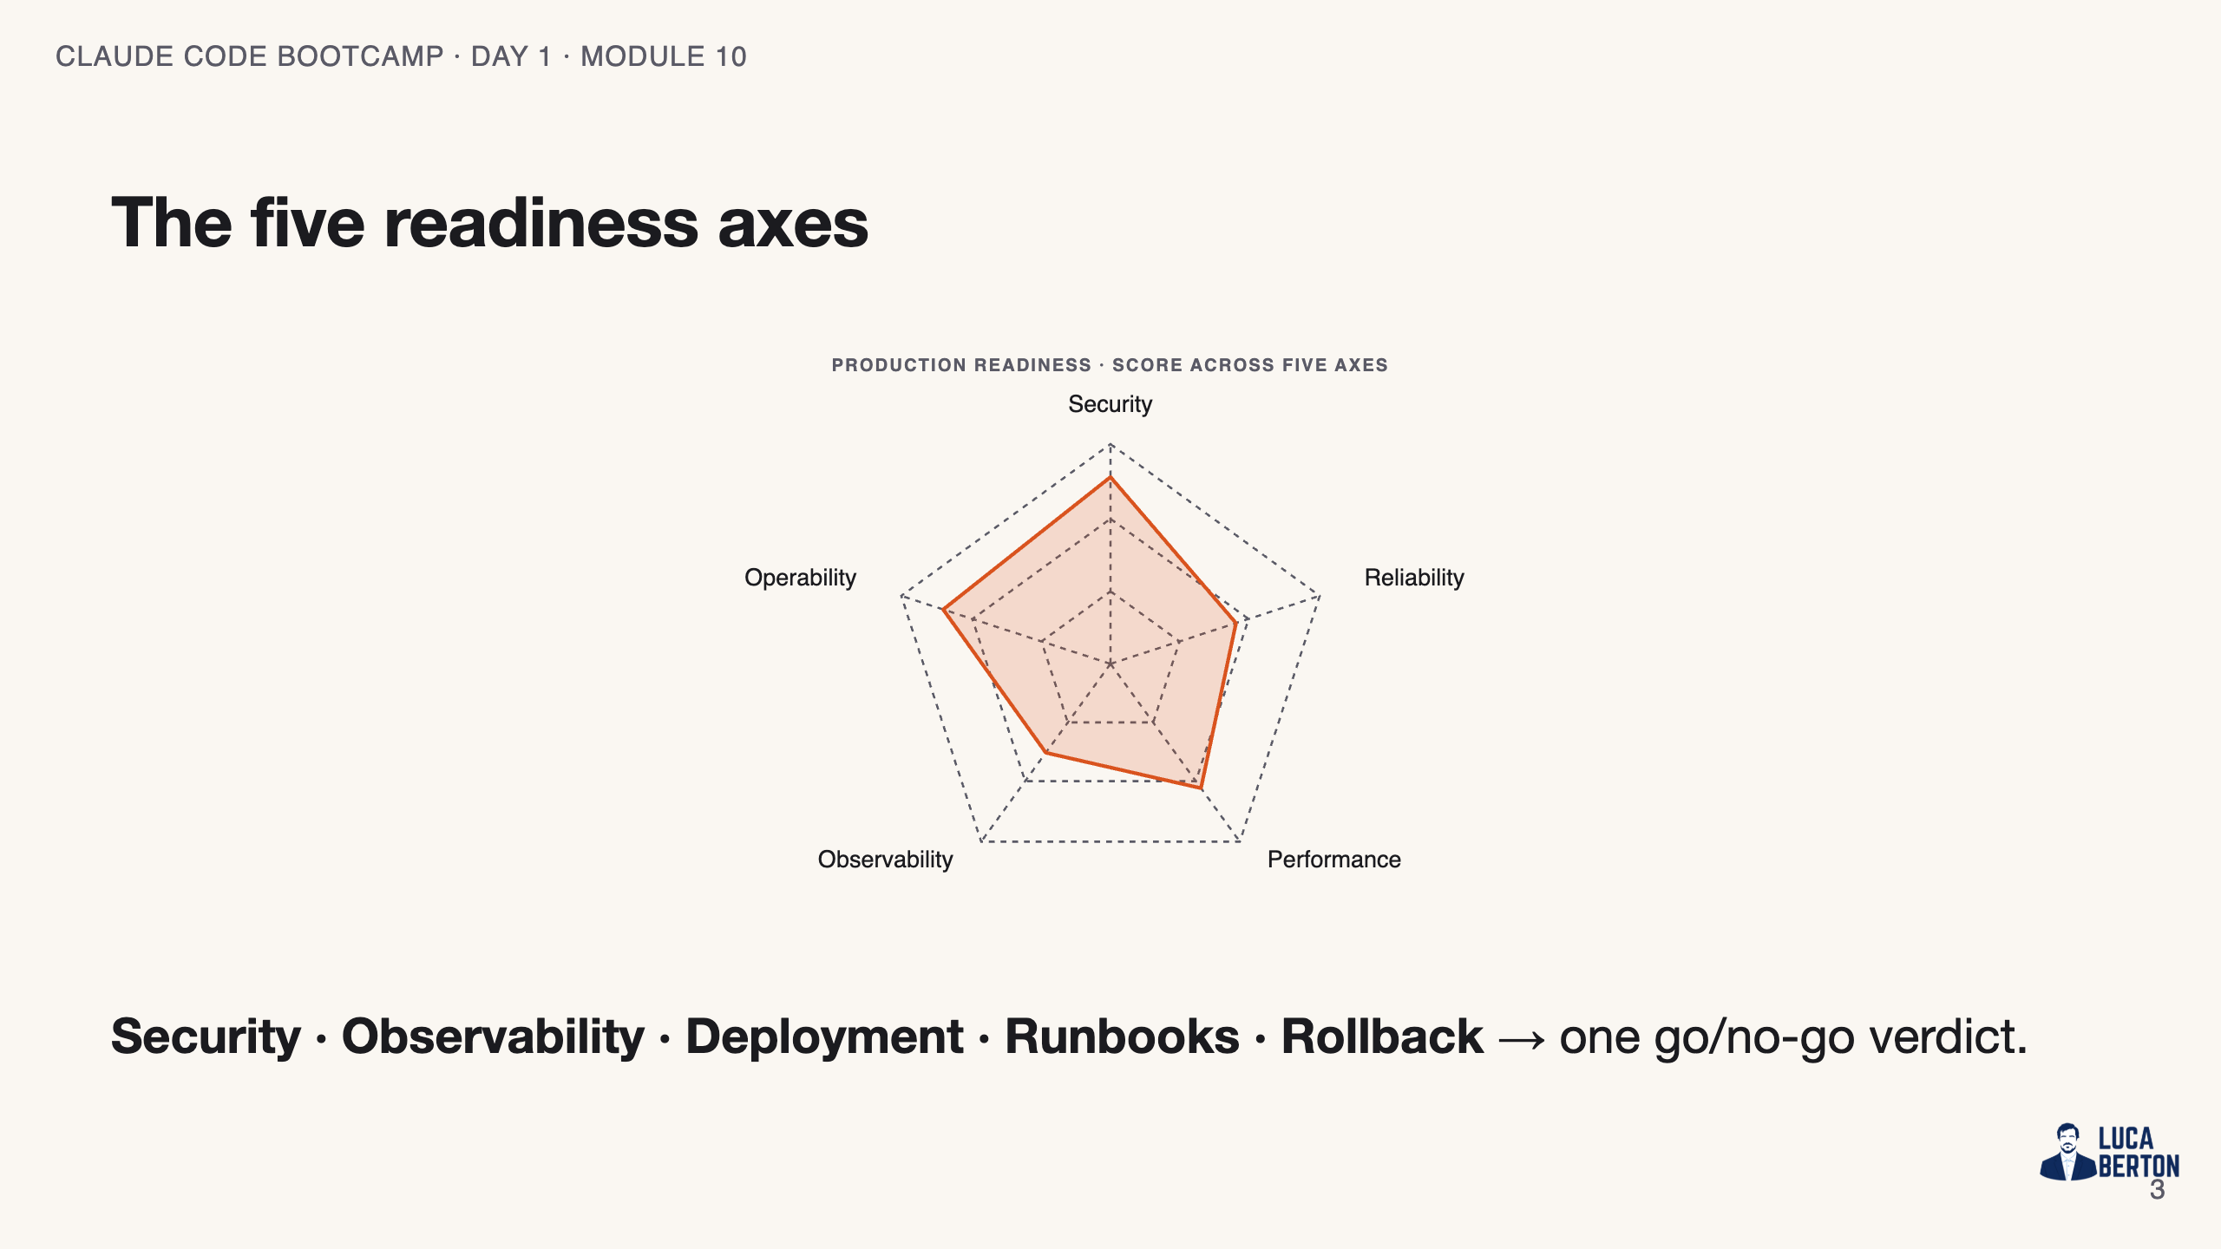
Notes:
SPEAKER NOTES — slide 3 (diagram, 1 min) - Each spoke gets a status; the hub is the verdict.

Slide 4
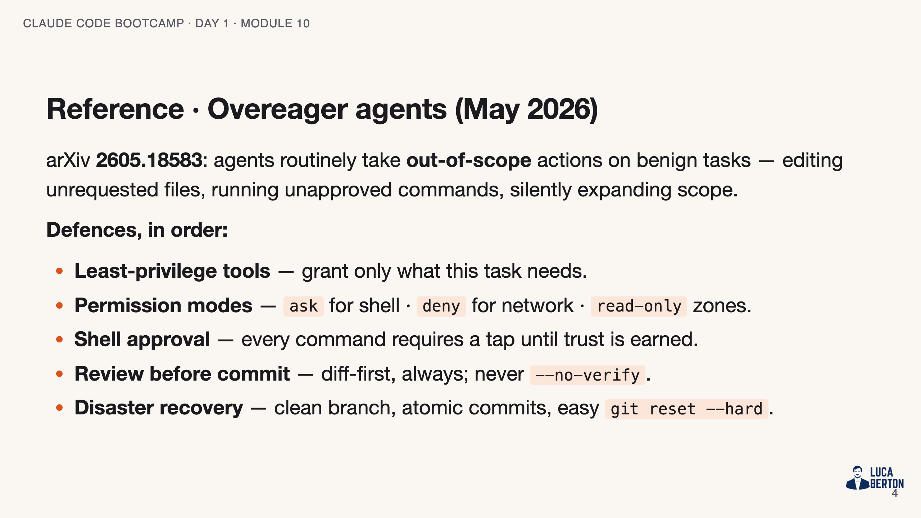
Notes:
SPEAKER NOTES — slide 3 (reference, 1 min) - Tie back to Module 6: the safe-git habits ARE the disaster-recovery plan.

Slide 5
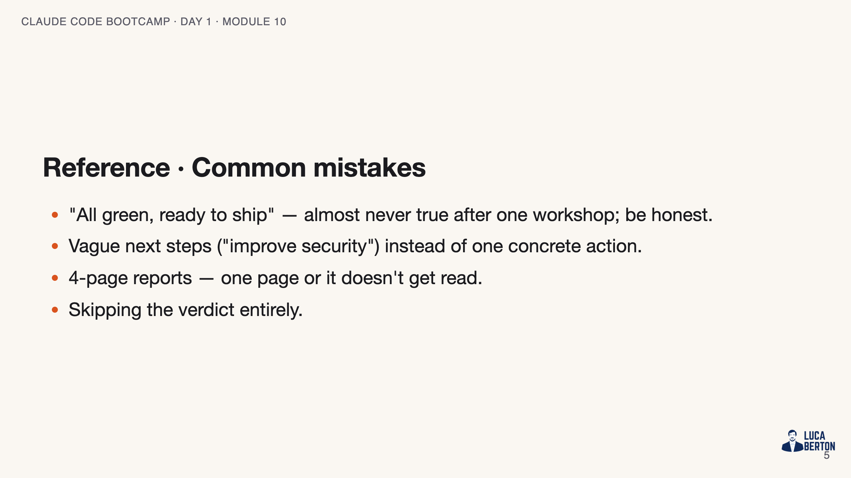
Notes:
SPEAKER NOTES — slide 4 (common mistakes, 30 sec) Instructor cues: - Model honesty: mark two axes red live and say why.

Slide 6
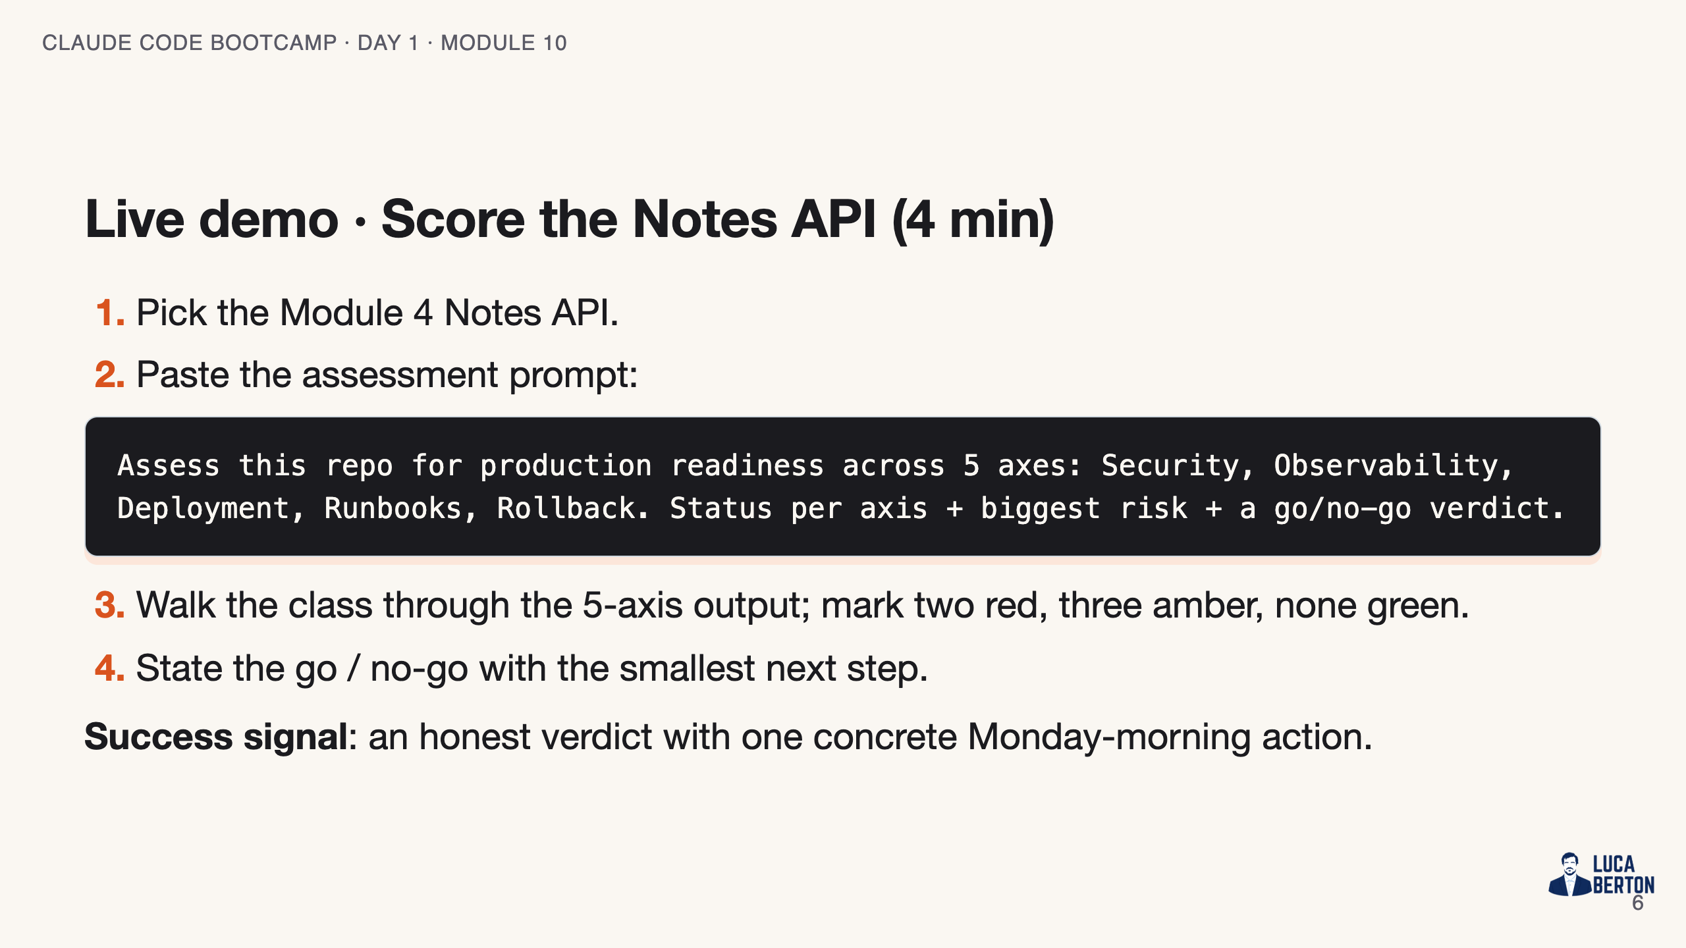
Notes:
SPEAKER NOTES — slide 5 (demo, 4 min)

Slide 7
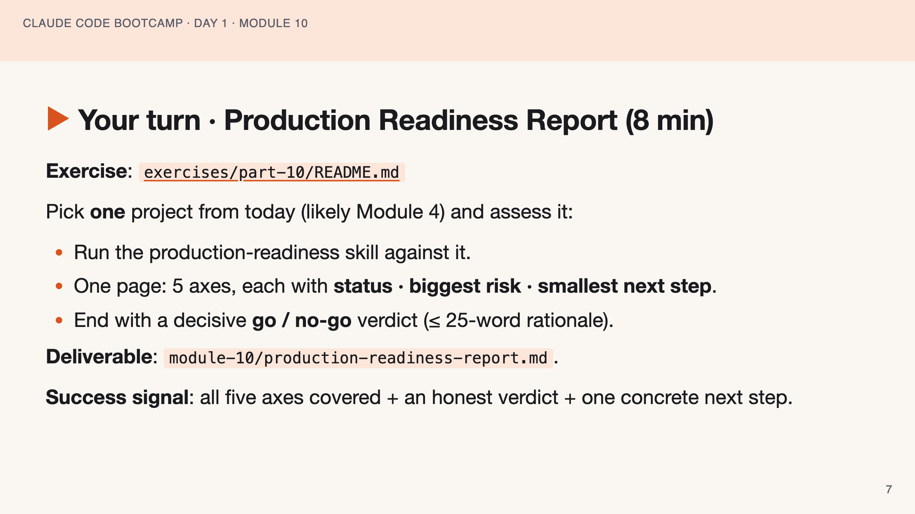
Notes:
SPEAKER NOTES — slide 6 (hands-on, 8 min) - Catch "all green" reports — send them back. 2-min warning at the 6-min mark.

Slide 8
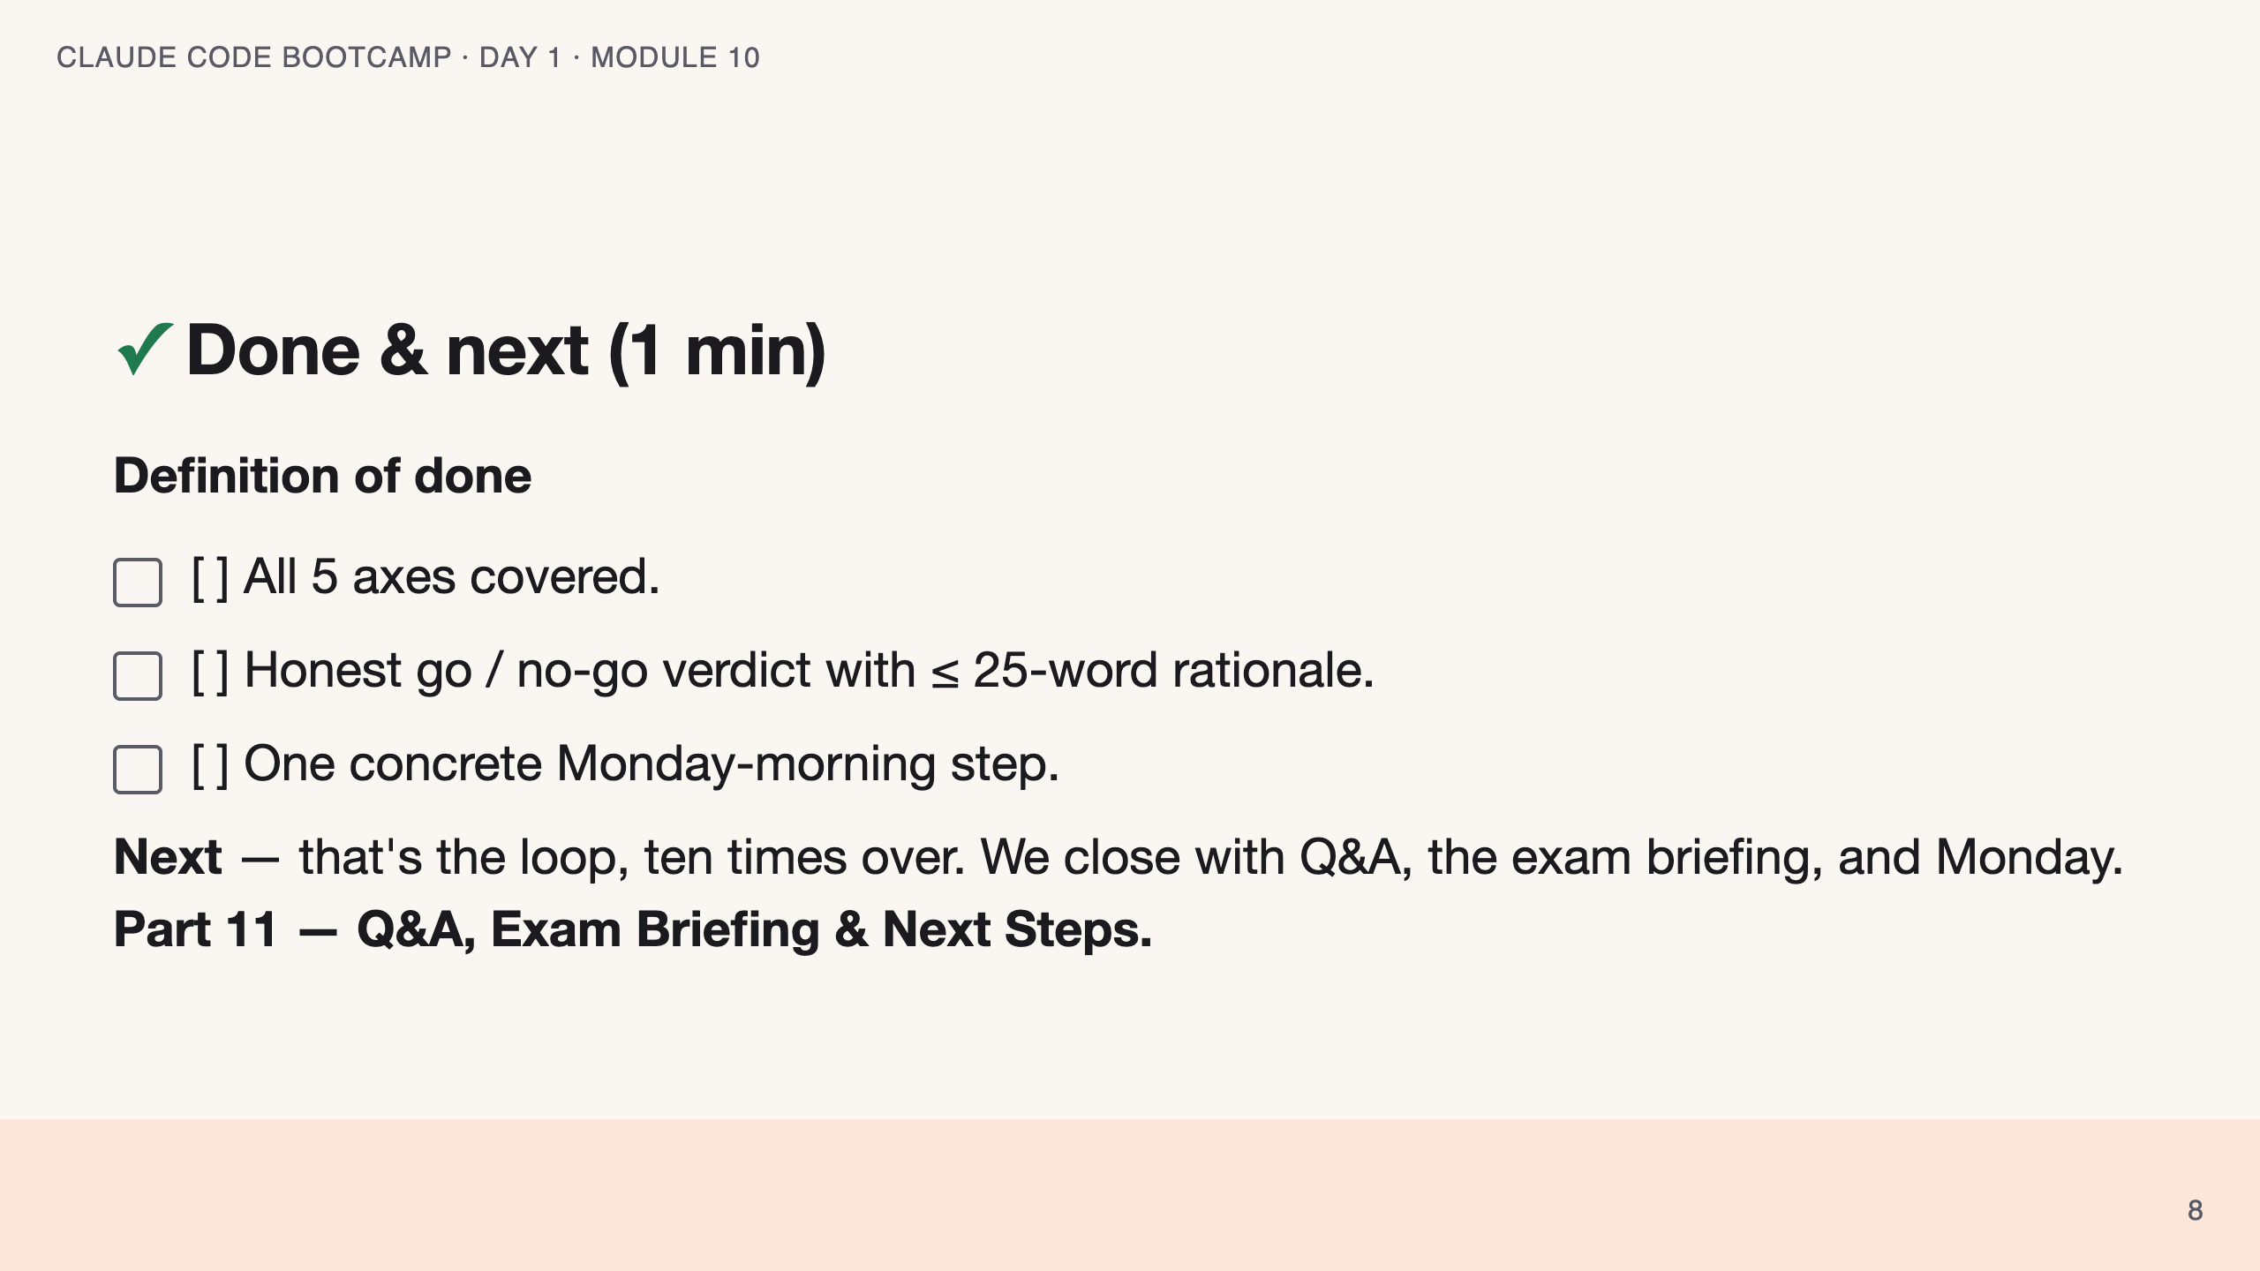
Notes:
SPEAKER NOTES — slide 7 (wrap, 1 min) polish-log 2026-05-28 · lean instructor-pacing shape (matches Module 1 pilot). cover -> theory (5 axes) -> reference (overeager agents · mistakes) -> live demo -> your turn -> done.

