Slide 1
Access and Access Services
Vesa Juvonen
Principal Consultant
Microsoft

Slide 2


Access 2013 Platform Overview
Desktop Access Apps
Access 2013 Web Apps
Used by millions today
Data stored in a local file
Requires Access software to view and edit data
Fully supported in 2013
Brings Access databases into a new web-connected era
Data stored on in SQL on Office 365 or on-premise server
Accessible everywhere through any browser

Slide 3
Introduction to Access Web Apps
Collaborative web applications on SharePoint & SQL Server
Access App is a SharePoint hosted SP App (own site)
Database is a single SQL Server database
Access is an abstraction layer over SQL Server
Simplified designers
Lowers barriers to entry
Provide capability for creating data tracking applications easily as business users
Developer-level experience not required
Most robust SP App designer for SharePoint 2013

Slide 4
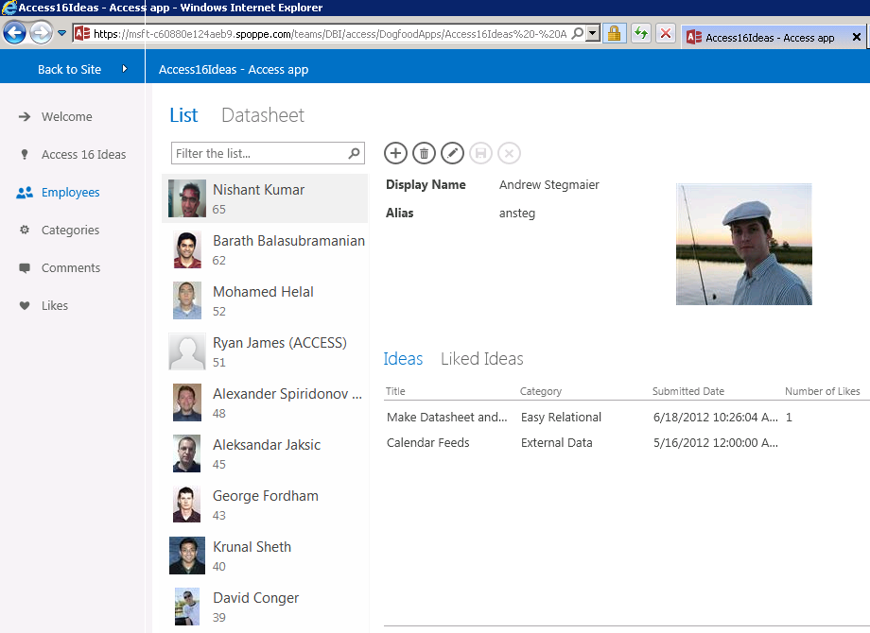
New app model
Simplified design experience
Pre-defined schema templates (nouns)
Build a functioning app in 60 seconds
Automatic generation of navigation, forms and buttons
Simplified, code-free configuration and customization
Polished, professional results
Apps automatically have an attractive, easy-to-use interface
Consistent user experience across all apps

Slide 5


SharePoint deployment
Access Apps = SharePoint Apps
Same cross-browser support
Same multi-user accessibility: many people can work on the same site/database at once
Same Active Directory-based permissions
Same SharePoint Store and App Catalogue for distribution and discovery
Same simple install/uninstall
Same central IT control
Same branded and customizable themes
Same cloud-based hosting through Office 365

Slide 6




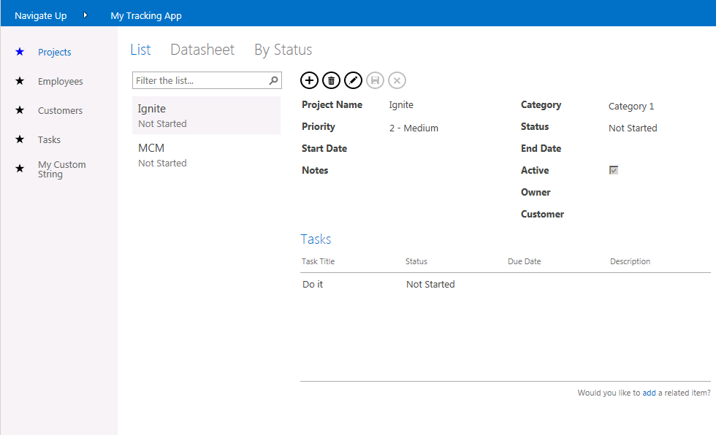

Access Web Apps – Rendering Process
SharePoint Access Host
1
IFrame
2
SQL Server 2012 Cluster

Slide 7




SQL back-end
The gold-standard for relational databases
Speed and reliability
Transparent to end user: if you don’t care, you don’t need to know
Use common tools for advanced reports and custom integrations
Developers can use existing skills to customize
Future upgrade path
View and Edit Data
Advanced Reporting & Integration
Desktop Access Reports
Excel
Power View
Crystal Reports
Custom Websites (.NET, PHP, etc.)
Access Services
SQL Server
Database Design

Slide 8
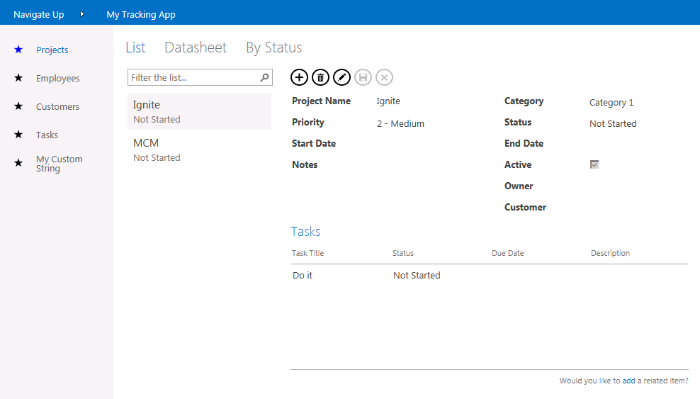
Service App Specific architecture
Retrieve SQL Objects
View
Retrieve HTML, JS, CSS, Image
Object Table
Access Services
WFE
SQL 2012
Notes:
High level rendering explanation how access services gets the stuff and is responsible of rendering hte outcome for Access Web App

Slide 9
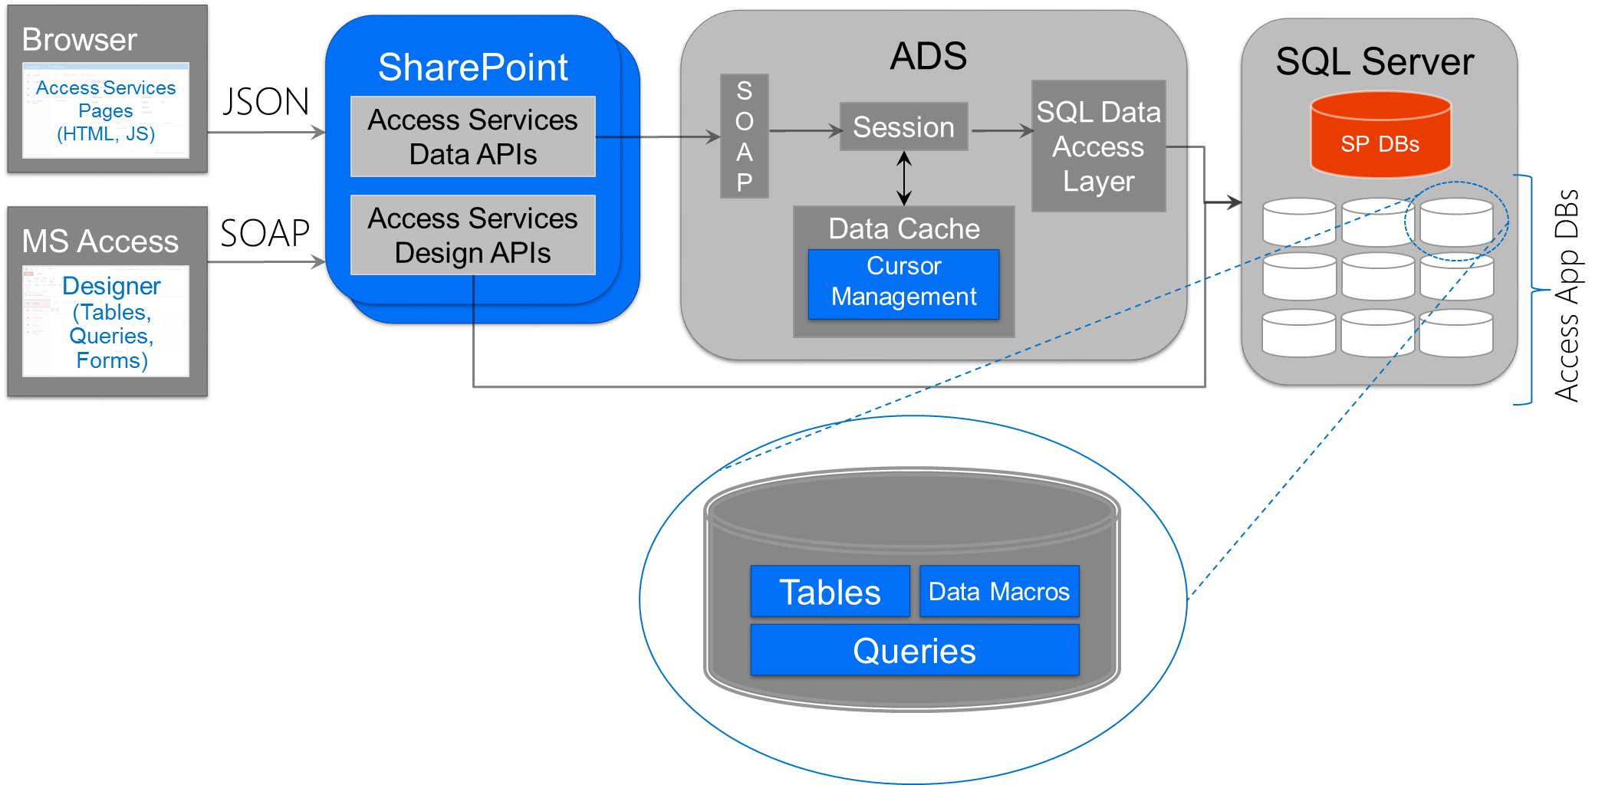
Access Services – Architecture Overview
Notes:
This slide depicts the high level architecture of Access services.
You use Microsoft Access to create and design Access database. Behind the scenes, Access calls SOAP-based Web service operations talk to Access Services to create and manage both the SharePoint app associated with an Access database as well as the SQL Server database.
Users of the Access database use the user interface exposes through a SharePoint app. The SharePoint app contains JavaScript code that is generated by Access to make REST calls into Access services to work with the data inside the SQL Server database.
ADS – Access Data Server

Slide 10


Access Services Deployment Options
SQL Server 2012 Cluster
SharePoint Access Host
Access Web Use
Notes:
Talk about different options with Access. SQL azure is supported option only with Office 365
On same server as SP - requires SQL Server 2012
Separate SQL Server 2012 deployment
SQL Azure – Only with Office365

Slide 11
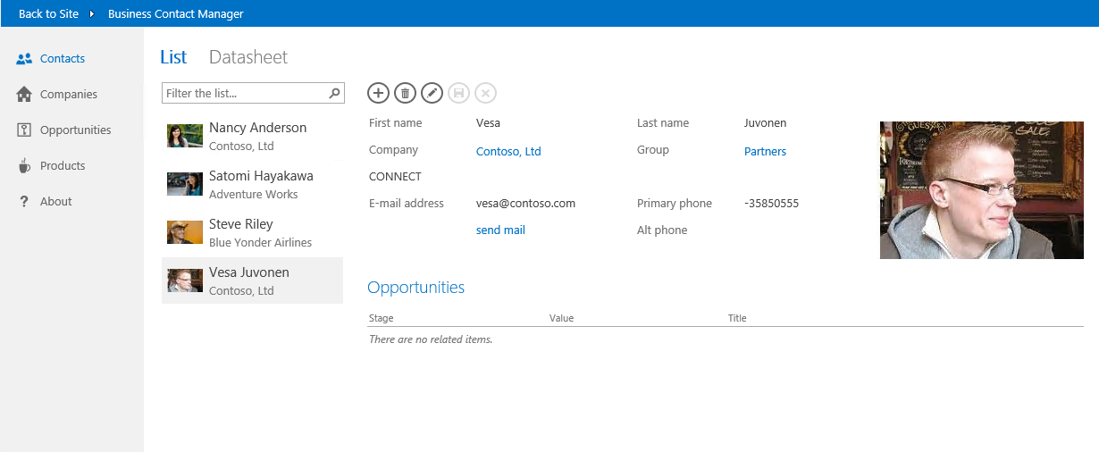
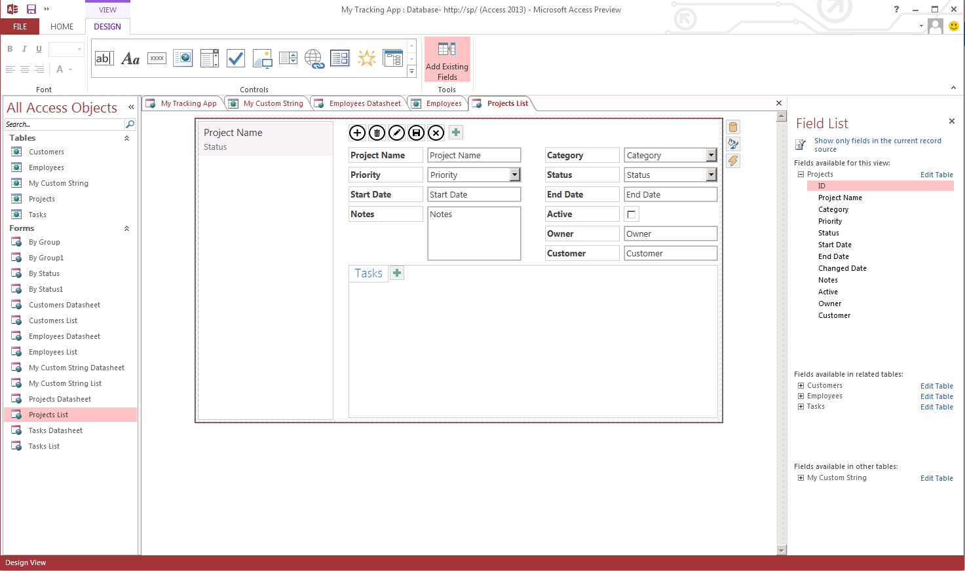
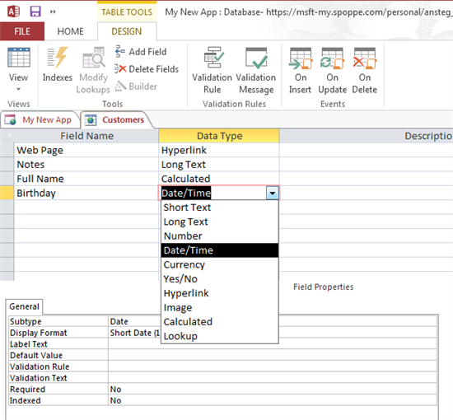
Access 2013 Client – Data and UI designer
Notes:
Just designer pictures to explain what happens there... Visualizes the Access side

Slide 12
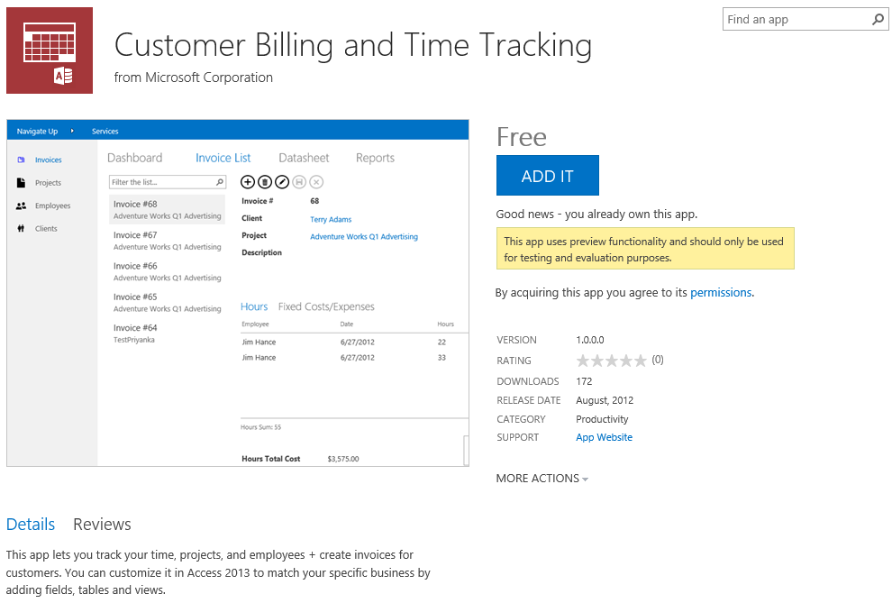
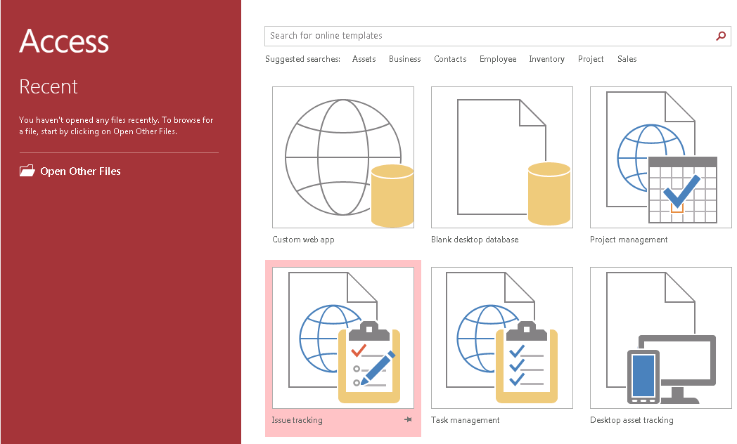
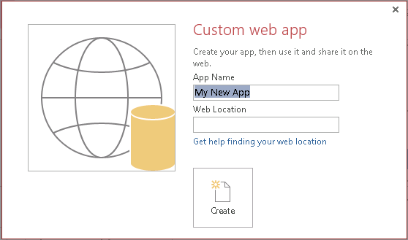
Getting started with Access Apps
Use Office Store Access Apps
Use Web App Templates
Build a Custom Web App
Notes:
Use Office Store Access Apps – Pre published applications by Microsoft in the Office Store
Use Web App Templates – from Access client
Build a Custom Web App – using Access client

Slide 13
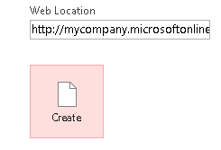
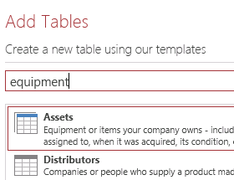
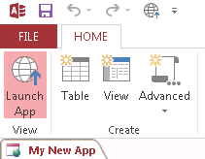
Web App in 60 Seconds
1. Select Location
You can publish your database to any SharePoint site, whether it is hosted on premise or through Office365.
2. Choose Tables
Search from an extensive list of table templates. You can easily combine or customize them to suit your needs.
3. Launch in Browser
When you open your app in the browser, you’ll find that it’s ready to use with navigation, forms, and a professional look-and-feel.

Slide 14

When We Click Create…
SharePoint app created and deployed
Deployed as SharePoint hosted app in own app site under given address
Inherits themes
Inherits permissions
SQL database provisioned
Hidden from end-user; accessible to developer
No separate connection, login, or setup

Slide 15
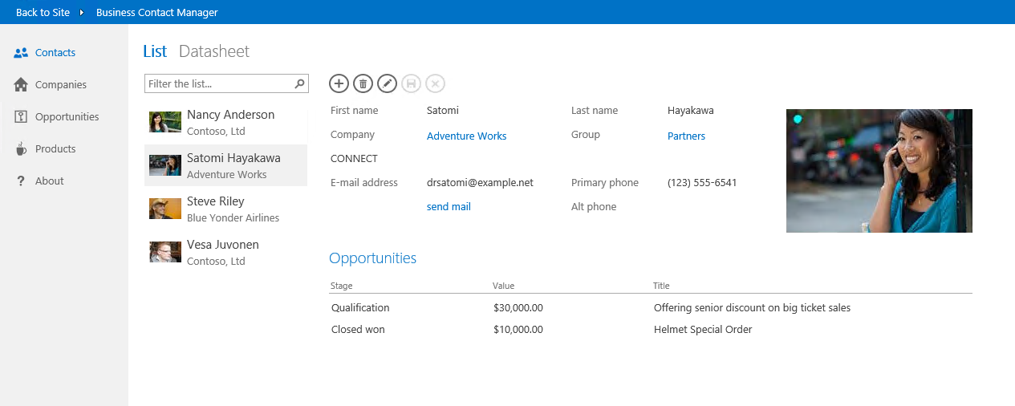
Polished, Professional User Interface
2. Choose View
1. Choose table
3. Search and Filter
4. Add and edit items

Slide 16
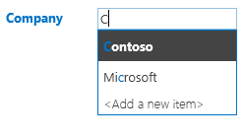
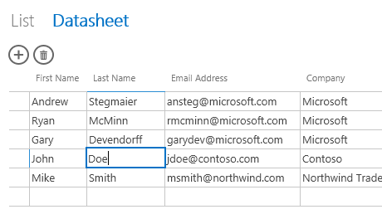

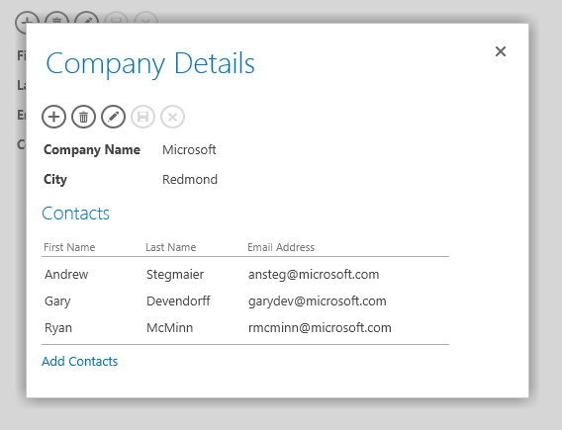
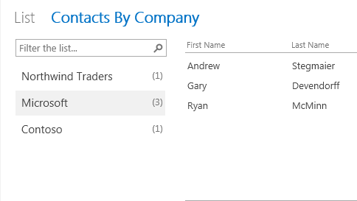
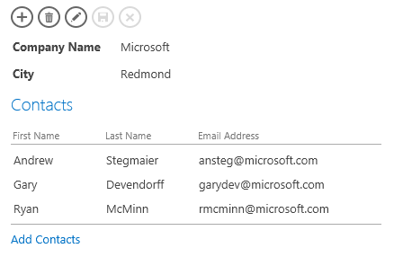

Polished, Professional User Interface
Autocomplete Control
Datasheet
Drill-Through Popups
Summary View
Related Items Control
Action Bar
Notes:
Consistent and professional UI cross applications…

Slide 17
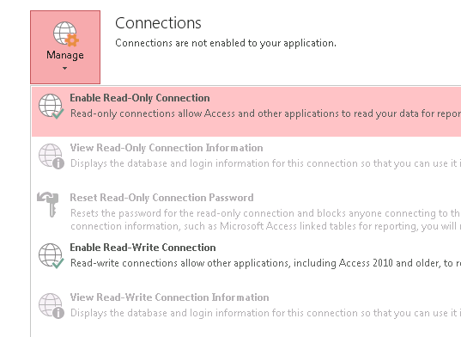
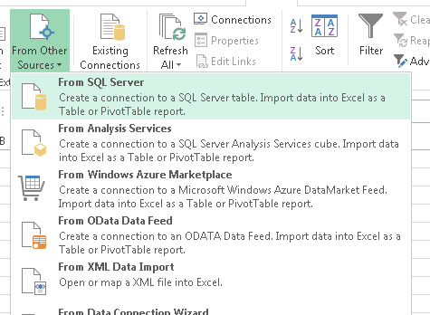
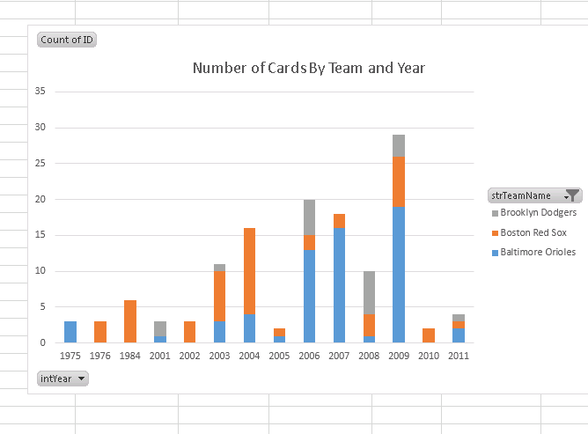
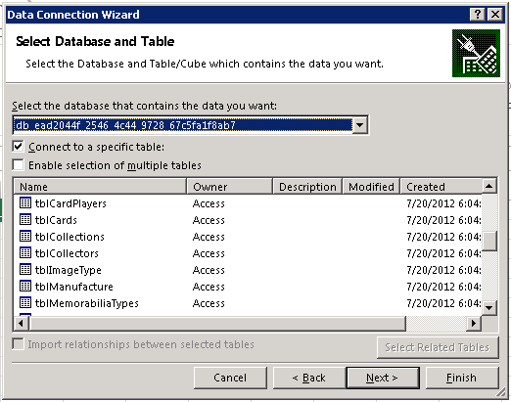
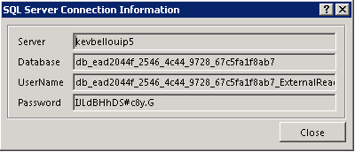
Harness the Power of SQL
Authorize in Access
Allow other programs to connect to the SQL Server database that powers your access app. You’ll find all the necessary credentials in one place.
Connect from Anywhere
Enter the SQL Server connection information from Access into your analysis program, and you’ll find all your database’s queries and tables available. SQL Server is an industry standard, so you have a choice of tools, from Excel to Crystal Reports.
Analyze and Report
Take advantage of the powerful charting and analysis tools that Excel already provides. Or crunch your data in a program of your choice.

Slide 18
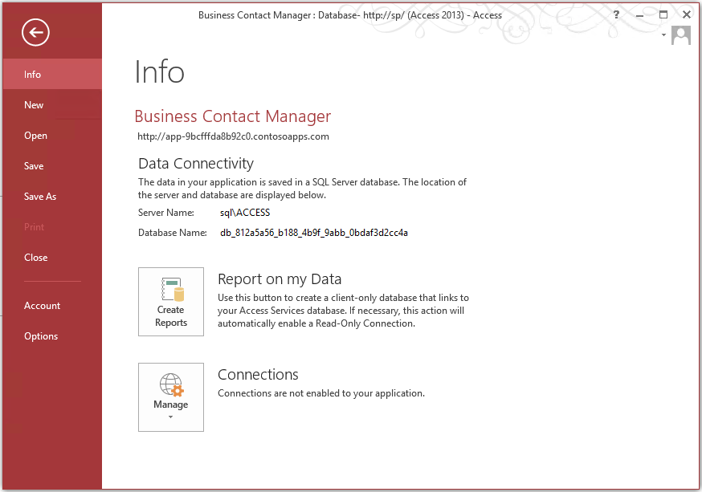
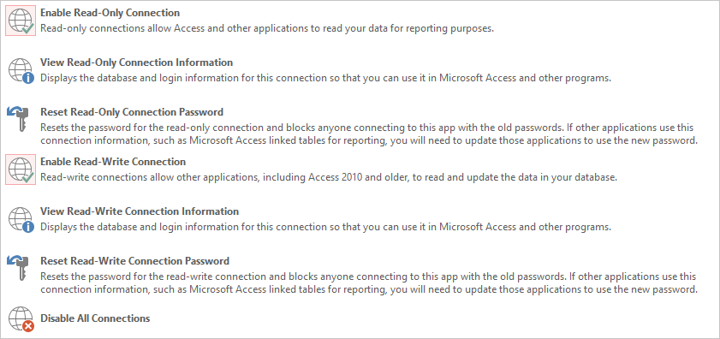
Reporting and connections
Notes:
You might be wondering why these details are important. For some users, the only visible effect of the new SQL Server back-end will be increased speed and reliability. They don't need to worry about the technical details. More advanced users, though, can directly connect to the SQL Server or SQL Azure database from outside of their Access app, which enables a whole new frontier of possibilities for advanced integration and extensions. This is big!
To enable external connections, simply click on the File menu to go to the Backstage. Under the Connections section, you'll find the SQL Server login credentials that you can use to connect to your database in SQL Server Management Studio, ASP.NET, or any other application that supports SQL Server.
The Manage connections button contains a number of commands that allow you to manage connections to the SQL Server database. You'll find that you can generate a read-only login and a read-write login. Use the read-only login when you want to connect to the SQL Server database from a program or app that doesn't need to modify the data, such as a reporting tool. Use the read-write login when you want to connect to the database and modify or enter new data. For example, you could create a public website in ASP.NET that allowed internet users to submit applications that get stored in your Access database.

Slide 19
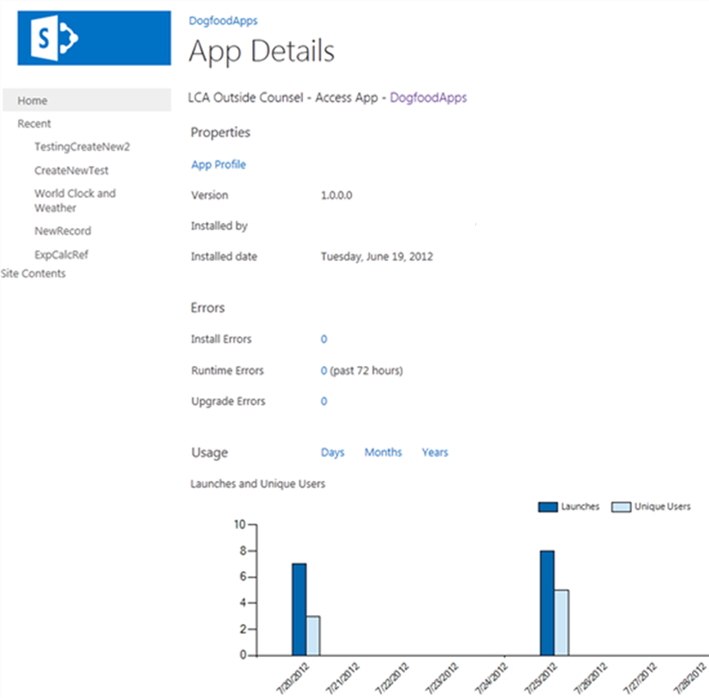
Managing Access databases in your organization
Reliability
Security
Monitoring
Notes:
Reliability: Office 365 and SQL Azure are both enterprise-class cloud services backed by robust Service Level Agreements. To learn more, check out the Office 365 Trust Center. Also, here's a recent blog post about fault-tolerance in SQL Azure Databases.
Security: You can use SharePoint permissions to control who can create new apps, modify the tables, queries, views and macros of existing ones, edit data and read data.
Monitoring: IT organizations often want visibility into the usage of applications in their organization. To meet this need, SharePoint collects data about each Access Services app. To access this information, visit the Site Contents page. Hover over the app, and click the "..." icon. Then click Details.

Slide 20
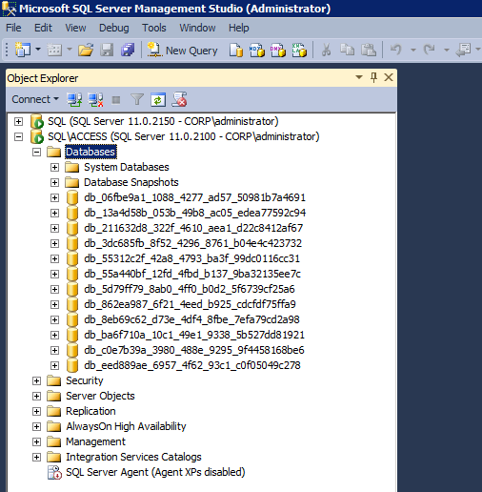
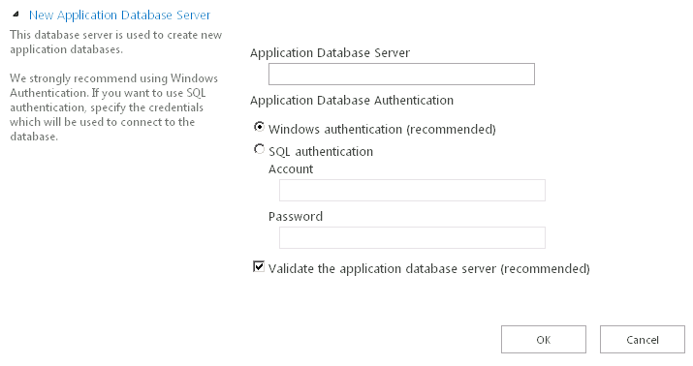
Service application and database configuration
Notes:
Database configuration in the Service App creation and how databases are created to SQL Server – visualization on one-db-per-app model
Recommendation to use separate instance with configurationally elements.

Slide 21
Data model in Web App databases
Tables in Access are tables in SQL
Designers are the Access designers (not ADP)
Primary key must be an Auto number/ IDENTITY field
Standard foreign key support
Data can be imported from multiple sources (excel, csv etc.)
Tables supports also dynamic SP list linking
Queries
Queries without parameters become Views
Queries with parameters become Table Valued Functions
Data Macros
Event data macros become triggers
Validation rules become check constraints

Slide 22
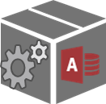
Access App Lifecycle Capabilities
Create and modify Access App directly in SharePoint
SharePoint
SharePoint
Deploy to other SharePoint environments with app database
Save Access app as re-deployable SP App
Contains all configurations done with Access client
Notes:
Access App content exported to dacpac which is included in SP App file… when imported to other s.ide, database optionally with content is created to target environment

Slide 23
Access Web Apps
Demo
Notes:
Demo of the access services functionality
Create Access App
Test app
Save it as SP App to desktop
Deploy to new location as demo as well
Edit in Access from new location

Slide 24
Access is SP App designer for business users

Slide 25
Considerations for Access Web Apps
Requires SQL Server 2012
Use at least dedicated SQL Server instance to differentiate Access App databases from SharePoint databases
Remember to consier Access App databases in disaster recovery plans
Content database contains link to Access App, but actual functionality is in it’s own database

Slide 26

© 2012 Microsoft Corporation. All rights reserved. Microsoft, Windows, Windows Vista and other product names are or may be registered trademarks and/or trademarks in the U.S. and/or other countries.
The information herein is for informational purposes only and represents the current view of Microsoft Corporation as of the date of this presentation. Because Microsoft must respond to changing market conditions, it should not be interpreted to be a commitment on the part of Microsoft, and Microsoft cannot guarantee the accuracy of any information provided after the date of this presentation. MICROSOFT MAKES NO WARRANTIES, EXPRESS, IMPLIED OR STATUTORY, AS TO THE INFORMATION IN THIS PRESENTATION.

