Slide 1
Business Continuity Management in SP2013
Name
Title
Company

Slide 2
Agenda
Introduction to BCM
RPO and RTO
Defining fault domains
BCM in SharePoint 2013
Clustering
Mirroring
Log shipping
Availability Groups

Slide 3
Introduction to BCM

Slide 4
RPO and RTO
Understanding RPO and RTO
Recovery Point Objective (RPO) – Tolerable Data Loss
Recovery Time Objective (RTO) – Tolerable Service Loss
Example:
RPO of 1 hour
RTO of 6 hours
“I can lose five minutes worth of data, and all of my data can be inaccessible for sixty minutes.”
Notes:
RPO or Recovery Point Objective and RTO , or Recovery Time Objective, are two critical concepts to grasp when establishing a BCM strategy. RPO is the amount of tolerable data loss during a system outage event, while RTO is the length of time the system may be down for during a disaster. RPO and RTO represent your contract with your users – that you will protect their data within certain broad parameters. Data loss is non-negotiable. You cannot go back to your user base and negotiate for the amount of data that you will recover for them post-event. You must establish the amount of data and the length of time of service availability as broadly communicated targets, and then focus your BCM engineering efforts on meeting those targets.
Establishing an achievable RPO and RTO also require that we evaluate our dependencies – what is the RPO and RTO targets of your Active Directory infrastructure? What about your network infrastructure? It makes very little sense to target RPO and RTO

Slide 5
RPO and RTO – The Cost
RPO/RTO
Cost
Notes:
Behavior is asymptotic – as RPO/RTO approach zero, cost begins to go to infinity (for all practical purposes). Must be explicit, “Data Loss Is Non-Negotiable” – Bill Baer
It’s easy to drive requirements to ideals, but it’s practically impossible to obtain those ideals – as services consultants and professionals, you’ve all likely seen this multiple times in your career.
In this model cost becomes astronomical relative to the RPO/RTO objectives
‘what threats are actually mitigated in design?’

Slide 6
Defining Fault Domains
“What Am I Protecting Against?”
Power Failures?
Network Outages?
Natural Disasters?
Man Made Disasters?
Datacenter
Natural Disaster
Man-Made Disaster
Farm
Network Failure
Service Application Failure
Database
Disk Failure
Data Corruption
Local Loop Failure
Notes:
Fault domain = single point of failure in infrastructure
Every environment is rife with them. Defining fault domains allow you to identify scenarios that would cause you to fail uneccessarily.
Talk through failure types, different levels.

Slide 7
RPO and RTO
Understanding RPO and RTO
Recovery Point Objective (RPO) – Tolerable Data Loss
Recovery Time Objective (RTO) – Tolerable Service Loss
Example:
RPO of 1 hour
RTO of 6 hours
“I can lose five minutes worth of data, and all of my data can be inaccessible for sixty minutes.”
Notes:
RPO or Recovery Point Objective and RTO , or Recovery Time Objective, are two critical concepts to grasp when establishing a BCM strategy. RPO is the amount of tolerable data loss during a system outage event, while RTO is the length of time the system may be down for during a disaster. RPO and RTO represent your contract with your users – that you will protect their data within certain broad parameters. Data loss is non-negotiable. You cannot go back to your user base and negotiate for the amount of data that you will recover for them post-event. You must establish the amount of data and the length of time of service availability as broadly communicated targets, and then focus your BCM engineering efforts on meeting those targets.
Establishing an achievable RPO and RTO also require that we evaluate our dependencies – what is the RPO and RTO targets of your Active Directory infrastructure? What about your network infrastructure? It makes very little sense to target RPO and RTO

Slide 8
RPO and RTO – The Cost
RPO/RTO
Cost
Notes:
Behavior is asymptotic – as RPO/RTO approach zero, cost begins to go to infinity (for all practical purposes). Must be explicit, “Data Loss Is Non-Negotiable” – Bill Baer
It’s easy to drive requirements to ideals, but it’s practically impossible to obtain those ideals – as services consultants and professionals, you’ve all likely seen this multiple times in your career.
In this model cost becomes astronomical relative to the RPO/RTO objectives
‘what threats are actually mitigated in design?’

Slide 9
Defining Fault Domains
“What Am I Protecting Against?”
Power Failures?
Network Outages?
Natural Disasters?
Man Made Disasters?
Datacenter
Natural Disaster
Man-Made Disaster
Farm
Network Failure
Service Application Failure
Database
Disk Failure
Data Corruption
Local Loop Failure
Notes:
Fault domain = single point of failure in infrastructure
Every environment is rife with them. Defining fault domains allow you to identify scenarios that would cause you to fail uneccessarily.
Talk through failure types, different levels.

Slide 10
RPO and RTO
Understanding RPO and RTO
Recovery Point Objective (RPO) – Tolerable Data Loss
Recovery Time Objective (RTO) – Tolerable Service Loss
Example:
RPO of 1 hour
RTO of 6 hours
“I can lose five minutes worth of data, and all of my data can be inaccessible for sixty minutes.”
Notes:
RPO or Recovery Point Objective and RTO , or Recovery Time Objective, are two critical concepts to grasp when establishing a BCM strategy. RPO is the amount of tolerable data loss during a system outage event, while RTO is the length of time the system may be down for during a disaster. RPO and RTO represent your contract with your users – that you will protect their data within certain broad parameters. Data loss is non-negotiable. You cannot go back to your user base and negotiate for the amount of data that you will recover for them post-event. You must establish the amount of data and the length of time of service availability as broadly communicated targets, and then focus your BCM engineering efforts on meeting those targets.
Establishing an achievable RPO and RTO also require that we evaluate our dependencies – what is the RPO and RTO targets of your Active Directory infrastructure? What about your network infrastructure? It makes very little sense to target RPO and RTO

Slide 11
RPO and RTO – The Cost
RPO/RTO
Cost
Notes:
Behavior is asymptotic – as RPO/RTO approach zero, cost begins to go to infinity (for all practical purposes). Must be explicit, “Data Loss Is Non-Negotiable” – Bill Baer
It’s easy to drive requirements to ideals, but it’s practically impossible to obtain those ideals – as services consultants and professionals, you’ve all likely seen this multiple times in your career.
In this model cost becomes astronomical relative to the RPO/RTO objectives
‘what threats are actually mitigated in design?’

Slide 12
Defining Fault Domains
“What Am I Protecting Against?”
Power Failures?
Network Outages?
Natural Disasters?
Man Made Disasters?
Datacenter
Natural Disaster
Man-Made Disaster
Farm
Network Failure
Service Application Failure
Database
Disk Failure
Data Corruption
Local Loop Failure
Notes:
Fault domain = single point of failure in infrastructure
Every environment is rife with them. Defining fault domains allow you to identify scenarios that would cause you to fail uneccessarily.
Talk through failure types, different levels.

Slide 13
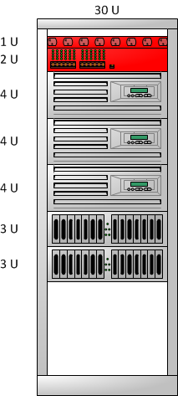
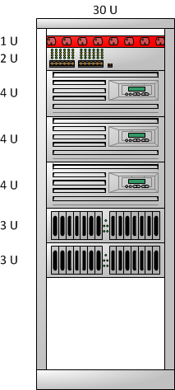
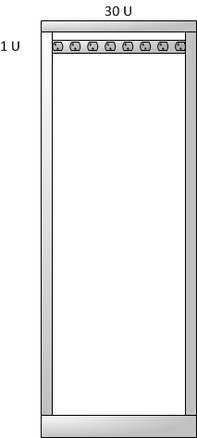
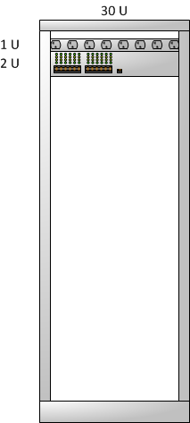
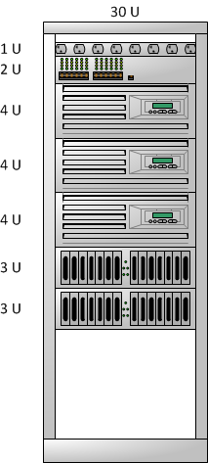

Defining Fault Domains
Lack of Redundant Power
Lack of Redundant Network Connectivity
Notes:
Let’s start with something pretty simple, that we can all likely visualize – a computer rack.
In example, add power strip and network connectivity

Slide 14
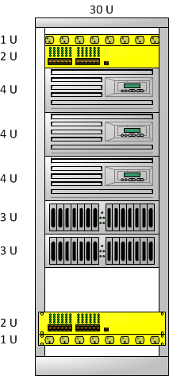
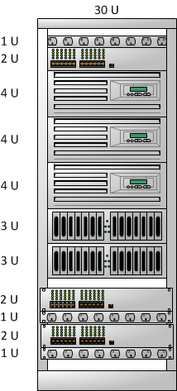
Defining Fault Domains
Frankenrack
The Datacenter People Hate You
Notes:
Better, but…
Minimally Available – add additional switch & power strip? But now I need servers with THREE redunant power suppies? And THREE network cards? And each network card now has to be addressable somehow?
What about Separate Power Sources? Am I just plugging in to the same electrical circuit?
And that network? Are we on separate subnets?
Assuming we’ve worked through issues of power availability and upstream router configuration, and we went out and spent a ton of money on servers with three power supplies, we’ve also just build a frankenrack that you’ll probably (hopefully?) never see in an actual production data center. Sensibility is on the next slide.

Slide 15
Defining Fault Domains
What about what’s inside?
Notes:
In our case, we can establish the rack as a fault domain
A single point of failure. It then becomes a conversation of, do I spread my hardware across two racks or three? Two racks represent a minimally available configuration; three racks (assuming you’d only lose one rack at a time) allow you to maintain HA protection.
But what about what’s inside?

Slide 16
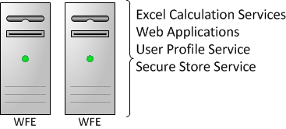
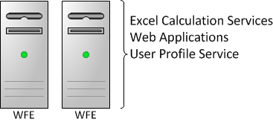
Defining Fault Domains
Notes:
Let’s say first rack is running two VMs’ on the first server, with these services.
And on another server, it’s running VM’s, with these services.
In the second rack, we’ve got a different VM set that’s running these services. Are we highly available?
We’re close. Conceptually, we’re talking about striping our application services across physical domains. In this example,
We’ve screwed up – we’re missing a secure store instance running on *some* node on the second rack, and so even though a cursory examination of our service topology would show us to be redundant, practially speaking we’re not. Someone trips on a power cord, and we are out of service, and we’re out of service in a way that might not be easily discoverable to your operations or response teams, triggering a failover unnecessarily.
Think about this for a moment – think about the separation of duties in most organizations. Now think just how frequently this particular scenario probably plays out in the real world, and consider the fact that physical topology is opaque to the environment operator; you don’t see what servers are in what rack in CA. Now consider the topology & application service distribution changes a running environment goes through during the normal lifecycle of a SharePoint farm; what may have been fine at production start may not be fine at some future point in time. The logical service topology is as opaque to the network engineers wiring the racks as the physical topology is to the SharePoint administrator looking at CA or PowerShell.
EVALUATE:
CREATE A TABLE REVIEW YOUR FAULT DOMAINS AND MITIGATION

Slide 17
Defining Fault Domains
Service Topology
Server Topology
Network
Datacenter Health
Database Availability
Network
Power
Datacenter Health
Datacenter Health
Notes:
What’s interesting is that as you begin to develop a set of fault domains for a given architecture, you quickly start to realize that there is a hieararhcy of sorts that you’re building. Redundancy of your service topology is only useful with redundancy of your physical hosting topology, is only useful with redundancy of your power and hosting infrastructure, etc.
Ultimately, though, you wind up being constrained with the single largest, likely un-mitigateable fault domain – the datacenter.
In a lot of customer cases, data center level redundancy is something of a punt. Especially when you’ve not done the due diligence of mitigating (as much as you can with the dollars you have) the risks in your child fault domains.
Without deeply investigating your redundancy caps within you’re your deployment, you’ll be forced into situations where you have to fall over to your secondary site (and lose data) because of potentially recoverable/sustainable local issues.

Slide 18
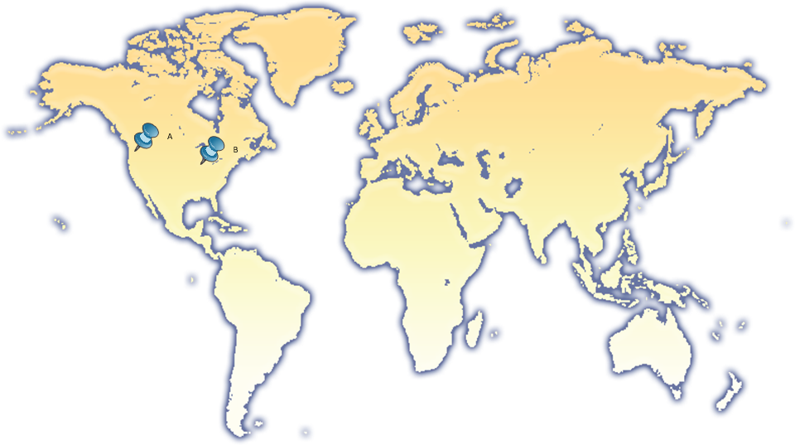
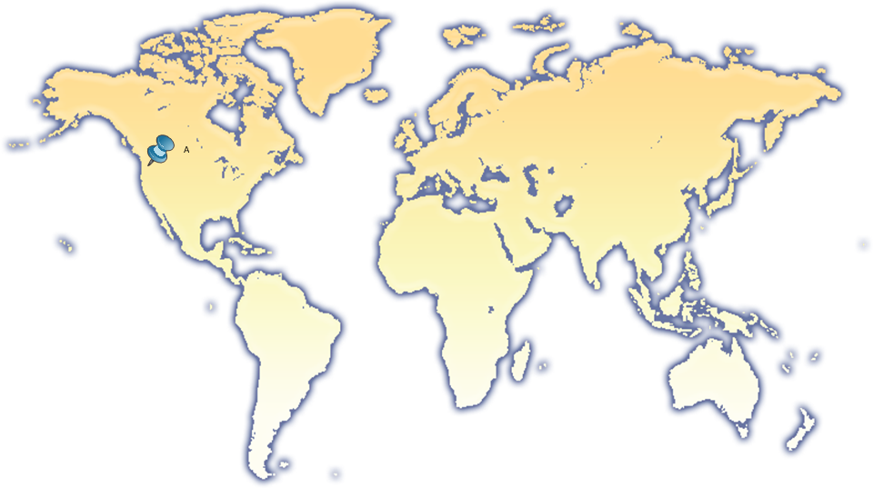
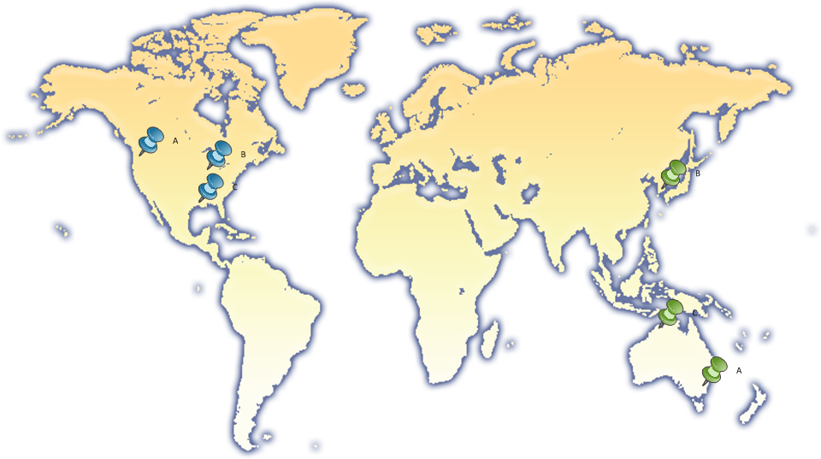
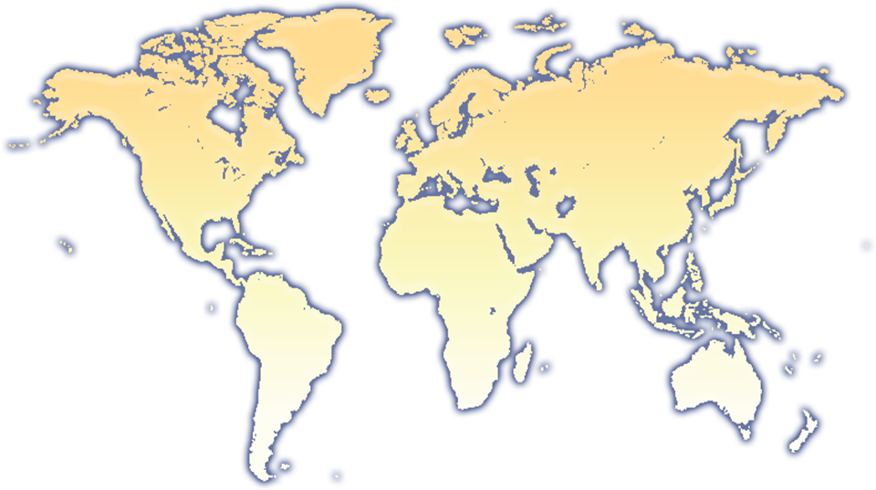
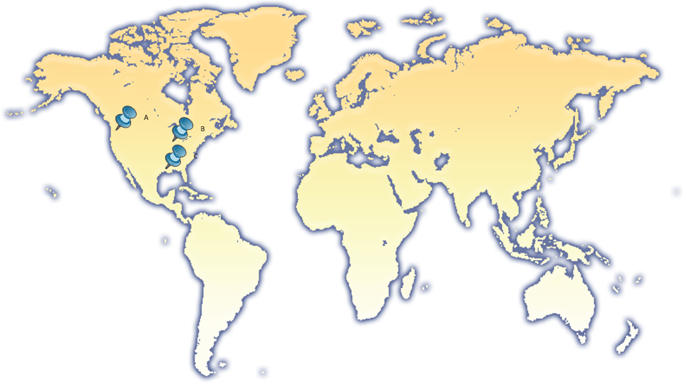

Example – Datacenters
Notes:
Fault domain likely concerned with natural disasters – things like earthquakes, tsunami, tornadoes, etc. Meeting a defined RPO/RTO in this case will require replication of your data to a different data center, likely thousands of miles away, far enough to avoid impact of whatever natural disaster you happened to be concerned with. Data replication is not an instantaneous event.
Now data center is one end of the extreme, the other end of the extreme (and the one which people spend the most amount of time focused on) is the database.

Slide 19
Example - Databases
Most common fault domain area of focus
Principal vehicle for service
Principal vehicle for recovery of service
“If you give me your databases, I can rebuild your farm. If you only give me your broken servers, I cannot help you.”
Notes:
Database is obvious critical fault domain for localized failures. It’s also a fault domain with a lot of great options for protection.

Slide 20
Technologies & Approaches
Database Protection

Slide 21
Supported Database Servers & Operating Servers
Windows Server 2008 R2 with Service Pack 1
Windows Server 2012
SQL Server 2008 R2 with Service Pack 1
SQL Server 2012 (aka “Denali”)

Slide 22
Native Backup/Restore
No Significant Surfaced Changes
Some “Plumbing” Improvements
Full/Differential Only
Does Not Backup the Transaction Log
Does Not Use Backup Compression
Knits Together SQL Backups & Hierarchal Storage Backups
IBackupRestore, for those that are interested in detailed internals

Slide 23
Failover Clustering
No Stored Data Loss
Mature Technology
Well Understood Recovery Model
SQL Server 2012 Geo-Clustering Enhancements
Complex Configuration & Operation
Shared Storage (Practical) Requirement
Perceived Hardware Under Usage
Very Low RPO/RTO – For Some Fault Domains
Still not technically zero!
There will be service interruption while the failover occurs!

Slide 24
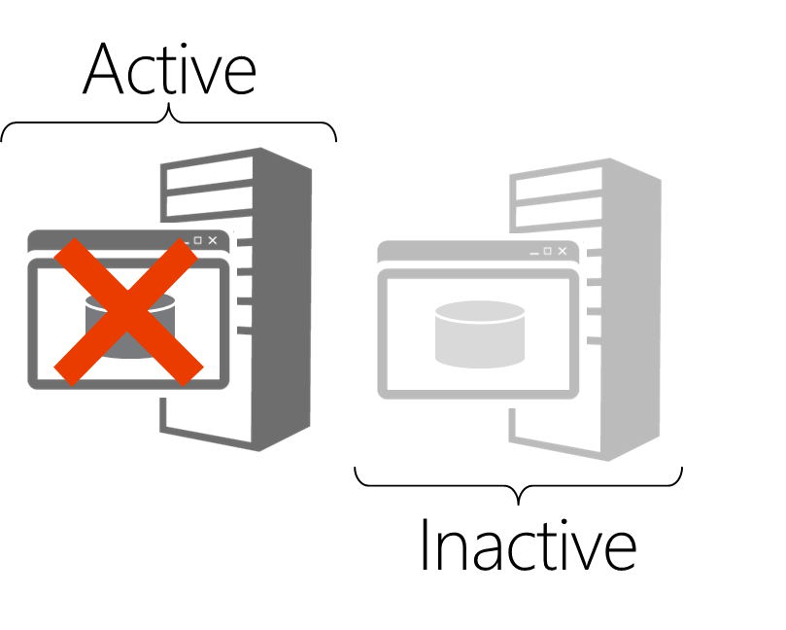
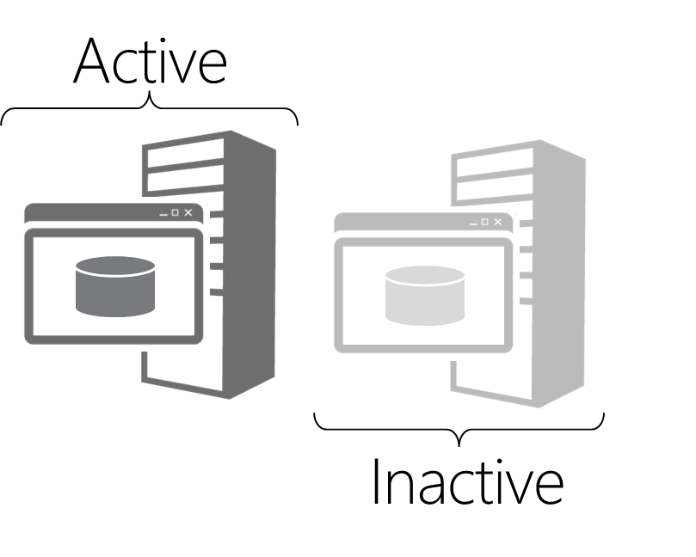
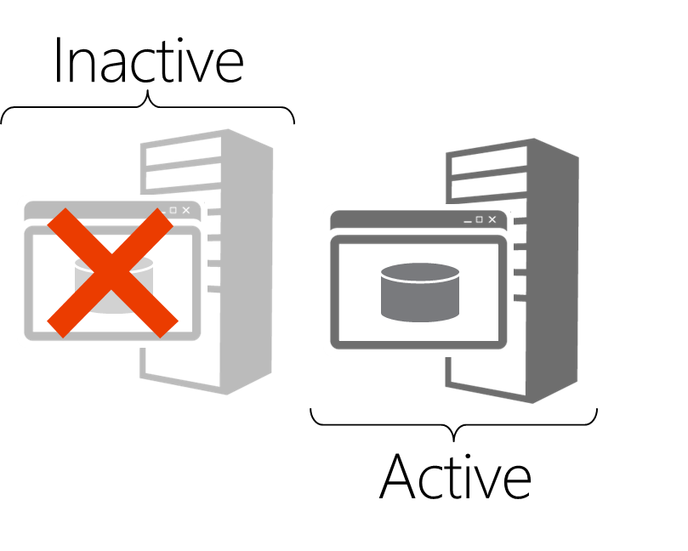
Failover Clustering - Examples
“Wasted Hardware”
“Perceived Complexity”

Slide 25
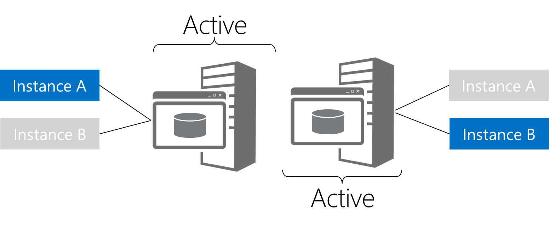
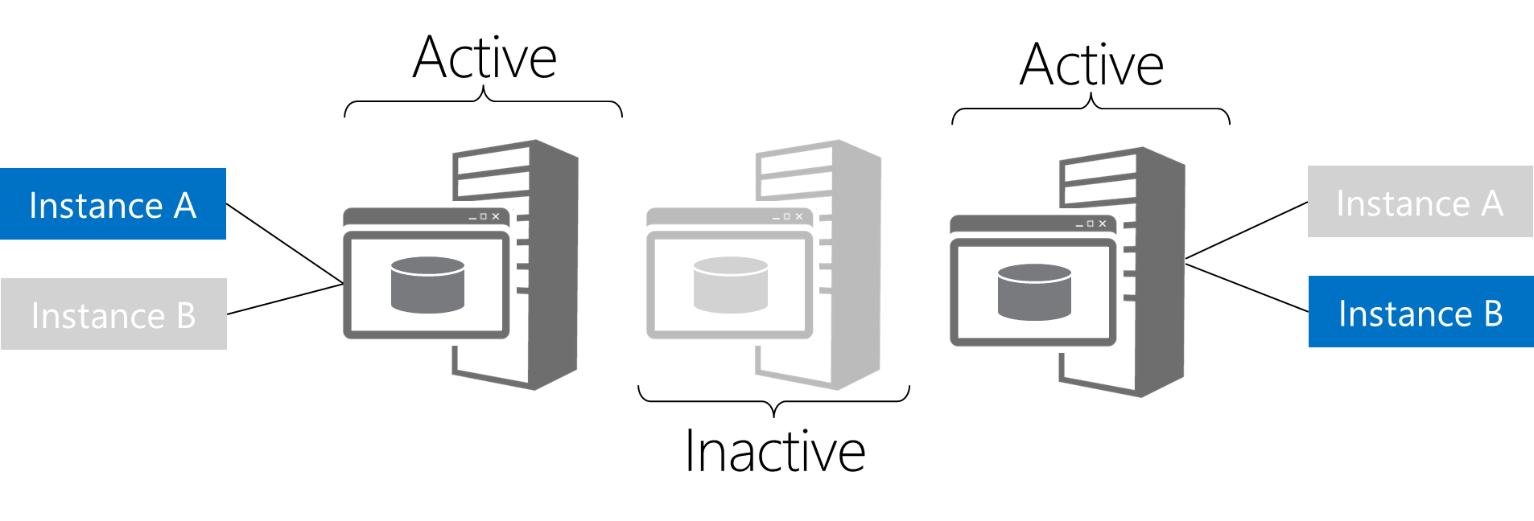
Failover Clustering - Examples

Slide 26
Database Mirroring
No Stored Data Loss
“Failover Clustering, only Simpler”
Less Perceived Hardware Under Usage
Redundant I/O Path
Database-Level Protection
Direct, Deep Support In The Product
SPDatabase.AddFailoverServiceInstance()
“Minimally Available”
Very Low RPO/RTO – For Some Fault Domains

Slide 27
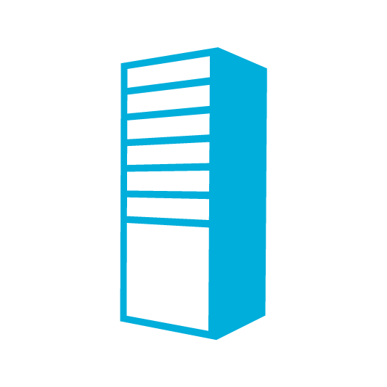
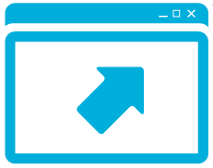
Database Mirroring – Examples
Active
Active
Instance A
Instance B
DB1
Unavailable
Unavailable
…
Notes:
Databases (dark gray) are unavailable

Slide 28
Log Shipping
“Backup, Restore, Repeat”
Read-Only Secondary Copies
Product Patches May Require Read/Write @ Secondary
Multiple Targets
Moderate RPO/RTO Achievable
Time Travel Environments
Geographic Redundancy Approachable
Notes:
*** Transaction log loss
Time to ship logs across network to secondary site/datacenter

Slide 29
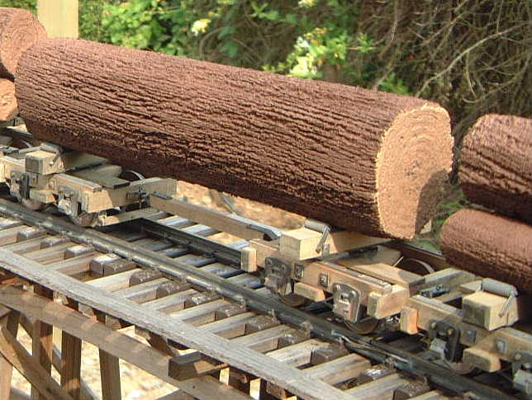
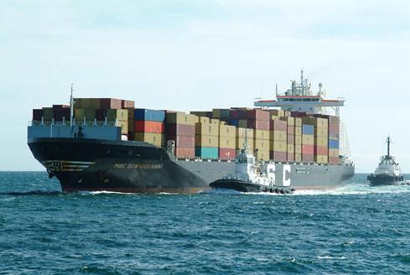
Log Shipping

Slide 30
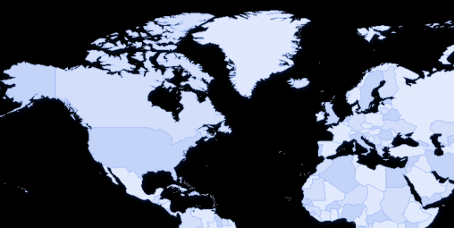

Log Shipping - Examples

Slide 31

Log Shipping Support
Service Application | Database | Supported
Core | Configuration
 | Content
 | Administration
Search | Administration
 | Crawl
 | Links
 | Analytics
User Profile | Profile
 | Synchronization
Usage and Health Data Collection | Logging
Access Services | Various | TBD

Slide 32
Log Shipping Support
Service Application | Database | Supported
Secure Store | SecureStoreService
State | StateService
PerformancePoint | PerformancePoint Service
Business Data Connectivity Services | BDCService
Subscription Settings | Subscription
Project | Project Service
Visio | StateService
Word Conversion | Word Automation Services
Machine Translation | Translation Service
Application Registry | Application Registry Service
Application License | AppMngService
Managed Metadata | Taxonomy

Slide 33
Hybrids
Failover Clusters…
… of Mirrored Databases
… Log Shipped
… Across Town
… and Across the Continent
Notes:
TODO add diagram build!!

Slide 34
Availability Groups
New AlwaysOn Availability Group functionality in SQL Server 2012
Not technically related to Database Mirroring or Log Shipping
Much of the vernacular is recycled
Ground-up re-architecture, at the SQL OS and Storage subsystem levels
Requires Windows Failover Clustering

Slide 35
Availability Groups
Requires SQL Server 2012 Enterprise Edition
Requires Windows Server 2008 Enterprise Edition
Requires Hotfixes
KB976097 – Adds support for asymmetric storage
KB2494036 – Adds support for node quorum vote configuration

Slide 36
Availability Groups
Failover Cluster
Clustered Resource
Listener
Notes:
Steps for the animation
First we’ll need to establish fail over cluster of two or more nodes each running SQL Server
Each one of these machines are running separate SQL Server instance, they are not running the same failover cluster instance - again SQL Server is not the clustered resource. Each SQL Server instances has also it’s own non-shared IO path, so they each contain their own copy of the database perhaps to local attached storage, perhaps to SAN. But unlike in a failover cluster where I have a single copy of my database shared between my failover cluster nodes (in the more common cases), in this configuration, each node has it's own copy of the database.
Now in the availability group, I have what is referred to as an availably group listener. And the availability group listener is the clustered resource. He is the guy, he is the component of this system that is part of the clustered resource who will fail over between the various nodes.
So as the listener moves between nodes, the listener is, simply put, the virtual network name that the clients connect through. So our clients (in this example, SharePoint), SharePoint points at the listener, and the listener points at a node in the failover cluster running SQL Server that is principle at any one point in time for it's databases. But failover clustering itself is not used for protecting the individual databases or replicating the transactions that are going to those databases between the nodes and the failover cluster.
That happens, just like with mirroring, in a peer-to-peer type of configuration. And in fact, if you're familiar with database mirroring, you're familiar with the concept of a database mirroring endpoint. In SQL Server 2012, we have the concept of a HADR endpoint. Now these endpoints are used to replicate the transactions between the various nodes. This replication can be synchronous (in which case we can support automatic failover) or it can even be asynchronous. So, for instance, in the example given here, we can be doing synchronous replication of our transactions between our first two SQL instances, and asynchronously replicate those transactions to a third SQL instance that perhaps is offsite in a second data center. Being able to do this is supported by the fact that we can now do geo clustering with Windows failover clustering since Windows Server 2008.

Slide 37
Availability Groups
Quorum Model Notes
Node Majority
Node with File Share Majority
Availability Groups
Not based on existing technological investments
Not “Database Mirroring on Steroids”
Database Mirroring
Deprecated in SQL Server 2012
Possibly removed from the next version of SQL Server
Notes:
In our demo, we used a Node Majority model – basically, treating our third node that was part of our cluster but never being an automatic failover target as a witness node. This configuration is fine. In multi-subnet configurations, you’ll likely wind up using Node with File Share Majority.
Great whitepapers on SQLCAT.com around multi-subnet clusters, recommended reading, some things to be aware of in cluster configuration with that design.
Availability groups = ground up re-architecture from SQL OS and Storage subsystem on up. This isn’t log shipping + database mirroring on steroids, and this is a very important thing to understand – while a lot of concepts and terms from Database Mirroring have been reused, we’re not using the same underlying code.
This is important to understand, because in SQL Server 2012 database mirroring is being deprecated. It’s still in the product, it still works, but it may be removed in a future release of SQL Server. To ease migration pain, as we saw in the demo, we support database mirroring connection strings for two node availability groups, and since SQL Server isn’t the clustered resource, knitting together existing standalone mirroring SQL Server instances into an Availability Group configuration is super simple and straightforward.

Slide 38
Availability Groups
SharePoint 2010 SP1 supports SQL Server 2012
Availability Group Listeners are a Clustered Resource
Listeners != Availability Group Protection
Careful Planning Needed for Availability Group Protection
Use Aliases to Listeners for flexibility
Use Multiple Aliases
Notes:
Listeners != Availability Group Protection
They are only a pointer, not a failover target

Slide 39
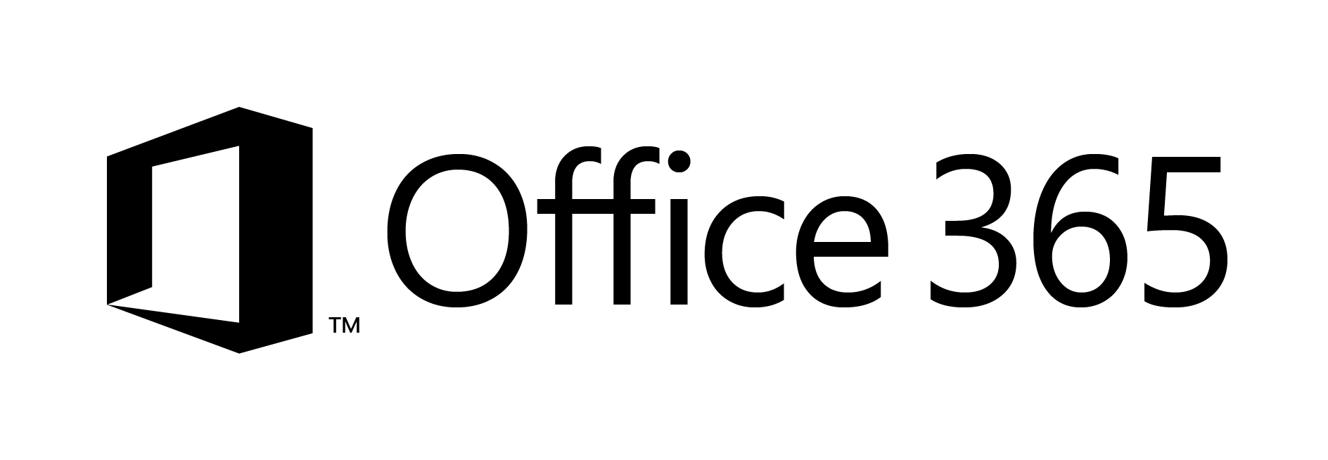
One Possible BCM Strategy…

Slide 40
Summary
Introduction to BCM
RPO and RTO
Defining fault domains
BCM in SharePoint 2013
Clustering
Mirroring
Log shipping
Availability Groups

Slide 41
Q&A

Slide 42

© 2012 Microsoft Corporation. All rights reserved. Microsoft, Windows, Windows Vista and other product names are or may be registered trademarks and/or trademarks in the U.S. and/or other countries.
The information herein is for informational purposes only and represents the current view of Microsoft Corporation as of the date of this presentation. Because Microsoft must respond to changing market conditions, it should not be interpreted to be a commitment on the part of Microsoft, and Microsoft cannot guarantee the accuracy of any information provided after the date of this presentation. MICROSOFT MAKES NO WARRANTIES, EXPRESS, IMPLIED OR STATUTORY, AS TO THE INFORMATION IN THIS PRESENTATION.

