Slide 1

Machine Targeted Repression
Assessing the predictability of trust in regime and regime-type preferences using random forests

Slide 2
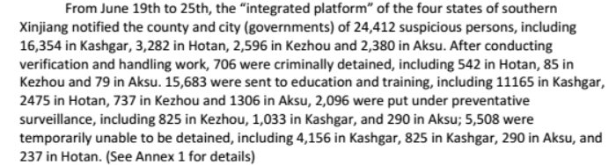
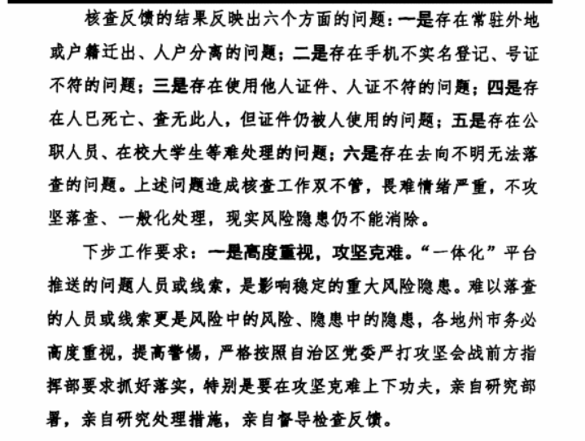
Intro - Xianjang

Slide 3
Why is this important
Current constraints on repression
  Expense of hiring repressive agents
  Moral hazard from coups
Ineffective
  Preference falsification
  Can increase opposition
Macro costs
  Reduces collective action => reduces growth
  Reduces regime information
Solve these problems, rule forever

Slide 4
How it works
Gather rectangular data on citizens
Data sources
  Personal information
  Government services
  Political participation
  Phone usage data => personality
  Social media data
  Movement data => social network
Gather training data (suveilance, protests, searches)
Integrate with existing repressive practices

Slide 5
What we know already
Xinjiang
  Difficult to achieve compliance (citizens obscure data)
  Not popular
  High false positive rate, used only on minorities
  HUngry for phone data
Globally
  Autocracies are interested in the tech (Zimbabwe, Singapore)
  But no known implementations

Slide 6
Research question
Specific questions
  How effective are these techniques at identifying citizens with grievances?
  How much data of which type is necessary?
  Will digital repression substitute for or enhance harsh, traditional repression
Broader question
  Signs of growing digital repression
  Strategies to prevent
Notes:
How much data is vague
Rephrase to mean what *variables* are needed

Slide 7
Methods
Arab barometer data
Train similar predictive algorithm
Comparison between our data

Slide 8
Results: model comparison

Slide 9
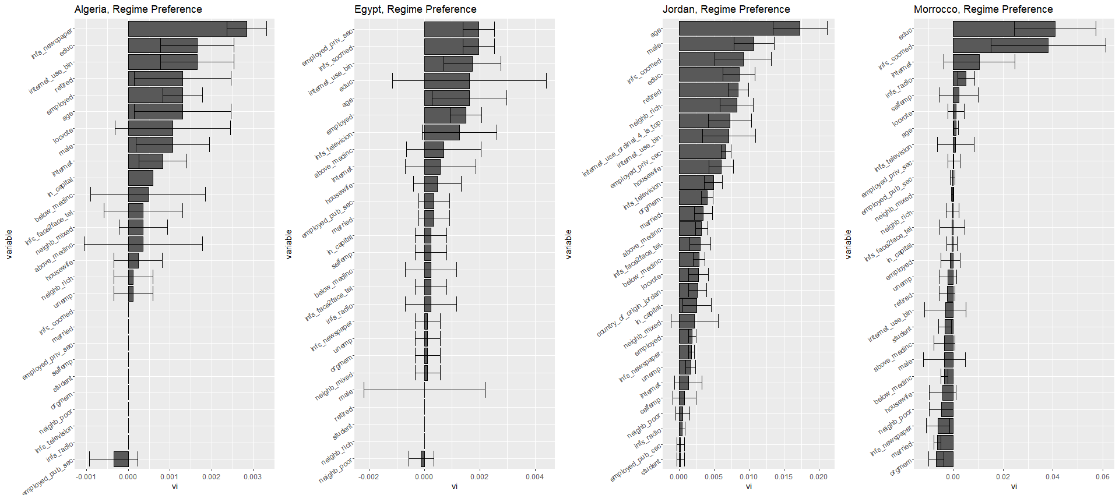
Results: cross validation

Slide 10
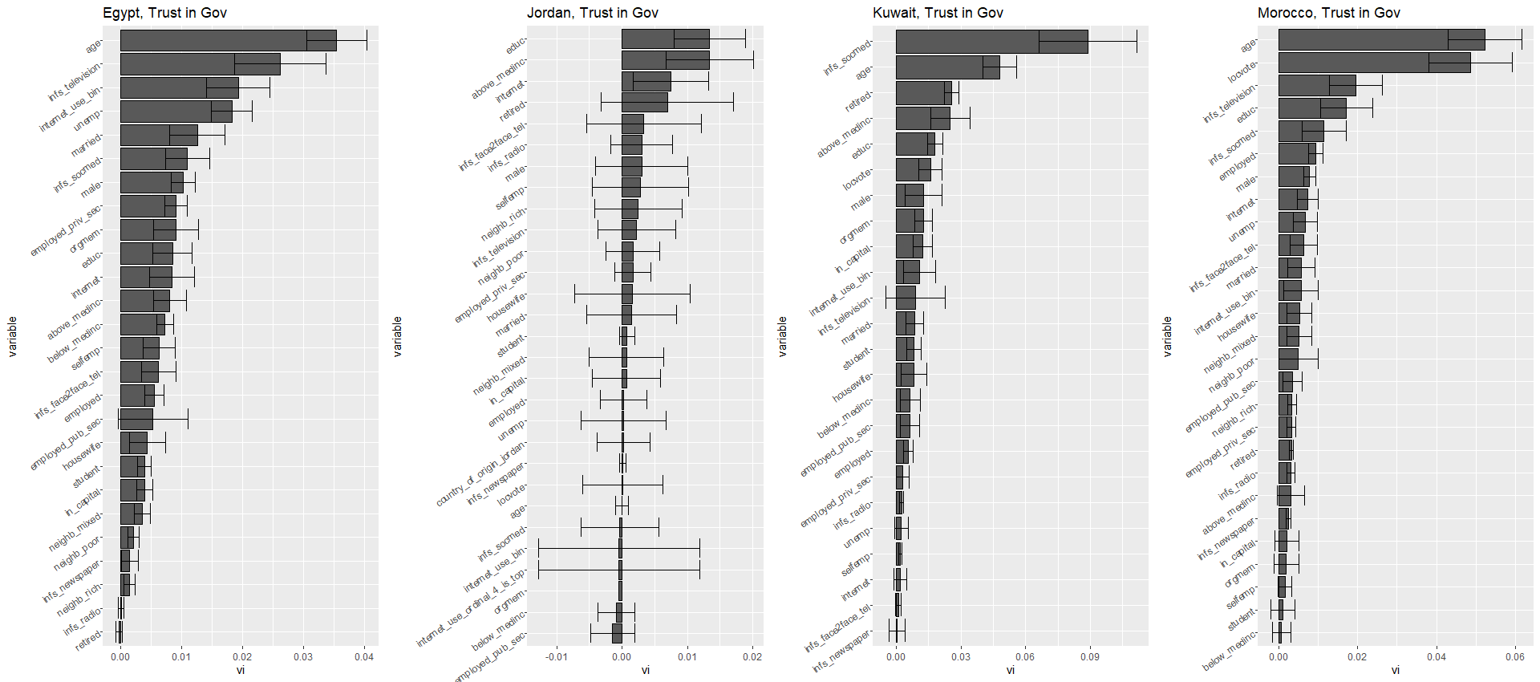
Notes:
Main takeaway from these is that internet or social media use are *always* significant, and always in the top 3. This supports the social media centrality thesis.
Secondly, we notice much greater structure in certain countries. So in Egypt “Trust in Gov” and Jordans “Regime Preference” there

Slide 11
Conclusions

