Slide 1
Immune Response in Trauma Patients
Ted Liu

Slide 2
Overview
Background
Methods
Results
Discussion

Slide 3
Physical trauma is the fourth leading cause of death in all ages
In the US, trauma accounts for ~150,000 deaths per year
Deaths as a result from injury accounts for 10% of the worlds deaths.
Differences in the protein expressions in blunt and penetrating trauma and how they influence outcomes are not well described.
Do trauma patients with blunt injury have a different immune response compared to those with penetrating injury?
Immune response in blunt patients will be higher than their penetrating injury counterparts.
Physical trauma [Internet]. [cited 2021May10]. Available from: https://www.nigms.nih.gov/education/fact-sheets/Pages/physical-trauma.aspx
Trauma facts and links [Internet]. 2020 [cited 2021May10]. Available from: https://www.aast.org/resources/trauma-facts
Injuries and violence: the facts [Internet]. World Health Organization. World Health Organization; 2012 [cited 2021Jun7]. Available from: https://www.who.int/violence_injury_prevention/key_facts/en/
Notes:
Physical trauma has two types:
Blunt trauma
An object or force that strikes the body without piercing skin
Penetrating trauma
An object piercing the skin or body

Slide 4
Methods
PROPPR Dataset – Original study was a blood transfusion study
Principal Component Analysis, K-Means Clustering, Random Forest Regression, Heatmaps.
 | Blunt Injury | Penetrating Injury | Total
Male | 222 | 252 | 474
Female | 86 | 27 | 113
Total | 308 | 279 | 587

Slide 5
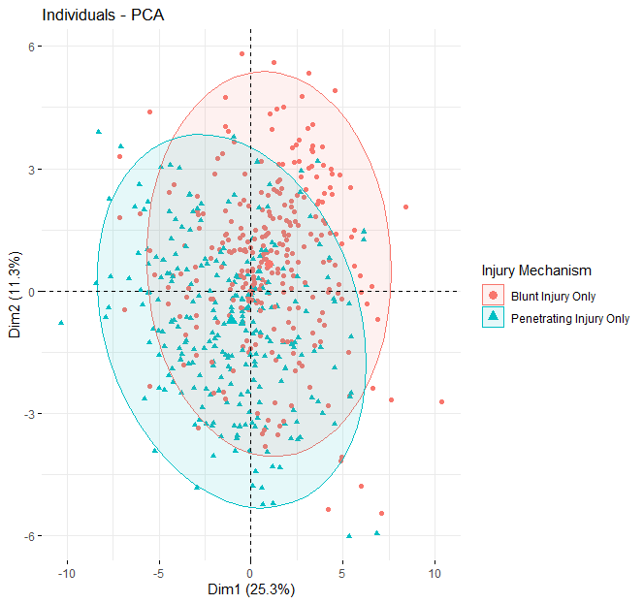
PCA suggests potential differential immune response

Slide 6
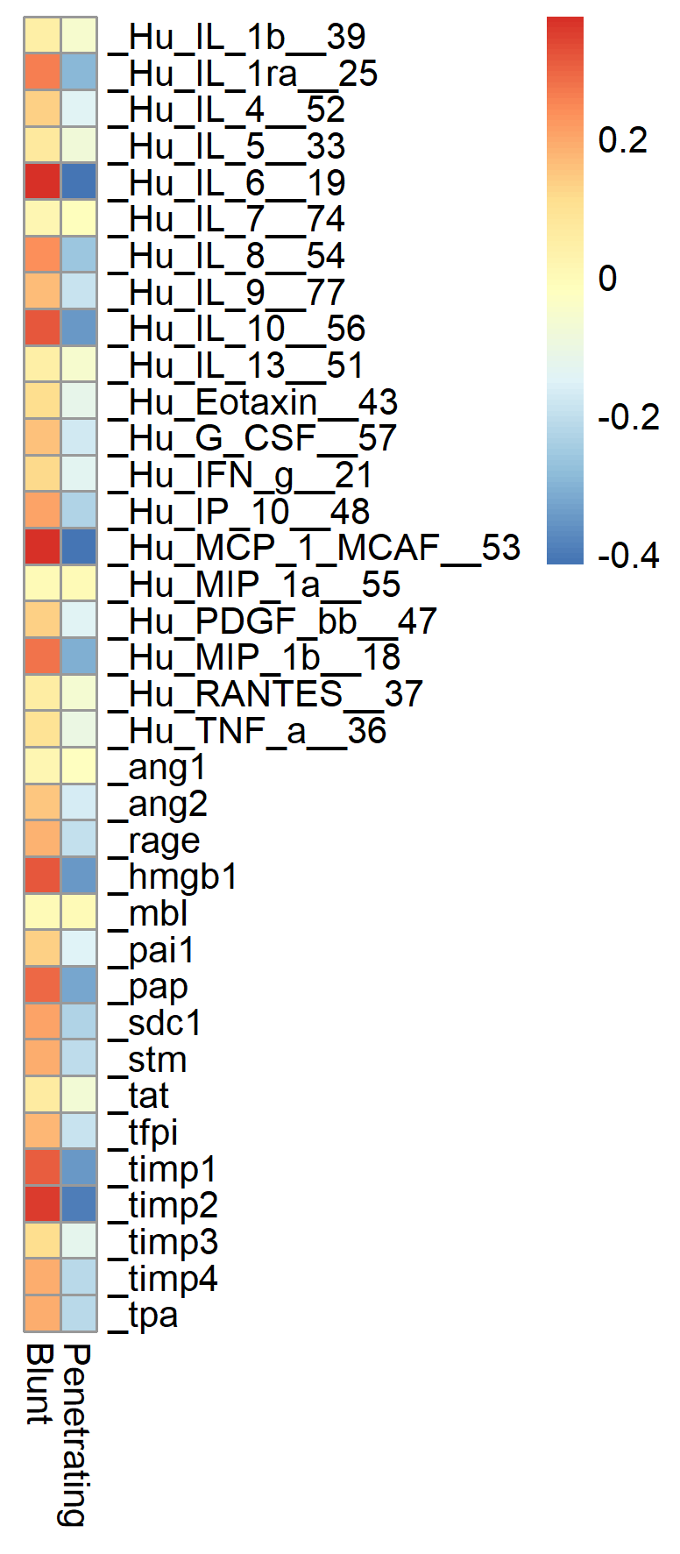
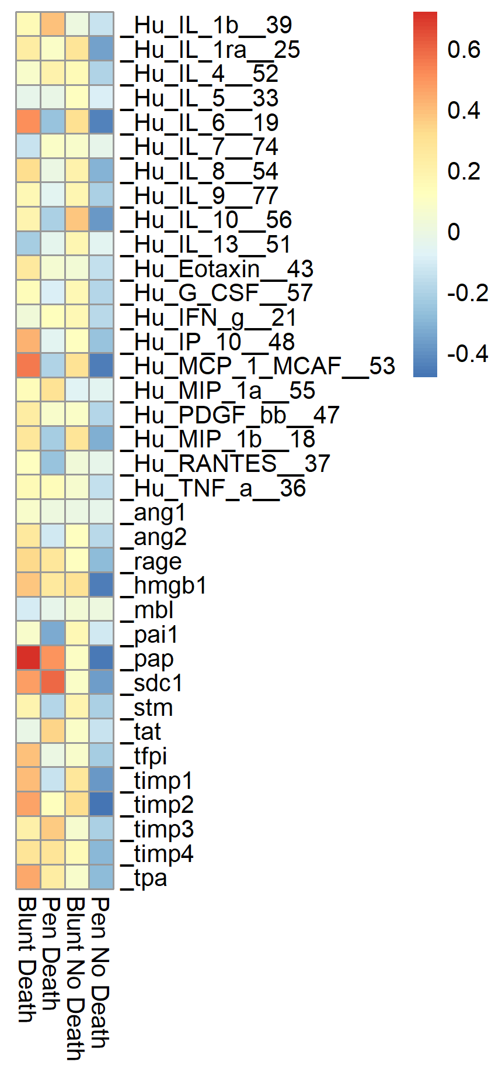
Cytokine profile is different between blunt and penetrating injury patients
Grouped by Injury Mechanism
Grouped by Injury Mechanism and death
Z Score
Z Score

Slide 7
Summary
Blunt injury possessed higher overall biomarker presence than penetrating injury.
Patients who survived had lower inflammatory biomarkers and higher anti-inflammatory markers.

Slide 8
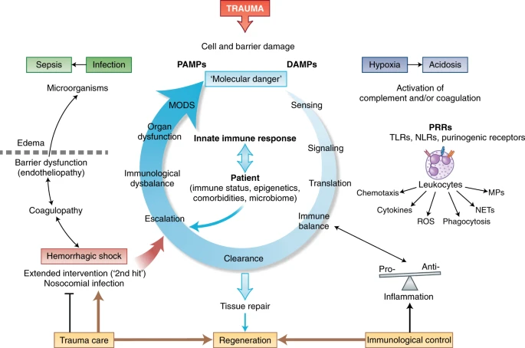
Poor outcomes in trauma are due to an imbalanced immune response
Huber-Lang, M., Lambris, J.D. & Ward, P.A. Innate immune responses to trauma. Nat Immunol 19, 327–341 (2018). https://doi.org/10.1038/s41590-018-0064-8

Slide 9
Additional Slides

Slide 10
Blunt injury has higher incidence of death by 30 days
Relative Risk Ratio:
Groups: Blunt / Penetrating Injury
Outcomes: Living / Death
Blunt / Pen RR = 2.1287 : CI = 1.52 to 2.97
P value < 0.0001
RR > 1 means that the risk of the outcome (death) is increased by the exposure (blunt injury)

Slide 11
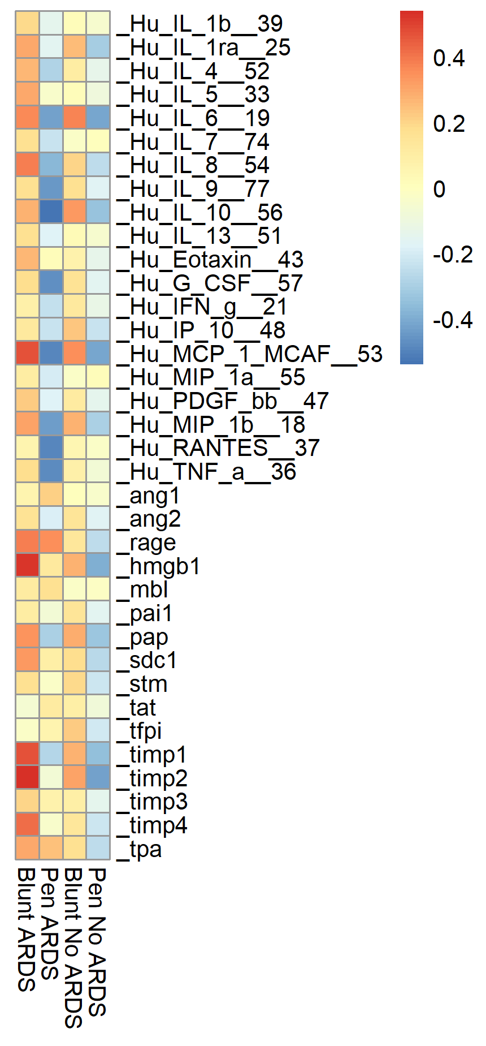
Cytokine profile of blunt injury in ARDS and no ARDS is different than penetrating injury

