Slide 1
Analysis of PROPPR Biomarkers
Ted Liu

Slide 2
Physical trauma is the fourth leading cause of death in all ages
In the US, trauma accounts for ~150,000 deaths per year
Deaths as a result from injury accounts for 10% of the worlds deaths.
Trauma injury can lead to life-threatening complications throughout a hospital course
Physical trauma [Internet]. [cited 2021May10]. Available from: https://www.nigms.nih.gov/education/fact-sheets/Pages/physical-trauma.aspx
Trauma facts and links [Internet]. 2020 [cited 2021May10]. Available from: https://www.aast.org/resources/trauma-facts
Injuries and violence: the facts [Internet]. World Health Organization. World Health Organization; 2012 [cited 2021Jun7]. Available from: https://www.who.int/violence_injury_prevention/key_facts/en/
Notes:
Physical trauma has two types:
Blunt trauma
An object or force that strikes the body without piercing skin
Penetrating trauma
An object piercing the skin or body

Slide 3
Overview
Data set characteristics
Data Cleaning
Clustering and Heatmaps
PCA Plots
Outcomes

Slide 4
Methods
PROPPR Dataset – Original study was a blood transfusion study
 | Blunt Injury | Penetrating Injury | Total
Male | 222 | 252 | 474
Female | 86 | 27 | 113
Total | 308 | 279 | 587

Slide 5
Data Cleaning
Removed biomarker columns that are missing more than 20% of their values
Removed any subjects with missing more than 10% of biomarker measurements
Imputed any missing values for k-means

Slide 6
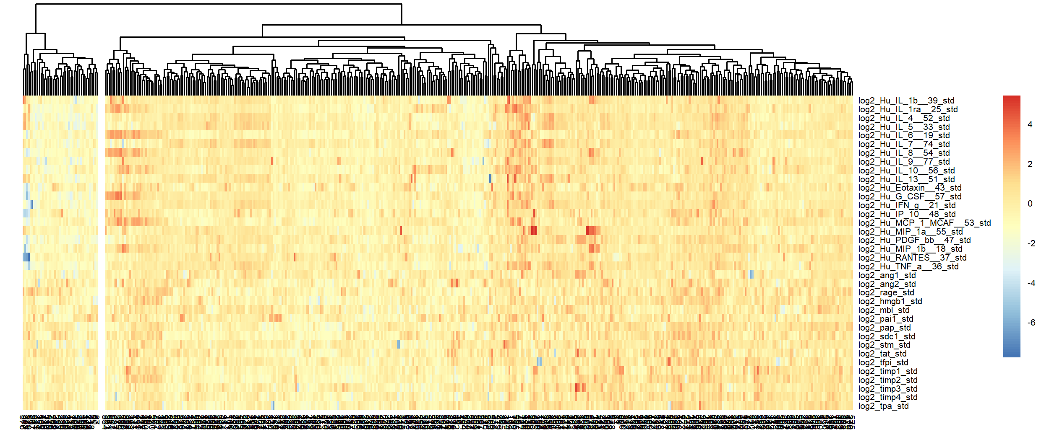
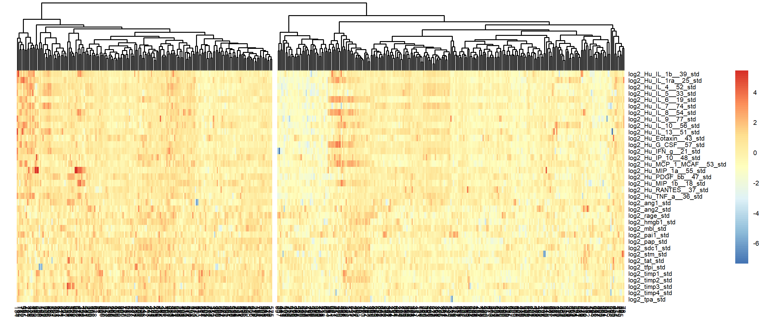
Four outliers greatly impact hierarchical clustering
With 4 ‘outliers’
Without ‘outliers’

Slide 7
Four outliers have little impact on k-means clustering
 | Cluster 1 | Cluster 2
K-Means No Outliers | 207 | 260
K-Means w/ Outliers | 204 | 267
Overlap | 200 | 260

Slide 8
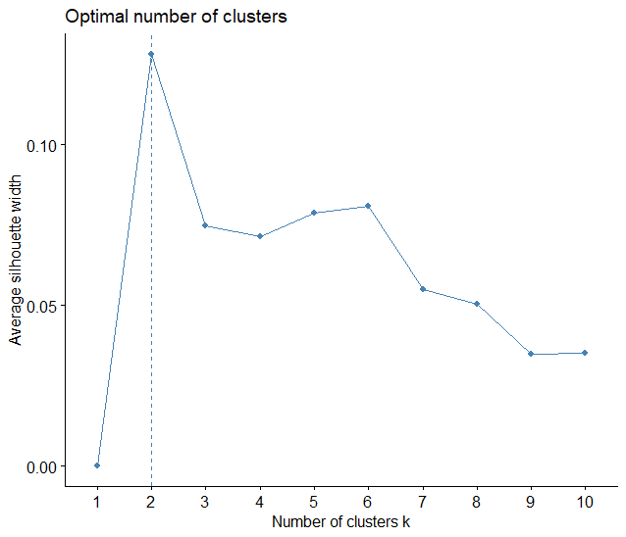
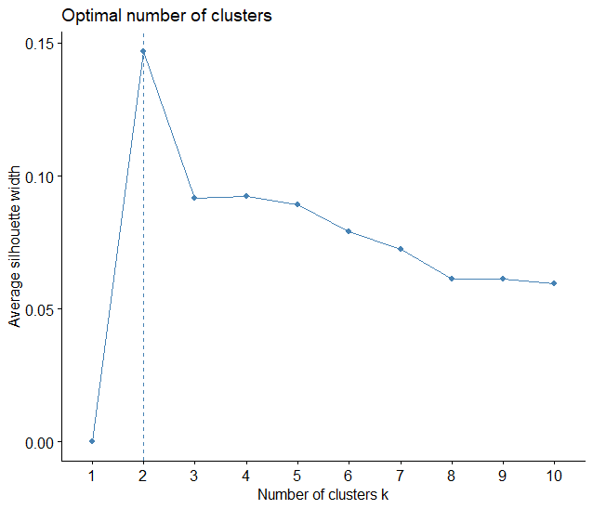
Silhouette scores suggest optimal number of clusters of 2
Hierarchical
K-Means

Slide 9
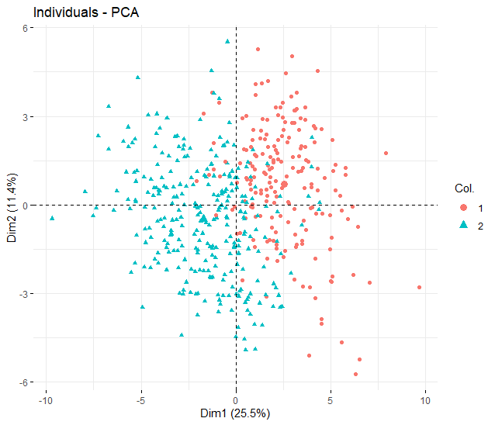
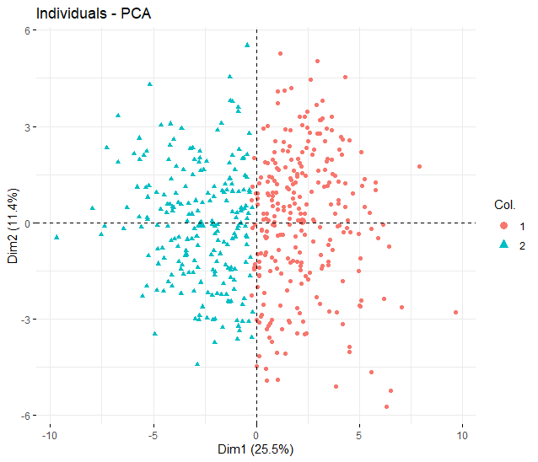
PCA plot shows clustering based on magnitude principal component 1
Hierarchical
K-Means

Slide 10
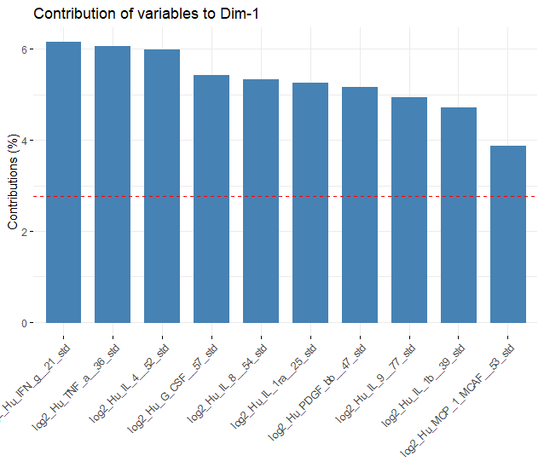
Hierarchical
K-Means

Slide 11
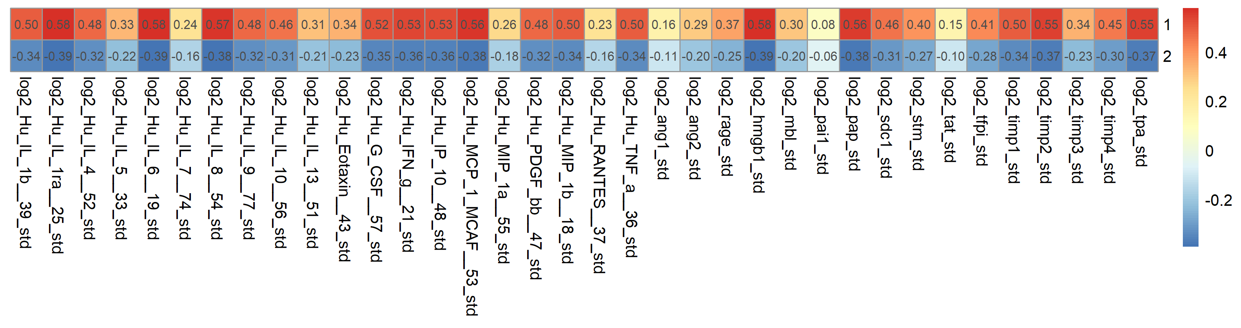
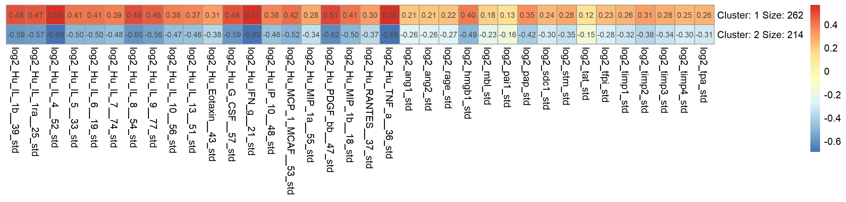
Hierarchical and Kmeans clustering suggest separation in trauma patient population based on magnitude of overall response
Hierarchical
K-Means
 | Cluster 1 | Cluster 2
Hclust | 192 | 284
K-Means | 262 | 214
Overlap | 182 | 204

Slide 12
Subjects in ‘high’ clusters see higher rates of complications and worse outcomes
Hierarchical
K-Means
Outcome | Cluster 1 | Cluster 2
ALI | 0.23 | 0.06
AKI | 0.30 | 0.18
Sepsis | 0.36 | 0.25
VAP | 0.27 | 0.13
Death | 0.32 | 0.16
ARDS | 0.20 | 0.07
RBC_10 | 0.57 | 0.41
Outcome | Cluster 1 | Cluster 2
ALI | 0.08 | 0.18
AKI | 0.18 | 0.28
Sepsis | 0.24 | 0.34
VAP | 0.14 | 0.23
Death | 0.16 | 0.29
ARDS | 0.09 | 0.15
RBC_10 | 0.39 | 0.55
RBC_10 = 10 or more units of RBC received in first 24 hours after ED admission

