Slide 1
Immune Response in Trauma Patients
Ted Liu

Slide 2
Overview
Background
Methods
Results
Discussion

Slide 3
Physical trauma is the fourth leading cause of death in all ages
In the US, trauma accounts for ~150,000 deaths per year
Trauma accounts for 10% of the worlds deaths.
Differences in the protein expressions in blunt and penetrating trauma and how they influence outcomes are not well described.
Do trauma patients with blunt injury have a different immune response compared to those with penetrating injury?
Immune response in blunt patients will be higher than their penetrating injury counterparts.
Physical trauma [Internet]. [cited 2021May10]. Available from: https://www.nigms.nih.gov/education/fact-sheets/Pages/physical-trauma.aspx
Trauma facts and links [Internet]. 2020 [cited 2021May10]. Available from: https://www.aast.org/resources/trauma-facts
Injuries and violence: the facts [Internet]. World Health Organization. World Health Organization; 2012 [cited 2021Jun7]. Available from: https://www.who.int/violence_injury_prevention/key_facts/en/
Notes:
Physical trauma has two types:
Blunt trauma
An object or force that strikes the body without piercing skin
Penetrating trauma
An object piercing the skin or body

Slide 4
Methods
PROPPR Dataset – Original study was a blood transfusion study
Principal Component Analysis, K-Means Clustering, Random Forest Regression, Heatmaps.
 | Blunt Injury | Penetrating Injury | Total
Male | 222 | 252 | 474
Female | 86 | 27 | 113
Total | 308 | 279 | 587

Slide 5
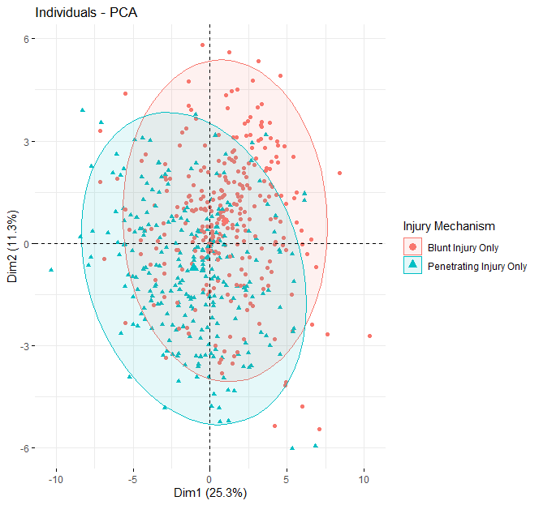
PCA suggests potential differential immune response

Slide 6
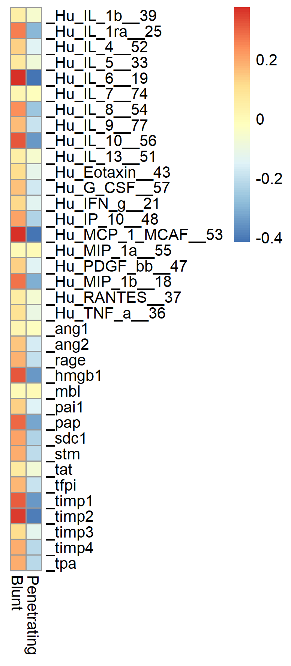
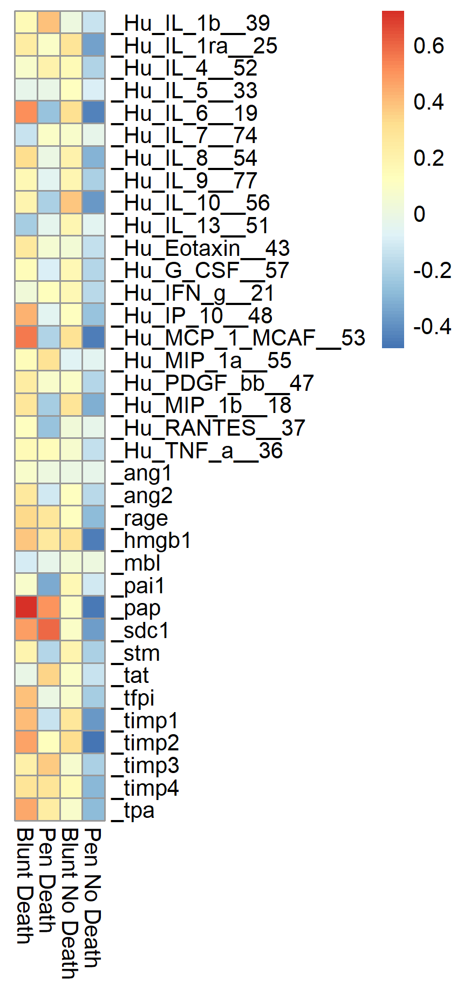
Cytokine profile is different between blunt and penetrating injury patients
Grouped by Injury Mechanism
Grouped by Injury Mechanism and death
Z Score
Z Score

Slide 7
Summary
Blunt injury possessed higher overall biomarker presence than penetrating injury.
Patients who survived had lower inflammatory biomarkers and higher anti-inflammatory markers.

Slide 8
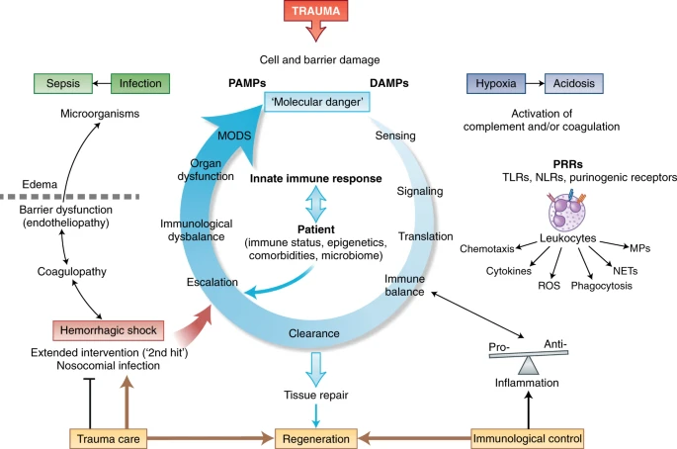
Poor outcomes in trauma are due to an imbalanced immune response
Huber-Lang, M., Lambris, J.D. & Ward, P.A. Innate immune responses to trauma. Nat Immunol 19, 327–341 (2018). https://doi.org/10.1038/s41590-018-0064-8

Slide 9
Additional Slides

Slide 10
Blunt injury has higher incidence of death by 30 days
Relative Risk Ratio:
Groups: Blunt / Penetrating Injury
Outcomes: Living / Death
Blunt / Pen RR = 2.1287 : CI = 1.52 to 2.97
P value < 0.0001
RR > 1 means that the risk of the outcome (death) is increased by the exposure (blunt injury)

Slide 11
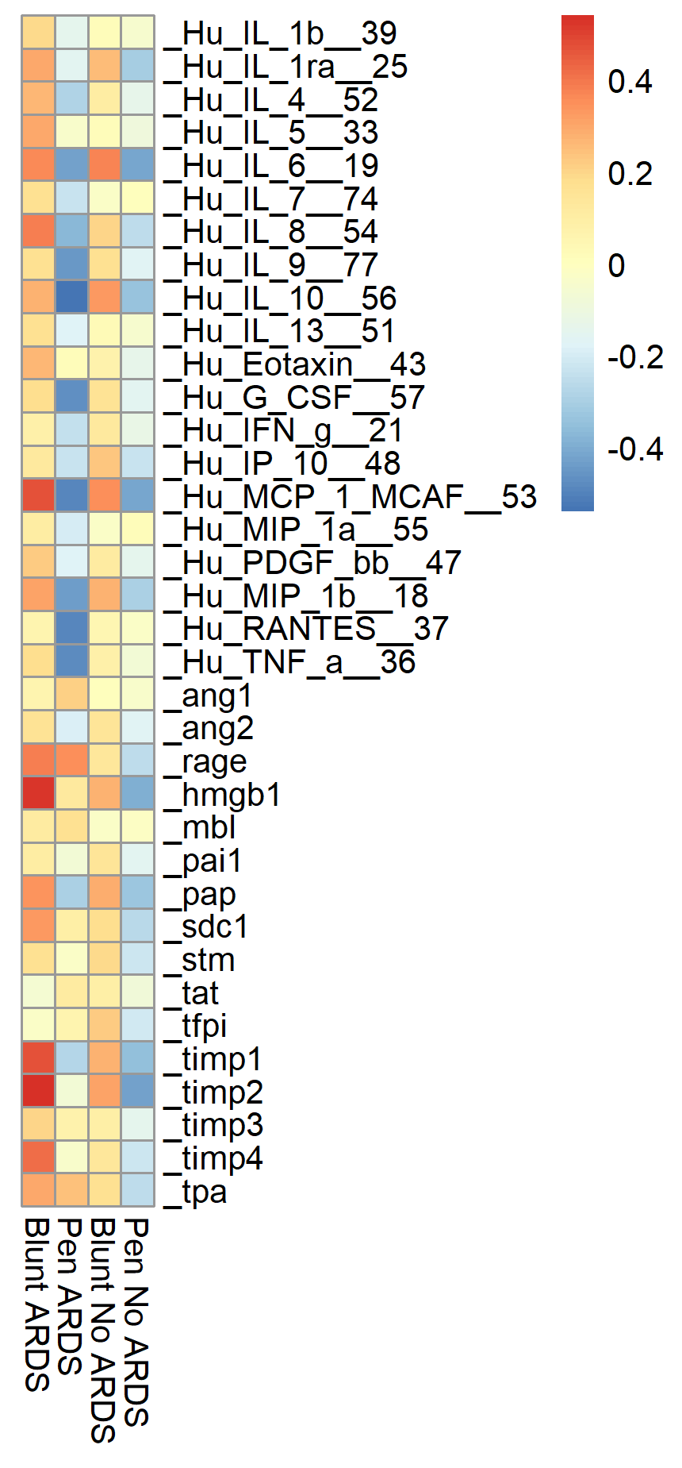
Cytokine profile of blunt injury in ARDS is different than penetrating injury

