Slide 1
Analysis of PROPPR Biomarkers
Ted Liu

Slide 2
Physical trauma is the fourth leading cause of death in all ages
In the US, trauma accounts for ~150,000 deaths per year
Deaths as a result from injury accounts for 10% of the worlds deaths.
Trauma injury can lead to life-threatening complications throughout hospitalization
Physical trauma [Internet]. [cited 2021May10]. Available from: https://www.nigms.nih.gov/education/fact-sheets/Pages/physical-trauma.aspx
Trauma facts and links [Internet]. 2020 [cited 2021May10]. Available from: https://www.aast.org/resources/trauma-facts
Injuries and violence: the facts [Internet]. World Health Organization. World Health Organization; 2012 [cited 2021Jun7]. Available from: https://www.who.int/violence_injury_prevention/key_facts/en/
Notes:
Physical trauma has two types:
Blunt trauma
An object or force that strikes the body without piercing skin
Penetrating trauma
An object piercing the skin or body

Slide 3
Overview
Data set characteristics
Data cleaning
Clustering and heatmaps
PCA plots
Outcomes

Slide 4
Methods
Dataset from PROPPR (Pragmatic, Randomized, Optimal Platelet and Plasma Ratios) Trial at timepoint 0.
 | Blunt Injury | Penetrating Injury | Both Types of Injury | Total
Male | 222 | 252 | 4 | 478
Female | 86 | 27 | 3 | 116
Total | 308 | 279 | 7 | 594
 | Blunt Injury | Penetrating Injury | Both Types of Injury
Age | 42.7 ± 18.9 | 34.3 ± 15.5 | 42.7 ± 18.9

Slide 5
R Libraries
Data manipulation:
Tidyverse
Hmisc
data.table
Visualization & Clustering
Pheatmap
Factoextra
ggplot2
Viridis
Rgl

Slide 6
Data Cleaning
Removed biomarker columns that are missing more than 20% of their values
Removed any subjects missing more than 10% of biomarker measurements
Imputed any missing values for k-means
After cleaning:
Dataset size: 476

Slide 7
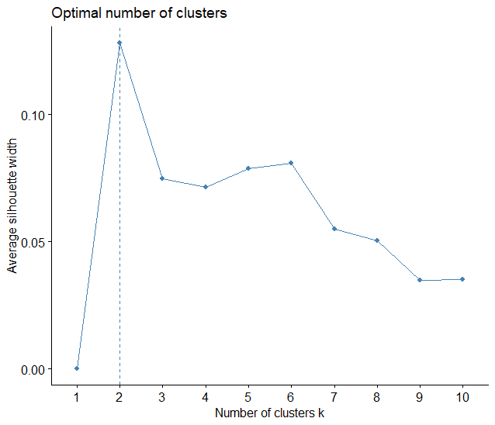
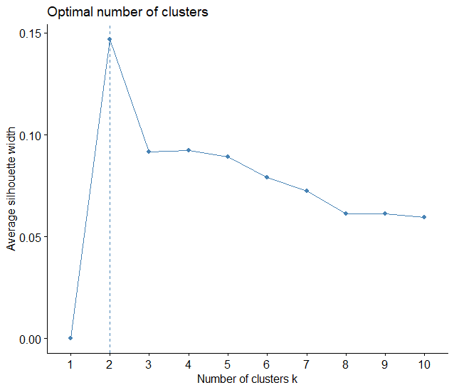
Silhouette scores shows optimal number of clusters of 2
Hierarchical
K-Means

Slide 8
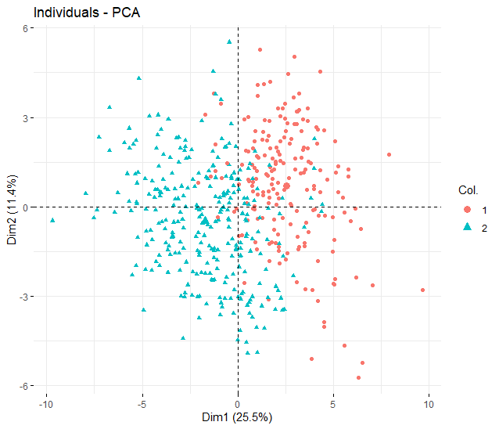
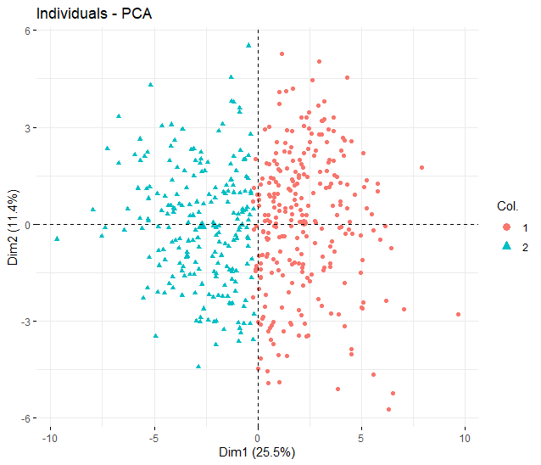
PCA plot shows clustering based on magnitude of principal component 1
Hierarchical
K-Means

Slide 9
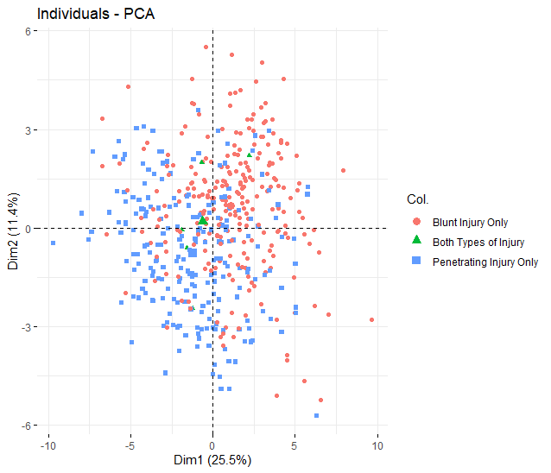
Clustering differs from grouping by injury mechanism
Hierarchical
Injury Mechanism

Slide 10
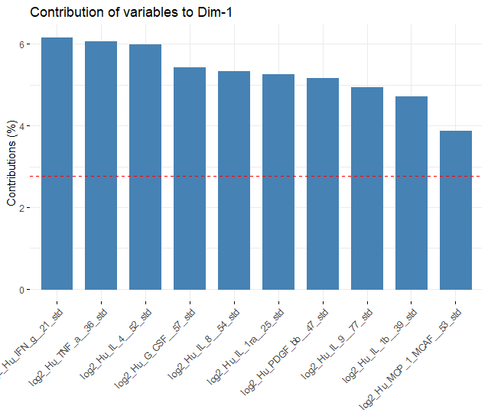
Variable contributions in principal component 1
Hierarchical
K-Means

Slide 11
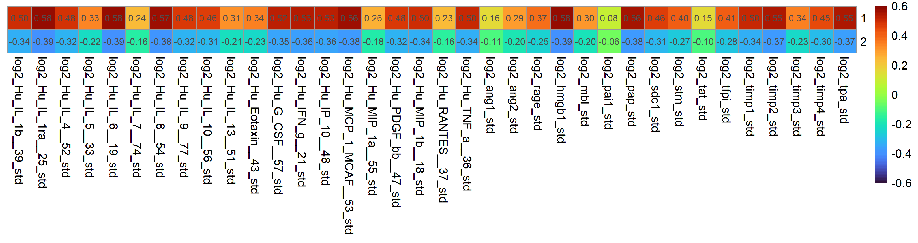
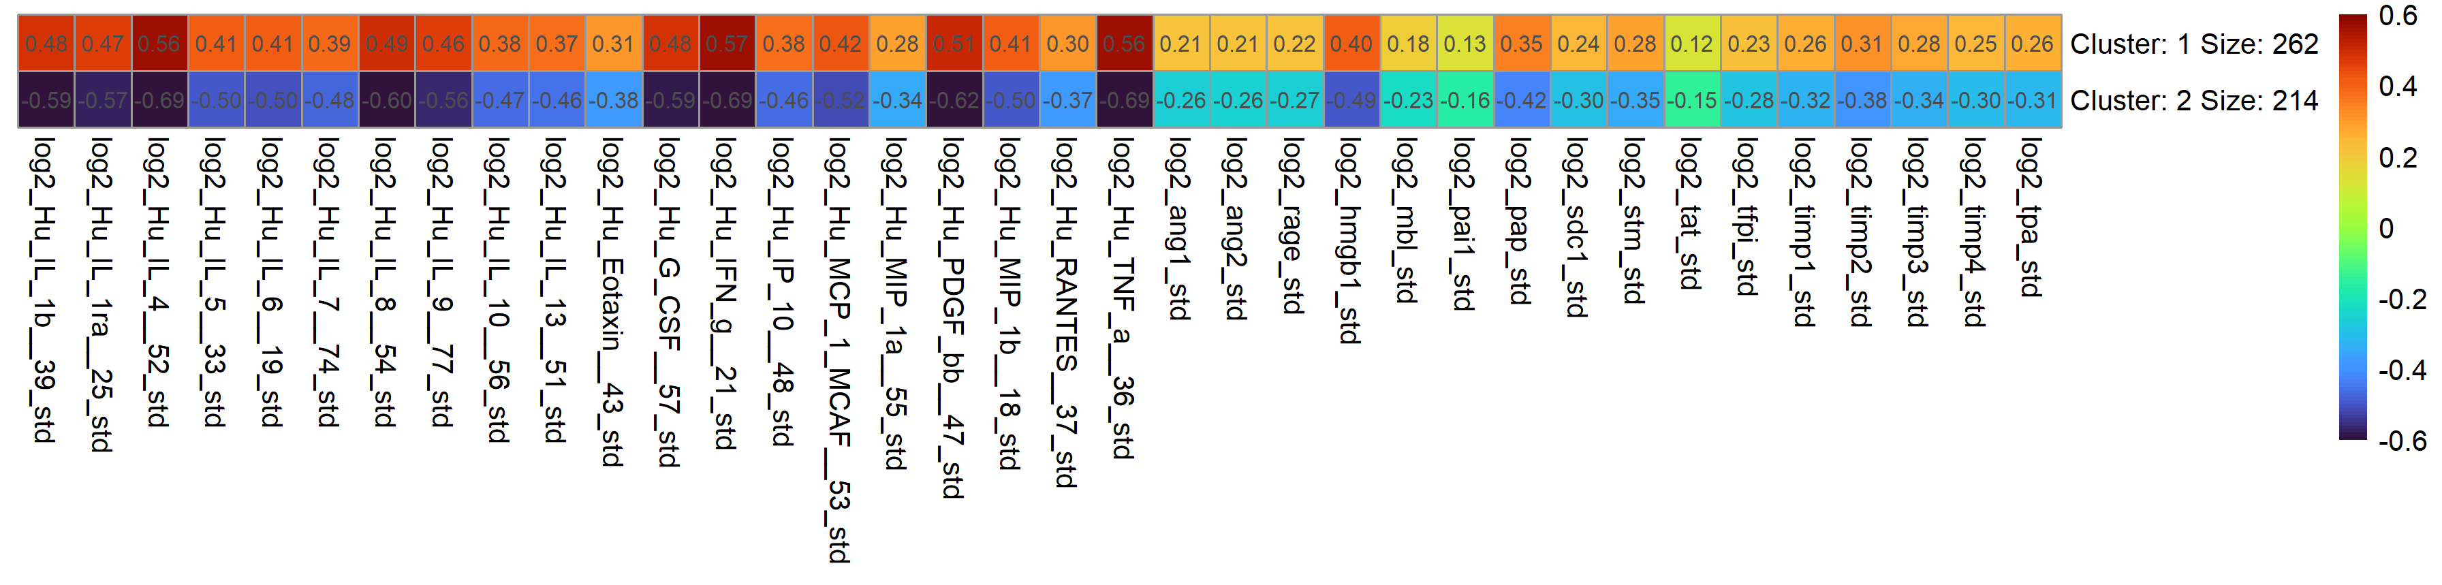
Hierarchical and Kmeans clustering suggest separation in trauma patient population based on magnitude of overall response
Hierarchical
K-Means
 | Cluster 1 | Cluster 2
Hclust | 192 | 284
K-Means | 262 | 214
Overlap | 182 | 204

Slide 12
Subjects in ‘high’ clusters see higher rates of complications and worse outcomes
Hierarchical
K-Means
Outcome | Cluster 1 | Cluster 2
ALI | 0.23 | 0.08
AKI | 0.30 | 0.19
Sepsis | 0.38 | 0.24
VAP | 0.27 | 0.13
Death | 0.34 | 0.17
ARDS | 0.18 | 0.09
RBC_10 | 0.60 | 0.40
Outcome | Cluster 1 | Cluster 2
ALI | 0.19 | 0.08
AKI | 0.27 | 0.18
Sepsis | 0.34 | 0.24
VAP | 0.23 | 0.13
Death | 0.29 | 0.17
ARDS | 0.16 | 0.09
RBC_10 | 0.55 | 0.40
RBC_10 = 10 or more units of RBC received in first 24 hours after ED admission

