Slide 1

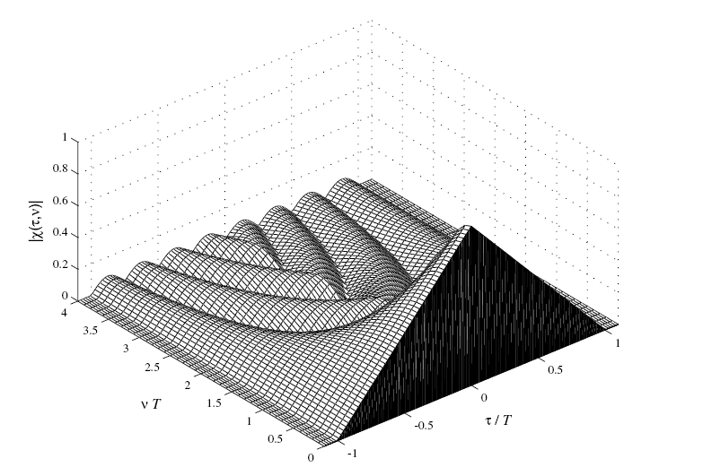
Radar Signals
Tutorial II: The Ambiguity Function

Slide 2
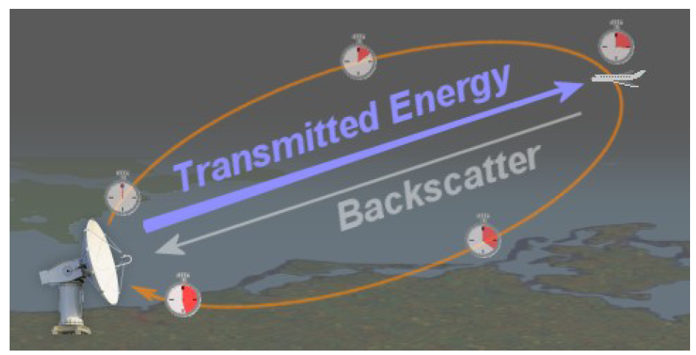
Brief Review
Purpose of radar: measure round trip time delay.

Slide 3
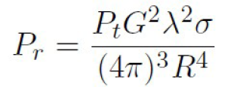
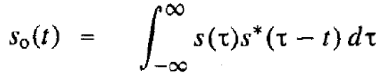
Brief Review
Radar equation:
Matched filter:
    Maximizes the SNR in the received signal.
    Response is described by the autocorrelation function of the signal.

Slide 4
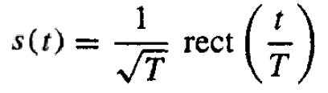
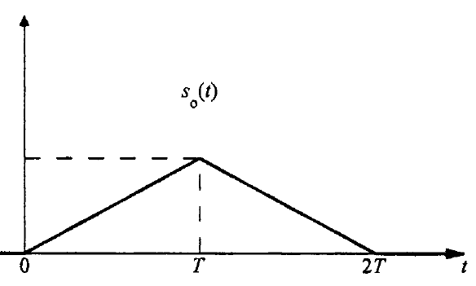
Brief Review
Autocorrelation of a signal:

Slide 5


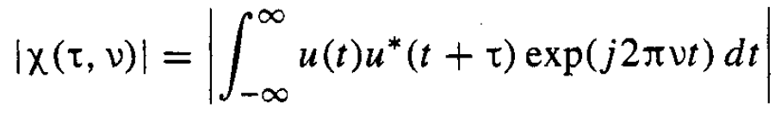
The Ambiguity Function
Definition: The ambiguity function is the time response of a filter matched to a given finite energy signal when the signal is received with a delay and a Doppler shift relative to the nominal values expected by the filter.

Slide 6
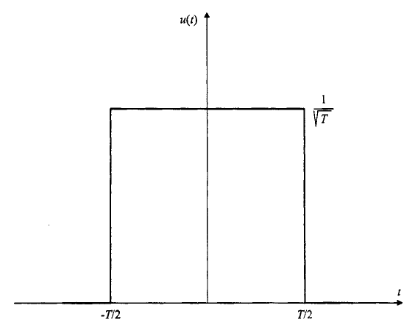
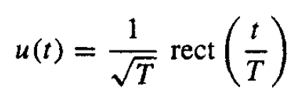
Example(1)
Complex envelope of a constant frequency pulse:

Slide 7
Example(1)
Partial AF:

Slide 8
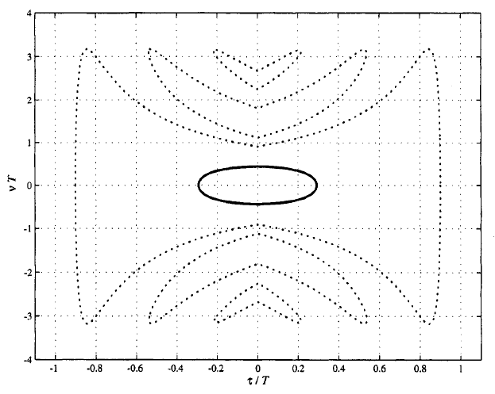
Example(1)
Contour plot of the AF:
Contour 0.1
Contour 0.707

Slide 9
Why is the AF important?

Slide 10
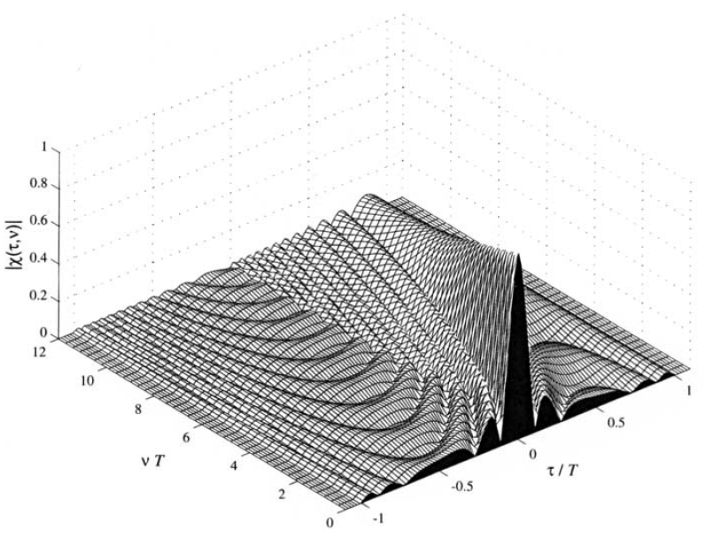
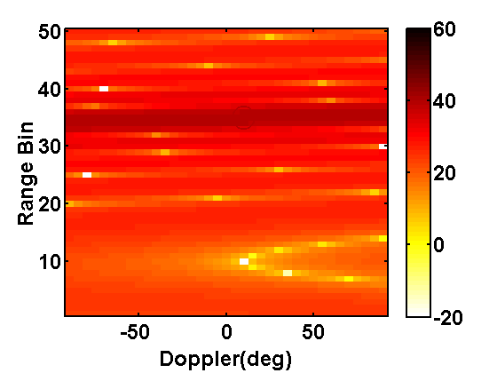
Example(2)
Why is the AF important?
  Chirp waveform
Ambiguity Function
SISO range-Doppler image

Slide 11
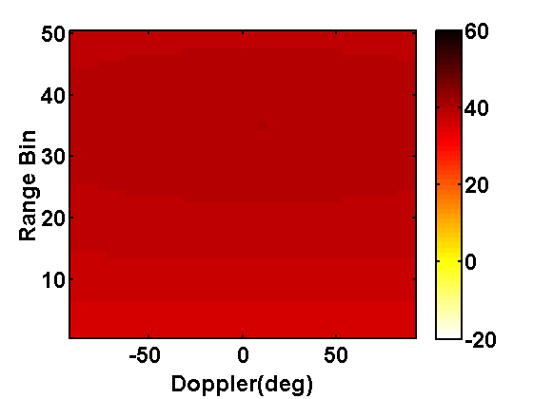
Example(2)
Why is the AF important?
  Unmodulated pulse
Ambiguity Function
SISO range-Doppler image

Slide 12

AF Properties (1)
Property 1: Maximum at (0,0).

Slide 13
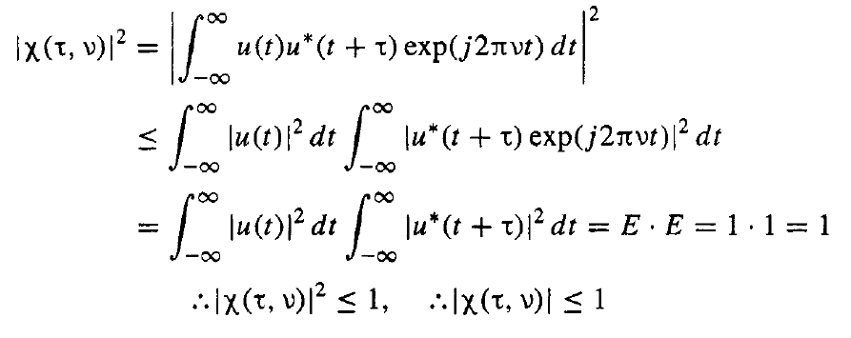
AF Properties (1)
Proof of property 1:
Apply CS

Slide 14
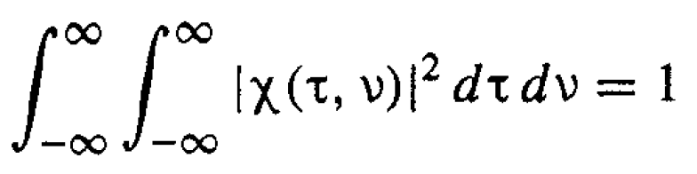
AF Properties (2)
Property 2: Constant volume.

Slide 15




AF Properties (2)
Proof of property 2:
  Rewrite , replacing with .

Slide 16

AF Properties (2)
Proof of property 2:
  Apply Parseval’s theorem – the energy in the time domain is equal to the energy in the frequency domain.

Slide 17

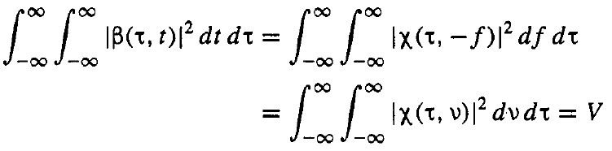
AF Properties (2)
Proof of property 2:
  Integrate both sides with respect to to yield volume .

Slide 18

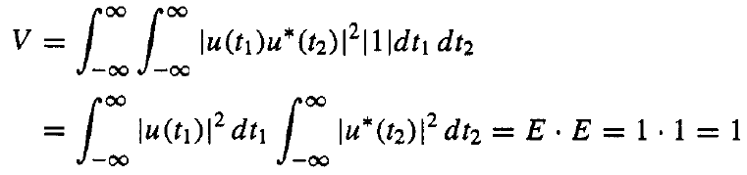
AF Properties (2)
Proof of property 2:
  Change variables and solve.

Slide 19
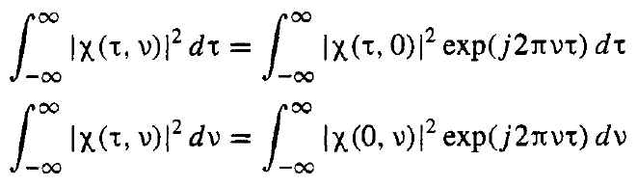
AF Properties (2)
Implications of property 2.
  Additional volume constraints:
  No matter how we design our waveform, the volume of the AF remains constant.

Slide 20

AF Properties (3)
Property 3: Symmetry with respect to the origin.

Slide 21



AF Properties (4)
Property 4: Linear FM effect.
If
,
then adding linear frequency modulation (LFM) implies that:
    .

Slide 22
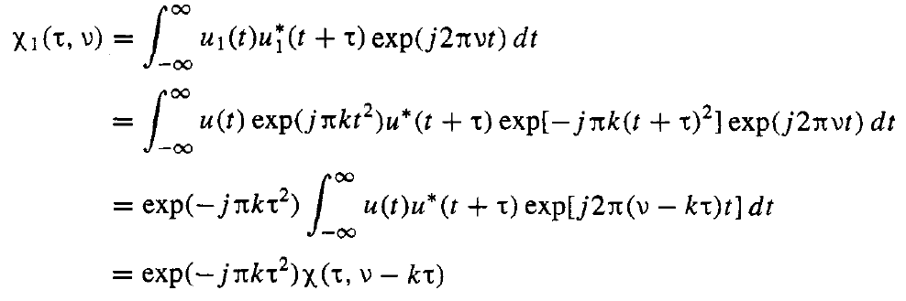
AF Properties (4)
Proof of property 4:

Slide 23
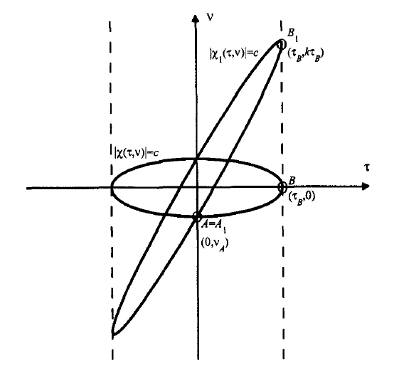
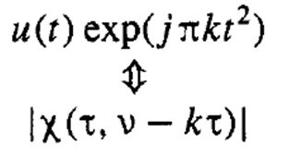
AF Properties (4)
Implications of property 4:

Slide 24
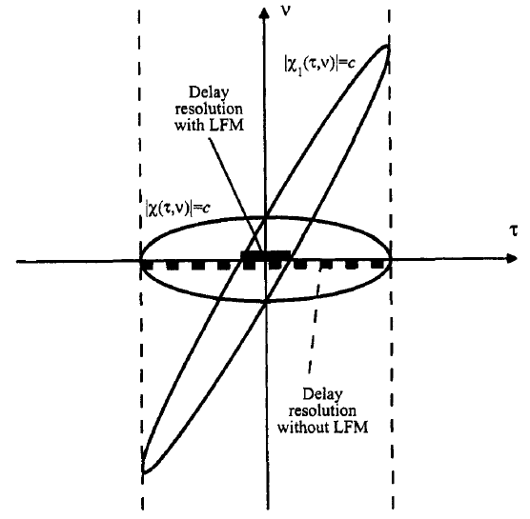
AF Properties (4)
Implications of property 4:

Slide 25
Chirp Waveform
Linear frequency-modulated (LFM) pulse (Chirp).
  The most popular pulse compression method.
  Conceived during WWII.
  Basic idea: sweep the frequency band linearly during the pulse duration .

Slide 26

Chirp Waveform
Linear frequency-modulated (LFM) pulse (Chirp).
  Complex envelope:
Chirp rate

Slide 27
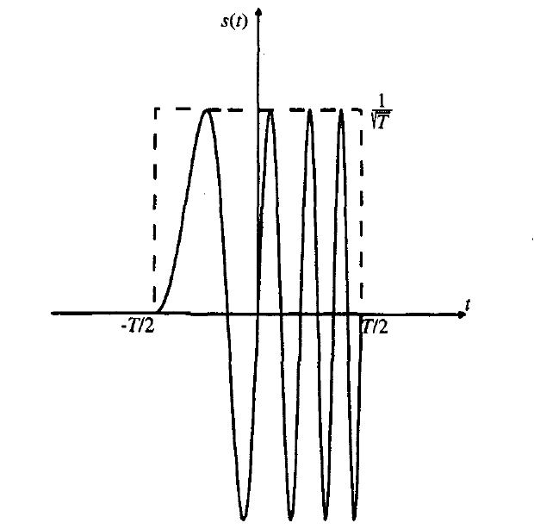
Chirp Waveform
Linear frequency-modulated (LFM) pulse (Chirp).
  Complex envelope:

Slide 28
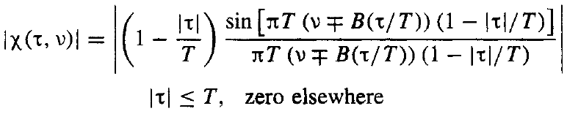
Chirp Waveform
Linear frequency-modulated (LFM) pulse (Chirp).
  Ambiguity Function:

Slide 29
Chirp Waveform
Linear frequency-modulated (LFM) pulse (Chirp).
  Ambiguity Function:

Slide 30
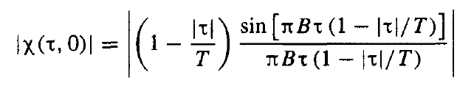


Chirp Waveform
Advantage of chirp: improved range resolution.
  Zero-Doppler cut:
  For a large time-bandwidth product
  ( ), the first null occurs at:

Slide 31
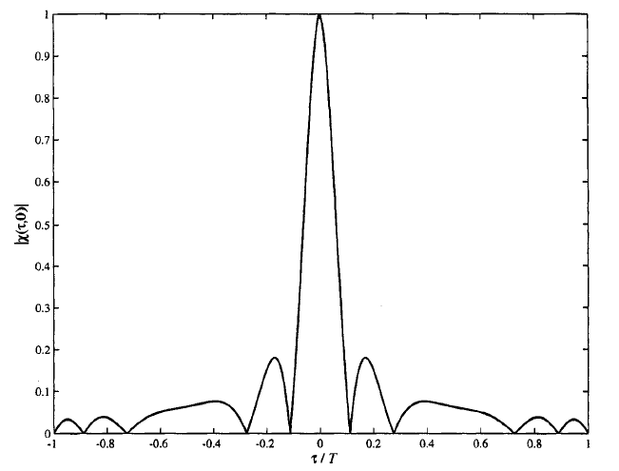

Chirp Waveform
Advantage of chirp: improved range resolution.
  Zero-Doppler cut:

Slide 32
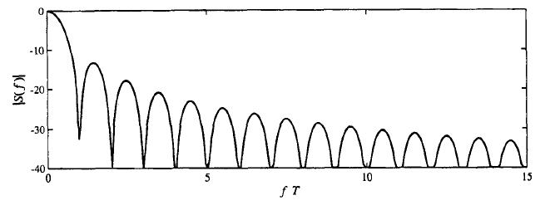
Chirp Waveform
Advantage of chirp: improved range resolution.
  Spectrum of unmodulated pulse:

Slide 33
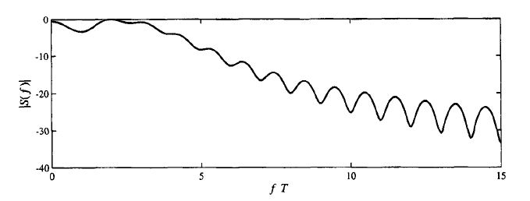
Chirp Waveform
Advantage of chirp: improved range resolution.
  Spectrum of LFM pulse:
LFM improves range resolution according to the time-bandwidth product!

Slide 34
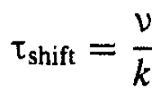
Chirp Waveform
Disadvantage of chirp: delay-Doppler coupling.
  For small Doppler shift , the delay location of the peak response is shifted from true delay by:
  Preferred in situations with ambiguous Doppler shifts.

Slide 35
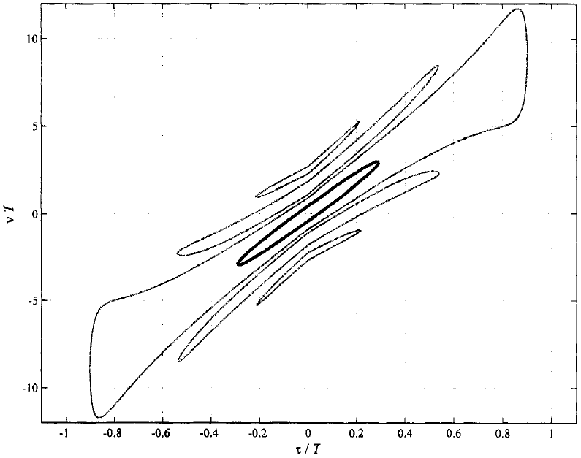
Chirp Waveform
Disadvantage of chirp: delay-Doppler coupling.
Contour 0.1
Contour 0.707
A target with positive Doppler appears closer than its true range!

Slide 36


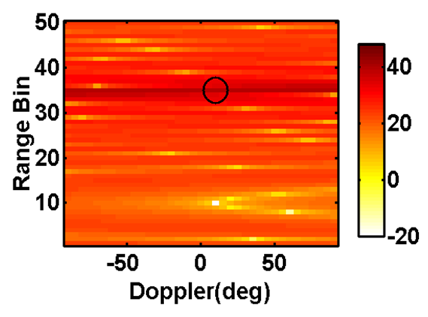
Example(3)
SISO range-Doppler imaging example
  Bandwidth , duration , chirp-rate .
40 dB target

Slide 37
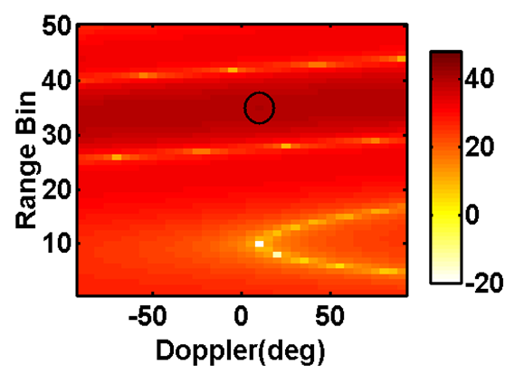
Example(3)
SISO range-Doppler imaging example
    , fix

Slide 38
Future Talks
Other forms of frequency modulation:
    LFM amplitude weighting.
    Costas coding.
    Nonlinear FM.
Phased-coded waveforms:
    Barker code.
    Chirp-like sequences.

