Slide 1
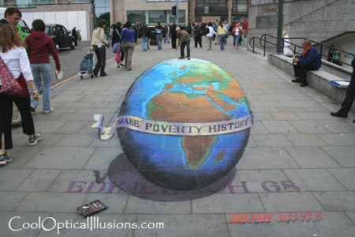
Projection
Readings
  Szeliski 2.1

Slide 2
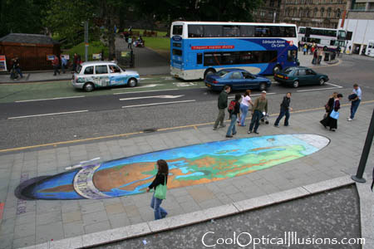
Projection
Readings
  Szeliski 2.1

Slide 3

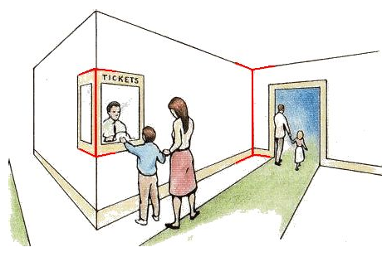
Müller-Lyer Illusion
by Pravin Bhat
http://www.michaelbach.de/ot/sze_muelue/index.html

Slide 4
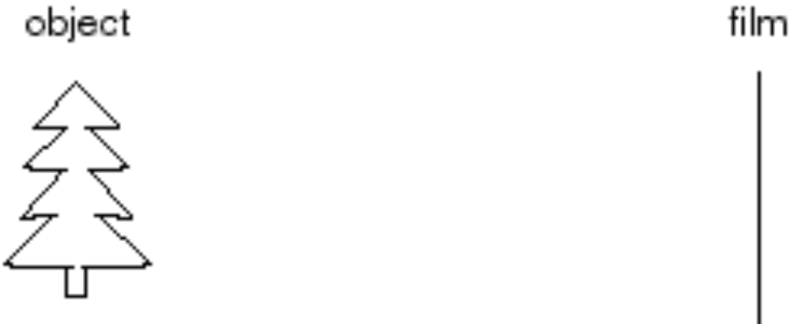
Image formation
Let’s design a camera
  Idea 1: put a piece of film in front of an object
  Do we get a reasonable image?

Slide 5
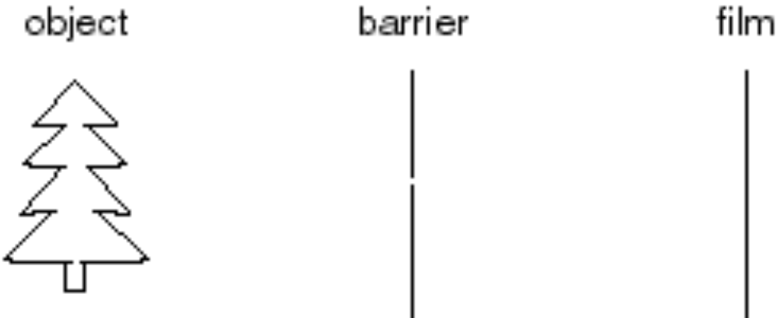
Pinhole camera
Add a barrier to block off most of the rays
  This reduces blurring
  The opening known as the aperture
  How does this transform the image?
Notes:
It gets inverted

Slide 6
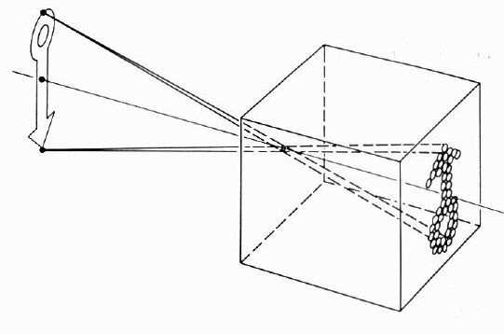
Camera Obscura
The first camera
  Known to Aristotle
  How does the aperture size affect the image?

Slide 7
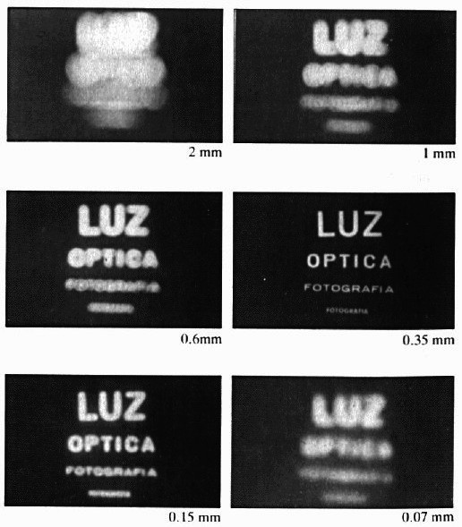
Shrinking the aperture
Why not make the aperture as small as possible?
  Less light gets through
  Diffraction effects...

Slide 8
Shrinking the aperture

Slide 9
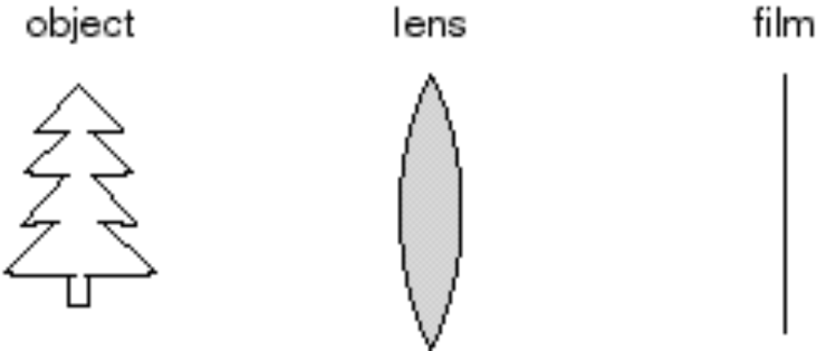
Adding a lens
“circle of
confusion”
A lens focuses light onto the film
  There is a specific distance at which objects are “in focus”
    other points project to a “circle of confusion” in the image
  Changing the shape of the lens changes this distance

Slide 10
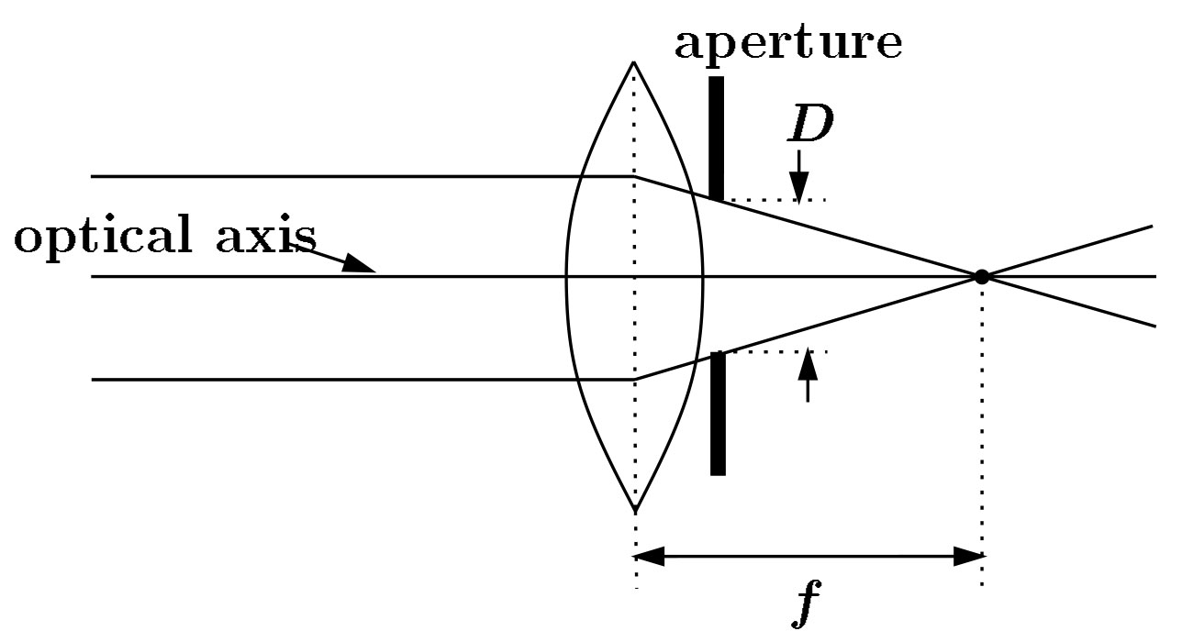
Lenses
F
focal point
optical center
(Center Of Projection)
A lens focuses parallel rays onto a single focal point
  focal point at a distance f beyond the plane of the lens
    f is a function of the shape and index of refraction of the lens
  Aperture of diameter D restricts the range of rays
    aperture may be on either side of the lens
  Lenses are typically spherical (easier to produce)

Slide 11
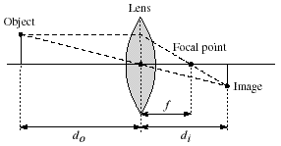
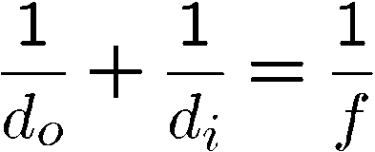
Thin lenses
Thin lens equation:
  Any object point satisfying this equation is in focus
  What is the shape of the focus region?
  How can we change the focus region?
  Thin lens applet: http://www.phy.ntnu.edu.tw/java/Lens/lens_e.html (by Fu-Kwun Hwang )

Slide 12

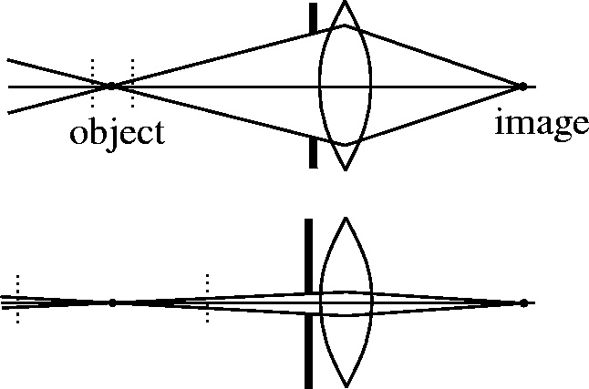

Depth of field
f / 5.6
f / 32
Changing the aperture size affects depth of field
  A smaller aperture increases the range in which the object is approximately in focus
Flower images from Wikipedia http://en.wikipedia.org/wiki/Depth_of_field

Slide 13
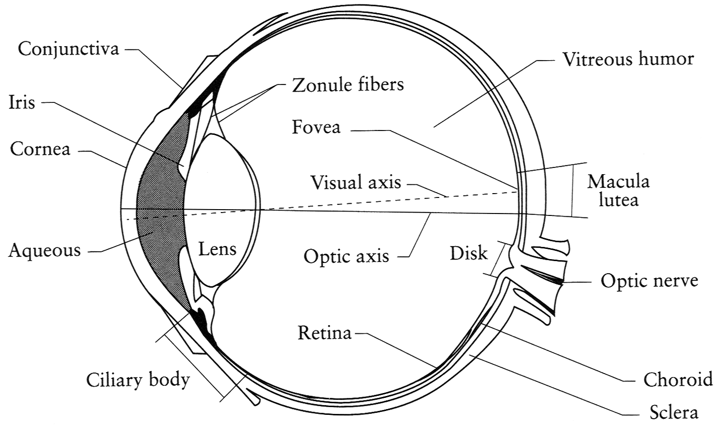
The eye
The human eye is a camera
  Iris - colored annulus with radial muscles
  Pupil - the hole (aperture) whose size is controlled by the iris
  What’s the “film”?
    photoreceptor cells (rods and cones) in the retina
Notes:
Note that the retina is curved

Slide 14
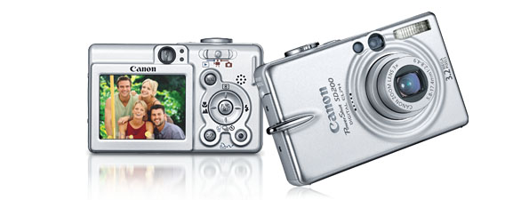
Digital camera
A digital camera replaces film with a sensor array
  Each cell in the array is a Charge Coupled Device
    light-sensitive diode that converts photons to electrons
    other variants exist: CMOS is becoming more popular
    http://electronics.howstuffworks.com/digital-camera.htm

Slide 15
Issues with digital cameras
Noise
    big difference between consumer vs. SLR-style cameras
    low light is where you most notice noise
Compression
    creates artifacts except in uncompressed formats (tiff, raw)
Color
    color fringing artifacts from Bayer patterns
Blooming
    charge overflowing into neighboring pixels
In-camera processing
    oversharpening can produce halos
Interlaced vs. progressive scan video
    even/odd rows from different exposures
Are more megapixels better?
    requires higher quality lens
    noise issues
Stabilization
    compensate for camera shake (mechanical vs. electronic)
More info online, e.g.,
  http://electronics.howstuffworks.com/digital-camera.htm
  http://www.dpreview.com/

Slide 16
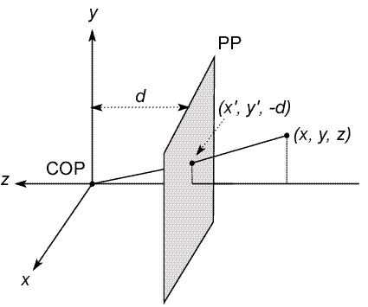
Modeling projection
The coordinate system
  We will use the pin-hole model as an approximation
  Put the optical center (Center Of Projection) at the origin
  Put the image plane (Projection Plane) in front of the COP
    Why?
  The camera looks down the negative z axis
    we need this if we want right-handed-coordinates
Notes:
This way the image is right-side-up

Slide 17
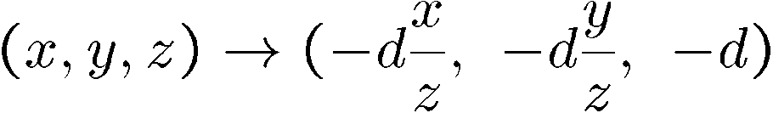
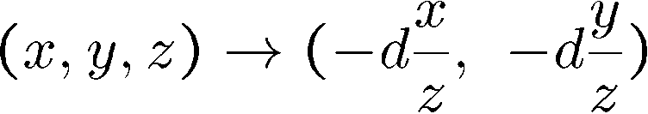
Modeling projection
Projection equations
  Compute intersection with PP of ray from (x,y,z) to COP
  Derived using similar triangles (on board)
  We get the projection by throwing out the last coordinate:

Slide 18
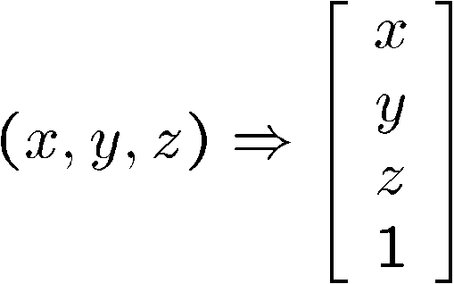
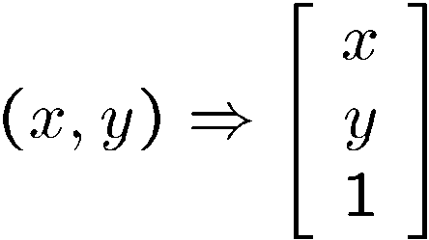
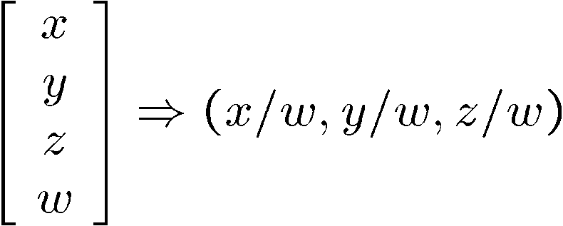
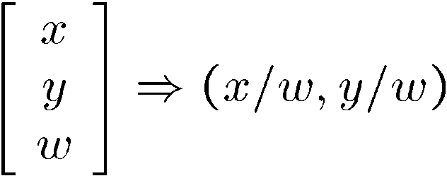
Homogeneous coordinates
Is this a linear transformation?
Trick: add one more coordinate:
  no—division by z is nonlinear
homogeneous image
coordinates
homogeneous scene
coordinates
Converting from homogeneous coordinates

Slide 19
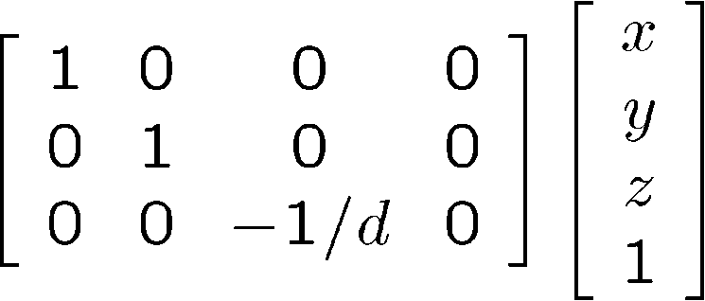
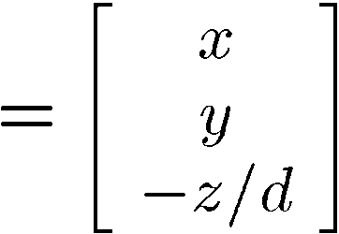
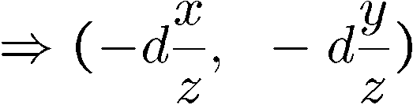
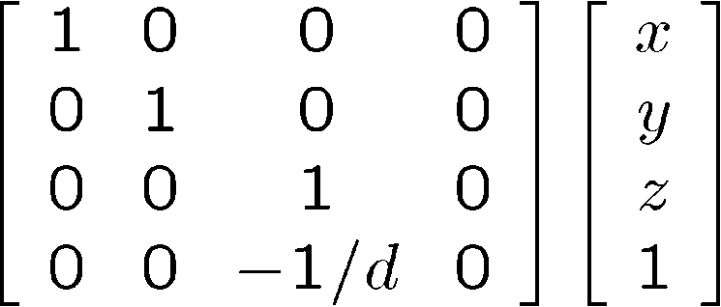
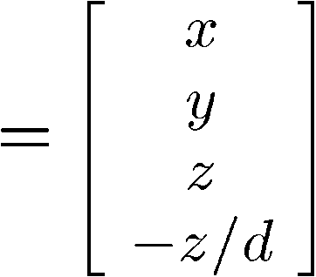
Perspective Projection
Projection is a matrix multiply using homogeneous coordinates:
divide by third coordinate
This is known as perspective projection
  The matrix is the projection matrix
  Can also formulate as a 4x4 (today’s reading does this)
divide by fourth coordinate

Slide 20
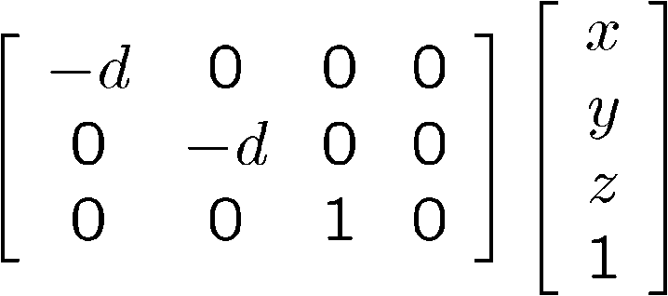
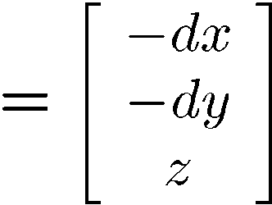
Perspective Projection
How does scaling the projection matrix change the transformation?

Slide 21
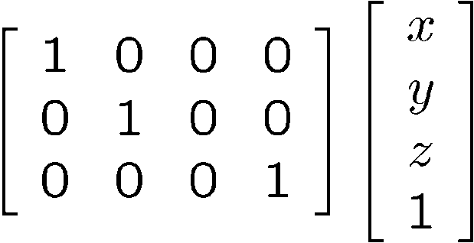
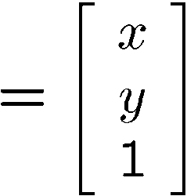

Orthographic projection
Special case of perspective projection
  Distance from the COP to the PP is infinite
  Good approximation for telephoto optics
  Also called “parallel projection”: (x, y, z) → (x, y)
  What’s the projection matrix?
Image
World

Slide 22

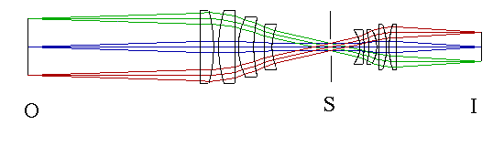
Orthographic (“telecentric”) lenses
Navitar telecentric zoom lens
http://www.lhup.edu/~dsimanek/3d/telecent.htm

Slide 23
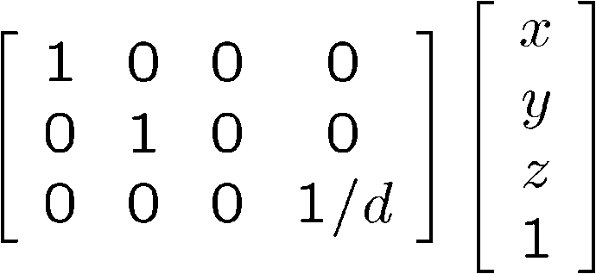
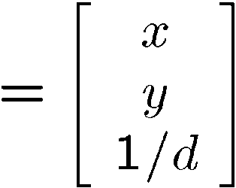

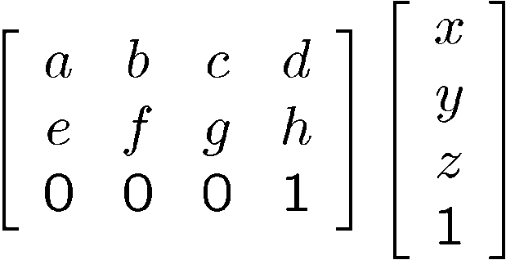
Variants of orthographic projection
Scaled orthographic
  Also called “weak perspective”
Affine projection
  Also called “paraperspective”

Slide 24
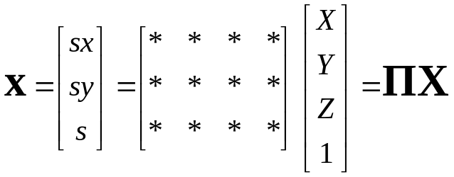





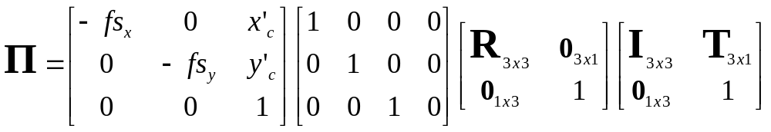
Camera parameters
A camera is described by several parameters
  Translation T of the optical center from the origin of world coords
  Rotation R of the image plane
  focal length f, principle point (x’_{c}, y’_{c}), pixel size (s_{x}, s_{y})
  blue parameters are called “extrinsics,” red are “intrinsics”
Projection equation
  The projection matrix models the cumulative effect of all parameters
  Useful to decompose into a series of operations
identity matrix
intrinsics
projection
rotation
translation
  The definitions of these parameters are not completely standardized
    especially intrinsics—varies from one book to another

Slide 25
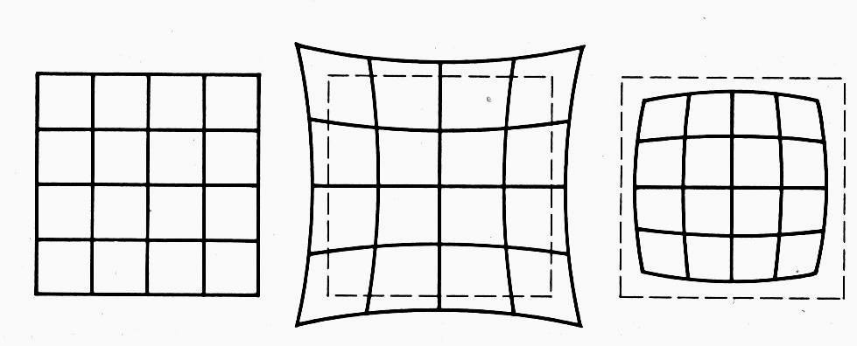
Distortion
No distortion
Pin cushion
Barrel
Radial distortion of the image
  Caused by imperfect lenses
  Deviations are most noticeable for rays that pass through the edge of the lens

Slide 26
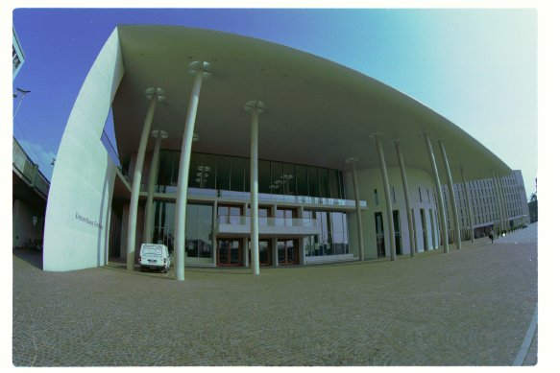
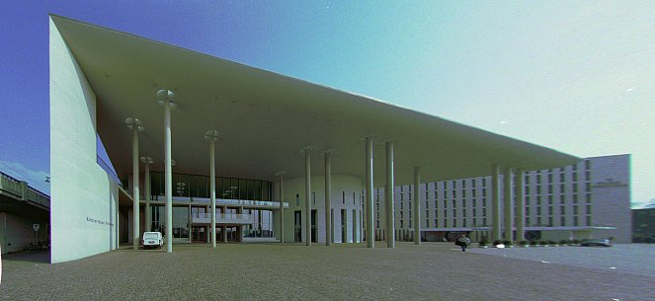
Correcting radial distortion
from Helmut Dersch

Slide 27
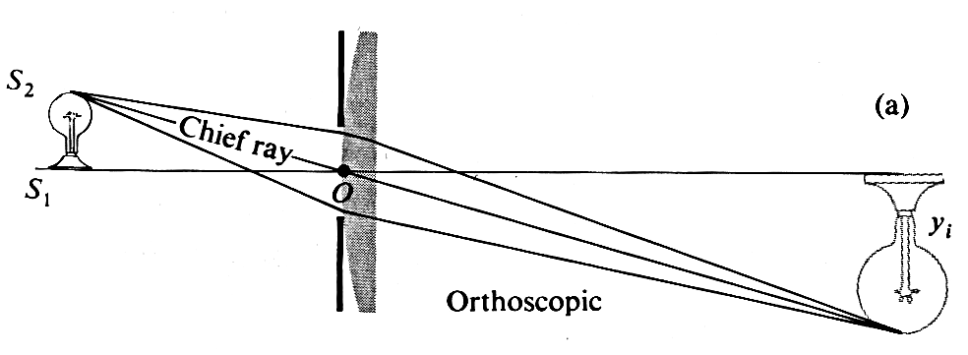
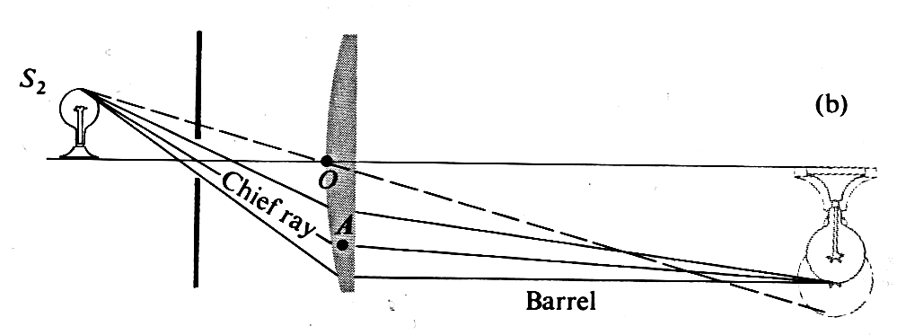
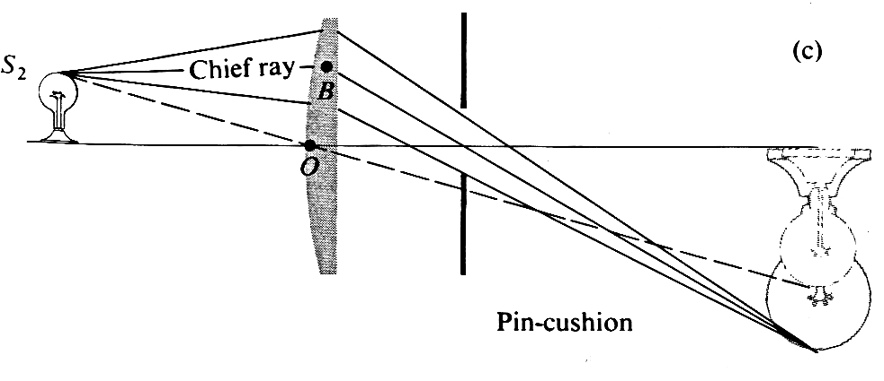
Distortion

Slide 28

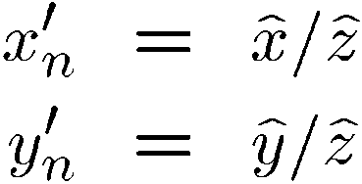
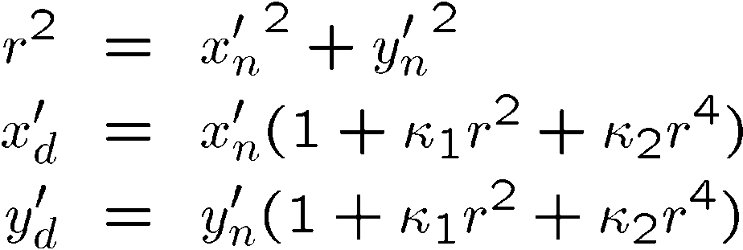
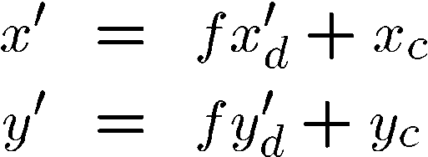
Modeling distortion
Project
to “normalized”
image coordinates
Apply radial distortion
Apply focal length
translate image center
To model lens distortion
  Use above projection operation instead of standard projection matrix multiplication

Slide 29
Other types of projection
Lots of intriguing variants…
(I’ll just mention a few fun ones)

Slide 30
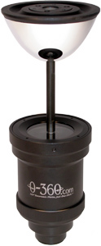
360 degree field of view…
Basic approach
  Take a photo of a parabolic mirror with an orthographic lens (Nayar)
  Or buy one a lens from a variety of omnicam manufacturers…
    See http://www.cis.upenn.edu/~kostas/omni.html

Slide 31
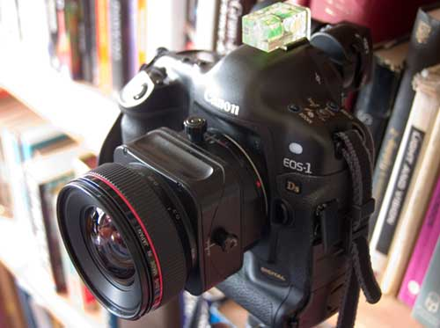
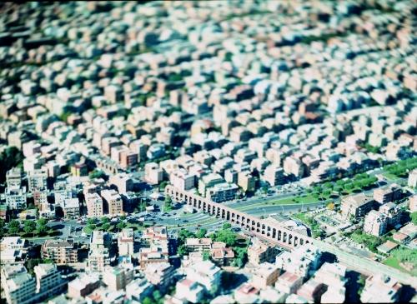
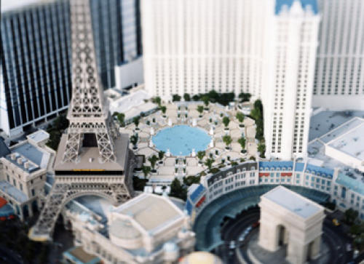
Tilt-shift
http://www.northlight-images.co.uk/article_pages/tilt_and_shift_ts-e.html
Titlt-shift images from Olivo Barbieri
and Photoshop imitations

Slide 32
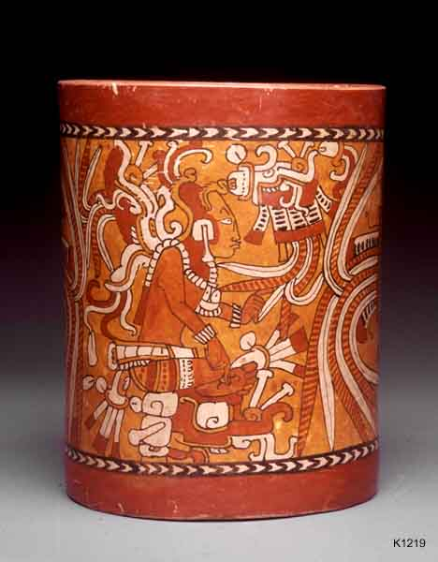

Rotating sensor (or object)
Rollout Photographs © Justin Kerr
http://research.famsi.org/kerrmaya.html
Also known as “cyclographs”, “peripheral images”

Slide 33

Photofinish

