Slide 1
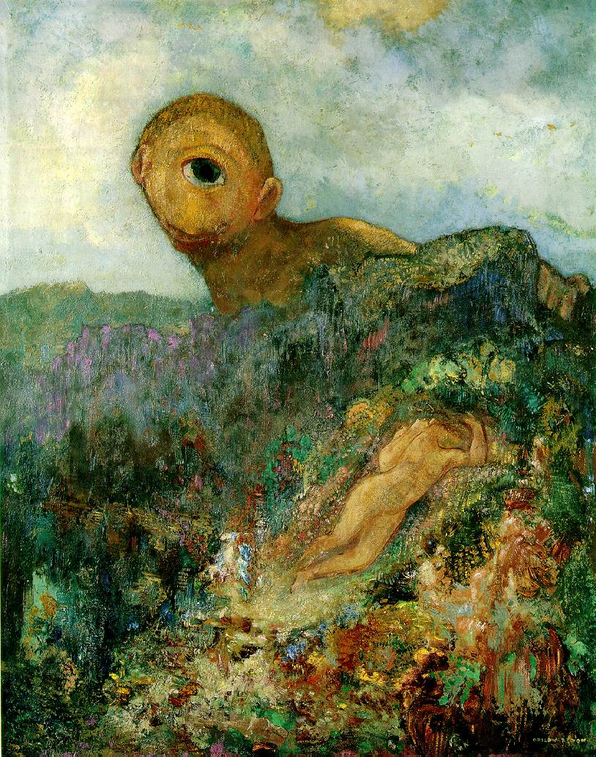
Single-view geometry
Odilon Redon, Cyclops, 1914

Slide 2
Our goal: Recovery of 3D structure
Recovery of structure from one image is inherently ambiguous
X?
X?
X?
x

Slide 3
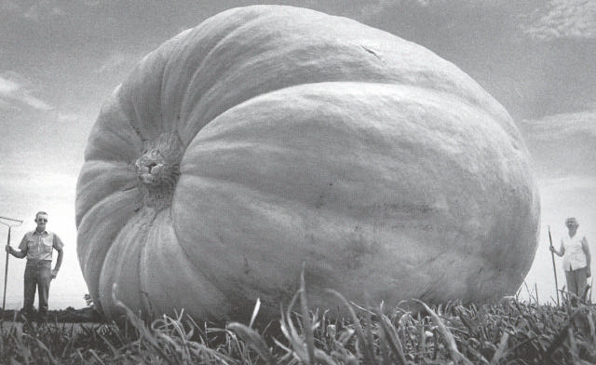
Our goal: Recovery of 3D structure
Recovery of structure from one image is inherently ambiguous

Slide 4
Our goal: Recovery of 3D structure
Recovery of structure from one image is inherently ambiguous

Slide 5
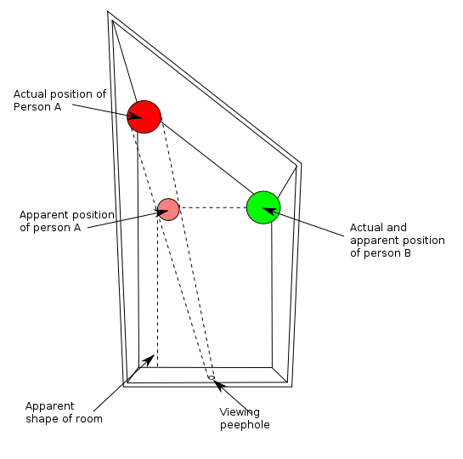
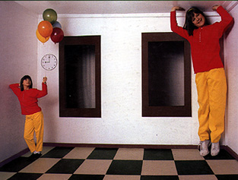
Ames Room
http://en.wikipedia.org/wiki/Ames_room

Slide 6
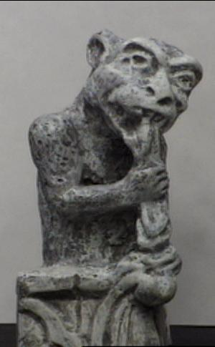
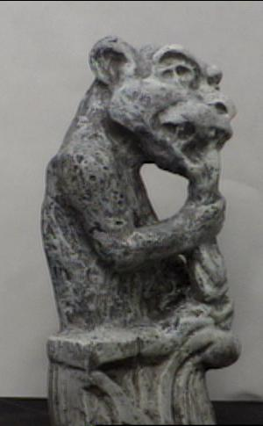
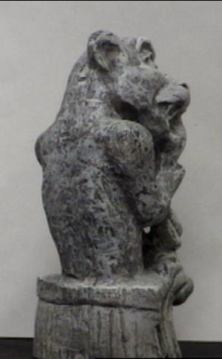
Our goal: Recovery of 3D structure
We will need multi-view geometry

Slide 7
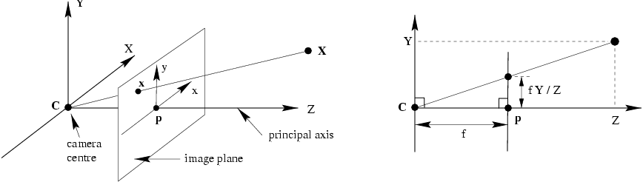
Recall: Pinhole camera model
Principal axis: line from the camera center perpendicular to the image plane
Normalized (camera) coordinate system: camera center is at the origin and the principal axis is the z-axis

Slide 8
Recall: Pinhole camera model

Slide 9
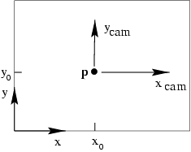
Principal point
p_{y}
p_{x}
Principal point (p): point where principal axis intersects the image plane (origin of normalized coordinate system)
Normalized coordinate system: origin is at the principal point
Image coordinate system: origin is in the corner
How to go from normalized coordinate system to image coordinate system?

Slide 10
Principal point offset
p_{y}
principal point:
p_{x}

Slide 11
Principal point offset
principal point:
calibration matrix

Slide 12
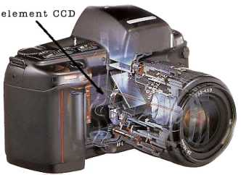
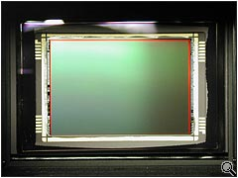
Pixel coordinates
Pixel size:
m_{x} pixels per meter in horizontal direction, m_{y} pixels per meter in vertical direction
pixels/m
m
pixels
Notes:
To convert from metric image coordinates to pixel coordinates, we have to multiply the x, y coordinates by the x, y pixel magnification factors (pix/m)
Beta_x, beta_y is the principal point coordinates in pixels

Slide 13
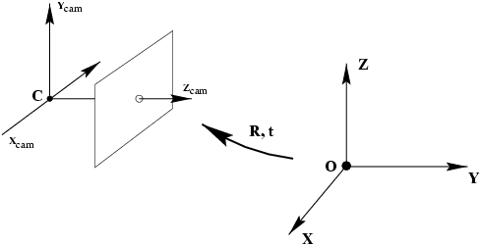
Camera rotation and translation
In general, the camera coordinate frame will be related to the world coordinate frame by a rotation and a translation
coords. of point in camera frame
coords. of camera center in world frame
coords. of a point in world frame (nonhomogeneous)

Slide 14
Camera rotation and translation
In non-homogeneous coordinates:
Note: C is the null space of the camera projection matrix (PC=0)

Slide 15
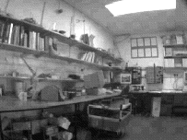
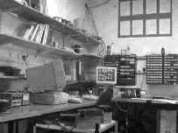
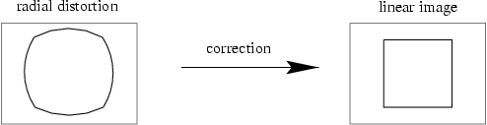
Camera parameters
Intrinsic parameters
Principal point coordinates
Focal length
Pixel magnification factors
Skew (non-rectangular pixels)
Radial distortion

Slide 16
Camera parameters
Intrinsic parameters
Principal point coordinates
Focal length
Pixel magnification factors
Skew (non-rectangular pixels)
Radial distortion
Extrinsic parameters
Rotation and translation relative to world coordinate system

Slide 17
Camera calibration

Slide 18
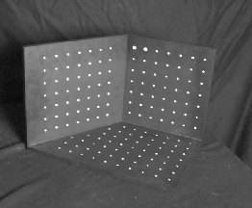
Camera calibration
Given n points with known 3D coordinates X_{i} and known image projections x_{i}, estimate the camera parameters
X_{i}
x_{i}

Slide 19
Camera calibration: Linear method
Two linearly independent equations

Slide 20
Camera calibration: Linear method
P has 11 degrees of freedom (12 parameters, but scale is arbitrary)
One 2D/3D correspondence gives us two linearly independent equations
Homogeneous least squares
6 correspondences needed for a minimal solution

Slide 21
Camera calibration: Linear method
Note: for coplanar points that satisfy Π^{T}X=0, we will get degenerate solutions (Π,0,0), (0,Π,0), or (0,0,Π)

Slide 22
Camera calibration: Linear method
Advantages: easy to formulate and solve
Disadvantages
Doesn’t directly tell you camera parameters
Doesn’t model radial distortion
Can’t impose constraints, such as known focal length and orthogonality
Non-linear methods are preferred
Define error as difference between projected points and measured points
Minimize error using Newton’s method or other non-linear optimization

Slide 23
Multi-view geometry problems
Structure: Given projections of the same 3D point in two or more images, compute the 3D coordinates of that point
?
Camera 1
Camera 3
R₁,t₁
Camera 2
R₃,t₃
R₂,t₂
Slide credit: Noah Snavely
Notes:
Structure from motion solves the following problem:
Given a set of images of a static scene with 2D points in correspondence, shown here as color-coded points, find…
a set of 3D points P and
a rotation R and position t of the cameras that explain the observed correspondences. In other words, when we project a point into any of the cameras, the reprojection error between the projected and observed 2D points is low.
This problem can be formulated as an optimization problem where we want to find the rotations R, positions t, and 3D point locations P that minimize sum of squared reprojection errors f. This is a non-linear least squares problem and can be solved with algorithms such as Levenberg-Marquart. However, because the problem is non-linear, it can be susceptible to local minima. Therefore, it’s important to initialize the parameters of the system carefully. In addition, we need to be able to deal with erroneous correspondences.

Slide 24
Multi-view geometry problems
Stereo correspondence: Given a point in one of the images, where could its corresponding points be in the other images?
Camera 1
Camera 3
R₁,t₁
Camera 2
R₃,t₃
R₂,t₂
Slide credit: Noah Snavely
Notes:
Structure from motion solves the following problem:
Given a set of images of a static scene with 2D points in correspondence, shown here as color-coded points, find…
a set of 3D points P and
a rotation R and position t of the cameras that explain the observed correspondences. In other words, when we project a point into any of the cameras, the reprojection error between the projected and observed 2D points is low.
This problem can be formulated as an optimization problem where we want to find the rotations R, positions t, and 3D point locations P that minimize sum of squared reprojection errors f. This is a non-linear least squares problem and can be solved with algorithms such as Levenberg-Marquart. However, because the problem is non-linear, it can be susceptible to local minima. Therefore, it’s important to initialize the parameters of the system carefully. In addition, we need to be able to deal with erroneous correspondences.

Slide 25
Multi-view geometry problems
Motion: Given a set of corresponding points in two or more images, compute the camera parameters
Camera 1
?
Camera 2
?
?
Camera 3
R₁,t₁
R₃,t₃
R₂,t₂
Slide credit: Noah Snavely
Notes:
Structure from motion solves the following problem:
Given a set of images of a static scene with 2D points in correspondence, shown here as color-coded points, find…
a set of 3D points P and
a rotation R and position t of the cameras that explain the observed correspondences. In other words, when we project a point into any of the cameras, the reprojection error between the projected and observed 2D points is low.
This problem can be formulated as an optimization problem where we want to find the rotations R, positions t, and 3D point locations P that minimize sum of squared reprojection errors f. This is a non-linear least squares problem and can be solved with algorithms such as Levenberg-Marquart. However, because the problem is non-linear, it can be susceptible to local minima. Therefore, it’s important to initialize the parameters of the system carefully. In addition, we need to be able to deal with erroneous correspondences.

Slide 26
Triangulation
Given projections of a 3D point in two or more images (with known camera matrices), find the coordinates of the point
X?
x₂
x₁
O₁
O₂

Slide 27
Triangulation
We want to intersect the two visual rays corresponding to x₁ and x₂, but because of noise and numerical errors, they don’t meet exactly
R₂
R₁
X?
x₂
x₁
O₁
O₂

Slide 28
Triangulation: Geometric approach
Find shortest segment connecting the two viewing rays and let X be the midpoint of that segment
X
x₂
x₁
O₁
O₂

Slide 29
Triangulation: Linear approach
Cross product as matrix multiplication:

Slide 30
Triangulation: Linear approach
Two independent equations each in terms of three unknown entries of X

Slide 31
Triangulation: Nonlinear approach
Find X that minimizes
X?
x’₁
x₂
x₁
x’₂
O₁
O₂

