Slide 1
FORK
tlmcguire/django-DefectDojo
STACK
CSCI 360 - SOFTWARE ARCHITECTURE, SECURITY, AND TESTING
Django + DRF, Celery, Postgres
Build Demo &
Applied Analysis
RUN VIA
Docker Compose (dev mode)
DefectDojo - application-security vulnerability management
Tyler McGuire · Fall 2026

Slide 2
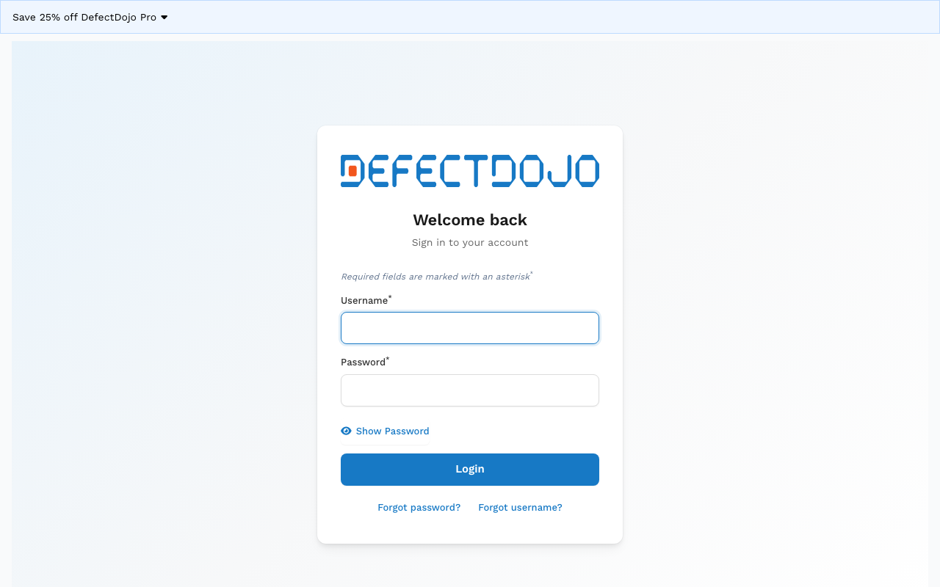
YOUR PROJECT RUNNING
The project, running from source
2m 53s
cold build, --no-cache,
every layer from scratch
29s
docker compose up →
first HTTP response
3
prerequisites: Docker Desktop,
macOS, nothing else
http://127.0.0.1:8080 - Docker Compose, dev mode, hot-reloading

Slide 3
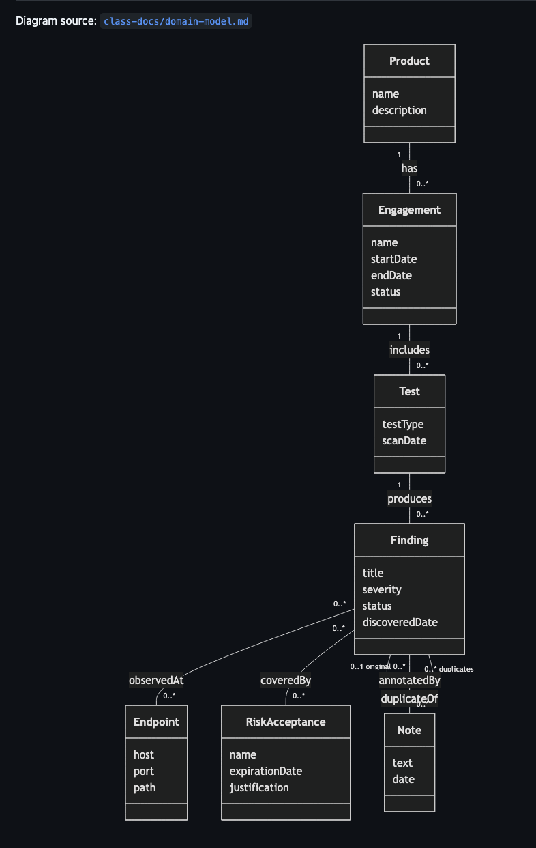
DOMAIN MODEL
Seven concepts from the real-world domain
class-docs/domain-model.md · no methods, no types - attributes and associations only
Full reasoning for these 7 concepts (and what's deliberately left out) is in class-docs/domain-model.md

Slide 4
THE REPRESENTATIONAL GAP
Remediation
The one representational gap I found most interesting
POOR MATCH
What was done to fix a finding
Domain concept: the record of what fix was applied, by whom, and whether it was verified.
In the code: nowhere as its own entity - split between Finding.mitigation (advice text, dojo/finding/models.py:179) and is_mitigated / mitigated / mitigated_by (closure tracking only, lines 281-295).
The cost: DefectDojo can tell you a finding is closed and who closed it - but not how. No structured way to ask “what fix pattern works across the fleet.”

Slide 5
THE HARDEST THING ABOUT THE BUILD
Nothing.
The project uses docker compose, so building locally was simple. Cold build to a responding login page: under 3.5 minutes. The closest thing to friction was Docker Desktop's daemon not being started yet on the first try - a config issue on my machine, not the project, fixed in about 30 seconds.

