Slide 1
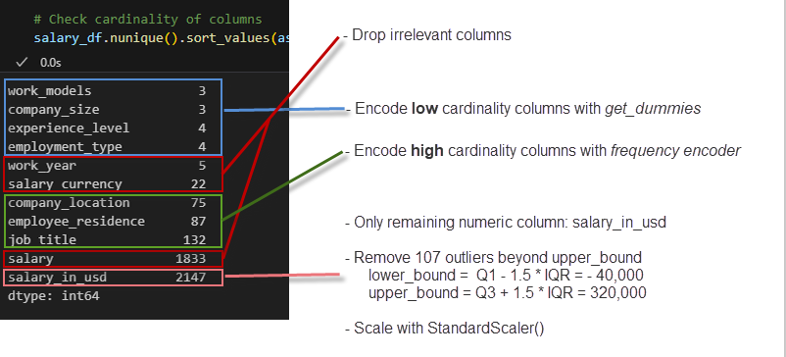
Unsupervised Machine Learning Analysis
Why?
Relatively low metrics from supervised ML models.
What are the important features?
How would the data cluster?
UML Preprocessing

Slide 2
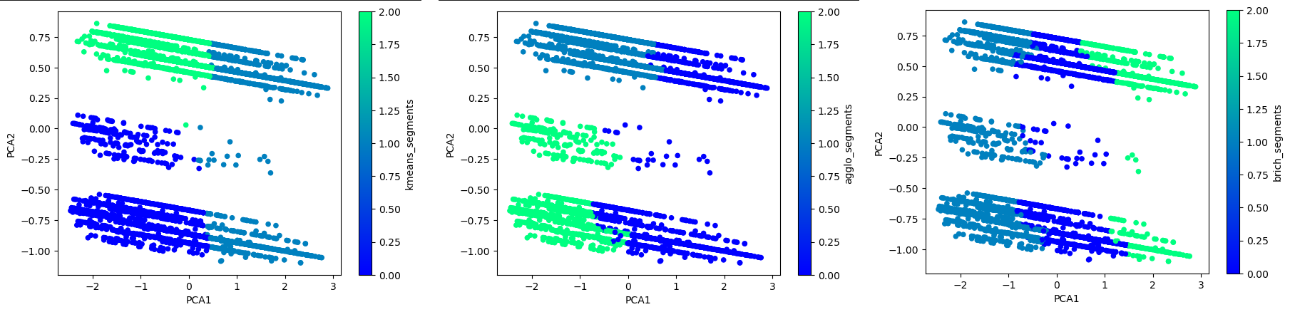
Unsupervised Machine Learning Analysis
Clustering PCA Optimized Data (K=3)
3-component Variance Ratio : [0.48, 0.21, 0.14] sum = 0.83
PCA1: salary_in_usd cw: 0.936
PCA2: work_models_On-site cw: 0.697
PCA3: experience_level_Senior cw: 0.699
Surprising Light Weights: job_title, employee_residency and company_location
K-Means Agglomerative Birch

Slide 3
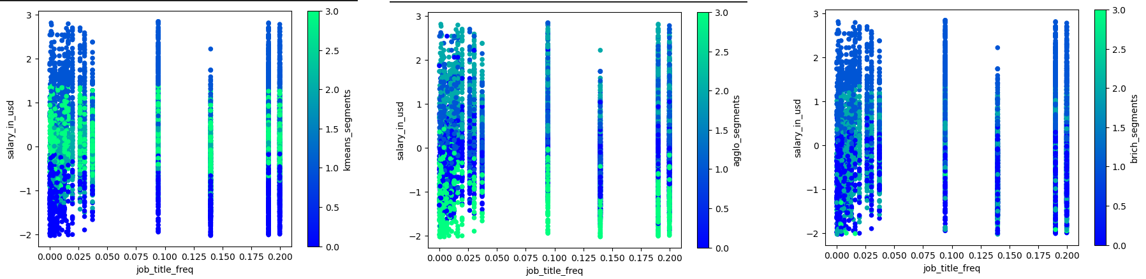
Unsupervised Machine Learning Analysis
Clustering Preprocessed Data (K=4)
Plots salary_in_usd vs job_title_freq
salary_in_usd is a strong feature in clustering
Other features unclear
K-Means Agglomerative Birch

Slide 4
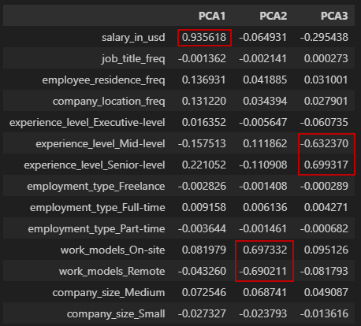
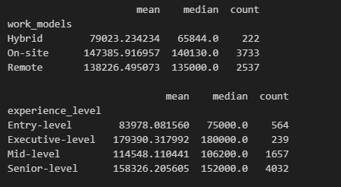
Unsupervised Machine Learning Analysis
PCA Component Weights Statistics of 2 Heavy Weights

