Slide 1

ABC-XYZ Analysis
Distribution Heatmap
Order Profiling
Network Design
Inventory Optimization
Warehouse Operations
LOGage 2026
Omni-Channel Distribution System Optimization — Round 2
Network Profiling · Fulfillment Strategy · Warehouse Operations

Slide 2
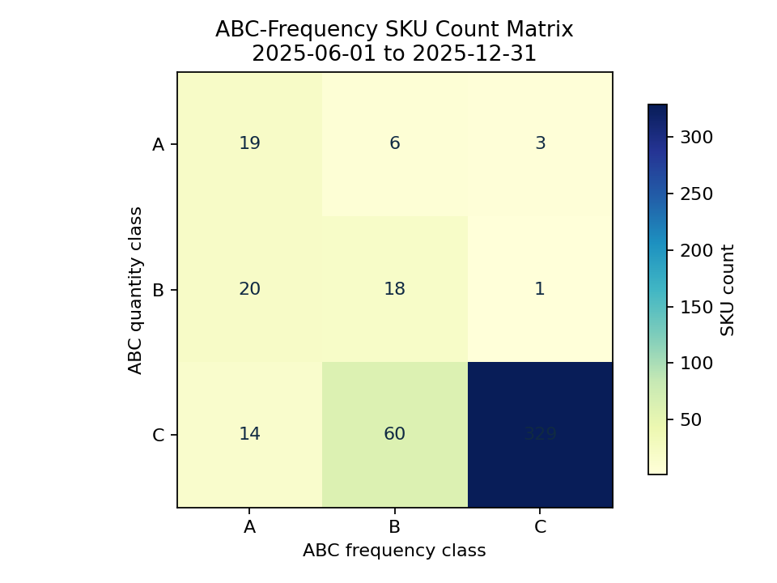
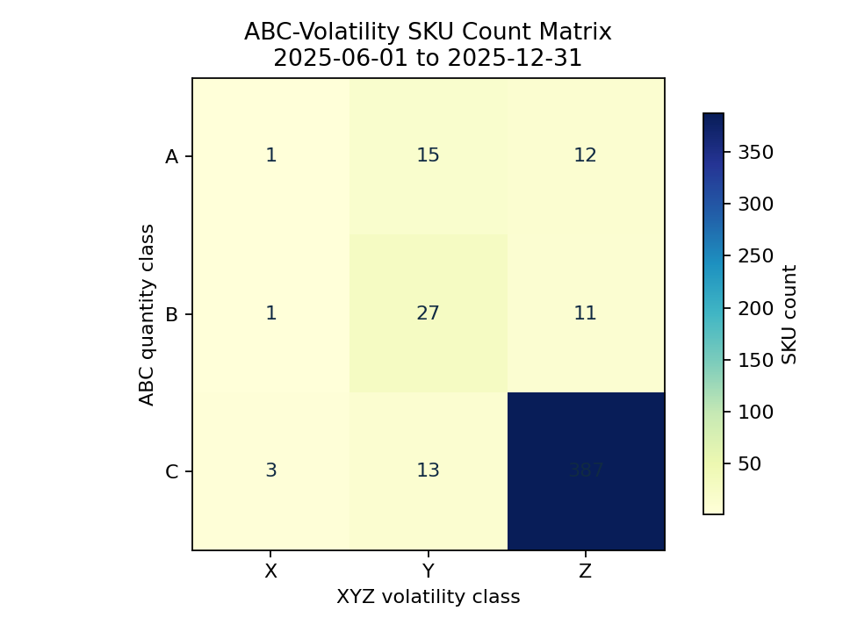
ABC-XYZ Analysis
Distribution Heatmap
Order Profiling
Network Design
Inventory Optimization
Warehouse Operations
Q1.1 — ABC-XYZ Analysis: 19 Class AA SKUs Drive 57.9% of Volume
19 Fast-Moving SKUs — Class AA: 57.9% volume, 25.9% order frequency
Top SKU 4200009163 — 163,014 units, 5,381 orders — highest operational pressure
Classification — Volume A ≥70%, Volume B ≥90%; Frequency A = top frequency class
Fast-Moving Group — Creates highest warehouse fulfillment pressure — prioritize slotting
ABC-XYZ Matrix: Frequency and Volatility classifications — AA cluster highlighted
ABC-XYZ Matrix: Frequency and Volatility classifications — AA cluster highlighted

Slide 3
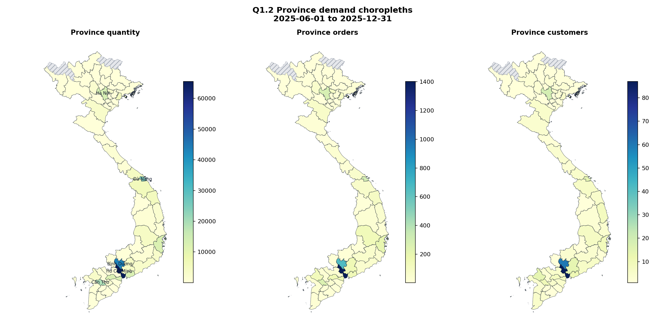
ABC-XYZ Analysis
Distribution Heatmap
Order Profiling
Network Design
Inventory Optimization
Warehouse Operations
Q1.2 — Severe Geographic Imbalance: My Phuoc Ships 92% of HCMC Volume
HCMC Top Province — 65,527 units — 23.7% of total outbound volume
Binh Duong — 43,012 units, #2 province — near My Phuoc RDC
Warehouse Imbalance — My Phuoc dominates all regions; Vinh Loc only leads in Bắc Ninh
Key Gap — Vinh Loc (in HCMC) ships only 8% of HCMC volume — severe underutilization
Province demand choropleth map and warehouse dominance visualization

Slide 4
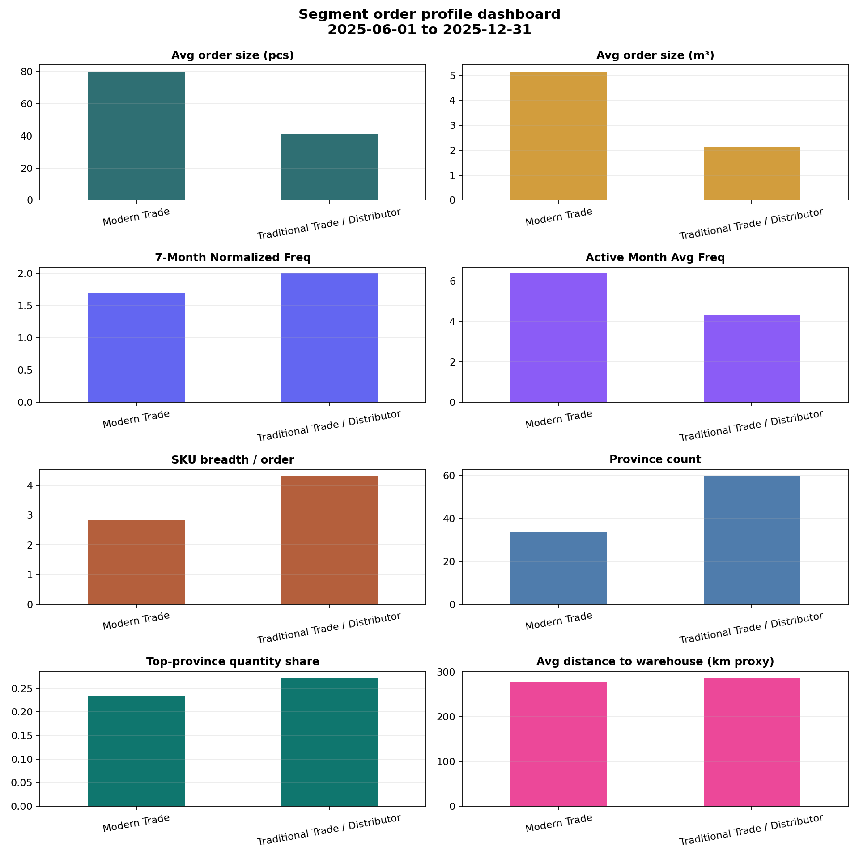
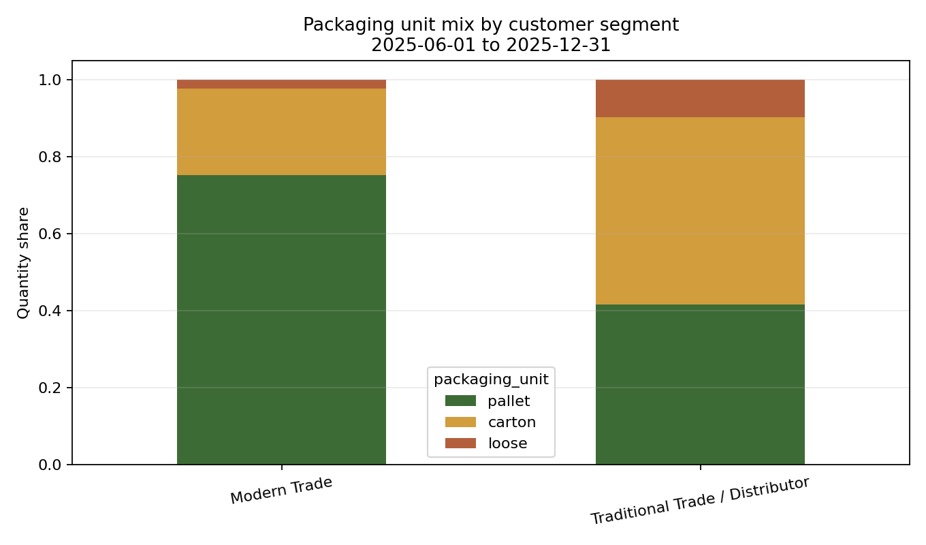
ABC-XYZ Analysis
Distribution Heatmap
Order Profiling
Network Design
Inventory Optimization
Warehouse Operations
Q1.3 — Modern Trade vs Traditional Trade: Two Distinct Fulfillment Profiles
Modern Trade — 80.2 units/order, 75% pallet, 2.8 SKUs/order — bulk B2B
Traditional Trade — 41.3 units/order, 49% carton, 4.3 SKUs/order — fragmented B2B/B2C
Lead Time Sensitivity — Modern Trade: High (4,948 SS); Traditional: Low (3,963 SS)
Geographic Spread — Modern: 34 provinces; Traditional: 60 provinces — wider network
Order profile comparison (left) and packaging unit mix (right)
Order profile comparison (left) and packaging unit mix (right)

Slide 5
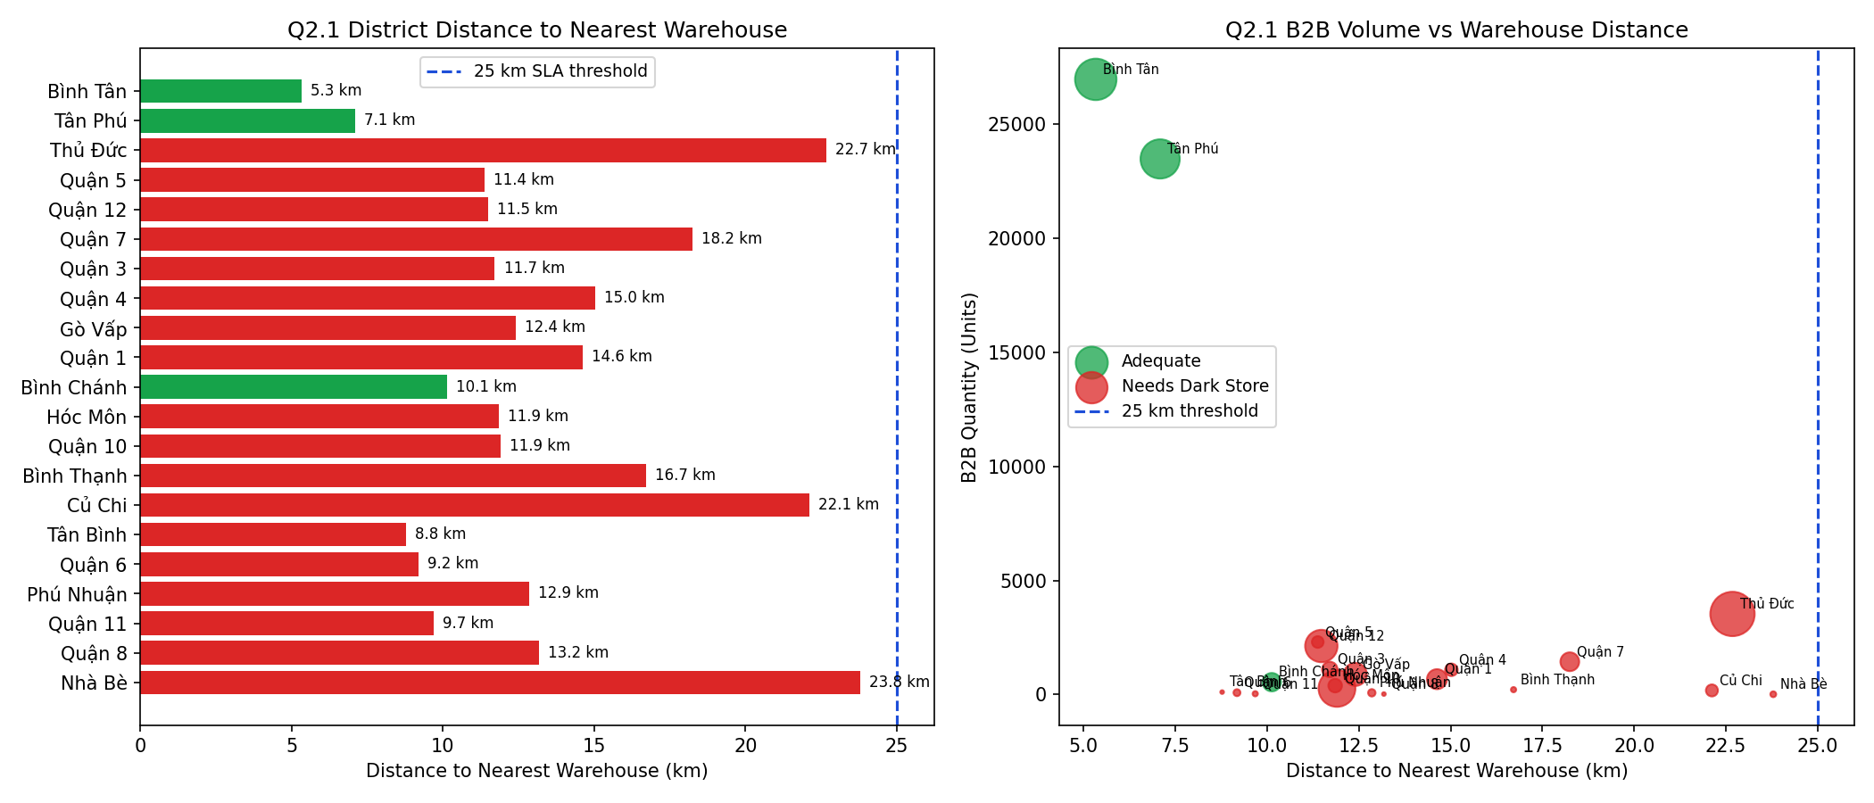
ABC-XYZ Analysis
Distribution Heatmap
Order Profiling
Network Design
Inventory Optimization
Warehouse Operations
Q2.1 — Current Two-RDC Model Fails B2C 2hr SLA for 85% of HCMC Districts
Baseline Service — 105–156 minutes (pick 30 + pack 30 + dispatch 30 + drive)
SLA Compliance — Only 3/19 districts meet 2hr SLA: Bình Tân, Tân Phú, Bình Chánh
Strengths — Good B2B coverage; My Phuoc well-positioned for industrial zones
Limitations — Vinh Loc too far from HCMC core; no urban fulfillment nodes
Network coverage map showing existing RDC locations and service areas

Slide 6
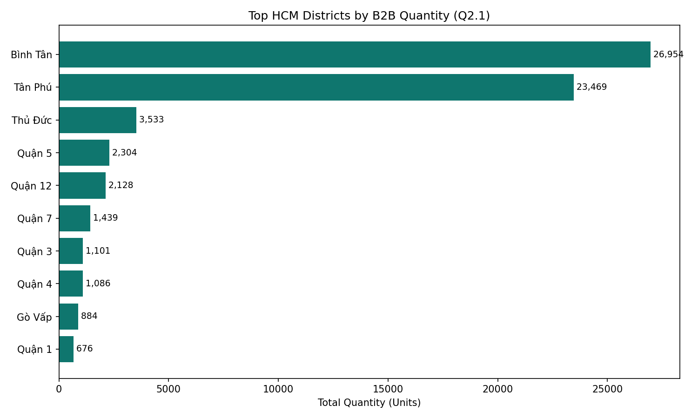
ABC-XYZ Analysis
Distribution Heatmap
Order Profiling
Network Design
Inventory Optimization
Warehouse Operations
Q2.1 — Two Dark Stores Enable 100% HCMC Coverage Within 2hr SLA
DS1 — Tân Phú — Covers West HCMC: 6 districts, avg 63 min drive saving
DS2 — Quận 1 — Covers Central/East: 12 districts, avg 92 min drive saving
Investment Case — Top 6 HCMC districts = 77% of volume — justifies dark store investment
Vinh Loc Retained — Củ Chi & suburban coverage; maintains B2B capability
HCMC district order volume distribution and service time analysis

Slide 7
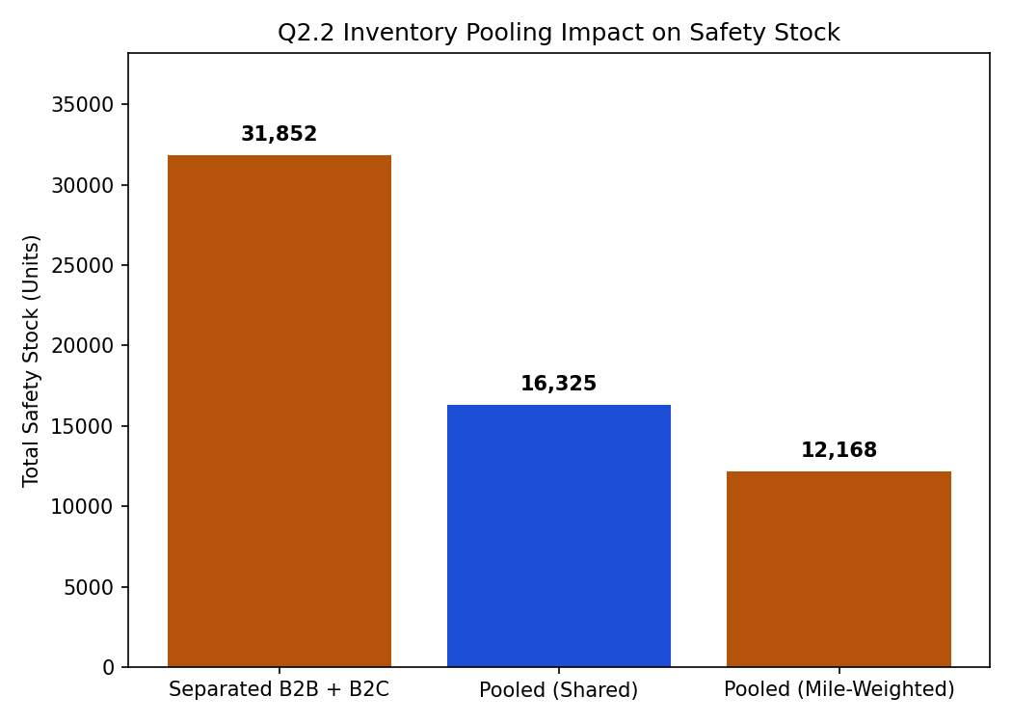
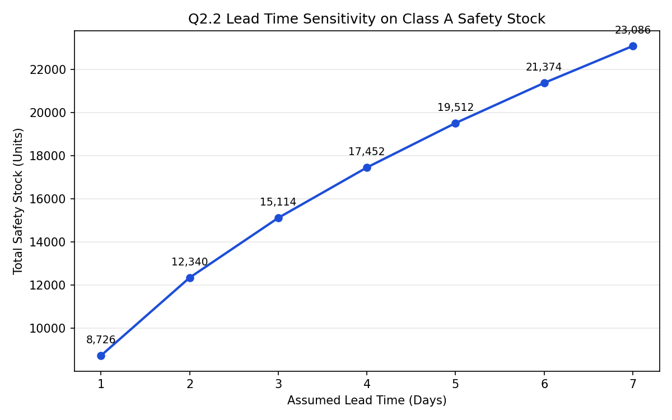
ABC-XYZ Analysis
Distribution Heatmap
Order Profiling
Network Design
Inventory Optimization
Warehouse Operations
Q2.2 — Pooling Reduces Safety Stock 49–62% While Preventing Cross-Channel Stockouts
Formula — SS = Z × σ_daily × √LT (Z=1.645, LT=1.94 days avg)
Top SKU SS — 4200009163: 3,174 units, ROP: 3,676 units
Pooling Scenarios — Separated: 31,852 → Shared Pool: 16,325 (−49%) → Mile-Weighted: 12,168 (−62%)
Allocation Rule — Real-time ATP → B2C priority if SLA-critical → B2B 24hr backorder → Escalate
Inventory pooling scenarios (left) and lead time sensitivity analysis (right)
Inventory pooling scenarios (left) and lead time sensitivity analysis (right)

Slide 8
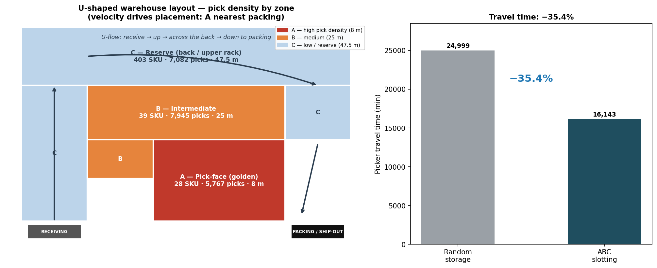
ABC-XYZ Analysis
Distribution Heatmap
Order Profiling
Network Design
Inventory Optimization
Warehouse Operations
Q3.1 — U-Shape Slotting Optimization: 38.2% Travel Time Reduction
Slotting Zones — Pick-Face (28 Class A) → Forward Reserve (Class B) → Reserve (Class C)
Travel Time — Baseline: 210m/order → Optimized: 130m/order
Methodology — ABC-based zoning with ergonomic height and proximity to packing
Result — SKU-to-zone assignment minimizes cross-aisle travel by 38.2%
U-Shape slotting heatmap showing pick-face zone assignment

Slide 9
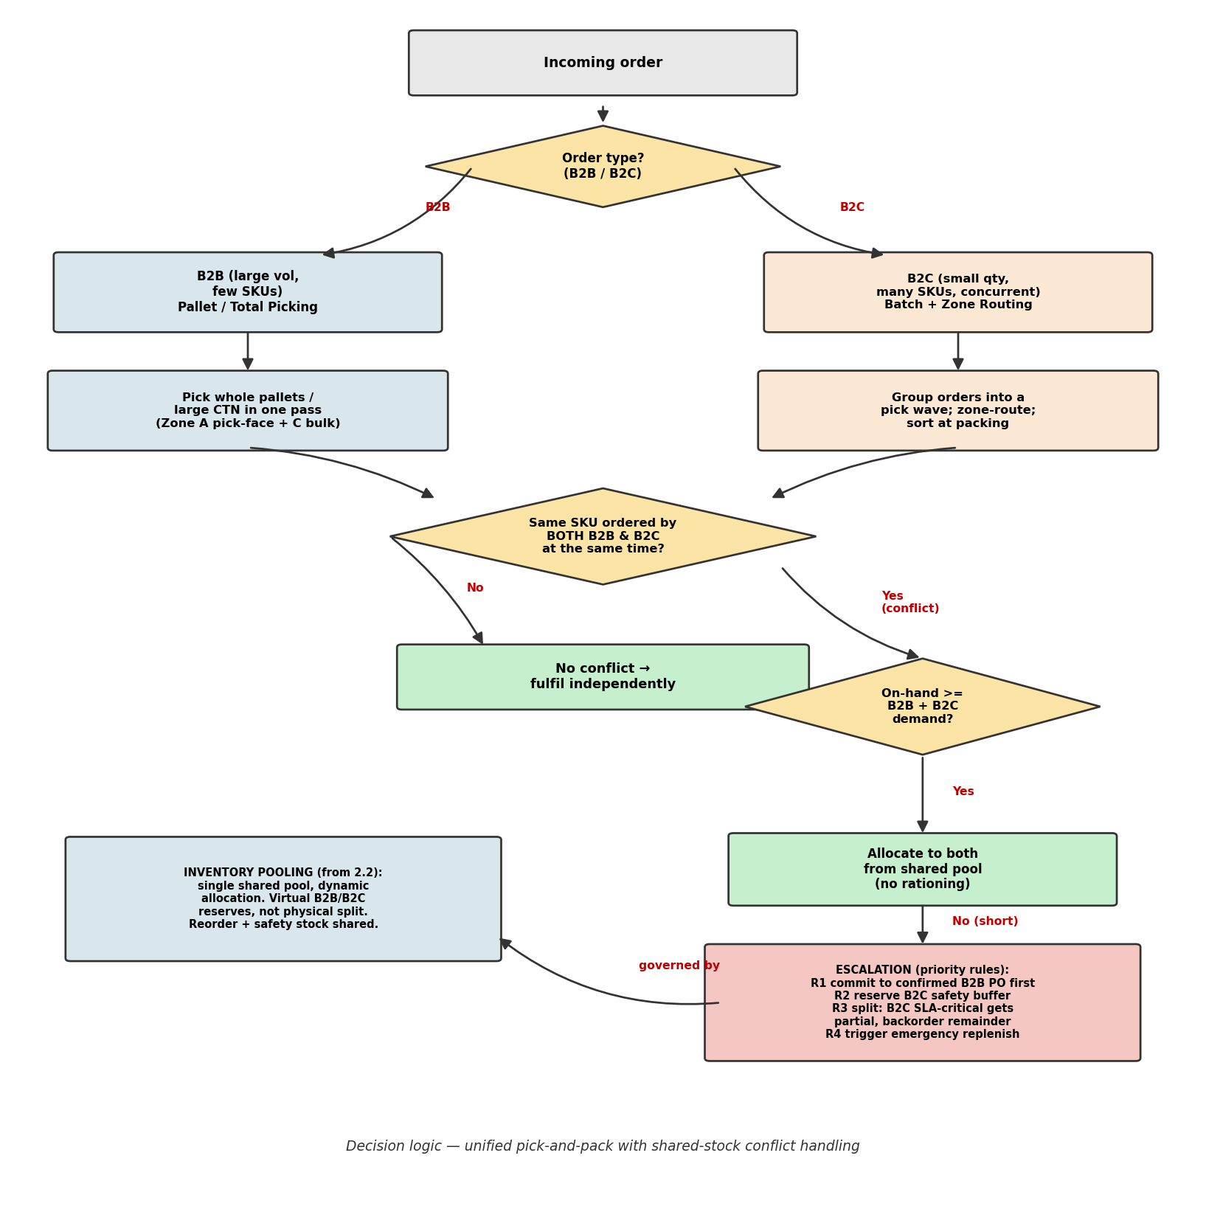
ABC-XYZ Analysis
Distribution Heatmap
Order Profiling
Network Design
Inventory Optimization
Warehouse Operations
Q3.2 — Omni-Channel Pick-and-Pack Decision Flowchart

